Slide 1
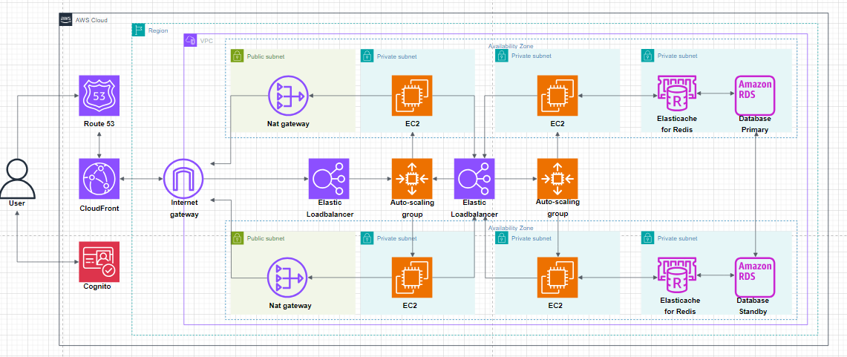
Architecture

Slide 2
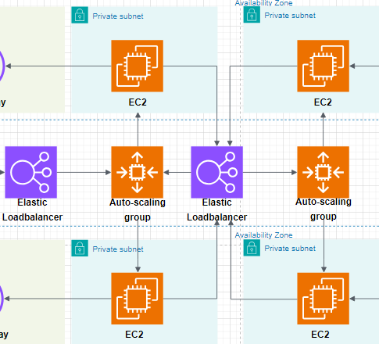
Computing
EC2 instances
Flexible
Steep learning curve
Auto scaling groups
Scales infrastructure horizontally
CloudWatch to trigger scaling
Elastic Load balancer
Route traffic to healthy instances
2 computing tiers

Slide 3
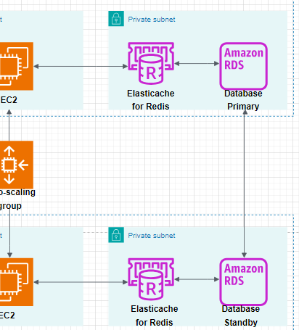
Database
RDS instances
Structured database for structured data
Fully managed service
Secondary instance for increased data durability and availability
Elasticache for Redis
More responsive user experience

Slide 4
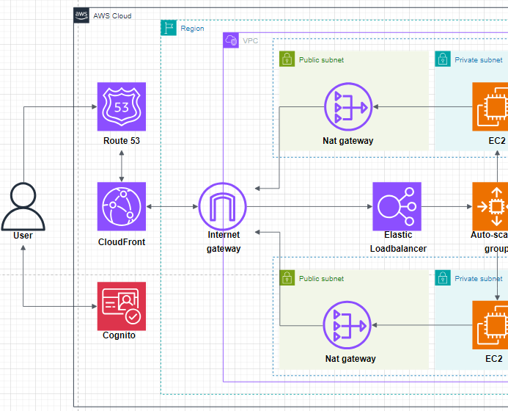
Networking
Goal is to make an available, fast, and secure network
Route 53
Edge routing
DNS routing
Domain name registration
CloudFront
Caching
Reduced latency
DDoS protection

Slide 5
Networking
Internet gateway
Entry into our VPC
Elastic Loadbalancer
Routes traffic to EC2 instances
Private subnets
Key services reside in private subnets
Limits accessibility
Public subnet
Outbound traffic

Slide 6
Security
Access control lists
Limit traffic type to TCP
Security groups
Granular control over traffic
Allow access for PuTTy maintenance
IAM
Give each team member only the rights they need
Principle of least privilege
Limit service access
Cognito
User authentication
Multi-factor authentication
Encryption
HTTPS
Cognito
Database encryption
Compliance
GDPR
Just a starting point

Slide 7
Caching
Means to temporarily store data in a more accessible location
High speed storage layer and/or closer to the user
Key benefits:
Cost savings
Increased performance
Challenges
Stale data
Caching search results difficult

Slide 8
Caching with CloudFront
CloudFront is a Content Delivery Network
Can be used to store images and video at edge locations
Instead of fetching data from the server, data can be retrieved from closer to the user
CloudFront is highly configurable using distributions

Slide 9
Caching with Redis
Elasticache for Redis is a database caching service
Works well for
Storing user sessions
Lazy loading
Very fast transfer speed
Uses RAM which can lead to high costs

Slide 10
CI/CD
Stands for Continuous Integration/Continous Delivery
Purpose is to cut down time spend on developing and deploying products
Challenges
Vast field with lots of expertise to be gained
Lack of experience within group
Some support issues with CloudFormation

Slide 11
CI/CD with CloudFormation
CloudFormation is an Infrastructure as Code service for AWS
Entire AWS architecture can be preseted in yaml
Deployment natively or integrate and automate with GitHub
Templates exist for quick start and learning

Slide 12
CodeDeploy and GitHub
CodeDeploy to deploy code into our EC2 instances (Auto scaling groups)
Pushing code to production Git automatically deploys to AWS
Source code stored in GitHub
GitHub and AWS linked using multiple authentication methods

