Slide 1
Welcome to TURF!
Sept 13, 2018

Slide 2
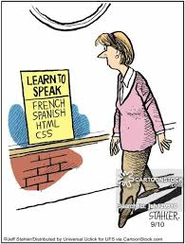
Why should you use R?
It’s Free.
It’s Open Source.
Advanced Statistics.
It Runs on Many Platforms.
Anyone Can Contribute
Notes:
From: https://www.rforexcelusers.com/excel-vs-r-when-to-use-what/

Slide 3
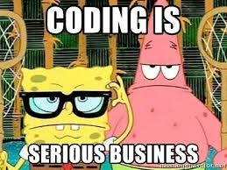
Why should you use R?
Easier to Find and Fix Errors.
Easier Automation.
Faster Computation.
It Reads Any Type of Data.
Easier Project Organization.
It Supports Larger Data Sets.
Reproducibility.
Notes:
From: https://www.rforexcelusers.com/excel-vs-r-when-to-use-what/

Slide 4
When to use R vs Excel?
Data not well structured?
If yes, then R, unless you have Excel voodoo skills to clean it up.
Quick and dirty one-time analysis?
If Yes, then Excel, as long as the data is not gigantic.
Advanced statistical analysis?
If Yes, then R. No contest.
Notes:
From: https://www.rforexcelusers.com/excel-vs-r-when-to-use-what/

Slide 5
When to use R vs Excel?
Something I will want to share in a web-based, interactive format that is nice to look at?
R with the Shiny framework
Unique and beautiful visuals the world has rarely seen?
R.
Notes:
From: https://www.rforexcelusers.com/excel-vs-r-when-to-use-what/

Slide 6
Cause we’re geeks…

Slide 7
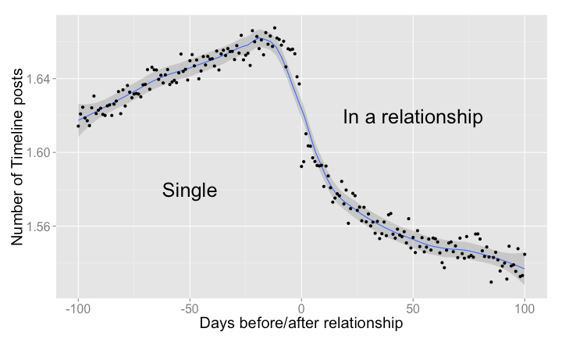
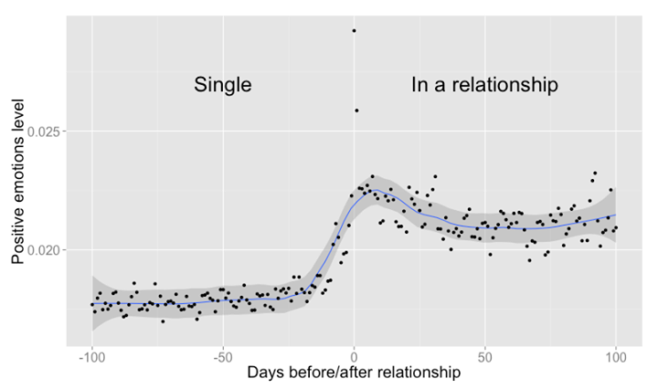
Who is using R?
AirBNB
Facebook
Twitter
Microsoft
John Deere
Google
Trulia and Zillow
Notes:
https://www.northeastern.edu/levelblog/2017/05/31/big-companies-using-r-data-analysis/

Slide 8
R password generator
See script

Slide 9
Image stitching for S5
See script

Slide 10
R missing music finder
See script

Slide 11



Where to go to practice on my own and get help?
https://datacarpentry.org/R-ecology-lesson/
https://www.datacamp.com/
https://stackoverflow.com/
www.google.com
http://www.cookbook-r.com/
ASK a friend/colleague!

