Slide 1
password generator
TEAM MEMBERS
Uma
Vidya
TEJASWI
GUNA
PRAVEEN

Slide 2
INTRODUCTION
Password Generator is a project has done by using HTML,CSS and JAVA SCRIPT, that can generate strong and unique passwords automatically for users. The primary purpose of password generator to enhance the security of online accounts and data by generating passwords that are difficult for hackers to guess or crack.
Here is an example of strong password generator by a password generator.
Ex: 7@v23@56#

Slide 3
functions
1.Math.floor()
2.Math.random()
3.array.join()
4.alert()
5.shuffle()

Slide 4
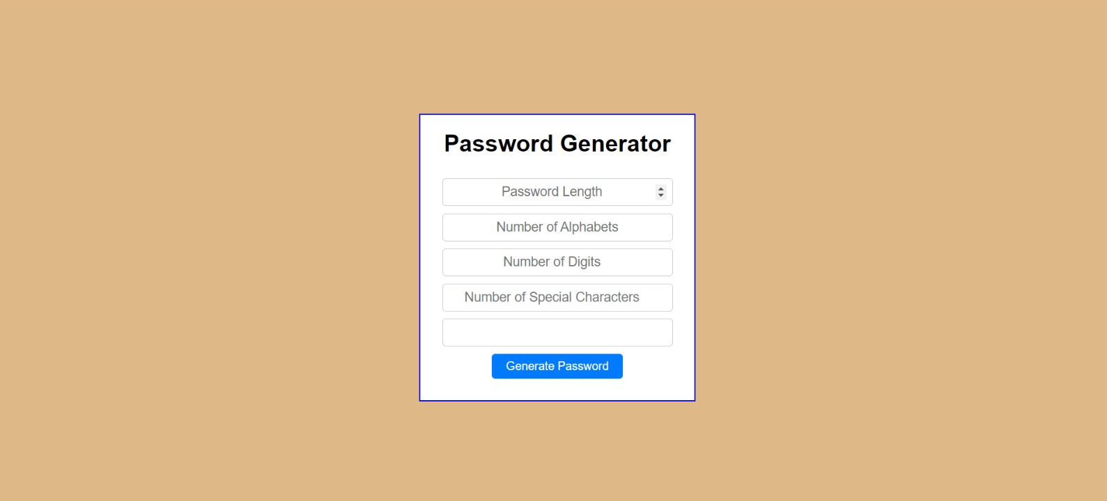
Web Page Interface

Slide 5
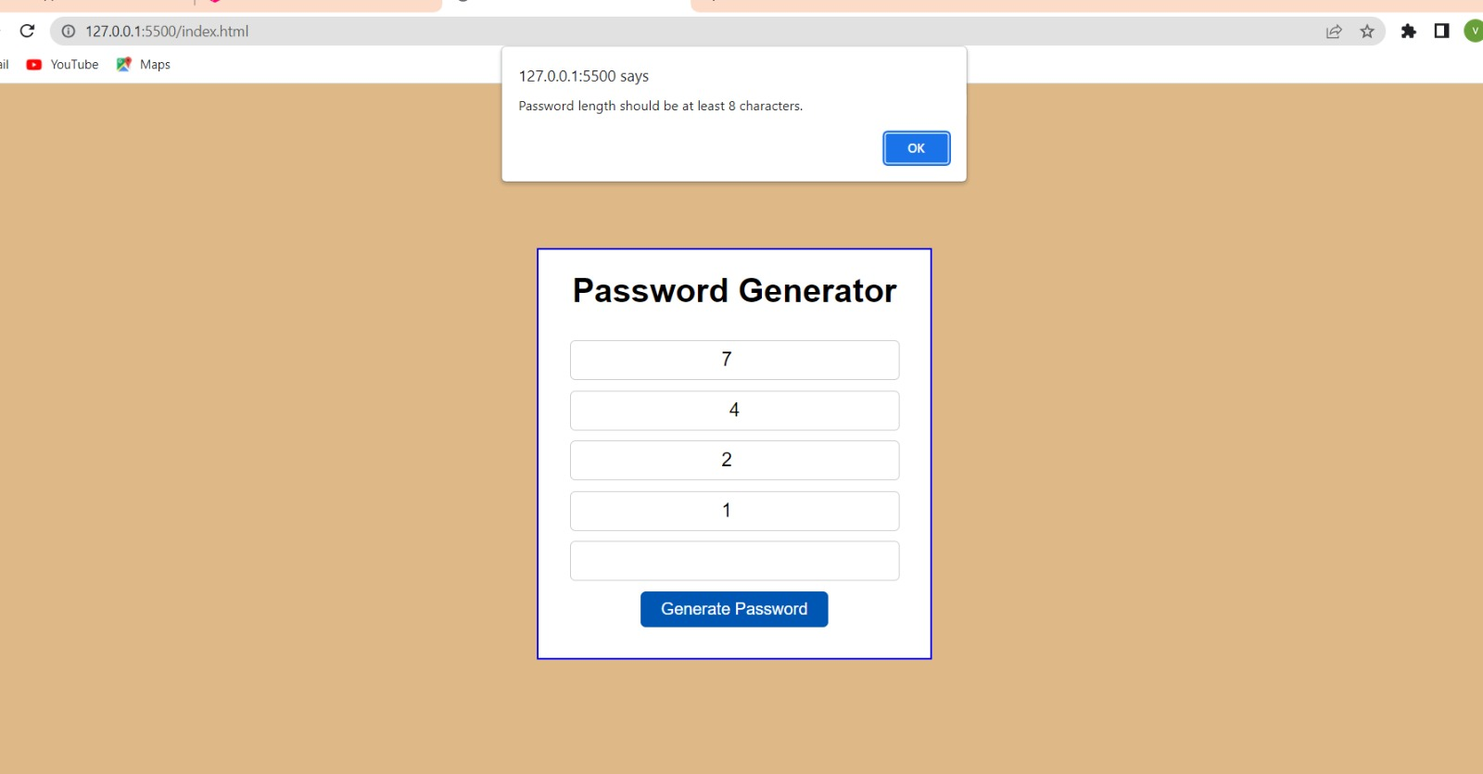

Slide 6
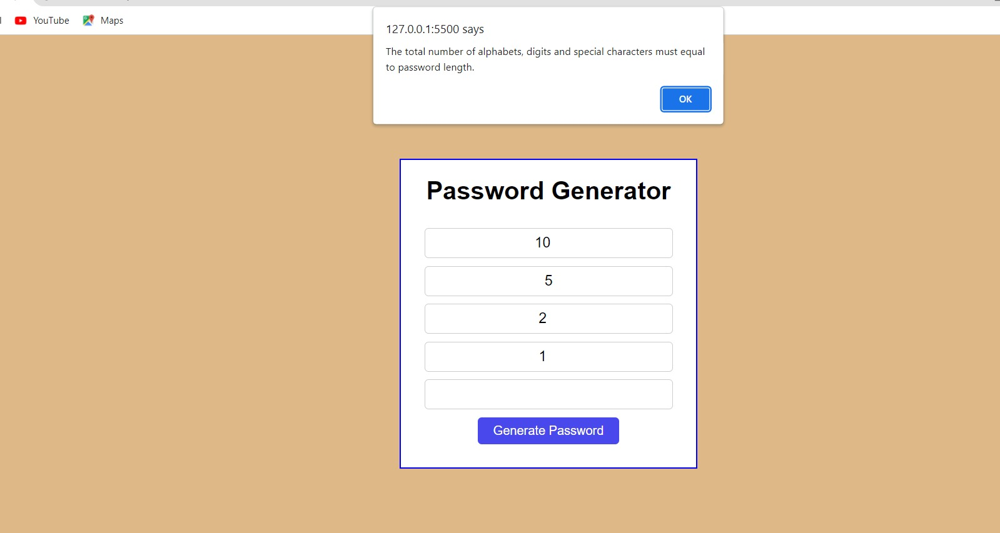

Slide 7
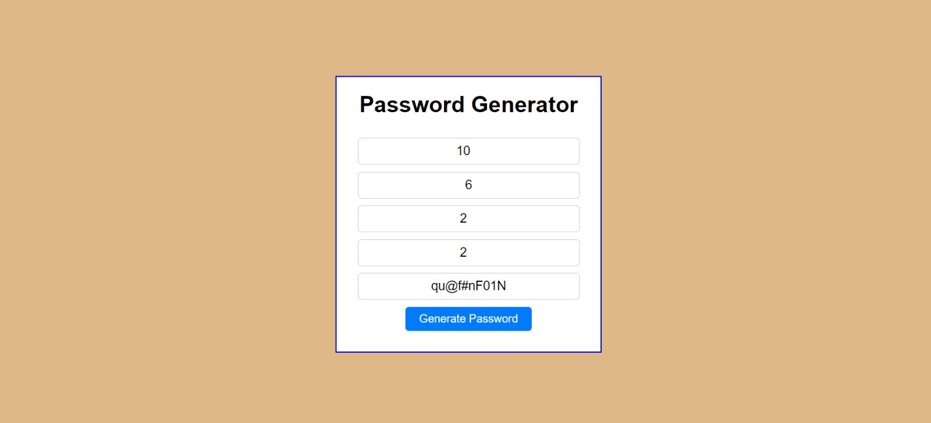

Slide 8


