Slide 1
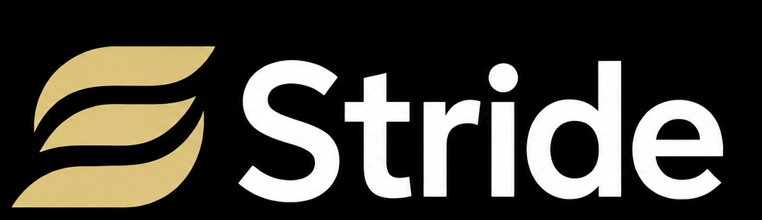
3D biometric running form analysis app

Slide 2


Problem
Elite sprint coaching costs $200–500/session. It is inaccessible to majority of young runners.
Middle/high school running teams are large: majority of runners get no coach attention. Thus, form errors and running issues persist.
Current running form analyzers require a video to be taken in highly specific conditions (often side-on, perfect lighting, runner in a certain position). Many times, racing form analysis do not meet these conditions.

Slide 3

Solution
Film a sprint at any angle and upload it onto the app.
Get a full biomechanical breakdown for 10+ metrics in ~15 seconds: joint angles, stride timing, form flaws, etc.
Costs are minimal compared to private training - affordable for amateur runners.
AI Coach provides more general advice: hydration, recruitment, in-depth analysis, etc.
  Real-time, instant coaching advice.

Slide 4
$11.9B
Massive >$11.9B running market with endless growth opportunities
TAM: A $11.9B running-software market growing 13% a year
$790M
SAM: $790M serviceable market across English-speaking runners and teams
SOM: A $7.3M business that needs just 0.9% share
$7.3M

Slide 5
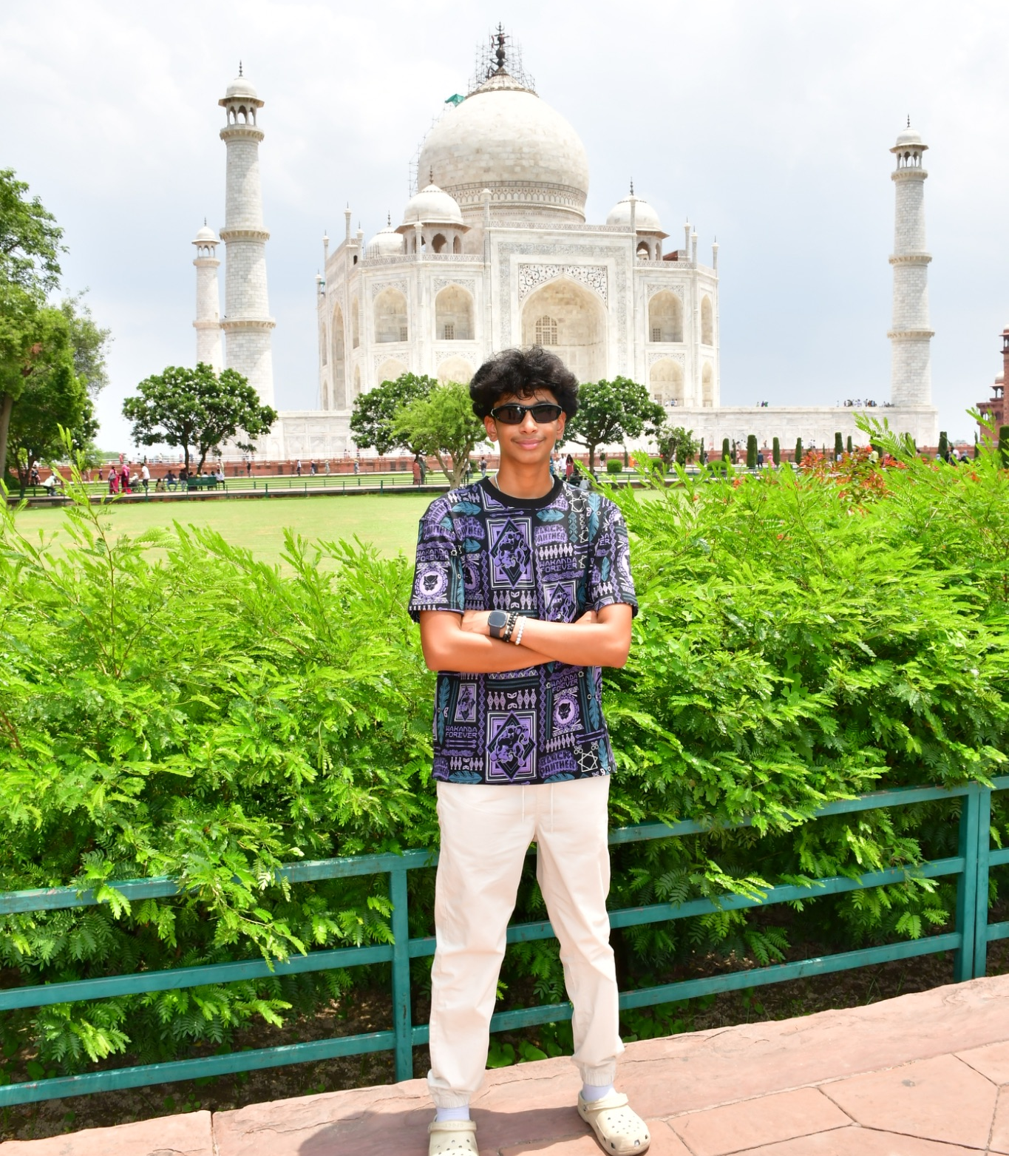
Team
Taran Bheemagani
Co-Founder
Adhiban Arulselvan
Co-Founder
RTM Pose pose pipeline, 11-metric sagittal engine, phase detection, single-athlete tracker, per-metric trust gating.
Created the groundwork for centroid-based frame tracking: A multi-frame based analysis structure.
Created a framework for an experimental angle-agnostic design.
Full AWS production stack (ECS Fargate, ALB, Aurora DSQL, S3, SQS) using Terraform.
IAM token-based database auth, least-privilege security groups, and auto-scaling policies.
Adopted an IoU-based frame tracking, which lowered detection errors to 0.
Formulated metric sensitivity protocols to produce a logic-backed form score.

Slide 6

Features/Demo
Angle agnostic: Runners can record a video for any angle and receive accurate feedback.
  Analyzes 3D clip using a production engine at multiple angles.
WHAM: Our machine learning model employs a 3D monocular lift.
  Analysis considers the real-world physics of motion.
Trust tiers: Any metric our ML model cannot validate at 100% certainty is marked experimental.
  Different metric weights influence Form Score.

Slide 7
Business Model
$1 /month for Premium Features
Free Tier
To access
LLM coach
Progress Tab
Training Plan
Access to video analysis
Estimated 90% profit margins
Hosting backend on AWS + running servers scaled to 100k users: <$5,000/month
90%+ of users buy low-cost monthly rate: >$95,000 monthly profit

Slide 8
Competitors
 | Stride | Ochy | GaitLAB | Hudl | VueMotion
Sprint-specific biometrics | X |  |  |  | X
Any-angle videos analysis on phone | X |  |  |  | X
3D Gravity Alignment | X | X
Low cost (<$5/month) | X |  | X
Full ecosystem (Coach, Workouts, etc.) | X | X | X

Slide 9
Roadmap
A verified sprint engine today — an any-angle, any-distance coaching platform in six quarters.
THIS ROUND · $125K · 12 MONTHS
3Q26
4Q26
1Q27
2Q27
3Q27
4Q27
PLATFORM
Ship & harden
TLS · WAF
App Store launch
Android · Play Store
CI/CD · alarms
Coach web dashboard
ML ENGINE
Earn the angle claim
Mocap validation set
IMU gravity fusion
Head-on → trusted
Tier-3 injury metrics
GPU 3D premium
PRODUCT
Coach, not just score
120/240 fps capture
LLM coach · plans
Personal baselines
Squad rosters · coach view
GO-TO-MARKET
One coach is forty athletes
SD team pilots
First 1,000 paying athletes
Team season licences
Marketing hire · coach network
Sequenced from the repo's own research plan. The mocap validation set is a hard gate — every angle claim after it depends on measured error, not assertion.

Slide 10
Our Ask
Raise pre-seed round of 125k and accomplish tasks in 12 months
Train ML model on diverse running forms to generalize use case - not just sprinting, jogging, 15+ different races, starts/finishes.
Gain traction with local businesses and acquire first 1,000 paying users
Hire marketing/partnership team member (Capture $7.3M SOM with targeted marketing)
Use of funds breakdown (example):
65% — User acquisition & marketing (Track team partnerships, targeted outreach)
35% — Engineering (infra scale, ML model robustness)

Slide 11
Our Ask
$125K on a SAFE. Twelve months to a validated engine and 1,000 paying athletes.
USE OF FUNDS
WHAT THE ROUND PROVES
65%
User acquisition & partnerships
Track-team pilots, coach outreach, first paid channels
1,000 paying athletes
with real retention cohorts, not waitlist counts
$81,250
Head-on metrics promoted to trusted
measured against mocap ground truth, not asserted
25%
Engineering
ML generalization beyond sprint · coach dashboard
$31,250
Live on App Store and Play Store
TLS, WAF and CI/CD hardened behind it
10%
Infrastructure, validation & compliance
Mocap ground-truth sessions · TLS/WAF · store fees
3+ paid team pilots
each converting to a season licence at renewal
$12,500
Engineering plus infrastructure is the 35% technical allocation.
WHY $125K IS ENOUGH
$0
raised to reach a working production stack
<$5K/mo
AWS infra at 100,000 users, autoscaled
90%+
gross margin — under 2¢ of compute per analysis

Slide 12
Thank you for your time. Let’s work together to bridge the gap between running and technology!

