Slide 1
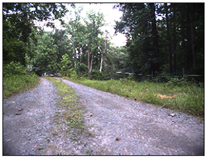
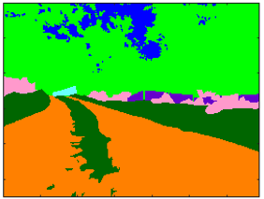
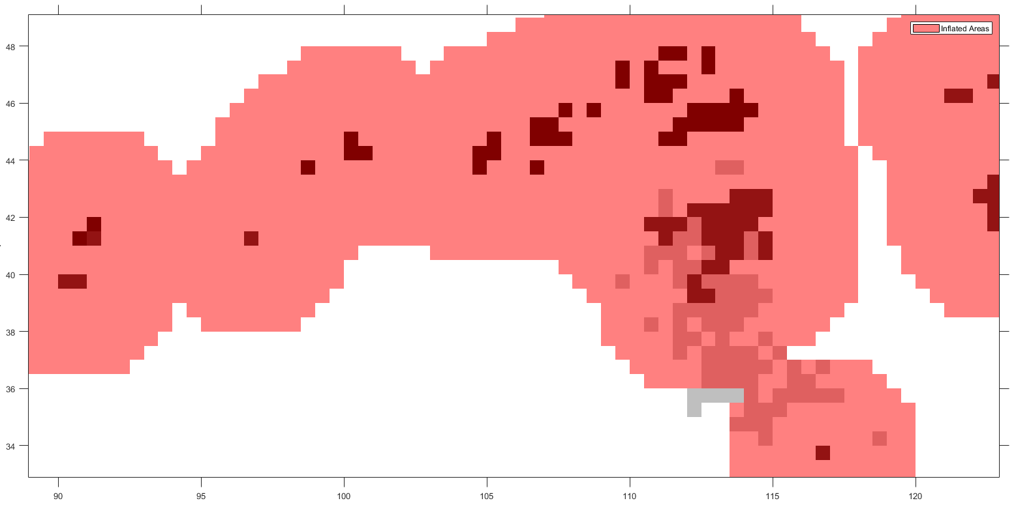
Problem: Autonomous Perception for Terrain Classification
Forward-looking Terrain Classification
Goal: Identification & Segmentation of Terrain Features and Areas
Reach goal: Real-time Estimation of Terrain Trafficability
Cost-map Generation for Autonomous Navigation

Slide 2
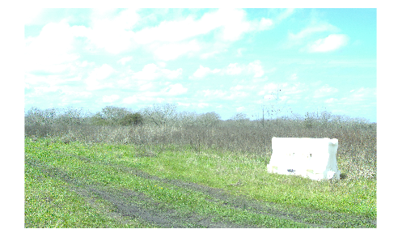
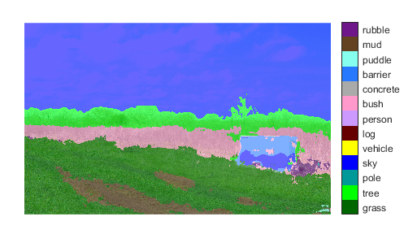
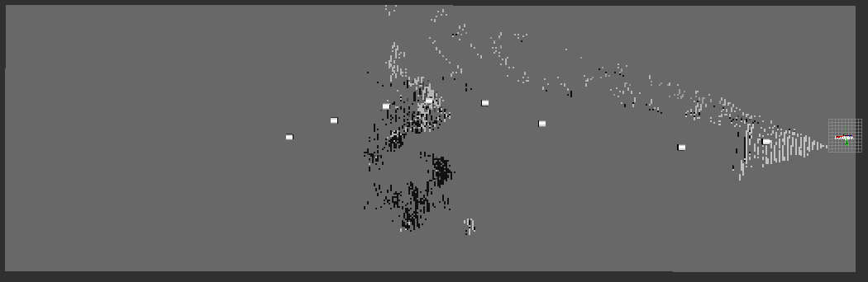
Problem: Autonomous Perception for Object Classification
Forward-looking Object Classification
Goal: Identification & Segmentation of Objects
Reach goal: Real-time Estimation of Obstacle Trafficability
E.g. Vehicle-dependent cost for driving over bush vs. tree
Cost-map & Occupancy Grid Generation for Autonomous Navigation

Slide 3
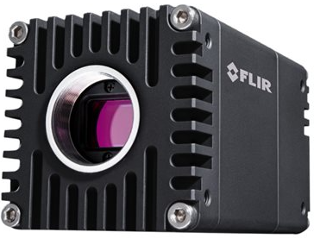
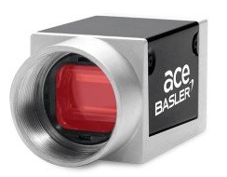
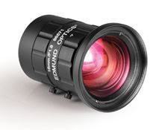
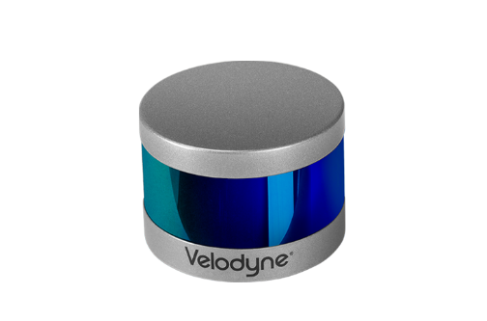
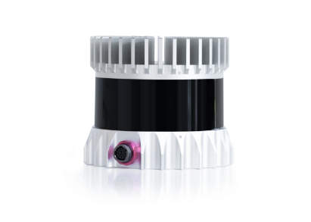
Exteroceptive Sensors
AVT-341 Sensors
Camera: Flir Oryx
Model: ORX-10G-51S5C-C
2448x2048, 162fps
Lens TBD
Lidar: Velodyne VLP
Model: VLP-16
16 Chan, 30⁰ Vertical FoV
900-3600 Horizontal Res., 5-20Hz
Public Dataset Sensors
Camera: Basler Ace
Model: acA1920-50gc
1920x1200, 50fps
16mm Prime Lens
Lidar: Ouster OS1
Model: OS1-64
64 Chan, 45⁰ Vertical FoV
2048 Horizontal Res., 10Hz

Slide 4
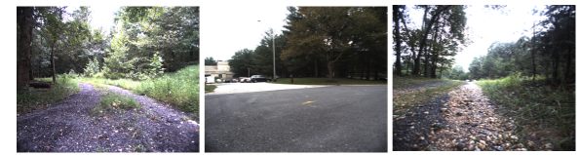
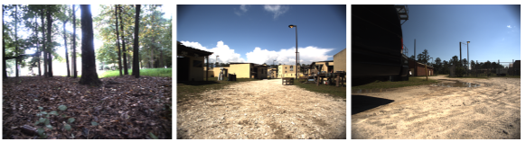
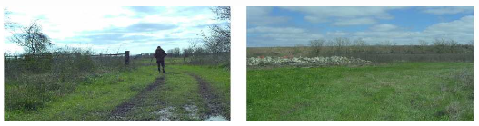
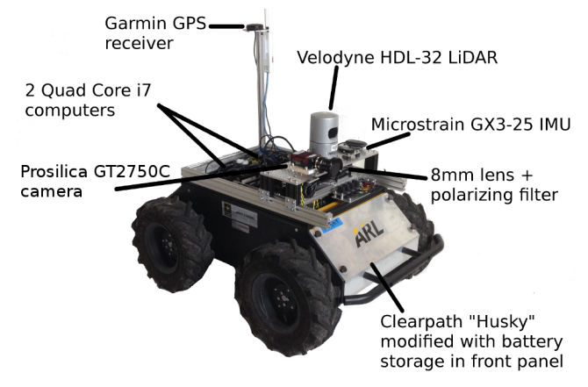
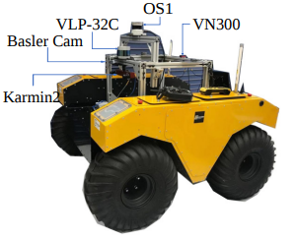
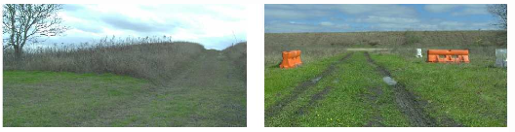
Publicly Available Datasets for Unstructured Environments
RUGD
Variety of Terrain Types
Only Camera Image Annotations
Rellis-3D
Similar Terrain Type
Camera Image and Lidar Annotations
Synchronized data from:
Stereo Camera
Velodyne and Ouster Lidar
Mono Camera

Slide 5
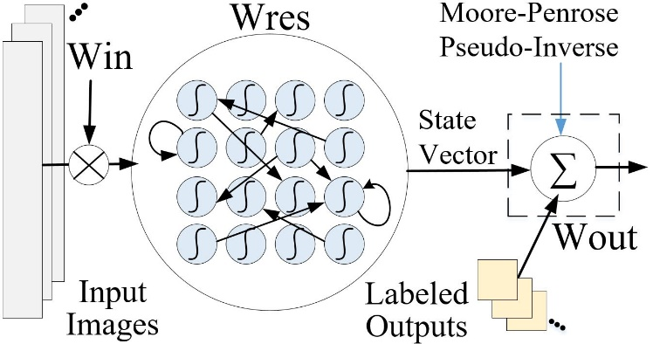
Machine Learning Architectures
Recurrent Neural Network (RNN)
Long training times
Requires high computing power
Echo State Network (ESN)
Reservoir Computing Architecture
Transforms linear data into high-dimensional state space
Very short training times! (only output layer is trained)

Slide 6
Modified Echo State Network
Run through the reservoirs…
Faster ESN performance!
Augment the data…
Split the image into equal parts…
The use of multiple smaller parallel and/or series reservoirs that split the input image into equal portions.
The total neuron count is the number of parallel reservoirs multiplied by the neurons per reservoir.
The neuron states of each parallel reservoir is concatenated into a single state vector.

Slide 7
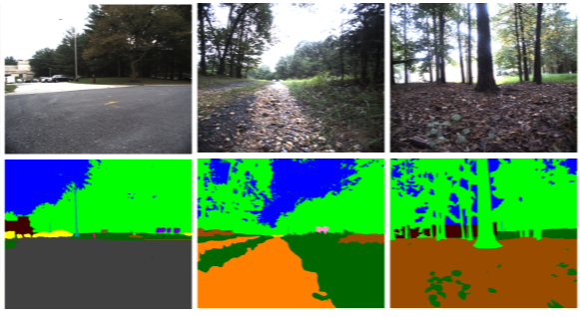
Modified ESN for Image Data
ESN programmed in MATLAB
Robot Unstructured Ground Driving (RUGD) Dataset^{[11]}
ESN Parameters | Value
Train/Test Samples | 60
Neurons | 100
Parallel Reservoirs | 16
Input Scaling | 0.0002
Spectral Radius | 0.0001
Learning Rate | 0.04
Time Steps | 60
Res. Connectivity | 10%
^{[11]}Wigness, M., Eum, S., Rogers, J. G., Han, D., & Kwon, H. (2019). A RUGD Dataset for Autonomous Navigation and Visual Perception in Unstructured Outdoor Environments.

Slide 8
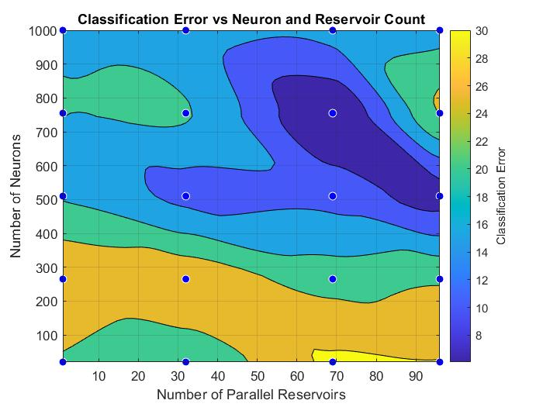
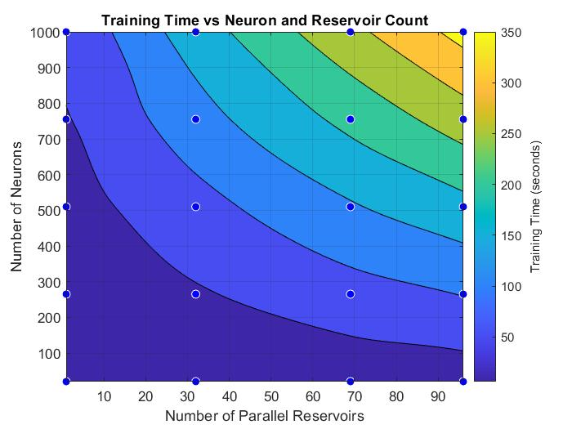
Optimization w/ Modified ESN for image data
Hyperparameter optimization with grid search takes only 30 minutes!
Error minimum = 6%; Train Time = 200 s (3 min 20 s)
69 parallel reservoirs
760 neurons per reservoir

Slide 9
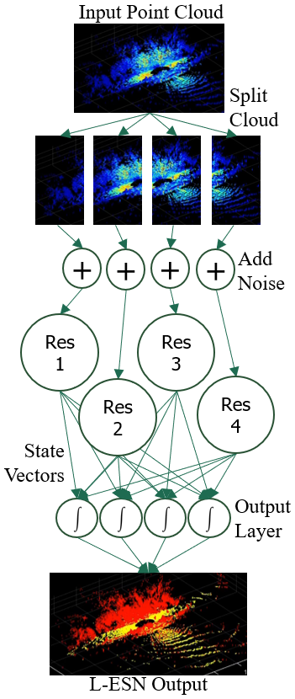
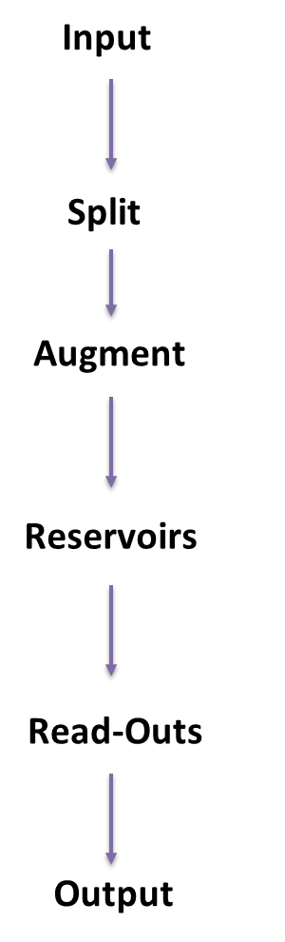
Modified ESN for Lidar Data
ROS2 input and output
PointCloud input features
[x y z intensity]
Other features exist
PointCloud sizes
4.2 MB / PCL
4 times camera image size
Gaussian Noise
SNR = 10 (not optimized)

Slide 10
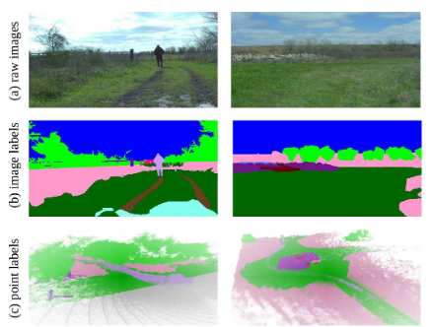
Modified ESN for Lidar data
RELLIS-3D Dataset*
Programmed in MATLAB
24 classes relabeled to 4
Trafficability | RGB Color | Cost Value
High | [0, 255, 0] | 0
Medium | [255, 255, 0] | 0.33
Low | [255, 128, 0] | 0.67
Zero | [255, 0, 0] | 1
*Jiang and al., “RELLIS-3D Dataset: Data, Benchmarks and Analysis”, arXiv, 2020

Slide 11
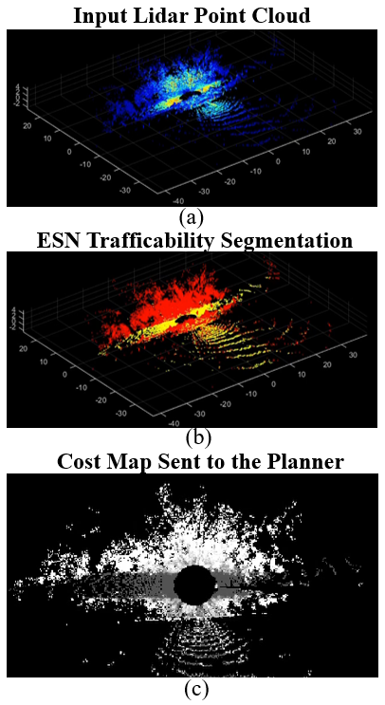
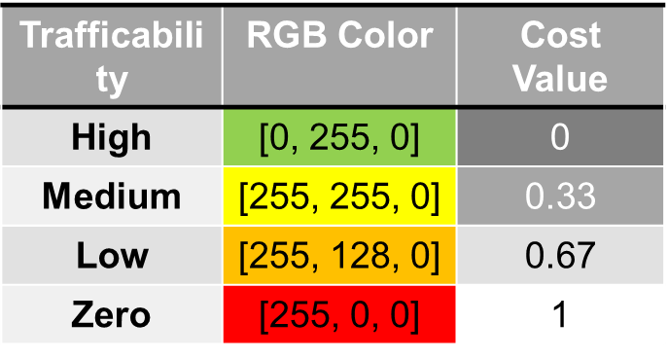
Modified ESN for Lidar data
L-ESN Parameters | Value
Train/Test Samples | 120
Neurons | 400
Parallel Reservoirs | 16
Reservoir Connectivity | 10%
Spectral Radius | 0.008
Learning Rate | 0.08
Time Steps | 30
Criteria | Performance
Avg. Class. Rate | 83.1%
Training Time | 31 min.
Avg. Class. Time | 1.9 sec.

Slide 12
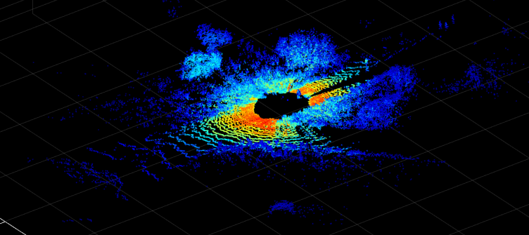
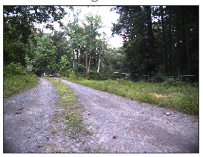
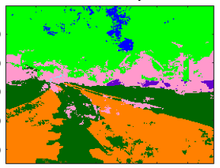
Motivation: Camera – Lidar Fusion
Lidar provides 3D Point Cloud
Difficult to train for reliable classification
Active sensor modality (“beacon” for adversaries)
Mono Camera provides pixel-wise Semantic Segmentation w/ Classifications
2D image…needs additional information to be mapped to 3D space
Passive sensor modality (sensitive to lighting conditions)

Slide 13
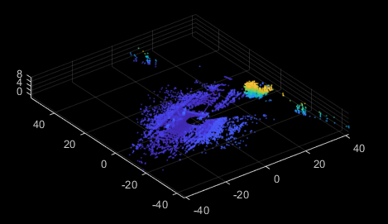
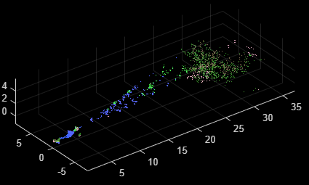
Camera + Lidar Perception Node
Raw Camera Image
Image Segmentation
Deeplab V3+ Train/Test Global Results
Global Accuracy | Mean Accuracy | Mean IoU | Weighted IoU
0.9113 | 0.9401 | 0.5906 | 0.8602
Deeplab V3+
Raw Lidar PCL
Image to Point Cloud
Vehicle
Fuse
2D Cost Map

Slide 14
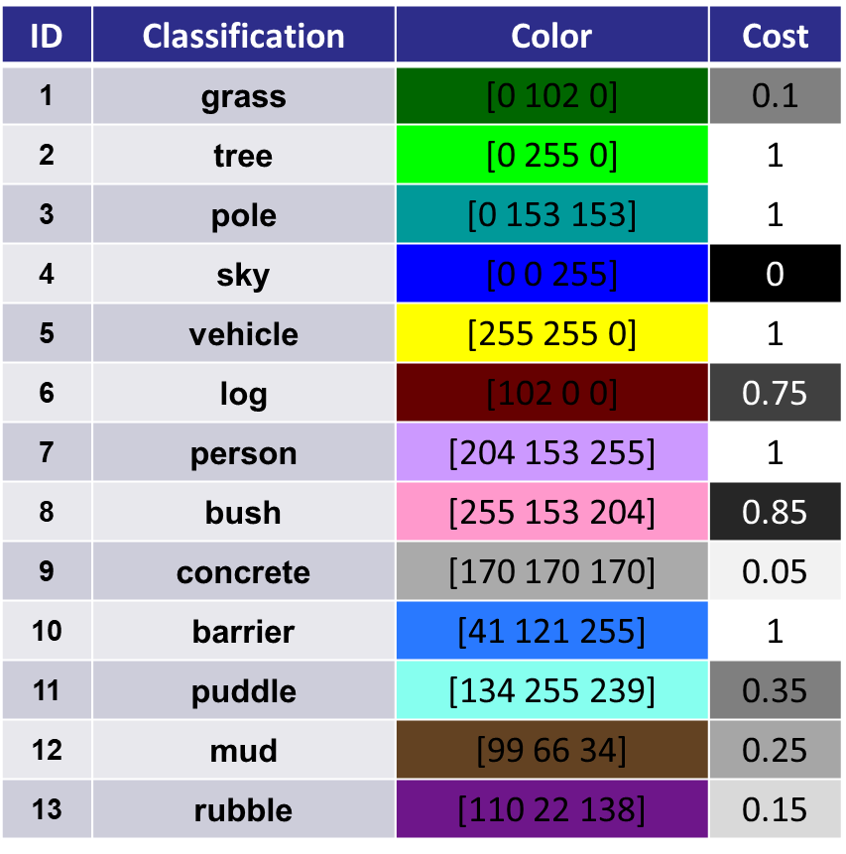
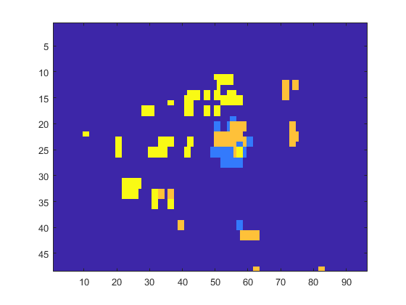

Mapping/Planning Integration
Output data types:
Matrix array
VehicleCostMap object
VehicleCostMap object​
Matrix array
Arbitrary Cost Assignment based on Classification

