Slide 1
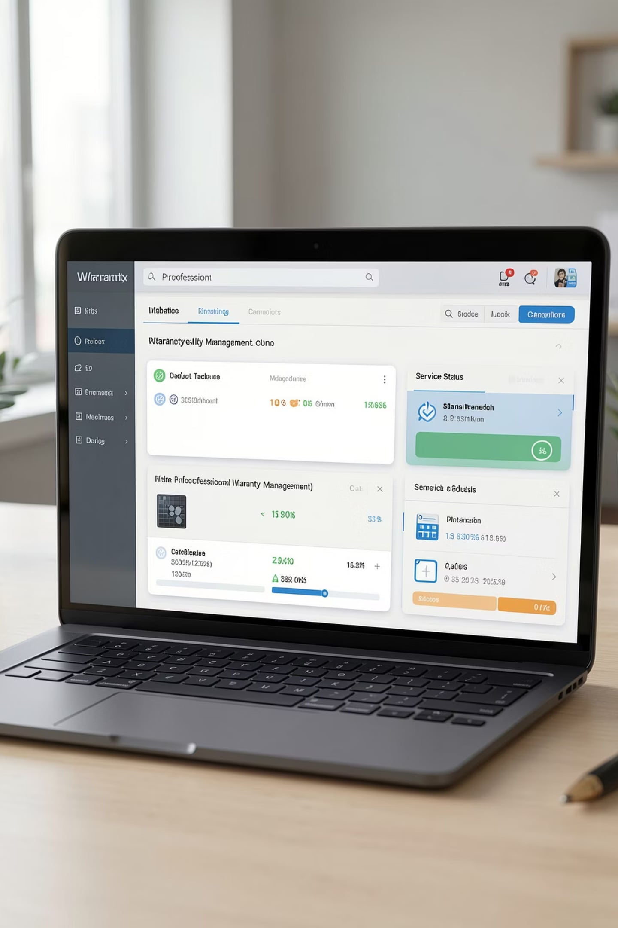
Smart Warranty & Product Service Tracker
IIT Mandi Capstone Project
https://github.com/Tulika1910/Smart_Warranty_and_Product_Service_Tracker/tree/main/Capstone_Project
Team Members
Tulika, Tisya, Ritvik, and Bhavya

Slide 2
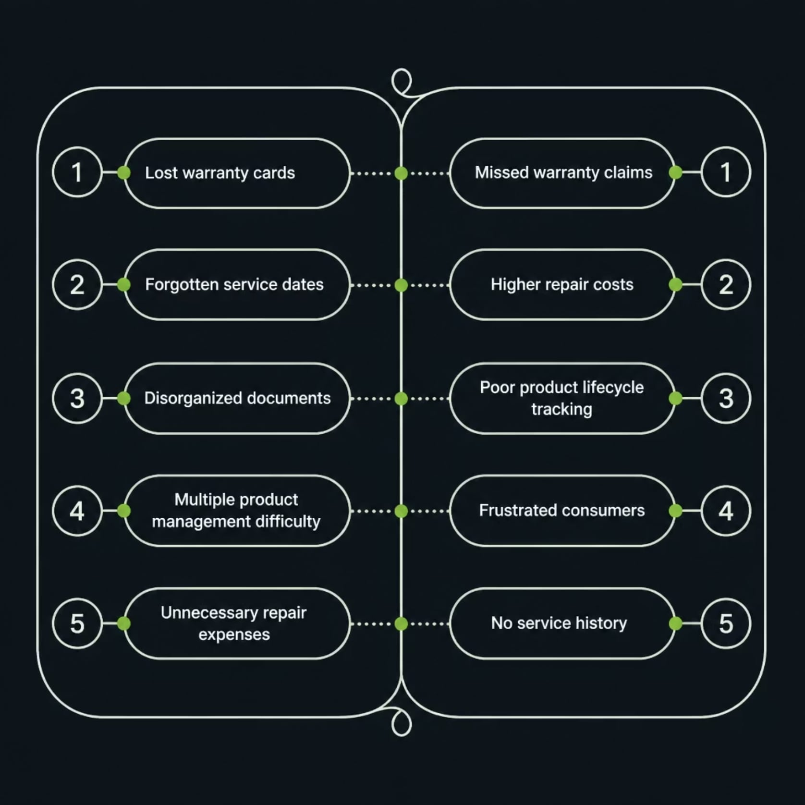

The Warranty Management Problem
Millions of consumers lose track of warranties every year — leading to missed service claims and unnecessary repair costs. Without a centralized system, warranty documents become scattered, forgotten, or lost entirely.
Why This Matters
Warranty cards are physical and easily lost
Service dates go untracked without reminders
No centralized view of all owned products
Missed claims result in avoidable expenses

Slide 3
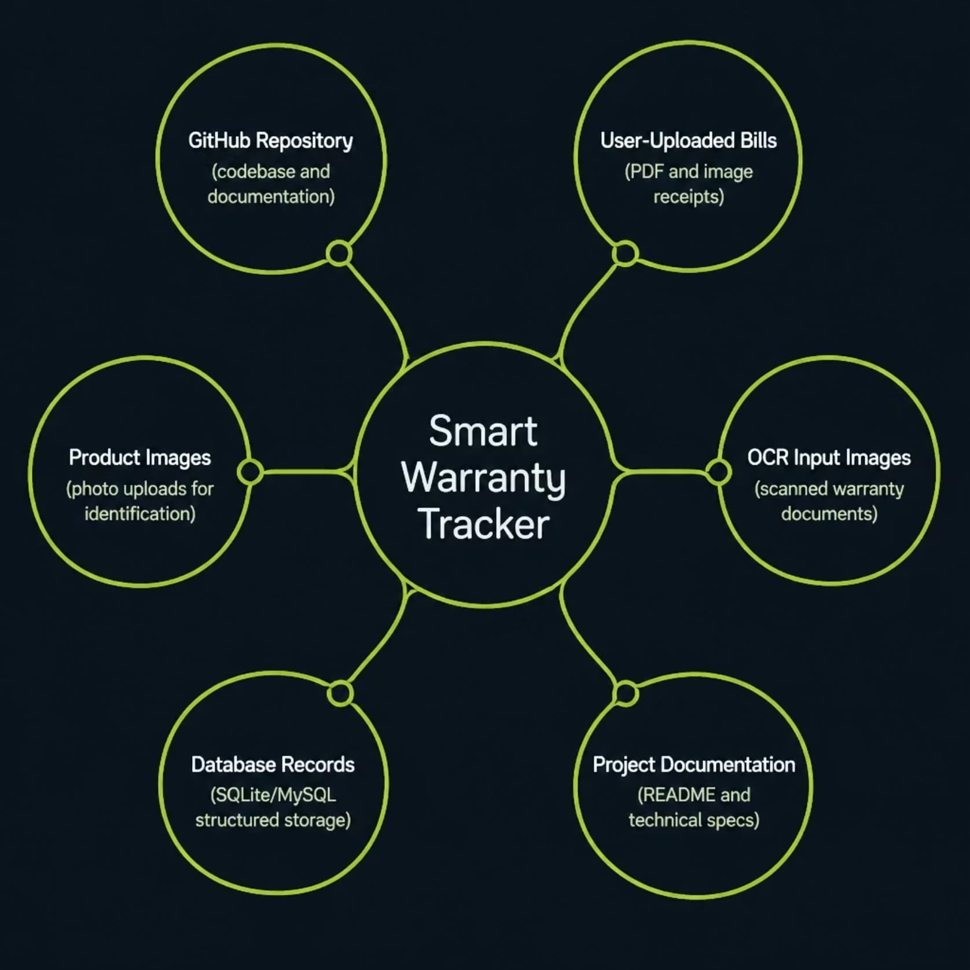




Project Inputs & Reference Sources
The system draws from multiple structured and user-provided data sources to enable intelligent warranty extraction and tracking.
Data Sources
GitHub Repository
Full source code, README, and project documentation
User-Uploaded Bills
Purchase receipts and invoices submitted by users
Product Images & OCR
Scanned documents processed through OCR pipeline
Database Records
Structured SQLite/MySQL storage for all warranty data

Slide 4
End-to-End System Workflow
From login to notification — every step is automated, secure, and user-friendly.
01
02
03
Login
Add Product
Upload Warranty Document
04
05
06
Store Product Information
Database
Dashboard
07
08
09
Warranty Tracking
Service Reminder
Chatbot Assistance
The pipeline processes user-uploaded bills through OCR, extracts key warranty fields automatically, persists data to the database, and triggers timely service reminders — all without manual data entry.

Slide 5






AI & Software Innovation
AI Chatbot
Streamlit Frontend
Database Management
Natural language processing for warranty queries and product assistance
Python web framework for building the interactive user interface and dashboard
SQLite/MySQL storing warranty, product, and user data
User Authentication
Warranty Tracking
Service Reminder System
Secure login with session management and access control
Real-time monitoring of warranty expiration dates
Automated alerts for upcoming service dates

Slide 6
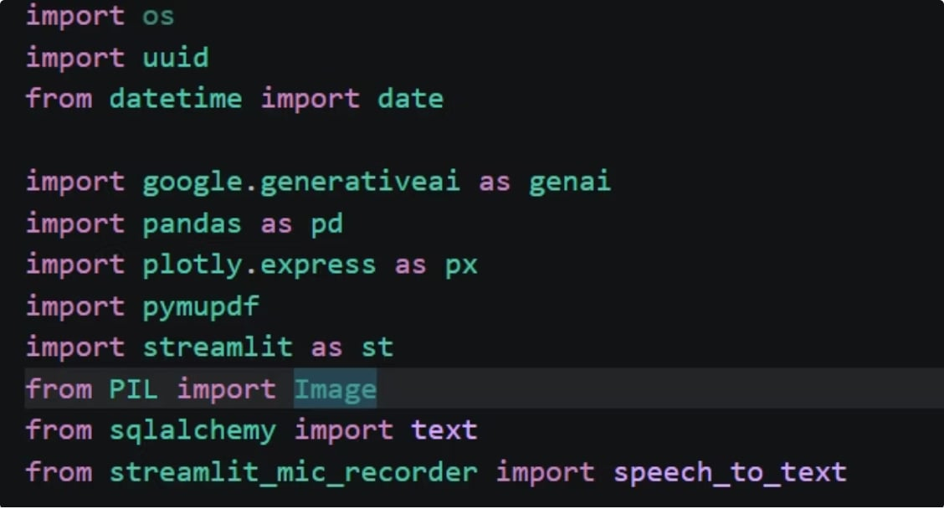









Tech Stack & Dependencies
Core Libraries
Key Technologies Used
Gemini API
Firebase Authentication
Google's generative AI for chatbot functionality
Secure user login and session management
Streamlit
Pandas
Interactive web framework for building the user interface
Data manipulation and analysis capabilities
Core libraries and APIs powering the application
Plotly Express
SQLAlchemy
Interactive visualizations for dashboard insights
Database Object-Relational Mapper (ORM) for data persistence
PIL/Pillow
PyMuPDF
Image processing library for handling product photos and scans
Efficient PDF handling for user-uploaded bills and documents
Streamlit Mic Recorder
Enables voice input for the AI chatbot

Slide 7
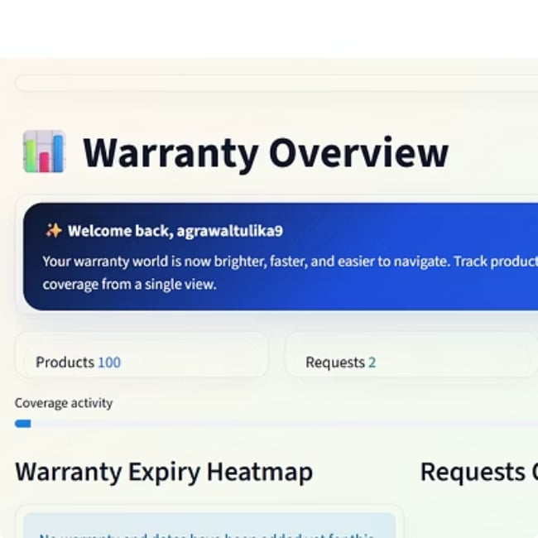
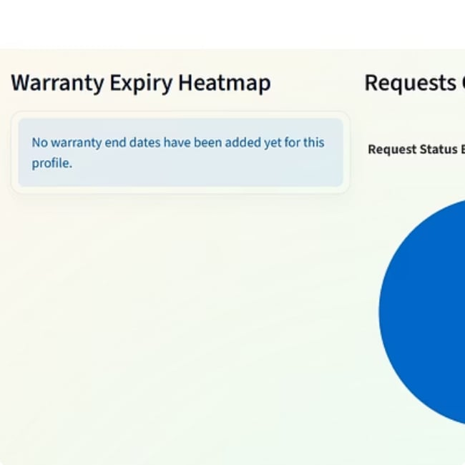
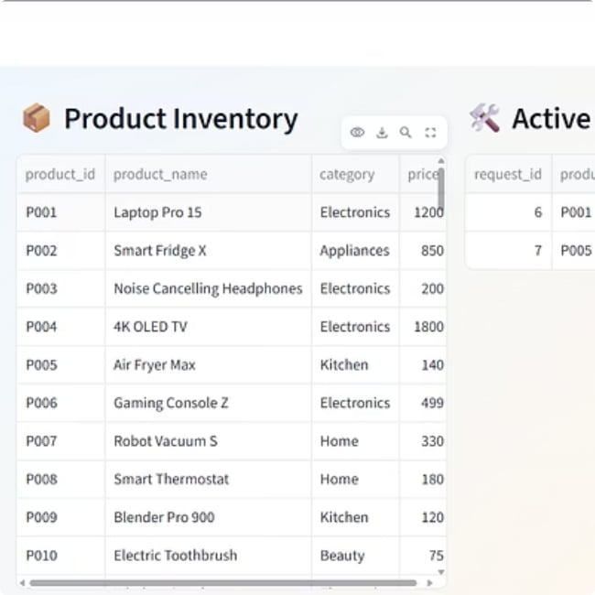
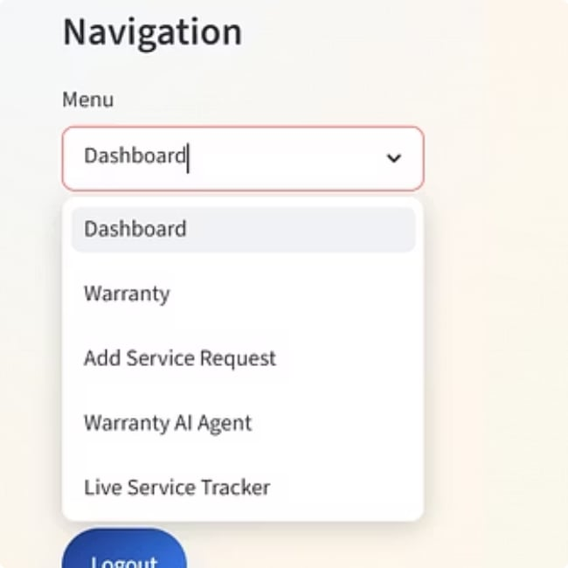
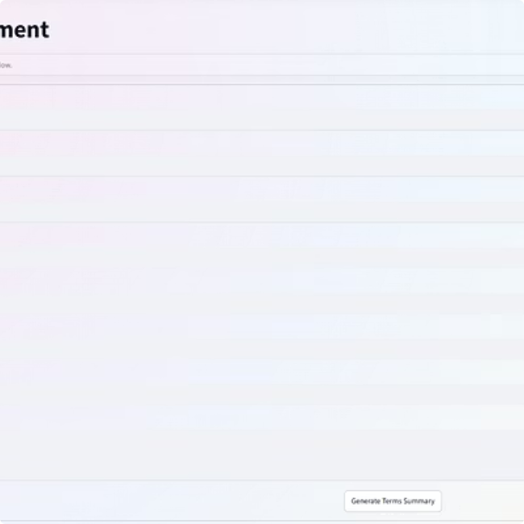
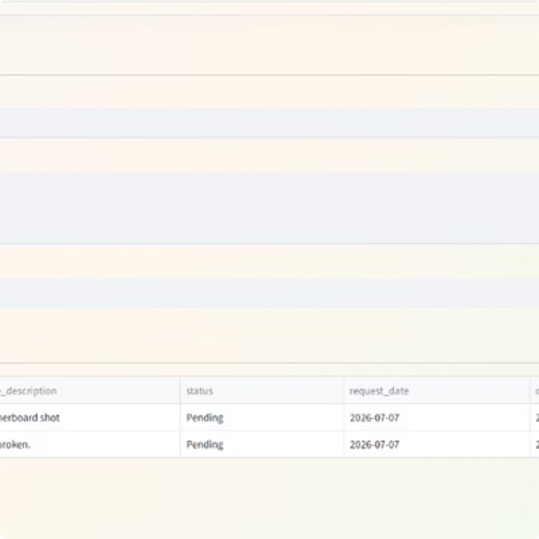
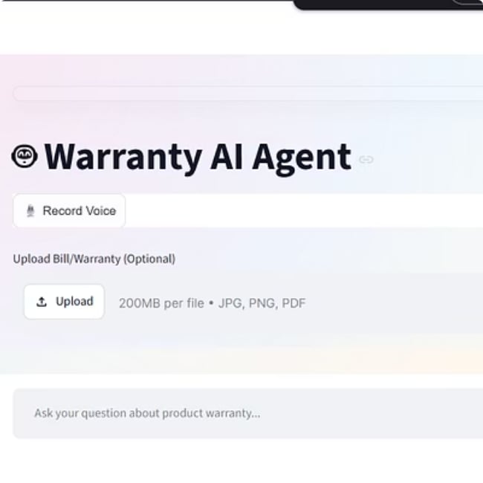
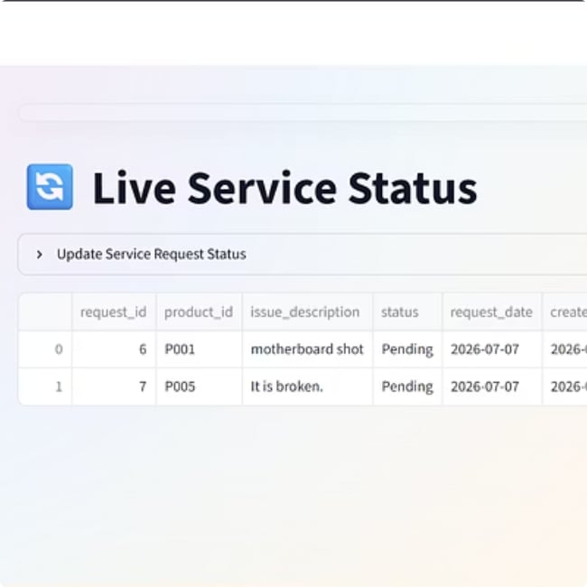
Prototype Screenshots
Key screens from the live application demonstrating the complete user journey from authentication to warranty management.

Slide 8
Results & Sample Outputs
Dashboard & Tracking
Product List
Warranty Details
Service Reminders
All registered products displayed with warranty status badges
Click-through view showing purchase date, expiry, and vendor info
Automated alerts triggered before warranty expiration dates

Slide 9


Limitations & Responsible Use
⚠️ Current Limitations
🛡️ Responsible Use Guidelines
OCR Quality Dependency — Extraction accuracy depends on bill image clarity and format
Manual Verification — Some fields may require user confirmation post-extraction
User Privacy — Personal purchase data must be protected and never shared
Secure Storage — Warranty documents should be encrypted at rest
Format Constraints — Limited support for non-standard bill layouts
Internet Dependency — Cloud-based OCR requires active connectivity
Access Control — Strong authentication prevents unauthorized document access
Ethical Use — Uploaded documents must not be misused or redistributed

Slide 10
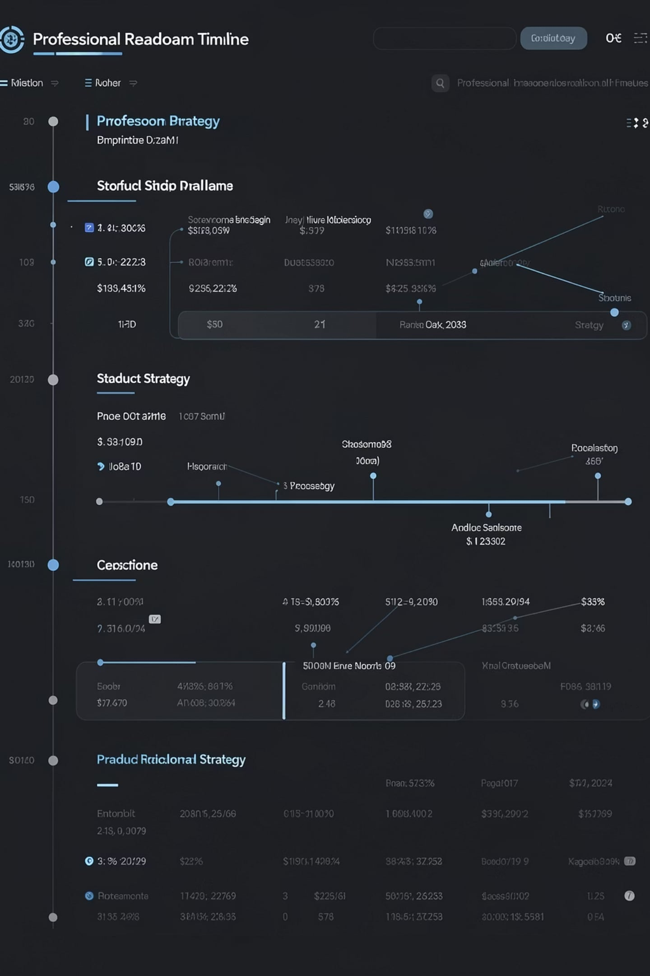
Future Roadmap
1
Phase 1 — Core Enhancements
Improved OCR accuracy, barcode scanner integration, QR code support for product registration
2
Phase 2 — Mobile & Cloud
Cross-platform mobile app (iOS/Android) with cloud synchronization for multi-device access
3
Phase 3 — AI Features
AI chat assistant for warranty queries, predictive maintenance alerts, and smart recommendations
4
Phase 4 — Global Reach
Multi-language support, regional vendor integrations, and enterprise deployment options

Slide 11
Conclusion
✅ Digitized
📦 Organized
Replaces physical warranty cards with a secure digital system
Centralized dashboard for all products and warranty documents
⏰ Proactive
🔒 Secure
Automated reminders prevent missed service and warranty claims
Authentication and encrypted storage protect user data
This project demonstrates practical software engineering — combining OCR, web development, and database design to solve a real consumer problem.
Thank You
Himshikar Capstone Project · Smart Warranty & Product Service Tracker
GitHub: https://github.com/Tulika1910/Smart_Warranty_and_Product_Service_Tracker

