Slide 1


Slide 2

Introduction / Background
A Global Health Crisis
Heart disease is one of the leading causes of death worldwide.
The Case for Early Detection
Early identification of at-risk patients can support timely intervention.
Machine Learning Approach
This project explores whether machine learning can learn patterns from historical clinical data and predict heart disease.
Assisting, Not Replacing
Machine learning is intended to assist—not replace—clinical decision-making.

Slide 3

Problem Statement
Complex Manual Diagnosis
Key Clinical Measurements
Manual diagnosis requires a doctor to interpret many clinical measurements simultaneously.
Relevant measurements include age, blood pressure, cholesterol, ECG results, chest pain and other clinical features.
Project Goal
The project addresses the problem of predicting whether a patient has heart disease using a machine learning classifier.

Slide 4
Aim / Objectives of the Project
01
02
03
Explore the Dataset
Preprocess Data
Train the Model
Explore and understand the UCI Heart Disease dataset.
Preprocess the data and prepare features (X) and target (Y).
Train a Logistic Regression classifier for binary prediction.
04
05
Evaluate Performance
Build Predictive System
Evaluate the model using training/test accuracy and a confusion matrix.
Build a simple predictive system for new patient records.

Slide 5

Literature Review / Existing System
Current Clinical Practice
Existing diagnosis relies heavily on clinical interpretation of multiple measurements.
Data Source
The uploaded project uses the UCI Heart Disease dataset (Cleveland subset) as the data source.
Existing Approach
The existing approach in this project is a supervised-learning pipeline using Logistic Regression.
Future Models
The presentation identifies Random Forest, SVM and XGBoost as possible models for future comparison.

Slide 6

Proposed Methodology / Approach
Load Data
Feature Split
Import and inspect the dataset
Separate X features and Y target
Load and inspect the dataset
Perform exploratory data analysis
Split features (X) and target (Y)
Train-test split: 80/20 with stratification
Train Logistic Regression
Evaluate accuracy and confusion matrix
Use the trained model for prediction on new patient data
Exploratory
Train-Test
Perform EDA and quality checks
80/20 split with stratify

Slide 7
Tools, Technologies & Dataset
Dataset
Records
Model
Training Setup
UCI Heart Disease dataset — Cleveland subset
303 patient records
Logistic Regression
242 training samples and 61 test samples
Data Quality
Columns
Target
No missing values; categorical fields already numerically encoded.
14 (13 clinical features + target)
1 = presence of heart disease, 0 = healthy

Slide 8

System Architecture / Flowchart
Data Collection
Data Preparation
Train/Test Split
Model & Evaluate
The end-to-end pipeline transforms raw clinical records into a binary prediction — indicating the presence or absence of heart disease — through a structured sequence of data preparation, model training, and evaluation steps.

Slide 9
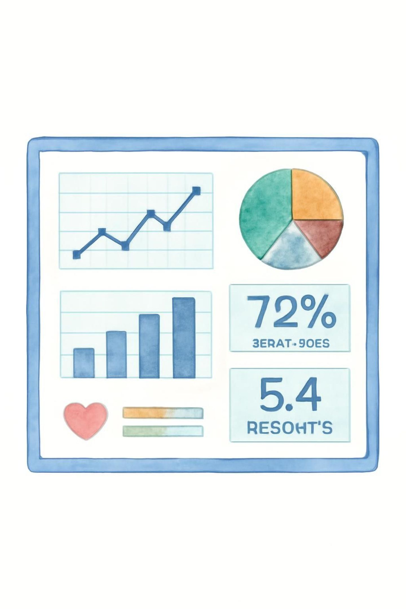
Expected Outcomes
81.97%
303
Test Accuracy
Patient Records
Achieved on the unseen test set.
Total records used in the study.
14
Clinical Features
13 features + 1 binary target variable.
A trained binary classification model for heart disease prediction.
A confusion matrix for understanding correct and incorrect predictions.
A reusable predictive system that accepts a new patient record and returns a prediction.
The project demonstrates that clinical features contain predictive signal for heart disease risk.

Slide 10
Timeline / Workplan
Phase 1
1
Dataset collection and inspection
2
Phase 2
Exploratory Data Analysis
Phase 3
3
Data preparation and train-test split
4
Phase 4
Logistic Regression model training
Phase 5
5
Model evaluation using accuracy and confusion matrix
6
Phase 6
Predictive-system implementation
Phase 7
7
Documentation and presentation

Slide 11
Challenges Faced
Small Dataset
Working with a relatively small dataset of only 303 patient records.
Multi-Feature Interpretation
Interpreting multiple clinical features together rather than relying on a single feature.
Class Balance
Ensuring the train/test split maintains class balance through stratification.
Accuracy Limitations
Avoiding over-interpretation of model accuracy on a small public dataset.
Scope Disclaimer
The model is a learning project and is not a certified diagnostic tool.

Slide 12

Future Scope
Model Comparison
Cross-Validation
Evaluate alternative machine learning models such as Random Forest, SVM, and XGBoost to identify the best performing classifier.
Implement k-fold cross-validation to ensure model robustness and generalize performance across different data subsets.
Larger Datasets
Web Deployment
Integrate larger and more diverse heart disease datasets to enhance model training and improve predictive accuracy.
Develop a user-friendly web application to deploy the trained model, allowing for practical, real-time predictions.
Feature Engineering
Explore advanced feature engineering techniques to extract more meaningful insights and potentially improve model performance from existing clinical data.

Slide 13
Conclusion & Key Takeaways
Model Performance
Confusion Matrix Insights
Predictive Value of Features
Achieved 81.97% test accuracy and 85.12% training accuracy on the UCI Heart Disease dataset, demonstrating the model's ability to generalize.
The confusion matrix provided a detailed view of correct and incorrect predictions, aiding in the understanding of the model's performance in identifying both positive and negative cases.
Clinical features were shown to contain a strong predictive signal for the presence of heart disease, validating their utility in machine learning applications.
Educational Prototype
This project serves as an educational prototype to demonstrate machine learning principles and is not intended for clinical diagnostic use.

Slide 14
References
UCI Heart Disease Dataset
Project Dataset
Scikit-learn Logistic Regression
The primary source of clinical data, specifically the Cleveland subset, used for training and testing.
A preprocessed and cleaned version of the Cleveland subset, locally stored as a CSV file for consistent project use.
Standard machine learning library used for implementing the binary classification model and associated utilities (train-test split, metrics).
Limited Sources Note
This project relies on a single public dataset; robust real-world applications would require broader and more diverse data for validation.

Slide 15
Thank You
We appreciate your time and attention to this project.
Questions & Answers
We are now happy to answer any questions you may have.

