Slide 1
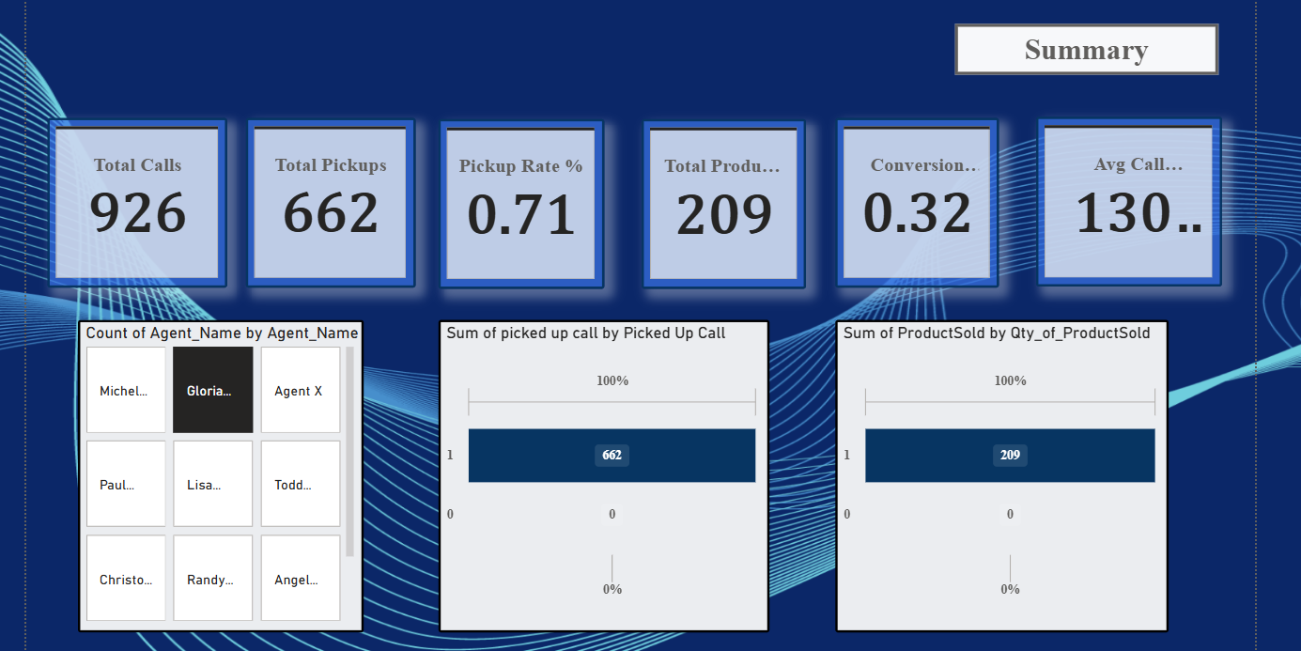
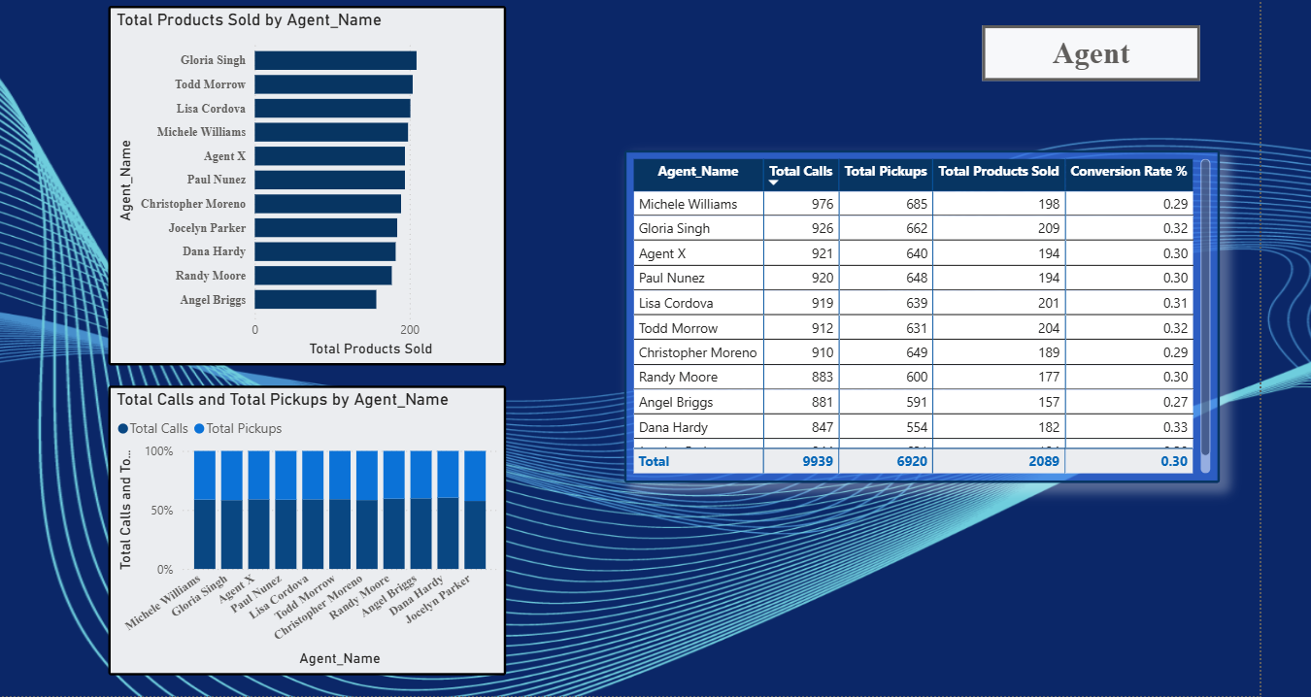
Call Center Sales Dashboard
Presented By : Tulika Sinha

Slide 2
Objective
Objective: Design an interactive dashboard for business stakeholders.
Tools: Power BI
Deliverables: Interactive Dashboard + PPT summary
Hints/Mini Guide:
Choose right KPIs (Sales, Profit, Growth)
Use slicers/filters for interactivity
Include time-series analysis
Add cards for totals/summary
Apply consistent color theme
Create navigation menu (if possible)

Slide 3
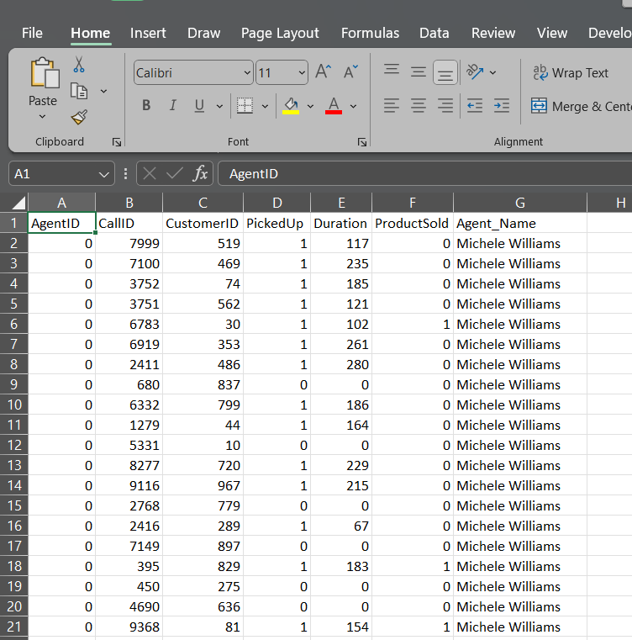
Datasets Details
1. Dataset Source : Kaggle
2. Dataset Link : Link (7 Columns , 9939 Data)
3. Data’s present in Dataset Contains following Data
3.1 Agent Id
3.2 Call Id
3.3 Customer Id
3.4 Picked Up
3.5 Duration
3.6 Project Sold
3.7 Agent Name
4. Power Bi Link : Link to BI

Slide 4
INTERACTIVE DASHBOARD AHEAD…

Slide 5


Microsoft Power BI

Slide 6
DASHBOARD SCREENSHOT AHEAD…

Slide 7
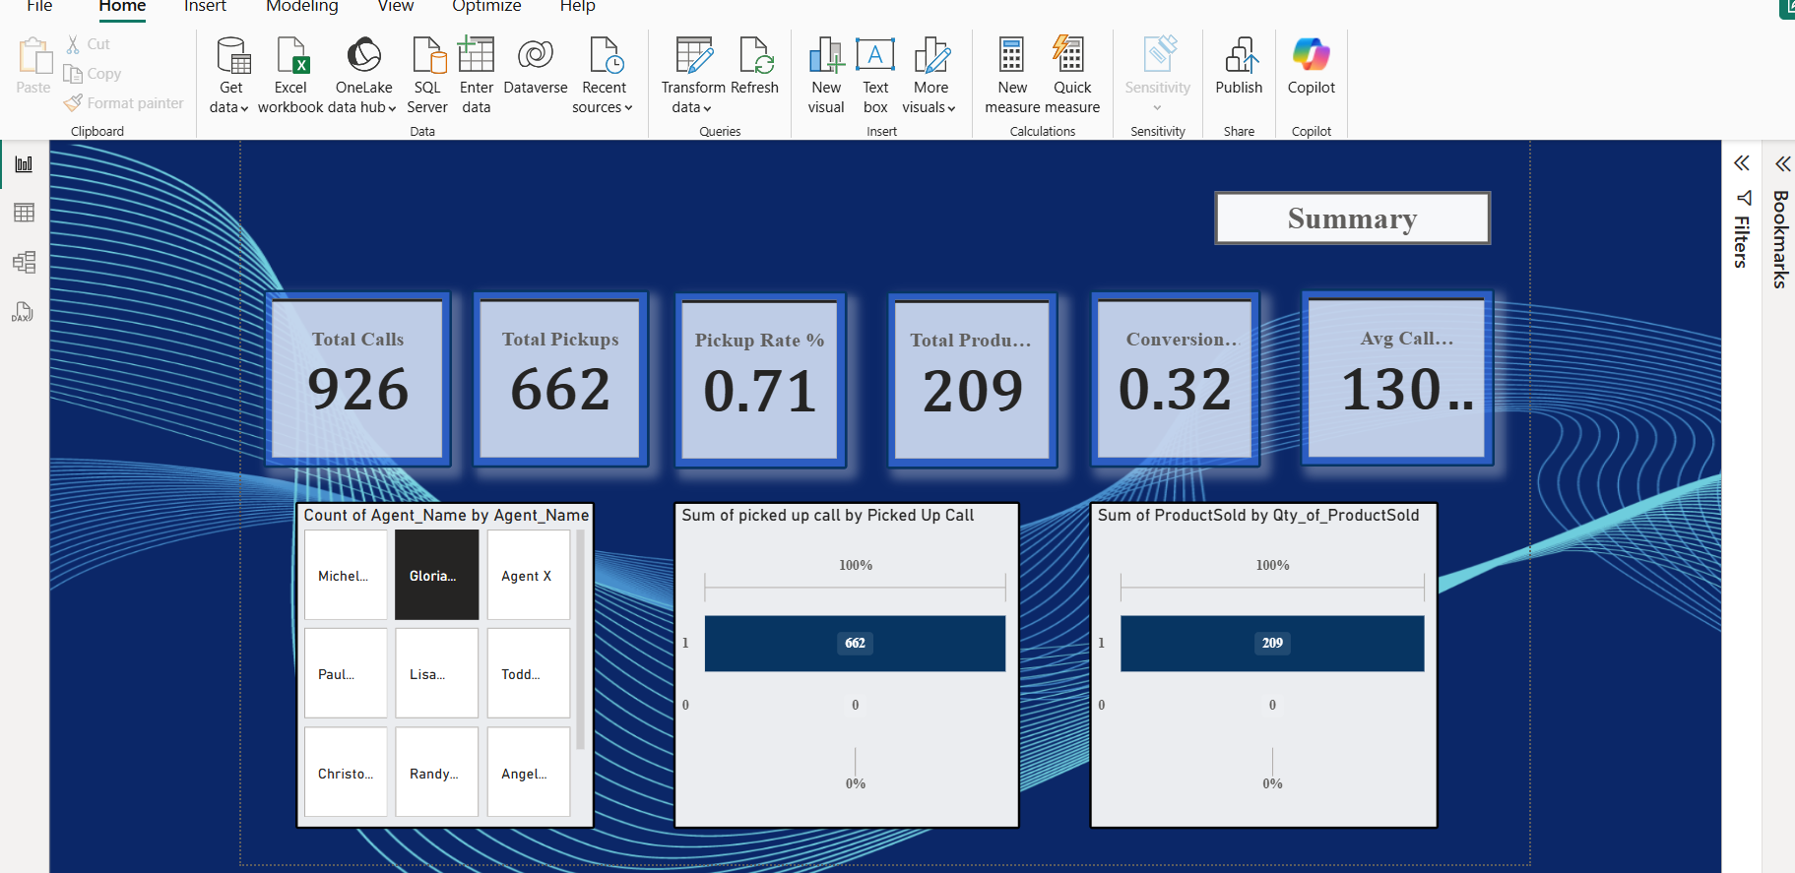
1. Executive summary

Slide 8
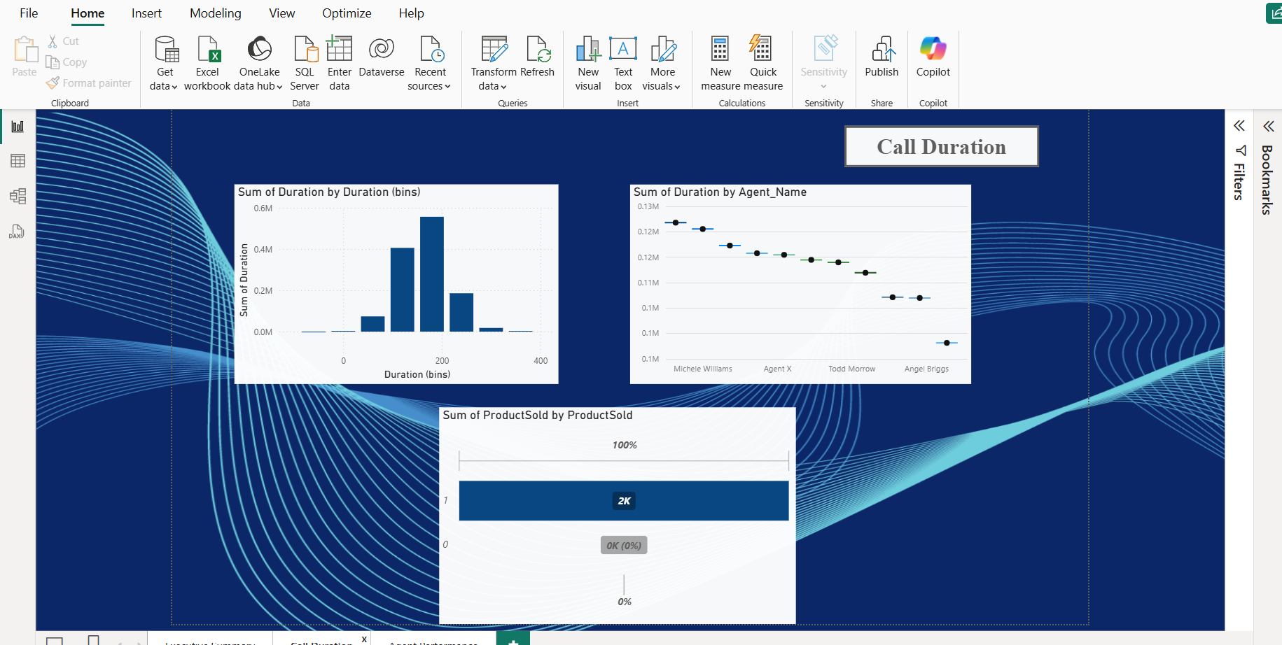
2. CALL Duration

Slide 9
3. AGENTB PERFORMANCE

