Slide 1



ReliefRoute:
Intelligent Disaster Relief Resource Allocation and Decision Support System
B.TECH INFORMATION TECHNOLOGY · MINOR PROJECT
Riverside
Old Town
A Python-Based Interactive Resource Allocation Prototype
Limited stock
Student: Tulika Srivastava Roll No.: 2300540130055
Central Ward
Hillview
Programme: B.Tech Information Technology College: BBDITM
Illustrative concept: stock shared across four simulated areas
Academic Year: 2026-27

Slide 2





Introduction
Essential supplies save lives
How ReliefRoute helps
Food, clean water and medical kits are the first needs after a flood, earthquake or landslide.
Resources are limited
Food
Water
Medical kits
Stock is often smaller than total demand, and areas differ in population, urgency and requirements.
ReliefRoute dashboard
Decisions need structure
A systematic method makes allocation choices easier to explain, compare and review.
Allocation plan + shortage view
Educational prototype using simulated data. Context: [7], [8]

Slide 3


Problem Statement
Limited disaster relief resources must be distributed among multiple affected areas that have different requirements and priorities.
Resource scarcity
Supply is smaller than total demand
Unequal requirements
Areas differ in population, urgency and need
Allocation complexity
Three resources must be shared at once
Unmet demand
Some areas will inevitably stay short
Hard to compare approaches
Different rules give different outcomes
From the app's built-in sample scenario (4 areas, default stock). Illustrative only.

Slide 4




Project Objectives
01
02
03
04
Develop an interactive resource allocation dashboard
Represent multiple simulated affected areas
Allow users to enter available resource quantities
Demonstrate two allocation strategies
05
06
07
Goal
A working dashboard for structured analysis of relief allocation
Visualise allocation outcomes and shortages
Enable CSV export of results
Support analysis of alternative allocation decisions

Slide 5
Proposed System and Key Features
Inputs
Processing
Outputs
Simulated area data in an editable table
Food, water and medical-kit stock
Strategy selection
Validate and clean the table
Allocate each resource by the chosen strategy
Round to whole units
Allocation and shortage table
Summary metrics
Allocated and unmet-demand charts
CSV download
INPUTS PROCESSING OUTPUTS

Slide 6




Technology Stack
Python
Streamlit
Pandas
NumPy
Application logic and processing [1]
Interactive web interface: sidebar, editable table, buttons [2]
Tabular data handling, cleaning and result tables [3]
Numeric arrays used in allocation calculations [4]
Plotly
CSV export
Visual Studio Code
requirements.txt
streamlit
pandas
numpy
plotly
Interactive grouped bar charts of allocation and shortage [5]
Allocation report downloaded from the dashboard
Development environment

Slide 7

System Architecture
Tables & Charts
Results table, two bar charts
User
Streamlit Dashboard
Input Processing
Strategy Selection
Allocation Results
Edits data, sets stock, chooses a strategy
Sidebar inputs, editable table, buttons
Checks rows, converts to numbers, clips urgency to 1–5
Priority-Weighted Greedy
Allocated amount and shortage per area, per resource
CSV Export
Proportional Fair-Share
Download report
Single Streamlit script (app.py). No separate server, database, API or microservices; data is kept in Streamlit session state.
allocate_one()
round_allocations()
st.session_state
Weighted water-filling for one resource, capped at each area's demand
Converts results to whole units, largest fractions first
Keeps the area table and last result between interactions

Slide 8
Allocation Strategies
 | Priority-Weighted Greedy | Proportional Fair-Share
Core principle | Share stock by priority weight, capped at each area's demand | Share stock in proportion to each area's requested quantity
Main consideration | Urgency and affected population | Size of each area's request
Potential benefit | Directs more stock to urgent, populous areas | Easy to explain: each area gets the same share of its demand
Potential limitation | Weights are a simple heuristic; low-urgency areas may stay short | Ignores urgency and population; not proven optimal or fair
In the source code
Priority weight = urgency × (1 + people ÷ max people)
Fair-share weight = requested quantity
Each round: split remaining stock by weight among areas with unmet need, cap at demand, repeat
If stock ≥ total demand: every area gets its full demand
Whole units: round down, then add leftovers by largest fraction

Slide 9

Workflow and Methodology
1
Start the app
2
Load sample data
3
Enter resources
4
Select strategy
streamlit run app.py opens the dashboard
Four sample areas in an editable table
Food, water and medical stock in the sidebar
Priority-weighted or proportional fair-share
8
Export CSV
7
Visualise shortages
6
Show allocation table
5
Generate plan
Download the result table as a CSV file
Grouped bar charts: allocated and unmet demand
Per-area allocation, shortage and coverage metrics
Validate, allocate each resource, round to whole units
Validation: no plan is generated if the table is empty or any area name is blank.

Slide 10
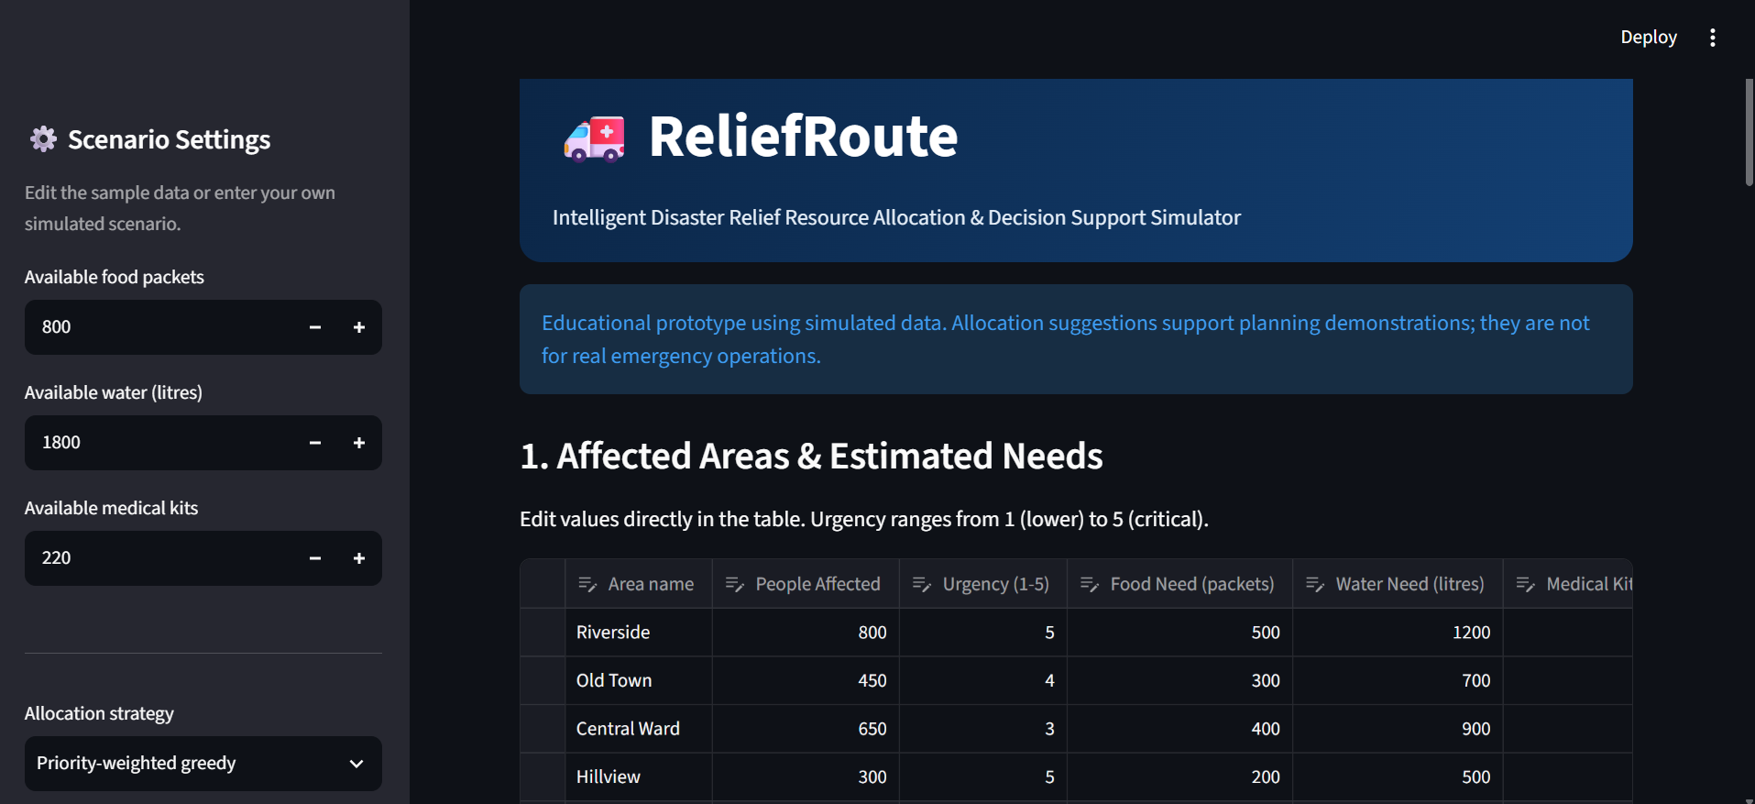
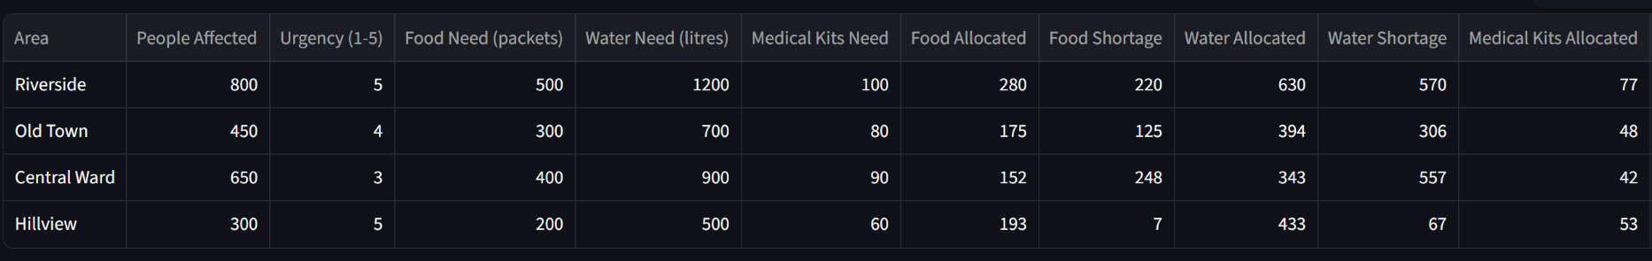

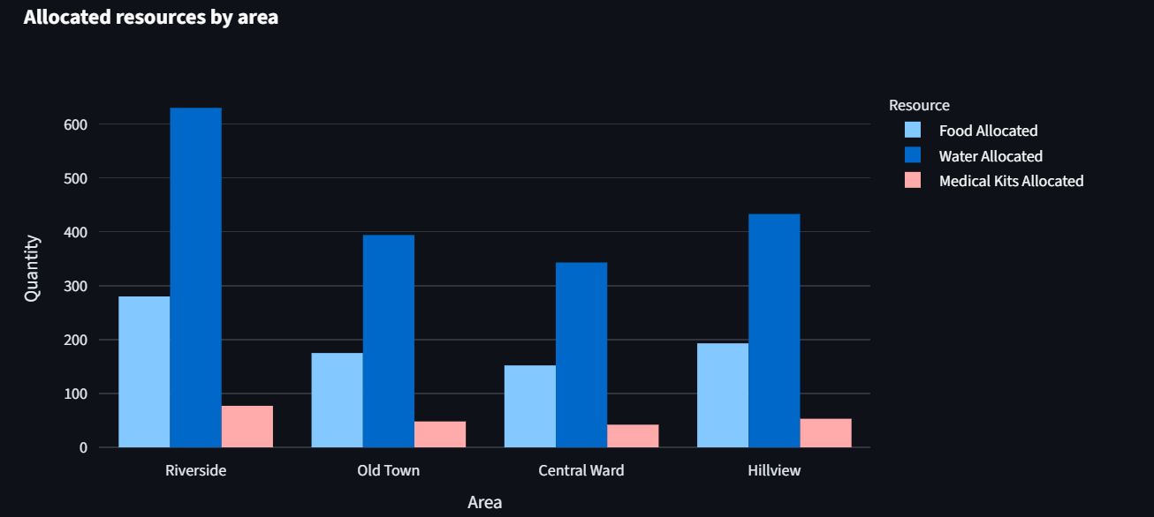
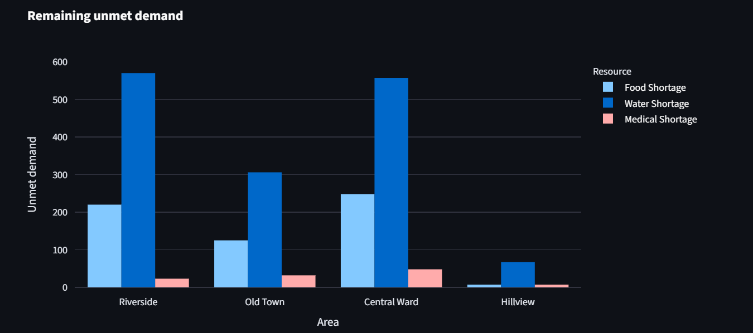
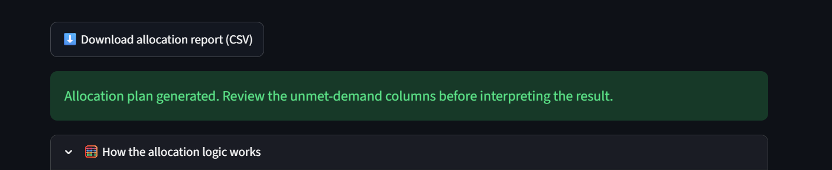
Working Prototype Demonstration
SCREENSHOT PLACEHOLDER
Allocation results table
SCREENSHOT PLACEHOLDER
SCREENSHOT PLACEHOLDER
Main dashboard
Sidebar stock inputs, strategy selector and editable area table
Allocated and unmet-demand charts
SCREENSHOT PLACEHOLDER
CSV export
Download button

Slide 11
Results and Observations
Users can enter resource quantities
Allocation plans can be generated with either strategy
Results can be inspected in tables
Charts help visualise allocation and shortages
Results can be exported as CSV
Output of app.py's allocation functions run on the built-in sample data. Illustrative only, not a validated or comparative result.

Slide 12

Limitations and Future Scope
Current limitations
Future scope
CURRENT PROTOTYPE
PROPOSED: NOT YET IMPLEMENTED
Uses simulated data only
No live disaster-data integration
Simplified allocation model
Real-world fairness and optimality not established
No validated GIS-based routing
Overall coverage % adds food, water and medical units together
Real-time disaster-data integration
GIS-based affected-area mapping
Relief vehicle route optimisation
Enhanced priority scoring
Per-resource and weighted coverage metrics
Additional allocation and optimisation algorithms
Testing with fairness, efficiency and resource-conservation metrics

Slide 13
Conclusion
Problem: limited supplies, many areas with different needs
ReliefRoute: interactive prototype for allocating food, water and medical kits
Two strategies: priority-weighted and proportional fair-share
Thank You
Working dashboard: inputs, results table, charts and CSV export
Questions & Answers
Visualisation: makes allocation and unmet demand easier to inspect
ReliefRoute: educational prototype, simulated data
Next: real data, GIS mapping, route optimisation, evaluation metrics

Slide 14
References
[1]
Python Software Foundation. Python 3 Documentation. https://docs.python.org/3/
[2]
Streamlit Inc. Streamlit Documentation. https://docs.streamlit.io
[3]
pandas Development Team. pandas Documentation. https://pandas.pydata.org/docs/
[4]
NumPy Developers. NumPy Documentation. https://numpy.org/doc/
[5]
Plotly Technologies Inc. Plotly Python Graphing Library. https://plotly.com/python/
[6]
Cormen, T. H., Leiserson, C. E., Rivest, R. L. and Stein, C. Introduction to Algorithms, 4th ed. MIT Press, 2022 (greedy algorithms).
[7]
Sphere Association. The Sphere Handbook: Humanitarian Charter and Minimum Standards in Humanitarian Response. https://spherestandards.org
[8]
United Nations Office for Disaster Risk Reduction (UNDRR). Sendai Framework for Disaster Risk Reduction 2015–2030. https://www.undrr.org

