Slide 1

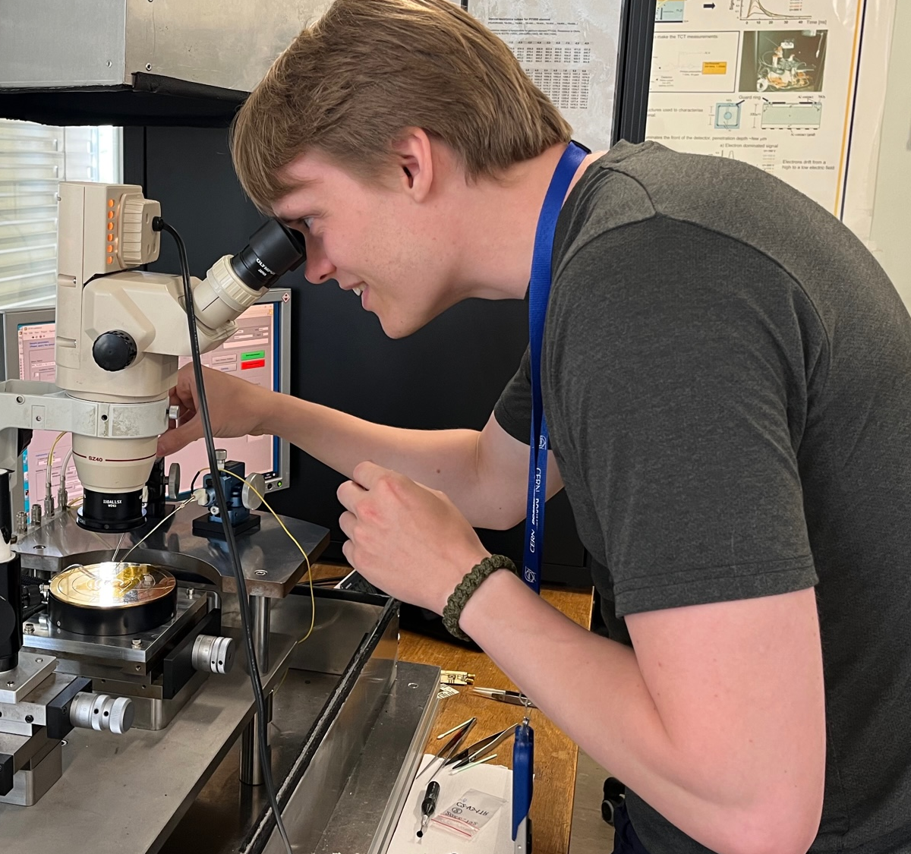
Tell us about yourself and background/studies
  Aarhus University
  Experimental Physics
  I’m building a neutron detector for hospitals
What you have done at CERN?
  3 month summer student. I was attached to a small group in the CMS collaboration, working on the PPS subdetector.
  My project was to investigate a new type of silicon detector, and find out how it would behave when damaged by radiation.
  I kept breaking these detectors, but I managed to find a way to break them systematically! I also maybe found a way to prevent them from breaking
  To simulate radiation damage in the detectors, I followed the method of other researchers at CERN, but found that the conventional method might not be valid for the physics in PPS.
Anton
Rindom
EP-CMT
ADD YOUR PHOTO HERE

Slide 2
What has coming to CERN taught you?
  I have learnt almost no actual physics, but I have learnt a lot about how to work with detectors!
  I learnt to characterize silicon detectors, how to test their timing performance, how to work during beamtime, and I learnt about radiation damage in detectors and how to measure and simulate it.
What advice would you give to other students?
  CERN has experts in basically every field, and they are usually helpful and don’t mind talking about their work. Reach out to them if you need help or are curious.
  Join a club! There are clubs for everything here, and you will likely meet interesting people from different fields and countries.
Anton
Rindom
EP-CMT
ADD YOUR PHOTO HERE

Slide 3
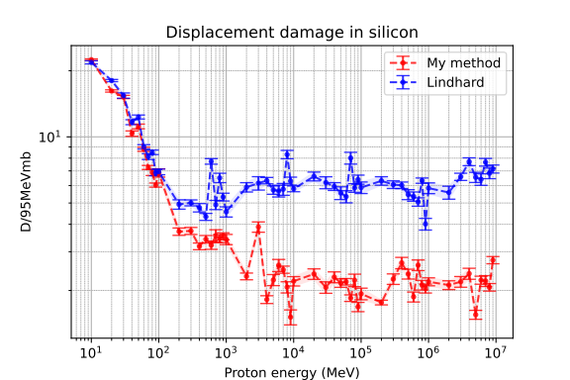
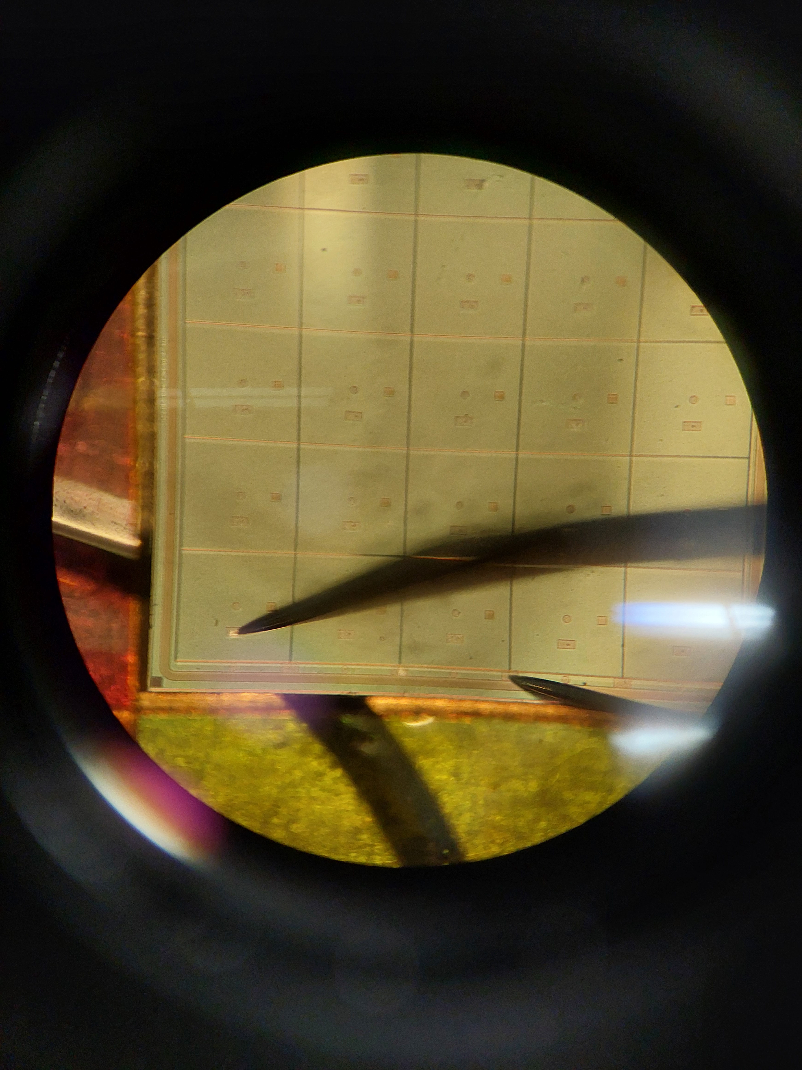
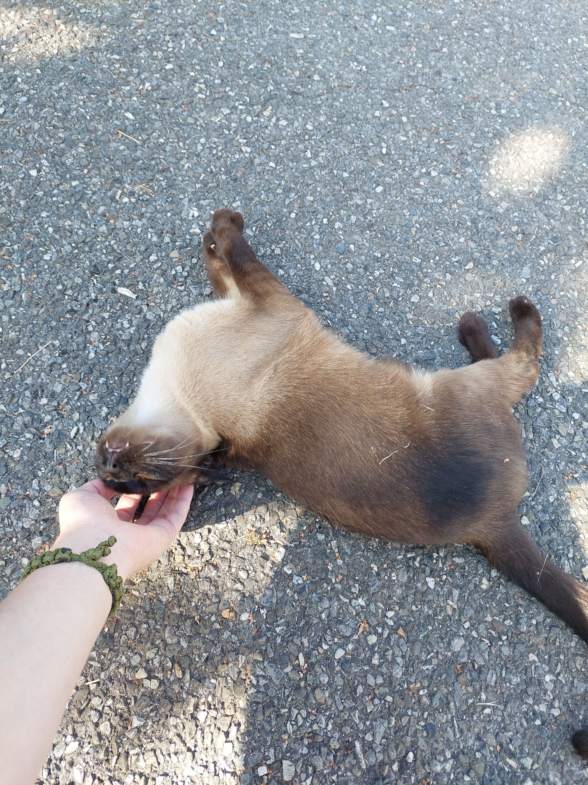
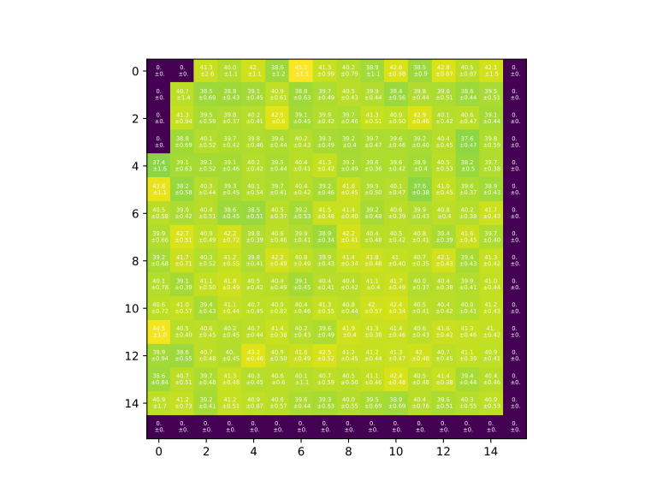
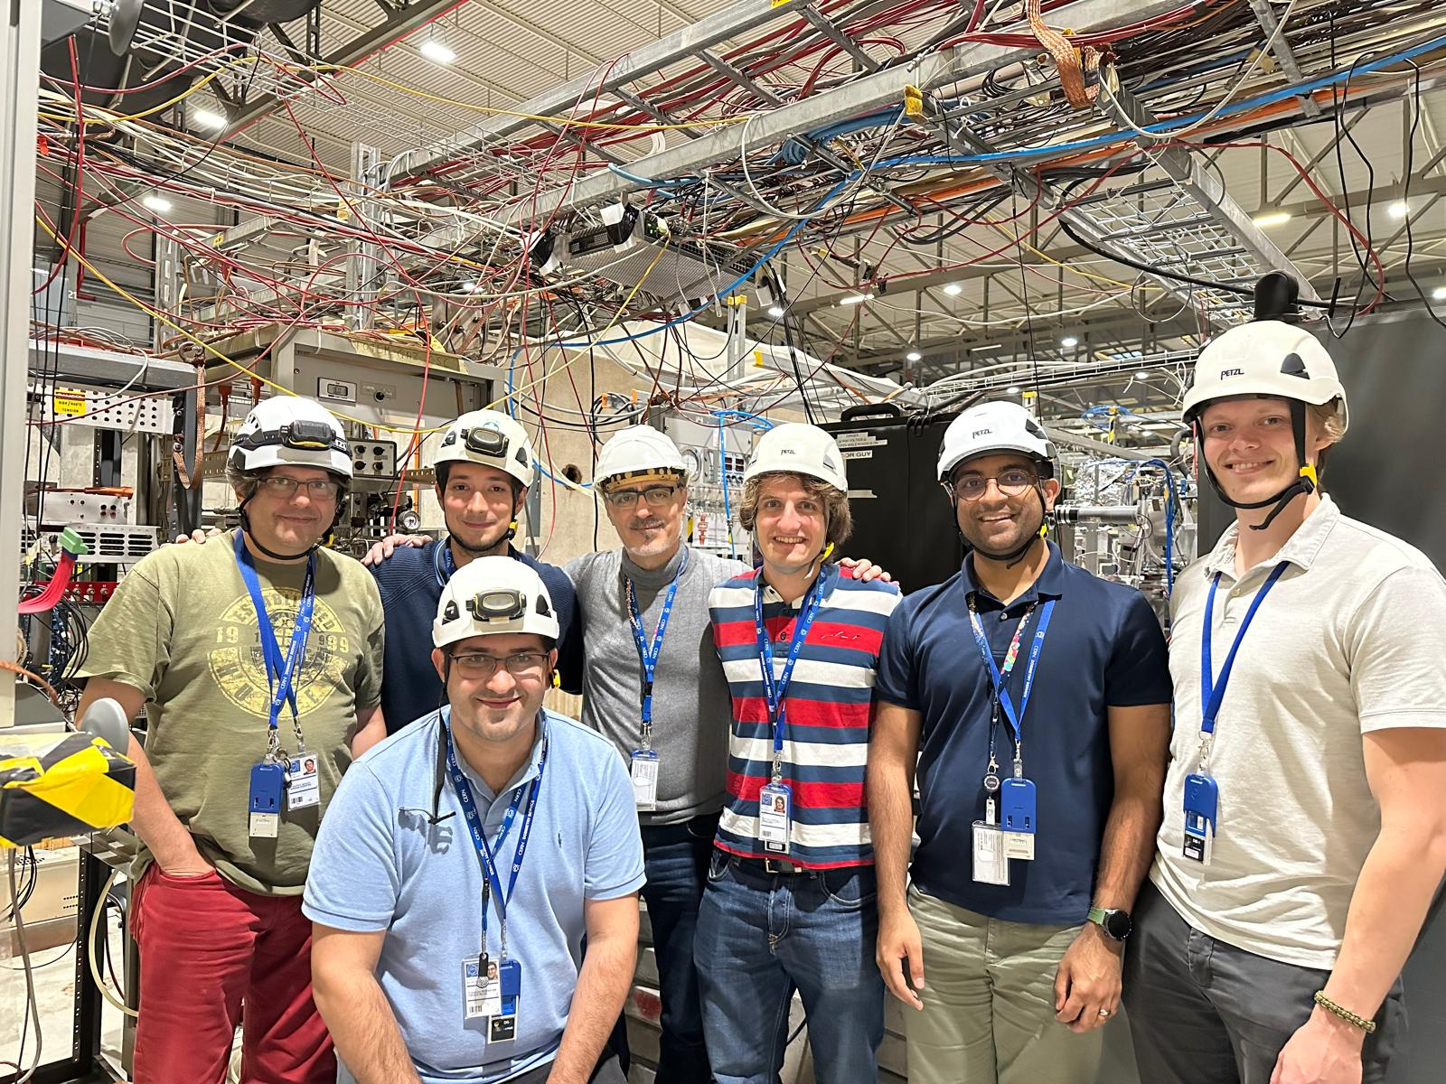
Anton
Rindom
EP-CMT

