Slide 1
WELCOME EVERYONE TO OUR PRESENTATION

Slide 2
TEAM MEMBERS
Suravi Akhter Nipa-------0827
Imam Hossain kawsar---0816
Tulshi Candra Das------0811

Slide 3
What is sorting????

Slide 4
Outline
Sort definition
Importance of Sorting
Insertion sort
Explanation
Algorithm
Walk through example
Runtime
Advantage and Disadvantage

Slide 5
Sorting at a glance: The Big Picture
Horrible algorithms:
Ω(n²⁾
Simple
algorithms:
O(n²⁾
Fancier
algorithms:
O(n log n)
Bogo Sort
Stooge Sort
Insertion sort
Selection sort
Bubble Sort
Shell sort
…
Comparison
lower bound:
Ω(n log n)
Heap sort
Merge sort
Quick sort (avg)
…
Specialized
algorithms:
O(n)
Bucket sort
Radix sort
IIT,DU
12.11.2016
Notes:
<number>

Slide 6
Why we do sorting?
Commonly encountered programming task in computing.
Examples of sorting:
List containing exam scores sorted from Lowest to Highest or from Highest to Lowest
List containing words that were misspelled and be listed in alphabetical order.
List of student records and sorted by student number or alphabetically by first or last name.

Slide 7
Why we do sorting?
Searching for an element in an array will be more efficient. (example: looking up for information like phone number).
It’s always nice to see data in a sorted display. (example: spreadsheet or database application).
Computers sort things much faster.

Slide 8
Insertion Sort
Real life example:
An example of an insertion sort occurs in everyday life while playing cards. To sort the cards in your hand you extract a card, shift the remaining cards, and then insert the extracted card in the correct place. This process is repeated until all the cards are in the correct sequence.

Slide 9
Insertion Sort
Insertion sort keeps making the left side of the array sorted until the whole array is sorted. It sorts the values seen far away and repeatedly inserts unseen values in the array into the left sorted array.
It is the simplest of all sorting algorithms.
Although it has the same complexity as Bubble Sort, the insertion sort is a little over twice as efficient as the bubble sort.

Slide 10
insertionsort(array,numberOFelement)
{
for :i←1 to numberOFelement-1
{
value ← array[i]
space ← i
while(space>0 && array[space-1]>value)
{
array[space] ← array[space-1]
space--
}
array[space] ← value
}
}

Slide 11
Insertion Sort Example
Sort: 34 8 64 51 32 21
34 8 64 51 32 21
The algorithm sees that 8 is smaller than 34 so it swaps.
8 34 64 51 32 21
51 is smaller than 64, so they swap.
8 34 51 64 32 21

Slide 12
Insertion Sort Example
Sort: 34 8 64 51 32 21
8 34 51 64 32 21 (from previous slide)
The algorithm sees 32 as another smaller number and moves it to its appropriate location between 8 and 34.
8 32 34 51 64 21
The algorithm sees 21 as another smaller number and moves into between 8 and 32.
Final sorted numbers:
8 21 32 34 51 64

Slide 13
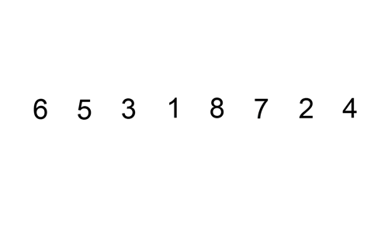
Visual Example

Slide 14
Insertion Sort runtimes
Best case: O(n).
It occurs when the data is in sorted order. After making one pass through the data and making no insertions, insertion sort exits.
for example::: 3 5 8 12 45
Average case: θ(n^2)
since there is a wide variation with the running time.
Worst case: O(n^2)
if the numbers were sorted in reverse order.
for example :: 45 12 8 5 3

Slide 15
insertionSort – Algorithm Complexity
How many compares are done?
1+2+…+(n-1), O(n2) worst case
(n-1)* 1 , O(n) best case
How many element shifts are done?
1+2+...+(n-1), O(n2) worst case
0 , O(1) best case
How much space?
In-place algorithm

Slide 16
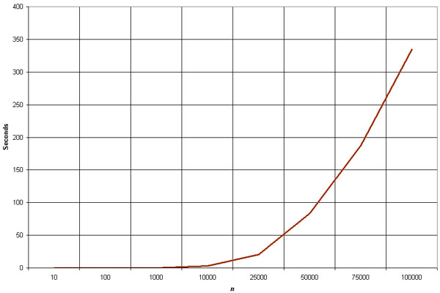
Empirical Analysis of Insertion Sort
The graph demonstrates the n^2 complexity of the insertion sort.
Source: http://linux.wku.edu/~lamonml/algor/sort/insertion.html

Slide 17
Best Times to Use Insertion Sort
When the data sets are relatively small.
Moderately efficient.
When you want a quick easy implementation.
Not hard to code Insertion sort.
When data sets are mostly sorted already.
(1,2,4,6,3,2)

Slide 18
Worst Times to Use Insertion Sort
When the data sets are relatively large.
Because the running time is quadratic
When data sets are completely unsorted
Absolute worst case would be reverse ordered. (9,8,7,6,5,4)

Slide 19


Faster Computer Vs Better Algorithm
Algorithmic improvement more useful
than hardware improvement.
E.g. 2^{n} to n³

Slide 20
THANK YOU
EVERYONE

Slide 21
Sawal / jawab

