Slide 1
Flip-Flops

Slide 2
Objectives of Lecture
The objectives of this lecture are:
to discuss the difference between combinational and sequential logic as well as the difference between asynchronous and synchronous circuits and to show why the operation of synchronous circuits is more predictable, given propagation delays.
to explain the operation of the common latches and flip-flops
SR or set–reset latch, which may also be called a SR flip-flop
D or data flip-flip
T or toggle flip-flop
JK flip-flop
to describe clocking and the differences between positive edge and negative edge triggering and discuss the type of control inputs — active high and active low; asynchronous, jam or direct.

Slide 3
Combinational Logic
The outputs depend only on the state of the inputs all of the time. Any change in the state of one of the inputs will ripple through the circuit immediately.
Examples of combinational logic are NAND and NOR gates, Inverters, and Buffers. These four logic gates form the basis of almost all combinational logic circuits as well as flip flops.
Circuits that change the state of the output in this manner are also known as asynchronous circuits.
However, not all asynchronous circuits are combinational logic circuits.

Slide 4
Sequential Logic
Has memory; the circuit stores the result of the previous set of inputs. The current output depends on inputs in the past as well as present inputs.
The basic element in sequential logic is the bistable latch or flip-flop, which acts as a memory element for one bit of data.

Slide 5
Clocked Circuits
Most flip-flops are clocked so that the output change state based upon the state of the inputs at precisely determined times.
Usage varies — in this course, ‘flip-flops’ will be used for clocked circuits and ‘latches’ for circuits that are asynchronous.
A common clock used in many flip-flips in one circuit ensures that all parts of a digital system change state at the same time. This is called a synchronous system

Slide 6
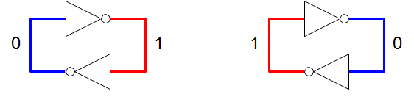
Bistable Circuit
At the heart of a bistable circuit is a pair of inverters connected in a loop — with feedback, in other words. It has two stable states.
Without some control, there isn’t a way to force the bistable circuit into one or the other state.

Slide 7
Bistable Circuits
The bistable circuit is used as a ‘bus keeper’ to hold a node at a definite 1 or 0. It is also the heart of a ‘static random access memory’ (SRAM) cell.
Similar operation occurs for any ring composed of an even number of invertors.
What would happen if 3 inverters (or larger odd number) are connected in series?
This type of circuit is called a ring oscillator.
Check this out in the laboratory or in PSpice!

Slide 8
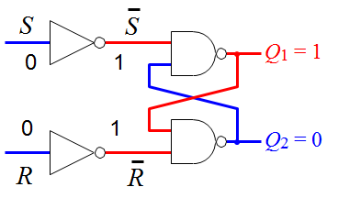
Core of a Flip-Flop: The set–reset or SR Latch
Acts as a simple memory with two stable states at the two output when S = R = 0
Q1 and Q2 are the outputs of the S-R latch.
When Q1 is known as Q and Q2 is also called Q’ or (spoken as Q bar), meaning that its value is not Q or the opposite of Q.

Slide 9
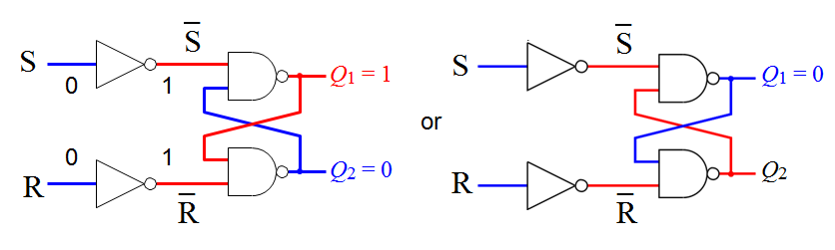
S-R Latch
Acts as a simple memory with two stable states when S = R = 0:
The latch
holds (stores) when S = R = 0
is set (to 1) by bringing S = 1 with R = 0
is reset (to 0) or cleared by bringing R = 1 with S = 0
The condition S = R = 1 must be avoided because it leads to an
indeterminate condition, where the output can not be predicted at any one point in time. This can cause a race condition to occur when the inputs change to S = R = 0.

Slide 10
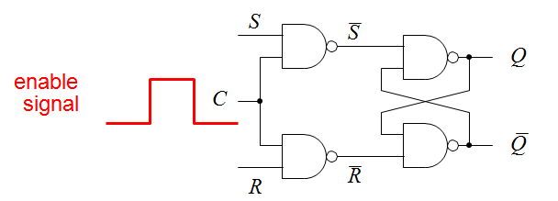
SR Latch with Enable
The S and R inputs only effect the output states when the enable input C is high.
This controls when the latch responds to its inputs.
The latch holds (stores) its value while the enable input is low — latches it!
Any changes in the inputs during the time when enable is high will affect the output immediately: the circuit is said to be transparent.
This circuit still has a major problem: the stored value is indeterminate if S = R = 1 when the clock goes low

Slide 11
Logic Table
SR Latch
SR Latch with Enable
S | R | Q
0 | 0 | Last Q
0 | 1 | 0
1 | 0 | 1
1 | 1
S | R | E | Q
0 | 0 | 1 | Last Q
0 | 1 | 1 | 0
1 | 0 | 1 | 1
1 | 1 | 1
X | X | 0 | Last Q

Slide 12
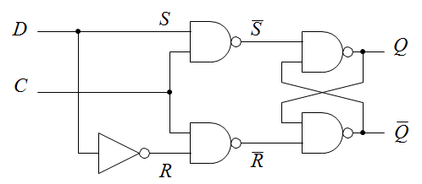
D Flip-Flop
The problem with S = R = 1 can be avoided using a common input D as shown above so that .
The output of the latch now:
follows the D input while C = 1 (transparent)
holds its value while C = 0 (Q = last Q when C went low) no matter what happens at the input
This circuit is often called a transparent latch. It can be bought as an integrated circuit, usually with several latches in a package.
The input C may be called control, clock, gate, or enable.

Slide 13
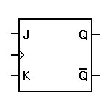
4.3 JK Flip Flop - Symbol
Another types of Flip flop is JK flip flop.
It differs from the RS flip flops when J=K=1 condition is not indeterminate but it is defined to give a very useful changeover (toggle) action.
Toggle means that Q and ¯ will switch to their opposite states.
The JK Flip flop has clock input Cp and two control inputs J and K.
Operation of Jk Flip Flop is completely described by truth table in Figure 4.3.3.
Figure 4.3.1 : PGT JK Flip flop symbol
Figure 4.3.2 : NGT JK Flip flop symbol
Q
13

Slide 14
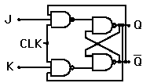
4.3 JK Flip Flop – Truth Table And Logic Circuit
Figure 4.3.3: Truth Table for JK Flip Flop
Figure 4.3.4: JK FLIP FLOP LOGIC CIRCUIT
clock | J | K | Q | ¯ | STATUS
 | 0 | 0 |  |  | HOLD (No Change)
 | 0 | 1 | 0 | 1 | RESET
 | 1 | 0 | 1 | 0 | SET
 | 1 | 1 |  |  | Toggle
Q
_
Q
Q
_
Q
Q
14

Slide 15
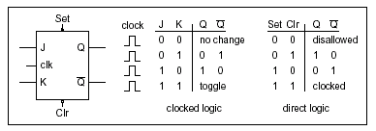
4.4 JK Flip Flop with Preset and Clear
Figure 4.4.1 : Symbol and Truth Table
15

Slide 16
JK Flip-Flop
J | K | Q_{n} | Qn+1 | description
0 | 0 | 0 | 0 | hold
0 | 0 | 1 | 1
0 | 1 | 0 | 0 | clear (reset)
0 | 1 | 1 | 0
1 | 0 | 0 | 1 | set
1 | 0 | 1 | 1
1 | 1 | 0 | 1 | toggle
1 | 1 | 1 | 0
J Q
K
Q
Q_{n+1} = J ◊ Q_{n} + K ◊ Q_{n}
The excitation table for a JK flip-flop is similar to SR flip-flop but doesn’t have the problem of S = R = 1. It can perform all the operations of the simpler types of flip-flop. However, the design of the circuit internal to the flip-flop makes it more expensive to manufacture than a number of other flip-flops so JK flip-flops are now rarely used.

Slide 17
End

