Slide 1
Digital Logic Design
Lecture 18

Slide 2
Announcements
HW 6 up on webpage, due on Thursday, 11/6

Slide 3
Agenda
MSI Components
Binary Adders and Subtracters (5.1, 5.1.1)
Carry Lookahead Adders (5.1.2, 5.1.3)
Decimal Adders (5.2)
Comparators (5.3)

Slide 4
Scale of Integration
Scale of Integration = Complexity of the Chip
SSI: small-scale integrated circuits, 1-10 gates
MSI: medium-scale IC, 10-100 gates
LSI: large scale IC, 100-1000 gates
VLSI: very large-scale IC, 1000+ gates
Today’s chip has millions of gates on it.
MSI components: adder, subtracter, comparator, decoder, encoder, multiplexer.

Slide 5
Scale of Integration
LSI technology introduced highly generalized circuit structures known as programmable logic devices (PLDs).
Can consist of an array of and-gates and an array of or-gates. Must be modified for a specific application.
Modification involves specifying the connections using a hardware procedure. Procedure is known as programming.
Three types of programmable logic devices:
Programmable read-only memory (PROM)
Programmable logic array (PLA)
Programmable array logic (PAL)

Slide 6
MSI Components

Slide 7
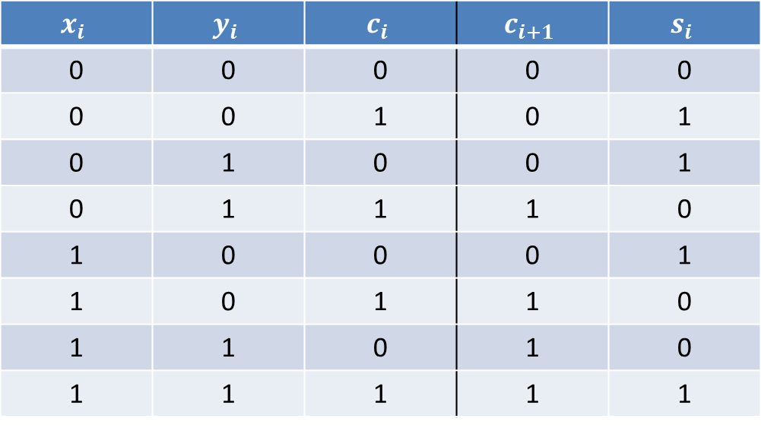
Binary Full Adder
$$x_{i}$$ | $$y_{i}$$ | $$c_{i}$$ | $$c_{i+1}$$ | $$s_{i}$$
0 | 0 | 0 | 0 | 0
0 | 0 | 1 | 0 | 1
0 | 1 | 0 | 0 | 1
0 | 1 | 1 | 1 | 0
1 | 0 | 0 | 0 | 1
1 | 0 | 1 | 1 | 0
1 | 1 | 0 | 1 | 0
1 | 1 | 1 | 1 | 1

Slide 8
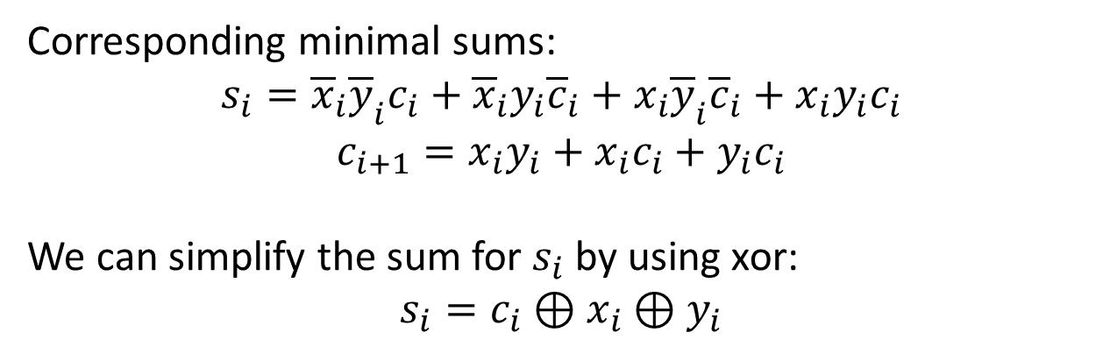
Finding a Simplified Circuit
0 | 1 | 0 | 1
1 | 0 | 1 | 0
0 | 0 | 1 | 0
0 | 1 | 1 | 1
Corresponding minimal sums:
$$s_{i}={\overline{x}}_{i}{\overline{y}}_{i}c_{i}+{\overline{x}}_{i}y_{i}{\overline{c}}_{i}+x_{i}{\overline{y}}_{i}{\overline{c}}_{i}+x_{i}y_{i}c_{i}$$
$$c_{i+1}=x_{i}y_{i}+x_{i}c_{i}+y_{i}c_{i}$$
We can simplify the sum for $s_{i}$ by using xor:
$$s_{i}=c_{i}⊕x_{i}⊕y_{i}$$

Slide 9
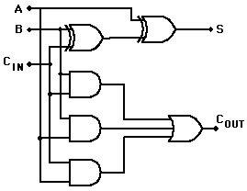





Realization of Full Binary Adder
$$x_{i}$$
$$y_{i}$$
$$s_{i}$$
$$c_{i}$$
$$c_{i+1}$$

Slide 10
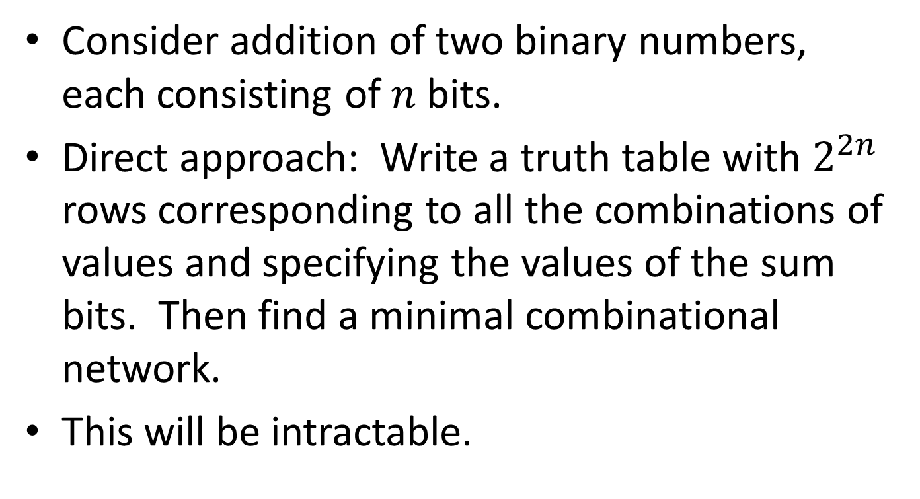
What about many bits?
Consider addition of two binary numbers, each consisting of $n$ bits.
Direct approach: Write a truth table with $2^{2n}$ rows corresponding to all the combinations of values and specifying the values of the sum bits. Then find a minimal combinational network.
This will be intractable.

Slide 11
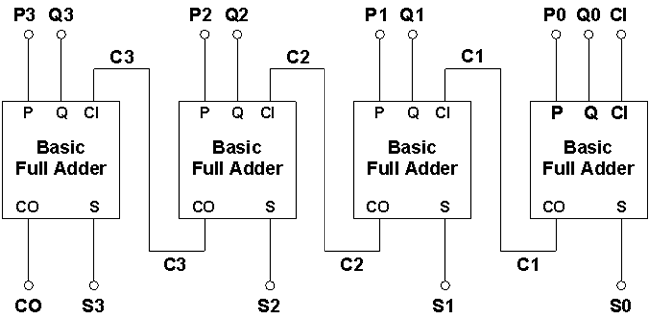





























Parallel (ripple) Binary Adder
$$x_{3}$$
$$y_{3}$$
$$x_{2}$$
$$y_{2}$$
$$x_{1}$$
$$y_{1}$$
$$x_{0}$$
$$y_{0}$$
$$c_{in}$$
$$c_{3}$$
$$c_{2}$$
$$c_{1}$$
$$x$$
$$y$$
$$c_{in}$$
$$x$$
$$y$$
$$c_{in}$$
$$x$$
$$y$$
$$c_{in}$$
$$x$$
$$y$$
$$c_{in}$$
$$c_{out}$$
$$s$$
$$c_{out}$$
$$s$$
$$c_{out}$$
$$s$$
$$c_{out}$$
$$s$$
$$c_{3}$$
$$c_{2}$$
$$c_{1}$$
$$c_{out}$$
$$s_{3}$$
$$s_{2}$$
$$s_{1}$$
$$s_{0}$$
Why is it called “ripple” adder?
Recall—signed binary numbers,
final carry-out may signal overflow.

Slide 12
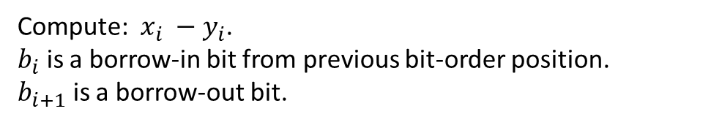
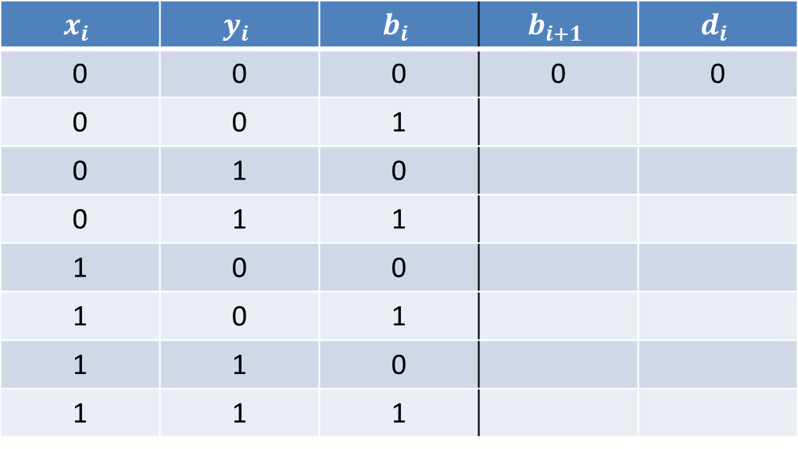
Binary Subtracters
Compute: $x_{i} −y_{i}$.
$b_{i}$ is a borrow-in bit from previous bit-order position.
$b_{i+1}$ is a borrow-out bit.
$$x_{i}$$ | $$y_{i}$$ | $$b_{i}$$ | $$b_{i+1}$$ | $$d_{i}$$
0 | 0 | 0 | 0 | 0
0 | 0 | 1
0 | 1 | 0
0 | 1 | 1
1 | 0 | 0
1 | 0 | 1
1 | 1 | 0
1 | 1 | 1

Slide 13
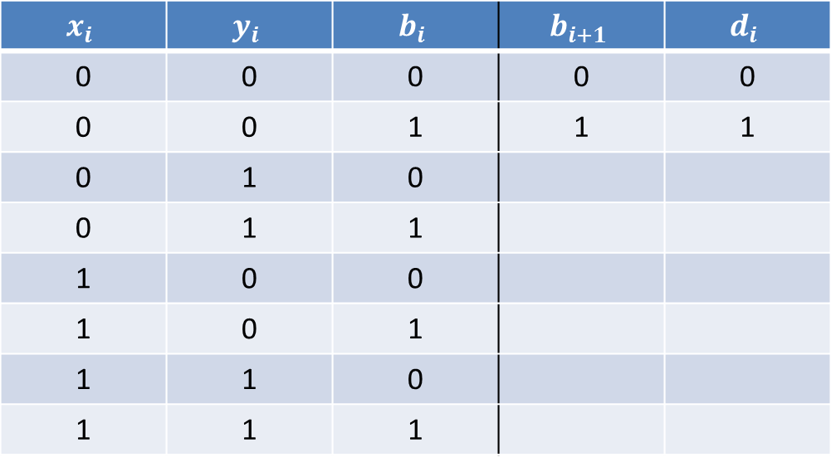
Binary Subtracters
Compute: $x_{i} −y_{i}$.
$b_{i}$ is a borrow-in bit from previous bit-order position.
$b_{i+1}$ is a borrow-out bit.
$$x_{i}$$ | $$y_{i}$$ | $$b_{i}$$ | $$b_{i+1}$$ | $$d_{i}$$
0 | 0 | 0 | 0 | 0
0 | 0 | 1 | 1 | 1
0 | 1 | 0
0 | 1 | 1
1 | 0 | 0
1 | 0 | 1
1 | 1 | 0
1 | 1 | 1
10
-0
1

Slide 14
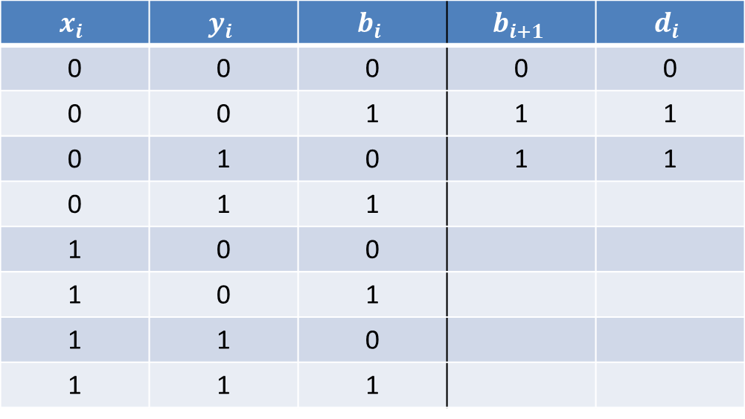
Binary Subtracters
Compute: $x_{i} −y_{i}$.
$b_{i}$ is a borrow-in bit from previous bit-order position.
$b_{i+1}$ is a borrow-out bit.
$$x_{i}$$ | $$y_{i}$$ | $$b_{i}$$ | $$b_{i+1}$$ | $$d_{i}$$
0 | 0 | 0 | 0 | 0
0 | 0 | 1 | 1 | 1
0 | 1 | 0 | 1 | 1
0 | 1 | 1
1 | 0 | 0
1 | 0 | 1
1 | 1 | 0
1 | 1 | 1
10
-1

Slide 15
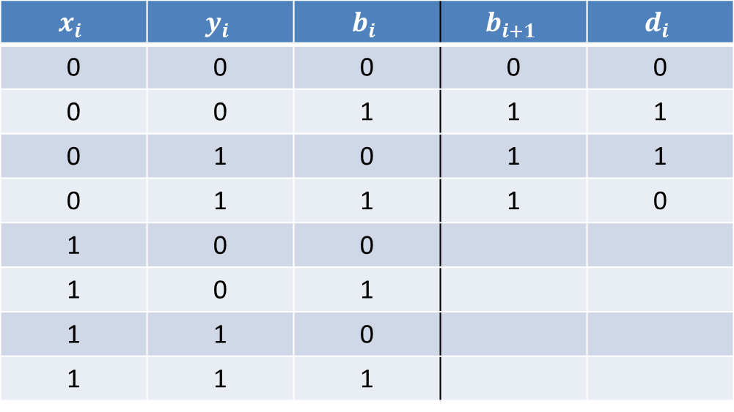
Binary Subtracters
Compute: $x_{i} −y_{i}$.
$b_{i}$ is a borrow-in bit from previous bit-order position.
$b_{i+1}$ is a borrow-out bit.
$$x_{i}$$ | $$y_{i}$$ | $$b_{i}$$ | $$b_{i+1}$$ | $$d_{i}$$
0 | 0 | 0 | 0 | 0
0 | 0 | 1 | 1 | 1
0 | 1 | 0 | 1 | 1
0 | 1 | 1 | 1 | 0
1 | 0 | 0
1 | 0 | 1
1 | 1 | 0
1 | 1 | 1
10
-1
1

Slide 16
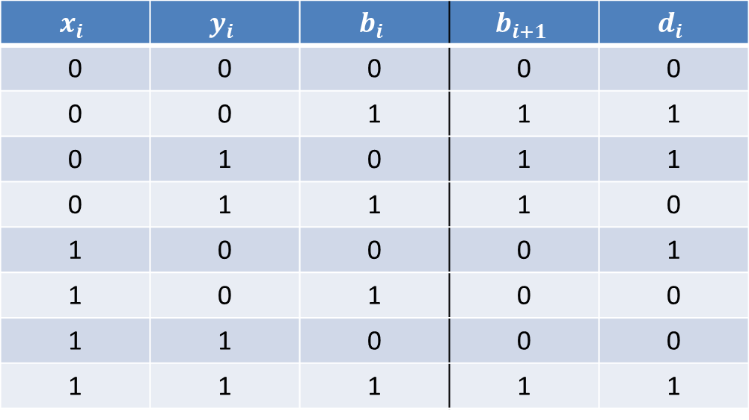
Binary Subtracters
Compute: $x_{i} −y_{i}$.
$b_{i}$ is a borrow-in bit from previous bit-order position.
$b_{i+1}$ is a borrow-out bit.
$$x_{i}$$ | $$y_{i}$$ | $$b_{i}$$ | $$b_{i+1}$$ | $$d_{i}$$
0 | 0 | 0 | 0 | 0
0 | 0 | 1 | 1 | 1
0 | 1 | 0 | 1 | 1
0 | 1 | 1 | 1 | 0
1 | 0 | 0 | 0 | 1
1 | 0 | 1 | 0 | 0
1 | 1 | 0 | 0 | 0
1 | 1 | 1 | 1 | 1
1

Slide 17
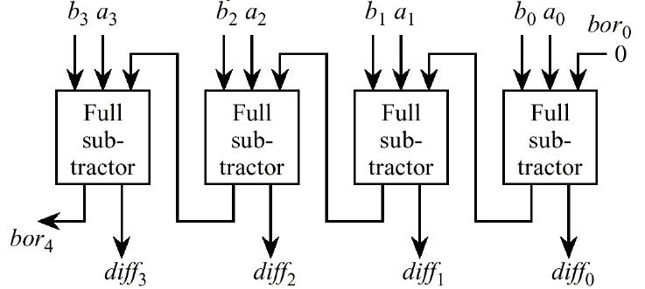















Finding a Simplified Circuit
$d_{i }=b_{i}⊕x_{i}⊕y_{i}$ (Same as sum in adder)
$$b_{i+1}={\overline{x}}_{i}y_{i}+{\overline{x}}_{i}b_{i}+y_{i}b_{i}$$
$$x_{3}$$
$$y_{3}$$
$$x_{2}$$
$$y_{2}$$
$$x_{1}$$
$$y_{1}$$
$$x_{0}$$
$$y_{0}$$
$$b_{0}$$
$$b_{4}$$
$$d_{3}$$
$$d_{2}$$
$$d_{1}$$
$$d_{0}$$

Slide 18

























A better approach using 2’s complement
$$y_{3}$$
$$y_{2}$$
$$y_{1}$$
$$y_{0}$$
$$x_{3}$$
$$x_{2}$$
$$x_{1}$$
$$x_{0}$$
$c_{in}$= 1
$$c_{3}$$
$$c_{2}$$
$$c_{1}$$
$$x$$
$$y$$
$$c_{in}$$
$$x$$
$$y$$
$$c_{in}$$
$$x$$
$$y$$
$$c_{in}$$
$$x$$
$$y$$
$$c_{in}$$
$$c_{out}$$
$$s$$
$$c_{out}$$
$$s$$
$$c_{out}$$
$$s$$
$$c_{3}$$
$$c_{2}$$
$$c_{1}$$
$$c_{out}$$
$$s_{3}$$
$$s_{2}$$
$$s_{1}$$
$$s_{0}$$

Slide 19
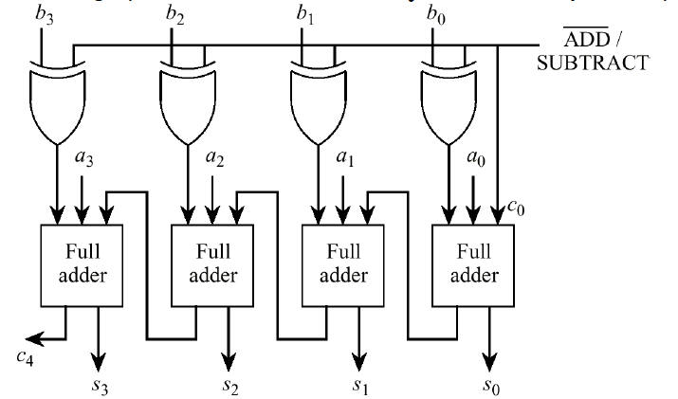






Parallel Adder/Subtracter
$$y_{3}$$
$$y_{2}$$
$$y_{1}$$
$$y_{0}$$
$$x_{3}$$
$$x_{2}$$
$$x_{1}$$
$$x_{0}$$

Slide 20
Carry Lookahead Adder
Ripple effect:
If a carry is generated in the least-significant-bit the carry must propagate through all the remaining stages.
Assuming two-levels of logic are need to propogate the carry through each of the next higher-order stages. Delay is 2n.
Must speed up propagation of the carries. Adders designed with this consideration in mind are called high-speed adders.

Slide 21
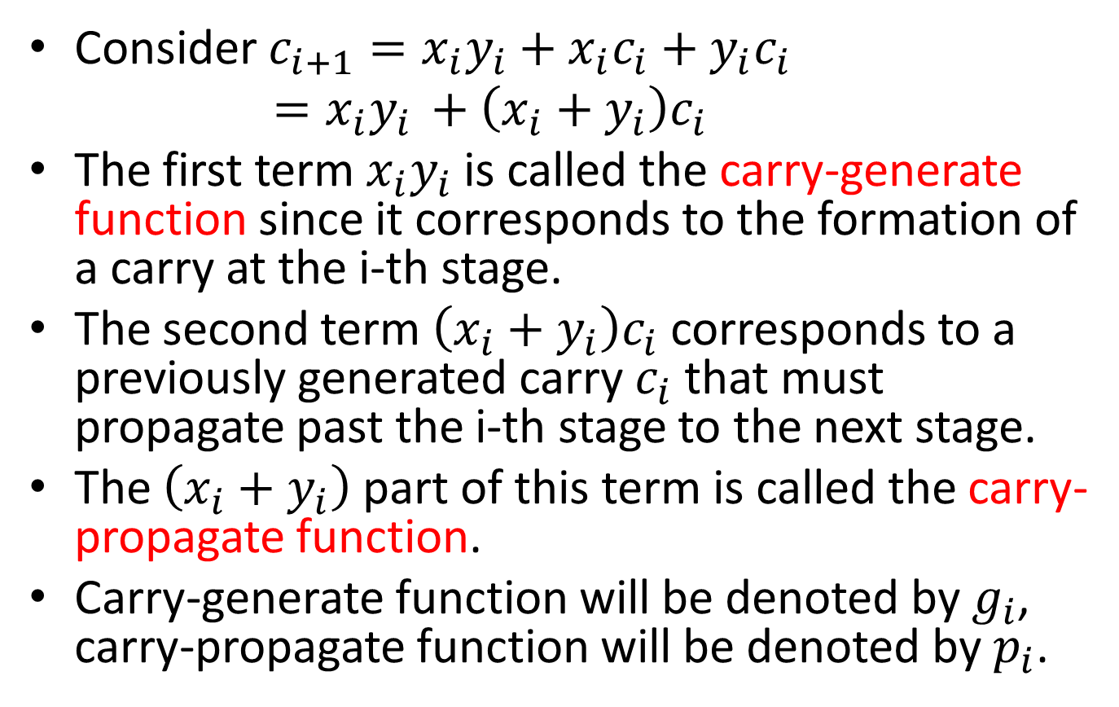
Carry Lookahead Adder
Consider $c_{i+1}=x_{i}y_{i}+x_{i}c_{i}+y_{i}c_{i}$
$=x_{i}y_{i }+\left(x_{i}+y_{i}\right)c_{i}$
The first term $x_{i}y_{i}$ is called the carry-generate function since it corresponds to the formation of a carry at the i-th stage.
The second term $\left(x_{i}+y_{i}\right)c_{i}$ corresponds to a previously generated carry $c_{i}$ that must propagate past the i-th stage to the next stage.
The $\left(x_{i}+y_{i}\right)$ part of this term is called the carry-propagate function.
Carry-generate function will be denoted by $g_{i}$, carry-propagate function will be denoted by $p_{i}$.

Slide 22
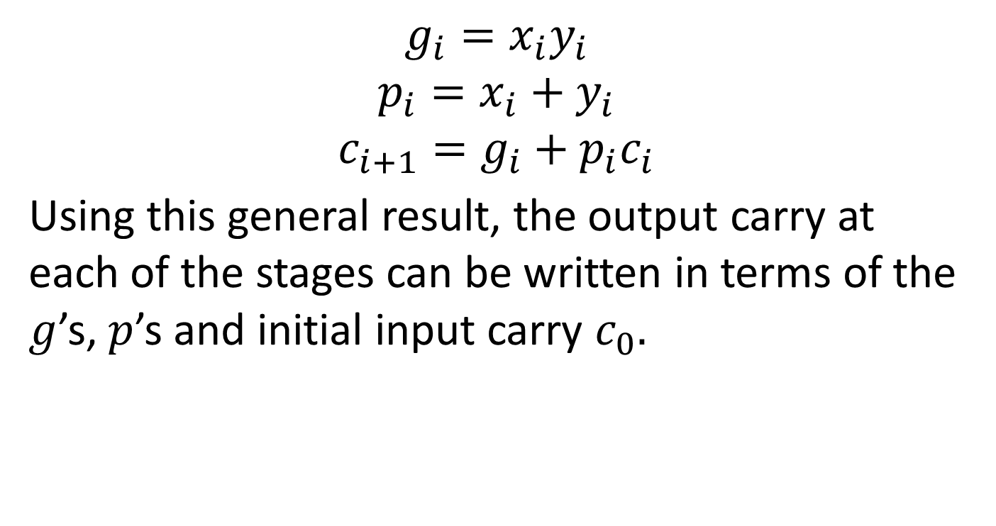
Carry Lookahead Adder
$$g_{i}=x_{i}y_{i}$$
$$p_{i}=x_{i}+y_{i}$$
$$c_{i+1}=g_{i}+p_{i}c_{i}$$
Using this general result, the output carry at each of the stages can be written in terms of the $g$’s, $p$’s and initial input carry $c_{0}.$

Slide 23
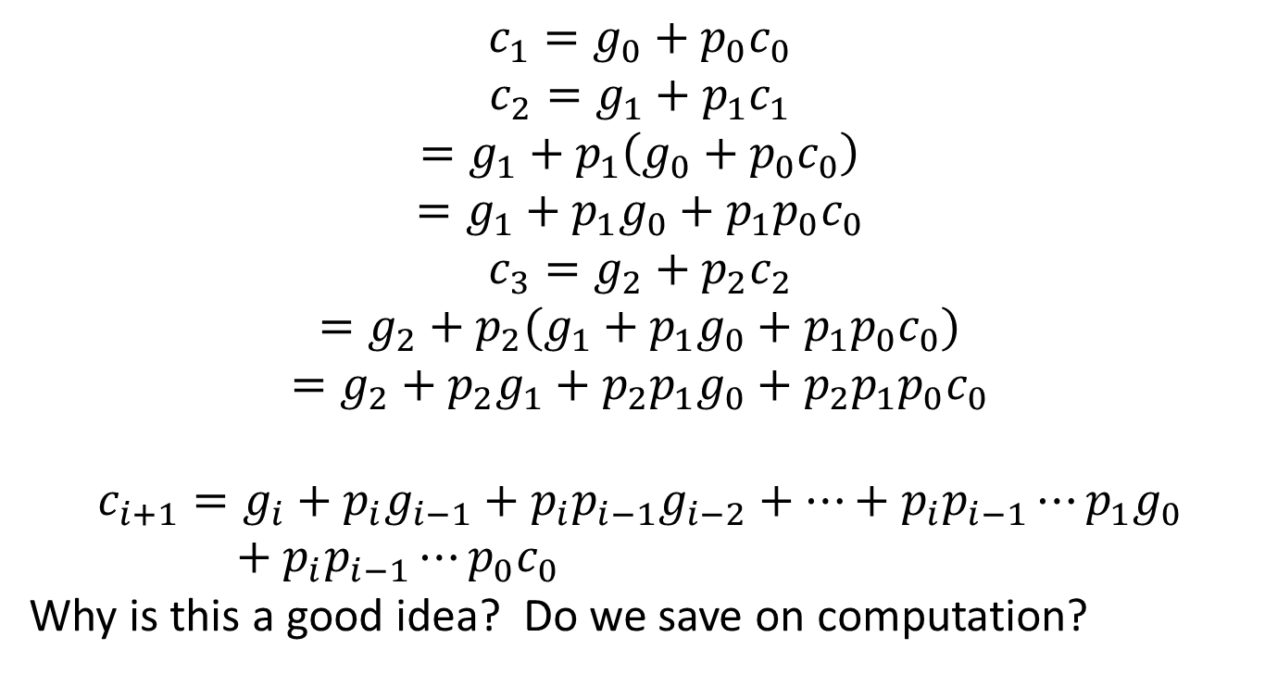
Carry Lookahead Adder
$$c_{1}=g_{0}+p_{0}c_{0}$$
$$c_{2}=g_{1}+p_{1}c_{1}$$
$$=g_{1}+p_{1}\left(g_{0}+p_{0}c_{0}\right)$$
$$=g_{1}+p_{1}g_{0}+p_{1}p_{0}c_{0}$$
$$c_{3}=g_{2}+p_{2}c_{2}$$
$$=g_{2}+p_{2}(g_{1}+p_{1}g_{0}+p_{1}p_{0}c_{0})$$
$$=g_{2}+p_{2}g_{1}+p_{2}p_{1}g_{0}+p_{2}p_{1}p_{0}c_{0}$$
$$c_{i+1}=g_{i}+p_{i}g_{i−1}+p_{i}p_{i−1}g_{i−2}+⋯+p_{i}p_{i−1}⋯p_{1}g_{0}+p_{i}p_{i−1}⋯p_{0}c_{0}$$
Why is this a good idea? Do we save on computation?

Slide 24
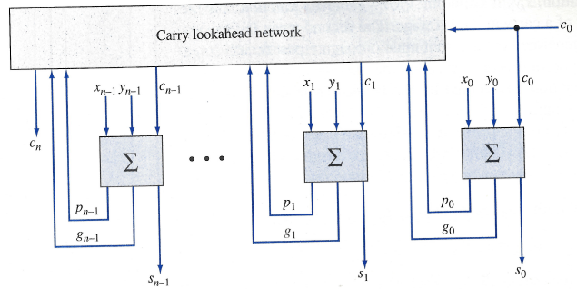
Carry Lookahead Adder

Slide 25
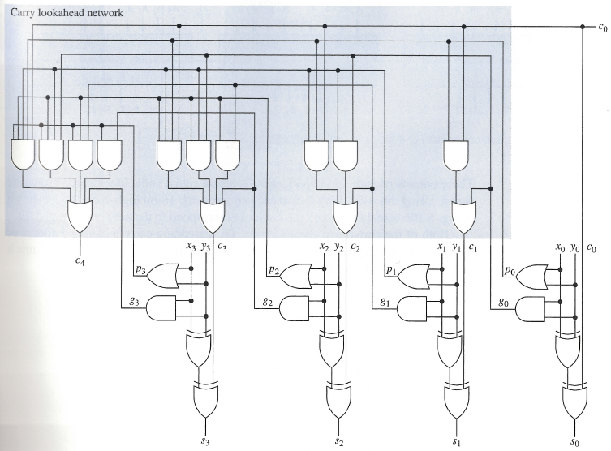
Carry Lookahead Adder

Slide 26
Carry Lookahead Adder
What is the delay?
One level of logic to form g’s, p’s
Two levels of logic to propagate through the carry lookahead
One level of logic to have the carry effect a sum output.
Total: 4 units of time.

Slide 27
Large High-Speed Adders
The carry lookahead network can very large as the number of bits increases.
Approach: Divide bits of the operands into blocks, use carry lookahead adders for each block. Cascade the adders for the blocks.
Ripple carries occur between the cascaded adders.

Slide 28
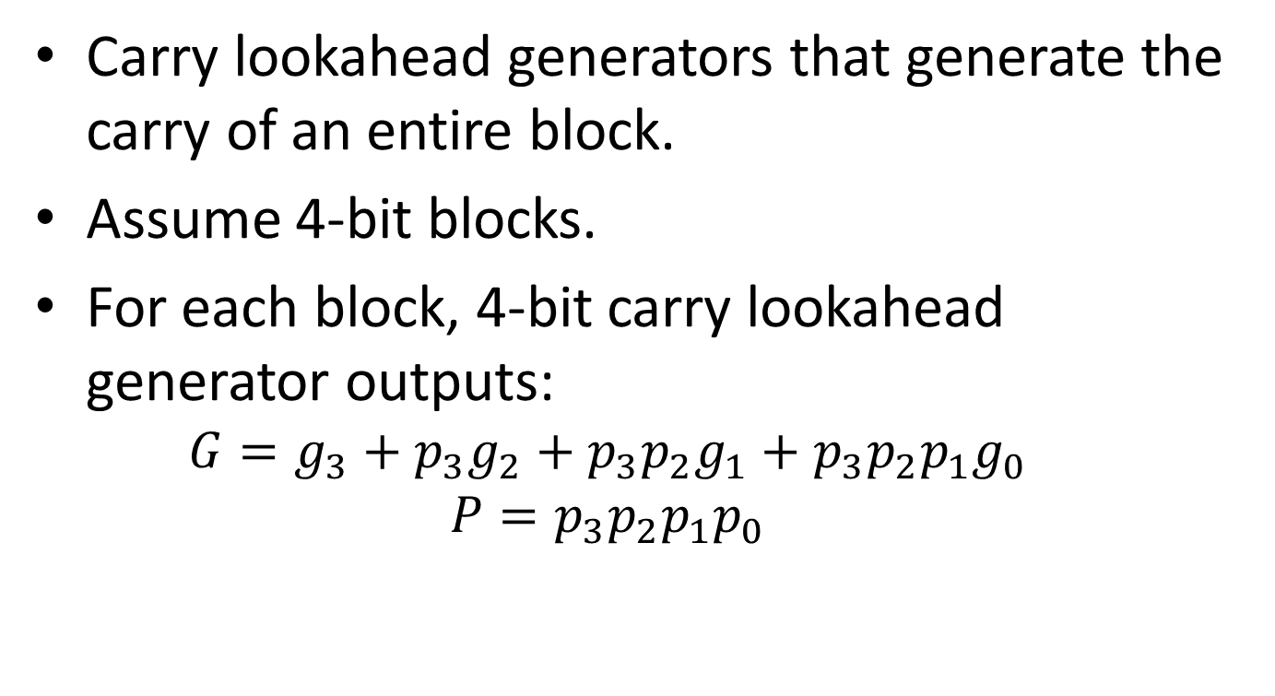
Another Approach to Large High-Speed Adders
Carry lookahead generators that generate the carry of an entire block.
Assume 4-bit blocks.
For each block, 4-bit carry lookahead generator outputs:
$$G=g_{3}+p_{3}g_{2}+p_{3}p_{2}g_{1}+p_{3}p_{2}p_{1}g_{0}$$
$$P=p_{3}p_{2}p_{1}p_{0}$$

Slide 29
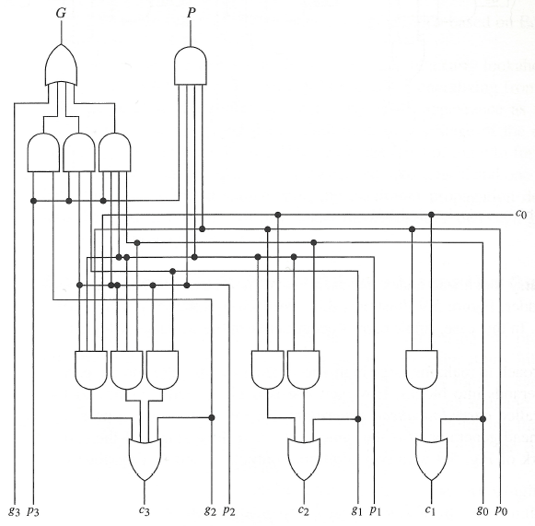
Carry Lookahead Generator

Slide 30
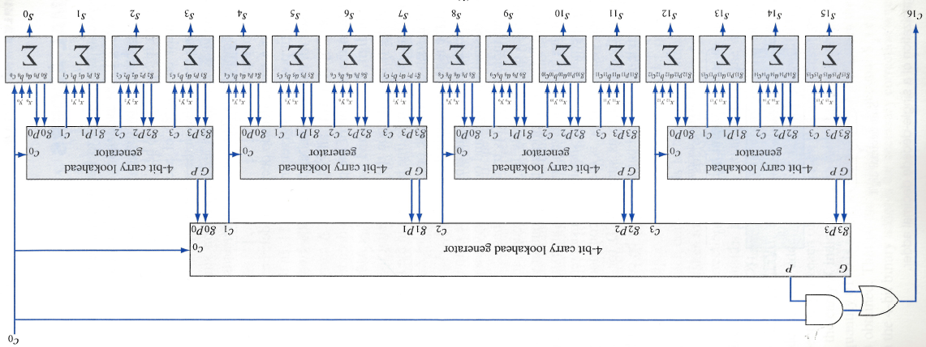
Large High-Speed Adders

Slide 31
Decimal Adders
8421 weighted coding scheme or BCD Code
Decimal Digit | BCD
0 | 0000
1 | 0001
2 | 0010
3 | 0011
4 | 0100
5 | 0101
6 | 0110
7 | 0111
8 | 1000
9 | 1001
Forbidden codes: 1010, 1011, 1100, 1101, 1110, 1111

Slide 32
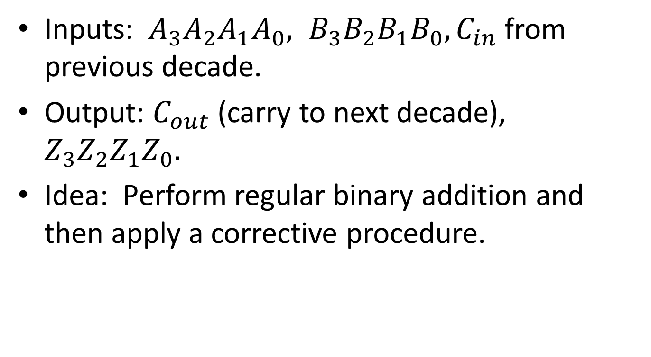
Decimal Adder
Inputs: $A_{3}A_{2}A_{1}A_{0}, B_{3}B_{2}B_{1}B_{0}, C_{in}$ from previous decade.
Output: $C_{out}$ (carry to next decade), $Z_{3}Z_{2}Z_{1}Z_{0}.$
Idea: Perform regular binary addition and then apply a corrective procedure.

