Slide 1
Theory of Computing SE-205
Context Free Grammars

Slide 2
Context Free Grammars
A context-free grammar is a notation for describing languages.
It is more powerful than finite automata or RE’s, but still cannot define all possible languages.
Every regular language is a CFL.
The class of regular languages is a proper subclass of CFLs.
CFL
Regular

Slide 3
Informal Example
Consider L_{pal} = {w ∈ Σ∗ : w = w^{R}}
For example otto ∈ L_{pal}, madamimadam ∈ L_{pal}.
Let Σ = {0, 1} and suppose L_{pal} were regular.
Let n be given by the pumping lemma.
Then
0^{n}10^{n} ∈ L_{pal}. In reading 0^{n} the FA must make
a loop. Omit the loop; contradiction.
Let’s define L_{pal} inductively:
Basis: ε, 0, and 1 are palindromes.
Induction:
and 1w1.
If w is a palindrome, so are 0w0

Slide 4
Informal Example
A context free grammar is a formal notation for expressing such (L_{pal}) recursive definitions of language. A grammar consists of one or more variables that represent classes of strings.
1. P → ε 2. P → 0 3. P → 1
4. P → 0P 0
5. P → 1P 1
0 and 1 are terminals
P is a variable (or nonterminal, category)
or syntactic
P is in this grammar also the start symbol.
1–5 are productions (or rules)

Slide 5
Context-Free Grammar (CFG)
Formally, A context-free grammar (CFG) G is a quadruple (V, T, P, S) where
V: a set of non-terminal symbols
T: a set of terminals (V ∩ Σ = Ǿ)
P: a set of production (P: V → (V U T)*)
S: a start symbol.
Example: G_{pal} = ({P }, {0, 1}, A, P ), where A =
{P → ε, P → 0, P → 1, P → 0P 0, P → 1P 1}.
Sometimes we group productions with the same head, e.g. A = {P → ε |0|1|0P 0|1P 1}.

Slide 6
Example of CFG
Example: CFG for { 0^{n}1^{n} | n > 1}
Productions:
S -> 01
S -> 0S1
Basis: 01 is in the language.
Induction: if w is in the language, then so is 0w1.
Variables = nonterminals = a finite set of other symbols, each of which represents a language.
Terminals = symbols of the alphabet of the language being defined.
Start symbol = the variable whose language is the one being defined.
A production has the form variable -> string of variables and terminals.
Convention:
A, B, C,… are variables.
a, b, c,… are terminals.

Slide 7
Example of CFG
Here is a formal CFG for { 0^{n}1^{n} | n > 1}.
Terminals = {0, 1}.
Variables = {S}.
Start symbol = S.
Productions =
S -> 01
S -> 0S1
G_{equ} = ({S }, {0, 1}, A, S ), where A={S -> 01
, S -> 0S1}

Slide 8
Derivation Using Grammar
We apply the productions of a CFG to infer that certain strings are in the language of a certain variable.
There are two approaches to this inference.
Recursive inference: is to use the rules from body to head
Derivations, using productions from head to body

Slide 9


Recursive inference
We consider some inferences we can make using tt₁
Recall tt₁:
E I
→ I | E + E | E ∗ E | (E)
→ a | b | Ia | Ib | I0 | I1
String Lang Prod String(s) used a I 5 -
b I 6 -
b0 I 9 (ii)
b00 I 9 (iii)
a E 1 (i)
b00 E 1 (iv)
a + b00 E 2 (v), (vi) (a + b00) E 4 (vii)
a *(a + b00) E 3 (v), (viii)
(i)
(ii)
(iii)
(iv)
(v)
(vi)
(vii)
(viii)
(ix)

Slide 10
Derivations
Applying productions from head to body requires the definition of a new relational symbol: ⇒
Let:
G = (V, T, P, S) be a CFG
Let αAβ be a string of terminals and variables where A ∈ V
α, β ⊂ (V ∪ T )∗ and
A → γ be a production of P
Then we write
αAβ ⇒αγβ
and say that αAβ derives αγβ.

Slide 11
Zero or more derivation steps
We define ⇒ to be the reflexive and transitive closure of ⇒ (i.e., to denote zero or more derivation steps):
Basis: Let α ∈ (V ∪ T )∗. Then α ⇒ α.
Induction: If α
∗ ∗
⇒ β and β ⇒ γ , then α ⇒ γ .

Slide 12
Example of Derivation
Note 1: At each step we might have several rules to choose from, e.g.
I ∗ E ⇒ a ∗ E ⇒ a ∗ (E), versus
I ∗ E ⇒ I ∗ (E) ⇒ a ∗ (E).
Note 2: Not all choices lead to successful derivations of a particular string, for instance
E ⇒ E + E (at the first step)
won’t lead to a derivation of a ∗ (a + b000).
Important: Recursive inference and derivation are equivalent. A string of terminals w is inferred to be in the language of some variable A iff A ⇒ w
Derivation of a ∗ (a + b000) by G
E ⇒ E ∗ E ⇒ I ∗ E ⇒ a ∗ E ⇒ a ∗ (E) ⇒
a ∗ (E + E) ⇒ a ∗ (I + E) ⇒ a ∗ (a + E) ⇒ a ∗ (a + I) ⇒
a ∗ (a + I0) ⇒ a ∗ (a + I00) ⇒ a ∗ (a + b00)

Slide 13
Leftmost and Rightmost derivation
In other to restrict the number of choices we have in deriving a string, it is often useful to require that at each step we replace the leftmost (or rightmost) variable by one of its production rules
Leftmost derivation rule-bodies
Rightmost derivation its rule-bodies.
⇒lm
: Always replace the left-most variable by one of its
⇒rm
: Always replace the rightmost variable by one of
EXAMPLES
1− Leftmost derivation: previous example
2− Rightmost derivation:
E E ∗ E
E ∗ (E)
⇒rm ⇒rm
⇒rm
⇒rm
E ∗ (E + E) E ∗ (E + I00)
E ∗ (a + b00)
⇒rm
⇒rm
⇒rm
E ∗ (E + I)
E ∗ (E + I0)
⇒rm
E ∗ (E + b00)
⇒rm
E ∗ (I + b00)
⇒rm
I ∗ (a + b00)
⇒rm
a ∗ (a + b00)
We can conclude that E
∗
⇒rm
a ∗ (a + b00)

Slide 14
The Language of the Grammar
If G(V, T, P, S) is a CFG, then the language of G is
∗
L(G) = {w in T ∗ | S ⇒_{G} w}
i.e., the set of strings over G derivable from the start symbol.
If L is a CFG, we call L(G) a context-free language.
Example: L(G_{pal}) is a context-free language.

Slide 15
Theorem
A string w ∈ {0, 1}∗ is in L(G_{pal}) iff w = w^{R}.
Proof : (⊇-direction.) Suppose w = w^{R}, i.e., that w is a palindrome. We show by induction on |w| that w ∈ L(G_{pal})
Basis: Basis: |w| = 0, or |w| = 1. Then w is ε , 0, or 1. Since P → ε, P → 0 , and
P → 1 are productions, we conclude that P ⇒ w in all base cases.
Induction: Suppose |w| ≥ 2. Since w = w^{R}, we have w = 0x0, or w = 1x1, and
x = x^{R}.
If w = 0x0 we know from the IH that P ⇒ x. Then
∗
P ⇒ 0P 0 ⇒ 0x0 = w
∗
∗
Thus w ∈ L(Gpal). The case for w = 1x1 is similar.

Slide 16
Proof
(⊆-direction.) We assume w ∈ L(G_{pal}) and we prove that w = w^{R}.
∗ ∗
Since w ∈ L(G_{pal}), we have P ⇒ w. We do an induction of the length of ⇒.
Basis: The derivation P ⇒ w is done in one step. Then w must be ε,0, or 1, all palindromes.
∗
Induction: Let n ≥ 1, and suppose the derivation takes n + 1 steps. Then we must have
∗
w = 0x0 ⇐ 0P 0 ⇐ P
or
∗
w = 1x1 ⇐ 1P 1 ⇐ P
where the second derivation is done in n steps. By the IH x is a palindrome, and the inductive proof is complete.

Slide 17
Sentential Forms
Derivation from the start symbol produce strings that have a special role.
We call these sentential forms.
Let G= (V, T, P, S) be a CFG, and α ∈ (V ∪ T )∗. If
∗
S ⇒ α
we say α is a sentential form.
If S⇒_{lm}α we say that α is a left-sentential form, and if S⇒rmα we say that is a right-sentential form.
Note: L(G) is those sentential forms that are in T ∗.

Slide 18
Example
Recall G₁: E
I
→ I | E + E | E ∗ E | (E)
→ a | b | Ia | Ib | I0 | I1
1− Then E ∗ (I + E) is a sentential form since
E ⇒ E ∗ E ⇒ E ∗ (E) ⇒ E ∗ (E + E) ⇒ E*(I + E)
This derivation is neither leftmost, nor right-most.
2− a ∗ E left-sentential form, since
E ⇒ E ∗ E ⇒ I ∗ E ⇒ a ∗ E
3− E ∗ (E + E) is a right-sentential form since
E ⇒ E ∗ E ⇒ E ∗ (E) ⇒ E ∗ (E + E)

Slide 19
Parse Tree
Definition: Let G = (V, T, P, S) be a CFG. A tree is a derivation (or parse) tree if:
Every interior node is labeled by a variable in V
Each leaf is labeled by either a variable, a terminal or ε. However if leaf is ε, then it must be the only child of its parent.
The label of the root is S
If a interior node is labeled A and its children are labeled X₁, X₂,…, X_{n}, from left to right, then
A –> X₁, X₂,…, X_{n}
must be a production in P
If a vertex has label ε, then that vertex is a leaf and the only child of its’ parent
More Generally, a derivation tree can be defined with any non-terminal as the root.

Slide 20
Parse Tree..
A parse tree showing the derivation of I+E from E
A parse tree showing the derivation of P ⇒ 0110

Slide 21
Parse Trees
Parse trees are trees labeled by symbols of a particular CFG.
Leaves: labeled by a terminal or ε.
Interior nodes: labeled by a variable.
Children are labeled by the right side of a production for the parent.
Root: must be labeled by the start symbol.

Slide 22
Example: Parse Tree
S -> SS | (S) | ()
S
S
S
(
S
)
(
)
(
)

Slide 23
Yield of a Parse Tree
The concatenation of the labels of the leaves in left-to-right order
That is, in the order of a preorder traversal.
is called the yield of the parse tree.
Example: yield of is (())()
S
S
S
(
S
)
(
)
(
)

Slide 24
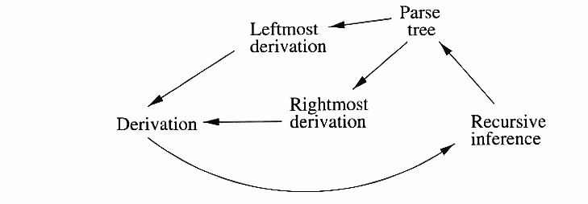
Inference, Derivation and Parse Tree

Slide 25


From Inference to Trees
We’ll prove:
If A =>_{*lm} w, then there is a parse tree with root A and yield w.
If there is a parse tree with root labeled A and yield w, then A =>_{*lm} w.

Slide 26
Proof: Part 1
Given a leftmost derivation of a terminal string, we need to prove the existence of a parse tree.
The proof is an induction on the length of the derivation.

Slide 27
Part 1 – Basis
If A =>*_{lm} a₁…a_{n} by a one-step derivation, then there must be a parse tree
A
a₁
. . .
a_{n}

Slide 28
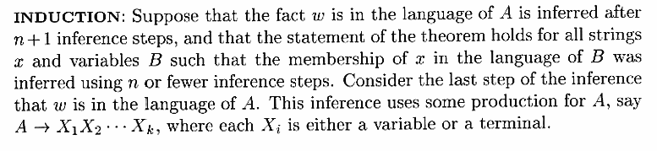
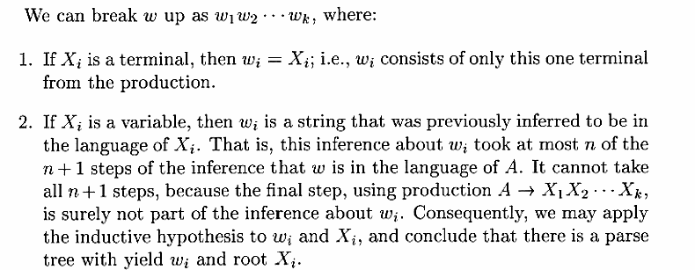
Part 1 – Induction

Slide 29
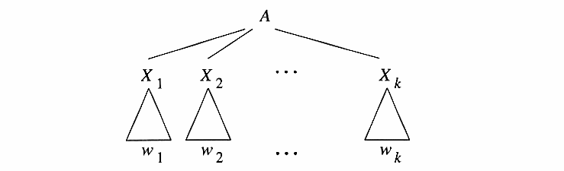
Induction – (2)

Slide 30
Proof – Part 2
We perform induction on the height of the tree.
Induction on the height (length of the longest path from the root) of the tree.
Basis: height 1. Tree looks like
A -> a₁…a_{n} must be a production.
Thus, A =>_{*lm} a₁…a_{n}.
A
a₁
. . .
a_{n}

Slide 31
Part 2 – Induction
If the height of the tree is n and n>1, then it looks like
By IH, X_{i} =>*_{lm} w_{i}.
Note: if X_{i} is a terminal, then X_{i} = w_{i}.
Thus, A =>_{lm} X₁…X_{n} =>*_{lm} w₁X₂…X_{n} =>*_{lm} w₁w₂X₃…X_{n} =>*_{lm} … =>*_{lm} w₁…w_{n}.
A
X₁
. . .
X_{n}
w₁
w_{n}

Slide 32
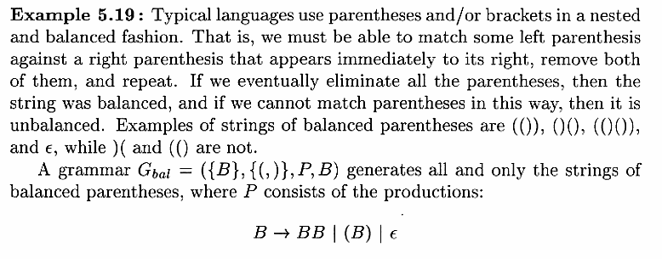
Applications of Context-free Grammars
Grammars are used to describe programming languages.

Slide 33
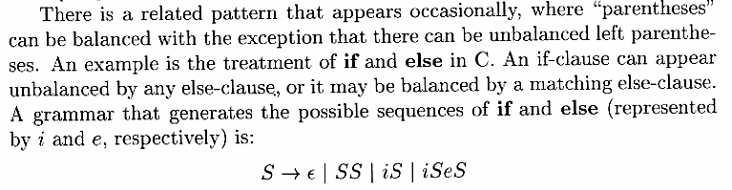

If-else

Slide 34
Ambiguous Grammar Derivation Trees
S → A | A B
A → ε | a | A b | A A
B → b | b c | B c | b B
Other derivation trees for this string?
w = aabb
?
S
?
S
S
A
A
B
A
B
A
A
Infinitely many others possible.
A
A
b
B
A
A
b
A
A
A
b
a
a
b
a
A
b
a
ε
A
b
a
a

Slide 35
Ambiguous Grammar
Definition. A CFG is ambiguous if there is a string in the language that has two or more parse trees
A grammar G is ambiguous if there is a word w ∈ L(G) having are least two different parse trees
S → A
S → B
S → AB
A → aA
B → bB
A → e
B → e
Notice that a has at least two left-most derivations

Slide 36
Ambiguity
CFG ambiguous ⇔ any of following equivalent statements:
∃ string w with multiple derivation trees.
∃ string w with multiple leftmost derivations.
∃ string w with multiple rightmost derivations.
Defining ambiguity of grammar, not language.

Slide 37
Ambiguity..
If there are two different parse trees, they must produce two different leftmost derivations by the construction given in the proof.
Conversely, two different leftmost derivations produce different parse trees by the other part of the proof.
Likewise for rightmost derivations.
Thus, equivalent definitions of “ambiguous grammar’’ are:
There is a string in the language that has two different leftmost derivations.
There is a string in the language that has two different rightmost derivations.

Slide 38
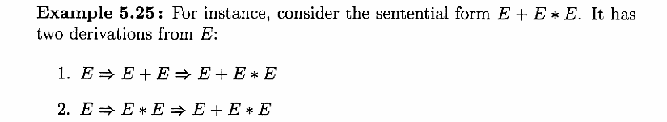
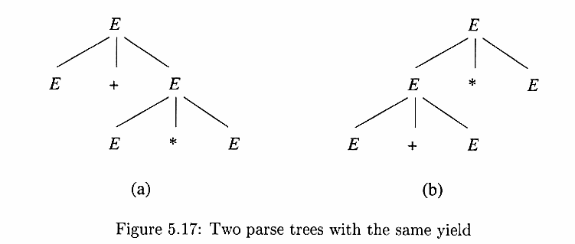
Example of ambiguity

Slide 39
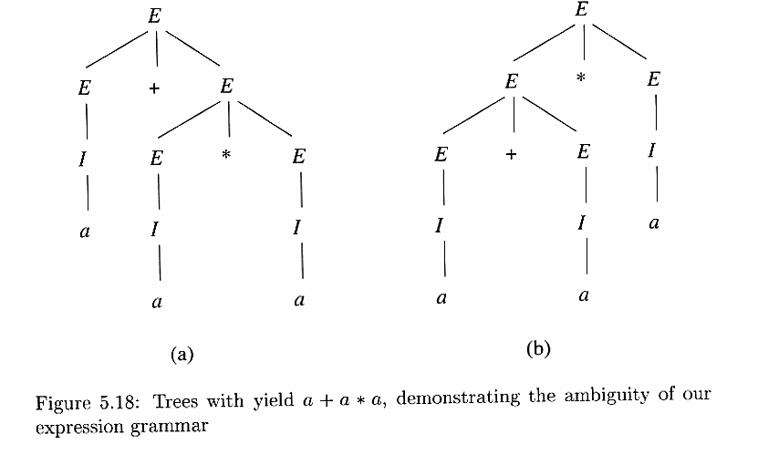
Example of ambiguity

Slide 40
Removing Ambiguity
There is no algorithm that can decide whether an arbitrary CFG is ambiguous, nor to remove all ambiguity
Some ambiguity can be removed by revising the CFG, such as separating the order of + and * in expressions:
There are two reasons for ambiguity in the previous slide
the precedence of the operation is not considered.
the sequence of identical operator can group either from the left or from the right.

Slide 41
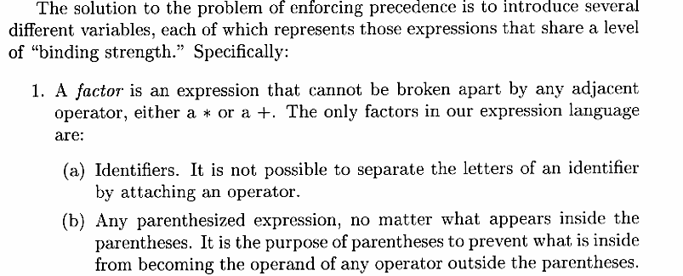
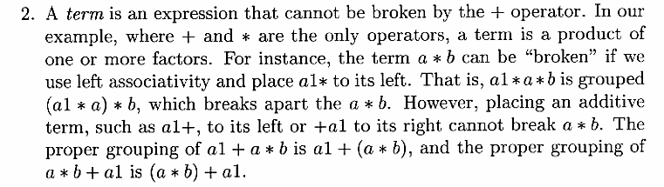
Removing Ambiguity

Slide 42
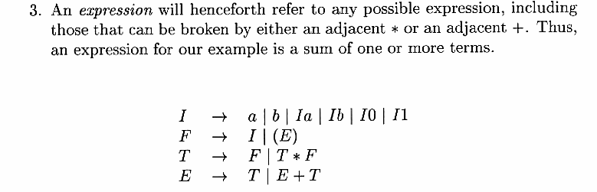
Removing Ambiguity

Slide 43
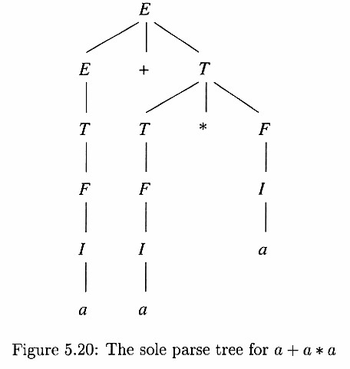
Removing Ambiguity

Slide 44
Inherently ambiguous
Unfortunately, certain CFL’s are inherently ambiguous, meaning that every grammar for the language is ambiguous.

