Slide 1
Chapter 8: Main Memory

Slide 2
Chapter 8: Memory Management
Background
Swapping
Contiguous Memory Allocation
Segmentation
Paging
Structure of the Page Table

Slide 3
Background
Program must be brought (from disk) into memory and placed within a process for it to be run
Main memory and registers are only storage CPU can access directly
Memory unit only sees a stream of addresses + read requests, or address + data and write requests
Register access in one CPU clock (or less)
Main memory can take many cycles
Cache sits between main memory and CPU registers
Protection of memory required to ensure correct operation

Slide 4

Base and Limit Registers
A pair of base and limit registers define the logical address space
CPU must check every memory access generated in user mode to be sure it is between base and limit for that user

Slide 5

Hardware Address Protection

Slide 6
Binding of Instructions and Data to Memory
Address binding of instructions and data to memory addresses can happen at three different stages
  Compile time: If memory location known a priori, absolute code can be generated; must recompile code if starting location changes
  Load time: Must generate relocatable code if memory location is not known at compile time
  Execution time: Binding delayed until run time if the process can be moved during its execution from one memory segment to another
    Need hardware support for address maps (e.g., base and limit registers)

Slide 7

Multistep Processing of a User Program

Slide 8
Logical vs. Physical Address Space
The concept of a logical address space that is bound to a separate physical address space is central to proper memory management
  Logical address – generated by the CPU; also referred to as virtual address
  Physical address – address seen by the memory unit
Logical and physical addresses are the same in compile-time and load-time address-binding schemes; logical (virtual) and physical addresses differ in execution-time address-binding scheme
Logical address space is the set of all logical addresses generated by a program
Physical address space is the set of all physical addresses generated by a program

Slide 9
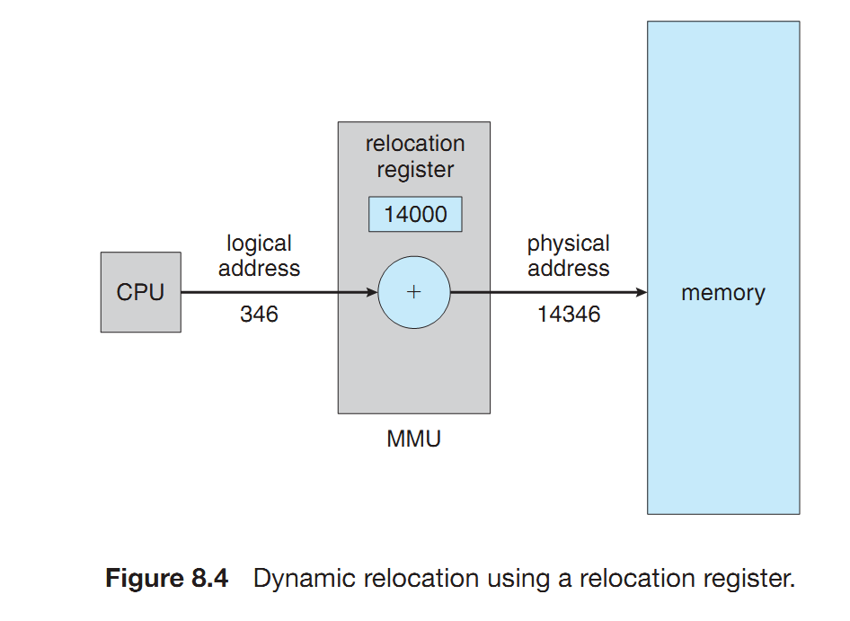

Slide 10
Memory-Management Unit (MMU)
Hardware device that at run time maps virtual to physical address
Many methods possible, covered in the rest of this chapter
To start, consider simple scheme where the value in the relocation register is added to every address generated by a user process at the time it is sent to memory
  Base register now called relocation register
  MS-DOS on Intel 80x86 used 4 relocation registers
The user program deals with logical addresses; it never sees the real physical addresses
  Execution-time binding occurs when reference is made to location in memory
  Logical address bound to physical addresses

Slide 11
Swapping
A process can be swapped temporarily out of memory to a backing store, and then brought back into memory for continued execution
  Total physical memory space of processes can exceed physical memory
Backing store – fast disk large enough to accommodate copies of all memory images for all users; must provide direct access to these memory images
Roll out, roll in – swapping variant used for priority-based scheduling algorithms; lower-priority process is swapped out so higher-priority process can be loaded and executed
Major part of swap time is transfer time; total transfer time is directly proportional to the amount of memory swapped
System maintains a ready queue of ready-to-run processes which have memory images on disk

Slide 12

Schematic View of Swapping

Slide 13
Context Switch Time including Swapping
If next processes to be put on CPU is not in memory, need to swap out a process and swap in target process
Context switch time can then be very high
100MB process swapping to hard disk with transfer rate of 50MB/sec
  Swap out time of 2000 ms
  Plus swap in of same sized process
  Total context switch swapping component time of 4000ms (4 seconds)

Slide 14

Multiple-partition allocation
Multiple-partition allocation
  Degree of multiprogramming limited by number of partitions
  Variable-partition sizes for efficiency (sized to a given process’ needs)
  Hole – block of available memory; holes of various size are scattered throughout memory
  When a process arrives, it is allocated memory from a hole large enough to accommodate it
  Process exiting frees its partition, adjacent free partitions combined
  Operating system maintains information about:
  a) allocated partitions b) free partitions (hole)

Slide 15
Dynamic Storage-Allocation Problem
How to satisfy a request of size n from a list of free holes?
First-fit: Allocate the first hole that is big enough
Best-fit: Allocate the smallest hole that is big enough; must search entire list, unless ordered by size
  Produces the smallest leftover hole
Worst-fit: Allocate the largest hole; must also search entire list
  Produces the largest leftover hole
First-fit and best-fit better than worst-fit in terms of speed and storage utilization

Slide 16
Fragmentation
Whenever a process is loaded or removed from the physical memory block, it creates a small hole in memory space which is called fragment.
Due to fragmentation, the system fails in allocating the contiguous memory space to a process even though it have the requested amount of memory but, in a non-contiguous manner.
The fragmentation is further classified into two categories Internal and External Fragmentation.

Slide 17
Internal Fragmentation
Internal Fragmentation –
occurs when fixed sized memory blocks are allocated to the process without concerning about the size of the process
allocated memory may be slightly larger than requested memory; this size difference is memory internal to a partition, but not being used. Consider a
multiple-partition allocation scheme with a hole of 18,464 bytes. Suppose that the next process requests 18,462 bytes. If we allocate exactly the requested block, we are left with a hole of 2 bytes.

Slide 18
External Fragmentation
occurs when the processes are allocated memory dynamically.
total memory space exists to satisfy a request, but it is not contiguous. As processes are loaded and removed from memory, the free memory space is broken into little pieces. External fragmentation exists when there is enough total memory space to satisfy a request but the available spaces are not contiguous: storage is fragmented into a large number of small holes.

Slide 19
Segmentation
Memory-management scheme that supports user view of memory
A program is a collection of segments
  A segment is a logical unit such as:
main program
procedure
function
method
object
local variables, global variables
common block
stack
symbol table
arrays

Slide 20
Example: C compiler
A C compiler might create separate segments for the following:
1. The code
2. Global variables
3. The heap, from which memory is allocated
4. The stacks used by each thread
5. The standard C library

Slide 21

User’s View of a Program

Slide 22
Logical View of Segmentation
1
1
4
2
3
4
2
3
user space
physical memory space

Slide 23
Segmentation Architecture
Logical address consists of a two tuple:
<segment-number, offset>,
Segment table – maps two-dimensional physical addresses; each table entry has:
  base – contains the starting physical address where the segments reside in memory
  limit – specifies the length of the segment
Segment-table base register (STBR) points to the segment table’s location in memory
Segment-table length register (STLR) indicates number of segments used by a program;
segment number s is legal if s < STLR

Slide 24

Segmentation Hardware
A logical address
consists of two parts: a segment number, s, and an offset into that segment, d.
The segment number is used as an index to the segment table.
The offset d of
the logical address must be between 0 and the segment limit. If it is not, we trap
to the operating system (logical addressing attempt beyond end of segment).

Slide 25
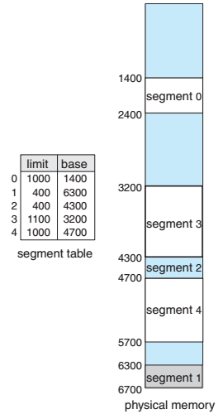
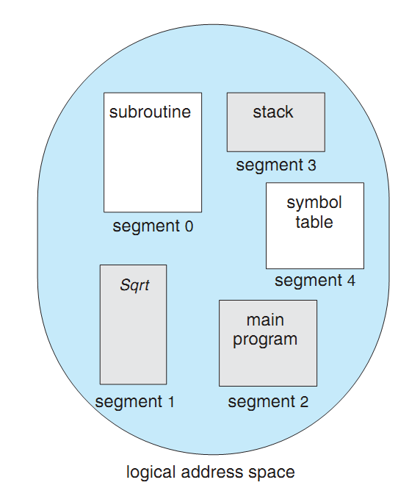
Example of segmentation.

Slide 26
Example of segmentation.
The segment table has a separate entry for each segment, giving the beginning address of the segment in physical memory (or base) and the length of that segment (or limit).
For example, segment 2 is 400 bytes long and begins at location 4300. Thus, a reference to byte 53 of segment 2 is mapped onto location 4300 + 53 = 4353.
A reference to segment 3, byte 852, is mapped to 3200 (the base of segment 3) + 852 = 4052.
A reference to byte 1222 of segment 0 would result in a trap to the operating system, as this segment is only 1,000 bytes long

Slide 27
Practice
Segment Base Limit
0 219 600
1 2300 14
2 90 100
3 1327 580
4 1952 96
What are the physical addresses for the following logical addresses?
a. 0,430
b. 1,10
c. 2,500
d. 3,500
e. 4,212
219+430 = 649
2300 + 10 = 2310
illegal reference, trap to operating system
1327+ 400= 1727
illegal reference, trap to operating system

Slide 28
Paging
Physical address space of a process can be noncontiguous; process is allocated physical memory whenever the latter is available
  Avoids external fragmentation
  Avoids problem of varying sized memory chunks
Divide physical memory into fixed-sized blocks called frames
  Size is power of 2, between 512 bytes and 16 Mbytes
Divide logical memory into blocks of same size called pages
Keep track of all free frames
To run a program of size N pages, need to find N free frames and load program
Set up a page table to translate logical to physical addresses
Backing store likewise split into pages
Still have Internal fragmentation

Slide 29

Address Translation Scheme
Address generated by CPU is divided into:
  Page number (p) – used as an index into a page table which contains base address of each page in physical memory
  Page offset (d) – combined with base address to define the physical memory address that is sent to the memory unit
  For given logical address space 2^{m} and page size 2^{n}

Slide 30
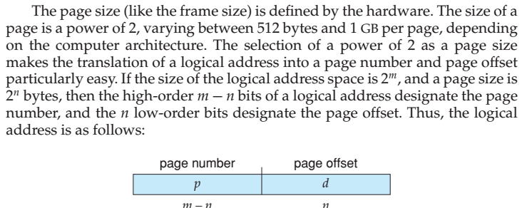
Page Size

Slide 31

Paging Hardware

Slide 32

Paging Model of Logical and Physical Memory

Slide 33

Paging Example
n=2 and m=4 32-byte memory and 4-byte pages. Logical
address 0 is page 0, offset 0. Indexing into the page table, we find that page 0 is in frame 5. Thus, logical address 0 maps to physical address 20 [= (5 × 4) + 0].

Slide 34

Free Frames
Before allocation
After allocation

Slide 35
Implementation of Page Table
Page table is kept in main memory
Page-table base register (PTBR) points to the page table
Page-table length register (PTLR) indicates size of the page table
In this scheme every data/instruction access requires two memory accesses
  One for the page table and one for the data / instruction
The two memory access problem can be solved by the use of a special fast-lookup hardware cache called associative memory or translation look-aside buffers (TLBs)

Slide 36
Memory Protection
Memory protection implemented by associating protection bit with each frame to indicate if read-only or read-write access is allowed
  Can also add more bits to indicate page execute-only, and so on
Valid-invalid bit attached to each entry in the page table:
  “valid” indicates that the associated page is in the process’ logical address space, and is thus a legal page
  “invalid” indicates that the page is not in the process’ logical address space
  Or use page-table length register (PTLR)
Any violations result in a trap to the kernel

Slide 37

Valid (v) or Invalid (i) Bit In A Page Table
Suppose, for example, that in a system with a 14-bit address space (0 to 16383), we have a program that should use only addresses 0 to 10468. Given a page size of 2 KB, we have the situation shown in Figure 8.15. Addresses in pages 0, 1, 2, 3, 4, and 5 are mapped normally through the page table. Any attempt to generate an address in pages 6 or 7, however, will find that the valid–invalid bit is set to invalid, and the computer will trap to the operating system (invalid page reference).

Slide 38
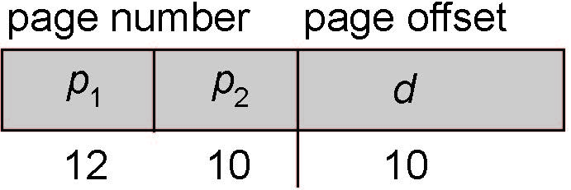
Two-Level Paging Example
A logical address (on 32-bit machine with 1K page size) is divided into:
  a page number consisting of 22 bits
  a page offset consisting of 10 bits
Since the page table is paged, the page number is further divided into:
  a 12-bit page number
  a 10-bit page offset
Thus, a logical address is as follows:
where p₁ is an index into the outer page table, and p₂ is the displacement within the page of the inner page table

Slide 39

Address-Translation Scheme

Slide 40
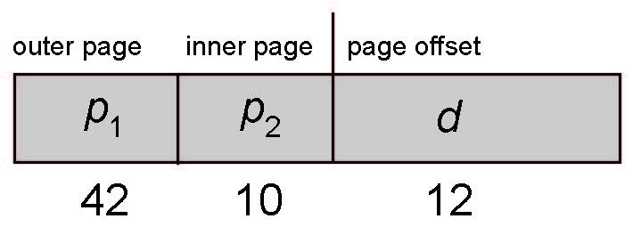
64-bit Logical Address Space
Even two-level paging scheme not sufficient
If page size is 4 KB (2¹²)
  Then page table has 2⁵² entries
  If two level scheme, inner page tables could be 2¹⁰ 4-byte entries
  Address would look like
  Outer page table has 2⁴² entries or 2⁴⁴ bytes
  One solution is to add a 2nd outer page table
  But in the following example the 2nd outer page table is still 2³⁴ bytes in size
    And possibly 4 memory access to get to one physical memory location

Slide 41


Three-level Paging Scheme

Slide 42
Hashed Page Tables
Common in address spaces > 32 bits
The virtual page number is hashed into a page table
  This page table contains a chain of elements hashing to the same location
Each element contains (1) the virtual page number (2) the value of the mapped page frame (3) a pointer to the next element
Virtual page numbers are compared in this chain searching for a match
  If a match is found, the corresponding physical frame is extracted
The virtual page number in the virtual address is hashed into the hash table. The virtual page number is compared with field 1 in the first element in the linked list. If there is a match, the corresponding page frame (field 2) is used to form the desired physical address. If there is no match, subsequent entries in the linked list are searched for a matching virtual page number.

Slide 43

Hashed Page Table

Slide 44
End of Chapter 8

