Slide 1
Chapter 21:
The Linux System

Slide 2
Chapter 21: The Linux System
Linux History
Design Principles
Kernel Modules
Process Management
Scheduling
Memory Management
File Systems
Input and Output
Interprocess Communication
Network Structure
Security

Slide 3
Objectives
To explore the history of the UNIX operating system from which Linux is derived and the principles upon which Linux’s design is based
To examine the Linux process model and illustrate how Linux schedules processes and provides interprocess communication
To look at memory management in Linux
To explore how Linux implements file systems and manages I/O devices

Slide 4
History
Linux is a modern, free operating system based on UNIX standards
First developed as a small but self-contained kernel in 1991 by Linus Torvalds, with the major design goal of UNIX compatibility, released as open source
Its history has been one of collaboration by many users from all around the world, corresponding almost exclusively over the Internet
It has been designed to run efficiently and reliably on common PC hardware, but also runs on a variety of other platforms
The core Linux operating system kernel is entirely original, but it can run much existing free UNIX software, resulting in an entire UNIX-compatible operating system free from proprietary code
Linux system has many, varying Linux distributions including the kernel, applications, and management tools

Slide 5
The Linux Kernel
Version 0.01 (May 1991) had no networking, ran only on 80386-compatible Intel processors and on PC hardware, had extremely limited device-drive support, and supported only the Minix file system
Linux 1.0 (March 1994) included these new features:
  Support for UNIX’s standard TCP/IP networking protocols
  BSD-compatible socket interface for networking programming
  Device-driver support for running IP over an Ethernet
  Enhanced file system
  Support for a range of SCSI controllers for
  high-performance disk access
  Extra hardware support
Version 1.2 (March 1995) was the final PC-only Linux kernel
Kernels with odd version numbers are development kernels, those with even numbers are production kernels

Slide 6
Linux 2.0
Released in June 1996, 2.0 added two major new capabilities:
  Support for multiple architectures, including a fully 64-bit native Alpha port
  Support for multiprocessor architectures
Other new features included:
  Improved memory-management code
  Improved TCP/IP performance
  Support for internal kernel threads, for handling dependencies between loadable modules, and for automatic loading of modules on demand
  Standardized configuration interface
Available for Motorola 68000-series processors, Sun Sparc systems, and for PC and PowerMac systems
2.4 and 2.6 increased SMP support, added journaling file system, preemptive kernel, 64-bit memory support
3.0 released in 2011, 20th anniversary of Linux, improved virtualization support, new page write-back facility, improved memory management, new Completely Fair Scheduler

Slide 7
The Linux System
Linux uses many tools developed as part of Berkeley’s BSD operating system, MIT’s X Window System, and the Free Software Foundation's GNU project
The main system libraries were started by the GNU project, with improvements provided by the Linux community
Linux networking-administration tools were derived from 4.3BSD code; recent BSD derivatives such as Free BSD have borrowed code from Linux in return
The Linux system is maintained by a loose network of developers collaborating over the Internet, with a small number of public ftp sites acting as de facto standard repositories
File System Hierarchy Standard document maintained by the Linux community to ensure compatibility across the various system components
  Specifies overall layout of a standard Linux file system, determines under which directory names configuration files, libraries, system binaries, and run-time data files should be stored

Slide 8
Linux Distributions
Standard, precompiled sets of packages, or distributions, include the basic Linux system, system installation and management utilities, and ready-to-install packages of common UNIX tools
The first distributions managed these packages by simply providing a means of unpacking all the files into the appropriate places; modern distributions include advanced package management
Early distributions included SLS and Slackware
  Red Hat and Debian are popular distributions from commercial and noncommercial sources, respectively, others include Canonical and SuSE
The RPM Package file format permits compatibility among the various Linux distributions

Slide 9
Linux Licensing
The Linux kernel is distributed under the GNU General Public License (GPL), the terms of which are set out by the Free Software Foundation
  Not public domain, in that not all rights are waived
Anyone using Linux, or creating their own derivative of Linux, may not make the derived product proprietary; software released under the GPL may not be redistributed as a binary-only product
  Can sell distributions, but must offer the source code too

Slide 10
Design Principles
Linux is a multiuser, multitasking system with a full set of UNIX-compatible tools
Its file system adheres to traditional UNIX semantics, and it fully implements the standard UNIX networking model
Main design goals are speed, efficiency, and standardization
Linux is designed to be compliant with the relevant POSIX documents; at least two Linux distributions have achieved official POSIX certification
  Supports Pthreads and a subset of POSIX real-time process control
The Linux programming interface adheres to the SVR4 UNIX semantics, rather than to BSD behavior

Slide 11
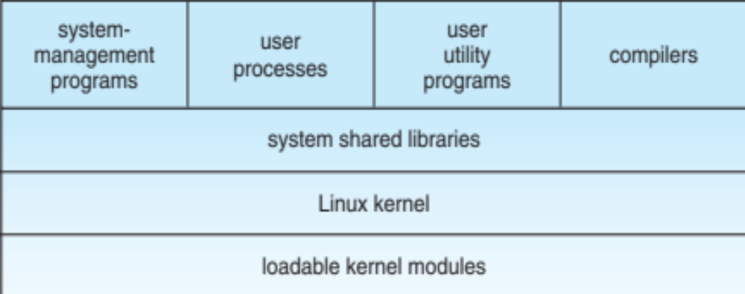
Components of a Linux System

Slide 12
Components of a Linux System
Like most UNIX implementations, Linux is composed of three main bodies of code; the most important distinction between the kernel and all other components.
The kernel is responsible for maintaining the important abstractions of the operating system
  Kernel code executes in kernel mode with full access to all the physical resources of the computer
  All kernel code and data structures are kept in the same single address space

Slide 13
Components of a Linux System (Cont.)
The system libraries define a standard set of functions through which applications interact with the kernel, and which implement much of the operating-system functionality that does not need the full privileges of kernel code
The system utilities perform individual specialized management tasks
User-mode programs rich and varied, including multiple shells like the bourne-again (bash)

Slide 14
Kernel Modules
Sections of kernel code that can be compiled, loaded, and unloaded independent of the rest of the kernel.
A kernel module may typically implement a device driver, a file system, or a networking protocol
The module interface allows third parties to write and distribute, on their own terms, device drivers or file systems that could not be distributed under the GPL.
Kernel modules allow a Linux system to be set up with a standard, minimal kernel, without any extra device drivers built in.
Four components to Linux module support:
  module-management system
  module loader and unloader
  driver-registration system
  conflict-resolution mechanism

Slide 15
Module Management
Supports loading modules into memory and letting them talk to the rest of the kernel
Module loading is split into two separate sections:
  Managing sections of module code in kernel memory
  Handling symbols that modules are allowed to reference
The module requestor manages loading requested, but currently unloaded, modules; it also regularly queries the kernel to see whether a dynamically loaded module is still in use, and will unload it when it is no longer actively needed

Slide 16
Driver Registration
Allows modules to tell the rest of the kernel that a new driver has become available
The kernel maintains dynamic tables of all known drivers, and provides a set of routines to allow drivers to be added to or removed from these tables at any time
Registration tables include the following items:
  Device drivers
  File systems
  Network protocols
  Binary format

Slide 17
Conflict Resolution
A mechanism that allows different device drivers to reserve hardware resources and to protect those resources from accidental use by another driver.
The conflict resolution module aims to:
  Prevent modules from clashing over access to hardware resources
  Prevent autoprobes from interfering with existing device drivers
  Resolve conflicts with multiple drivers trying to access the same hardware:
    Kernel maintains list of allocated HW resources
    Driver reserves resources with kernel database first
    Reservation request rejected if resource not available

Slide 18
Process Management
UNIX process management separates the creation of processes and the running of a new program into two distinct operations.
  The fork() system call creates a new process
  A new program is run after a call to exec()
Under UNIX, a process encompasses all the information that the operating system must maintain to track the context of a single execution of a single program
Under Linux, process properties fall into three groups: the process’s identity, environment, and context

Slide 19
Process Identity
Process ID (PID) - The unique identifier for the process; used to specify processes to the operating system when an application makes a system call to signal, modify, or wait for another process
Credentials - Each process must have an associated user ID and one or more group IDs that determine the process’s rights to access system resources and files
Personality - Not traditionally found on UNIX systems, but under Linux each process has an associated personality identifier that can slightly modify the semantics of certain system calls
  Used primarily by emulation libraries to request that system calls be compatible with certain specific flavors of UNIX
Namespace – Specific view of file system hierarchy
  Most processes share common namespace and operate on a shared file-system hierarchy
  But each can have unique file-system hierarchy with its own root directory and set of mounted file systems

Slide 20
Process Environment
The process’s environment is inherited from its parent, and is composed of two null-terminated vectors:
  The argument vector lists the command-line arguments used to invoke the running program; conventionally starts with the name of the program itself.
  The environment vector is a list of “NAME=VALUE” pairs that associates named environment variables with arbitrary textual values.
Passing environment variables among processes and inheriting variables by a process’s children are flexible means of passing information to components of the user-mode system software.
The environment-variable mechanism provides a customization of the operating system that can be set on a per-process basis, rather than being configured for the system as a whole.

Slide 21
Process Context
The (constantly changing) state of a running program at any point in time
The scheduling context is the most important part of the process context; it is the information that the scheduler needs to suspend and restart the process
The kernel maintains accounting information about the resources currently being consumed by each process, and the total resources consumed by the process in its lifetime so far
The file table is an array of pointers to kernel file structures
  When making file I/O system calls, processes refer to files by their index into this table, the file descriptor (fd)

Slide 22
Process Context (Cont.)
Whereas the file table lists the existing open files, the
file-system context applies to requests to open new files
  The current root and default directories to be used for new file searches are stored here
The signal-handler table defines the routine in the process’s address space to be called when specific signals arrive
The virtual-memory context of a process describes the full contents of the its private address space

Slide 23
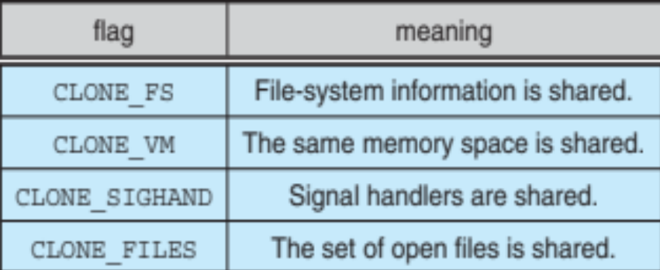
Processes and Threads
Linux uses the same internal representation for processes and threads; a thread is simply a new process that happens to share the same address space as its parent
  Both are called tasks by Linux
A distinction is only made when a new thread is created by the clone() system call
  fork() creates a new task with its own entirely new task context
  clone() creates a new task with its own identity, but that is allowed to share the data structures of its parent
Using clone() gives an application fine-grained control over exactly what is shared between two threads

Slide 24
Scheduling
The job of allocating CPU time to different tasks within an operating system
While scheduling is normally thought of as the running and interrupting of processes, in Linux, scheduling also includes the running of the various kernel tasks
Running kernel tasks encompasses both tasks that are requested by a running process and tasks that execute internally on behalf of a device driver
As of 2.5, new scheduling algorithm – preemptive, priority-based, known as O(1)
  Real-time range
  nice value
  Had challenges with interactive performance
2.6 introduced Completely Fair Scheduler (CFS)

Slide 25
CFS
Eliminates traditional, common idea of time slice
Instead all tasks allocated portion of processor’s time
CFS calculates how long a process should run as a function of total number of tasks
N runnable tasks means each gets 1/N of processor’s time
Then weights each task with its nice value
  Smaller nice value -> higher weight (higher priority)

Slide 26
CFS (Cont.)
Then each task run with for time proportional to task’s weight divided by total weight of all runnable tasks
Configurable variable target latency is desired interval during which each task should run at least once
  Consider simple case of 2 runnable tasks with equal weight and target latency of 10ms – each then runs for 5ms
    If 10 runnable tasks, each runs for 1ms
    Minimum granularity ensures each run has reasonable amount of time (which actually violates fairness idea)

Slide 27
Kernel Synchronization
A request for kernel-mode execution can occur in two ways:
  A running program may request an operating system service, either explicitly via a system call, or implicitly, for example, when a page fault occurs
  A device driver may deliver a hardware interrupt that causes the CPU to start executing a kernel-defined handler for that interrupt
Kernel synchronization requires a framework that will allow the kernel’s critical sections to run without interruption by another critical section

Slide 28
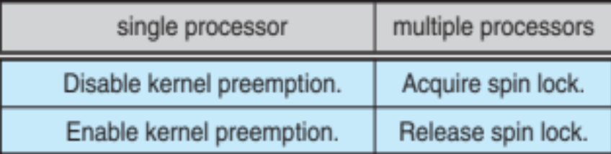
Kernel Synchronization (Cont.)
Linux uses two techniques to protect critical sections:
  1. Normal kernel code is nonpreemptible (until 2.6)
  – when a time interrupt is received while a process is
  executing a kernel system service routine, the kernel’s
  need_resched flag is set so that the scheduler will run
  once the system call has completed and control is
  about to be returned to user mode
  2. The second technique applies to critical sections that occur in an interrupt service routines
  – By using the processor’s interrupt control hardware to disable interrupts during a critical section, the kernel guarantees that it can proceed without the risk of concurrent access of shared data structures
  Provides spin locks, semaphores, and reader-writer versions of both
    Behavior modified if on single processor or multi:

Slide 29
Kernel Synchronization (Cont.)
To avoid performance penalties, Linux’s kernel uses a synchronization architecture that allows long critical sections to run without having interrupts disabled for the critical section’s entire duration
Interrupt service routines are separated into a top half and a bottom half
  The top half is a normal interrupt service routine, and runs with recursive interrupts disabled
  The bottom half is run, with all interrupts enabled, by a miniature scheduler that ensures that bottom halves never interrupt themselves
  This architecture is completed by a mechanism for disabling selected bottom halves while executing normal, foreground kernel code

Slide 30
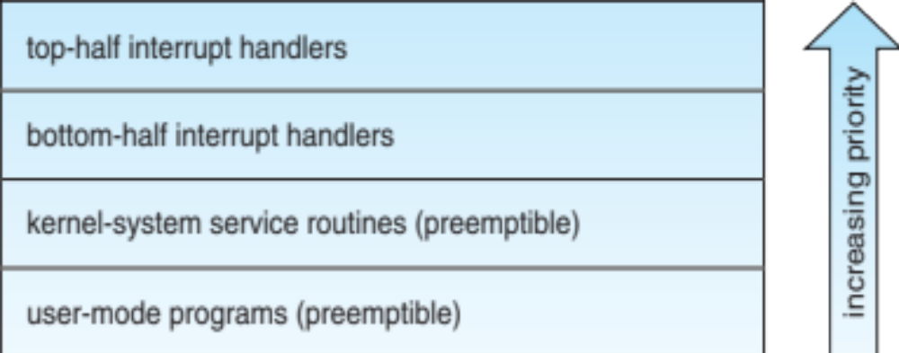
Interrupt Protection Levels
Each level may be interrupted by code running at a higher level, but will never be interrupted by code running at the same or a lower level
User processes can always be preempted by another process when a time-sharing scheduling interrupt occurs

Slide 31
Symmetric Multiprocessing
Linux 2.0 was the first Linux kernel to support SMP hardware; separate processes or threads can execute in parallel on separate processors
Until version 2.2, to preserve the kernel’s nonpreemptible synchronization requirements, SMP imposes the restriction, via a single kernel spinlock, that only one processor at a time may execute kernel-mode code
Later releases implement more scalability by splitting single spinlock into multiple locks, each protecting a small subset of kernel data structures
Version 3.0 adds even more fine-grained locking, processor affinity, and load-balancing

Slide 32
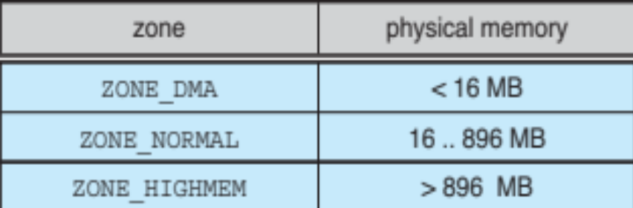
Memory Management
Linux’s physical memory-management system deals with allocating and freeing pages, groups of pages, and small blocks of memory
It has additional mechanisms for handling virtual memory, memory mapped into the address space of running processes
Splits memory into four different zones due to hardware characteristics
  Architecture specific, for example on x86:

Slide 33
Managing Physical Memory
The page allocator allocates and frees all physical pages; it can allocate ranges of physically-contiguous pages on request
The allocator uses a buddy-heap algorithm to keep track of available physical pages
  Each allocatable memory region is paired with an adjacent partner
  Whenever two allocated partner regions are both freed up they are combined to form a larger region
  If a small memory request cannot be satisfied by allocating an existing small free region, then a larger free region will be subdivided into two partners to satisfy the request

Slide 34
Managing Physical Memory (Cont.)
Memory allocations in the Linux kernel occur either statically (drivers reserve a contiguous area of memory during system boot time) or dynamically (via the page allocator)
Also uses slab allocator for kernel memory
Page cache and virtual memory system also manage physical memory
  Page cache is kernel’s main cache for files and main mechanism for I/O to block devices
  Page cache stores entire pages of file contents for local and network file I/O

Slide 35
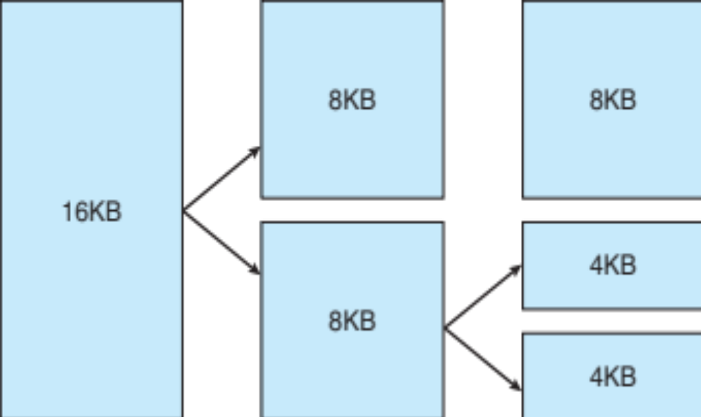
Splitting of Memory in a Buddy Heap

Slide 36

Slab Allocator in Linux

Slide 37
Virtual Memory
The VM system maintains the address space visible to each process: It creates pages of virtual memory on demand, and manages the loading of those pages from disk or their swapping back out to disk as required.
The VM manager maintains two separate views of a process’s address space:
  A logical view describing instructions concerning the layout of the address space
    The address space consists of a set of non-overlapping regions, each representing a continuous, page-aligned subset of the address space
  A physical view of each address space which is stored in the hardware page tables for the process

Slide 38
Virtual Memory (Cont.)
Virtual memory regions are characterized by:
  The backing store, which describes from where the pages for a region come; regions are usually backed by a file or by nothing (demand-zero memory)
  The region’s reaction to writes (page sharing or copy-on-write
The kernel creates a new virtual address space
  1. When a process runs a new program with the exec() system call
  2. Upon creation of a new process by the fork() system call

Slide 39
Virtual Memory (Cont.)
On executing a new program, the process is given a new, completely empty virtual-address space; the program-loading routines populate the address space with virtual-memory regions
Creating a new process with fork() involves creating a complete copy of the existing process’s virtual address space
  The kernel copies the parent process’s VMA descriptors, then creates a new set of page tables for the child
  The parent’s page tables are copied directly into the child’s, with the reference count of each page covered being incremented
  After the fork, the parent and child share the same physical pages of memory in their address spaces

Slide 40
Swapping and Paging
The VM paging system relocates pages of memory from physical memory out to disk when the memory is needed for something else
The VM paging system can be divided into two sections:
  The pageout-policy algorithm decides which pages to write out to disk, and when
  The paging mechanism actually carries out the transfer, and pages data back into physical memory as needed
  Can page out to either swap device or normal files
  Bitmap used to track used blocks in swap space kept in physical memory
  Allocator uses next-fit algorithm to try to write contiguous runs

Slide 41
Kernel Virtual Memory
The Linux kernel reserves a constant, architecture-dependent region of the virtual address space of every process for its own internal use
This kernel virtual-memory area contains two regions:
  A static area that contains page table references to every available physical page of memory in the system, so that there is a simple translation from physical to virtual addresses when running kernel code
  The reminder of the reserved section is not reserved for any specific purpose; its page-table entries can be modified to point to any other areas of memory

Slide 42
Executing and Loading User Programs
Linux maintains a table of functions for loading programs; it gives each function the opportunity to try loading the given file when an exec system call is made
The registration of multiple loader routines allows Linux to support both the ELF and a.out binary formats
Initially, binary-file pages are mapped into virtual memory
  Only when a program tries to access a given page will a page fault result in that page being loaded into physical memory
An ELF-format binary file consists of a header followed by several page-aligned sections
  The ELF loader works by reading the header and mapping the sections of the file into separate regions of virtual memory

Slide 43
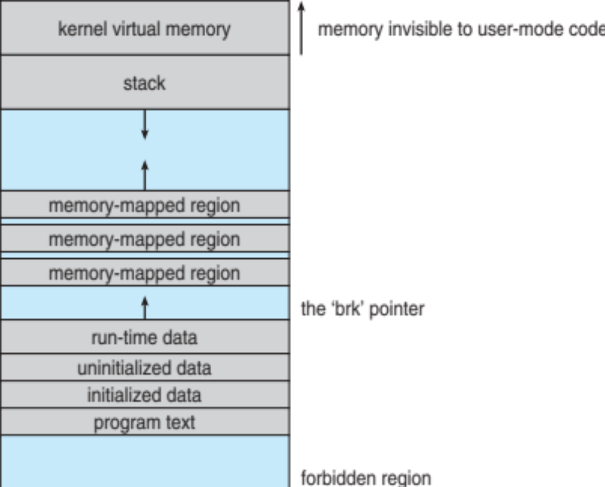
Memory Layout for ELF Programs

Slide 44
Static and Dynamic Linking
A program whose necessary library functions are embedded directly in the program’s executable binary file is statically linked to its libraries
The main disadvantage of static linkage is that every program generated must contain copies of exactly the same common system library functions
Dynamic linking is more efficient in terms of both physical memory and disk-space usage because it loads the system libraries into memory only once

Slide 45
Static and Dynamic Linking (Cont.)
Linux implements dynamic linking in user mode through special linker library
  Every dynamically linked program contains small statically linked function called when process starts
  Maps the link library into memory
  Link library determines dynamic libraries required by process and names of variables and functions needed
  Maps libraries into middle of virtual memory and resolves references to symbols contained in the libraries
  Shared libraries compiled to be position-independent code (PIC) so can be loaded anywhere

Slide 46
File Systems
To the user, Linux’s file system appears as a hierarchical directory tree obeying UNIX semantics
Internally, the kernel hides implementation details and manages the multiple different file systems via an abstraction layer, that is, the virtual file system (VFS)
The Linux VFS is designed around object-oriented principles and is composed of four components:
  A set of definitions that define what a file object is allowed to look like
    The inode object structure represent an individual file
    The file object represents an open file
    The superblock object represents an entire file system
    A dentry object represents an individual directory entry

Slide 47
File Systems (Cont.)
To the user, Linux’s file system appears as a hierarchical directory tree obeying UNIX semantics
Internally, the kernel hides implementation details and manages the multiple different file systems via an abstraction layer, that is, the virtual file system (VFS)
The Linux VFS is designed around object-oriented principles and layer of software to manipulate those objects with a set of operations on the objects
  For example for the file object operations include (from struct file_operations in /usr/include/linux/fs.h
    int open(. . .) — Open a file
    ssize t read(. . .) — Read from a file
    ssize t write(. . .) — Write to a file
    int mmap(. . .) — Memory-map a file

Slide 48
The Linux ext3 File System
ext3 is standard on disk file system for Linux
  Uses a mechanism similar to that of BSD Fast File System (FFS) for locating data blocks belonging to a specific file
  Supersedes older extfs, ext2 file systems
  Work underway on ext4 adding features like extents
  Of course, many other file system choices with Linux distros

Slide 49
The Linux ext3 File System (Cont.)
The main differences between ext2fs and FFS concern their disk allocation policies
  In ffs, the disk is allocated to files in blocks of 8Kb, with blocks being subdivided into fragments of 1Kb to store small files or partially filled blocks at the end of a file
  ext3 does not use fragments; it performs its allocations in smaller units
    The default block size on ext3 varies as a function of total size of file system with support for 1, 2, 4 and 8 KB blocks
  ext3 uses cluster allocation policies designed to place logically adjacent blocks of a file into physically adjacent blocks on disk, so that it can submit an I/O request for several disk blocks as a single operation on a block group
  Maintains bit map of free blocks in a block group, searches for free byte to allocate at least 8 blocks at a time

Slide 50
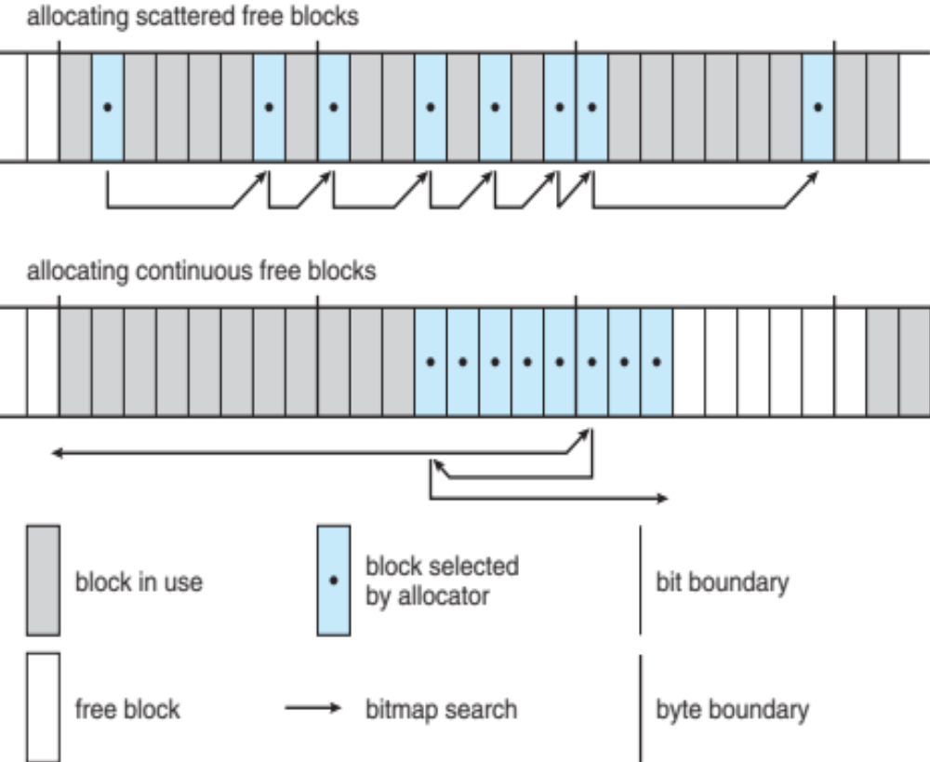
Ext2fs Block-Allocation Policies

Slide 51
Journaling
ext3 implements journaling, with file system updates first written to a log file in the form of transactions
  Once in log file, considered committed
  Over time, log file transactions replayed over file system to put changes in place
On system crash, some transactions might be in journal but not yet placed into file system
  Must be completed once system recovers
  No other consistency checking is needed after a crash (much faster than older methods)
Improves write performance on hard disks by turning random I/O into sequential I/O

Slide 52
The Linux Proc File System
The proc file system does not store data, rather, its contents are computed on demand according to user file I/O requests
proc must implement a directory structure, and the file contents within; it must then define a unique and persistent inode number for each directory and files it contains
  It uses this inode number to identify just what operation is required when a user tries to read from a particular file inode or perform a lookup in a particular directory inode
  When data is read from one of these files, proc collects the appropriate information, formats it into text form and places it into the requesting process’s read buffer

Slide 53
Input and Output
The Linux device-oriented file system accesses disk storage through two caches:
  Data is cached in the page cache, which is unified with the virtual memory system
  Metadata is cached in the buffer cache, a separate cache indexed by the physical disk block
Linux splits all devices into three classes:
  block devices allow random access to completely independent, fixed size blocks of data
  character devices include most other devices; they don’t need to support the functionality of regular files
  network devices are interfaced via the kernel’s networking subsystem

Slide 54
Block Devices
Provide the main interface to all disk devices in a system
The block buffer cache serves two main purposes:
  it acts as a pool of buffers for active I/O
  it serves as a cache for completed I/O
The request manager manages the reading and writing of buffer contents to and from a block device driver
Kernel 2.6 introduced Completely Fair Queueing (CFQ)
  Now the default scheduler
  Fundamentally different from elevator algorithms
  Maintains set of lists, one for each process by default
  Uses C-SCAN algorithm, with round robin between all outstanding I/O from all processes
  Four blocks from each process put on at once

Slide 55
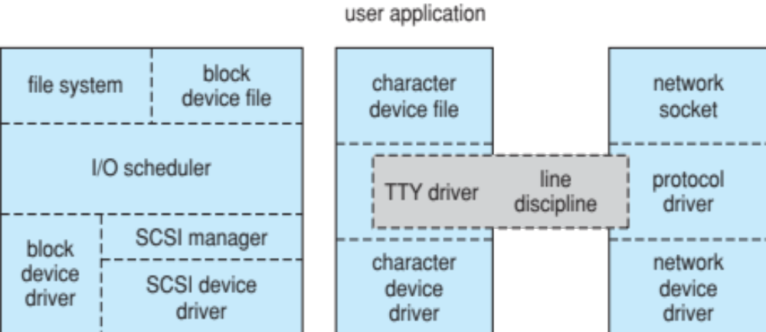
Device-Driver Block Structure

Slide 56
Character Devices
A device driver which does not offer random access to fixed blocks of data
A character device driver must register a set of functions which implement the driver’s various file I/O operations
The kernel performs almost no preprocessing of a file read or write request to a character device, but simply passes on the request to the device
The main exception to this rule is the special subset of character device drivers which implement terminal devices, for which the kernel maintains a standard interface

Slide 57
Character Devices (Cont.)
Line discipline is an interpreter for the information from the terminal device
  The most common line discipline is tty discipline, which glues the terminal’s data stream onto standard input and output streams of user’s running processes, allowing processes to communicate directly with the user’s terminal
  Several processes may be running simultaneously, tty line discipline responsible for attaching and detaching terminal’s input and output from various processes connected to it as processes are suspended or awakened by user
  Other line disciplines also are implemented have nothing to do with I/O to user process – i.e. PPP and SLIP networking protocols

Slide 58
Interprocess Communication
Like UNIX, Linux informs processes that an event has occurred via signals
There is a limited number of signals, and they cannot carry information: Only the fact that a signal occurred is available to a process
The Linux kernel does not use signals to communicate with processes with are running in kernel mode, rather, communication within the kernel is accomplished via scheduling states and wait_queue structures
Also implements System V Unix semaphores
  Process can wait for a signal or a semaphore
  Semaphores scale better
  Operations on multiple semaphores can be atomic

Slide 59
Passing Data Between Processes
The pipe mechanism allows a child process to inherit a communication channel to its parent, data written to one end of the pipe can be read a the other
Shared memory offers an extremely fast way of communicating; any data written by one process to a shared memory region can be read immediately by any other process that has mapped that region into its address space
To obtain synchronization, however, shared memory must be used in conjunction with another Interprocess-communication mechanism

Slide 60
Network Structure
Networking is a key area of functionality for Linux
  It supports the standard Internet protocols for UNIX to UNIX communications
  It also implements protocols native to non-UNIX operating systems, in particular, protocols used on PC networks, such as Appletalk and IPX
Internally, networking in the Linux kernel is implemented by three layers of software:
  The socket interface
  Protocol drivers
  Network device drivers
Most important set of protocols in the Linux networking system is the internet protocol suite
  It implements routing between different hosts anywhere on the network
  On top of the routing protocol are built the UDP, TCP and ICMP protocols
Packets also pass to firewall management for filtering based on firewall chains of rules

Slide 61
Security
The pluggable authentication modules (PAM) system is available under Linux
PAM is based on a shared library that can be used by any system component that needs to authenticate users
Access control under UNIX systems, including Linux, is performed through the use of unique numeric identifiers (uid and gid)
Access control is performed by assigning objects a protections mask, which specifies which access modes—read, write, or execute—are to be granted to processes with owner, group, or world access

Slide 62
Security (Cont.)
Linux augments the standard UNIX setuid mechanism in two ways:
  It implements the POSIX specification’s saved user-id mechanism, which allows a process to repeatedly drop and reacquire its effective uid
  It has added a process characteristic that grants just a subset of the rights of the effective uid
Linux provides another mechanism that allows a client to selectively pass access to a single file to some server process without granting it any other privileges

Slide 63
End of Chapter 21

Slide 64
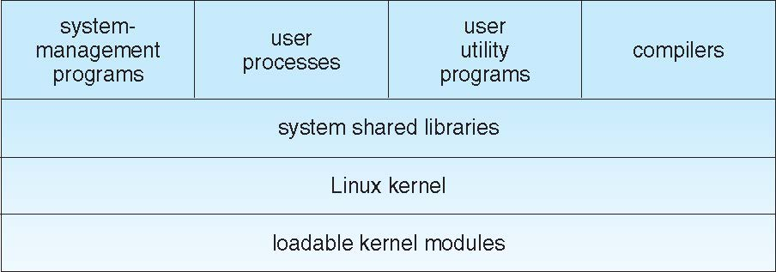
Figure 21.01

Slide 65
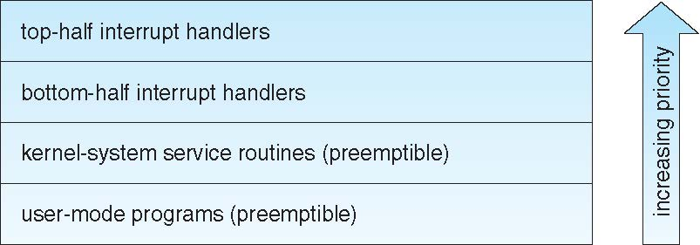
Figure 21.02

Slide 66
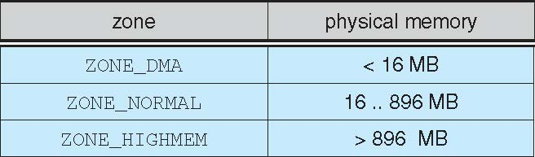
Figure 21.03

Slide 67
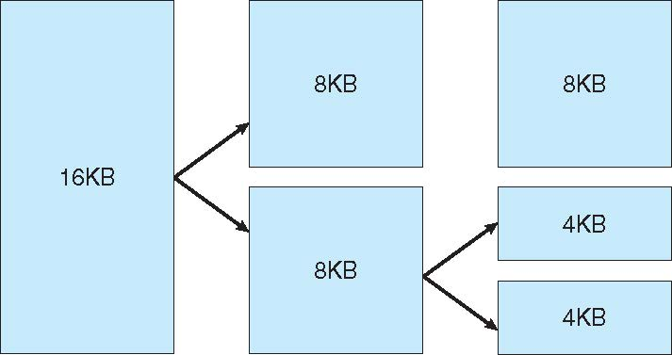
Figure 21.04

Slide 68
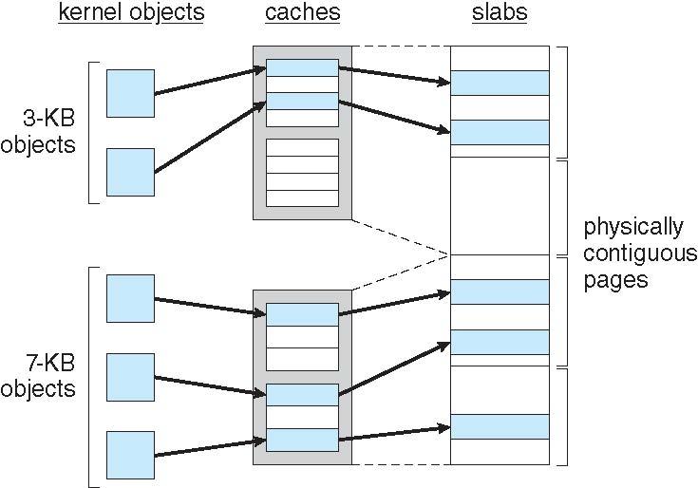
Figure 21.05

Slide 69
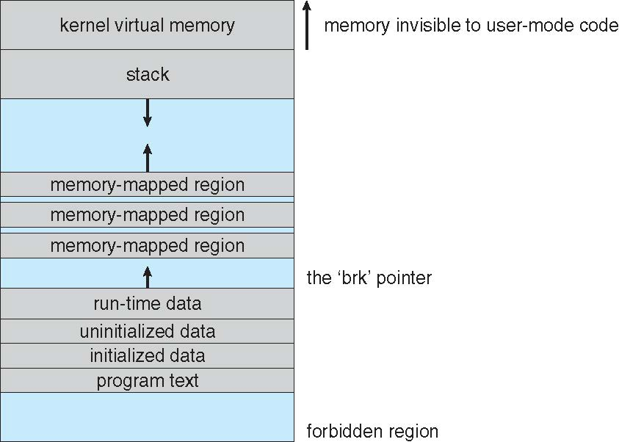
Figure 21.06

Slide 70
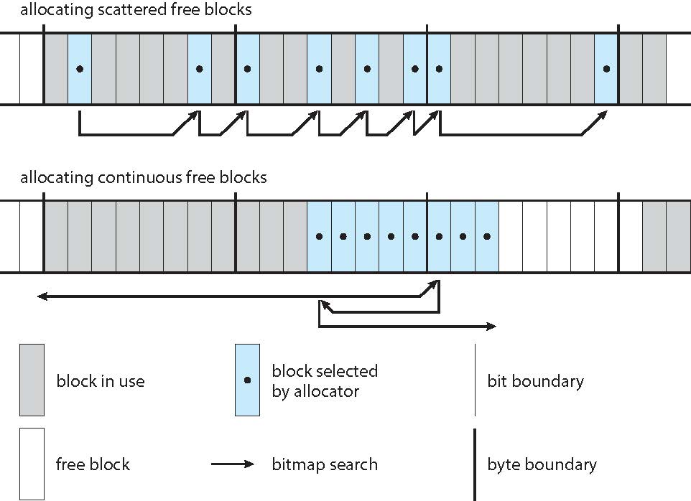
Figure 21.07

Slide 71
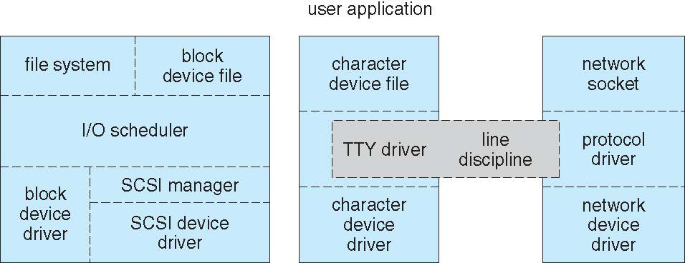
Figure 21.08

Slide 72
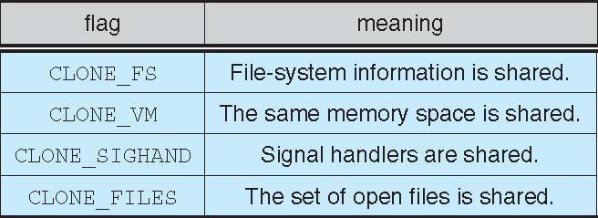
Figure in-21.01

Slide 73
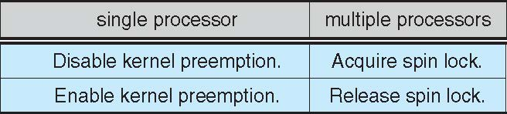
Figure in-21.02

