Slide 1









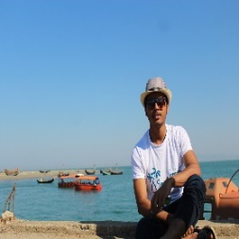





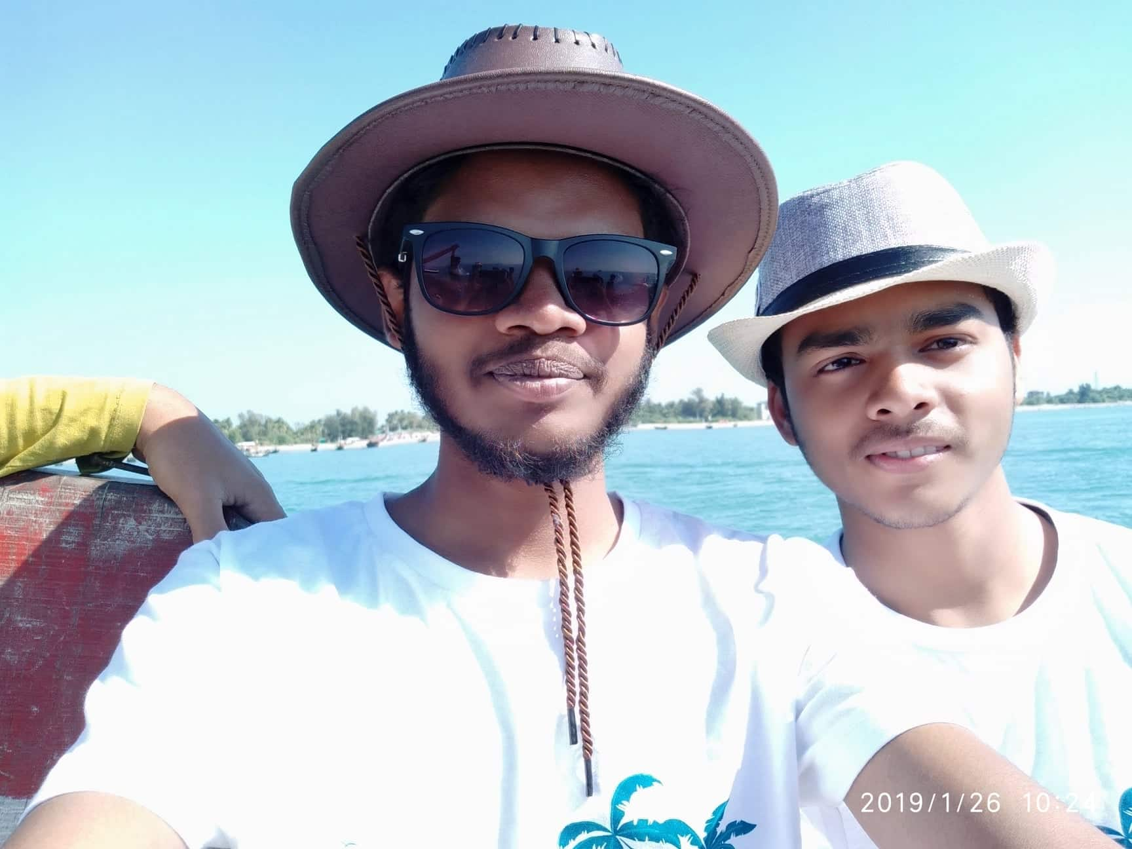




L
Home
Create
Search
Note Your Life
Life is fucking beautiful
Note what’s on your mind…
Photo/Video
Blood Bank
Dairy
…
View your note
Your Dairy
Sopnil Mottafi Billah
Set Your Calendar
1w .
Public
Have you ever heard, create some job and be an entrepreneur rather be a
qualified product and sell yourself to other successful entrepreneur in your
University life? I didn’t.
V-case
Shopping Mall
Library
Provide translation
react
Comment
Share
Put down a comment…

