Slide 1

IBM DATA SCIENCE PROFESSIONAL CERTIFICATE — CAPSTONE
SpaceX Falcon 9
First Stage Landing Prediction
Name:
Tulsi Naik
PLATFORM:
IBM Skills Network / Coursera
https://github.com/Tulsi-Naik/spacex-capstone
GitHub:
TOOLS:
Python · SQL · Folium · Plotly Dash · scikit-learn

Slide 2

Executive Summary
OVERVIEW
90+
4
4
83.3%
Total Launches
Launch Sites
ML Models Built
Best Accuracy
Project Goals
Key Findings
Predict Falcon 9 first-stage landing success to estimate launch cost savings
SpaceX charges $62M vs. competitors' $165M+; reuse is the key differentiator
Enable rival bidders to forecast launch costs based on landing probability
Build end-to-end data science pipeline: collection → EDA → ML prediction
KSC LC-39A had the highest launch success rate among all four sites
Success rate improves with increasing flight number — experience matters
Orbits ES-L1, GEO, HEO, SSO achieved 100% success rates
Decision Tree & SVM both achieved 83.3% accuracy on hold-out test set
F9 B5 booster showed strongest landing success correlation
2 / 12

Slide 3


Introduction
BACKGROUND
Problem Statement
Can we predict whether the Falcon 9 first stage will land successfully, enabling cost-competitive launch pricing analysis for alternative providers bidding against SpaceX?
Dataset Overview
Project Objectives
Technologies Used
SpaceX REST API — rocket, payload, launchpad metadata
Wikipedia web scrape — historical Falcon 9 launch records
Spacex.csv — 90+ Falcon 9/Heavy missions
Fields: Date, Launch Site, Payload Mass, Orbit, Booster Version, Landing Outcome
Collect data via SpaceX API & web scraping
Perform SQL + visual EDA to identify patterns
Build interactive Folium maps of launch sites
Develop Plotly Dash analytical dashboard
Train & compare ML classification models
Python (Pandas, NumPy, Matplotlib, Seaborn)
SQL / SQLite — structured data queries
Folium — interactive geographic mapping
Plotly Dash — interactive web dashboard
scikit-learn — ML model training & evaluation
3 / 12

Slide 4

Data Collection & Wrangling Methodology
LAB 1 & 2
SpaceX API
GET Request
Wikipedia
Web Scraping
Data
Cleaning
Feature
Engineering
Training
Labels
Data Collection Sources
Wrangling & Preprocessing
SpaceX REST API v4: rockets, launchpads, payloads, cores
Helper functions: getBoosterVersion(), getLaunchSite(), getPayloadData(), getCoreData()
HTTP GET requests via Python requests library
Wikipedia: List of Falcon 9 & Falcon Heavy Launches
BeautifulSoup4 HTML parser to extract launch tables
Structured into Pandas DataFrame (90 rows × 17 features)
Null value analysis: PayloadMass, LandingPad had missing values — imputed with column mean
Landing outcomes encoded: True/False × Ocean/RTLS/ASDS → binary Class (1=success, 0=failure)
Identified 4 launch sites: CCAFS LC-40, CCAFS SLC-40, KSC LC-39A, VAFB SLC-4E
Orbit types classified: LEO, GTO, ISS, SSO, VLEO, MEO, GEO, HEO, ES-L1, PO
StandardScaler applied for ML feature normalization
80/20 train-test split with random_state=2
4 / 12

Slide 5




EDA & Interactive Visual Analytics Methodology
LABS 3–5
EDA with Matplotlib & Seaborn
SQL-Based EDA (SQLite)
catplot: FlightNumber vs LaunchSite, PayloadMass vs LaunchSite (hue=Class)
Bar charts: success rate per orbit type
Line chart: yearly launch success trend
Feature correlation heatmap for ML feature selection
Loaded SpaceX CSV into SQLite SPACEXTBL via ipython-sql
Aggregation queries: COUNT, SUM, AVG, MIN, MAX
Filtering with LIKE, WHERE conditions
GROUP BY for outcome distributions & year analysis
Folium Interactive Maps
Plotly Dash Dashboard
Mapped all 4 launch sites with CircleMarker (color = success/fail)
MarkerCluster plugin for dense launch point grouping
MousePosition plugin for real-time lat/lon display
PolyLine overlays for proximity distances to coast, rail, highway
Dropdown: filter by launch site (All / individual)
RangeSlider: filter Payload Mass 0–10,000 kg
Pie chart callback: success distribution per site
Scatter chart callback: payload vs. outcome colored by Booster Version
5 / 12

Slide 6
Predictive Analysis Methodology
LAB 5 — ML
1. Load
dataset_part_2
& part_3
2. Extract
Class column
as Y array
3. StandardScaler
normalize X
4. train_test_split
80/20 split
random_state=2
5. GridSearchCV
cv=10 folds
Hyperparameter
6. Compare
4 Classifiers
& Select Best
Logistic Regression
Support Vector Machine
Decision Tree Classifier
K-Nearest Neighbors
C ∈ {0.01, 0.1, 1}
penalty: L2 (Ridge)
solver: lbfgs
kernel: linear/rbf/poly/sigmoid
C: logspace(−3,3,5)
gamma: logspace(−3,3,5)
criterion: gini/entropy
max_depth: 2–18
min_samples_leaf: 1/2/4
n_neighbors: 1–10
algorithm: auto/ball_tree/kd_tree/brute
p: 1 or 2 (Manhattan/Euclidean)
Evaluation: Accuracy score on 18 test samples + Confusion Matrix (seaborn heatmap)
6 / 12

Slide 7
EDA Visualization Results
LAB 3 RESULTS
Key Findings
ES-L1, GEO, HEO, SSO, VLEO orbits achieved 100% success — highest-value missions
Flight number strongly correlates with landing success — booster experience is crucial
VAFB SLC-4E had zero heavy-payload (>10,000 kg) launches in dataset
7 / 12

Slide 8
EDA with SQL Results
LAB 4 — SQL
Task 1 — Unique Launch Sites
Task 3 — Total NASA (CRS) Payload Mass
SELECT DISTINCT "Launch_Site" FROM SPACEXTBL;
SELECT SUM("PAYLOAD_MASS__KG_") AS Total_Payload_Mass
FROM SPACEXTBL WHERE Customer = 'NASA (CRS)';
→ CCAFS LC-40 · CCAFS SLC-40 · KSC LC-39A · VAFB SLC-4E
→ 45,596 kg total payload carried for NASA CRS missions
Task 5 — First Successful Ground Pad Landing
Task 6 — Boosters: Drone Ship + 4000–6000 kg Payload
SELECT MIN(Date) AS First_Successful_Landing
FROM SPACEXTBL WHERE "Landing_Outcome" = 'Success (ground pad)';
SELECT DISTINCT "Booster_Version" FROM SPACEXTBL
WHERE "Landing_Outcome" = 'Success (drone ship)'
AND "PAYLOAD_MASS__KG_" BETWEEN 4000 AND 6000;
→ 2015-12-22 — First successful ground pad landing achieved
→ F9 FT B1022 · F9 FT B1026 · F9 FT B1021.2 · F9 FT B1031.2
Task 7 — Mission Outcome Counts
Task 8 — Boosters with Max Payload Mass
SELECT "Mission_Outcome", COUNT(*) AS Outcome_Count
FROM SPACEXTBL GROUP BY "Mission_Outcome";
SELECT DISTINCT "Booster_Version" FROM SPACEXTBL
WHERE "PAYLOAD_MASS__KG_" = (SELECT MAX("PAYLOAD_MASS__KG_") FROM SPACEXTBL);
→ Success: 98 · Failure (in flight): 1 · Success (payload status unclear): 1
→ F9 B5 B1048.4 · F9 B5 B1049.4 · F9 B5 B1051.3 · F9 B5 B1056.4 · F9 B5 B1048.5
8 / 12

Slide 9
Interactive Map Results — Folium
LAB 5 — MAPS
SpaceX Launch Site Coordinates
Geographic Insights
Launch Site | Latitude | Longitude | Location
CCAFS LC-40 | 28.5621°N | 80.5774°W | Cape Canaveral, FL
CCAFS SLC-40 | 28.5620°N | 80.5770°W | Cape Canaveral, FL
KSC LC-39A | 28.6080°N | 80.6040°W | Kennedy Space Center, FL
VAFB SLC-4E | 34.6325°N | 120.6108°W | Vandenberg AFB, CA
All US launch sites cluster near coastlines — ocean safety corridor for booster descent
Cape Canaveral sites (FL) benefit from Earth's equatorial rotation speed boost
KSC LC-39A proximity to rail and road infrastructure enables rapid payload integration
VAFB SLC-4E (CA) favors polar & SSO orbits due to southward trajectory over Pacific
No sites located inland — ocean proximity is a hard safety and operational constraint
Minimum distance to coastline < 1 km for all four active SpaceX sites
MarkerCluster — groups launches geographically at varying zoom levels
CircleMarker — green=success, red=failure, radius proportional to payload
MousePosition plugin — live lat/lon readout on cursor hover
PolyLine overlays — measured proximity distances to nearest coastline, railway, and highway
DivIcon labels — site name annotations directly on the map
9 / 12

Slide 10
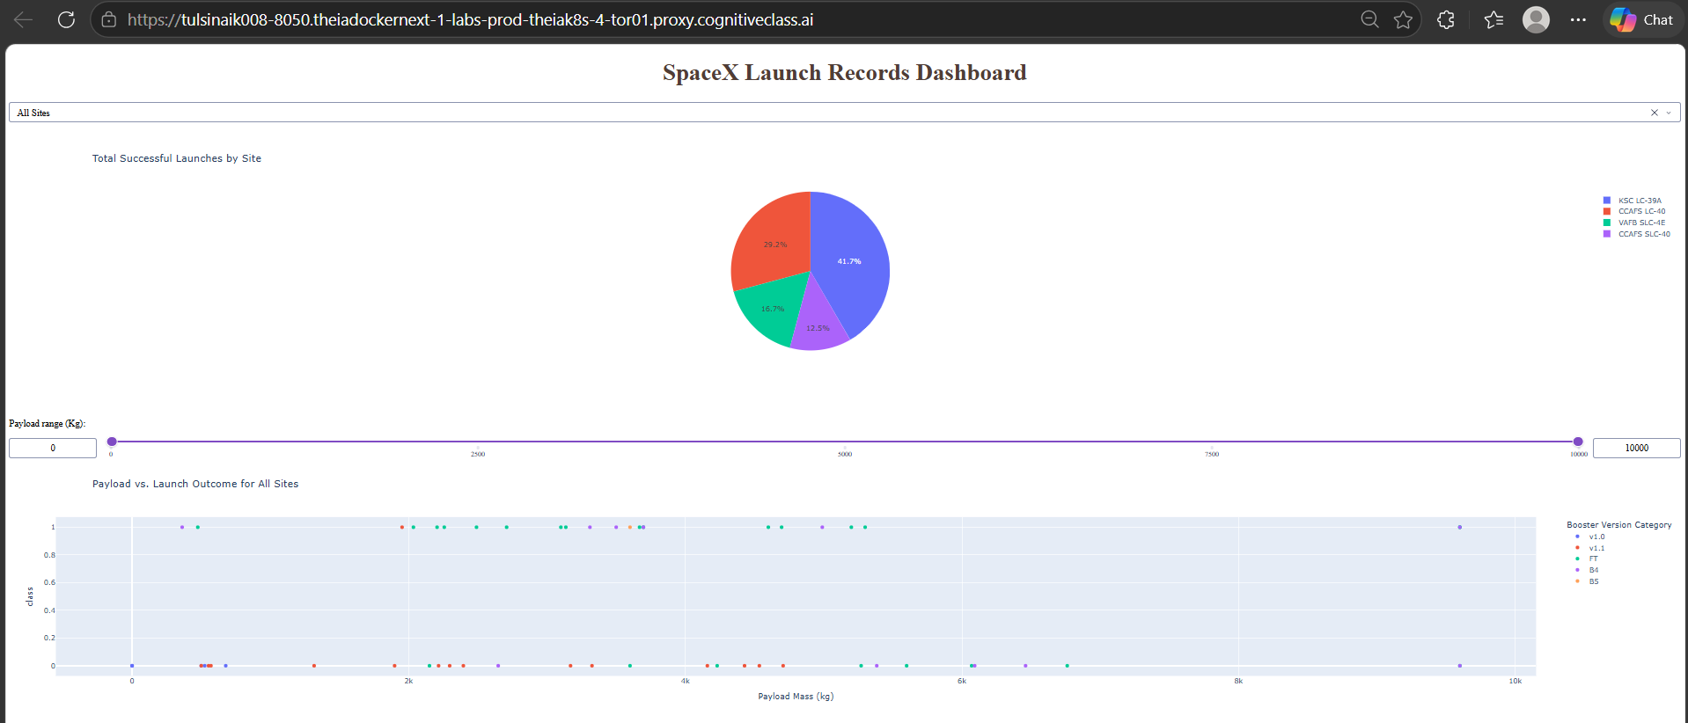
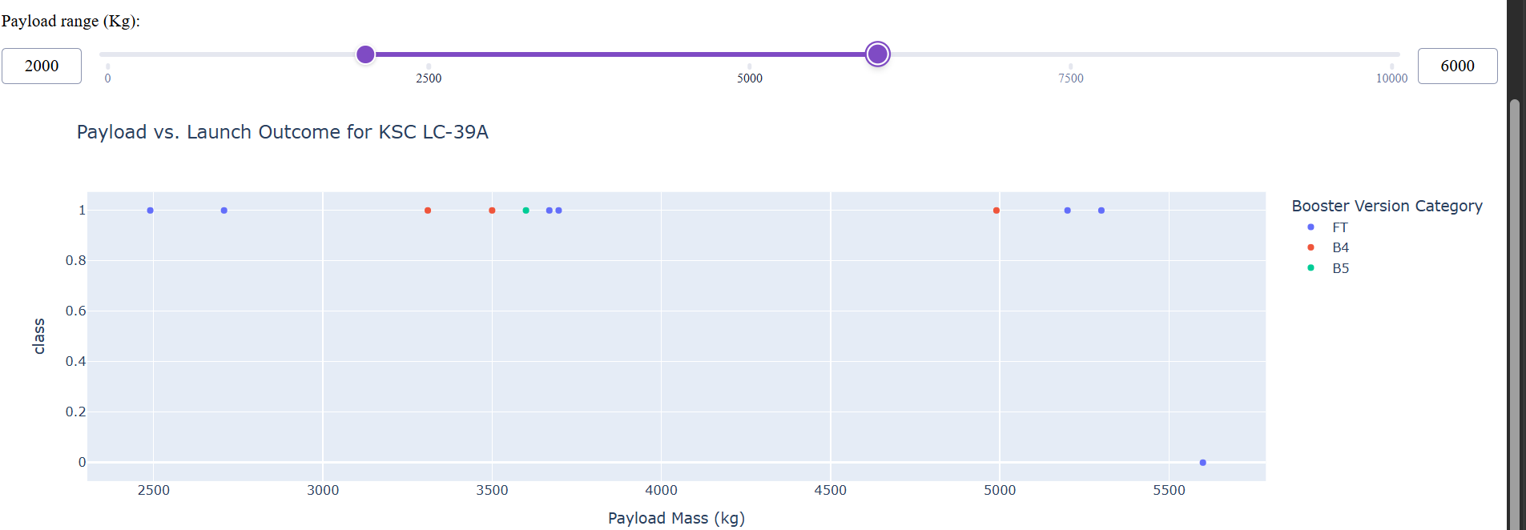
Plotly Dash Dashboard Results
LAB 6 — DASHBOARD
Fig 2: KSC LC-39A selected — payload with range between 2000 -6000
Dashboard Components
Dropdown: All Sites / CCAFS LC-40 / CCAFS SLC-40 / KSC LC-39A / VAFB SLC-4E
Pie chart: total success by site (All) or success/fail ratio (per site)
RangeSlider: 0–10,000 kg payload mass filter with 1,000 kg step
Scatter: Payload Mass vs Class, colored by Booster Version Category
Fig 1: Full dashboard — All Sites, payload 0–10,000 kg
10 / 12

Slide 11
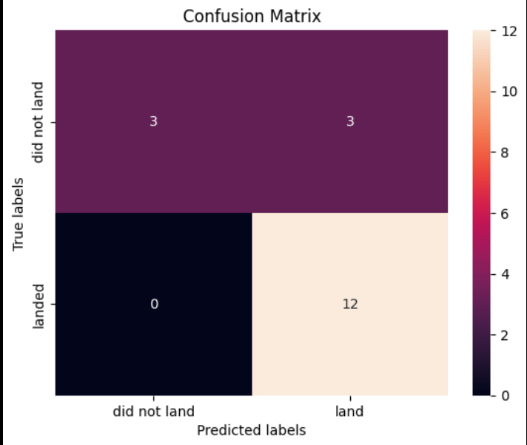
Predictive Analysis Results
LAB 5 — ML
Confusion Matrix — Decision Tree
True Positives (TP): 12 — landed correctly predicted
True Negatives (TN): 3 — no-land correctly predicted
False Positives (FP): 3 — predicted land, did not land
False Negatives (FN): 0 — no missed landing predictions
Precision: 80.0% | Recall: 100% | F1: 0.889
KNN scored 77.78% — lowest due to 4 misclassifications
Best Model: Decision Tree (tied)
All three top models achieved 83.33% accuracy (15/18 correct). Decision Tree selected for interpretability.
11 / 12

Slide 12

Conclusion
SUMMARY
Project Delivered
Key Learnings
Full end-to-end data science pipeline built from scratch
Data collected via API, web scraping, and CSV ingestion
SQL EDA, visual EDA, Folium maps, and Dash dashboard all completed
4 ML classifiers trained, tuned, and evaluated with GridSearchCV
Booster reuse experience (flight number) is the strongest success predictor
Launch site geography directly constrains orbit types achievable
ES-L1, GEO, HEO missions all achieved 100% landing success
KSC LC-39A leads in success rate among all four active sites
Model Performance
Future Improvements
Best test accuracy: 83.33% (Logistic Regression, SVM, Decision Tree)
Decision Tree preferred for interpretability and feature visibility
Small test set (18 samples) limits statistical confidence — noted
All models outperform 50% baseline, confirming predictive signal
Expand dataset with 2021–2024 Starship and Falcon 9 flights
Engineer weather and sea-state features at launch time
Explore ensemble methods (Random Forest, XGBoost) for higher accuracy
Deploy model as REST API to enable real-time cost estimation tool
This capstone demonstrates a complete data science workflow: collection → wrangling → EDA → visualization → predictive modeling
12 / 12

