Slide 1

NagarSetu: Bilingual AI System for Civic Complaint and Information Assistance
BY
PRACHITI PARAB (22106028)
AAFREEN KHAN (22106048)
SNEHA GUPTA (22106046)
TULSI DUBEY (22106055)
Project Guide
Dr. Rahul Ambekar

Slide 2
Outline
Introduction
Literature Survey of the existing systems
Limitations of the existing systems
Problem statement
Proposed System
Experimental Setup
Implementation
Conclusion and future work
References
Research Paper Publication / Patent/ Copyright status

Slide 3
Introduction
NagarSetu is a bilingual AI-powered system designed to assist citizens in filing civic complaints and generating RTI (Right to Information) drafts with ease. It bridges the gap between citizens and local governance by providing a simple, interactive platform that supports Hindi and English, voice inputs, and step-by-step assistance for both grievances and information access.
Key Features:
Multimodal Complaint Submission – Supports text, photo, and audio.
Image Classification – Identifies potholes, broken streetlights, garbage, water leakages.
RTI Assistance – Generates drafts in Hindi/English using AI.
Geo-Tagging – Maps issues precisely via Google Maps API.
Real-Time Tracking – Citizens get live updates via notifications.

Slide 4
Introduction
Motivation
Citizens face hurdles in reporting civic issues (potholes, streetlights, garbage, leakage).
Current systems: time-consuming forms, queues, or helplines.
Manual routing leads to delays, errors, and mismanagement.
Citizens lack simple tools for RTI requests.
AI-powered NagarSetu: Automates classification, ensures faster routing.
Objectives
To develop an AI-enabled web and mobile platform that enables citizens to report civic issues (with images, text, audio and location),
To automates the classification and prioritization of complaints
To integrates geolocation, and facilitates real-time status tracking, resolution, and feedback through a multi-role dashboard system.
To ensure timely redressal by routing complaints to appropriate departments.
To simplify the RTI drafting process through AI-powered natural language support.

Slide 5
Literature Survey of the existing system
Year | Title | Domain | Algorithm | Dataset | Gap
2024 | Automated Complaint Classification& Routing Using NLP | NLP, ML | TF-IDF, Logistic Regression, BERT | Complaint datasets | No image classification
2025 | CivicFix: Smart Complaint Routing for Urban Solutions | AI, Smart Governance | Smart routing model, classification, FastAPI backend | Case study datasets from urban complaints | Limited categories; no bilingual/voice/RTI integration
2025 | Digital Grievance Redressal for the Cleaner andSmarter India | Smart City, CivicTech | Location tagging + AI classification | Case study dataset | No bilingual/ voice support
2019 | AI-Driven Complaint Management System – Shreyas Shedge, Pratik Wadkar, Atreya Raorane, Bushra Shaikh | CivicTech, Smart City Applications | AI complaint categorization + database integration | Simulated citizen complaint dataset | Lacks multimodal input (no image/voice); no RTI support

Slide 6
Limitations of Existing Systems
English-only interfaces → Excludes non-English speakers.
Manual complaint routing → Delays in resolution.
Weak Complaint Prioritization → Existing systems treat all complaints equally
No image/voice inputs → Poor usability.
Weak RTI support → Citizens struggle with drafting requests.
No real-time tracking → Lack of trust and transparency.

Slide 7
Problem statement
Urban citizens often encounter public issues such as potholes, garbage accumulation, broken streetlights, or water leakage. there is no efficient & user-friendly system for reporting these issues to the appropriate municipal department. As a result, grievances are either unresolved or delayed. Additionally, people face confusion in drafting RTI (Right to Information) requests because they are unaware of the correct format, language, or process, which limits public access to government-held information and weakens civic participation.

Slide 8
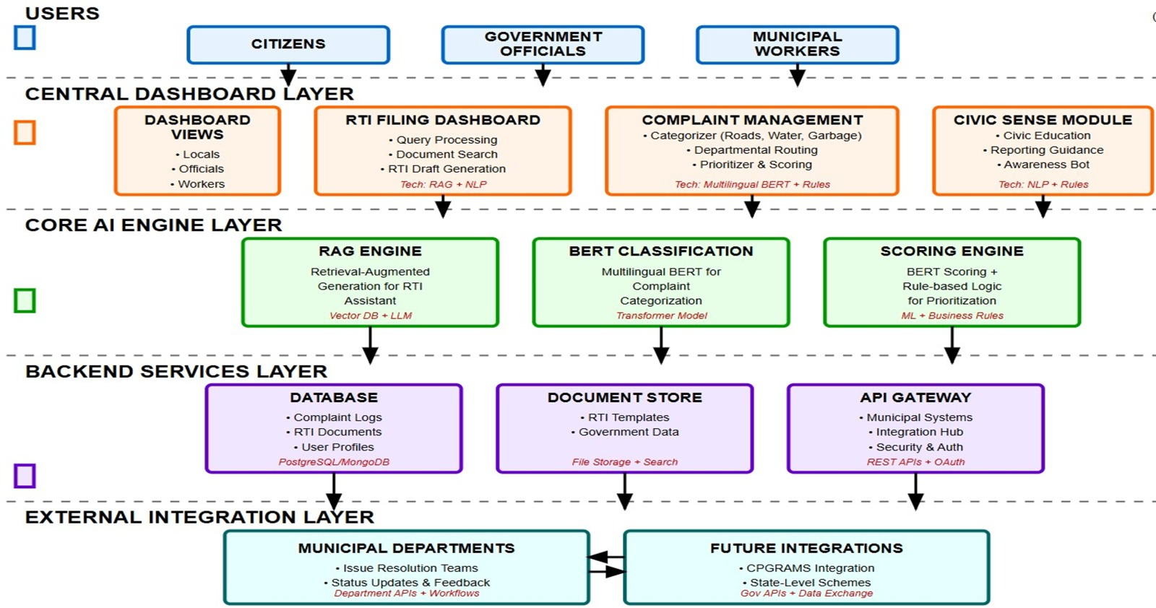
System Design
This chapter concentrates on detailed explanation of the approach you follow in solving this problem. Design diagrams of all modules, their functioning, techniques / methods / algorithms, their relations with other modules, interactive parameters between the modules, databases, database relations, the platforms you propose to use, etc., need to be explained in detail in this chapter.
Also highlight the changes you propose or customization done in comparison to existing solutions. This is very important part of the whole project as it talks about your proposed changes. It is the value addition from you to solve this problem.

Slide 9
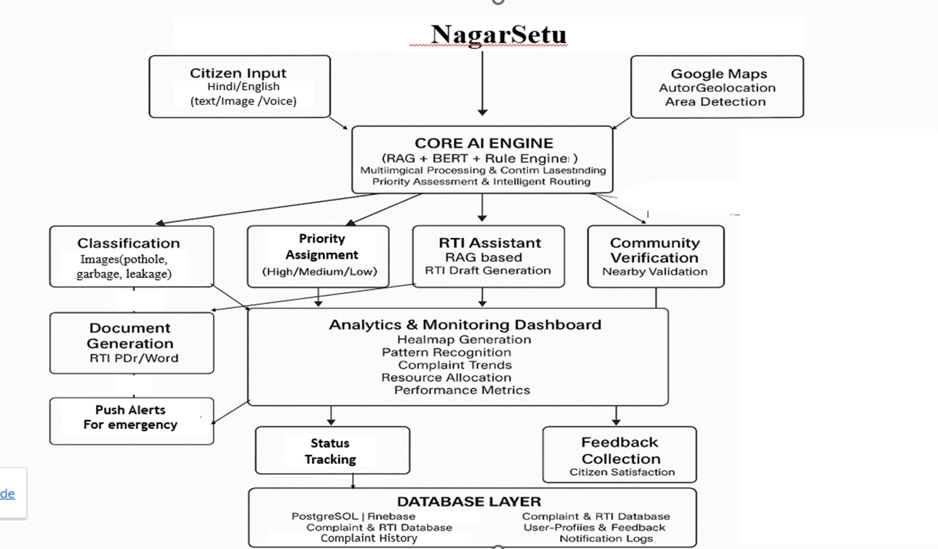

NagarSetu

Slide 10
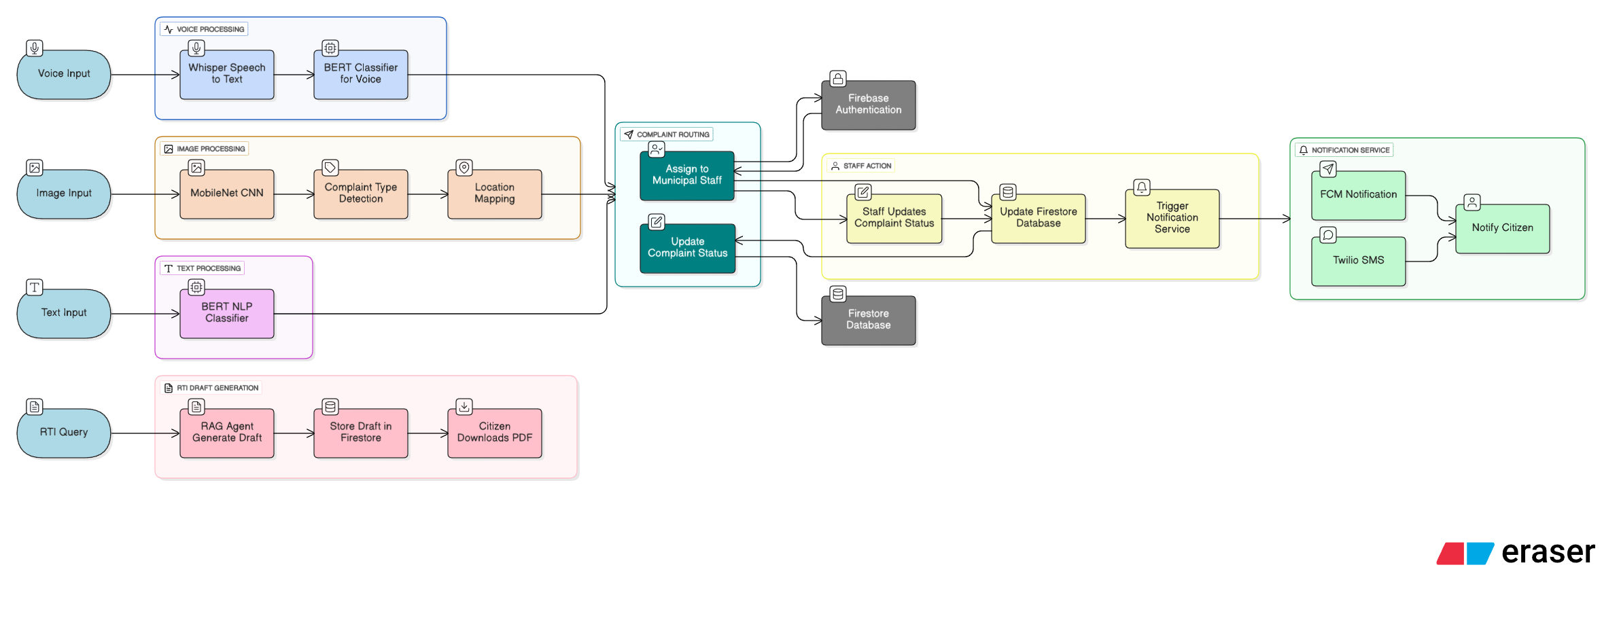

Slide 11
Technologies and methodologies
Frontend: React.js + Tailwind CSS.
Backend: Develop REST API using FastAPI for data flow.
AI/NLP Modules:
Complaint Classification: Use CNN models (e.g., MobileNet + TensorFlow) for image classification (e.g., pothole, garbage, leak) & Use NLP (BERT) to extract complaint type from user text/voice.
RTI Drafting: RAG approach to Retrieves relevant RTI from user input.
Voice Input: Whisper for speech-to-text conversion.
Geo-tagging: Integrate Google Map API.
Notifications: Use Firebase Cloud Messaging and Twilio.
Database: Firebase for authentication, database, and real-time updates.

Slide 12
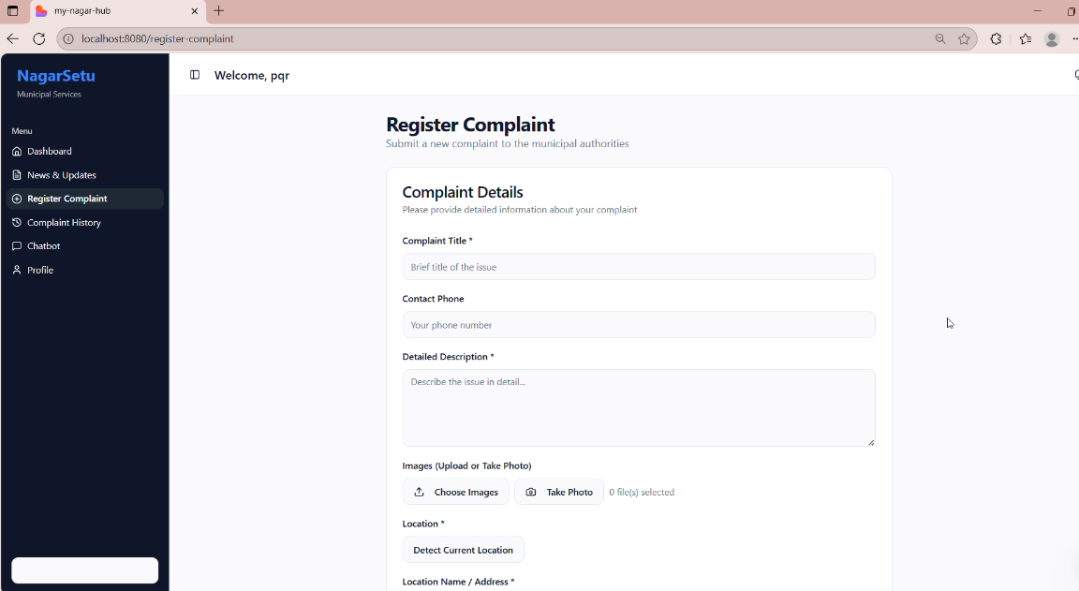
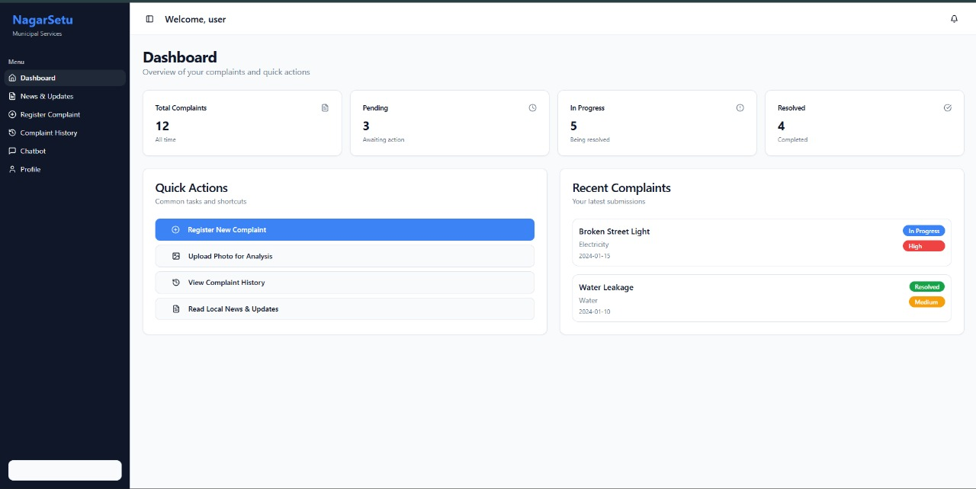
Implementation

Slide 13
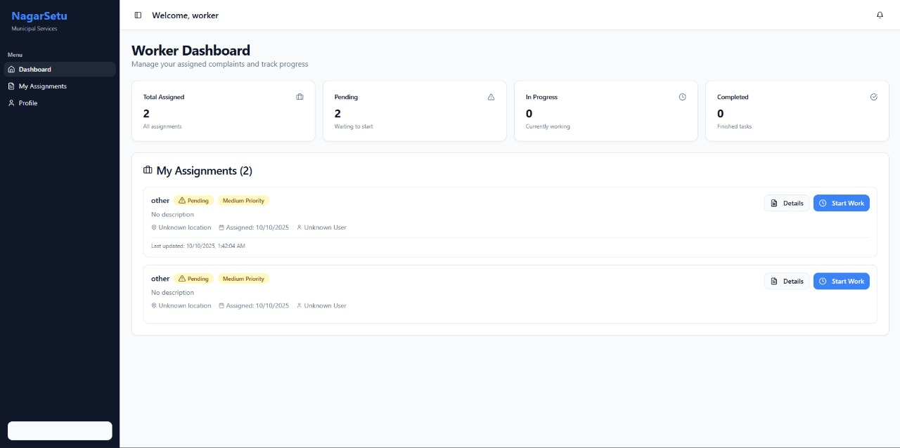
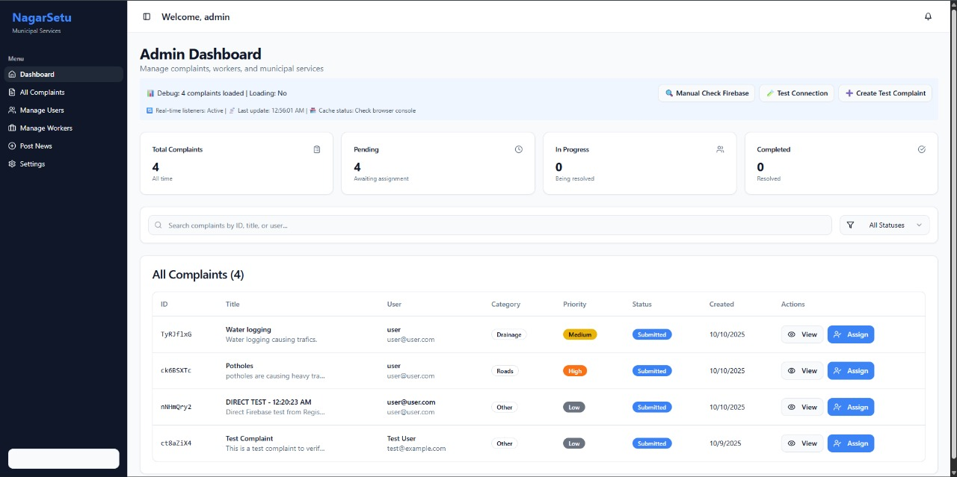

Slide 14
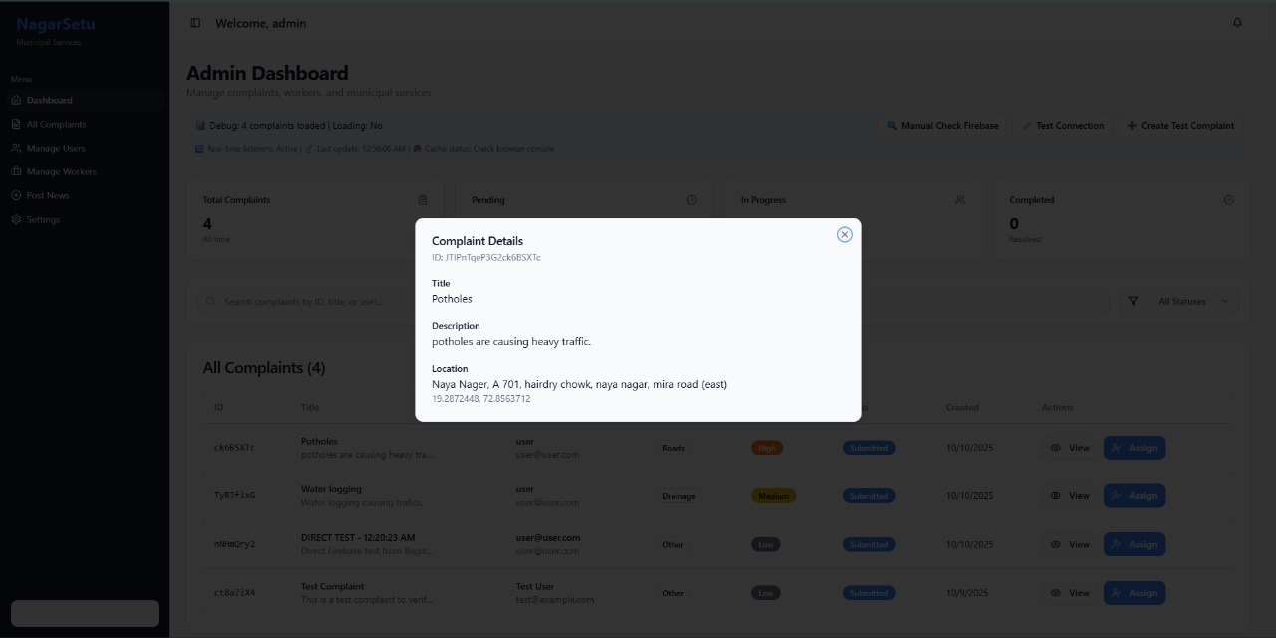
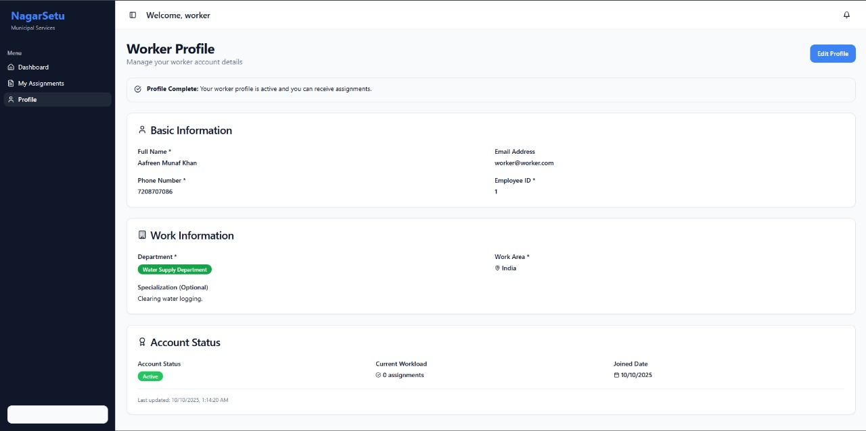

Slide 15
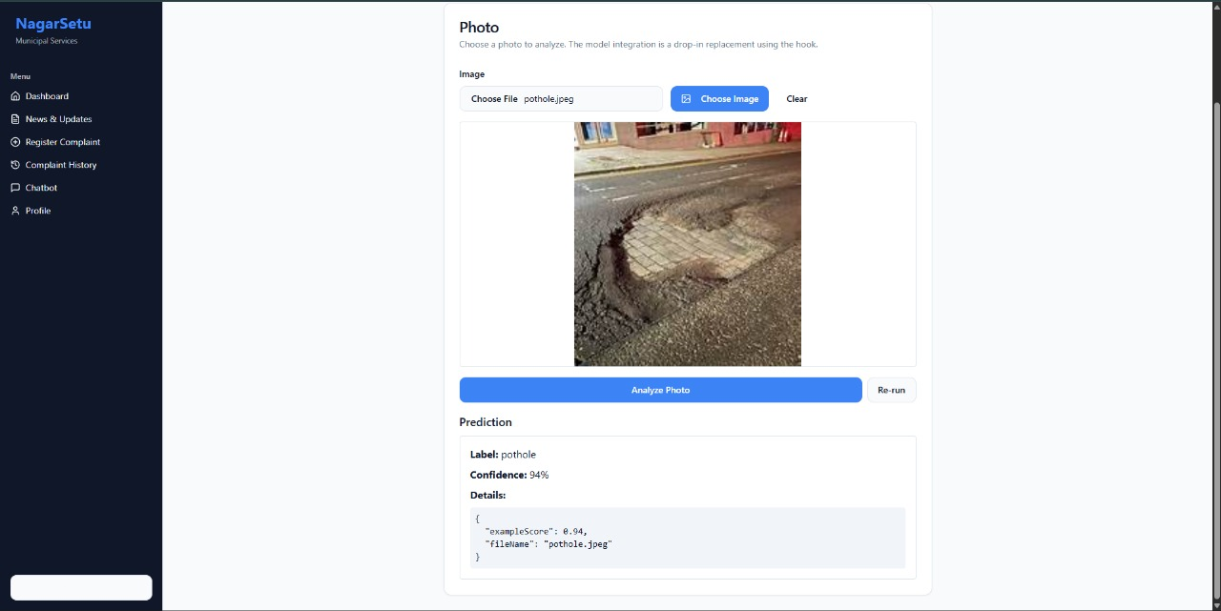

Slide 16
Conclusion
NagarSetu provides a bilingual, AI-driven platform for civic complaint redressal and RTI drafting.
Supports multimodal input: text, image (potholes, garbage, leakage, streetlights), and voice.
Ensures faster and accurate complaint classification using MobileNet (images), BERT (text).
RAG-based RTI draft generation empowers citizens to demand accountability.
Integrates geo-tagging, real-time notifications, and dashboards for transparency.
Bridges the gap in existing systems → enhances citizen trust, efficiency, and participation in governance.

Slide 17
References
Wadkar, Pratik; Raorane, Atreya; Shaikh, Bushra; Shedge, Shreyas, “AI-Driven Complaint Management System”, Proceedings of the 4th International Conference on Advances in Science & Technology (ICAST 2021), 2021.
https://papers.ssrn.com/sol3/papers.cfm?abstract_id=3866078
B. N. Roopesh Kumar; R. Shravya; P. R. Shreya; R. Sunidhi; S. Thanusha, “CivicFix: Smart Complaint Routing for Urban Solutions”, International Journal of Advanced Research in Computer and Communication Engineering (IJARCCE), Vol. 14, Issue 6, June 2025. DOI: 10.17148/IJARCCE.2025.14636.
https://ijarcce.com/wp-content/uploads/2025/06/IJARCCE.2025.14636.pdf
G., Shanmugam; Dharani, Asst. Prof. A., “Revolutionizing Civic Complaints with Intelligent Complaint Management System for Smart City”, International Research Journal of Modernization in Engineering Technology and Science (IRJMETS), Vol. 07, Issue 05, May 2025.
https://www.irjmets.com/upload_newfiles/irjmets70500252030/paper
Sunny Raj & Aryan Kumar, “Digital Grievance Redressal for Cleaner, Smarter India”, International Journal of Computer Techniques, vol. 12, no. 3, pp. 45-52, 2025.
https://zenodo.org/records/15655946/files/DIGITAL%20GRIEVANCE%20REDRESSAL%20FOR%20CLEANER%2C%20SMARTER%20INDIA.pdf

Slide 18
Thank You...!!

