Slide 1

Predictive Analytics for Identifying Emerging Trends in Quality-Oriented Employment
Group members
Vrushabh Jain (22106120)
Harsh Salunkhe (22106133)
Sunny Chavan (22106008)
Christina D’Cruz (22106024)
Project Guide
Ms./Mr. Taruna Sharma
Notes:
1

Slide 2
Outline
Introduction
Literature Survey of the Existing Systems
Limitations of the Existing Systems
Problem Statement
Proposed System Design
Framework/Algorithm
Technologies Stack for Proposed System
Details of Database / Input to the System
Implementation(Partial)
Conclusion
References
Notes:
2

Slide 3
Introduction
In today's rapidly evolving job market, the nature of employment is undergoing significant transformation, thus with an increasing focus shifting towards quality-oriented job roles.
Understanding the importance of these job roles is primarily important for all the educational organizations , businesses , students etc. in order to align their strategies with the future demands of the workforce.
This project aims to develop a sophisticated software solution that leverages machine learning (ML) techniques to forecast trends in quality-oriented jobs by analyzing the past data of majorly these four sectors: Technology, Healthcare, Finance and Manufacturing.
The predictive models developed through this project will offer valuable insights into future job opportunities based on location, industry sector, salary packages, and eligibility criteria.

Slide 4
Motivation
As the necessity of certain job roles is increasing rapidly, the motivation for predicting trends in quality-oriented jobs is rooted in the need to adapt to a changing job market, empower individuals and institutions, and support strategic decision-making for businesses and policymakers.
According to the research from the previous existing solutions ,it can be said that it is constrained to a particular or few sectors only , the main motive is cover a variety of sectors present which will improve accuracy and relevance of the prediction.
A drawback of other existing systems is that they were build using complex techniques and algorithms such as ANN which is quite time consuming and complex to implement, hence to enhance the accuracy for predicting quality oriented jobs, the proposed AI will be constructed using latest techniques and algorithms.
By anticipating the future landscape of employment, this project can contribute to a more resilient, satisfied, and skilled workforce, ultimately driving economic growth and societal well-being increasing and impact of the research.

Slide 5
Objectives
The objectives of a project focused on predicting the trends of quality-oriented jobs are to provide actionable insights into the future of the job market in quality-related fields. Here’s a detailed breakdown of the objectives:
Forecast Future Job Demand :Predict the future demand for quality-oriented jobs across various industries and regions according to different sectors.
Identify Emerging Skills and Competencies : Analyze trends in required skills and competencies for quality-oriented roles.
Understand Industry-Specific Trends: Examine how the demand for quality-oriented jobs varies across different industries and sectors over a period of time.
Analyse Geographical Distribution: Mapping the geographical trends in quality-oriented job demand with respect to different regions in the nation.
Predict Salary Trends: Analyse and forecast future salary trends for job roles in different sectors according to the emerging need of the jobs.

Slide 6
Literature Survey
Ref No | Year | Authors | Title of the paper | Features | Algorithm used | Results & Conclusion | Research Gaps | Limittions
[1] | IEEE International conference for convergence in technology 2023 (I2CT 2023), 7-9 April 2023 | Sharanaja Senthurvelautham; Nipuna Senanayake | A machine learning-based job forecasting and trend analysis system to predict future job markets using historical data. | Accurate predictions in job trends using LSTM model. Considers the required skill and role for accurate prediction. | Auto-Regressive Prediction using A Bidirectional LSTM model | a) Predicting emerging job trends on the basis of skill and role. b) Generated reports that can be used to illustrate the trends and patterns in various aspects such as role and skill in the job market . | a)Research lacks the use of multiple factors and domains resulting in restricted sectors. | a)Only restricted to certain factors i.e skill and role. b)Complexity in training and implementation of model.
[2] | International Journal of Science and Research (IJSR) ISSN: 2319-7064 SJIF (2020): 7.803 | Sahil Yadav1 , Suyrakant Singh2 , Dev Patel3 , Silviya D’Monte4 | Predicting the Trends of Quality Oriented Jobs | Focuses on data collection from job sites, trend analysis using machine learning, and predictions based on location, and eligibility. | Random Forest Algorithm | a)Effective in predicting the trends in the IT job sector. b)Quick and easy to implement as it focuses on only one job sector | a)Research about other sectors lacks. b)Insufficient research on model selection. | a)Focuses only on single sector. b)The prediction results are not so accurate. c)Large amount of data leading to higher time for preprocessing.

Slide 7
Literature Survey
Ref No | Year | Authors | Title of the paper | Features | Algorithm used | Results & Conclusion | Research Gaps | Limitations
[3] | 2018 Proceedings of PICMET '18: Technology Management for Interconnected World | Nathan Kosylo1 , John Smith1 , Matthew Conover1 , Leong Chan2 , Hongtao Zhang3 , Hanfei Mei3 , Renzhi Cao1 | Artificial Intelligence on Job-Hopping Forecasting: AI on Job-Hopping | Considers multiple factors like GPA,location,degree,University,Major,Company for prediction | Sequentially optimized Naïve Bayesian Algorithm | a)Detected the Impact of GPA on Job-hopping Pattern. b) Detected the Impact of Degree Information on Job-hopping Patterns. c) Compared the efficiency of Convulational Neural Networks and SNOB algorithm. | a)Implementation of long term prediction lacks. b)Uses only bar graphs for Data visualizations | a)Does not accurately predict future trends rather focuses on the present trends more. b)Short term prediction analysis

Slide 8
Limitations of Existing Systems
Complex Algorithms: Existing systems often rely on complex models like Artificial Neural Networks (ANN), making them time-consuming and difficult to implement.
Limited Industry Coverage: Current solutions primarily focus on specific industries, reducing the accuracy and relevance of predictions across diverse sectors.
Data Overload Challenges: The complexity of handling large datasets often leads to slower processing and delayed insights.
Lack of Customization: Existing systems offer limited options for personalized predictions based on job roles, locations, and salary trends.
Minimal User Interaction: Conventional systems often lack interactive dashboards and visual insights, making it harder for users to understand job trends effectively
Notes:
8

Slide 9
Problem statement
In today's dynamic job market, the landscape of employment is evolving towards quality oriented roles that emphasize skill proficiency, job satisfaction, and career growth. Predicting these emerging trends is crucial for individuals, educational institutions, policymakers, and businesses to align their strategies with future job demands effectively. The objective is to develop a software solution to predict the future jobs based on location, job roles, and other criteria. Big data analysis can be useful to collect and analyse data from different job sites and predict the future requirements applying machine learning techniques.

Slide 10
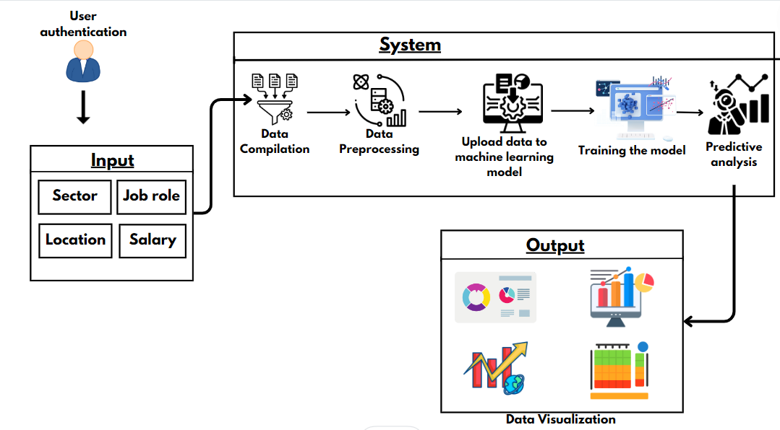
Proposed System Design
Notes:
10

Slide 11
Framework/Algorithm
User friendly website along with easy to access dashboards and reports of prediction through data visualization.
Customized predictions based on the sectors like technology, healthcare, finance and manufacturing along with job role and designation.
Location based detailed insights of the job role in the particular sector, enabling localized insights into job market trends.
The system uses advanced machine learning model SARIMA to predict job trends based on historical data and identify emerging job roles for long term and short term prediction.
The proposed system incorporates user feedback to refine and improve the system’s features and usability.

Slide 12
Technology Stack for Proposed System
Data Collection : Web scraping through various platforms like linkendn, Naukri.com, Internshaala etc.
Data preprocessing and storage: Using python and libraries like numpy ,pandas for data preprocessing and MySQL database for data storage.
Machine Learning and Predictive Modeling: SARIMA ( Seasonal Autoregressive Integrated Moving Average) model for predictive analytics using machine learning frameworks like scikit-learn and TensorFlow.
Frontend Development: Developing an user-friendly website using HTML, CSS and Javascript along with React.js Framework.
Data Visualization: Visualization tools like Tableau.
Notes:
12

Slide 13
Details of Database
Data Sources: Data is collected from popular job platforms such as LinkedIn, Naukri.com, and Internshala to gather diverse job market insights.
Data Types: The system utilizes structured data including job roles, salary ranges, geographical locations, required skills, and industry trends.
Database Management System: MySQL is employed for efficient data storage, ensuring organized management of large datasets.
Data Preprocessing: Python libraries like NumPy and Pandas are used for cleaning, transforming, and preparing data for accurate predictions.
Data Volume and Frequency: The system handles large-scale historical data along with periodic updates to improve prediction accuracy.

Slide 14

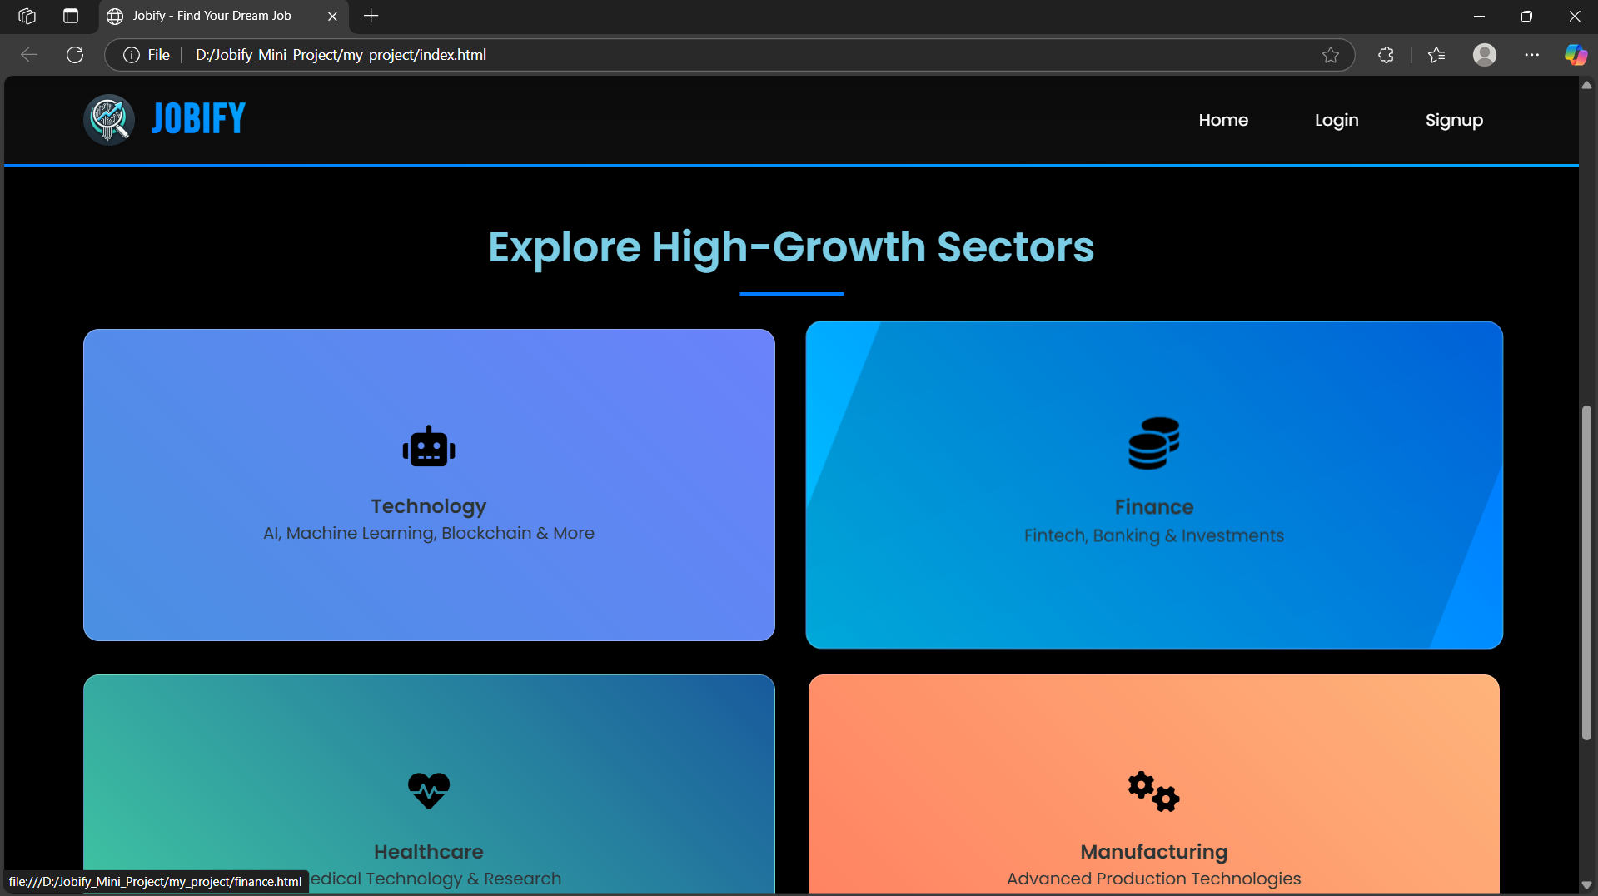
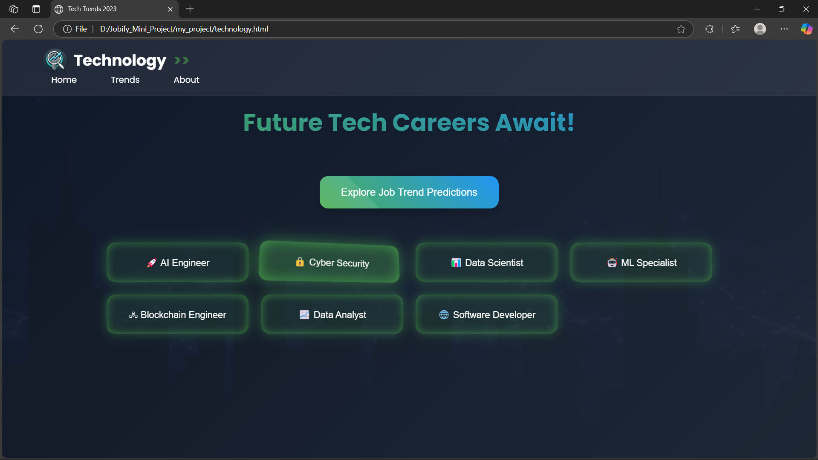
Implementation
Notes:
14

Slide 15
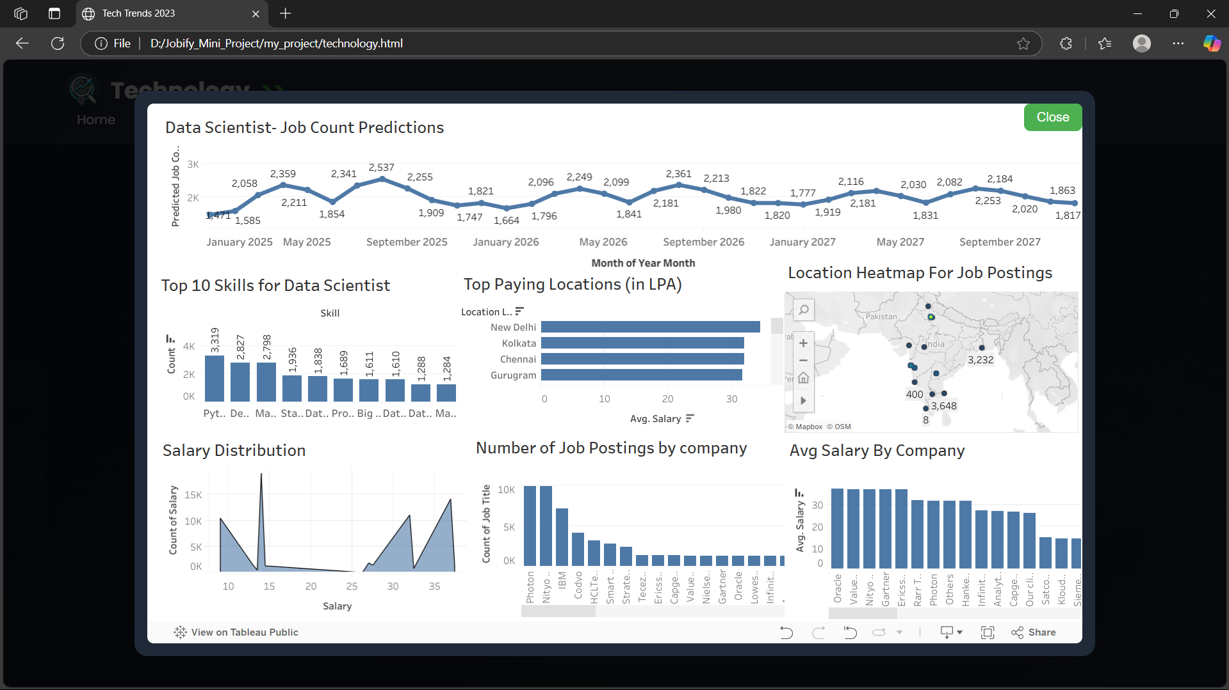
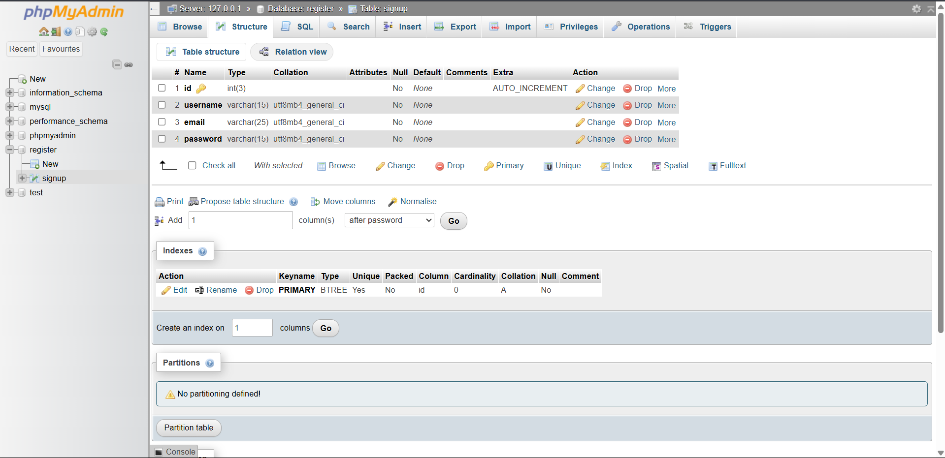

Slide 16
Conclusion
In conclusion, this project can be considered an efficient and a robust system that leverages big data analysis and advanced machine learning techniques to forecast trends in quality-oriented jobs.
This system will identify and highlight key factors driving the demand for quality-oriented jobs, such as technological advancements, economic conditions, and changes in industry standards.
The system will help provide job seekers with insights into emerging job roles, required skills, and salary expectations, helping them align their career paths with future opportunities.
Notes:
16

Slide 17
References
1)N. Ahmed, A. L. C. Barczak, M. A. Rashid, and T. Susnjak, “Runtime prediction of big data jobs: performance comparison of machine learning algorithms and analytical models,” J. Big Data, vol. 9, no. 1,2022. 2)“Job market trends and insights for 2021,” Aston Carter Staffing & Recruiting Services. [Online]. Available: https://www.astoncarter.com/en/insights/articles/job-market-trendsand-insights-for-2021. 3)[20]. M. Scarnò, “Use of Artificial Intelligence And Web Scraping Methods To Retrieve Information From The World Wide Web,” Journal of Engineering Research and Application, vol. 8, 2018. 4)“Predicting the Trends of Quality Oriented Jobs” International Journal of Science and Research(ISJR) 2020. 5)“Artificial Intelligence on Job-Hopping Forecasting: AI on Job-Hopping” Proceedings of PICMET '18: Technology Management for Interconnected World 2018.
Notes:
17

Slide 18
Thank You...!!
Notes:
18

