Slide 1
A.M.S PROJECT
RFID BASED

Slide 2
REQUIREMENTS
HARDWARE
SOFTWARE
Arduino Board
RFID Reader
RFID Tags[5-10]
ESP 8266
Jumper Wires
Buzzer
LEDs
CPU Fan
LCD Screen
Arduino IDE
Web Hosting
Postman (For testing APIs)

Slide 3
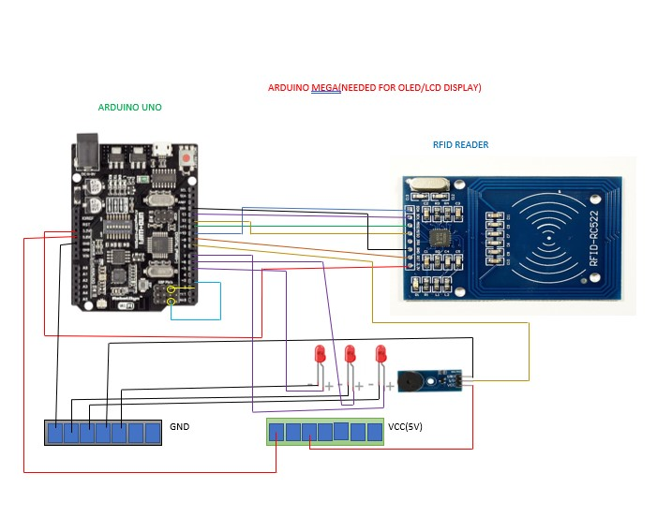
CONNECTION DIAGRAM

Slide 4
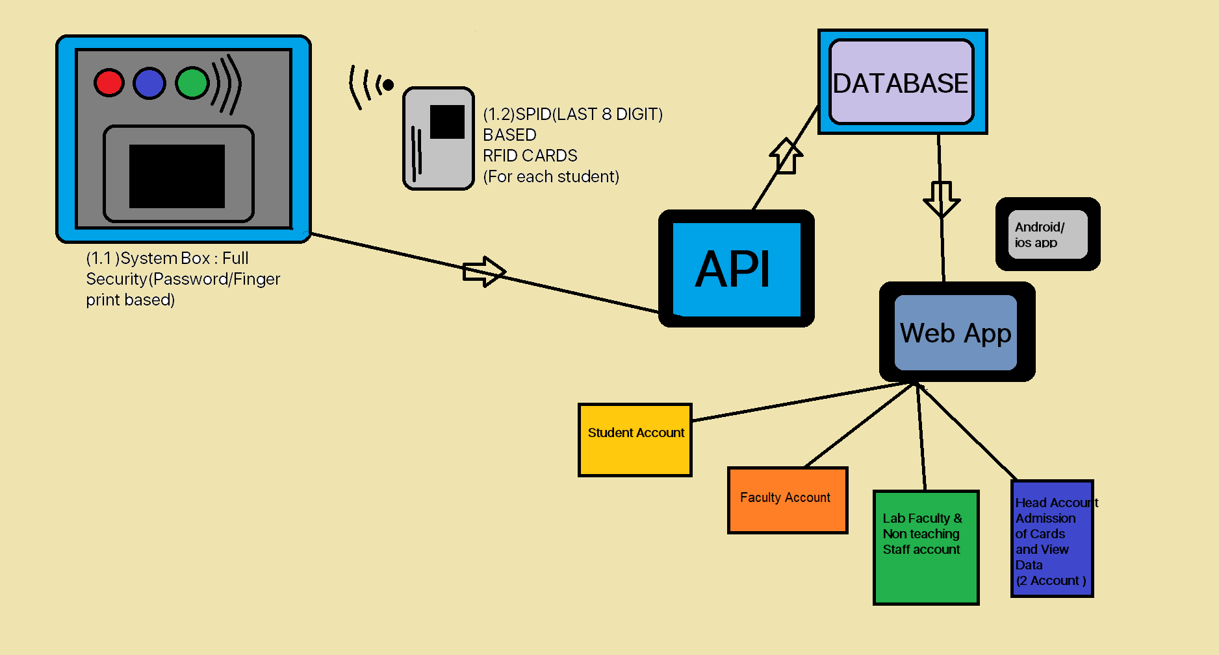
SYSTEM DESIGN

Slide 5
OVERVIEW
8 - digit RFID ID programmed in the card as well as stored in the database.
A blank RFID card is programmed before starting its functionality.
Student details can be inserted in the database through a registration form containing relevant fields
API would validate data
Data transfer flow : Database to ESP8266 to Arduino to LCD screen
LED blinks in various colors will determine the ongoing process in the Arduino.
LCD screen will display the student ID and name to confirm the details scanned from the RFID.

Slide 6
THANK YOU

