Slide 1
ML/AI Microservices
22/11/24 - SEP Project

Slide 2
Image Processing - openCV
Justice Mintah
Preliminary
We primarily used the openCV to handle image processing.
Using cv2 we take in video stream the camera,
in this case the laptop web cam.
Next we resize the image to the appropriate size image the roboflow api expects
Save space and bandwidth.
We then encode the image as a base-64 string ready to be sent over to the roboflox x network.
The roboflow api returns the result and we parse it

Slide 3
Preliminary Neural Network
Kanghyeon Kim
Preliminary
Project name : People counter
Get dataset from Roboflow universe
Train model via yolov11

Slide 4
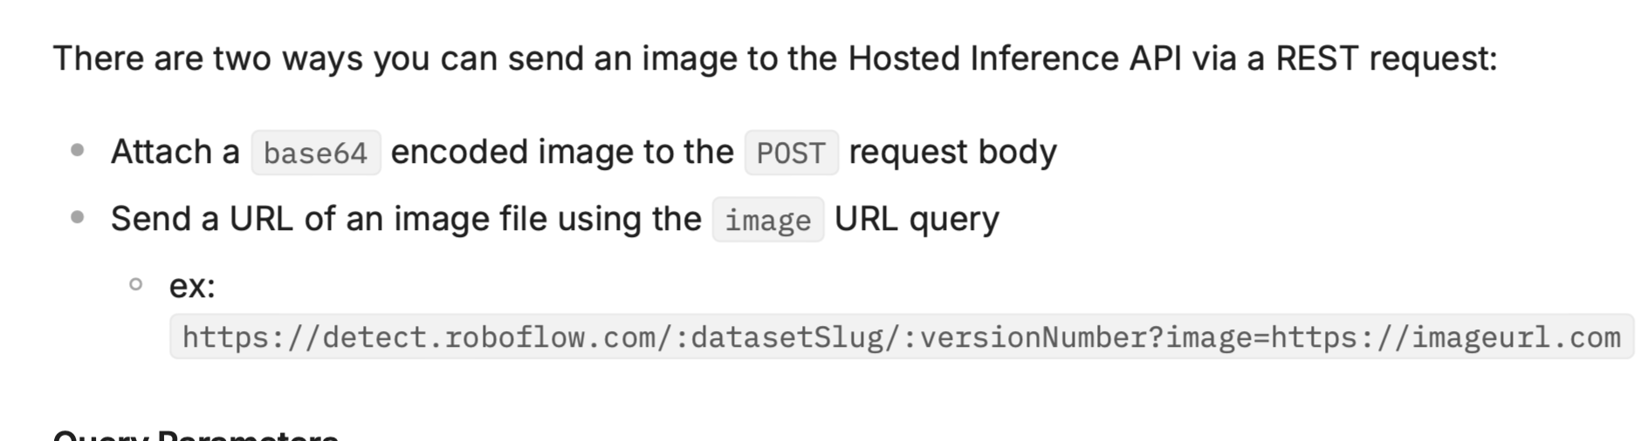

Preliminary Raspberry Pi
Justice Mintah
Preliminary
To run on the raspberry pi the code is mostly the same except it had to be changed a little. There are 2 ways of sending an image to the roboflow api. Instead of encoding the image as a base-64 string, we have to instead upload it as a file in the form of application/x-www-form-urlencoded. Apart from this everything else is the same and the code ran smoothly.

Slide 5
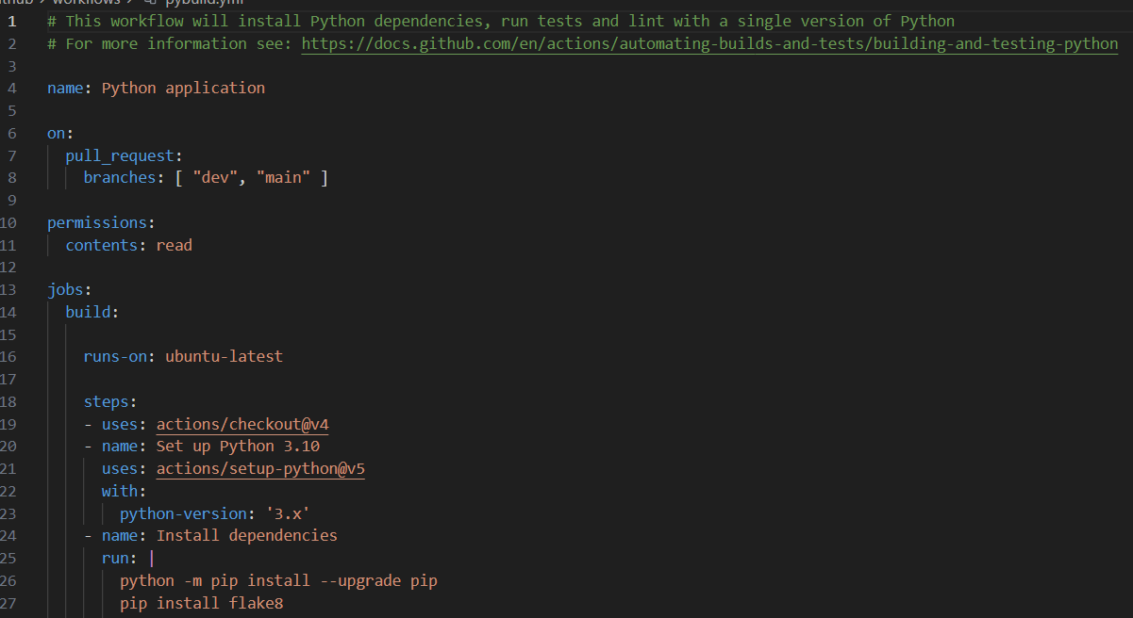
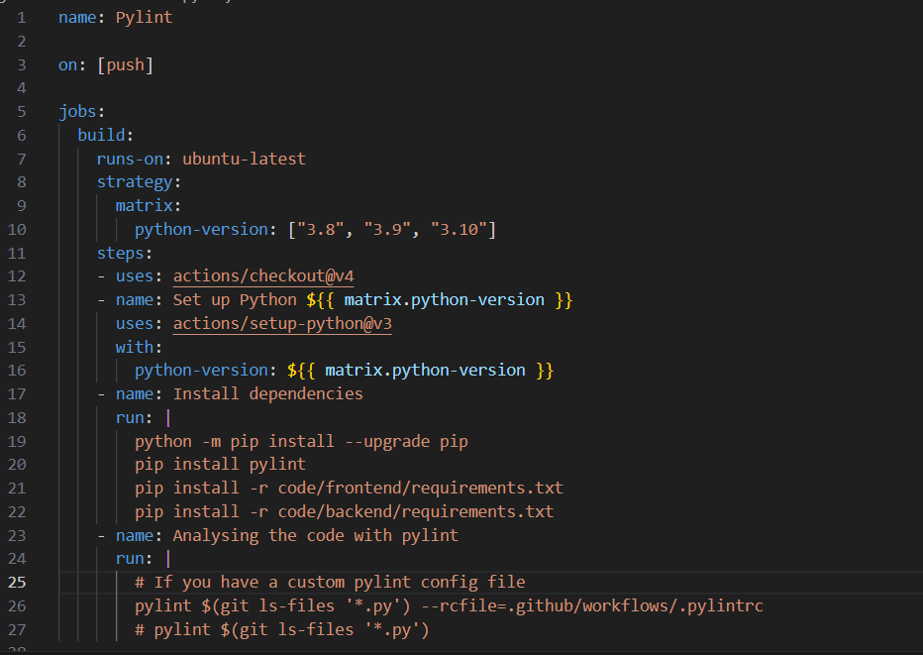
Continuous Integration
Xinyuan Chen
Organisation
On pull: pybuild (Install python dependencies, run tests and lint with a single version of Python)
On push: pylint (checking coding style, detecting errors and helping refactoring)
Pybuild
Pylint

Slide 6
MAIN DEMO
RTSP, Alerts, Trained network, Image preprocessing

Slide 7
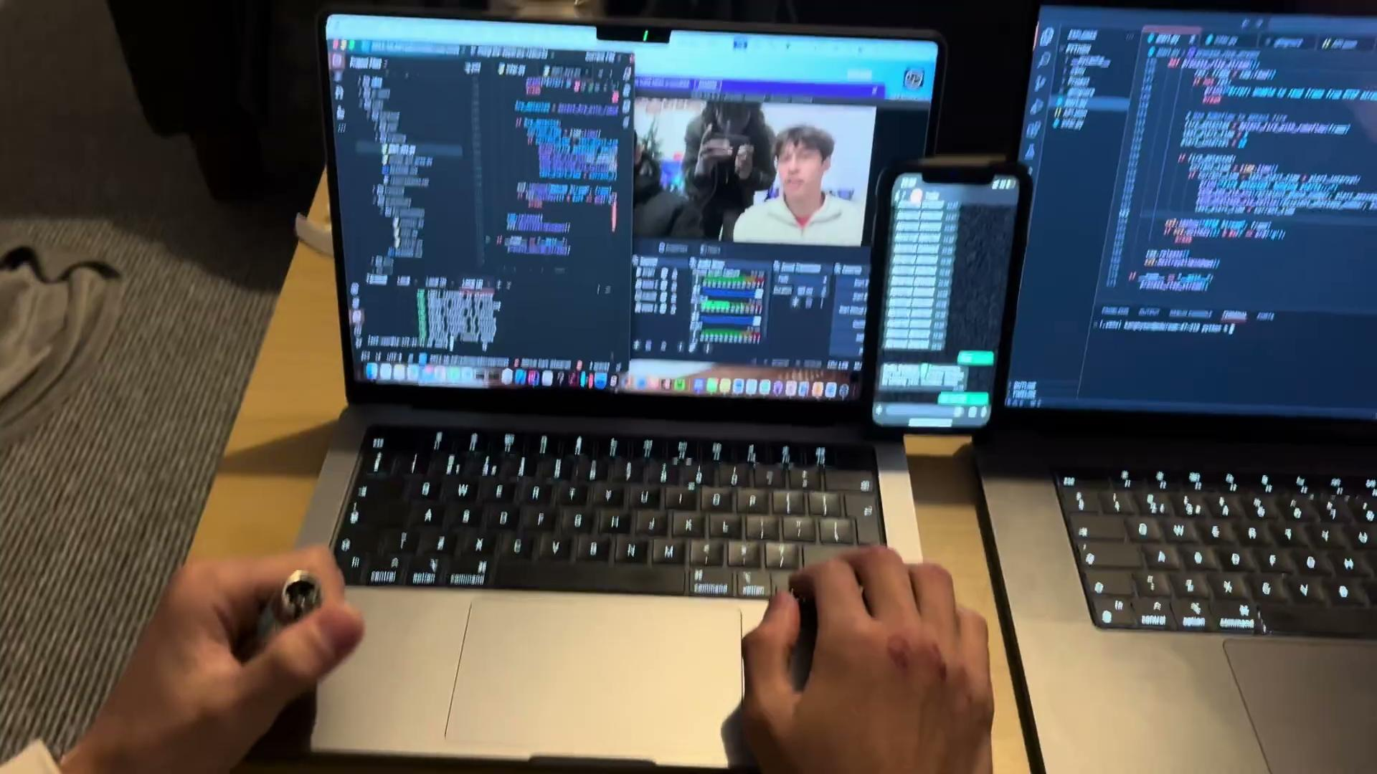
RTSP server on ec2 instance
OBS streams to RTSP on machine 1
Read stream on machine 2
Call roboflow model on machine 2
Model returns predictions
If prediction is made,
Send alert to phone 1

Slide 8
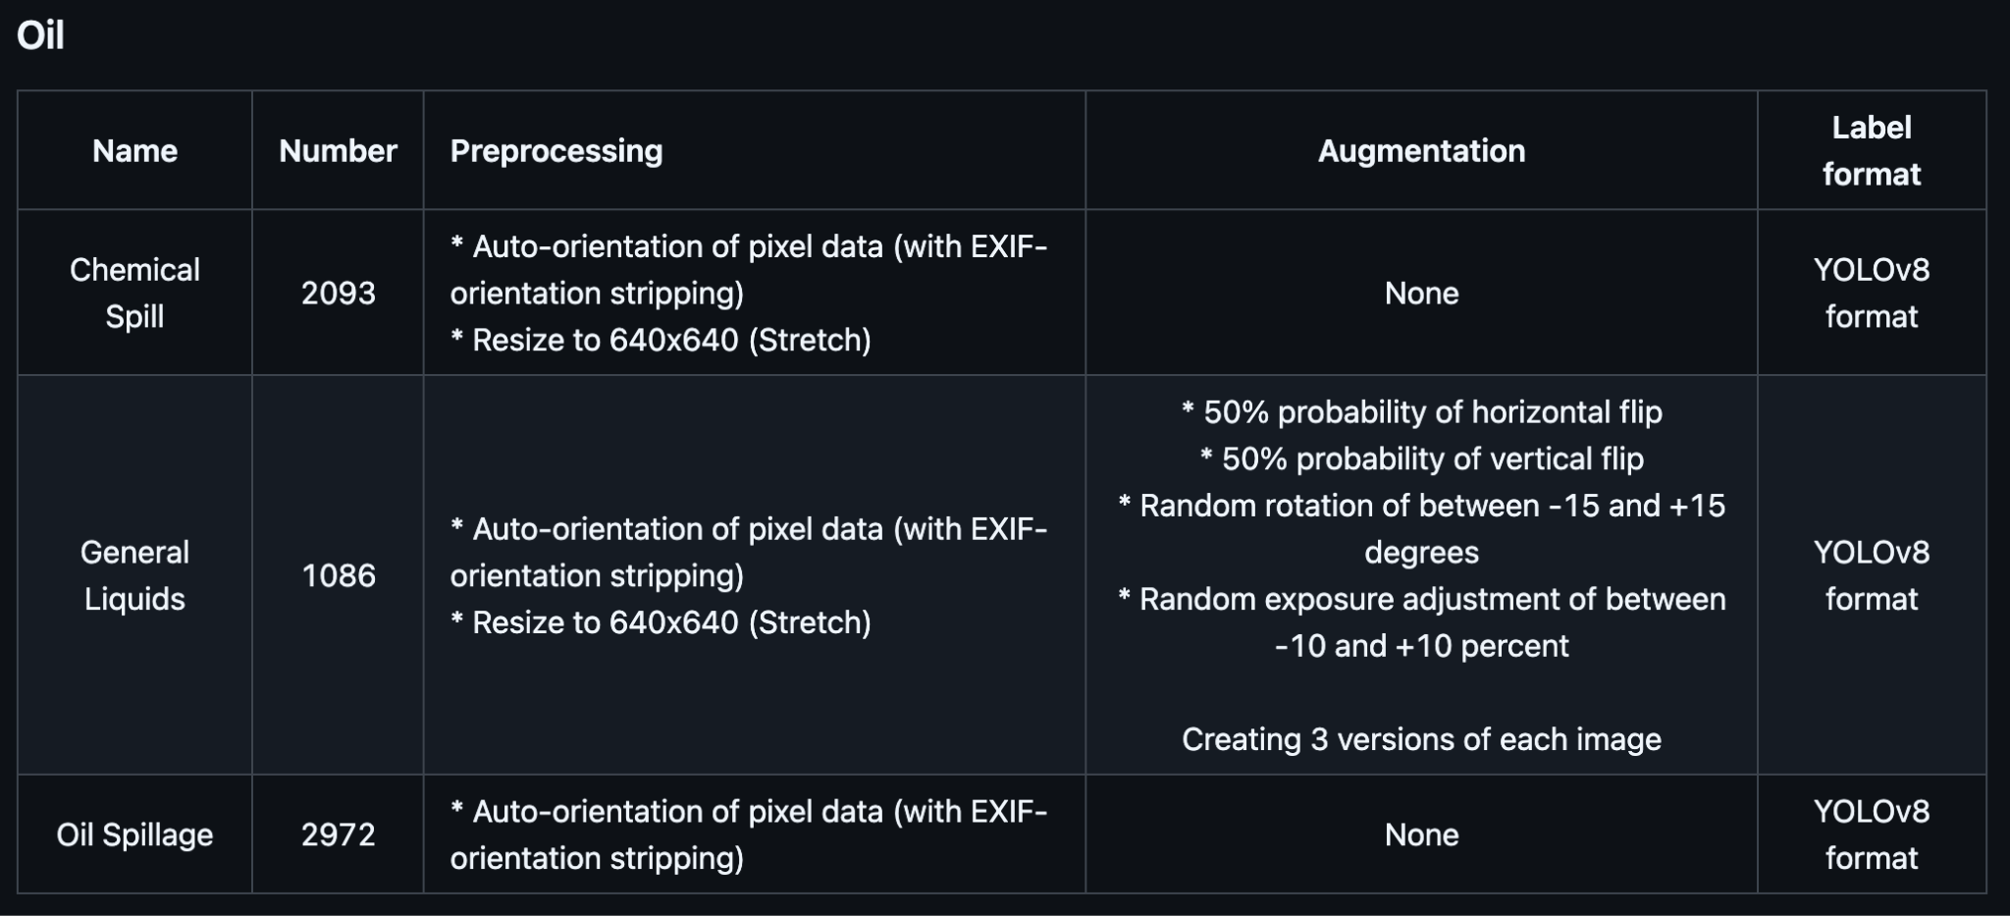
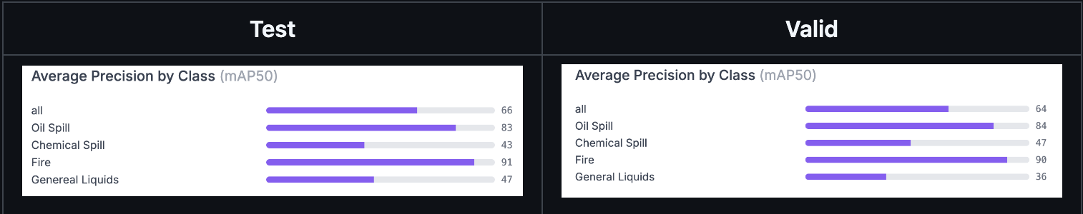
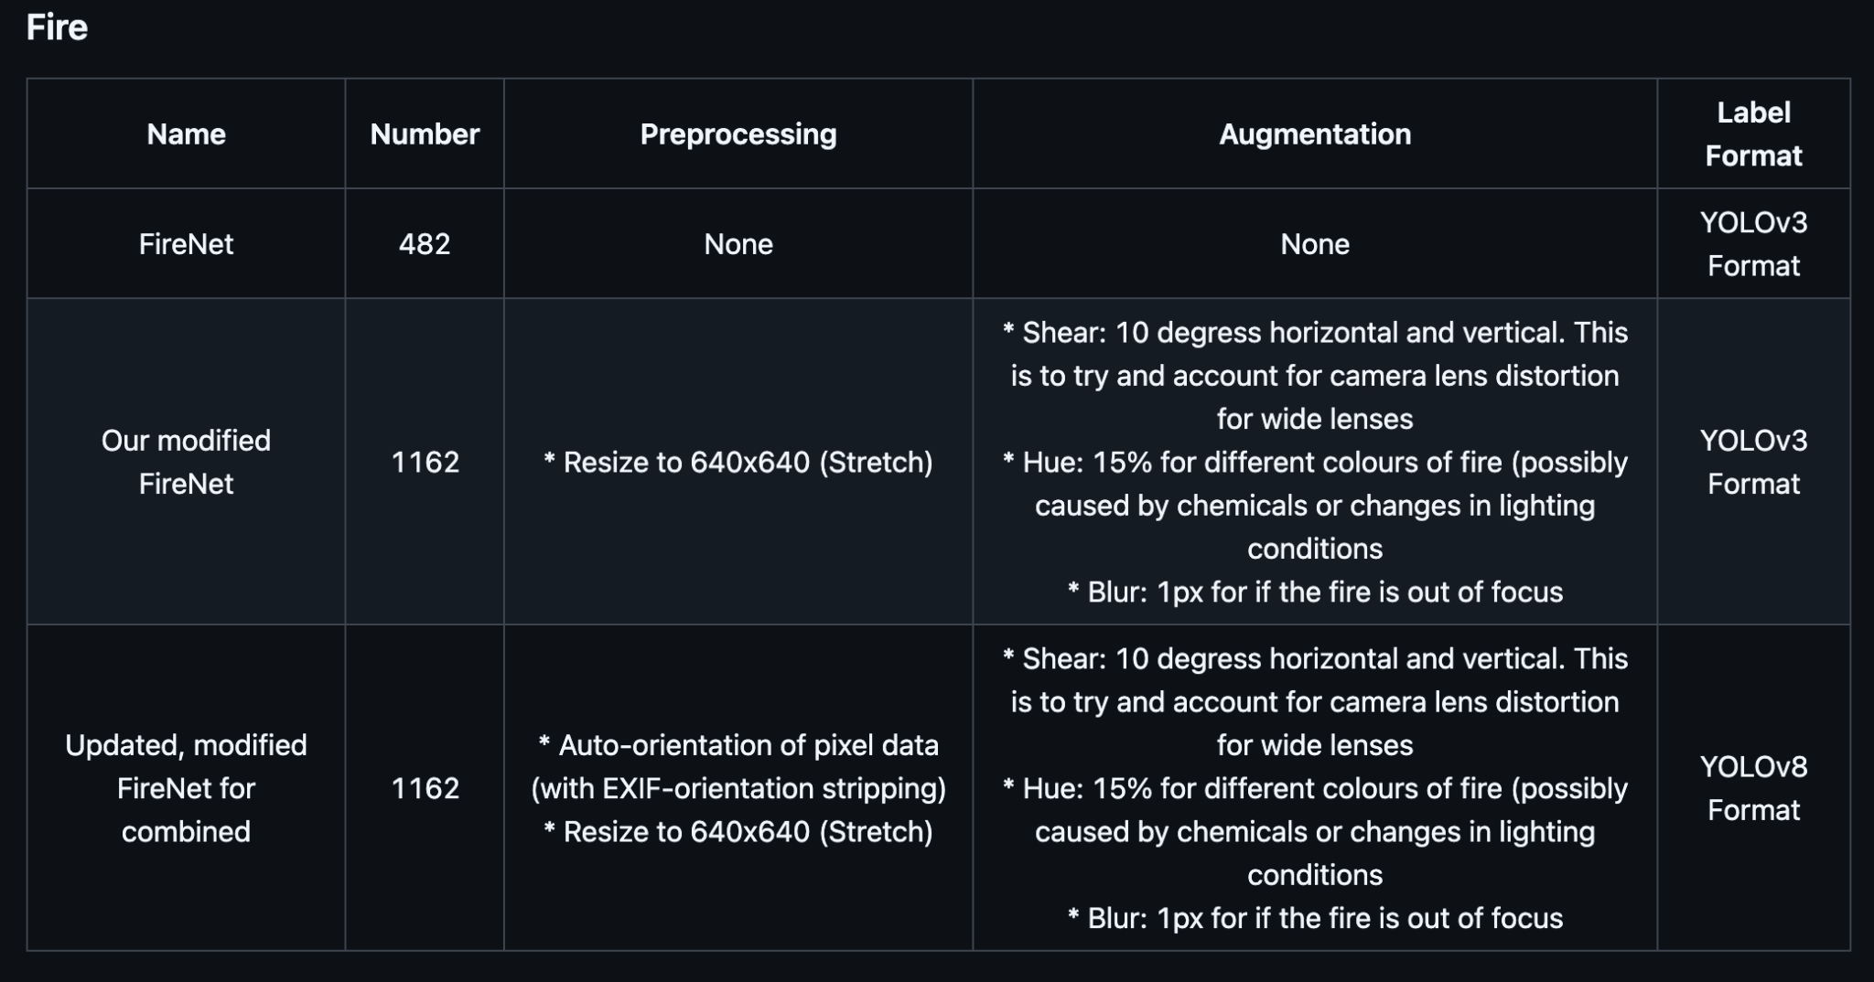
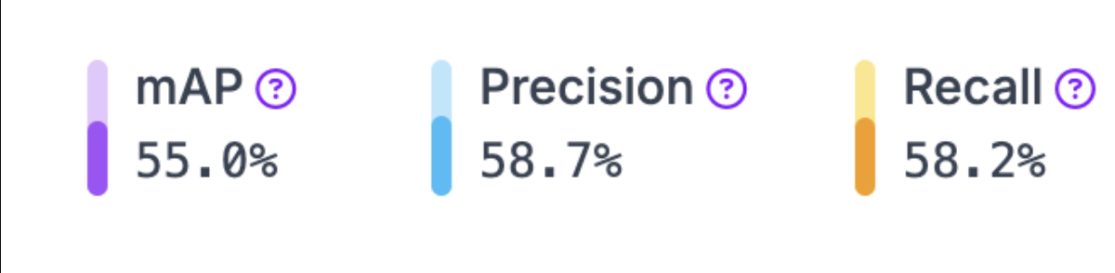
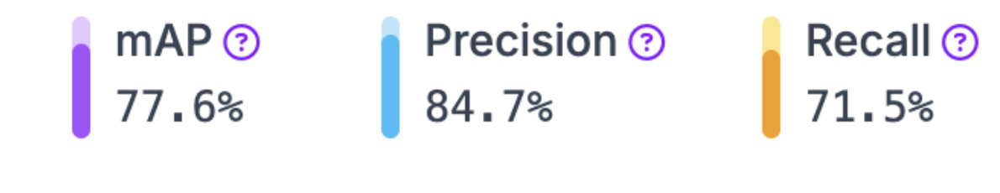
Neural Network Training
Thomas Bale
Back end
Roboflow again
Using yolov11 / v8
MSCOCO objection detection checkpoint
Real data 14/12/24

Slide 9
Alert System
Kanghyeon Kim
Back end
Read frame from the RTSP camera
Send the frame to Roboflow for detecting fire
Get back predictions from the API in the form of a JSON
If the JSON states any predictions:
Send notification to related person

Slide 10
RTSP Streaming
Thomas Bale
Back end
Testing:
Mediamtx for simple RTSP server
OBS studio to stream to RTSP
openCV to take RTSP URL as camera input
For final product:
Intel-based cameras will stream to RTSP
We note their unique RTSP URL
Use this URL for openCV camera input

Slide 11
Figma Designs
Sin Yi Tay
Front End
Main Sections and UI Components
User Authentication
Dashboard (Admin Landing Page)
Configurations Tab
Alerts Console Tab
Action Settings Tab

Slide 12
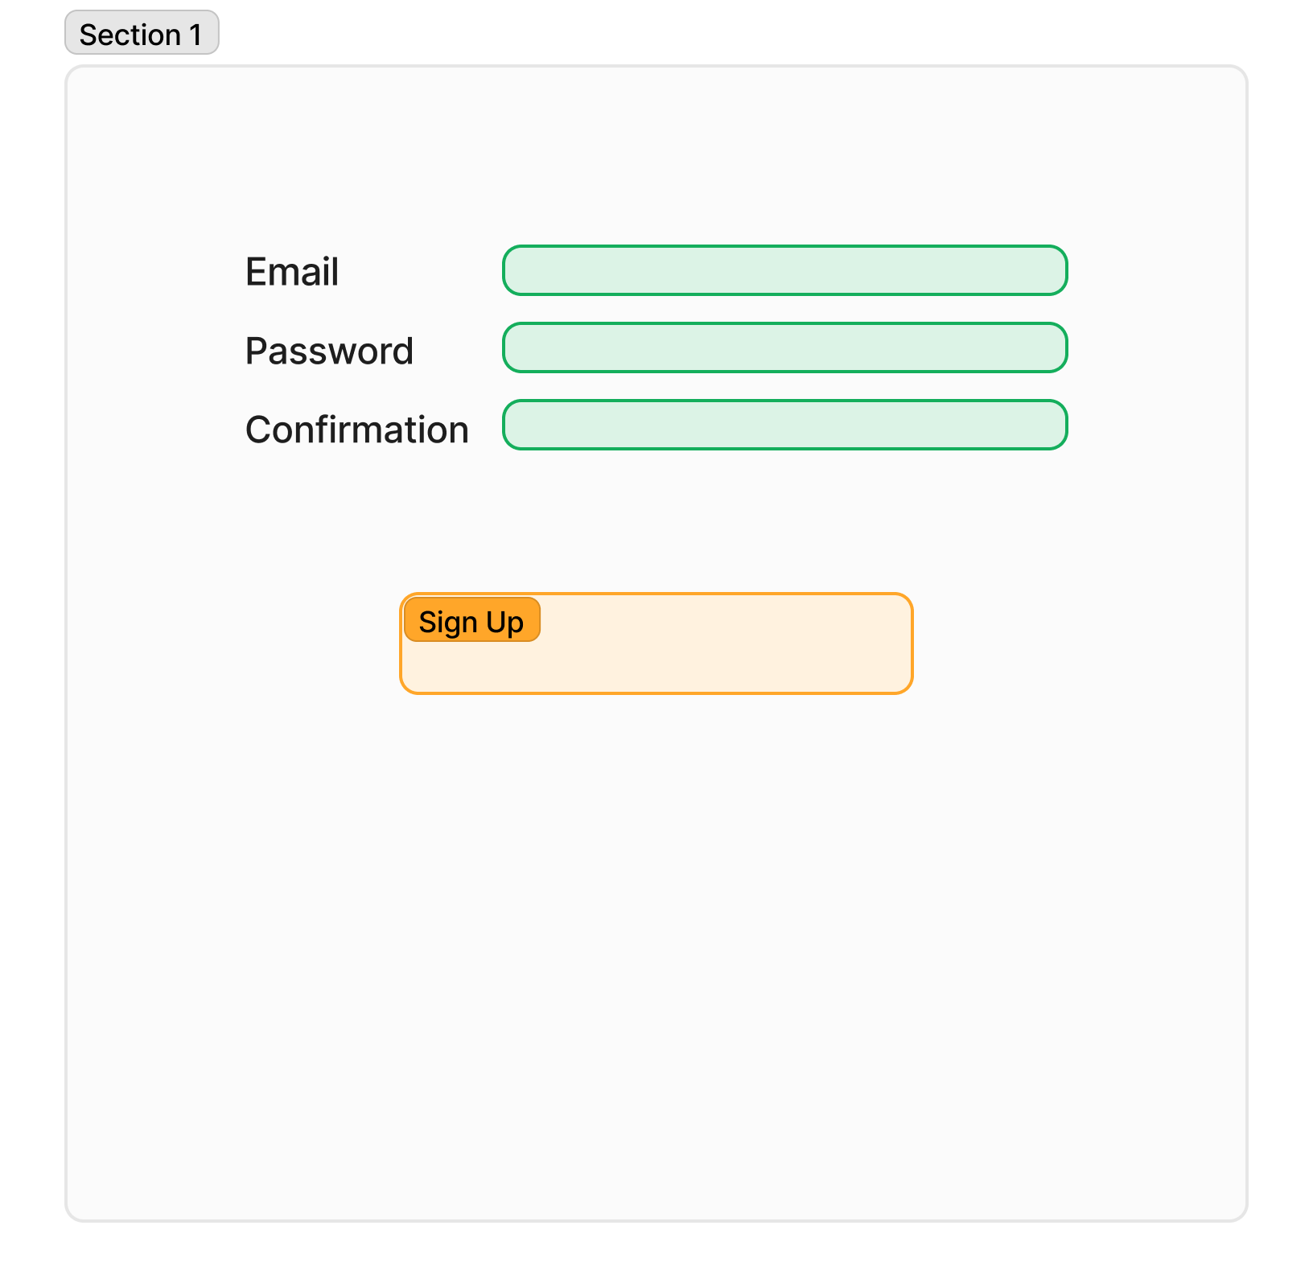
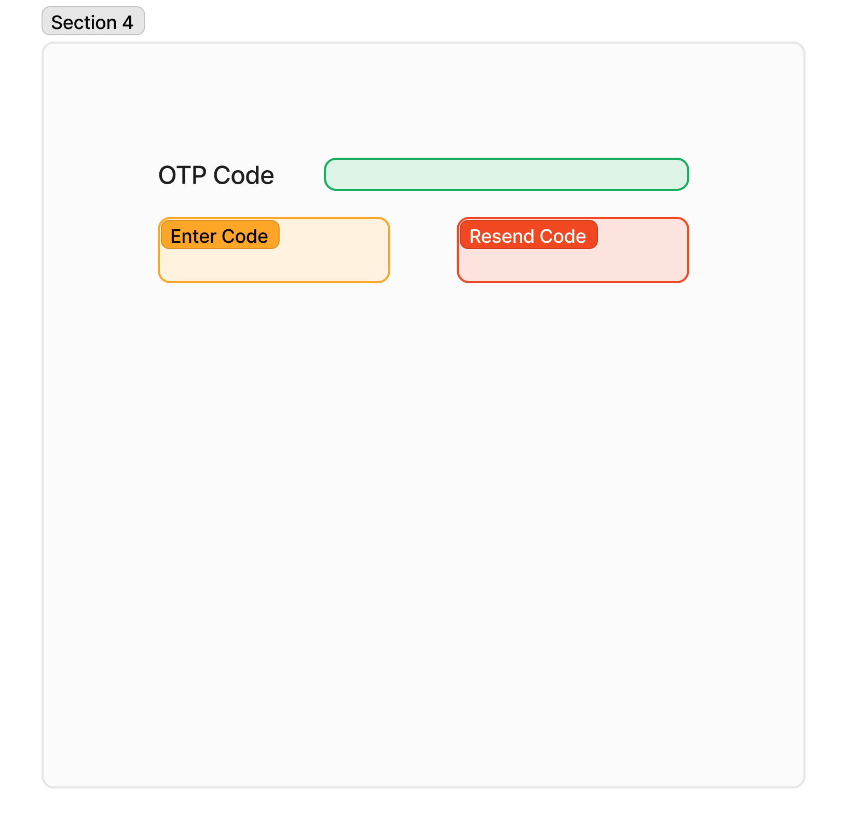
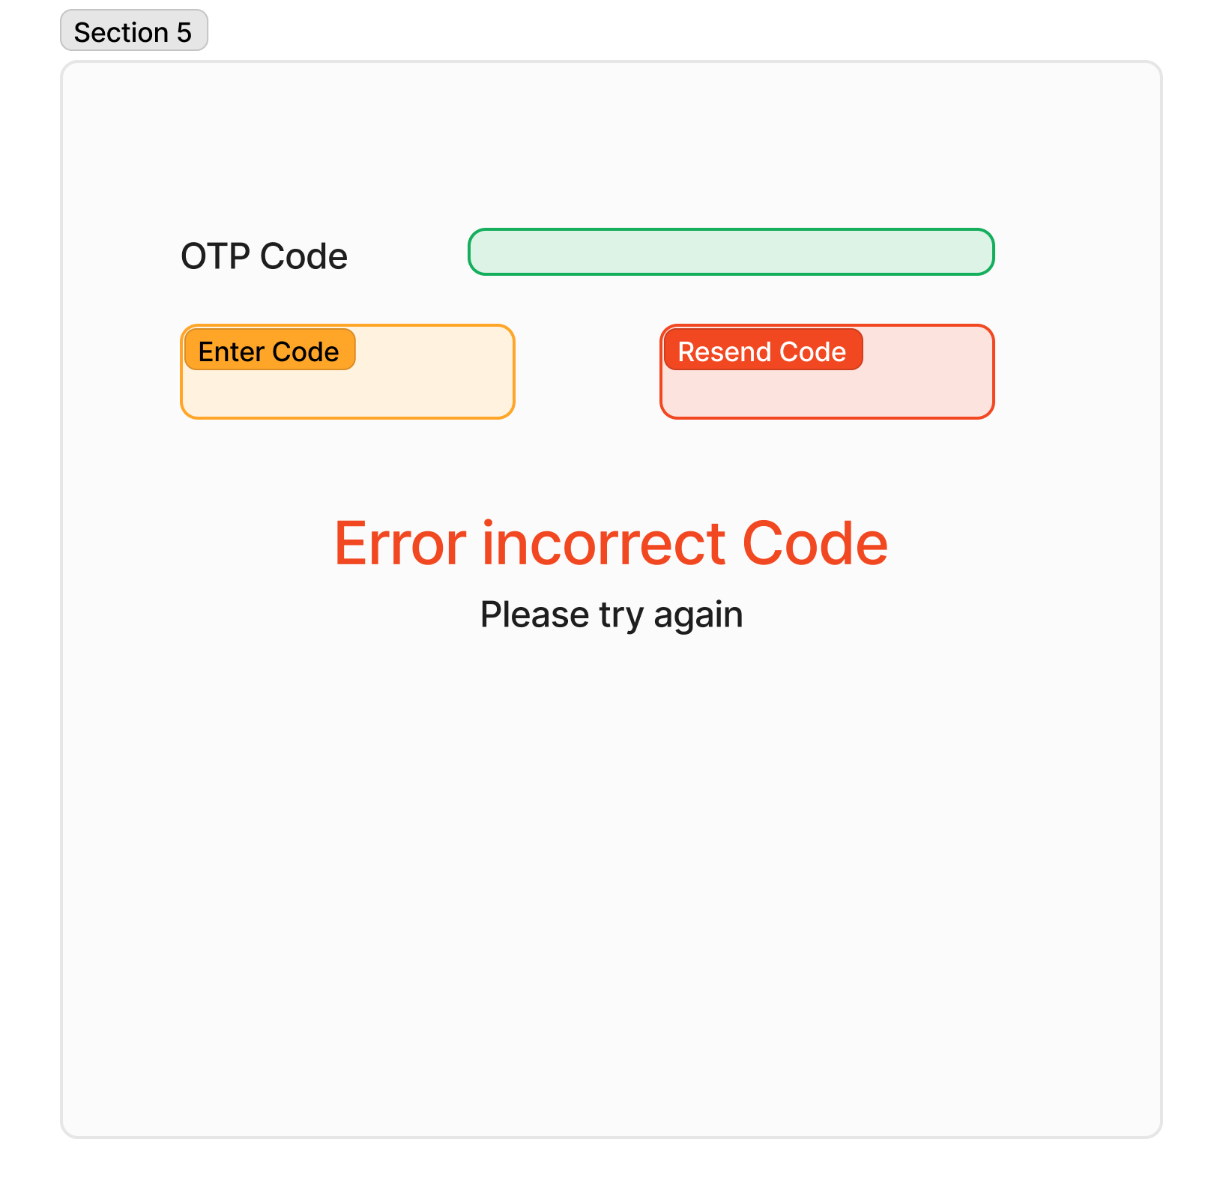
Figma Designs
Sin Yi Tay
Front End
User Authentication

Slide 13
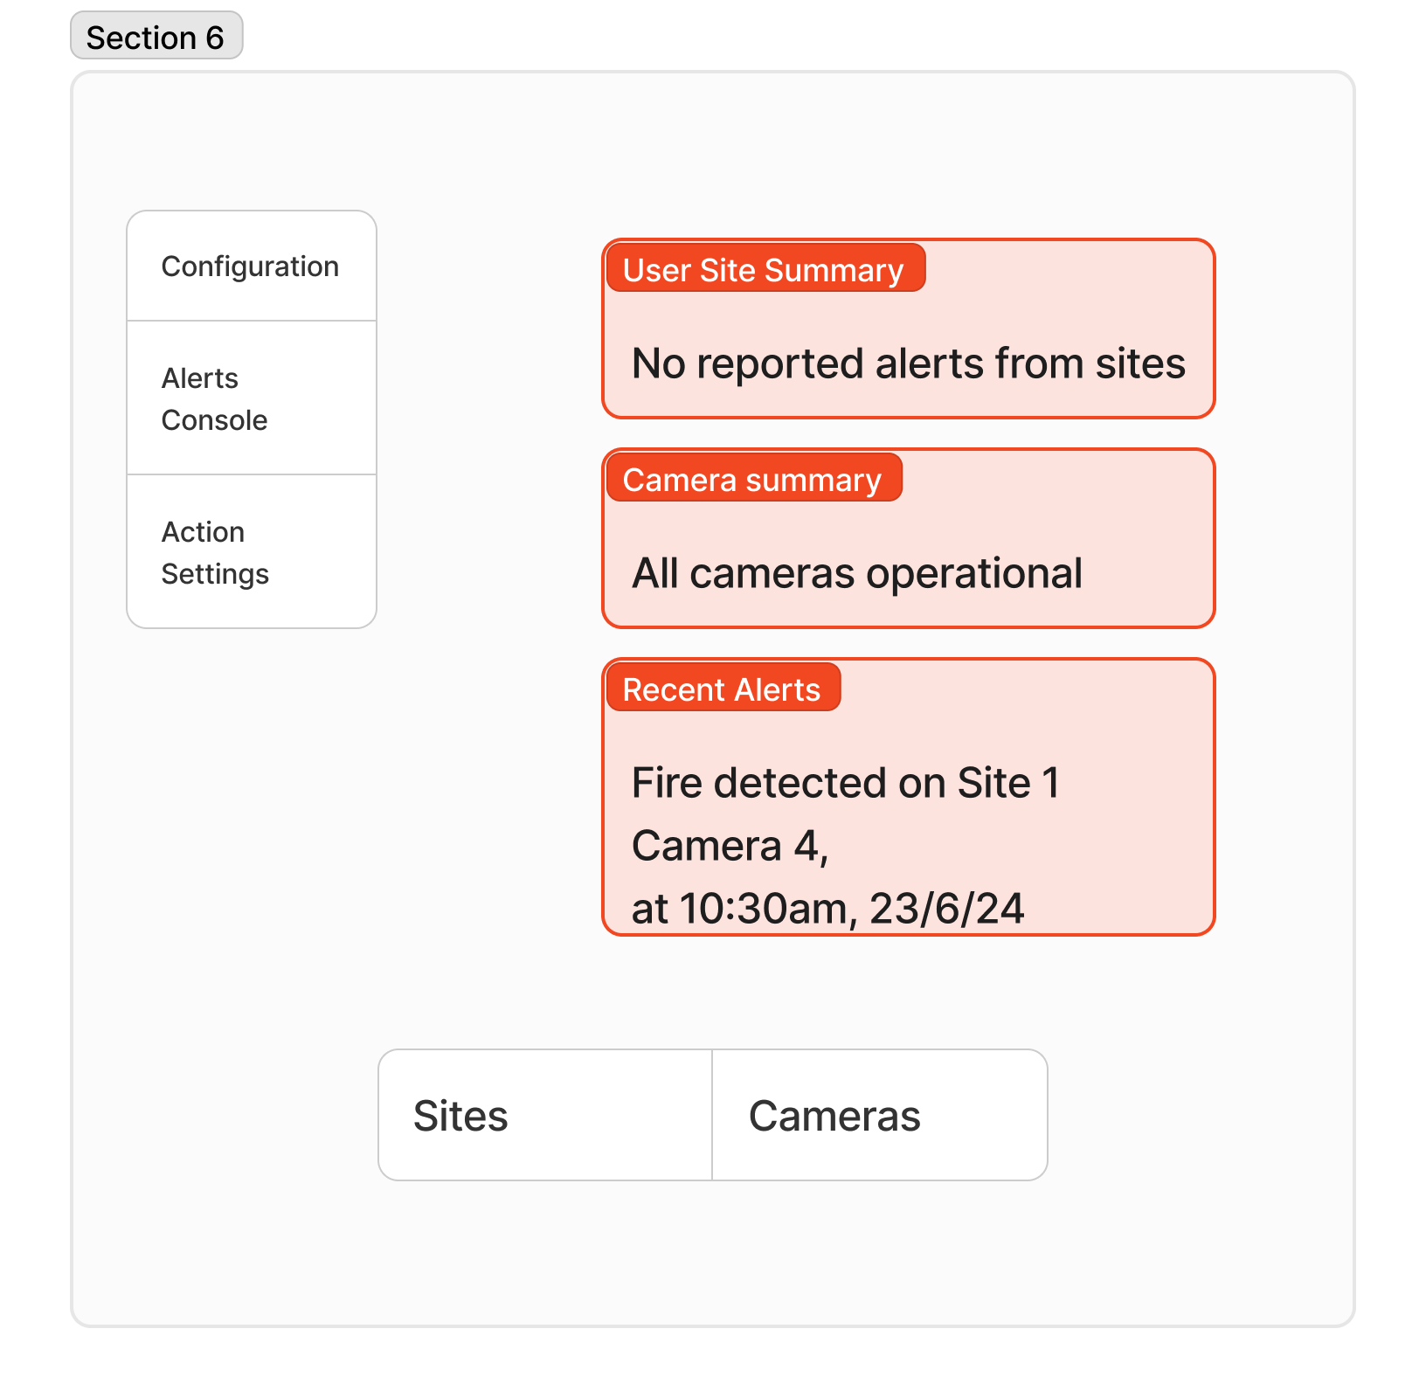
Figma Designs
Sin Yi Tay
Front End
Dashboard (Admin Landing Page)

Slide 14
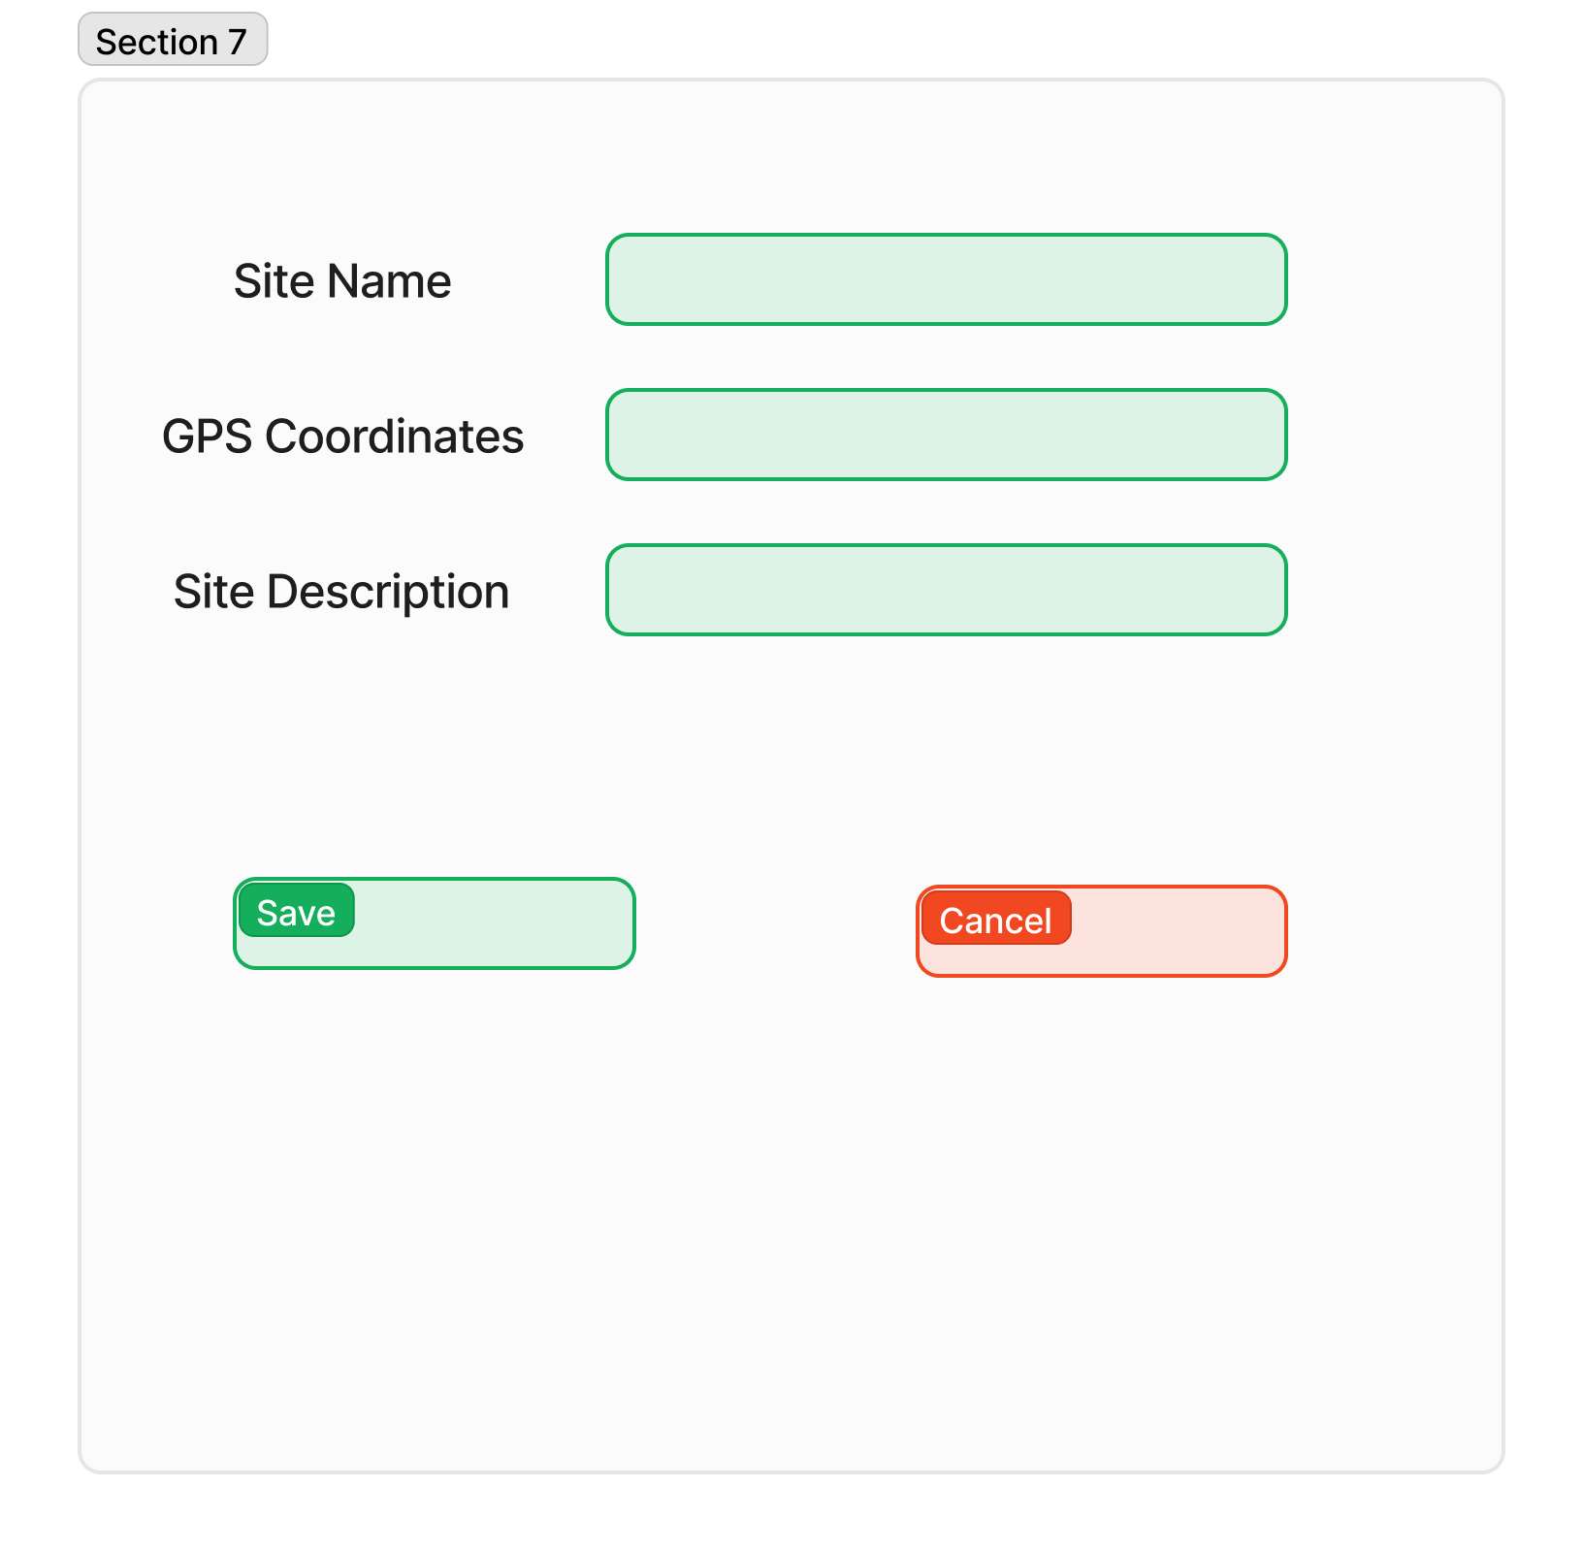
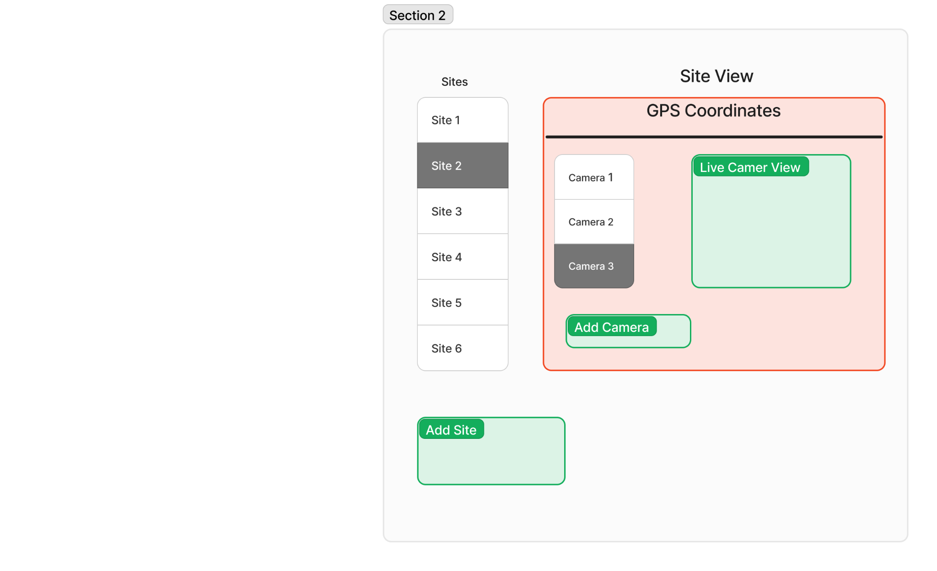
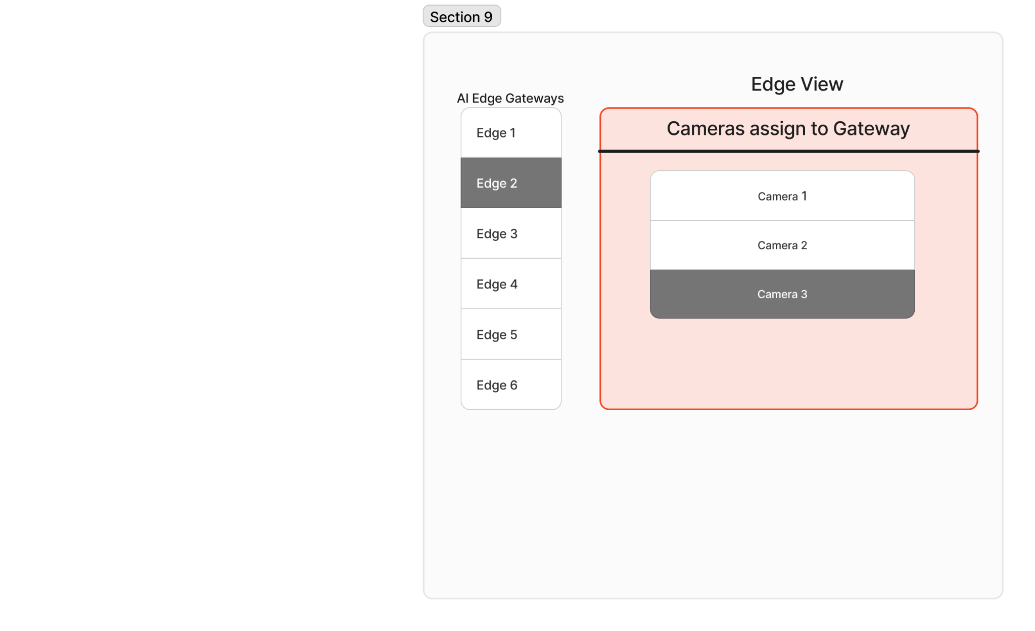
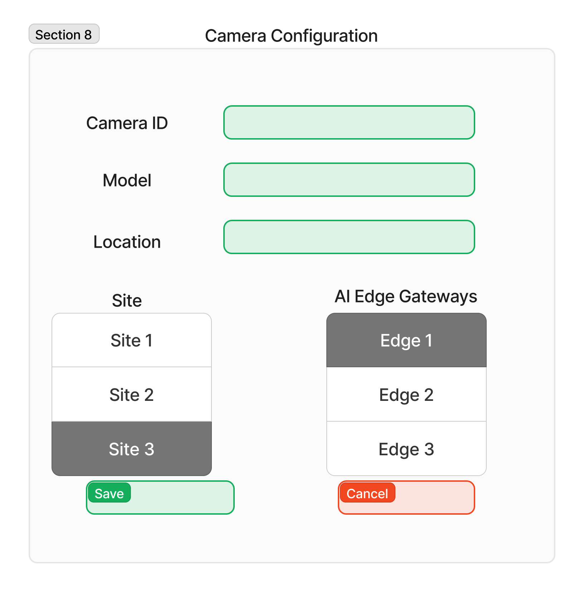
Figma Designs
Site Configuration
Sin Yi Tay
Front End
Configurations Tab
Gateway Mapping

Slide 15
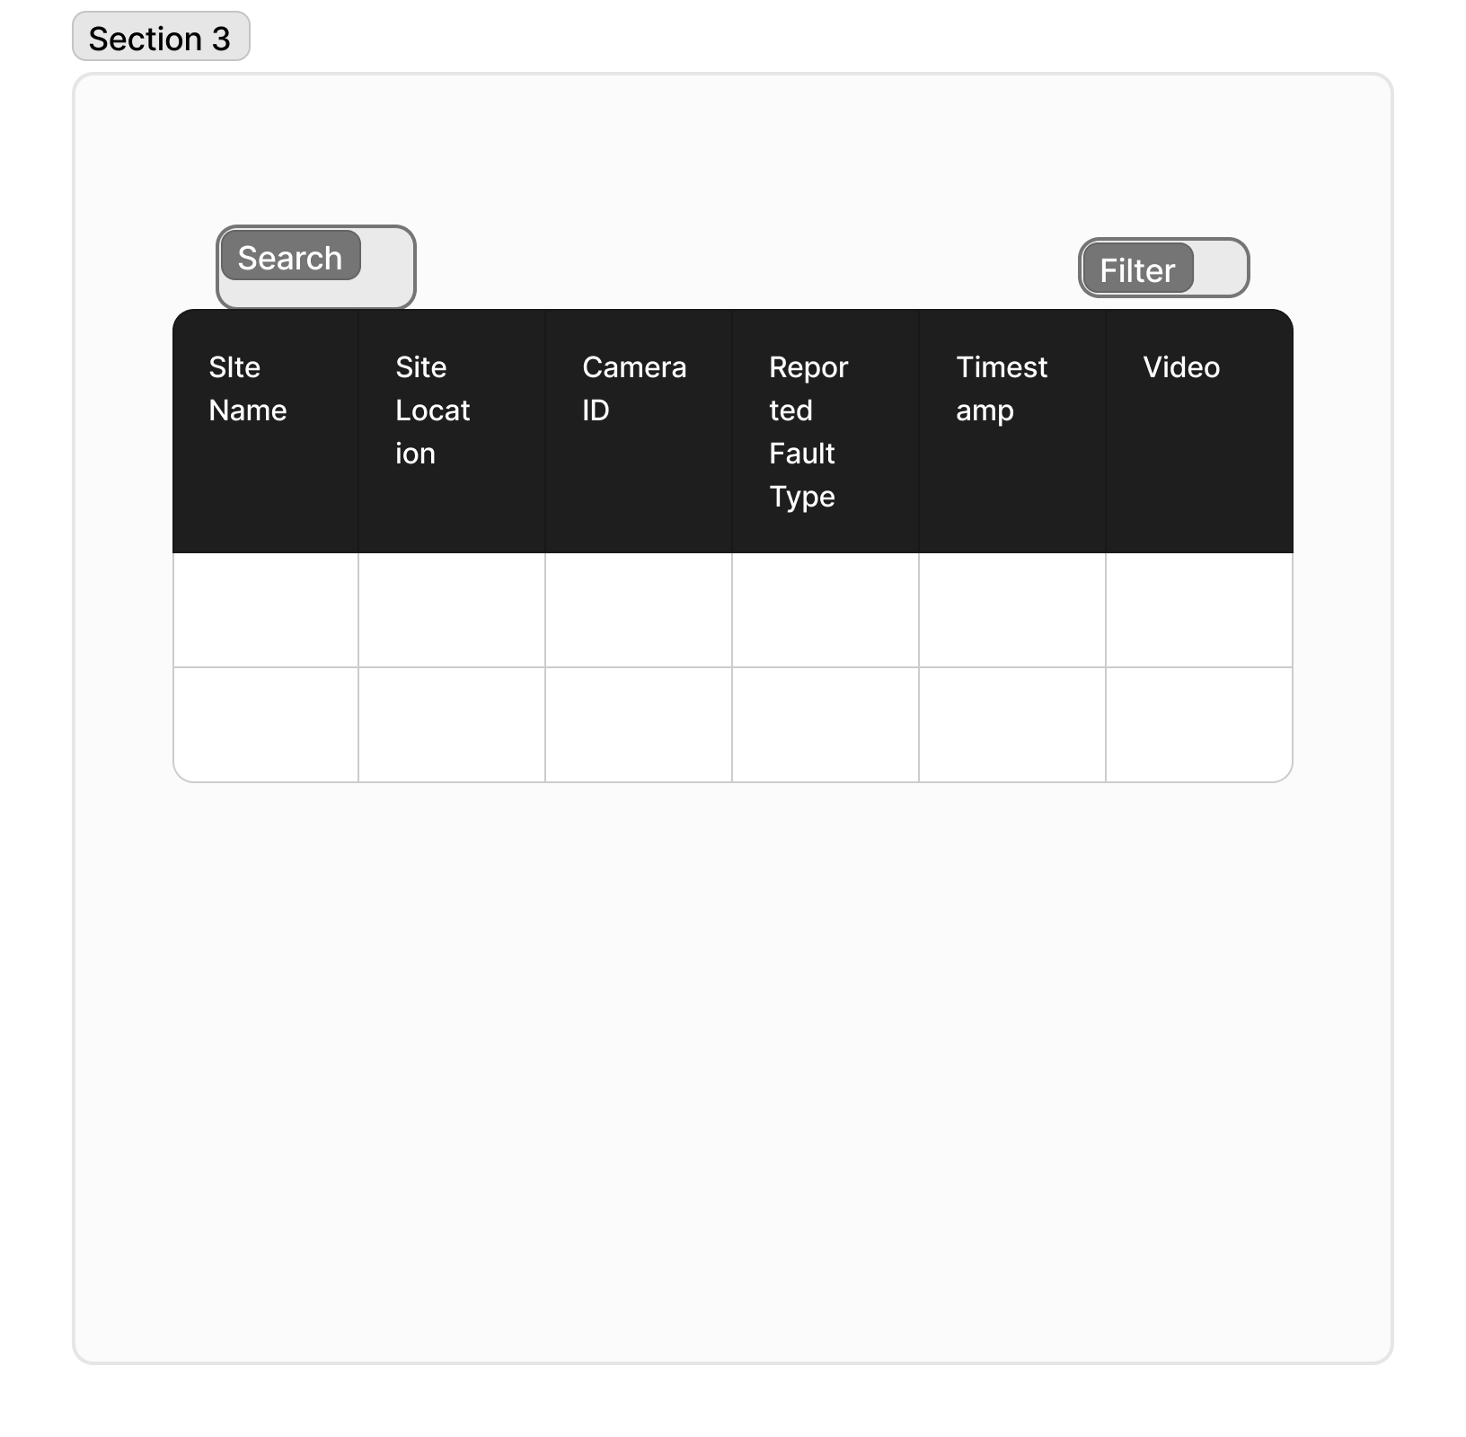
Figma Designs
Sin Yi Tay
Front End
Alerts Console Tab

Slide 16
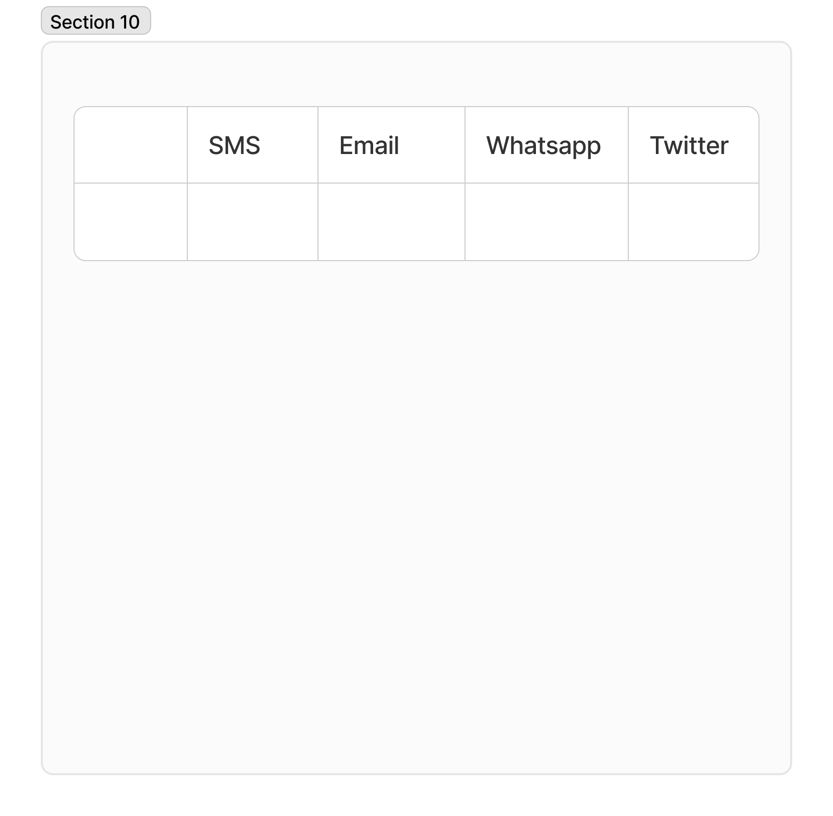
Figma Designs
Sin Yi Tay
Front End
Action Settings Tab

Slide 17
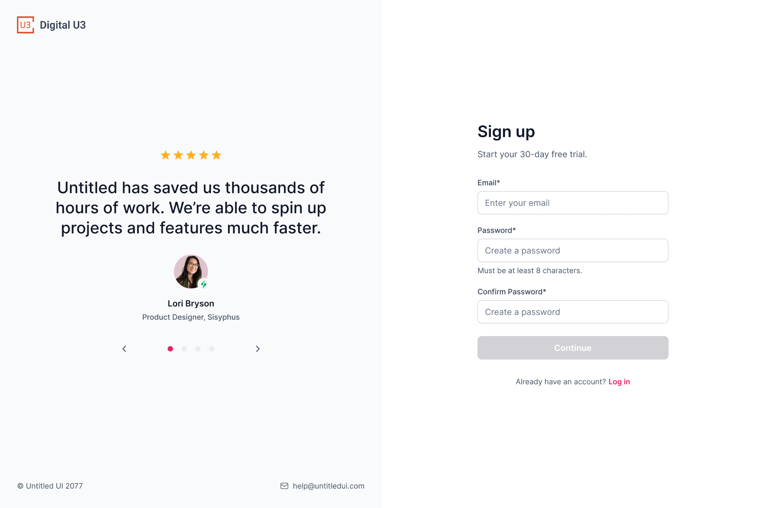
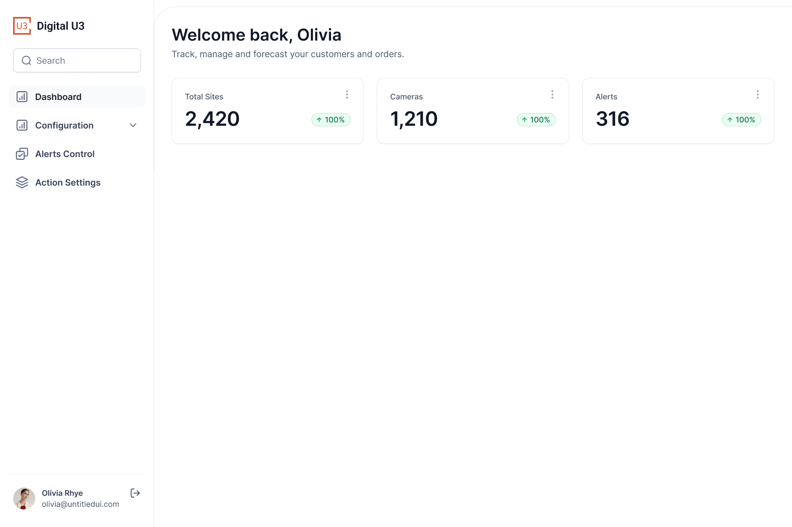
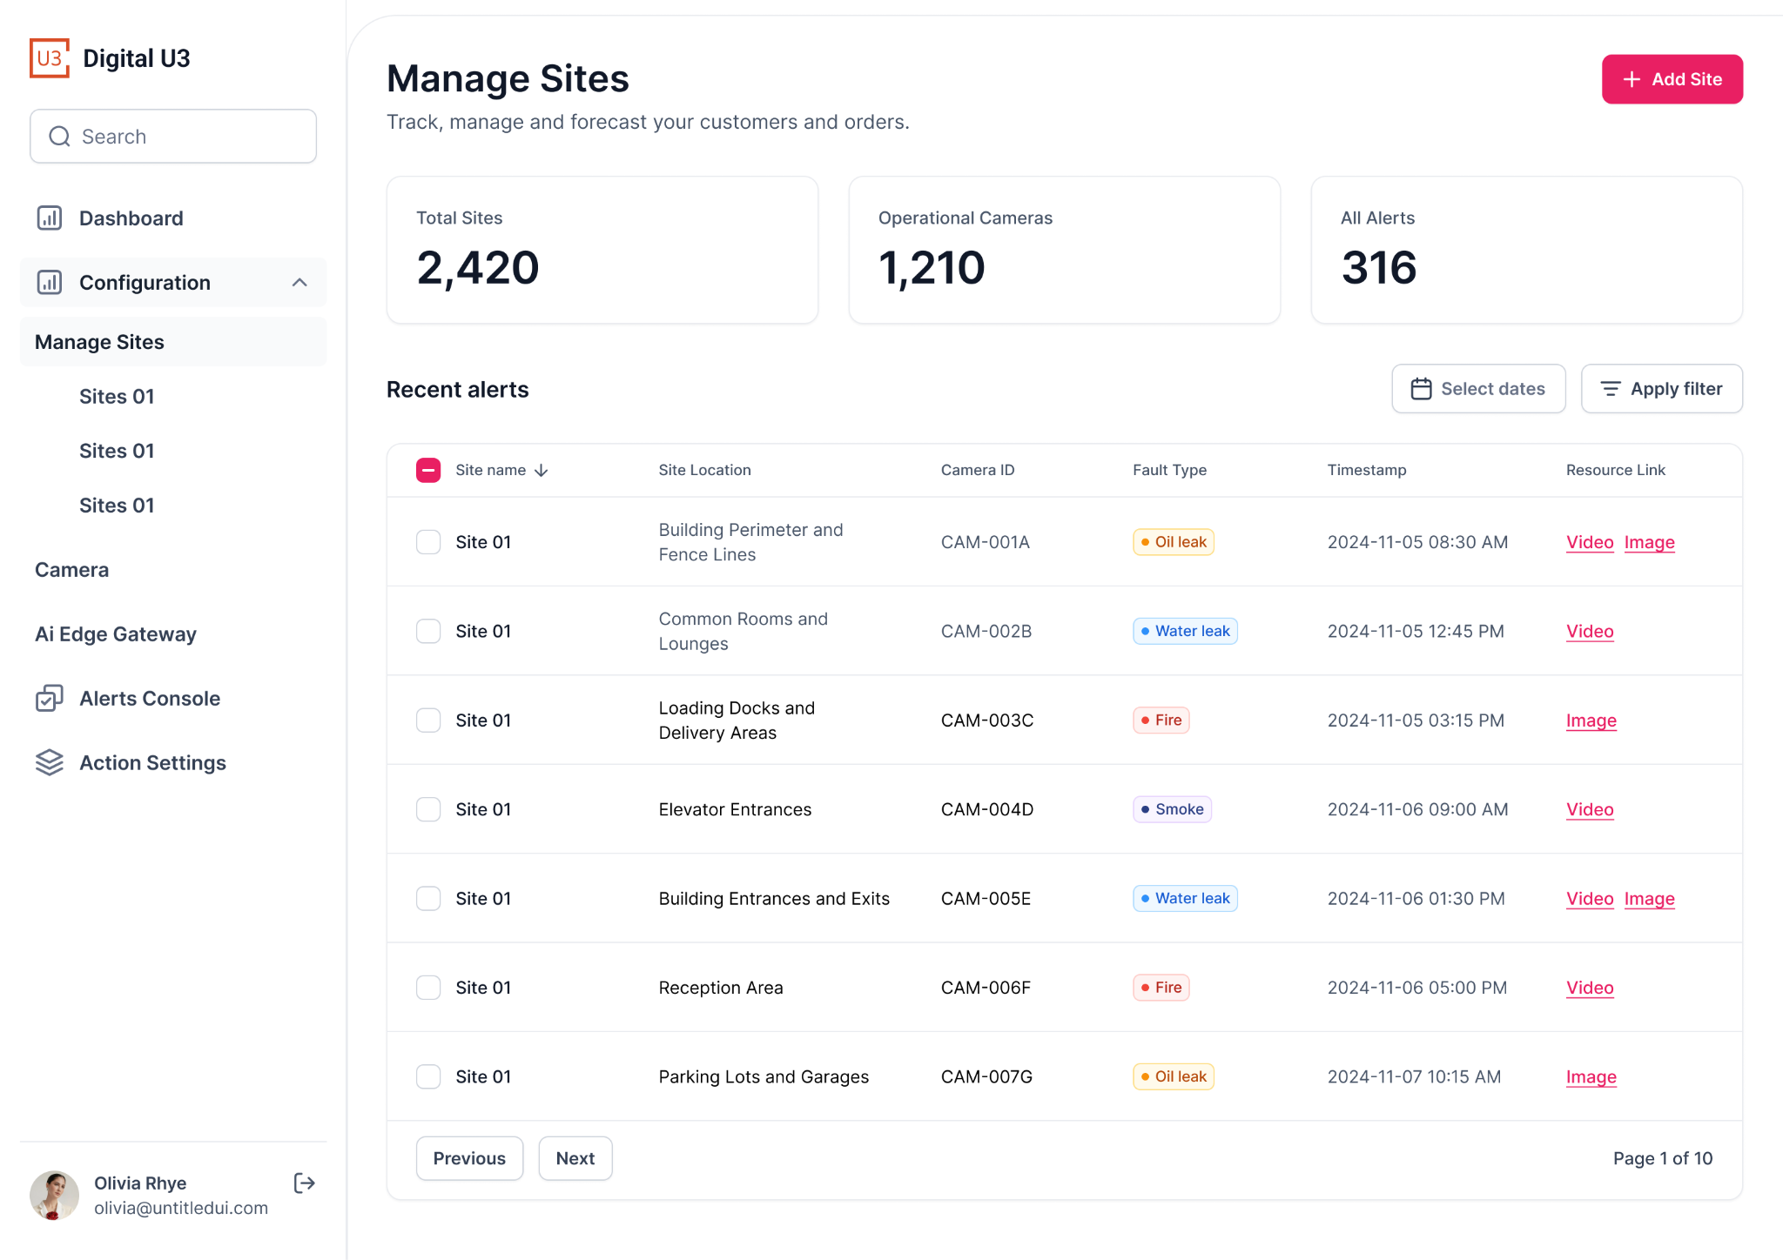
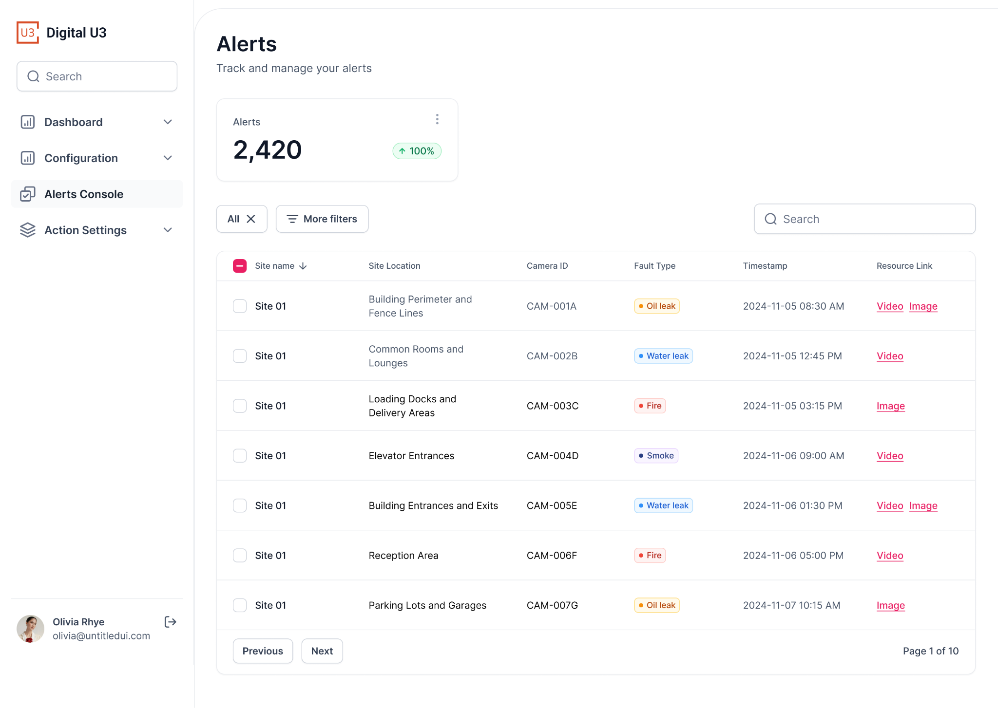
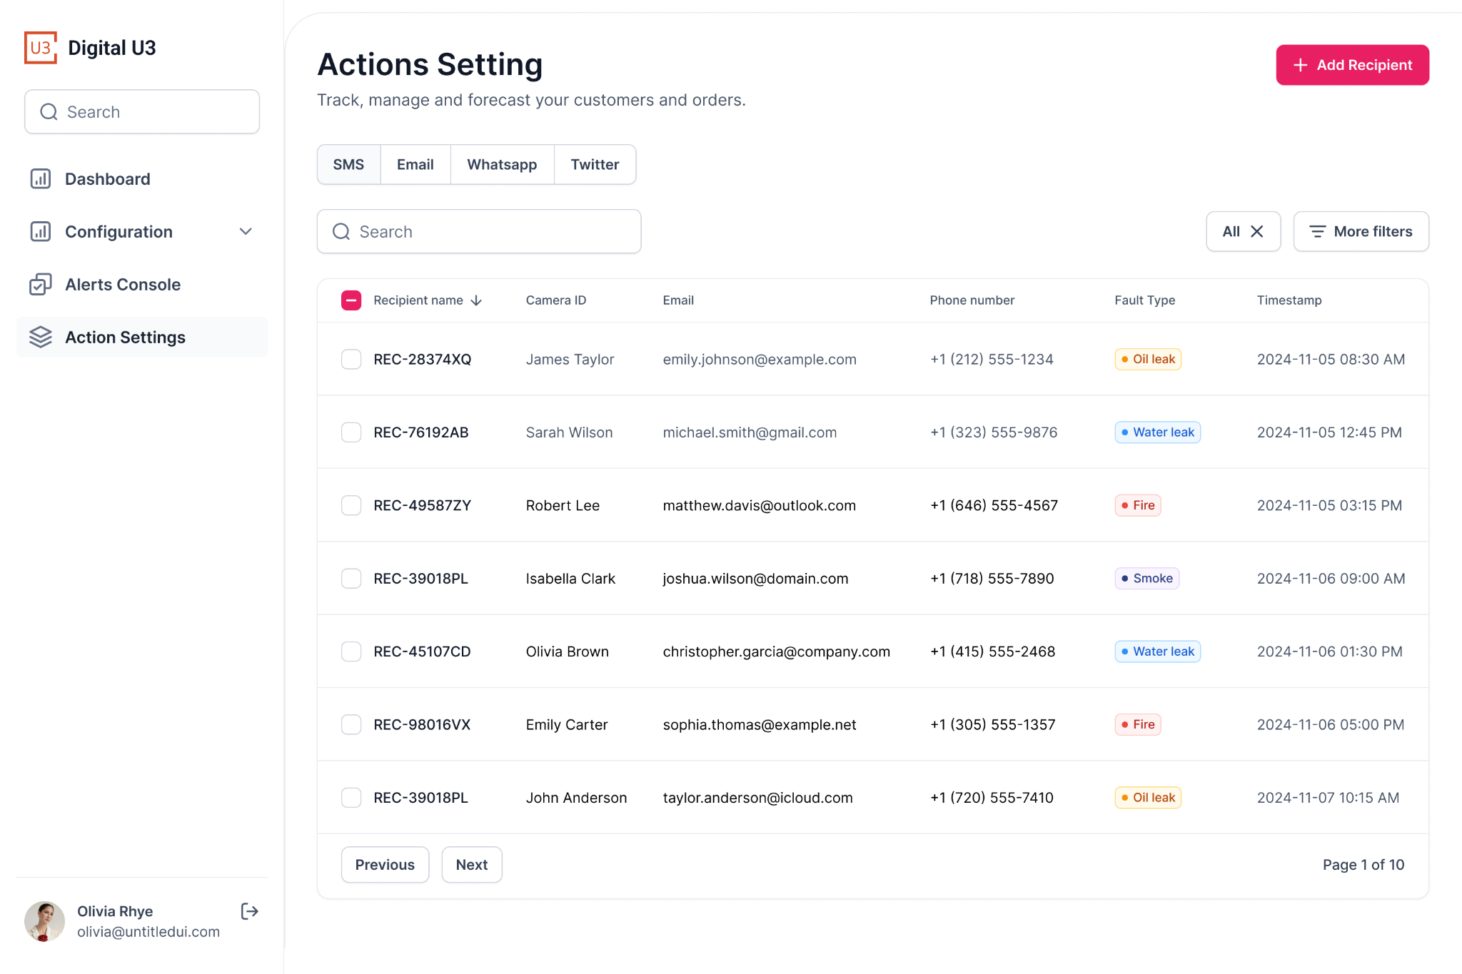
UI Designs
Sin Yi Tay
Front End

Slide 18


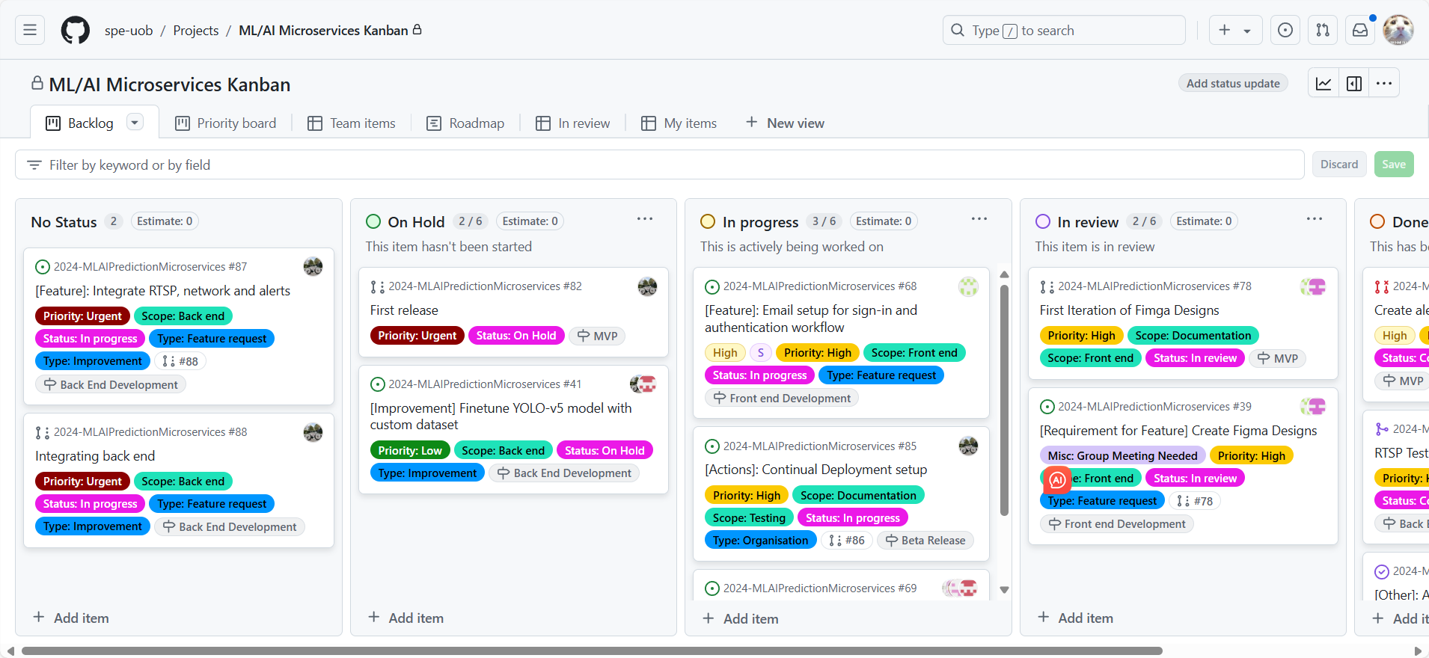
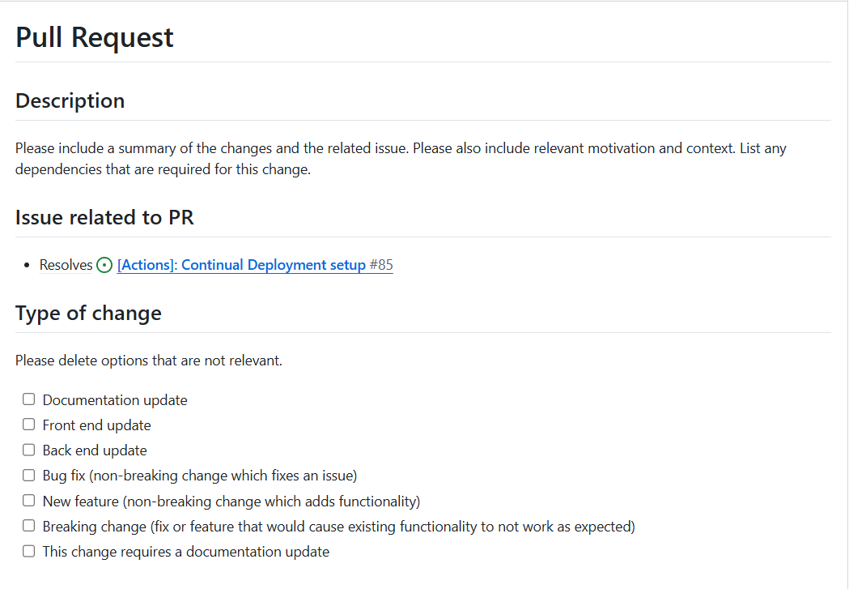
Working as a Team
Xinyuan Chen
Organisation
-We use Discord and Teams to communicate, arrange meetings
-Publishing and distribute tasks through github
-PR templates are used when tasks are finished
-Every PR will be viewed by other teammates

