Slide 1
Intro to gate-based quantum
Single qubit gates

Slide 2
Qubits?
States and representation

Slide 3
The state of a qubit
Quantum computers are made up of qubits, which has a state
Instead of the state of a bit (0 or 1), states of a qubits is a vector
The state of a qubit is a vector in a two-dimensional vector space
No idea what a qubit is physically
state of the qubit could be stored somehow on an electron, or a photon, or an atom

Slide 4
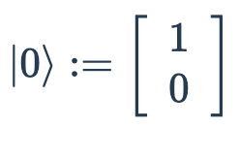
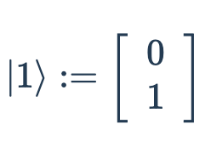
General states of qubits
We have computational basis states
Superposition
Amplitude
Notes:
Superposition:
linear combination of the computational basis states
0.6∣0⟩+0.8∣1⟩ are a superposition
Amplitude
coefficient from the state in superposition

Slide 5
Quantum gate

Slide 6
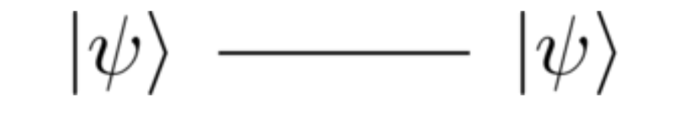
Quantum wires
Notes:
quantum wire represents a single qubit
wire is just the passage of time, with nothing happening to the qubit
Important or special is because we don’t know how to store a qubit.
Hard to represent because we need it to be stored in someone that isn’t easily disturbed, and quite stable
But when its too stable or reacts weakly with other systems then its harder to manipulate the qubits or apple quantum gates to them

Slide 7
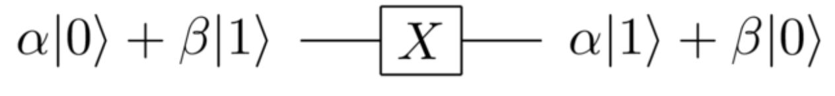
NOT gate - Pauli-X
NOT∣0⟩=∣1⟩
NOT∣1⟩=∣0⟩
Notes:
Write matrix representation
Show that XX = I

Slide 8
Hadamard gate
Hadamard gates expand the range of operations (range of states we can access)
allow computers to move in a way not possible for conventional classical computers
used to (hopefully) solve computational problems faster

Slide 9
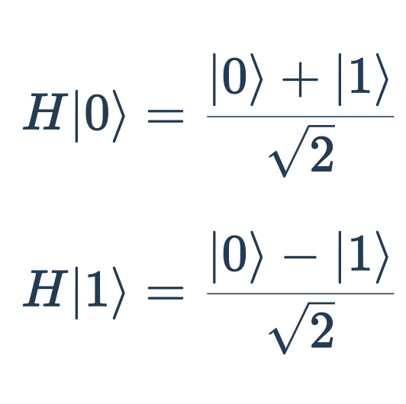
Hadamard gate on computational basis

Slide 10
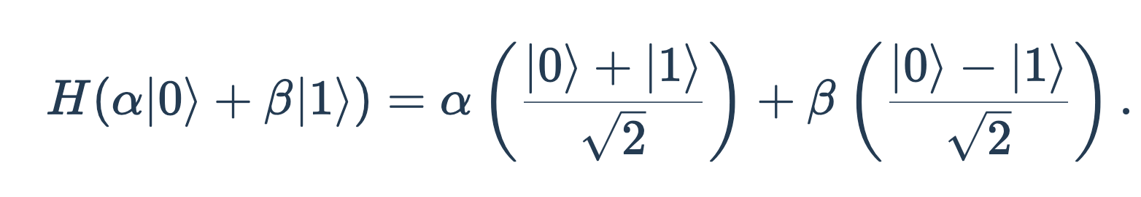
Hadamard gate on general
Notes:
H gate in its circuit and matrix representations

Slide 11
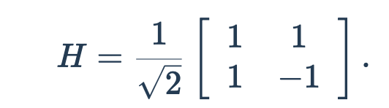
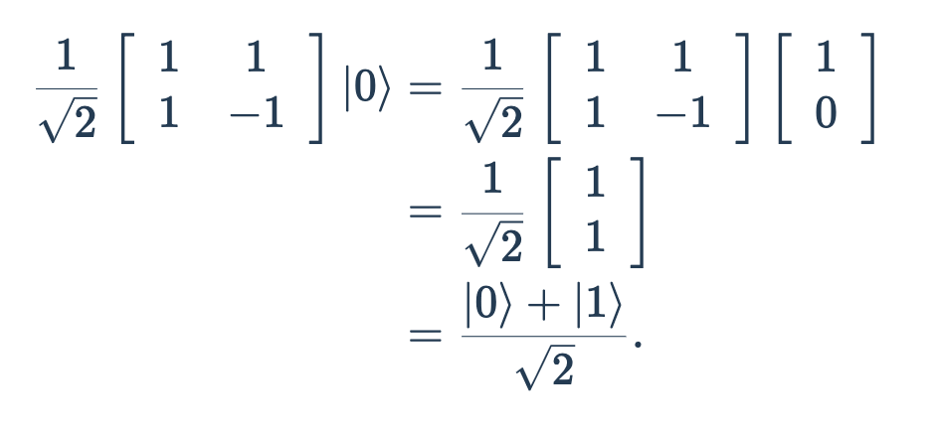
Notes:
The Hadamard gate can also be expressed as a 90º rotation around the Y-axis, followed by a 180º rotation around the X-axis

Slide 12
What is the Hadamard used for
Creates a superposition, meaning it transforms a qubit so that it has an equal probability of being in |0⟩ or |1⟩ when measured
By applying the Hadamard gate to many qubits, we can create all possible states at once in a quantum system.
Grover's search algorithm, which rely on superposition and interference to speed up computation.
Notes:
Refer back to classical bits - quantum system allows a qubit to be in a superposition of both at the same time.

Slide 13
Multi-qubit gates

Slide 14
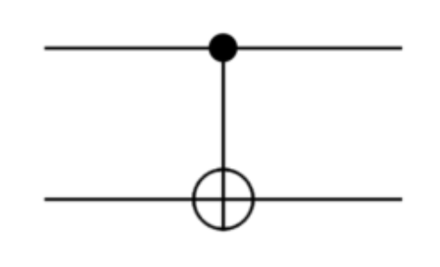
The controlled-NOT gate
Notes:
Im just going to describe the circuit and youre just going to take it as a given at the moment
The wire with the small, filled dot on it (the top wire, in this example) is called the control qubit,
. And the wire with the larger, unfilled circle on it is called the target qubit.

Slide 15
Two-qubit systems
Four computational basis states, corresponding to the four possible states of a two-bit system
∣00⟩
∣01⟩
∣10⟩
and ∣11⟩
α∣00⟩+β∣01⟩+γ∣10⟩+δ∣11⟩
Notes:
Like before, the normalization condition applies
the sum of the squares of the absolute values is 11

Slide 16
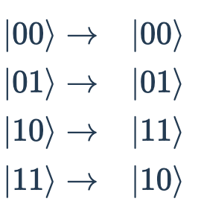
Going back to CNOT GATES
Control qubit is set to 1, as in the states ∣10⟩ and ∣11⟩∣
then it flips (i.e., NOTs) the target qubit
Otherwise, nothing
Notes:
CNOT as a very simple kind of if-then statement
if the control qubit is set, then NOT the target qubit.

Slide 17
Thank you
Next week: Multi qubit gates

