Slide 1

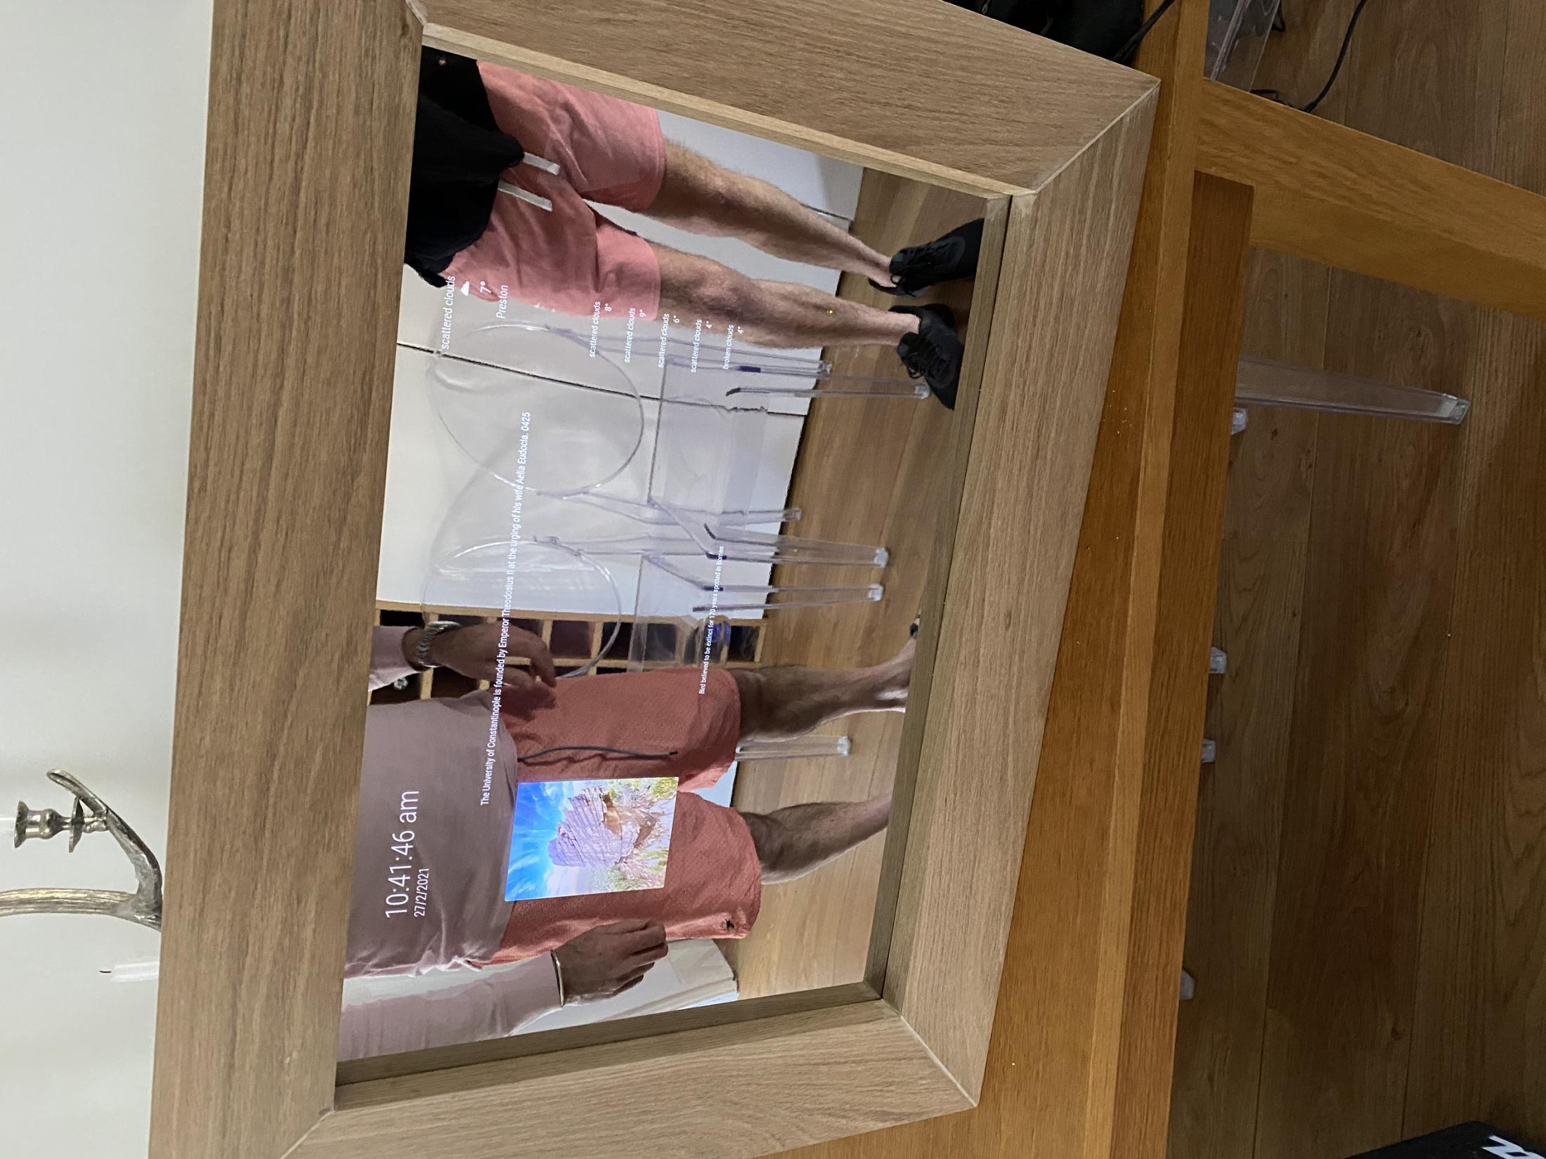

Magic Mirror
created by Jamie Peel
Context:
To develop a smart mirror using various languages and technologies to fit a specific client brief. The mirror is voice interactive, displays client chosen information, can sense a user’s presence and looks fanastic!
The future is here...
Features:
Amazon Alexa - Amazon Alexa is built into the Magic Mirror and is activated when the clent says the word 'Alexa'. Functionality is limited on a Raspberry Pi, but Alexa can still give important information, tell jokes, give directions and check the weather!
PIR Sensor - A PIR Sensor (Passive infrared sensor) is used to check whether the client is sat in front of the mirror. If they are, it keeps the display on. If not, it will turn off and stay off until the client (or anyone for that matter) sits in front of the mirror again.
Weather & 5-Day Forecast - The Magic Mirror uses the JSON fetch function to gather weather information according to the users location. CSS then styles this information for it to be displayed within the application.
Newsfeed & History Feed - A newsfeed of uplifting news and a feed of historical events that happened on this day are displayed per the client's request. The information is taken from JSON files from different subreddits.
Pictures from Around the World - Different pictures taken from around the world are also displayed in a feed per the client's request. Again, these images are taken from a subreddit JSON file and change every day.
Future Work:
Gesture control, more information displayed, bigger mirrors, less bezels, higher resolution screen, sleeker design, more lightweight, cheaper and much more!

