Slide 1
Encrypted Project
Rakhmanberdiev Tamerlan

Slide 2
Actuality of Encrypted
Every year millions of computer data get stolen. And every year this number is increasing with the rise of computer users and lack of computer education

Slide 3

Frameworks and Libraries
I used Python, Framework Django

Slide 4
Encryptions algorithms
There is two types of algorithms in this project:
Symmetric
Asymmetric

Slide 5
Symmetric Encryption
Symmetric encryption is an encryption method that uses a single key to encrypt and decrypt data. Though generally less secure than asymmetric encryption, it’s often considered more efficient because it requires less processing power.

Slide 6
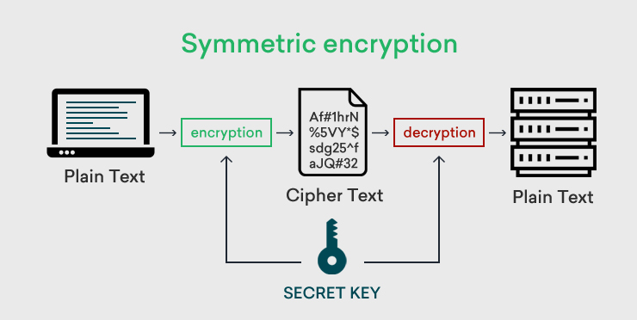
How it works
Symmetric encryption works by creating a single shared key. With the key you can encrypt and decrypt data.

Slide 7
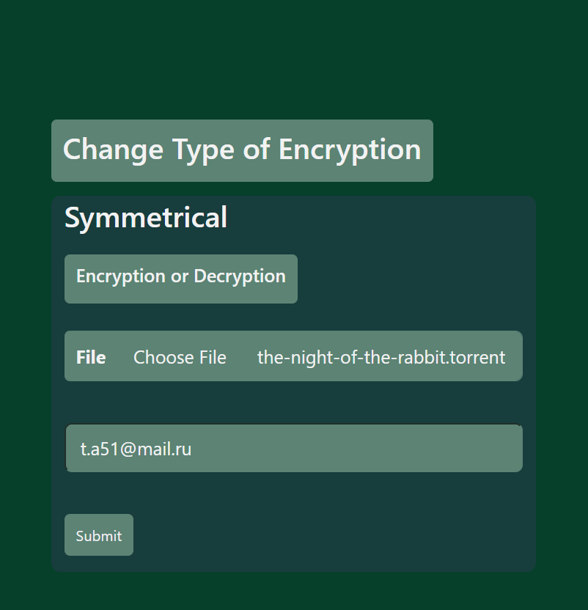
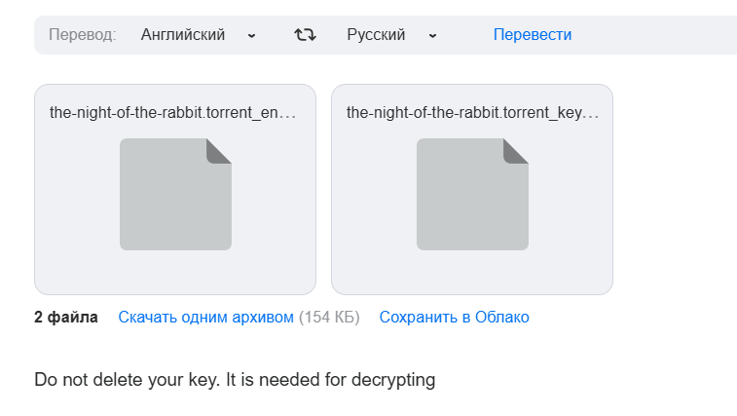
Symmetric Encryption in project
Filling the form and submitting
Receiving the encrypted file and key

Slide 8
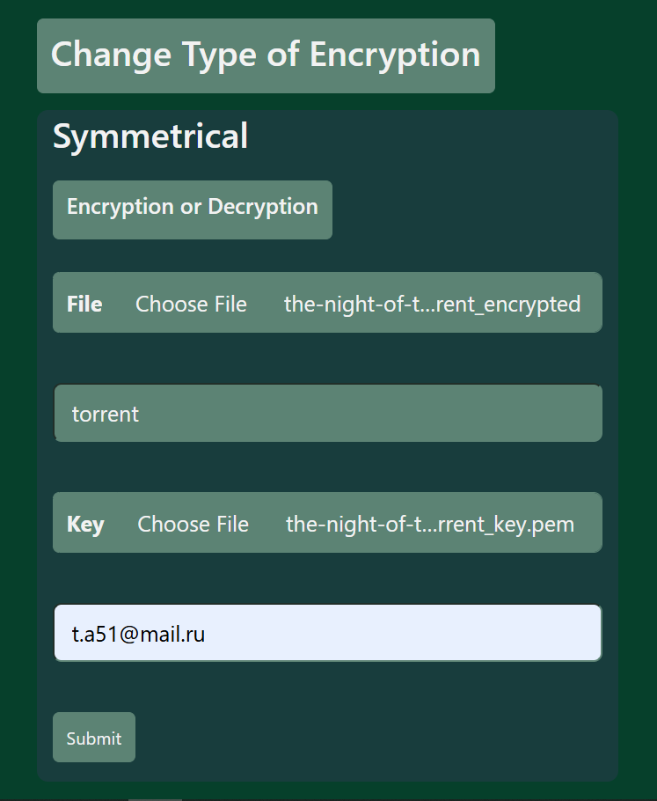
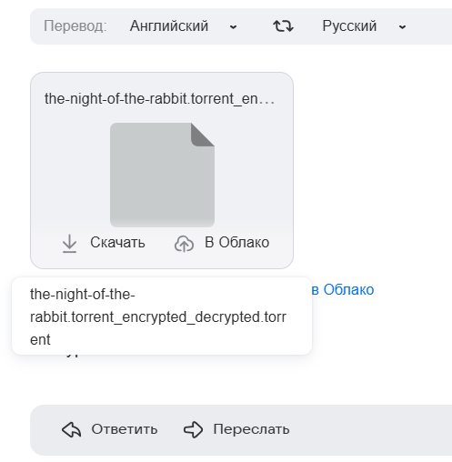
Symmetric Decryption in project
Filling the form and submitting
Decrypted file send to the mail

Slide 9
Pros
Symmetric encryption is fast and efficient for encrypting large amounts of data, such as files, disks, or databases.
Symmetric encryption is easy to understand and set up.
Symmetric encryption is widely used in the industry

Slide 10
Cons
The key must be kept secret, and the transmission of the key must be secure. If the key is compromised, all the data encrypted with that key is vulnerable.
Distributing and managing keys can be challenging, especially for large or dynamic networks.
Symmetric encryption does not verify the identity of the sender or prevent the sender from denying the message.

Slide 11
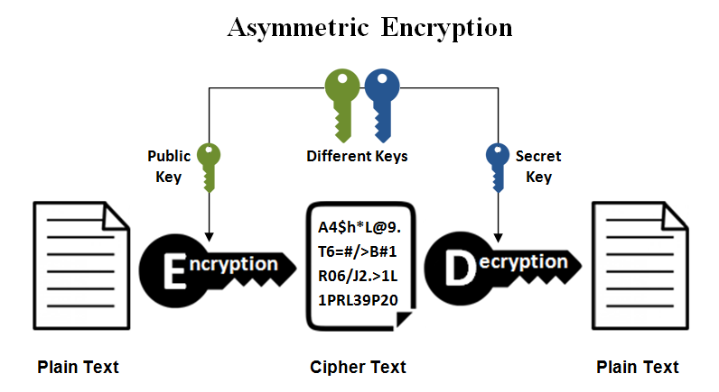
Asymmetric Encryption
Asymmetric cryptography, also known as public key cryptography, is a process that uses a pair of related keys - one public key and one private key – to encrypt and decrypt a data and protect it

Slide 12
How it works
Keys in Asymmetric encryption are mathematically related. If you encrypt data with public key X, it means you can decrypt data ONLY with private key X.

Slide 13
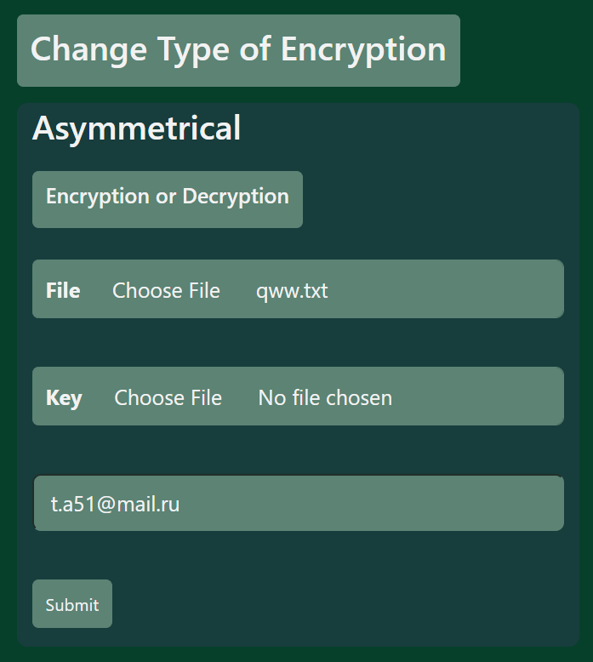
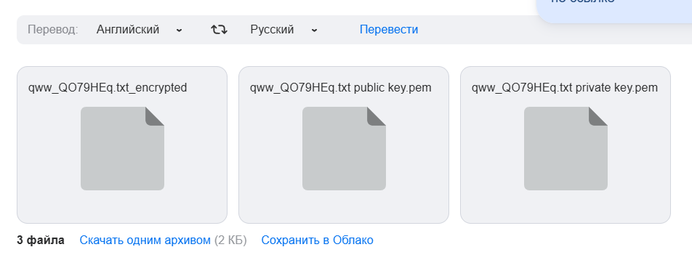
Asymmetric Encryption in project
Filling the form and submitting without key
Encrypted file and keys send to mail

Slide 14
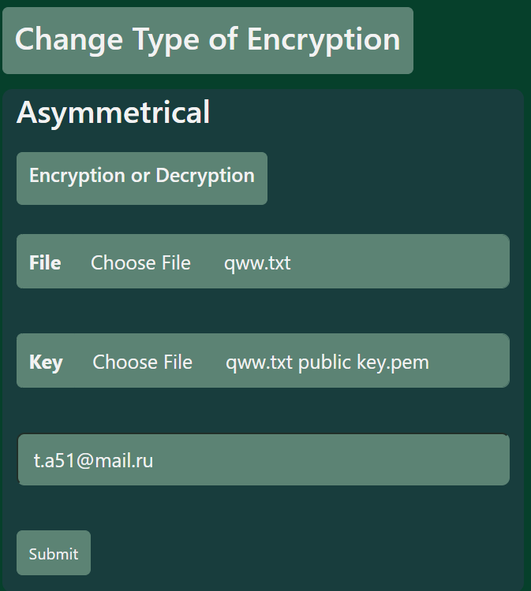
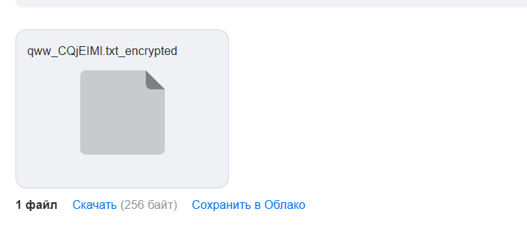
Filling the form and submitting with key
Encrypted file send to mail

Slide 15
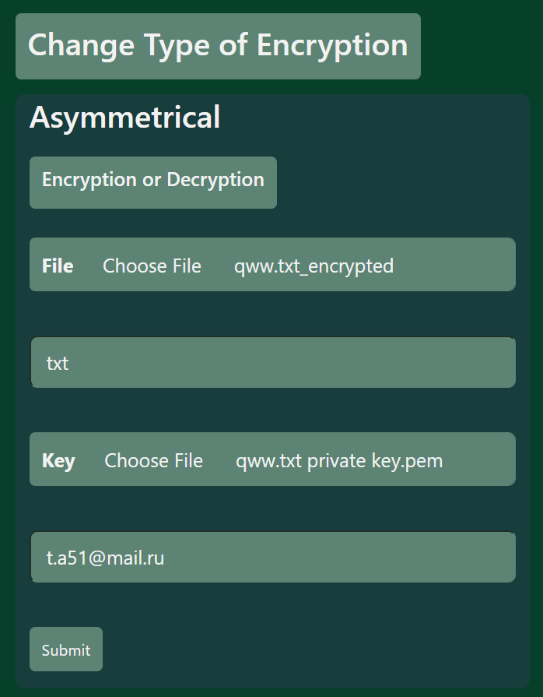
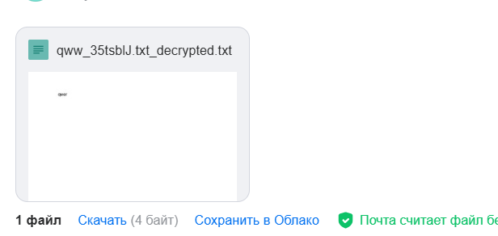
Asymmetric Decryption in project
Filling the form and submitting
Decrypted file send to mail

Slide 16
Pros
Asymmetric encryption offers more information security.
The recipient can verify the origin of a message, making it easier to avoid messages from unknown senders.
Asymmetric encryption creates security signatures that allow users to authenticate documents.

Slide 17
Cons
Asymmetric encryption is slower than symmetric encryption because of the computationally intensive operations involved.
Asymmetric encryption is less efficient than symmetric encryption, making it unsuitable for encrypting large amounts of data.
If the private key is lost, no one can decrypt the information.
All parties must use the same form of encryption to share messages.

Slide 18
End

