Slide 1
Music Library API Project
Rakhmanberdiev Tamerlan

Slide 2

Frameworks and Libraries
I used Python, Framework Django and Django REST Framework, MySQL.

Slide 3
Structure of API
API has 4 tables:
Author – author of songs and albums
Album – album that contains songs
Genre – genre of song
Song – song itself has genres and authors

Slide 4
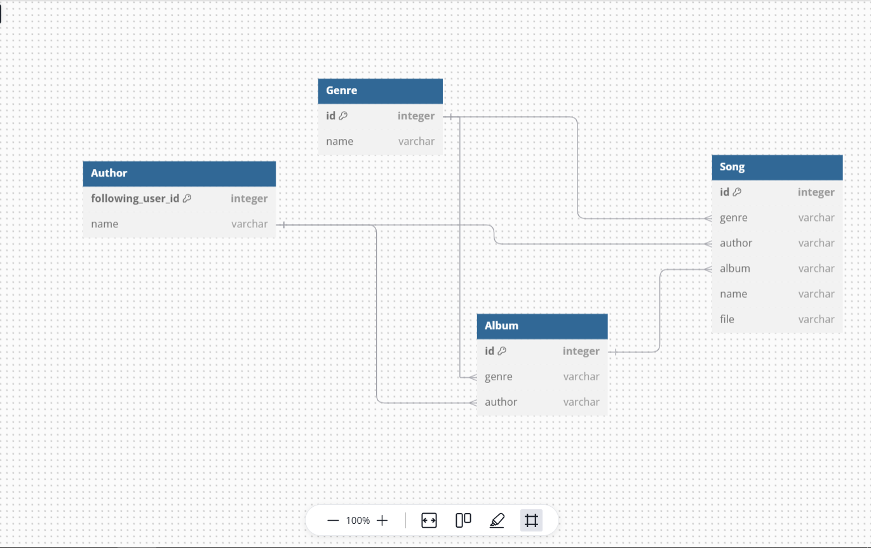

Slide 5
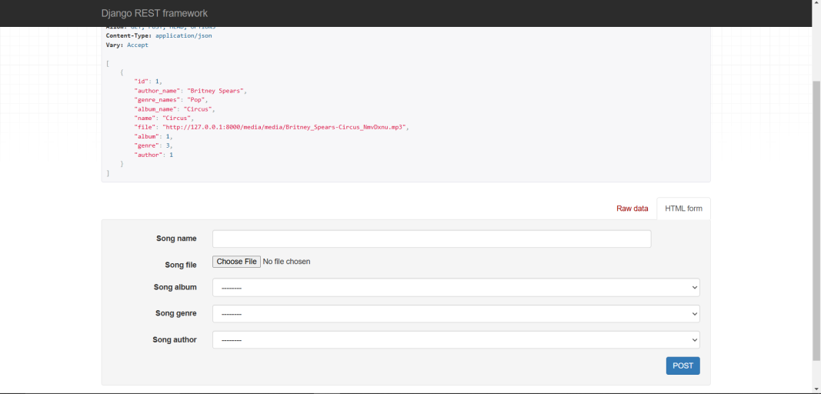
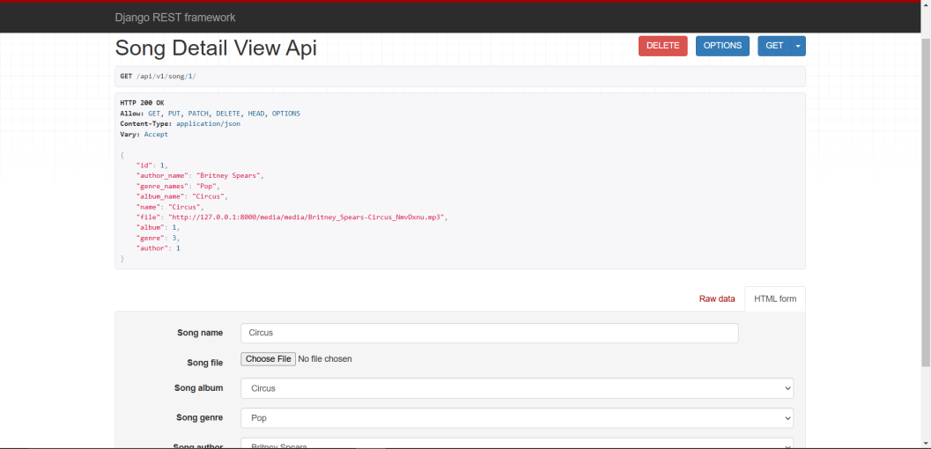
CRUD Implementation
Every Model can be created, retrieved, updated and deleted.
Song Model as example

Slide 6
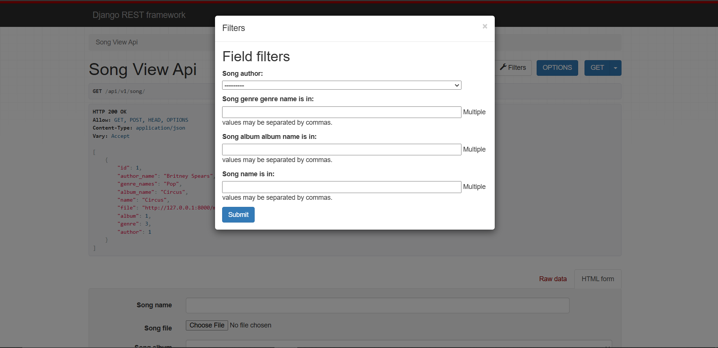
Filtration
Song, Albums and Authors can be filtrated.

Slide 7
Admin Panel Changes
I used Django-Jazzmin to improve Admin Panel looks and make it more understandable

Slide 8
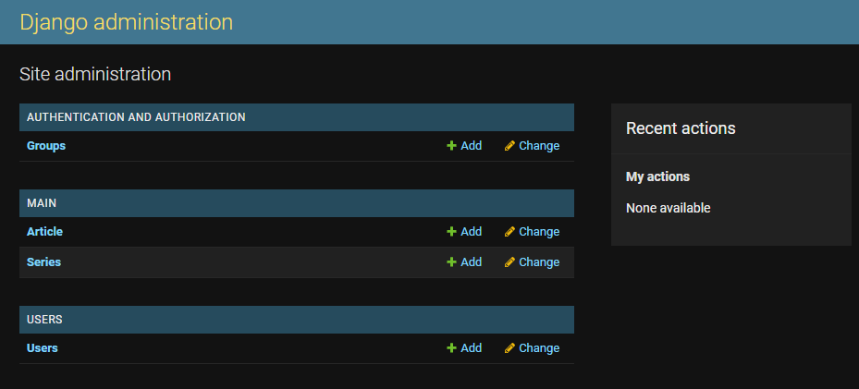

Slide 9
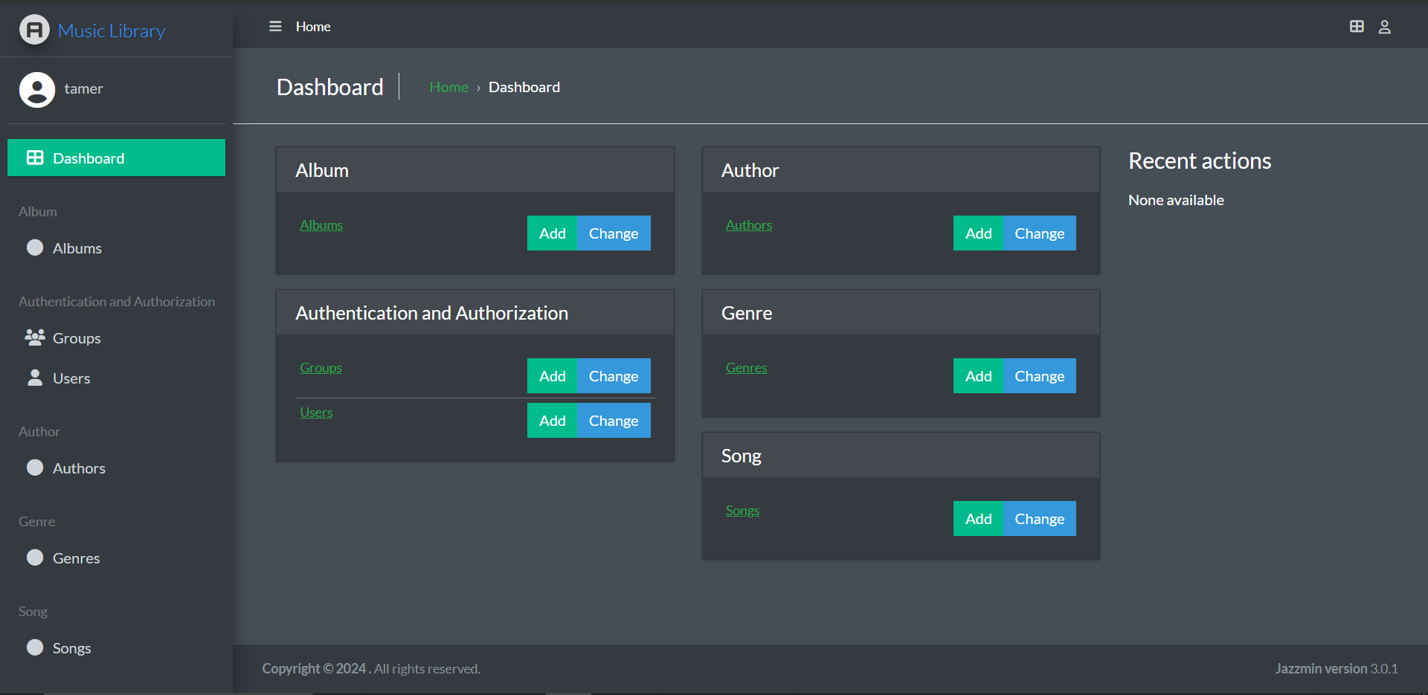

Slide 10
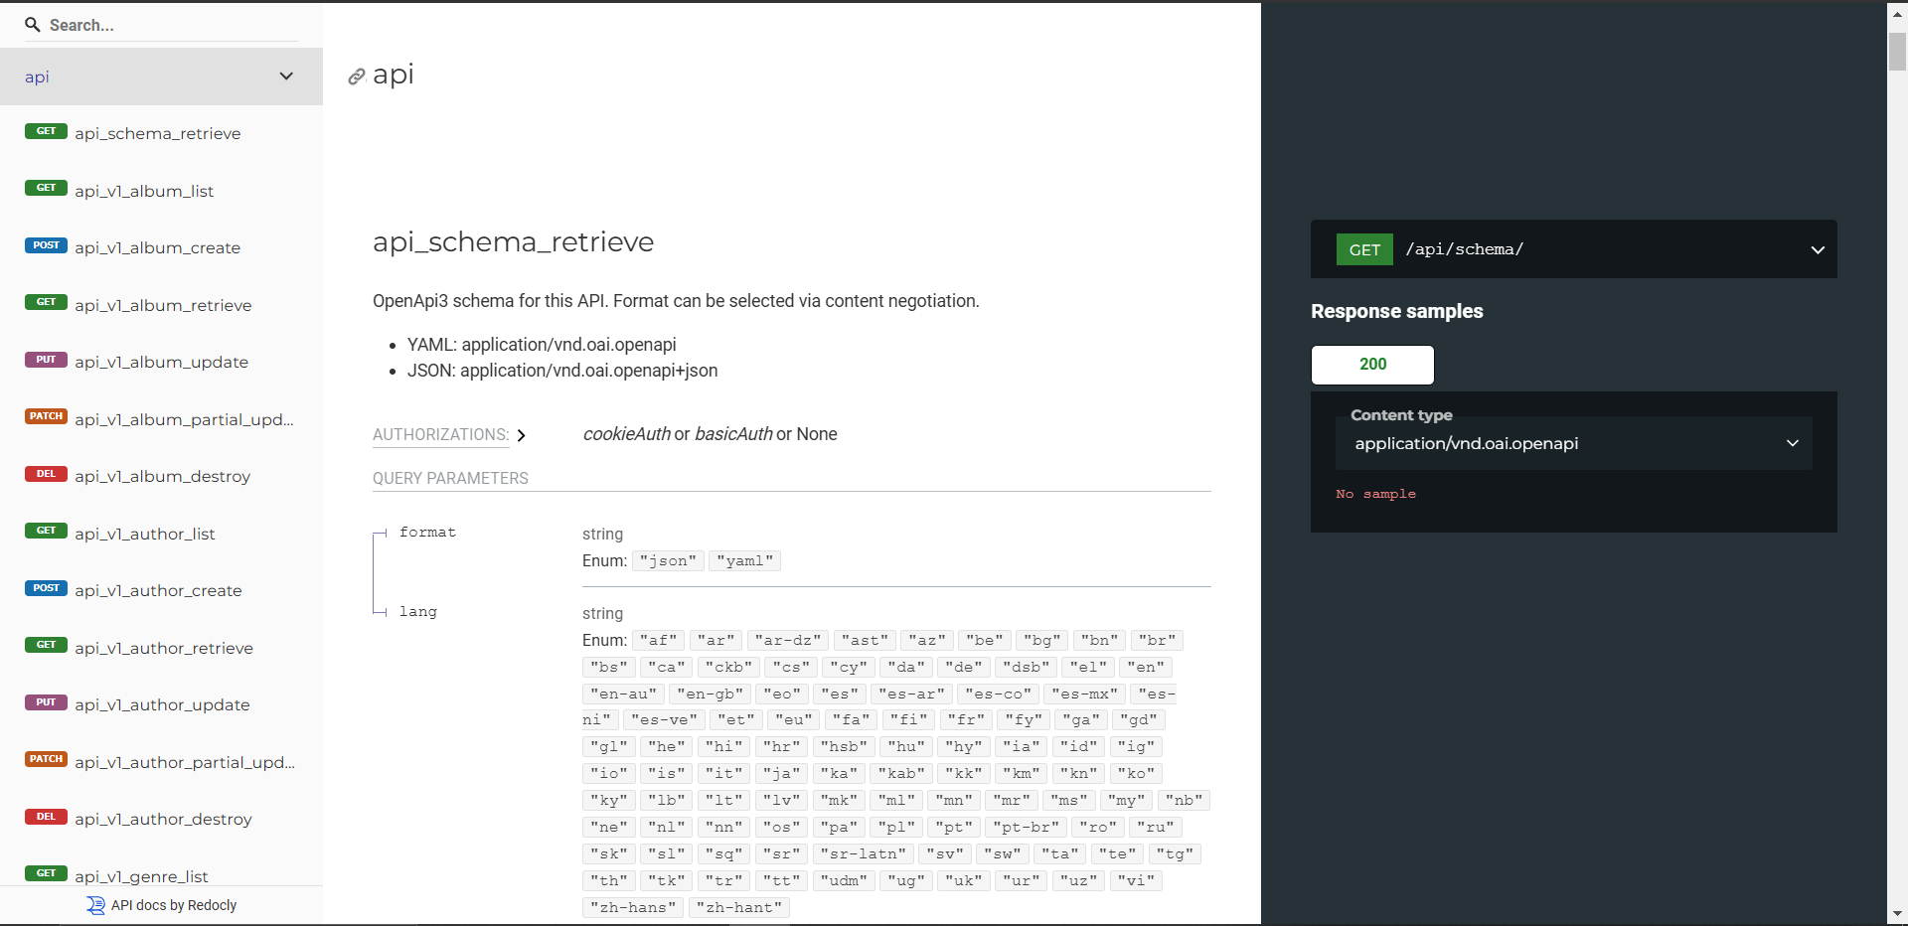
Swagger UI
Swagger UI is Used for better visualization of API

Slide 11
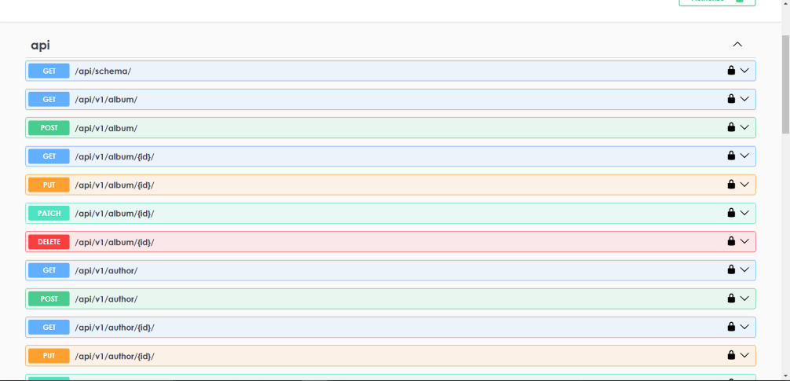
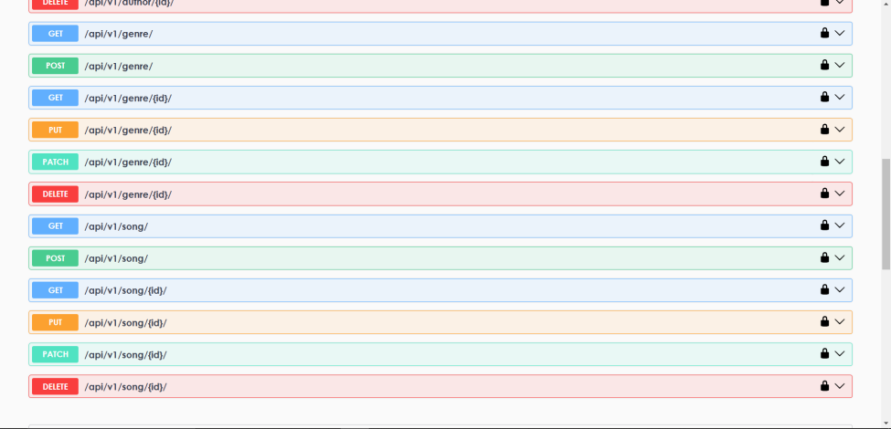
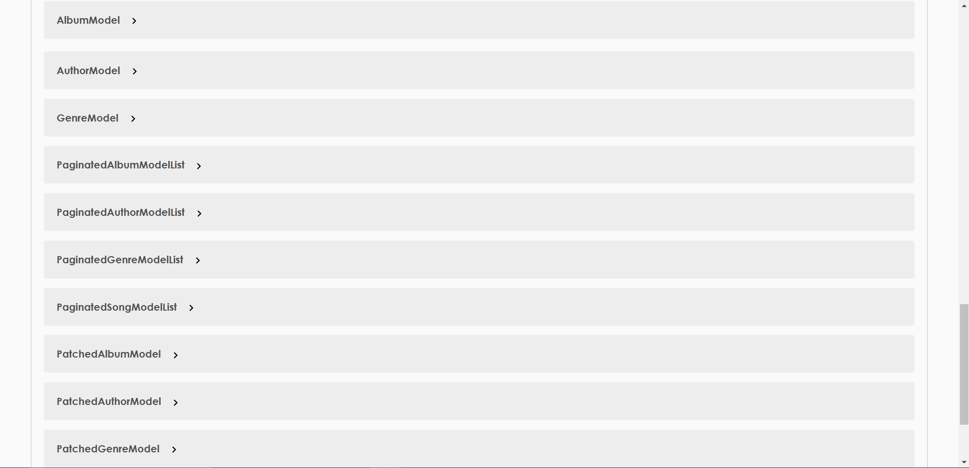

Slide 12
End

