Slide 1
Contract Monthly claims system
ST10448312
Tumelo Monese
PROG 6212

Slide 2
Introduction
The Contract Monthly claims System is created to help simplify the process of claims being made by contractors and being approved by managers
It helps automate submissions, validations, and approval of claims made
Accuracy, transparency, and automation are focused on

Slide 3
challenges
Integrating the automation feature into the pre existing monthly claim system
Implementing the document upload feature
Ensuring communication and tracking of a claim and its current status

Slide 4
Challenges addressed
Manually submitting claims would cause time delays and allow room for human error when submitting or when claiming
Focused on the shortage/lack of a claims platform for all stakeholders
High workload caused by repeating tasks
Transparency of the status of the claim

Slide 5
Features
Automated validation of claims made using FluentValidation
Status tracking in real time
Different dashboards for different roles(lecturer, coordinator, manager)
Online webapp with document upload features
Automated calculations and tracking

Slide 6
architecture
UI, business logic, and data are separated using the MVC framework
Data is represented in the Models
UI interfaces are represented I the Views
Business logic, validation and user requests are represented In the Controllers

Slide 7
User interface
Submissions are in a form format with validation and clear fields to input
Dashboard shows claims( previous and current)
Design is responsive to different devices
There are visual signs to show the status of a claim

Slide 8
verification
System checks for:
  Hours worked are between 0.5 to 200 hours
  Hourly rate charged is between R1 and R10,000
Claims failing these checks are automatically rejected with clear error messages
Valid claims are marked 'Verified' and sent for managerial approval.

Slide 9

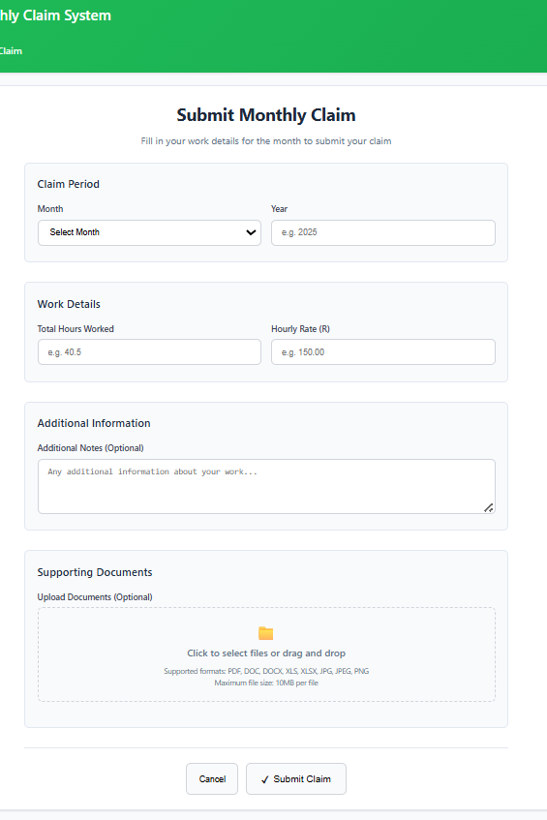

Claim submission form
Form used by lecturer to submit claims

Slide 10
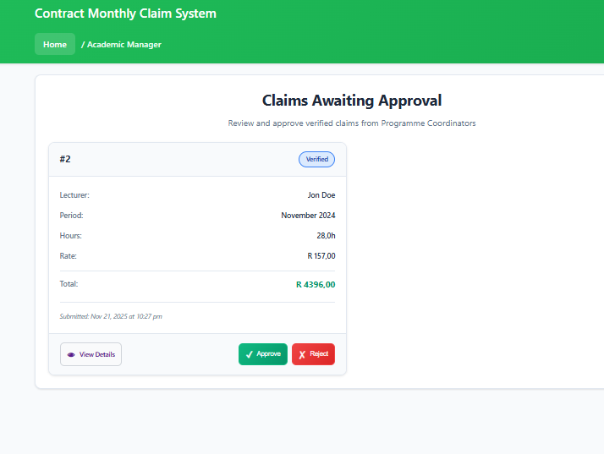
Academic manager view
Academic managers dashboard to view claims already verified

