Slide 1







Team
RCMBA

Slide 2





The Team
Tumi Fadare
Vladamir Sanchez
Katherine Bollinger
Stephen Phillips
Mentor

Slide 3





Agenda
01
02
03
How we started
Light Bulb Moment
Key Tools
04
06
Key Trends
Conclusion

Slide 4





How we started out...

Slide 5

Light Bulb Moment
Bad Data Exist
Key Decisions
“Gartner.com states that organizations lose $13.3 Million yearly average on poor data”
Clean out any wrong years
Clean out any duplicated movie names
Remove any null data by replacing it with “unknown”

Slide 6

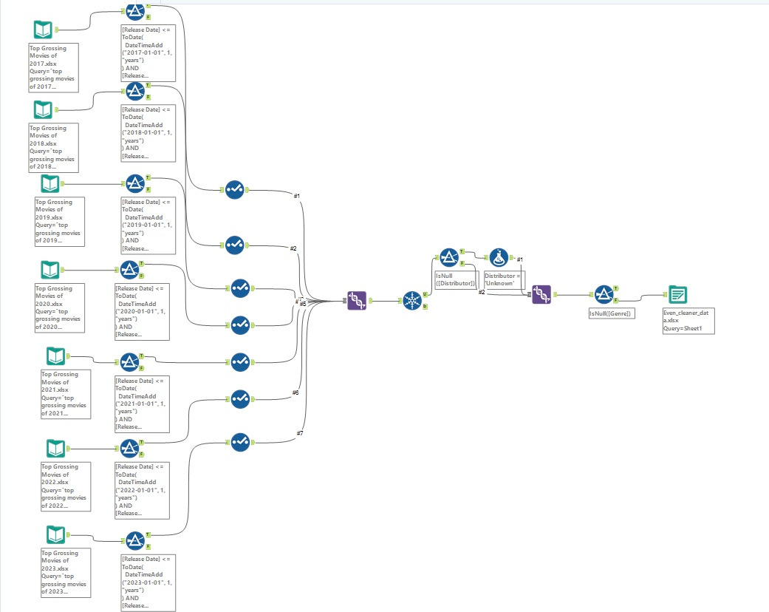



Our Work Flow
Key Alteryx Tools
Filter Tool
Filter Wrong Years
Select Tool
Change “Yearly Gross” to “Gross”
Union Tool
Filter Wrong Years
Unique Tool
To Filter Duplicate Movie Ttiles
Filter Tool
find missing distributor
Select Tool
To Find Nulls
Output Tool
To Export to Excel

Slide 7
Trends
Genre
Pre, Covid, and Post
Movies
Distributors
Genre
Future

Slide 8
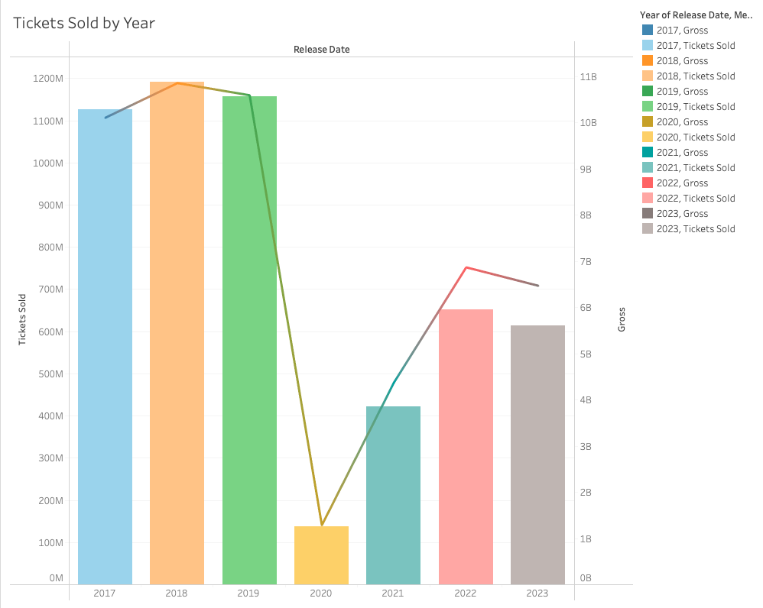
Movies

Slide 9
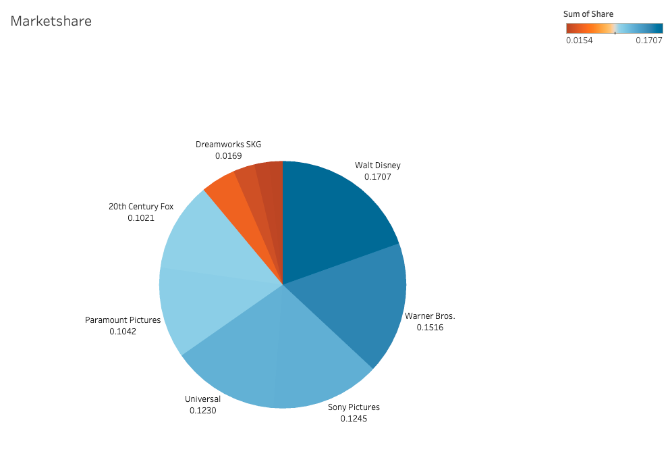
Distributors

Slide 10
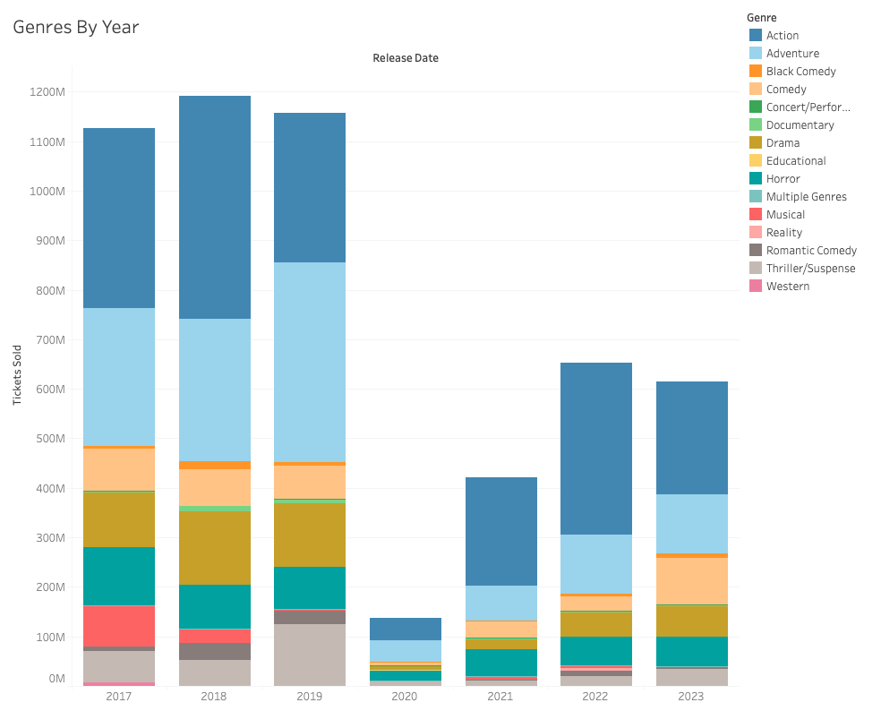
Genre

Slide 11
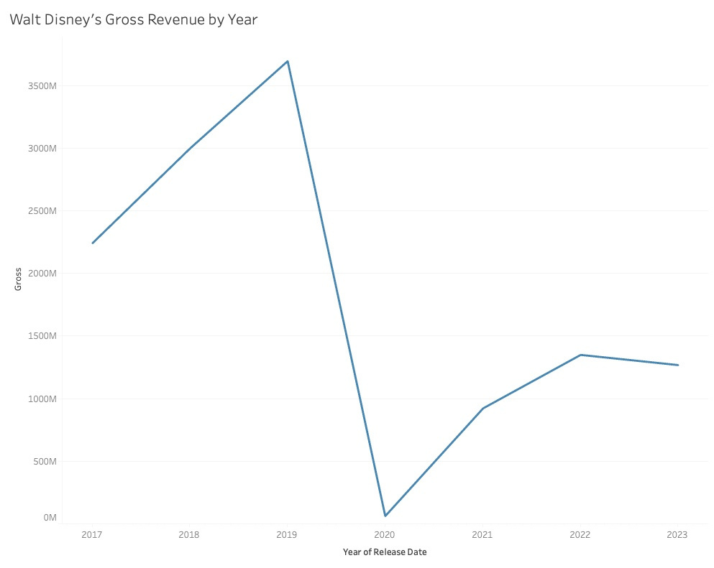
Future

Slide 12
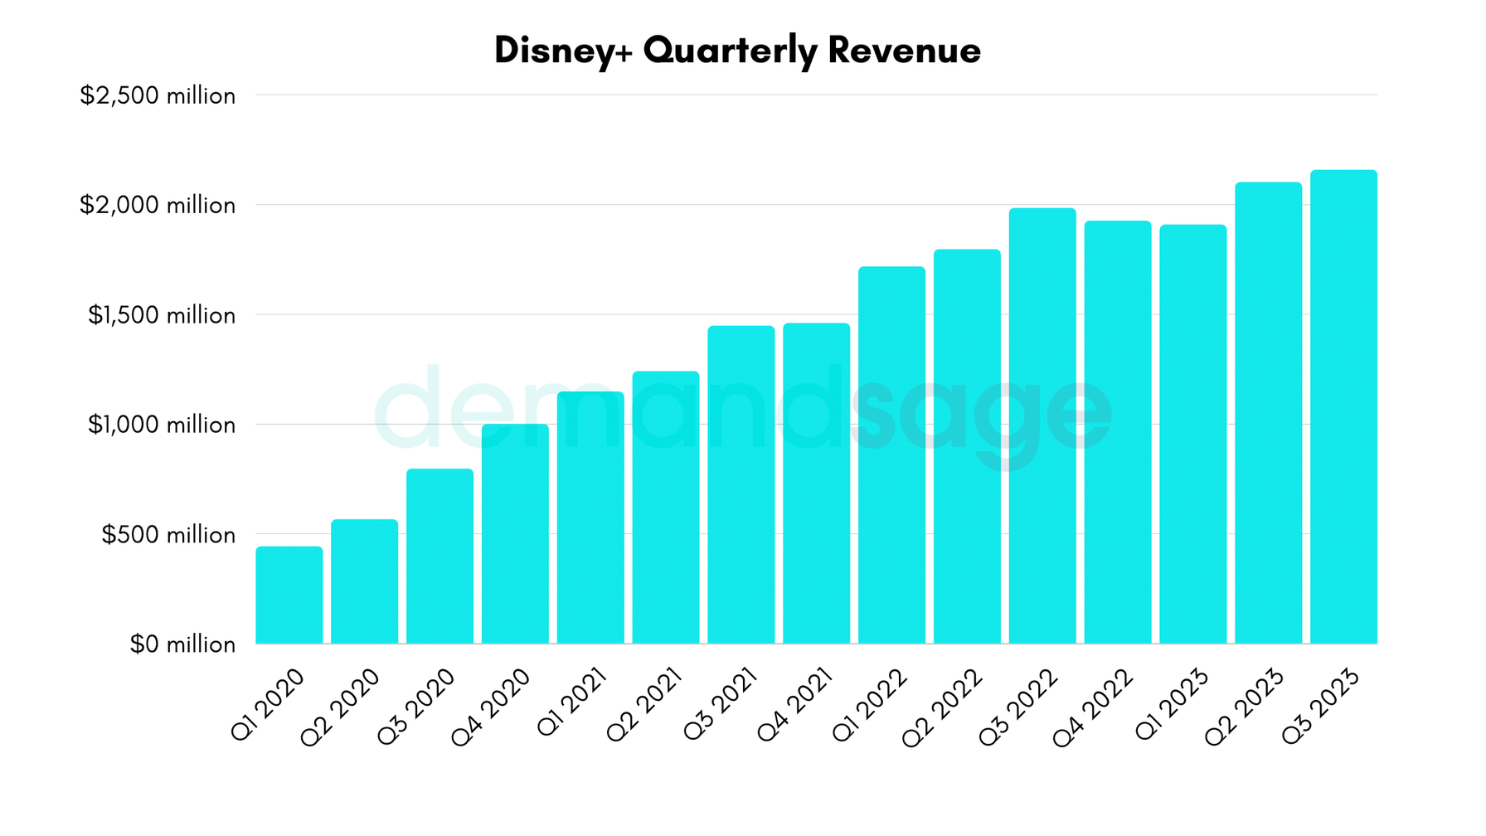
Future

Slide 13






Conclusions
Spike in 2023 Movie Sales
What we learned
Data only went up until the end of September
3 more months
Major movies coming out
Wonka
Hunger Games: The Ballad of Songbirds and Snakes
Aquaman and the Lost Kingdom
2023 should surpass 2022 but not reach pre-pandemic levels
Streaming Services and the Future
“85% of U.S. households have at least one video streaming subscription”
“Since the start of the COVID-19 pandemic, subscriptions have increased across all major services.”
The boom of Disney+, Paramount +, Netflix and other streaming services
We can expect movie sales to not reach pre-pandemic levels as the use of streaming services continues to rise
Important to filter through data
Multiple trends can occur in one industry
Alteryx is a powerful tool that can be combined with other tools

Slide 14



Thank you
@Pitt_RCMBA

