Slide 1


IT STORE ASSET INVENTORY MANAGEMENT
Name : Tummeti Sai Ram Kumar
Salary Code : 90001192

Slide 2
Table of Content
01
02
03
04
Project Overview
Technologies
Agenda
Milestones
05
06
07
08
Features
Demonstration
QR Arena
Views

Slide 3

Project Overview
IT Store Asset Inventory Management deals with the management and tracking of assets in stock , this keeps a proper track of the assets which comes in and goes out of IT store which is a major requirement for our business to run well .
Customer Logo
Began with a vision to maintain the right balance of assets in stock (STCK) , this ensures the asset availability in store . The project is made with a motto to save time and make the asset tracking easier and hands on.
Link : IT Store Asset Inventory Management (murmuring-wildwood-34908.herokuapp.com)

Slide 4

Technologies Used
HTML CSS
Node JS
JAVASCRIPT
Express JS
IMAGE CAPTION
API
MongoDB

Slide 5
Agenda
IT Store Asset Inventory Management
Mission
To track and manage the assets which are in stock in the corporate office.
Vision
To make the things easier for the Infra department regarding asset inventory management .

Slide 6


With the difficulty in maintaining the assets data in excel sheets , a new interface is being made for easier maintenance and CRUD operations .
Project Milestones
From the stage of having the assets physically available with no proper tracking to finally implementing the tracking of all the assets in one interface , this project came through a lot of milestones .
Excel Stage
Interface Stage
The data of the assets which is physically verified is then uploaded into Excel sheets in different files .

Slide 7

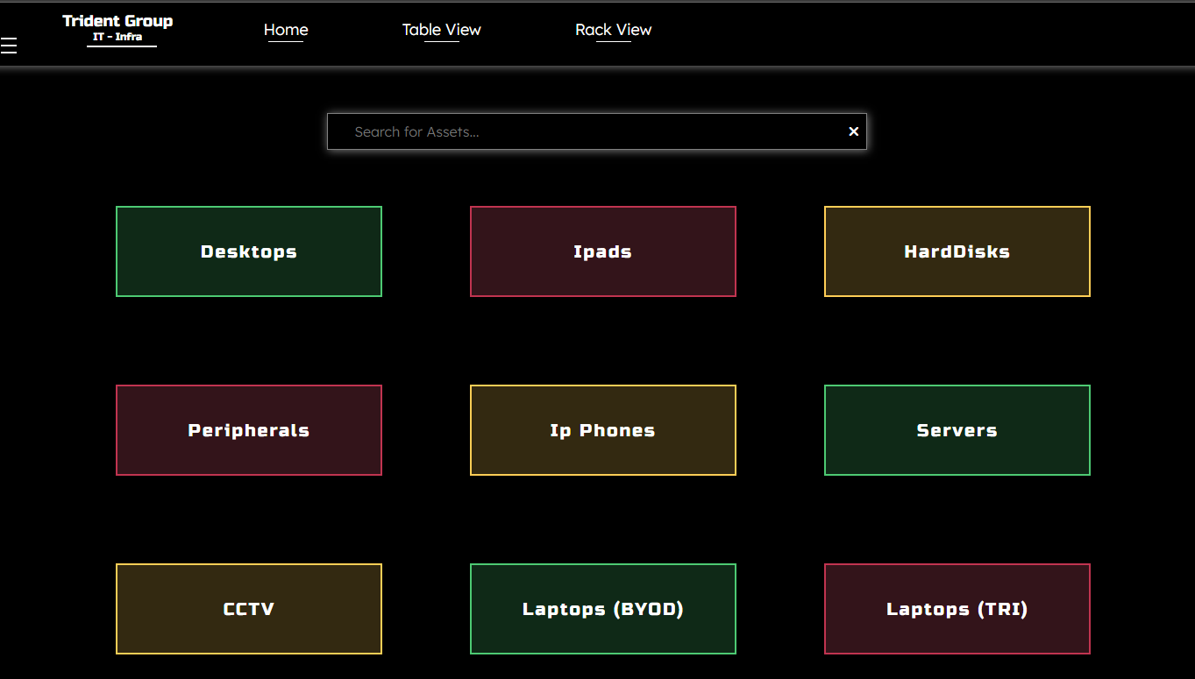





Features
Assets
Auto Lock
Search
The interface consists of wide range of assets starting from harddisks to the peripherals .
The interface gets auto locked after every five minutes for higher security purposes .
With the assets being made into different categories , making searching easier .
Dark-Light
QR Tech
Responsiveness
The interface is being implemented in dark and light modes .
Implemented QR based tracking for servers
The interface can be used from any device .

Slide 8
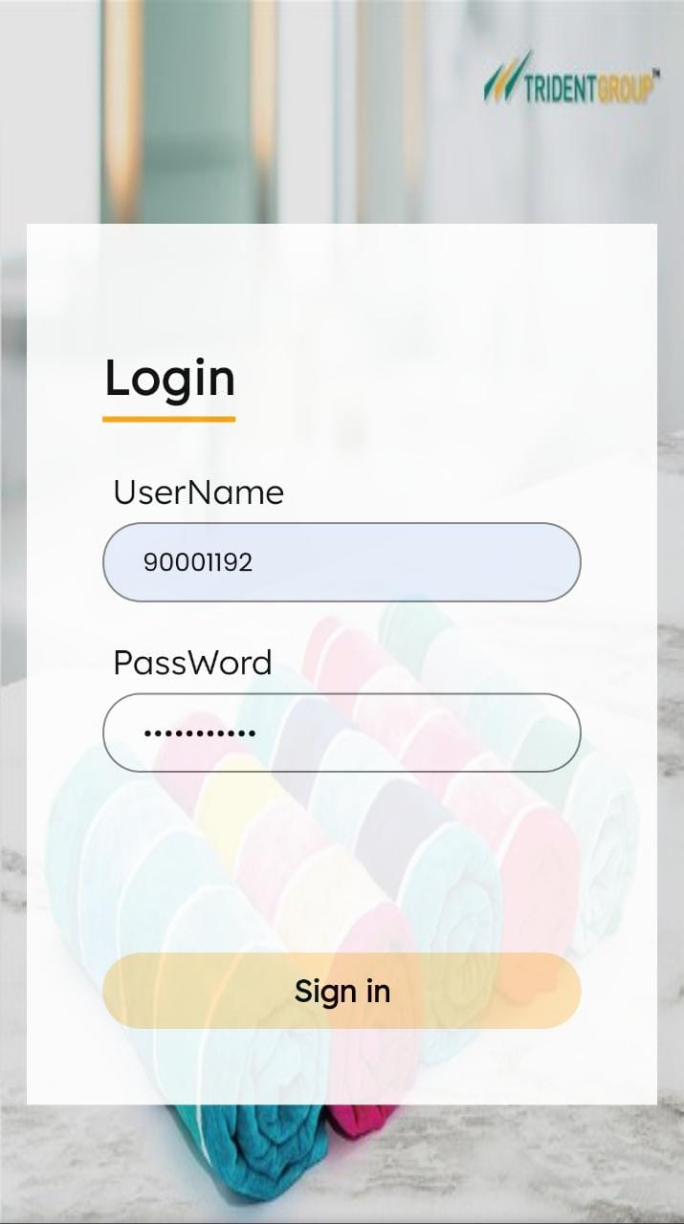
Login Page
The interface has the auto locking system which redirects the user directly to the login page after every five minutes , this is implemented for security purposes . The user details are stored in MongoDB .

Slide 9
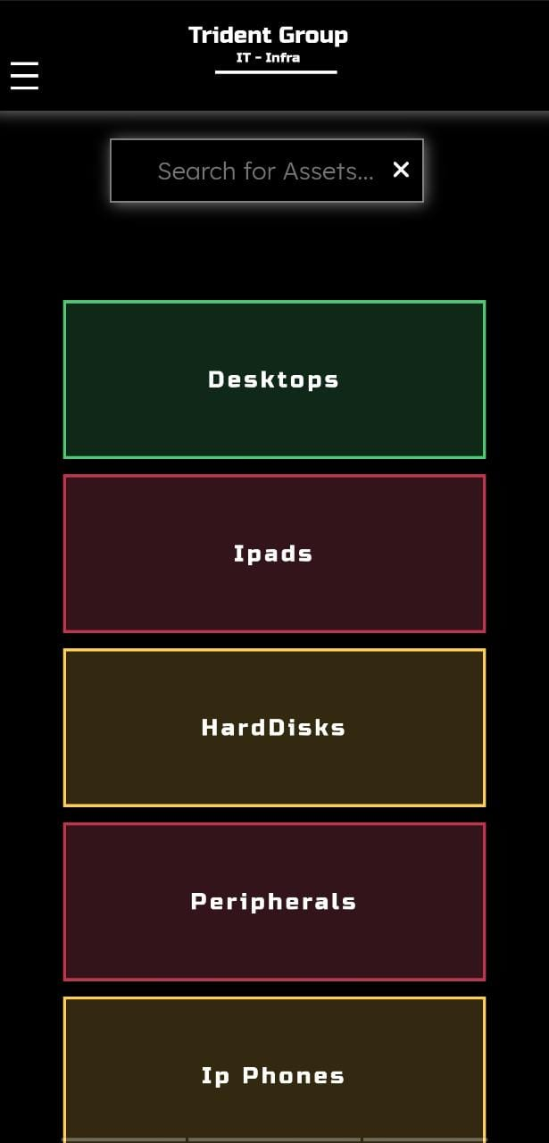
Home Page
The home page consists of several assets categorized into different databases , and we can apply CRUD operations separately for every asset which perfectly ensures the proper balance and tracking of assets which are in stock . From this home page , you can navigate to any page of the website .
IMAGE CAPTION

Slide 10
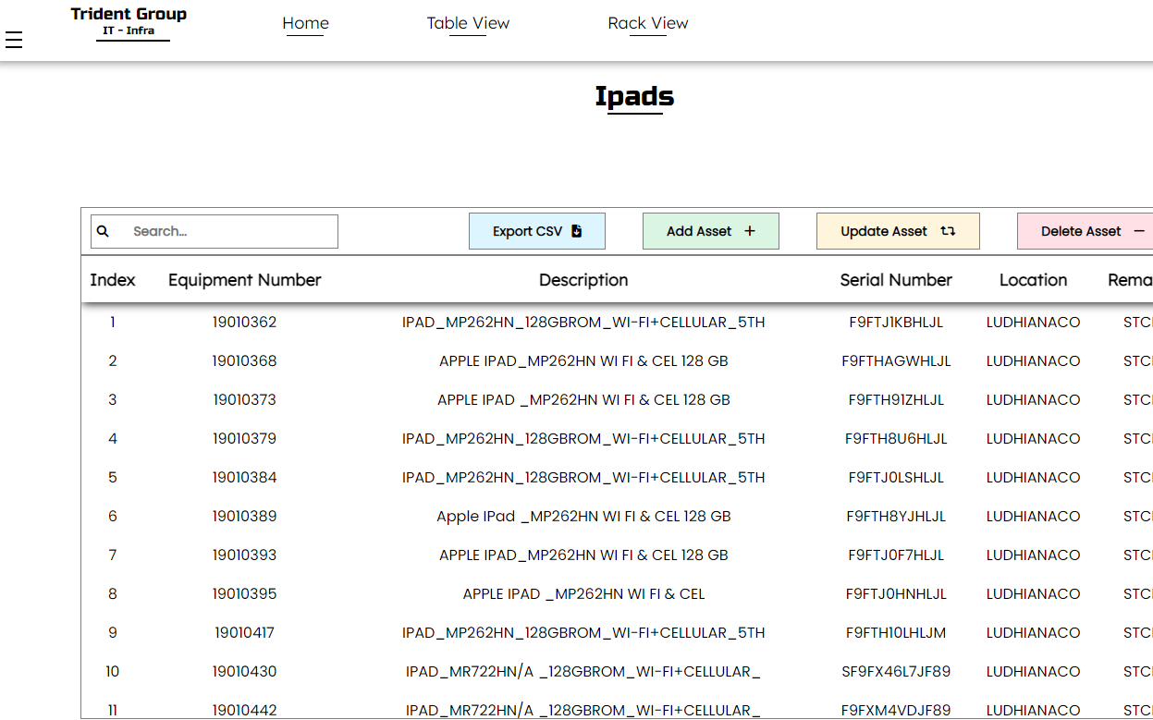
Asset Operations
The table consists of all the assets of the selected category
Add Asset can be used if any new entry is to be made .
The search algorithm is designed in such a manner to make the searching of asset easier .
Update Asset can be used if any updates for a particular asset are to be made .
IMAGE CAPTION
Export CSV downloads the .csv file of the selected asset
Delete Asset can be used to delete the asset entry from the dashboard .

Slide 11
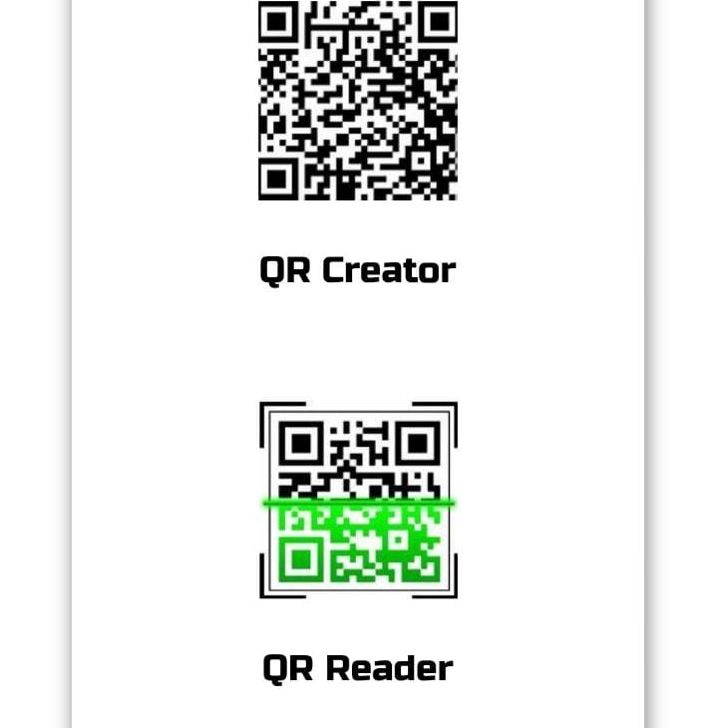
QR Arena
QR Arena consists of QR Creator and QR Reader which can be used for implementing the QR based asset inventory tracking for the most important servers .
IMAGE CAPTION
QR Creator
QR Reader

Slide 12
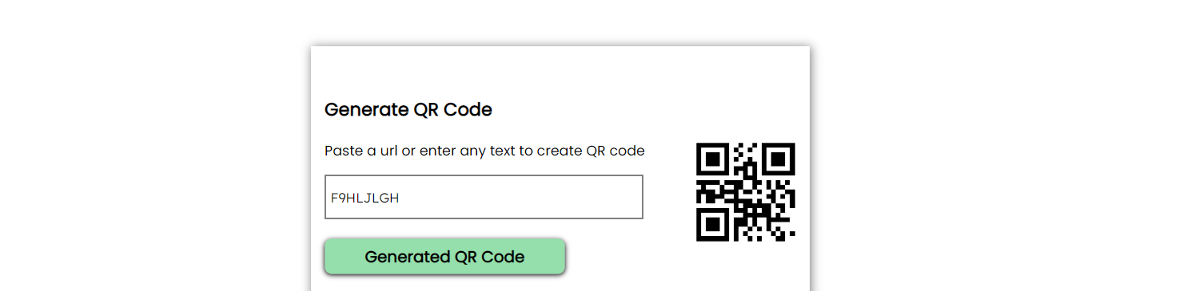
IMAGE CAPTION
QR Creator
Enter the serial number of the asset (Server) for generating the QR code , and this Serial Number is used for getting the data of the asset from the database .

Slide 13
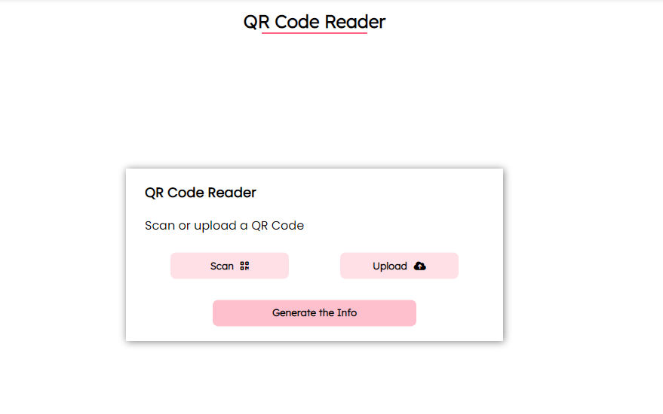
QR Reader
1
Scan or Upload the QR
2
Click on Generate the info option for getting the serial number.
3
Click View Info for getting the information of the asset .
IMAGE CAPTION

Slide 14
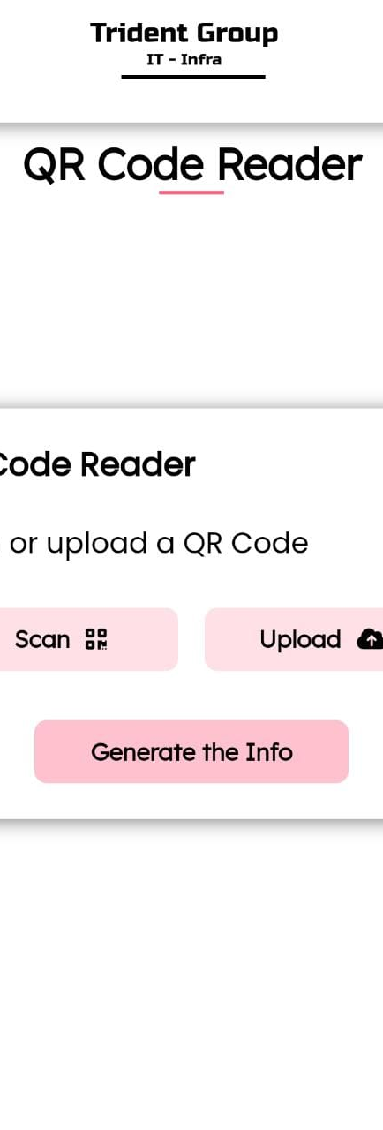
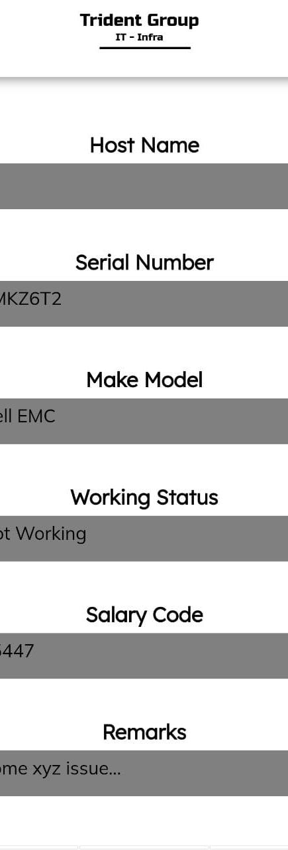
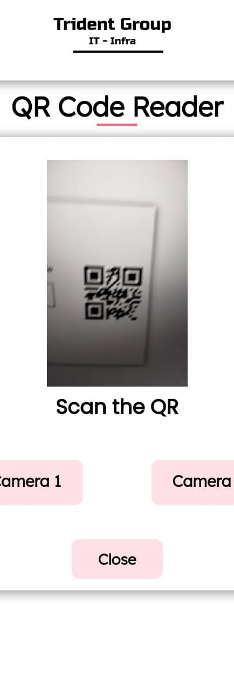
Scan or Upload any QR
The generated info consists of the asset details
After scanning the QR , generate the info .

Slide 15
Key Features
01
03
A
B
Time
Prevents Info Loss
This QR based Approach saves a lot of time .
Prevents the loss of content written on the asset .
02
C
04
D
Details
Working
The info after scanning the QR consists of Host Name , Serial Number , Working Status , Remarks .
Works on any device and on any browser .

Slide 16
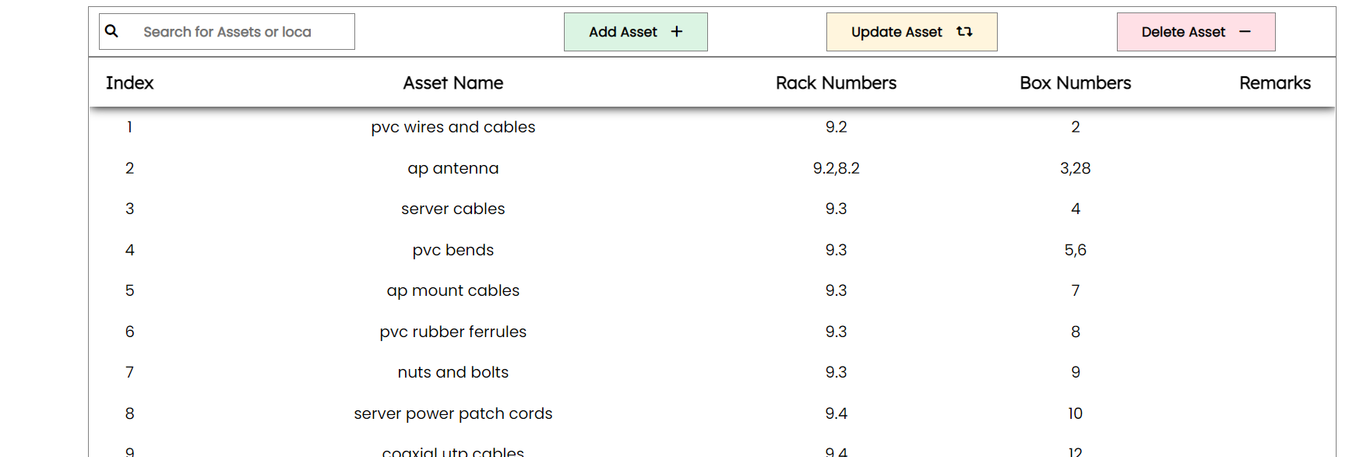
Table View
Particularly made for peripherals , this tabular view consists of Asset Name and the racks in which they are in .
Search a particular rack or Search a box or Search for an asset or Search for remarks .

Slide 17
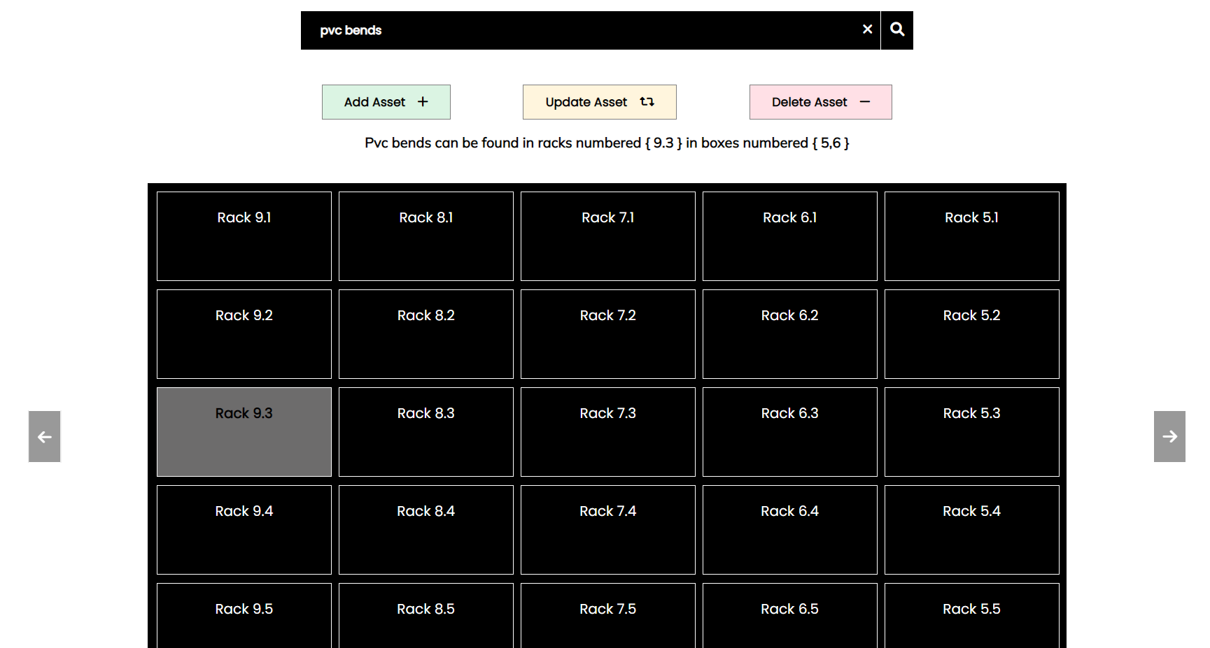
Rack View
This is the view of the racks present in store . This view is implemented to visually locate a particular asset in store . This gives a clear view of asset including the rack and box numbers .
IMAGE CAPTION

Slide 19
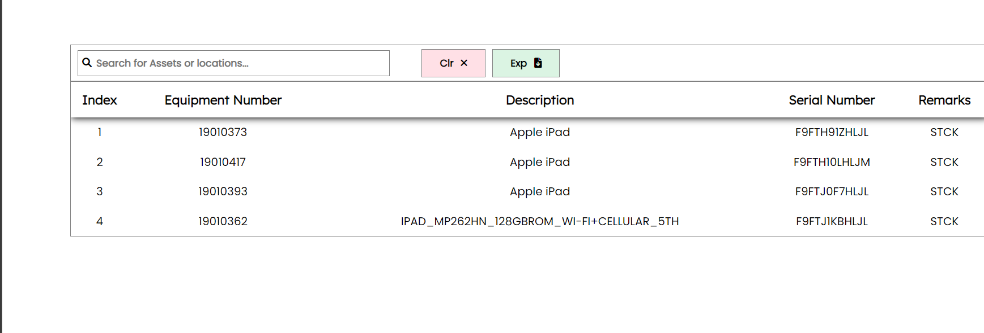
The Bin
The Bin stores the information of the assets which are deleted , this also consists of two options Clear and Export .
Clr clears destroys the data from the Bin
Exp exports the bin data into a csv file
IMAGE CAPTION

Slide 20
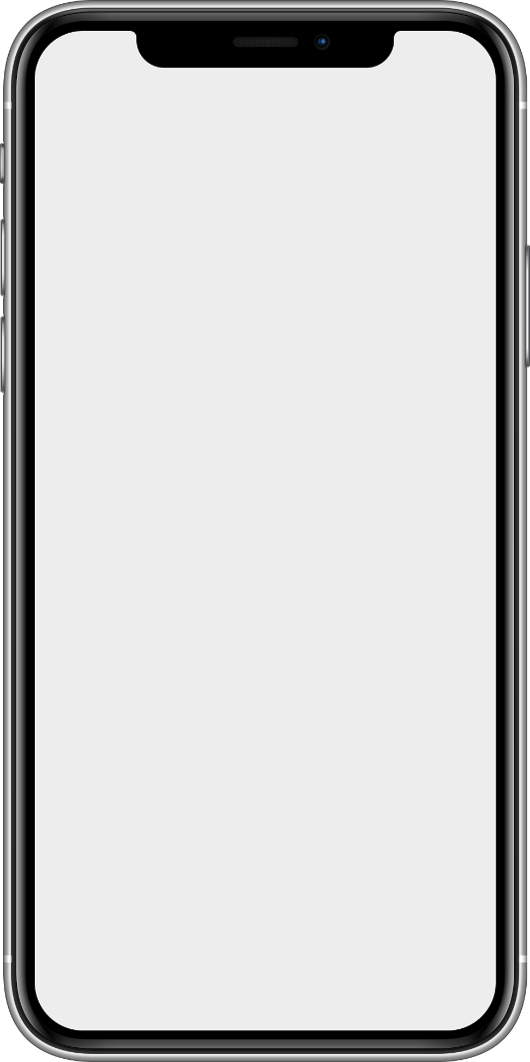
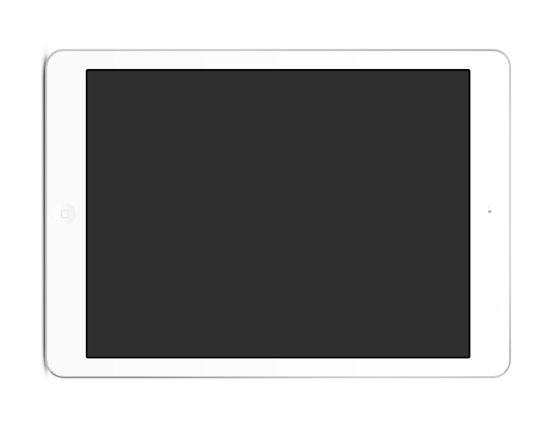
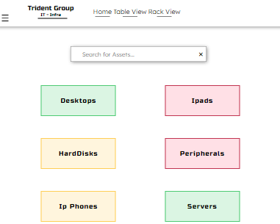
Responsiveness
The Responsiveness
The Responsiveness of the interface makes it to be used from any device and from any where .

Slide 21
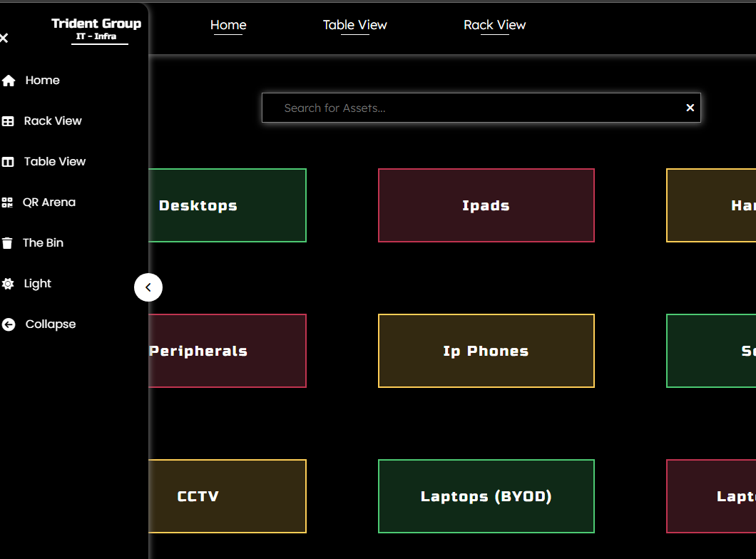
The Dark Mode

Slide 22

Key Learning's
Learnt HTML, CSS & JS
Learnt about functioning of QR Codes
Learnt about backend technologies like Node JS, Mongo DB and Express JS
Learnt how a large organization manages its assets

Slide 23
THANK YOU
www.tridentindia.com

