Slide 1
F
G
A
B
C
D
E
F
G
A
B
C
D
E
x 3/2
x 3/2
x 1/2
x 3/2

Slide 2
F
G
A
B
C
D
E
F
G
A
B
C
D
E
x 5/4
x 6/4
x 5/4
x 6/4
x 5/4
x 6/4

Slide 3
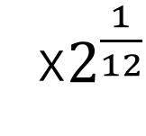
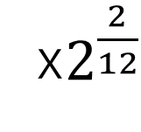
F
G
A
B
C
D
E
F
G
A
B
C
D
E
x$2^{\frac{2}{12}}$
x$2^{\frac{1}{12}}$

