Slide 1
TRUSTSHIELD UEBA
AI-Powered Explainable Insider Threat Detection Framework for Defence Networks
PRESENTED BY
P TANVEE SATYA (CH.SC.U4CYS24045)
T MOULYA SRI (CH.SC.U4CYS24053)

Slide 2
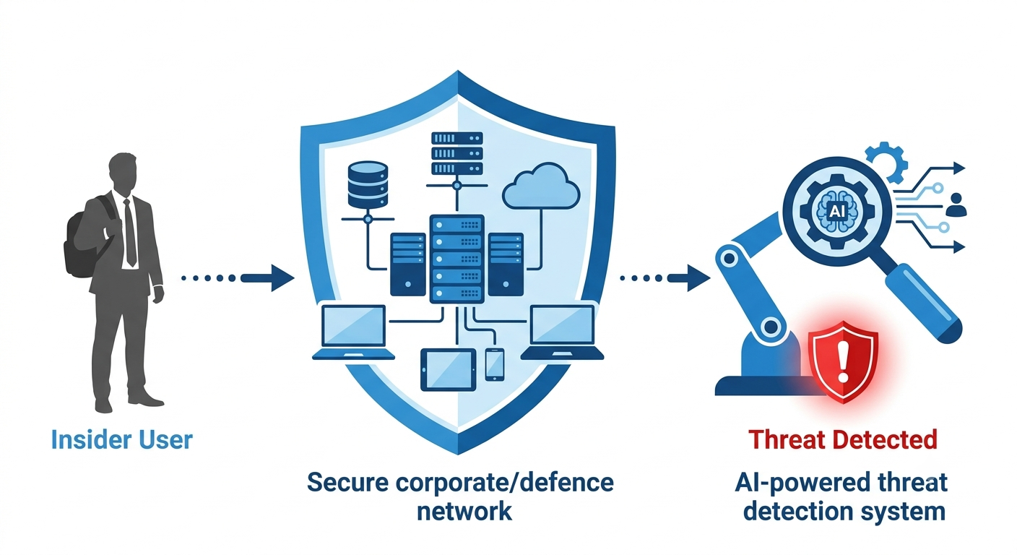
PROBLEM STATEMENT
Organizations generate millions of user activity logs every day. Traditional cybersecurity systems focus mainly on external attacks and fail to detect malicious activities performed by authorized users (insider threats).
Research Problem
How can an adaptive, explainable, and lightweight UEBA framework accurately detect insider threats while reducing false positives and supporting deployment in air-gapped defence environments?
Challenges
Static rule-based detection
High false-positive alerts
Black-box AI models
Lack of behavioural adaptation
Cloud dependency
Poor analyst trust

Slide 3
PROJECT GOAL
Develop an intelligent User and Entity Behaviour Analytics (UEBA) framework that:
Detects insider threats using AI and Machine Learning.
Adapts to changing user behaviour.
Provides explainable security alerts.
Reduces false positives.
Supports secure offline deployment for defence environments.

Slide 4
PROBLEM MOTIVATION
Why is this Problem Important?
Insider threats are increasing and difficult to detect.
Trusted users already possess legitimate system access.
Millions of security logs make manual monitoring impractical.
Traditional IDS, Firewalls & SIEM primarily detect external attacks.
Privileged users can misuse authorized access without triggering conventional security controls.
A single insider can compromise sensitive defence data and mission-critical infrastructure.

Slide 5
LITERATURE REVIEW
Research Work | Approach | Key Findings | Research Gap
Al-Shehari et al. (IEEE Access, 2023) | Isolation Forest | Achieved high anomaly detection accuracy on CERT dataset. | Relies on a single model with static behavioural baselines, leading to false positives.
Artioli et al. (Frontiers, 2024) | Behaviour Clustering (HDBSCAN, DenMune) | Effective user grouping for UEBA. | No adaptive learning, context-aware risk scoring, or explainability.
Alketbi & Mehmood (IEEE Access, 2025) | Explainable AI (SHAP/LIME) | Improved analyst trust through interpretable alerts. | Does not evaluate explanation reliability or adaptive behaviour.
Hybrid UEBA Models (2025–2026) | Autoencoders & Deep Learning | Better temporal anomaly detection performance. | Computationally expensive and unsuitable for lightweight offline deployment.
Systematic Literature Reviews (2024–2026) | Survey | Highlights the importance of behavioural analytics in UEBA. | Existing solutions lack integrated adaptive learning, explainability, and defence-focused deployment.

Slide 6
PROPOSED SOLUTION
TrustShield UEBA
TrustShield UEBA is an AI-powered insider threat detection framework that continuously learns user behaviour, identifies anomalous activities through multiple AI models, evaluates contextual risk, provides explainable security decisions, and enables lightweight deployment in secure defense environments.
Key Features
Adaptive Behaviour Learning
Consensus-Based Multi-Model Detection
Context-Aware Risk Engine
Explainable AI (XAI)
Explanation Reliability Score
Interactive Analyst Dashboard
Lightweight Offline Deployment

Slide 7
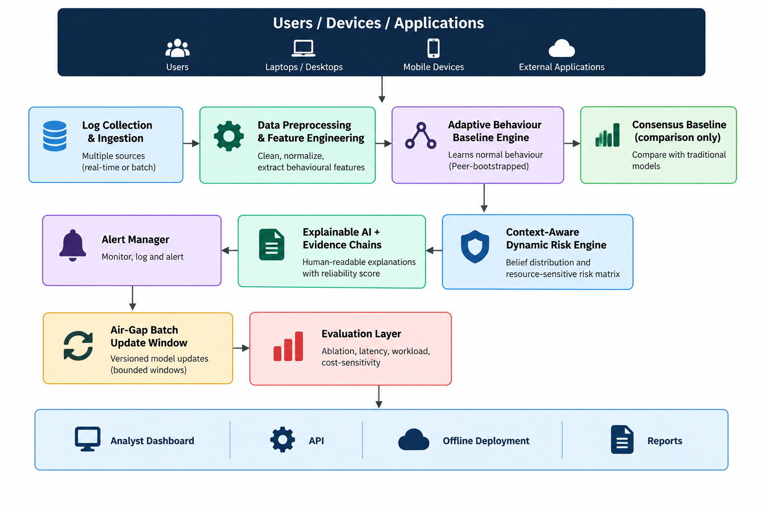
ARCHITECTURE
DIAGRAM

Slide 8
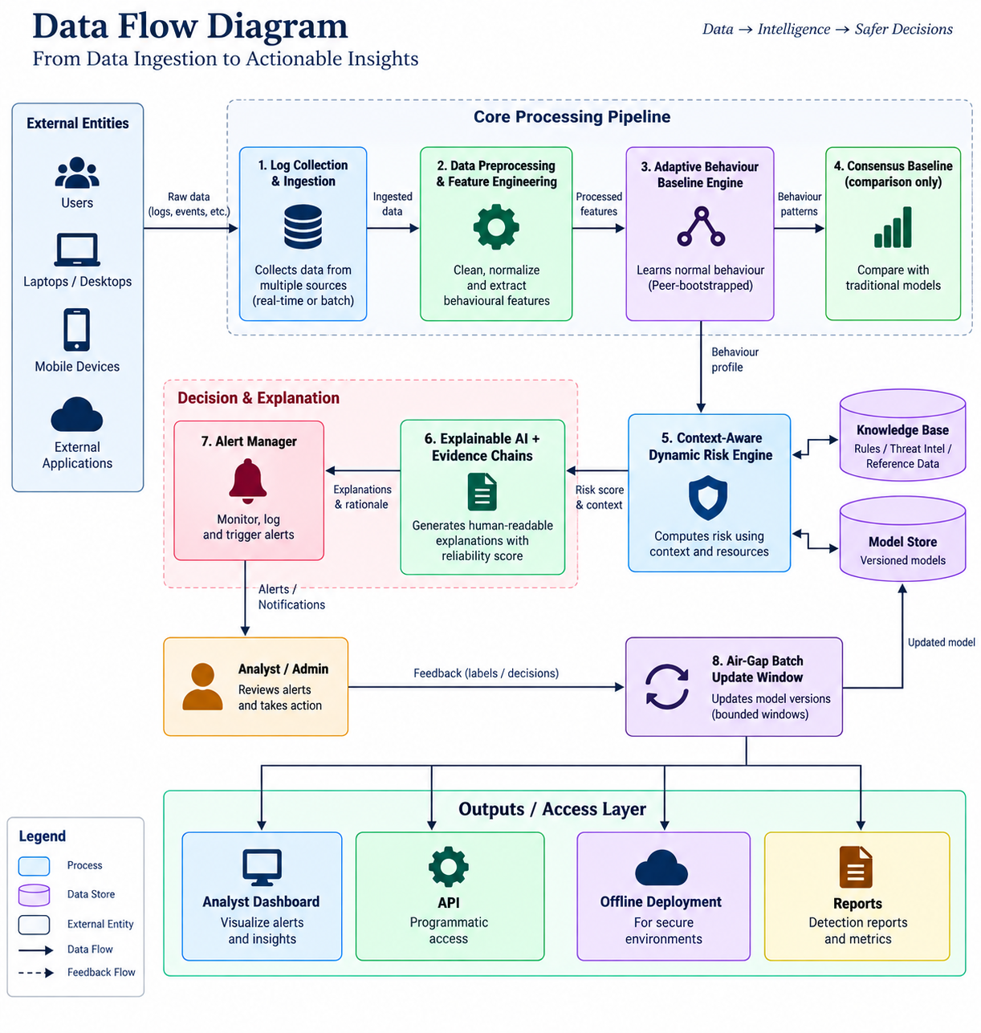
DATAFLOW
DIAGRAM

Slide 9
DEMO

Slide 10
REFERENCES
Alketbi, K. S., & Mehmood, A. (2025). Explainable AI Techniques for Insider Threat Detection. IEEE Access.
Al-Shehari, T., et al. (2023). Insider Threat Detection Using Isolation Forest. IEEE Access.
Artioli, P., et al. (2024). Clustering Algorithms for User and Entity Behaviour Analytics. Frontiers in Big Data.
Proactive Insider Threat Detection Framework. Faith Journal.
Artificial Intelligence-Based Insider-Threat Detection. Computers (MDPI), 2026.
Cybersecurity Threat Detection Based on a UEBA Framework Using Deep Autoencoders. arXiv, 2025.
Explainable Bidirectional LSTM Autoencoder for Insider Threat Detection. IEEE.
Attention-Driven Fusion of Sequential and Graph Neural Models for Insider Threat Detection. Scientific Reports, 2026.
Insider Threat Mitigation: A Systematic Literature Review. Computers & Security.
A Review of Insider Threat Detection: Classification, Machine Learning Techniques, Datasets, Open Challenges, and Recommendations. Electronics (MDPI)

Slide 11
THANK YOU

