Slide 1
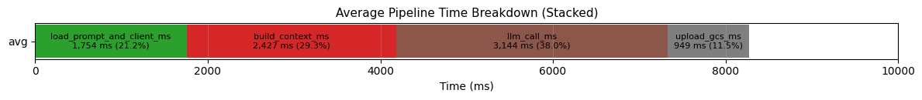
Thu,260311
Done
Drafted documentation for single_HyDE_generator (in progress)
Refactored the function to accept JSON input
Identified the reason why load_prompt_and_client_ms and _build_context_ms are slow
the config and prompt are being loaded on every execution.To improve performance, this part should be moved outside the main process and loaded only once.
Currently, I estimate that fixing this could reduce the per-user processing time from ~8 seconds to around 4–5 seconds.
Todo
Complete documentation for single_HyDE_generator
Prepare slides for sprint review + talk with Shin
Write documentation for subscore
Issue
-

Slide 2
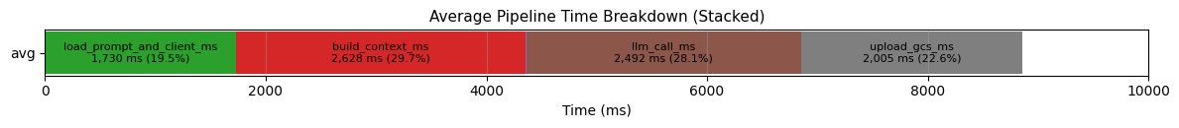
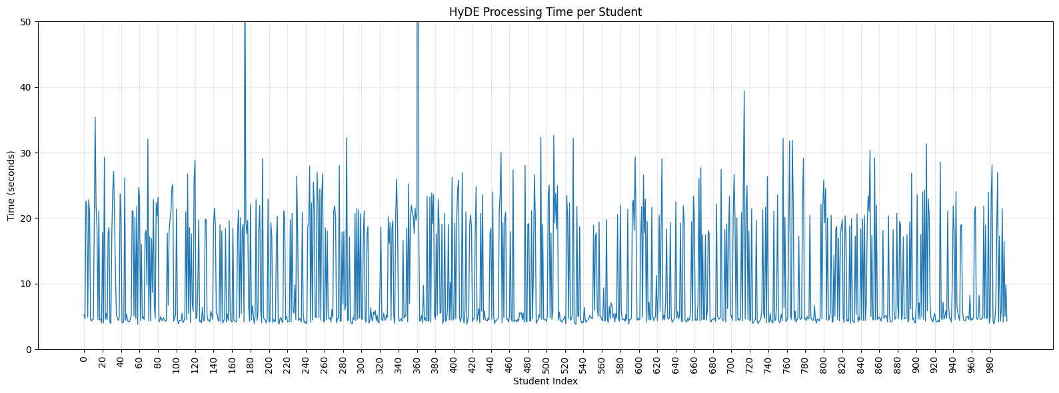
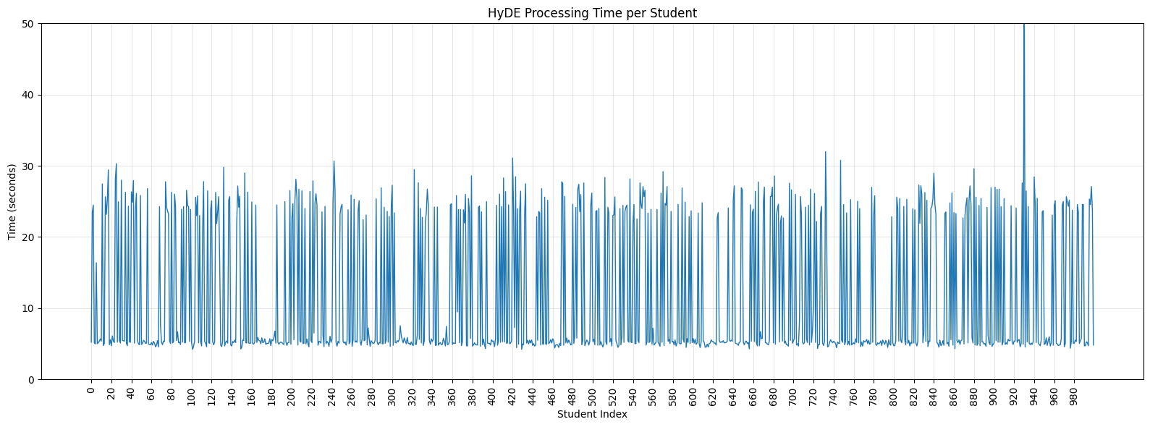
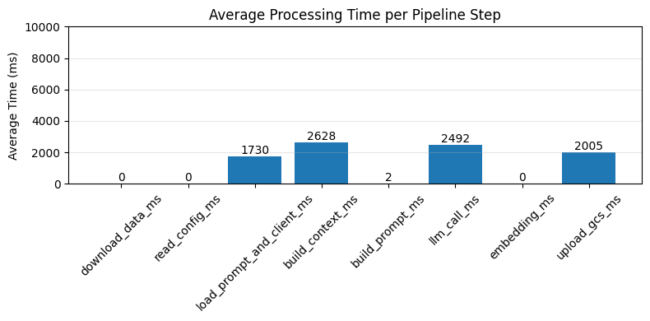
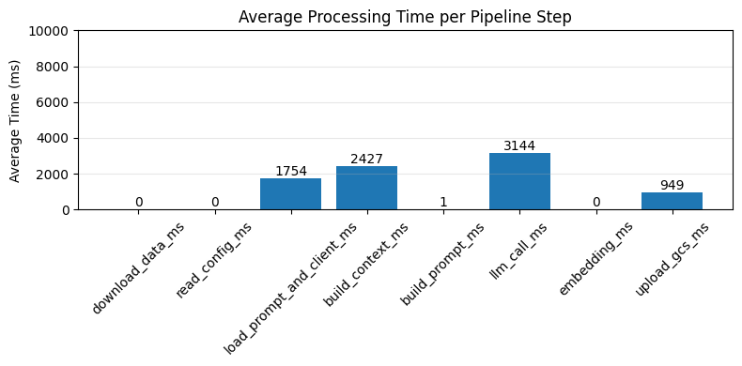
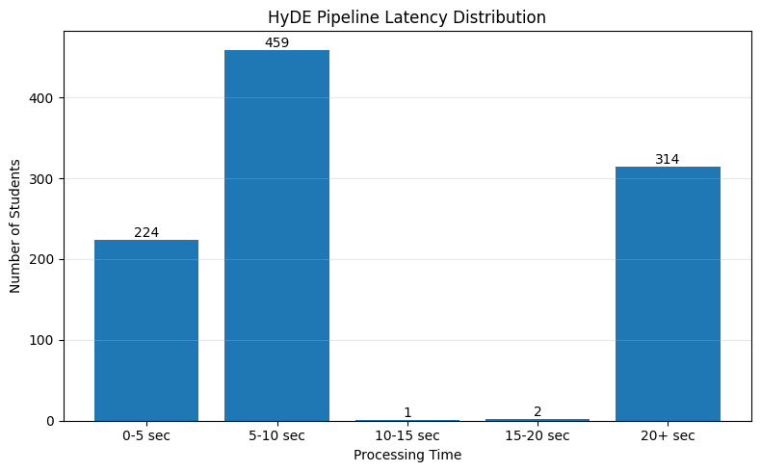
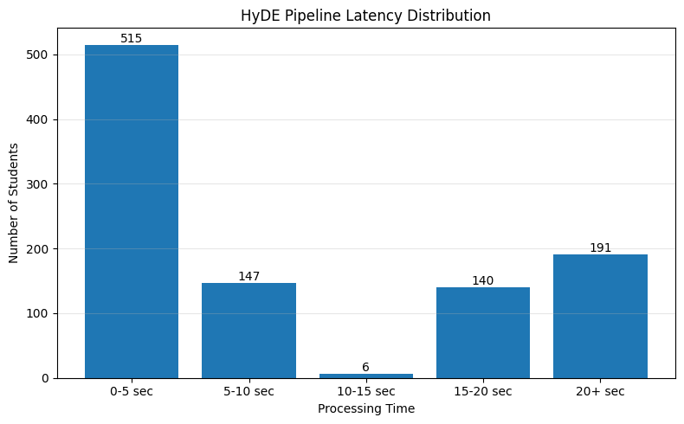
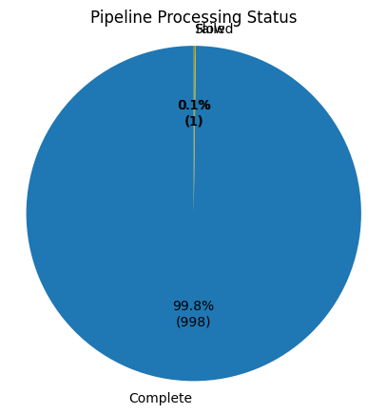
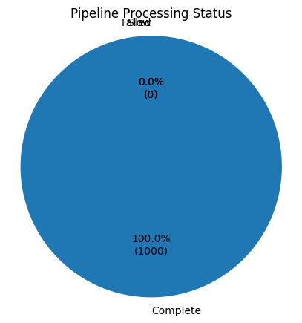
gemini-embedding-2-preview

Slide 3
Wed,260311
Done
Drafted documentation for single_HyDE_generator (in progress)
Refactored the function to accept JSON input
Identified the reason why load_prompt_and_client_ms and _build_context_ms are slow
the config and prompt are being loaded on every execution.To improve performance, this part should be moved outside the main process and loaded only once.
Currently, I estimate that fixing this could reduce the per-user processing time from ~8 seconds to around 4–5 seconds.
Todo
Complete documentation for single_HyDE_generator
Prepare slides for sprint review + talk with Shin
Write documentation for subscore
Issue
-

Slide 4
Fri,260306
Done
Change GCS storage format to store everything as a single object (currectly it requires 5+1+1 separate upload calls)
Run results
1,000 samples -> Pass
10,000 samples -> Fail
Todo
Summarize the results of the 1,000 sample run
Summarize findings on Parallel and Horizontal scaling
Ask for more details and design an API that accepts the required BigQuery data via input payload (instead of querying directly inside the service)
Issue
There seems to be something abnormal with the Parallel (ThreadPool) execution. I’m not sure why it consumes more resources and runs slower on Cloud Run, while on Local it becomes faster depending on the number of workers.

Slide 5
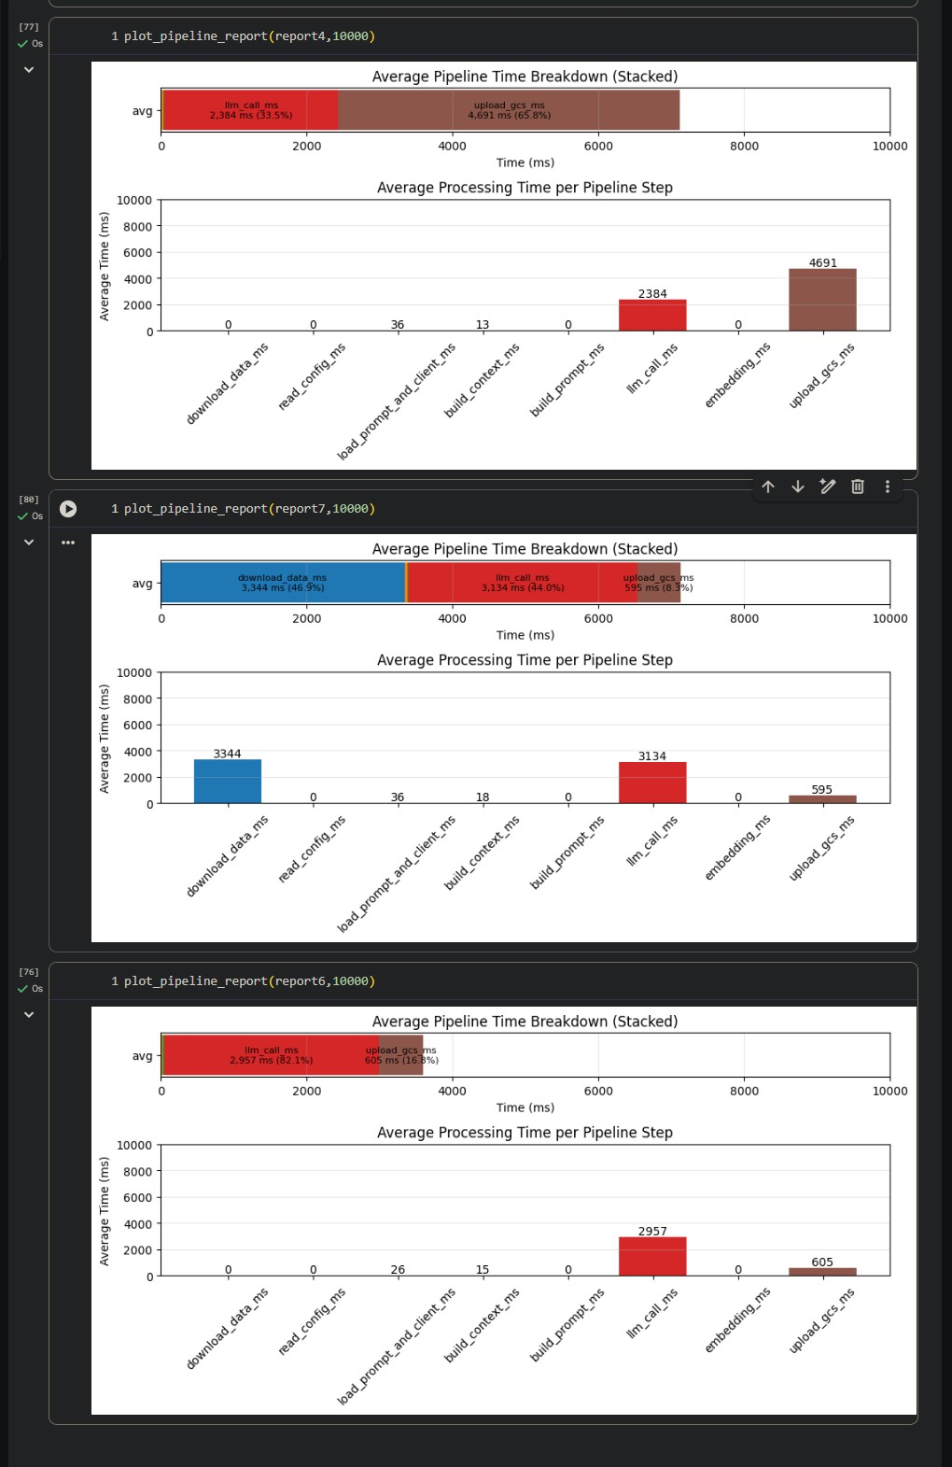
On : Cloudrun
Sample : 13
Run concurrent
Upload GCS : 5 embedding + 1 metadata + 1 hyde_Json
On : Cloudrun
Sample : 13
Run concurrent
Download : bigquery every student
Upload GCS : 1 (embedding + metadata + hyde json)
On : Cloudrun
Sample : 13
Run concurrent
Download : once time
Upload GCS : 1 (embedding + metadata + hyde json)

Slide 6
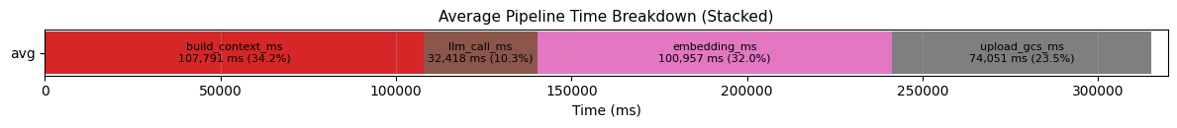
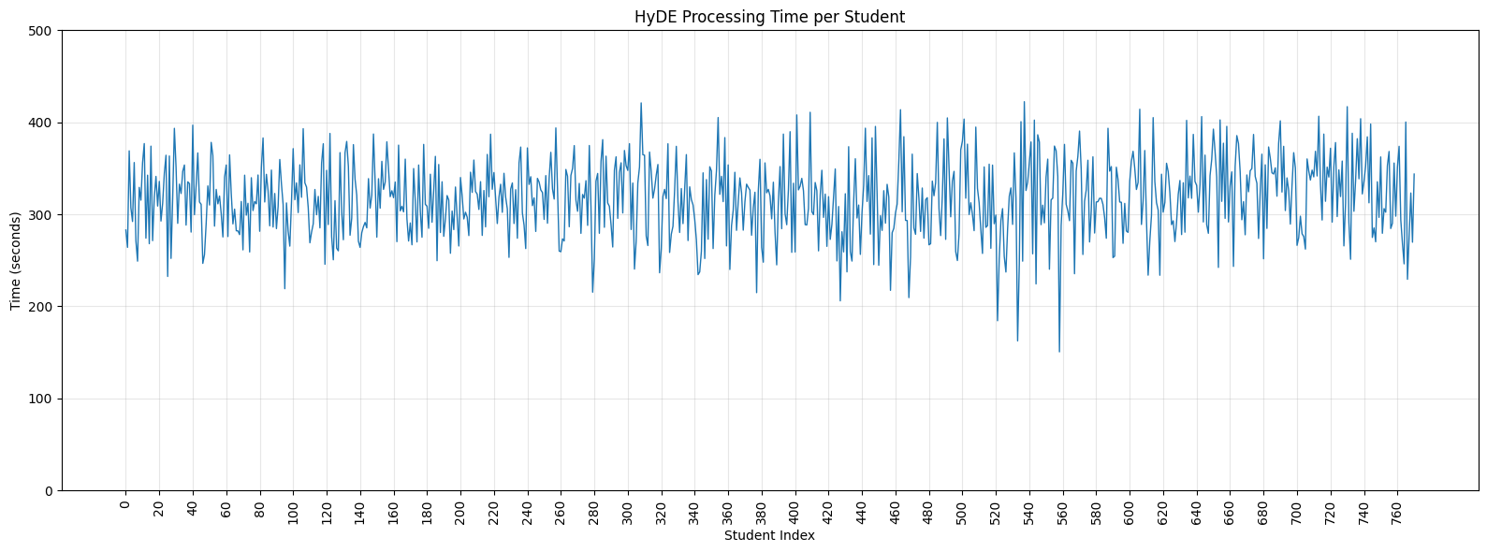
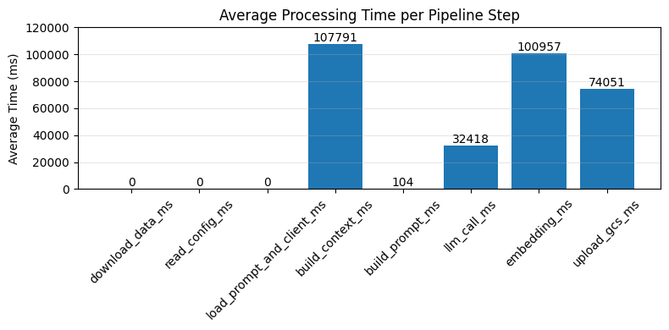
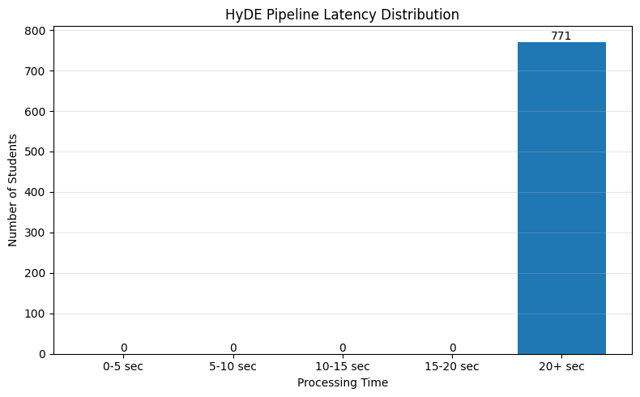
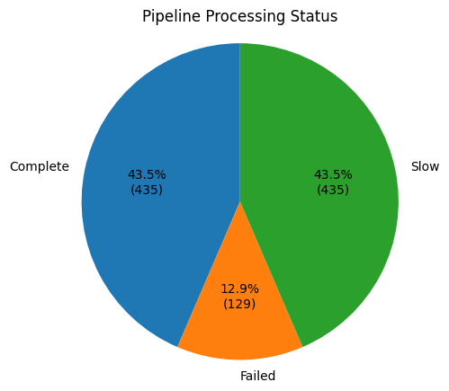

Slide 7
embedding-001

Slide 8
Sequential Processing
Parallel Processing (Worker Pool)
Horizontal Scaling
VM1
|- worker01
| - Process student_0001
| - Process student_0002
| - Process student_0003
…
| - Process student_1000
VM1
|- worker01
| - Job student_0001
| - Job student_0004
…
| - Job student_000(n)
|- worker02
| - Job student_0002
| - Job student_0005
…
| - Job student_000(n+1)
|- worker03
| - Job student_0003
| - Job student_0006
…
| - Job student_000(n+2)
VM1
|- worker01
| - Job student_0001
| - Job student_0004
…
| - Job student_000(n)
VM2
|- worker01
| - Job student_0002
| - Job student_0005
…
| - Job student_000(n+1)
VM3
|- worker01
| - Job student_0003
| - Job student_0006
…
| - Job student_000(n+2)

Slide 9
Horizontal Scaling
VM1
|- worker01
| - Job student_0001
| - Job student_0004
…
| - Job student_000(n)
VM2
|- worker01
| - Job student_0002
| - Job student_0005
…
| - Job student_000(n+1)
VM3
|- worker01
| - Job student_0003
| - Job student_0006
…
| - Job student_000(n+2)
Sequential Processing

Slide 10
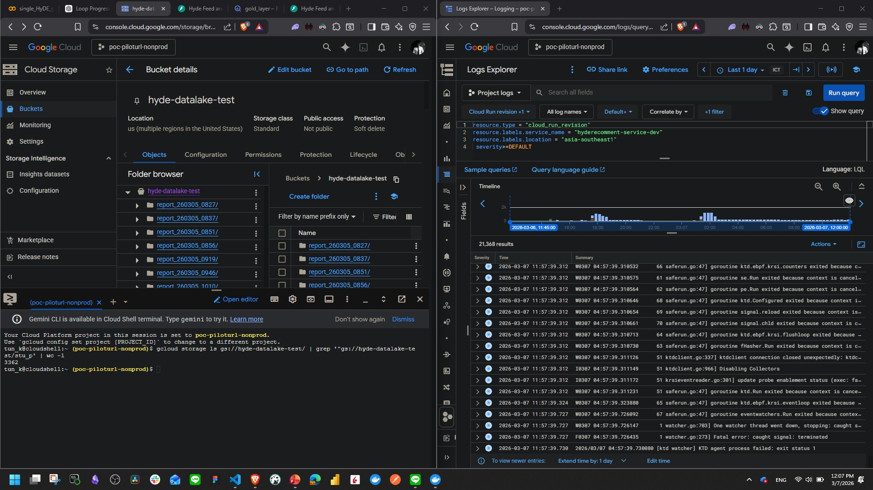

Slide 11
Fri,260306
Done
Refactored the code
Switched Gemini 3 Flash Preview -> gemini-3.1-flash-lite-preview
Improve the performance of `single_user_generator`
Implement async embedding
LLM malform
Find a way to prevent Cloud Run from shutting down automatically
Config
Modify code to use batch + for loop (like concurrent)
Todo
Change GCS storage format to store everything as a single object (currectly it requires 5+1+1 separate upload calls)
P’por report (Run 10,000 sample < 2 hours)
Issue
Code behave differently on Local vs Cloud (Cloud is more complicated)
BigQuery connection is slow
Uploading to GCS is slow

Slide 12
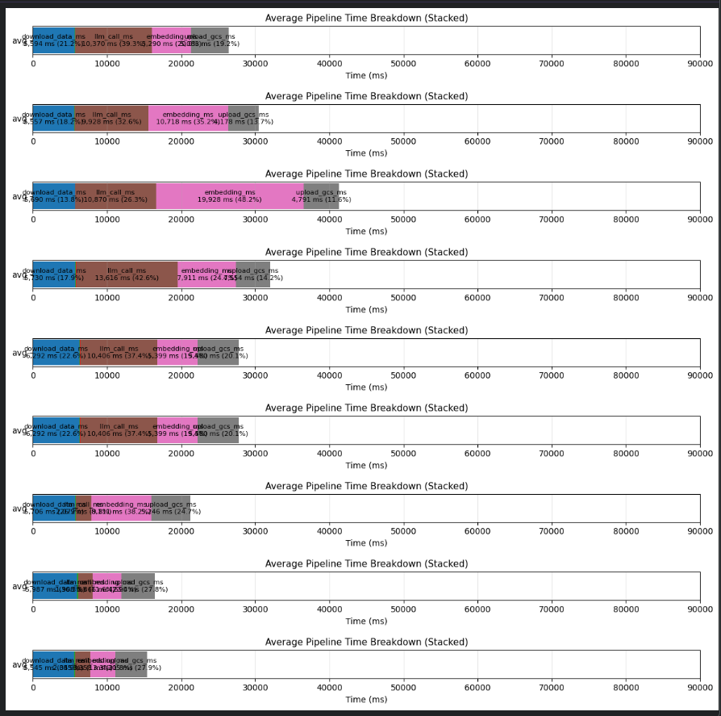
gemini-2.5-flash
gemini-3-flash-preview
gemini-3.1-flash-lite-preview

Slide 13
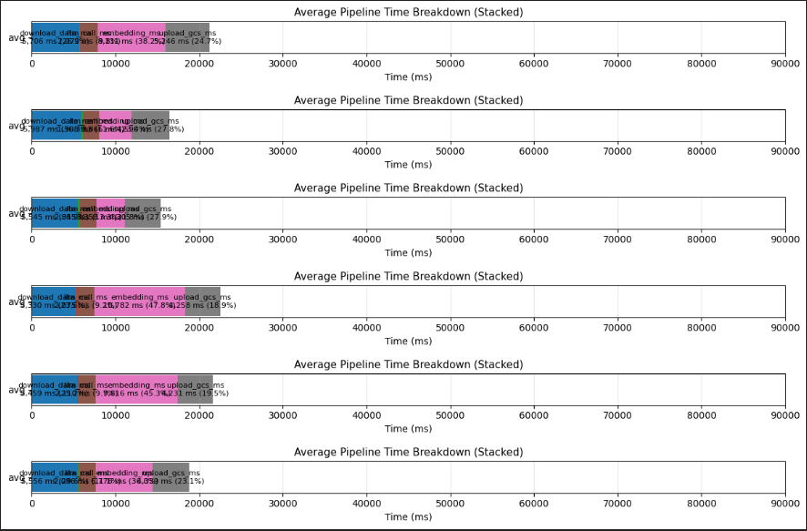
gemini-3.1-flash-lite-preview
gemini-3.1-flash-lite-preview
+ embedding async

Slide 14
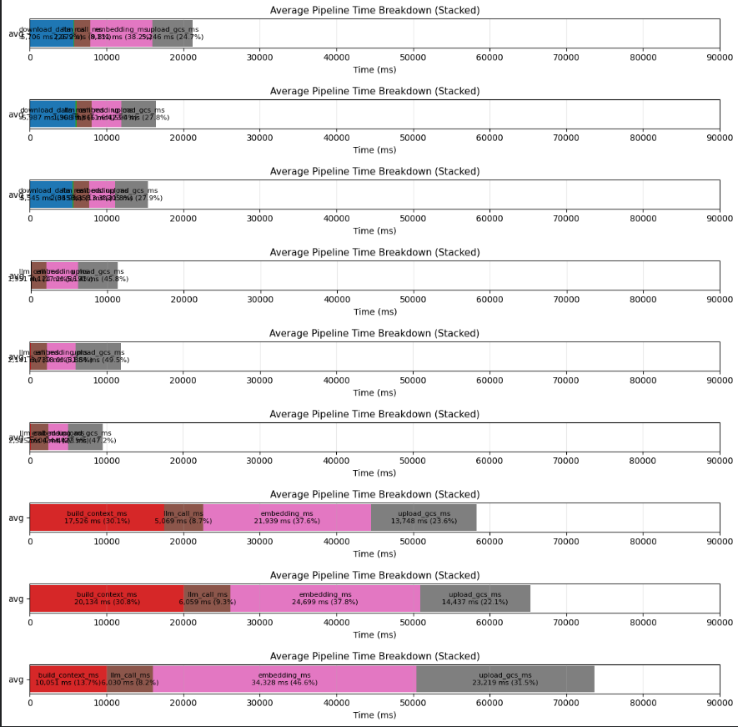
gemini-2.5-flash
gemini-3-flash-preview -> batch
gemini-3.1-flash-lite-preview -> batch
-> Cloudrun

Slide 15
Pipeline | Duration time | workers | updated_count | failed_count | slow_count
gemini-2.5-flash -> batch -> Cloudrun | 17786.24 sec ~ 296 min ~ 4.9 h | 20 | 741 | 259 | 741
gemini-3.1-flash-lite-preview -> batch -> Cloudrun | 18403.05 sec ~ 306 min ~ 5.1 h | 20 | 771 | 229 | 771

Slide 16
Thu,260305
Done
Deploy local code to Cloud run
Refactored the code
Switched from Gemini-2.5-Flash -> Gemini 3 Flash Preview
Refactored to connect to BigQuery only once (performance now close to local execution)
Report as a json -> GCS
Todo
Improve the performance of `single_user_generator`
Implement async embedding
Change GCS storage format to store everything as a single object (currectly it requires 5+1+1 separate upload calls)
LLM malform
Find a way to prevent Cloud Run from shutting down automatically
Config
Modify code to use batch + for loop (like concurrent)
Run 10,000 sample < 2 hours
P’por report
Issue
Code behave differently on Local vs Cloud (Cloud is more complicated)
BigQuery connection is slow
Uploading to GCS is slow
UI + logs are very poor
It’s sometimes shuts down during execution
Cloud has cold start -> warm behavior

Slide 17
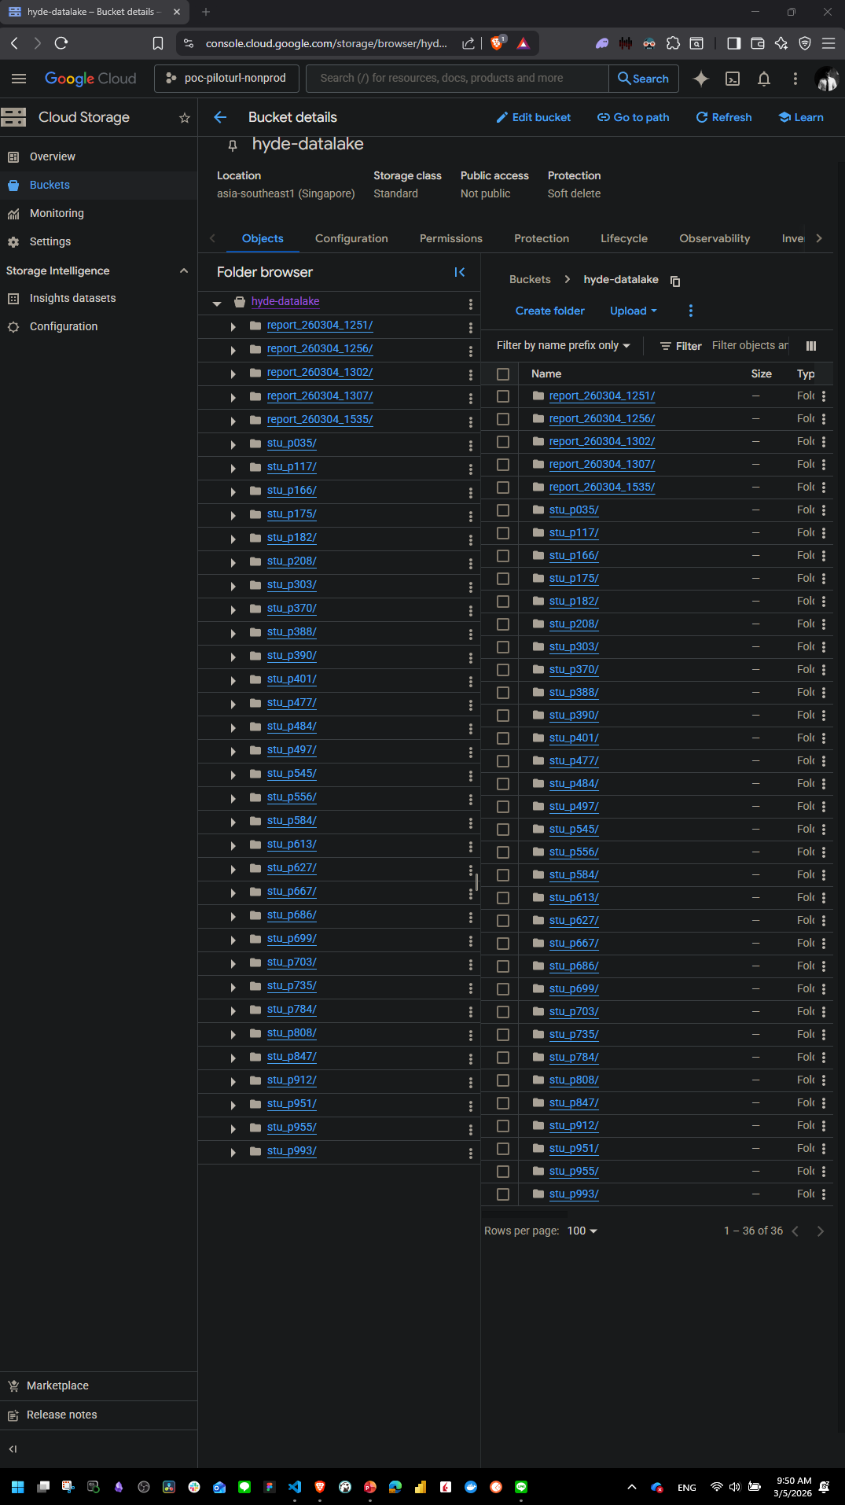
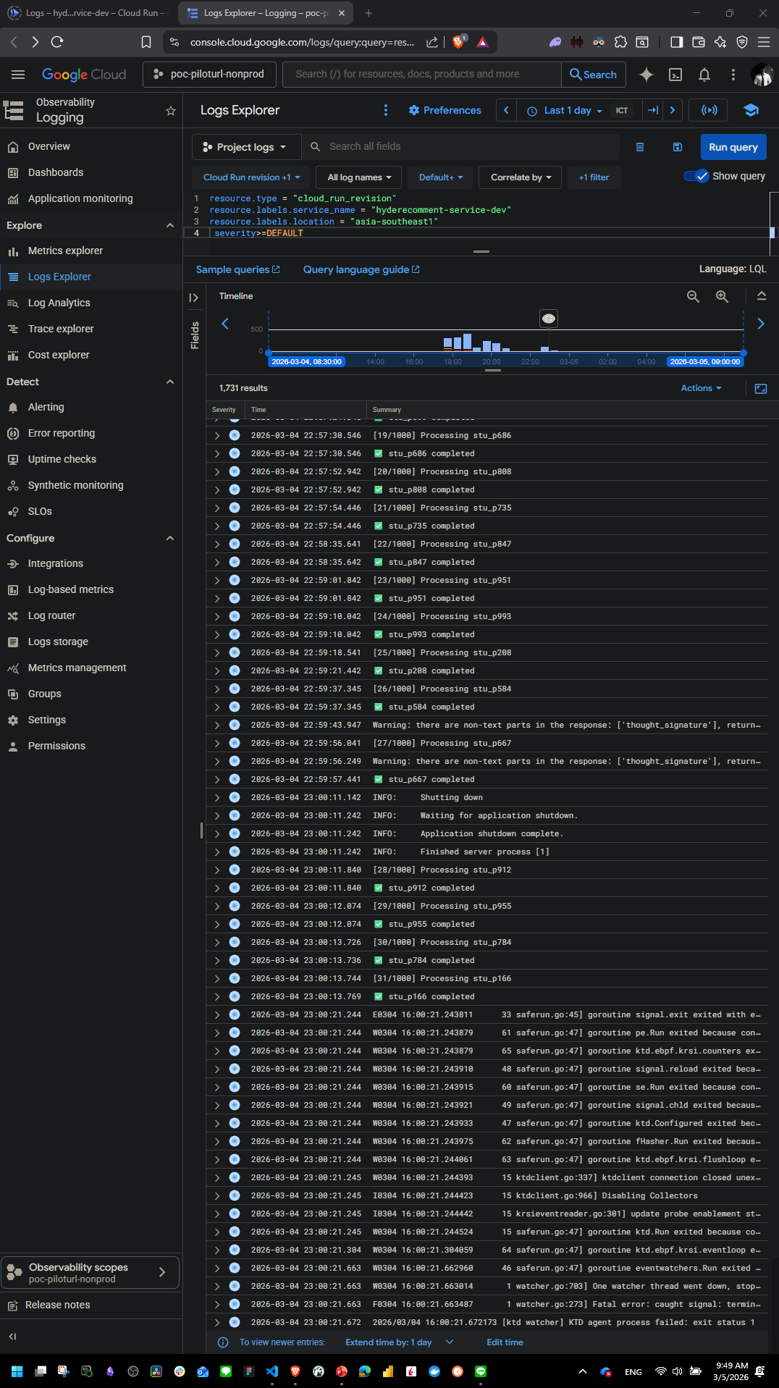

Slide 18
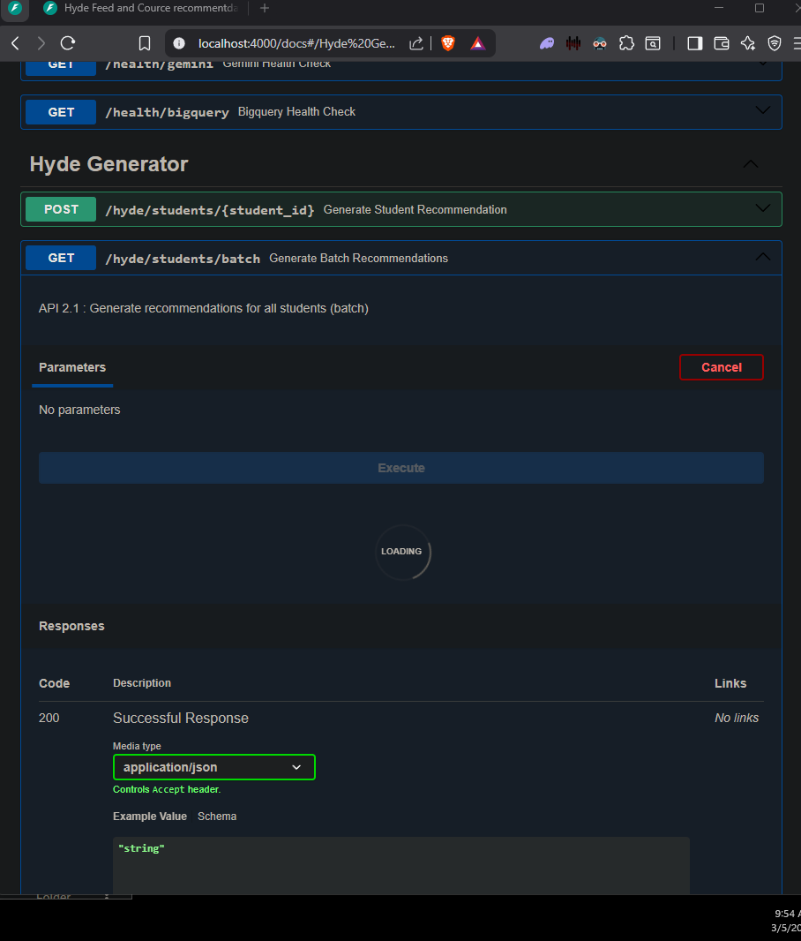
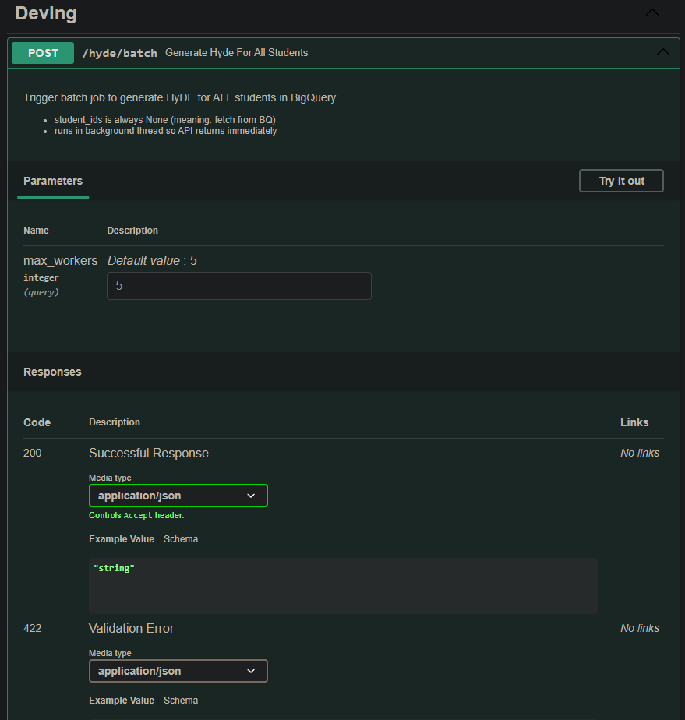

Slide 19
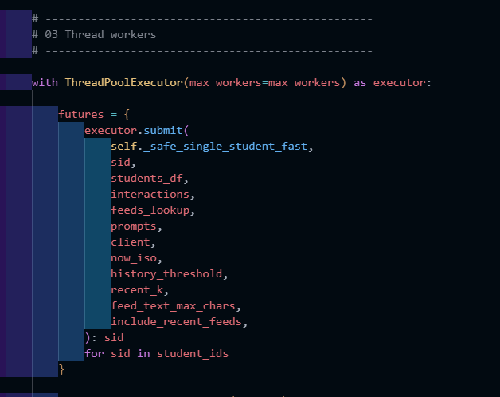
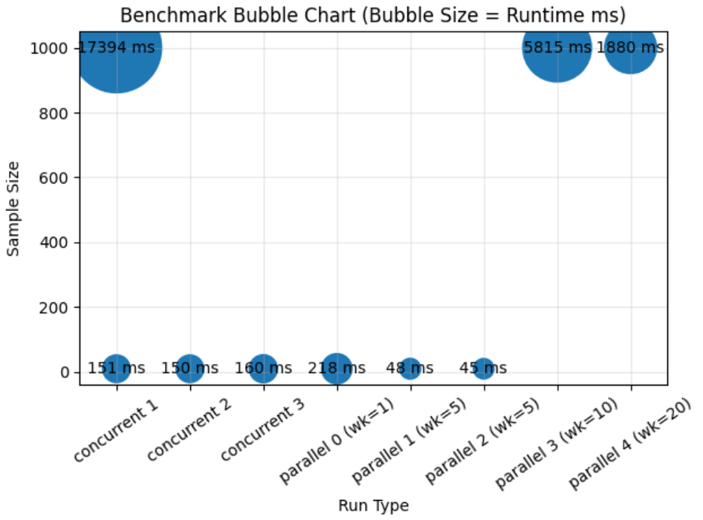

Slide 20
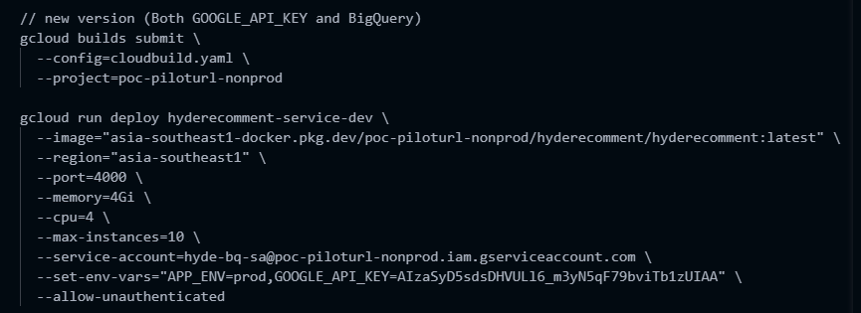
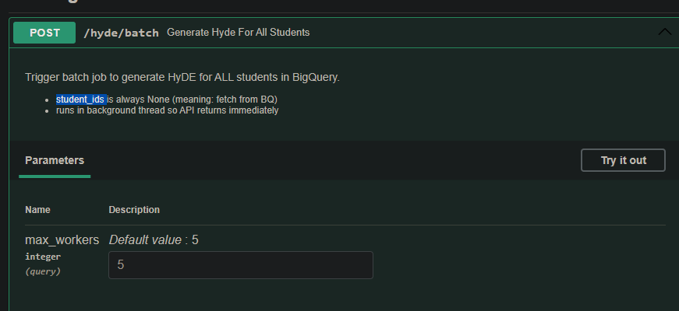
Max_workers = 14 - 18

Slide 21
Thu,260305
Done
Refactor code
เปลี่ยนจาก Gemini – 2.5 – flash -> gemini-3-flash-preview
Refactor ให้มีการเชื่อมต่อไปยัง BigQuery แต่ครั้งเดียว (ความเร็วเพิ่มขึ้น ใกล้เคียงกับ Local)
Deploy local code -> Cloud run
Todo
เพิ่มความเร็วของ single_user_generator
Async embedding
เปลี่ยนรูปแบบการเก็บบน GCS ให้เป้นแค่ก้อนเดียว (ปัจจุบันเนี้ยจะต้อง มีการยิง ผลลัพธ์ เพื่อไปเก็บ 5 + 1 + 1)
หาวิธีทำให้ Cloud run ไม่ shutdown ตัวเอง
Issue
การทำงานของ Code บน Local และ Cloud ต่างกัน (บน cloud มีเรื่องยุ่งยากกว่า)
การติดต่อ BigQuery ช้า
การส่งข้อมูลไป GCS ก็ช้า
UI + Log โคตรแย่
ทำๆ ไปมัน shutdown
Cloud มี Cold และ Warm

Slide 23
Tue,260224
Done
Run API แบบ concurrence 1000 samples student
Develop asynchronous API then test
Todo
Issue
-

Slide 24
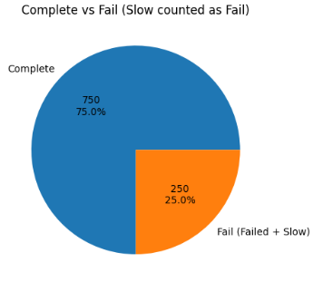
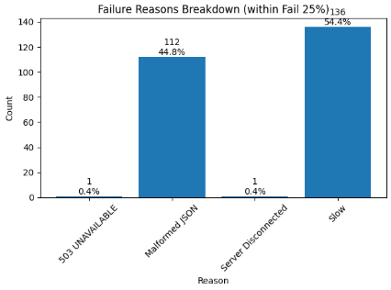

Slide 25
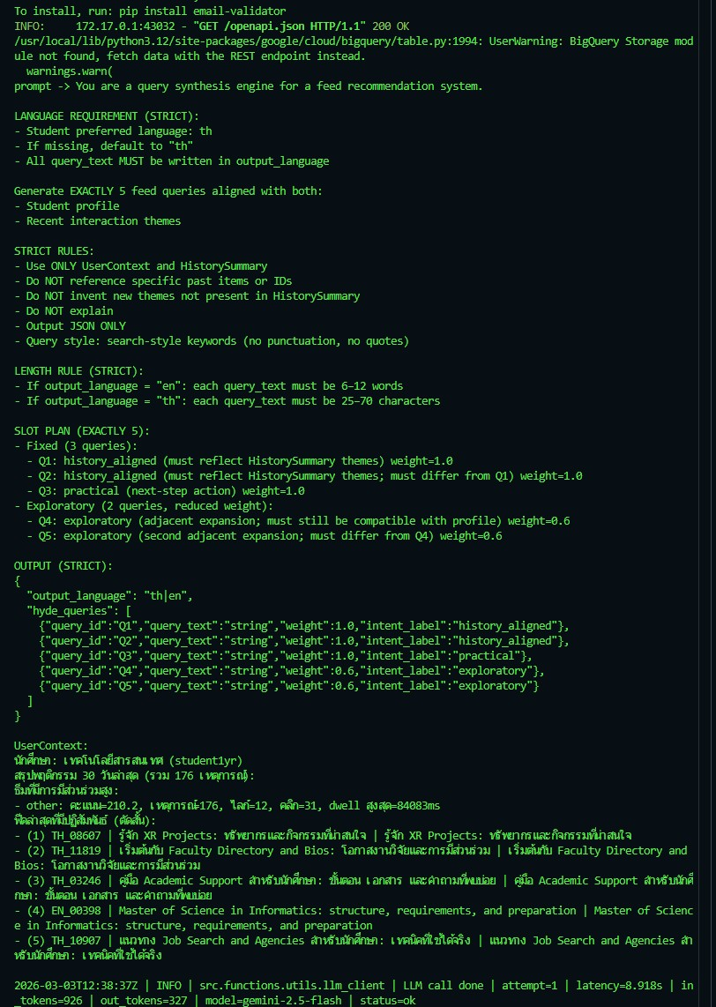
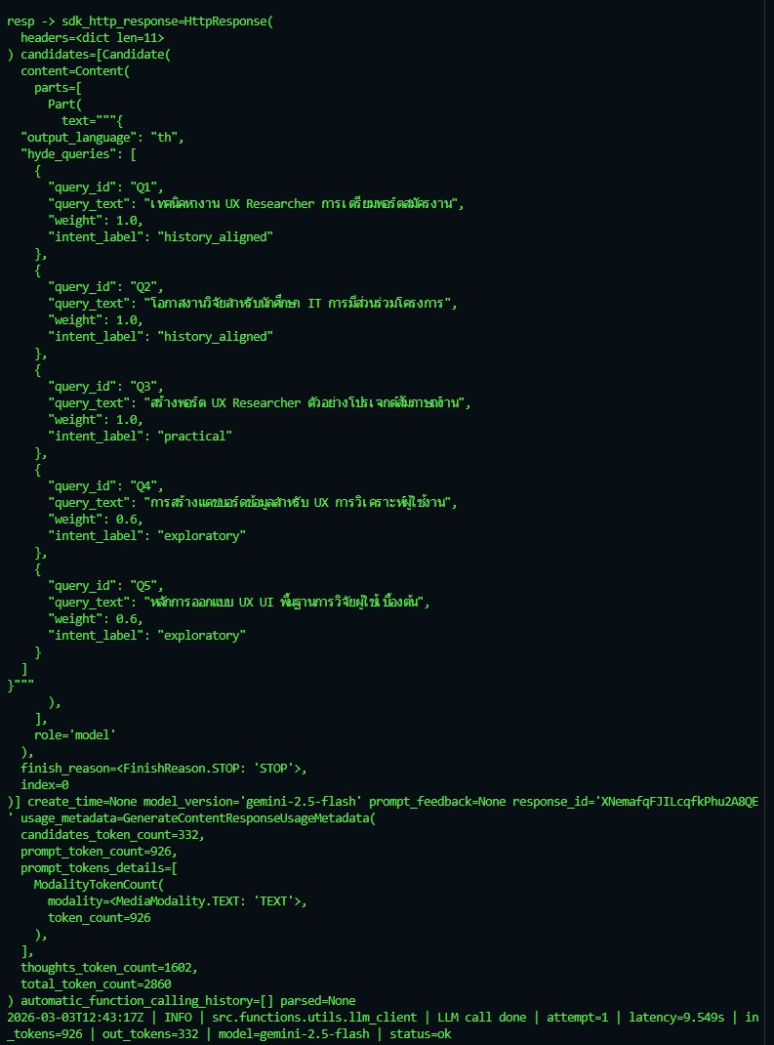

Slide 26
1 Prompts
1 Llm call
5 HyDE queries

Slide 27
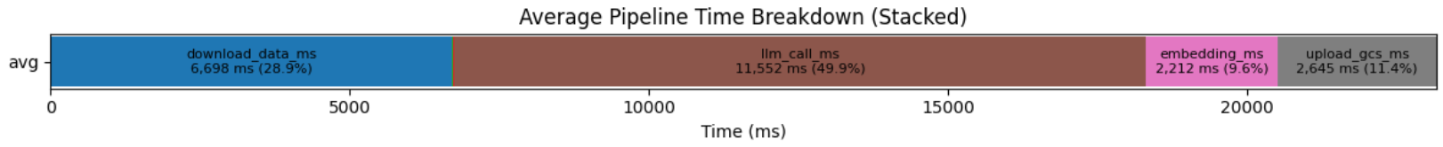
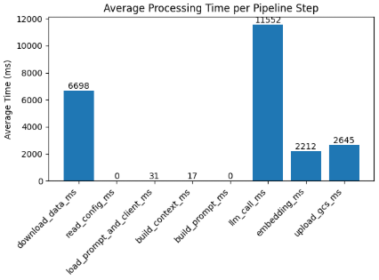
student_id | download_data_ms | read_config_ms | load_prompt_and_client_ms | build_context_ms | build_prompt_ms | llm_call_ms | embedding_ms | upload_gcs_ms | total_ms
stu_p001 | 6,676.34 | 0.04 | 30.48 | 17.83 | 0.01 | 10,569.14 | 1,858.89 | 2,698.69 | 21,852.45
stu_p002 | 6,542.91 | 0.06 | 26.57 | 15.8 | 0.01 | 9,630.89 | 2,245.47 | 2,638.83 | 21,101.04
stu_p003 | 6,484.72 | 0.04 | 27.93 | 17.46 | 0.01 | 6,540.38 | 1,900.97 | 2,749.61 | 17,721.76
stu_p004 | 6,264.18 | 0.01 | 27.47 | 15.9 | 0.01 | 10,172.45 | 2,329.14 | 2,562.46 | 21,372.12
stu_p005 | 6,998.55 | 0.01 | 26.22 | 16.16 | 0.02 | 8,043.34 | 2,302.06 | 2,561.47 | 19,948.55
stu_p006 | 7,063.04 | 0.01 | 29.04 | 17.42 | 0.01 | 9,127.42 | 1,891.49 | 2,626.31 | 20,755.28
stu_p007 | 6,686.17 | 0.04 | 26.5 | 14.59 | 0.02 | 10,783.59 | 2,279.08 | 2,743.67 | 22,534.26
stu_p008 | 6,842.37 | 0.01 | 26.17 | 16.21 | 0.01 | 8,602.45 | 2,735.80 | 2,717.34 | 20,941.17
stu_p009 | 6,655.42 | 0.01 | 25.62 | 14.12 | 0.01 | 9,007.64 | 2,245.55 | 2,631.08 | 20,580.48
stu_p010 | 6,770.32 | 0.02 | 61.37 | 21.09 | 0.05 | 33,046.21 | 2,331.73 | 2,523.96 | 44,755.40
avg | 6,698.40 | 0.03 | 30.74 | 16.66 | 0.02 | 11,552.35 | 2,212.02 | 2,645.34 | 23,156.25

Slide 28
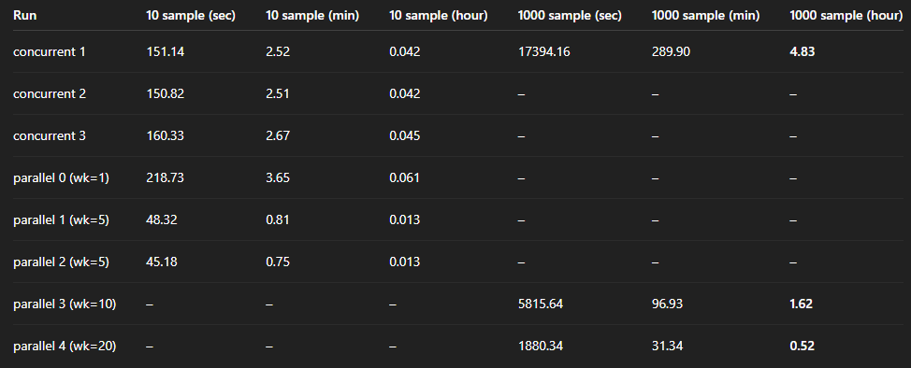

Slide 29
Sprint review #12 HyDE feed recommendation
API Spec Link :
Orchestrator :
API core evaluation link : https://hyderecomment-service-du7yhkyaqq-as.a.run.app
Github : https://github.com/TunKedsaro/Hyde
QA : https://humanintelligence.atlassian.net/wiki/spaces/CPM/pages/134611027/QA+Test+Plan+CV+Evaluation+Pipeline
Test : https://humanintelligence.atlassian.net/wiki/spaces/CPM/pages/148636743/HyDE+Core+Recommendation+Engine+Test+Plan

Slide 30
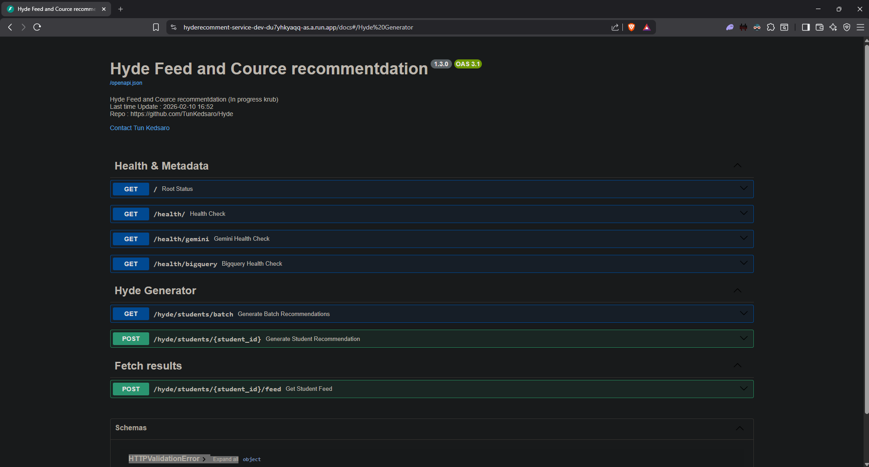
HyDE Feed Recommendation – HyDE generation
HyDE recommentdation core engine API
GCS / hyde-datalake (Test)

Slide 31
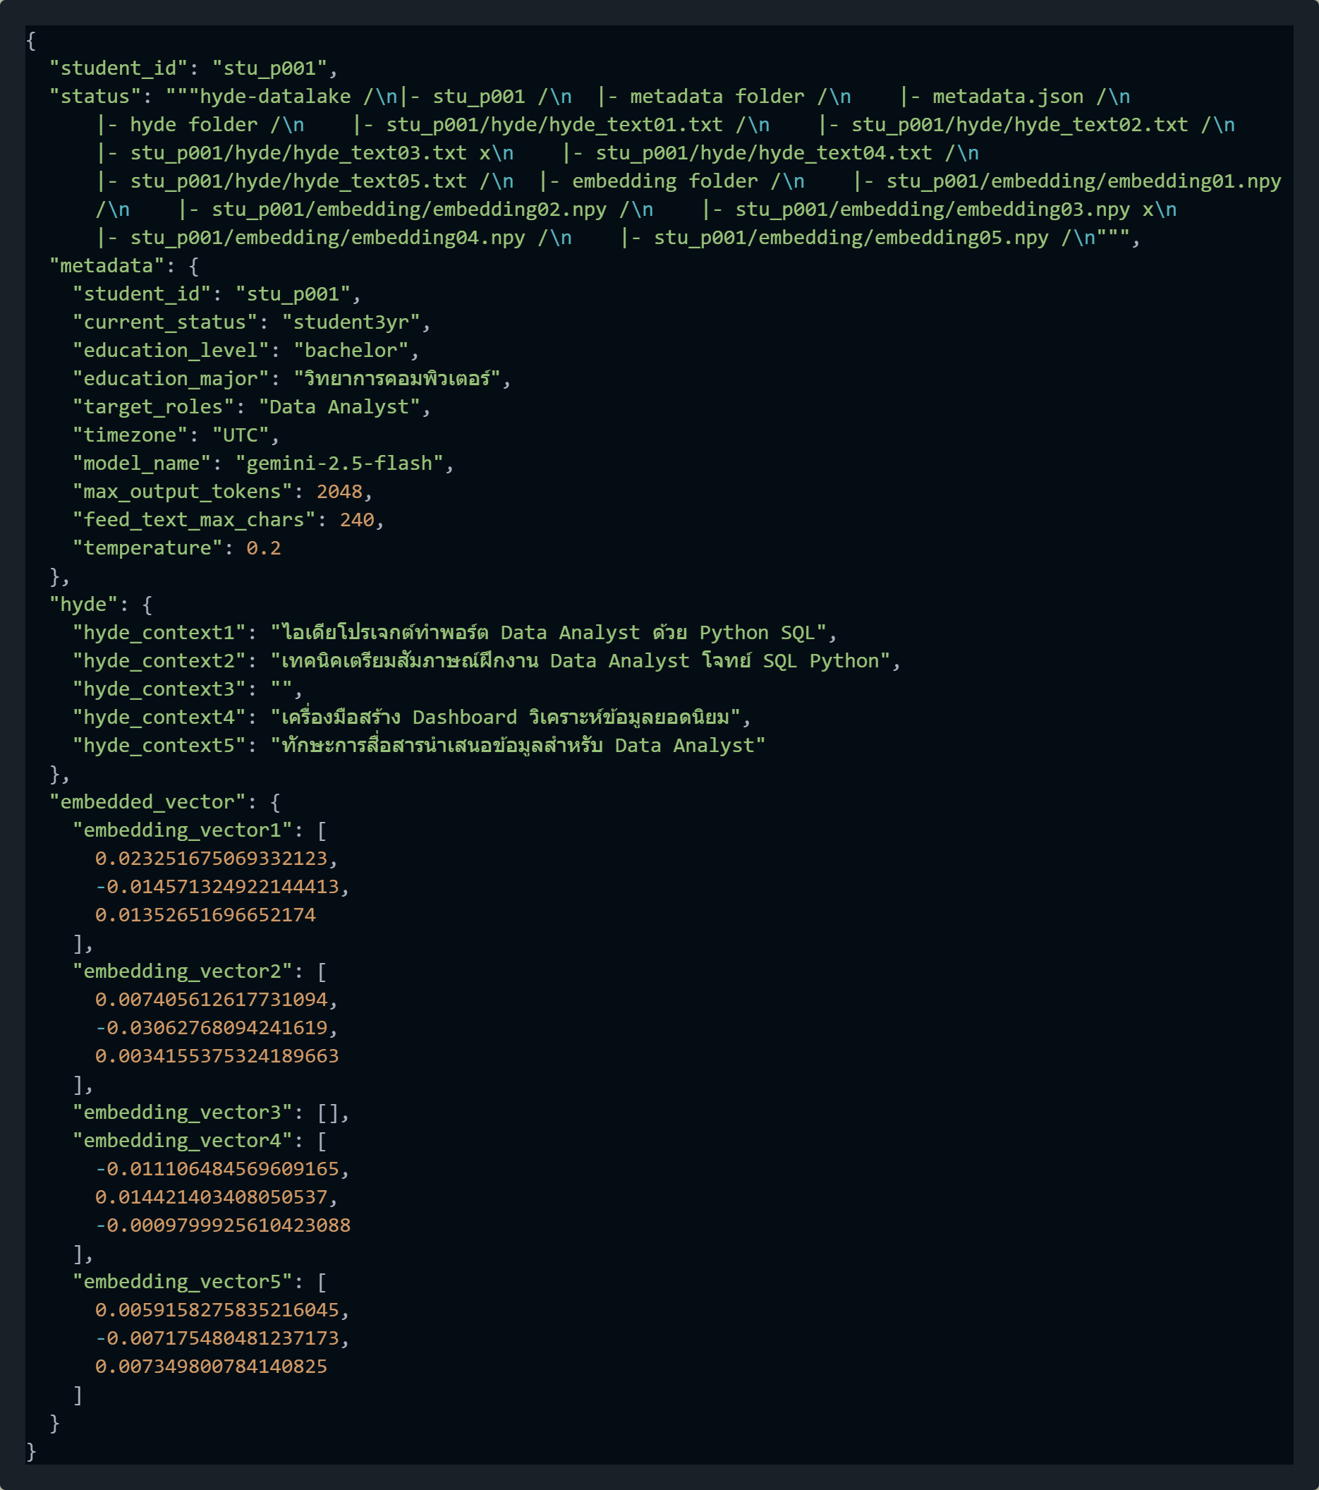
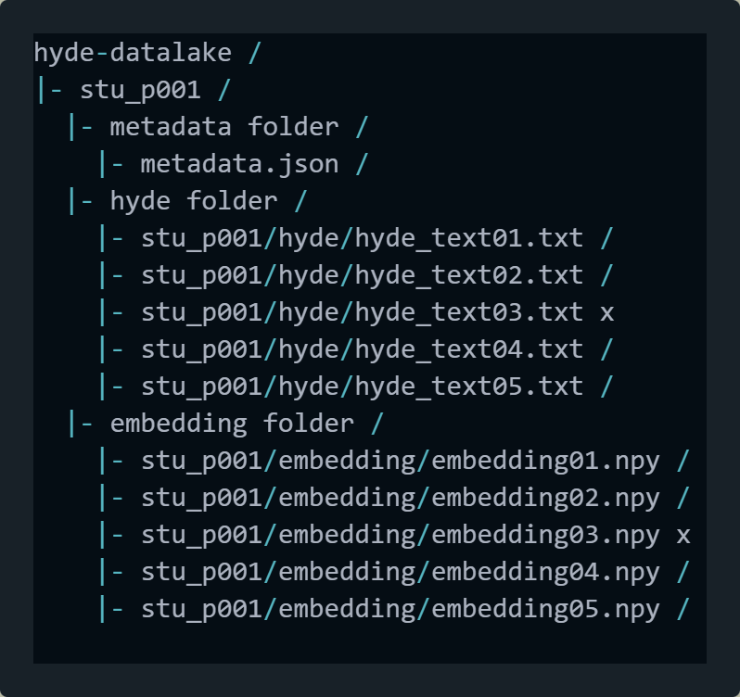
HyDE Feed Recommendation – HyDE generation
Overview

Slide 32
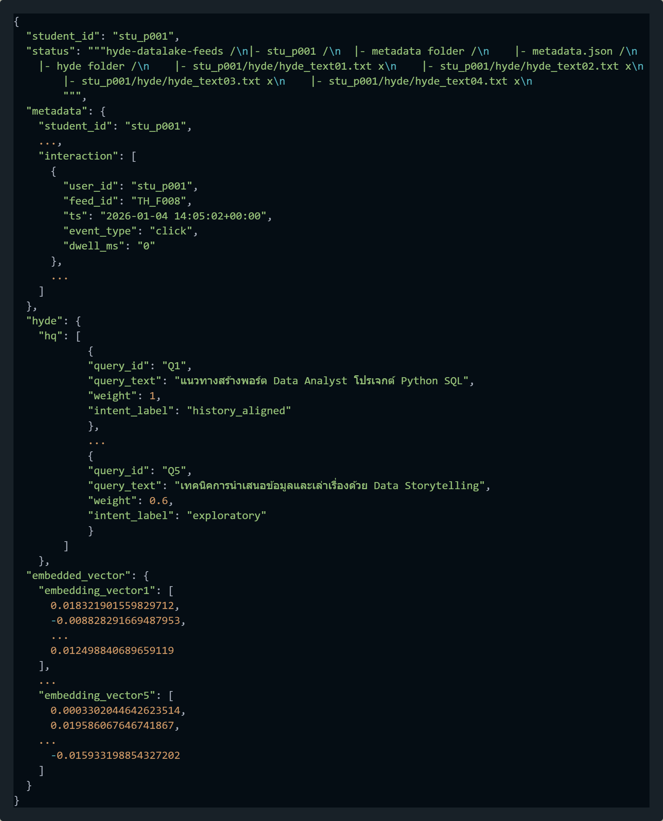
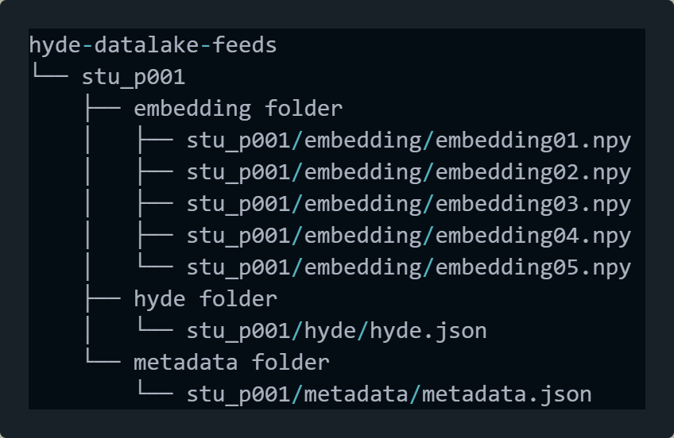
HyDE Feed Recommendation – HyDE generation

Slide 33
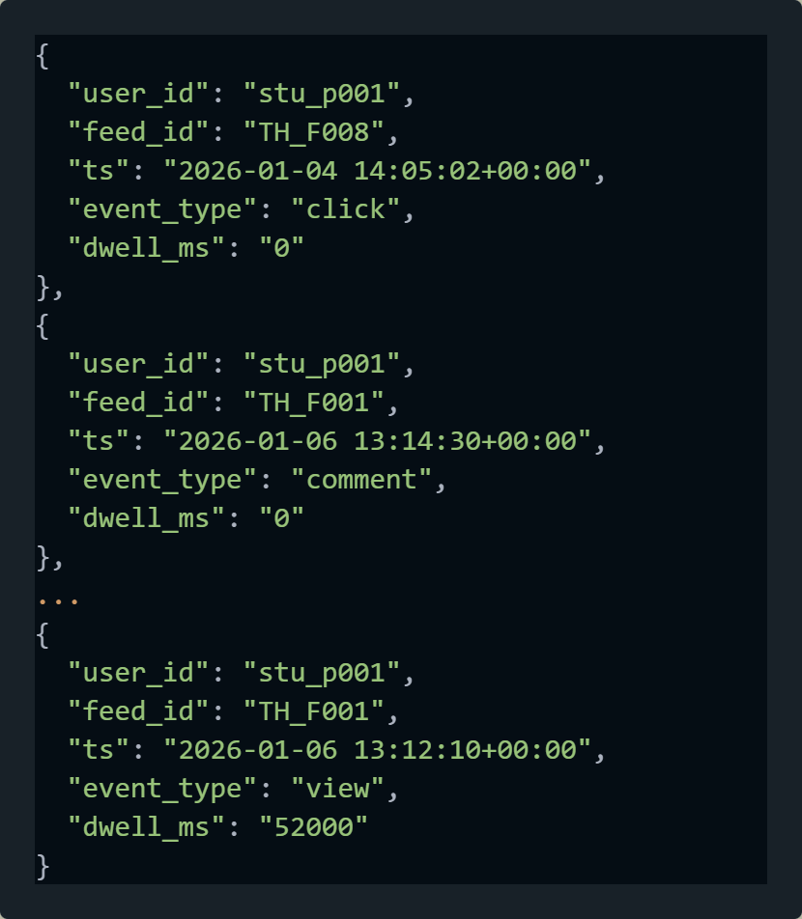
HyDE Feed Recommendation – HyDE generation
กำหนดให้ feed_metadata < 100
หาจำนวนที่เพราะสม
บางส่วนอาจจะหายไปกับเพราะเวลา out of date

Slide 34
HyDE Feed Recommendation - Subscore
Inputs
Load FAISS Index read_index()
Shin
Inputs
scores
feed_id
.npy
feed
Load + Validate
FAISS Search Top K
Score + indices
Map Indices <-> Meta
Candidates (feed_id)
Seen_feed
.json
.yaml
User Embedding
(1 – 5 queries)
Subscore function
vector
…
recency
popularity
Legend
Input
Process
Json response
Sort + Top-N + Final Output
Weighted Aggregation
Output
Process
-อาจจะ update ให้เป็น pararell ในอนาคต ตัว subscore
- อาจจะ update ช่วง ยิง shin ฟยร

Slide 35
HyDE Feed Recommendation - Subscore
Overview
Inputs
scores
feed_id
Seen feed
Subscore function
vector
…..
recency
popularity
Weighted Aggregation
Sort + Top-N + Final Output
Json response

Slide 36
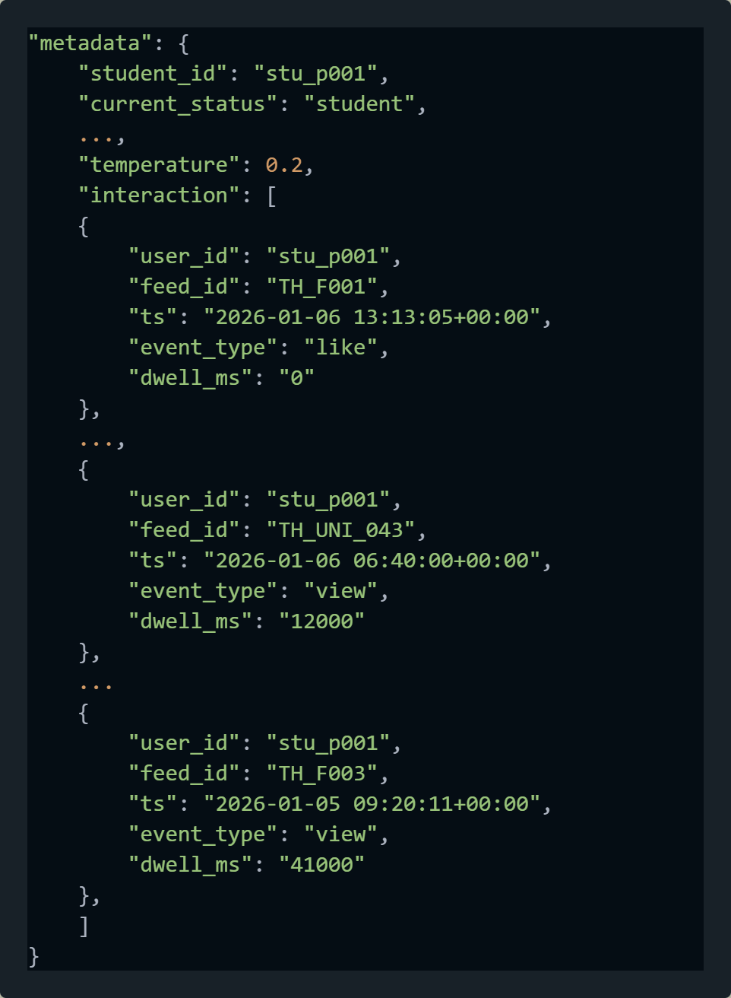

HyDE Feed Recommendation - Subscore
Overview
Inputs
scores
feed_id
Seen feed
Subscore function
vector
…..
recency
popularity
Weighted Aggregation
Sort + Top-N + Final Output
Json response

Slide 37
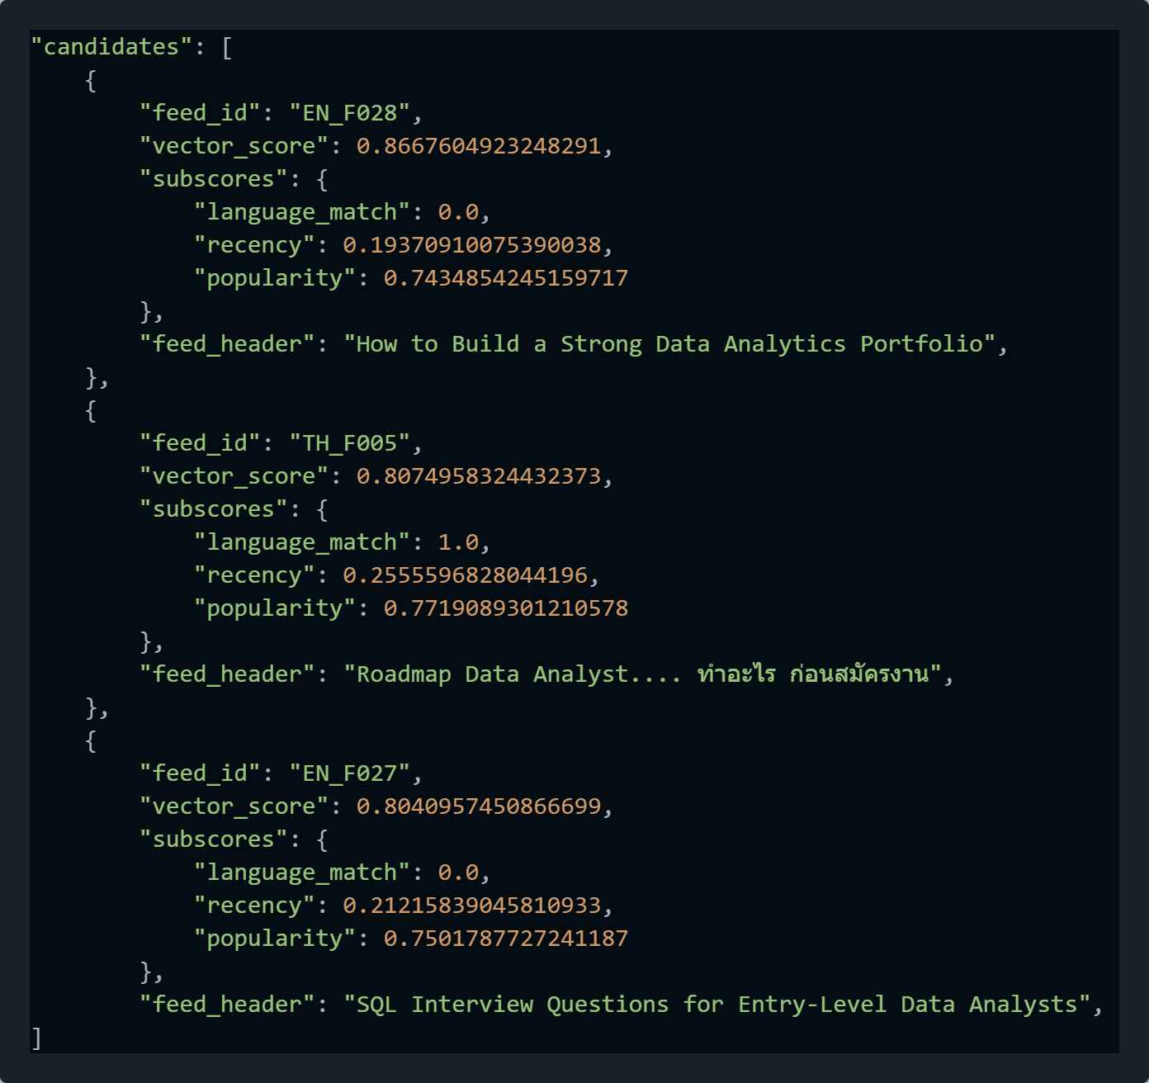
HyDE Feed Recommendation - Subscore
Overview
Inputs
scores
feed_id
Seen feed
Subscore function
vector
…..
recency
popularity
Weighted Aggregation
Sort + Top-N + Final Output
Json response

Slide 38
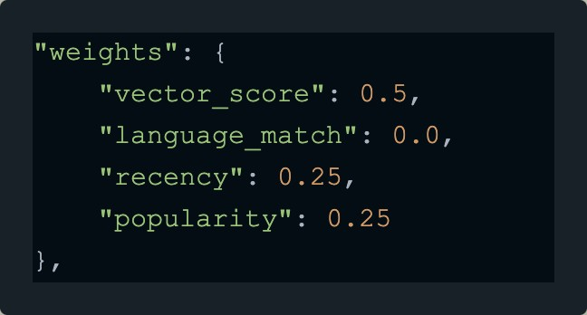
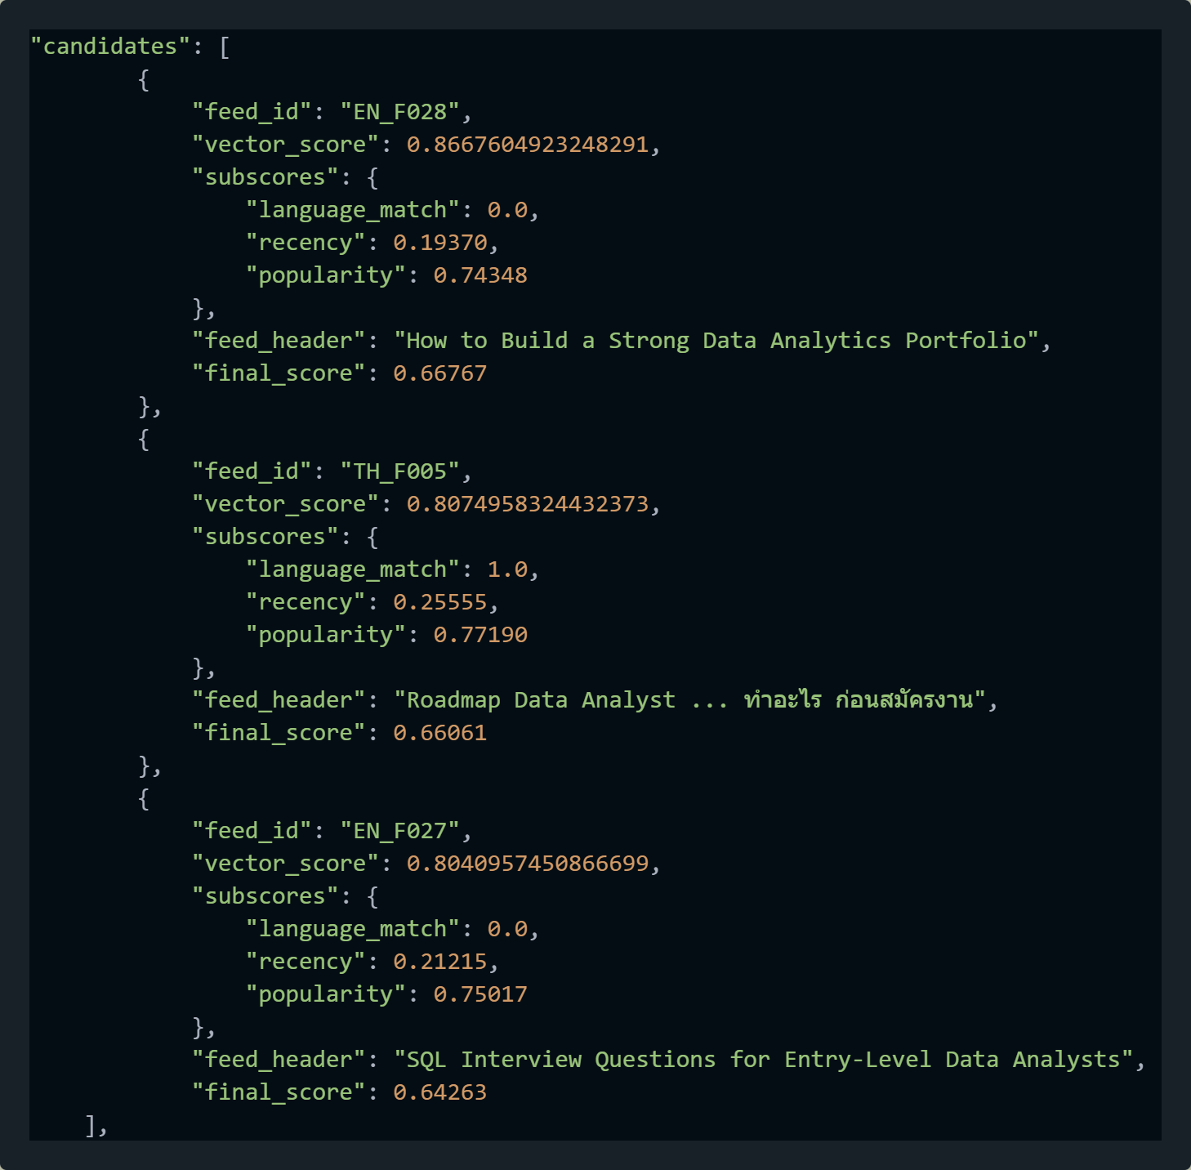
HyDE Feed Recommendation - Subscore
Overview
Inputs
scores
feed_id
Seen feed
Subscore function
vector
…..
recency
popularity
Weighted Aggregation
Sort + Top-N + Final Output
Json response

Slide 39
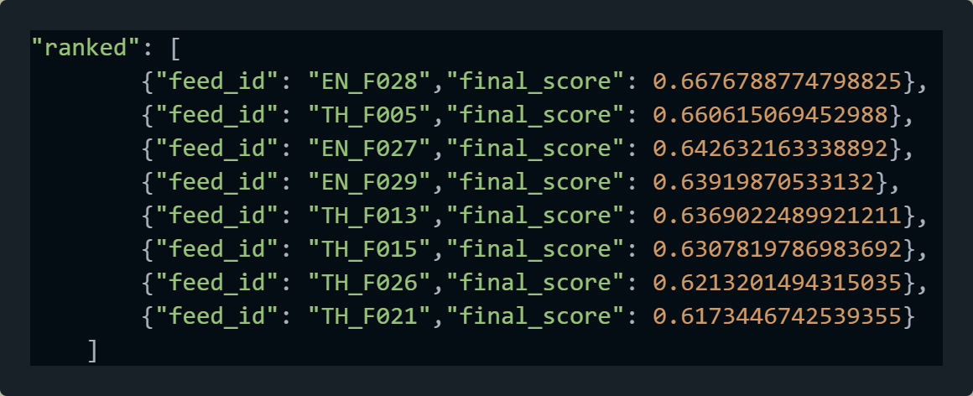
HyDE Feed Recommendation - Subscore
Overview
Inputs
scores
feed_id
Seen feed
Subscore function
vector
…..
recency
popularity
Weighted Aggregation
Sort + Top-N + Final Output
Json response

Slide 40
HyDE Feed Recommendation - Subscore
Test ID | Description | Method | Type | Result | Evidence
5.1.1 | Scorer (user_state, candidates) E2E contract | PyTest | Contract | PASS | test_5_1_scorer_contract.py
5.1.2 | return_debug=False production shape | PyTest | Contract | PASS | test_5_1_scorer_contract.py
5.1.3 | Deterministic same input → same output * Decimal issue | PyTest | Determinism | PASS | test_5_1_scorer_contract.py
5.2.1 | Popularity log formula correct | PyTest | Unit | PASS | test_5_2_popularity.py
5.2.2 | Recency exponential decay correct | PyTest | Unit | PASS | test_5_2_recency.py
5.2.3 | YAML weight change deterministic | PyTest | Aggregation | PASS | test_5_2_yaml_determinism.py
5.3.1 | Tie-breaker stable | PyTest | Ranking | PASS | test_5_3_tie_breakers.py
5.3.2 | Post-processing preserves order | PyTest | Ranking | PASS | test_5_3_post_processing.py
5.3.3 | NaN safety | PyTest | Robustness | PASS | test_5_3_nan_safety.py

Slide 41
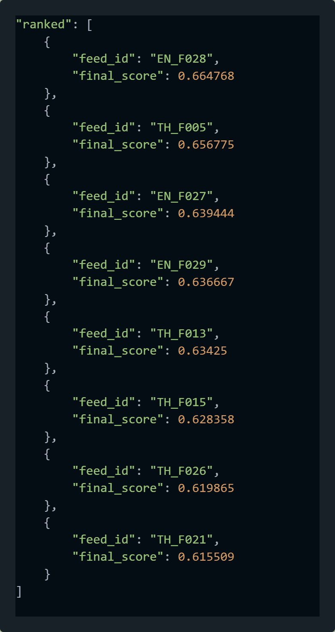
HyDE Feed Recommendation - Subscore
Run | Top1 | Top2 | Top3 | Top4 | Top5
1 | EN_F028 (0.66477) | TH_F005 (0.656778) | EN_F027 (0.639446) | EN_F029 (0.636669) | TH_F013 (0.634252)
2 | EN_F028 (0.66477) | TH_F005 (0.656777) | EN_F027 (0.639446) | EN_F029 (0.636669) | TH_F013 (0.634252)
3 | EN_F028 (0.66477) | TH_F005 (0.656777) | EN_F027 (0.639446) | EN_F029 (0.636669) | TH_F013 (0.634252)
4 | EN_F028 (0.664769) | TH_F005 (0.656777) | EN_F027 (0.639446) | EN_F029 (0.636668) | TH_F013 (0.634252)
…
10 | EN_F028 (0.664768) | TH_F005 (0.656775) | EN_F027 (0.639444) | EN_F029 (0.636667) | TH_F013 (0.634252)
delta | -0.000002 | -0.000003 | -0.000002 | -0.000002 | 0.000000
Delta (Δ) = ± 0.000003

Slide 42
HyDE Feed Recommendation - Subscore
Run | load_params | extract_query weight | Vector retrieval | Exclude seen | Build candidate | Score aggregation | total_ms
1 | 2.857 | 0.008 | 0.431 | 13.244 | 0.135 | 2.012 | 183.546
2 | 3.023 | 0.024 | 0.211 | 4.087 | 0.076 | 1.399 | 126.233
3 | 3.002 | 0.009 | 0.109 | 3.91 | 0.092 | 1.994 | 122.945
4 | 2.933 | 0.009 | 0.113 | 4.01 | 0.101 | 1.527 | 119.943
5 | 3.013 | 0.008 | 0.133 | 4.478 | 0.1 | 2.244 | 128.047
6 | 5.121 | 0.019 | 0.241 | 8.278 | 0.1 | 1.248 | 126.97
7 | 5.414 | 0.022 | 0.243 | 8.259 | 0.078 | 1.093 | 133.769
8 | 4.277 | 0.021 | 0.241 | 7.845 | 0.098 | 1.375 | 131.184
9 | 2.941 | 0.009 | 0.113 | 3.998 | 0.1 | 1.521 | 132.694
10 | 2.893 | 0.009 | 0.116 | 4.051 | 0.087 | 1.346 | 123.491
avg | 3.5474 | 0.0138 | 0.1951 | 6.216 | 0.0967 | 1.5759 | 132.8822
Goal all pipeline < 1500 ms
Notes:
load_params : load yaml
Extract_query : เตรียม vector ต่างๆ อาจจะเป็นการ x weight เพื่อ Normallize ความสำคัญของ vector score เหล่านั้น เราสามารถ defual = [1.0, 1.0, 1.0, 1.0, 1.0]
Vector retrieval : [5,50] -> [1,50] เป็นการเปรียบเทียบคะแนนของแต่ละ feed เพื่อหา candidate return ออกพร้อม {[feed_id:score]}
Exclude_seen : ดึงข้อมูลจาก metadata สำหรับแต่ละ student -> ตัด feed ที่เคยเห็นออก
Build candidate : คำนวณ subscore
Score aggregation : คูณน้ำหนักตาม weight

Slide 43
Sprint review #11 HyDE feed recommendation
API Spec Link :
Orchestrator :
API core evaluation link : https://hyderecomment-service-v1-1-0-du7yhkyaqq-as.a.run.app/docs#/
Github : https://github.com/TunKedsaro/Hyde
QA : https://humanintelligence.atlassian.net/wiki/spaces/CPM/pages/134611027/QA+Test+Plan+CV+Evaluation+Pipeline

Slide 44
HyDE Feed Recommendation - System Overview
Llm
Gemini_flast_2.5
feeds.jsonl
stu_p001.npy
Interactions.csv
Prepare_history
User_context
Embedding
gemini-embedding-001
Embedded vector
stu_p001.json
Students.csv
HyDE_prompt
Legend
Input
Process
Output
Process

Slide 45
HyDE Feed Recommendation - System Overview
HyDE recommentdation core engine API
GCS / hyde-datalake (Test)

Slide 46
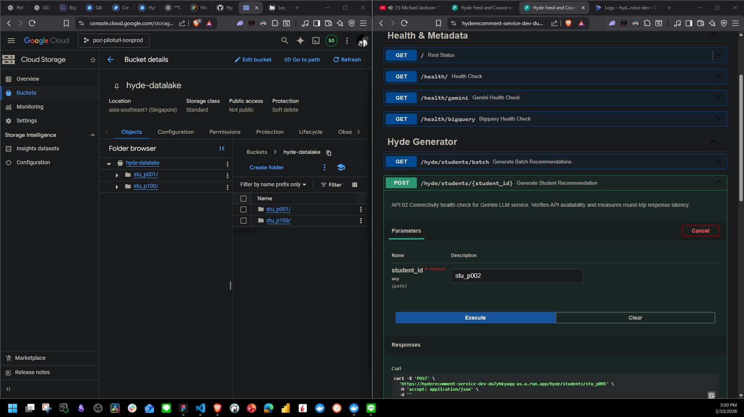
HyDE Feed Recommendation - Generate HyDE bundle for a single student
HyDE recommentdation core engine API
GCS / hyde-datalake (Test)

Slide 47
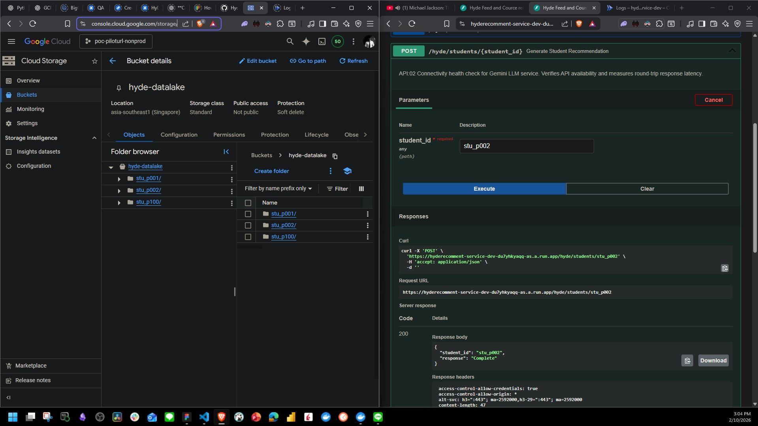
HyDE Feed Recommendation - Generate HyDE bundle for a single student
HyDE recommentdation core engine API
GCS / hyde-datalake (Test)

Slide 48
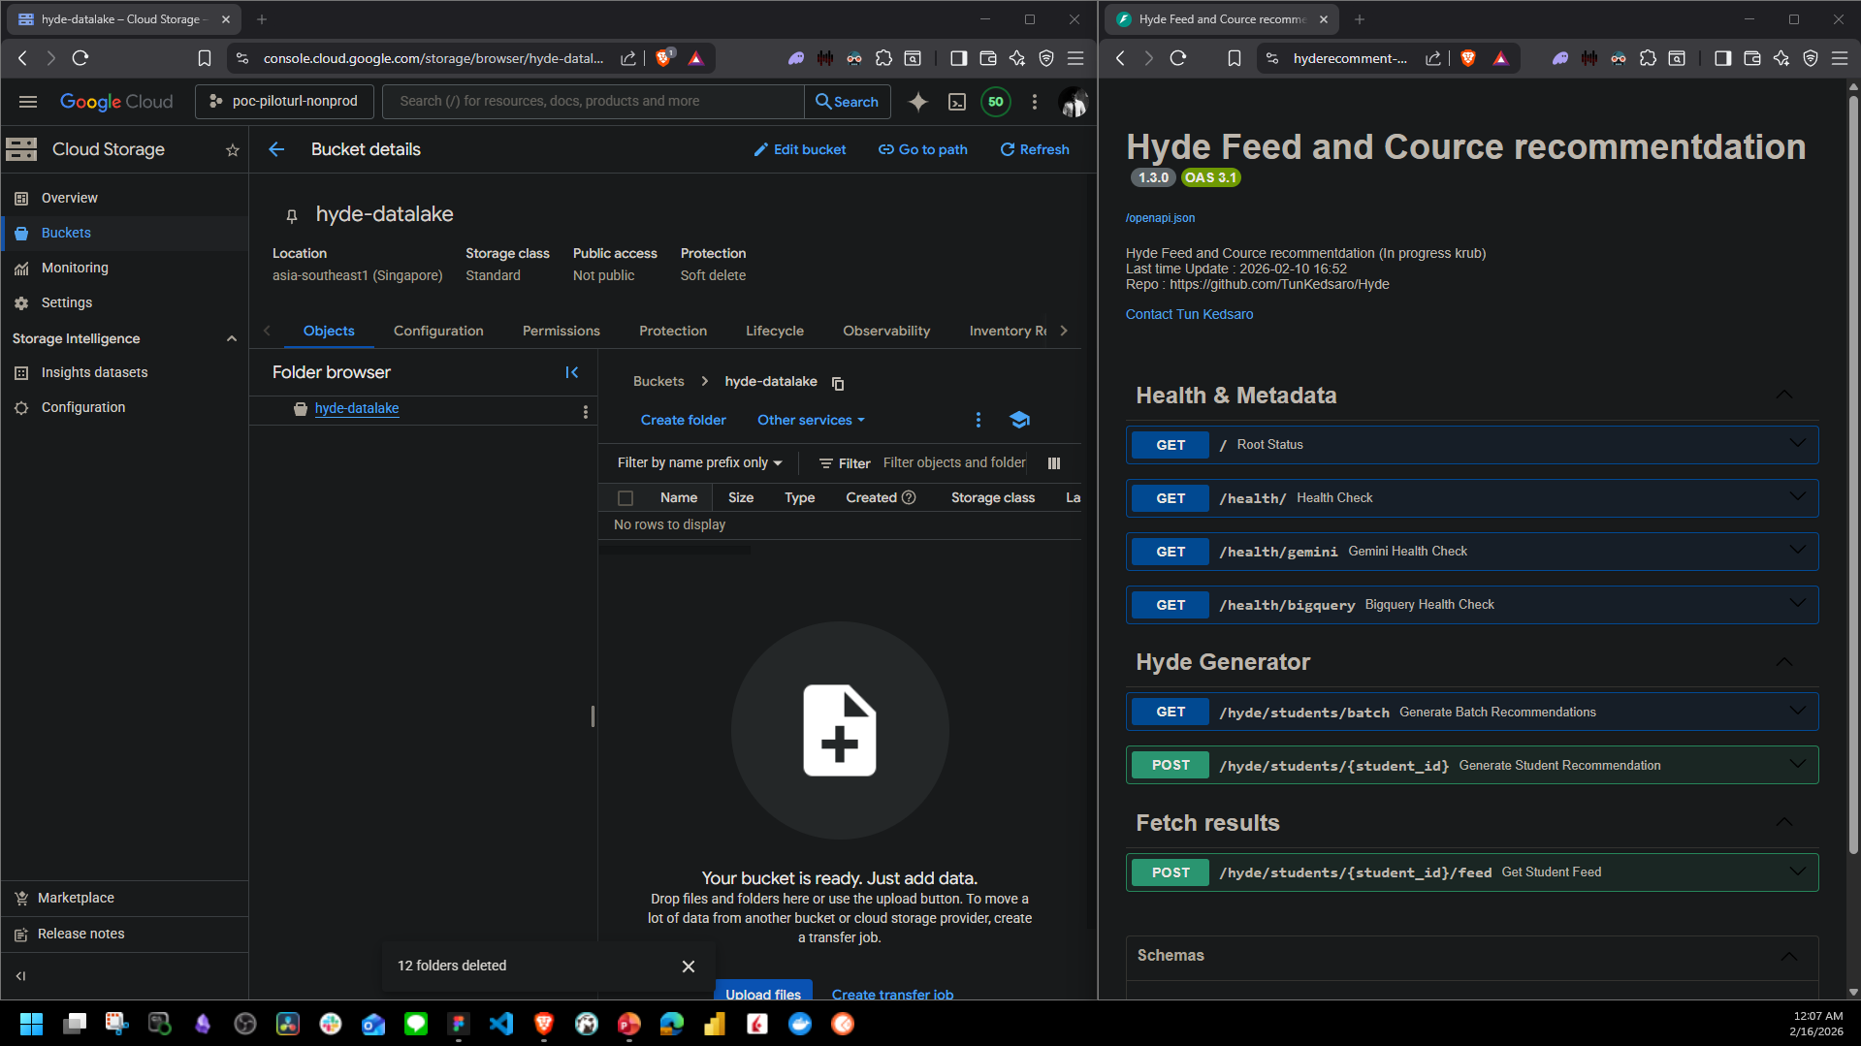
HyDE Feed Recommendation - Generate HyDE bundle for a single student
HyDE recommentdation core engine API
GCS / hyde-datalake (Test)

Slide 49

HyDE Feed Recommendation - Generate HyDE bundle for a single student
HyDE recommentdation core engine API
GCS / hyde-datalake (Test)

Slide 50

HyDE Feed Recommendation – Fetch result
HyDE recommentdation core engine API
GCS / hyde-datalake (Test)

Slide 51
HyDE Feed Recommendation – Fetch result
HyDE recommentdation core engine API
GCS / hyde-datalake (Test)

Slide 52
HyDE Feed Recommendation - System Overview
Overview

Slide 53
HyDE Feed Recommendation - System Overview
Overview

Slide 54



HyDE Feed Recommendation - System Overview
Overview
2.5 -> gemini-3.0

Slide 55

HyDE Feed Recommendation - System Overview
Overview

Slide 56

HyDE Feed Recommendation - System Overview
Overview

Slide 57
HyDE Feed Recommendation - System Overview
Overview
Inputs
scores
indices
Subscore function
vector
language
recency
popularity
Weighted Aggregation
Sort + Top-N + Final Output
Json response

Slide 58
HyDE Feed Recommendation - System Overview
Overview
Inputs
scores
indices
Subscore function
vector
language
recency
popularity
Weighted Aggregation
Sort + Top-N + Final Output
Json response

Slide 59

HyDE Feed Recommendation - Subscore
Overview
Inputs
scores
indices
Subscore function
Subscore function
recency
recency
popularity
vector
popularity
language
language
..…
Weighted Aggregation
Sort + Top-N + Final Output
Json response

Slide 60

HyDE Feed Recommendation - Subscore
Overview
Inputs
scores
indices
Subscore function
language
..…
recency
popularity
Weighted Aggregation
Sort + Top-N + Final Output
Json response

Slide 61
HyDE Feed Recommendation - Subscore
Overview
Mapping retrieval outputs to real feed items
- We got internal vector ids (indices), NOT business ids
- We convert `index_id` -> `feed_id` via aligned metadata array
- Then join `feed_id` -> full feed metadata from feeds_meta.jsonl
- Resuts candidates become “real feed items” with fields like title, language created_at, views
Inputs
scores
indices
Subscore function
language
..…
recency
popularity
Weighted Aggregation
Sort + Top-N + Final Output
Json response

Slide 62

HyDE Feed Recommendation - Subscore
Overview
Deterministic Subscore
- We compute 3 interpretable signals per feed
1. Language_match : exact match
2. Recency : exponential decay using half-life days
3. Popularity : log-normalized engagement (views/likes/etc.)
- All score are bounded in [0,1]
- Subscore are deterministic (same inputs -> same output0
Inputs
scores
indices
Subscore function
language
..…
recency
popularity
Weighted Aggregation
Sort + Top-N + Final Output
Json response

Slide 63

HyDE Feed Recommendation - Subscore
Overview
Deterministic Subscore
- We compute 3 interpretable signals per feed
1. Language_match : exact match
2. Recency : exponential decay using half-life days
3. Popularity : log-normalized engagement (views/likes/etc.)
Inputs
scores
indices
- Read feed language from : feed_meta["lang"]
- If equal user language -> 1.0 else ->0.0
- It’s a hard match (not similarity, just exact match)
- If user prefers "th" , Thai content gets a boost
Subscore function
language
..…
recency
popularity
Weighted Aggregation
Sort + Top-N + Final Output
Json response

Slide 64


HyDE Feed Recommendation - Subscore
Overview
Deterministic Subscore
- We compute 3 interpretable signals per feed
1. Language_match : exact match
2. Recency : exponential decay using half-life days
3. Popularity : log-normalized engagement (views/likes/etc.)
Inputs
scores
indices
$$recency=2^{−\frac{age_days}{half_life_days}}$$
Subscore function
language
..…
recency
popularity
Weighted Aggregation
Sort + Top-N + Final Output
Json response

Slide 65


HyDE Feed Recommendation - Subscore
Overview
Deterministic Subscore
- We compute 3 interpretable signals per feed
1. Language_match : exact match
2. Recency : exponential decay using half-life days
3. Popularity : log-normalized engagement (views/likes/etc.)
Inputs
scores
indices
$$recency=2^{−\frac{age_days}{half_life_days}}$$
Subscore function
language
..…
recency
popularity
- This is a “freshness score”
- age = 0 days -> recency = 1.0 (2**(-0/30) -> 1.0)
- age = 15 days -> recency = 0.707 (2**(-15/30) -> 0.707)
- age = 30 days -> recency = 0.5 (2**(-30/30) -> 0.5)
- age = 60 days -> recency = 0.25 ( 2**(-60/30) -> 0.25)
- The half - life is configurable (recency_half_life_days from YAML)
Weighted Aggregation
Sort + Top-N + Final Output
Json response

Slide 66


HyDE Feed Recommendation - Subscore
Overview
Deterministic Subscore
- We compute 3 interpretable signals per feed
1. Language_match : exact match
2. Recency : exponential decay using half-life days
3. Popularity : log-normalized engagement (views/likes/etc.)
Inputs
scores
indices
$$popularity=min\left(1,\frac{\log{(1+v)}}{\log{(1+1,000,000)}}\right)$$
Subscore function
language
..…
recency
popularity
Weighted Aggregation
Sort + Top-N + Final Output
Json response

Slide 67


HyDE Feed Recommendation - Subscore
Overview
Deterministic Subscore
- We compute 3 interpretable signals per feed
1. Language_match : exact match
2. Recency : exponential decay using half-life days
3. Popularity : log-normalized engagement (views/likes/etc.)
Inputs
scores
indices
$$popularity=min\left(1,\frac{\log{(1+v)}}{\log{(1+1,000,000)}}\right)$$
Subscore function
language
..…
recency
popularity
- This is a “popularity score”
- view = 0 -> popularity = 0.0 (log(1) / 13.8155 -> 0)
- view = 10,000 -> popularity = 0.67 (log(10,001) / 13.8155 -> 0.67)
- view = 100,000 -> popularity = 0.83 (log(100,001) / 13.8155 -> 0.83)
- view = 1,000,000 -> popularity = 1.0 (log(1,000,001) / 13.8155 -> 1.0)
- Popular feeds get boost But they do NOT overpower semantic similarity
- We clamp to 1 (Prevents runaway values)
Weighted Aggregation
Sort + Top-N + Final Output
Json response

Slide 68


HyDE Feed Recommendation - Subscore
Overview
Weighted Aggregation
- Subscore + vector score are combined into one final_score
Inputs
scores
indices
$$fianl_score=\sum_{i}{{weight}_{i} ∗clamp(value)}$$
Subscore function
- YAML controls weights (easy to tune without touching code) - which features participate
- their weights
- whether to clamp inputs
- whether to renormalize weights (sum to 1)
language
..…
recency
popularity
Weighted Aggregation
Sort + Top-N + Final Output
Json response

Slide 69
HyDE Feed Recommendation - Subscore
Overview
Sort + Top-N + Final output
- Sort candidates by ranking score key
- Return - student_id
- meta configuration for debugging / reproducibility
- candidate list (previews/top-N)
- Candidate includes both
- raw retrieval score (vector_score)
- interpretable subscores (why it ranked)
Inputs
scores
indices
Subscore function
language
..…
recency
popularity
Weighted Aggregation
Sort + Top-N + Final Output
Json response

Slide 70

HyDE Feed Recommendation - Subscore
Overview
Sort + Top-N + Final output
Inputs
scores
indices
Subscore function
language
..…
recency
popularity
Weighted Aggregation
Sort + Top-N + Final Output
Json response

Slide 71
Sprint review #10 HyDE feed recommendation
API Spec Link :
Orchestrator :
API core evaluation link : https://hyderecomment-service-v1-1-0-du7yhkyaqq-as.a.run.app/docs#/
Github : https://github.com/TunKedsaro/Hyde
QA : https://humanintelligence.atlassian.net/wiki/spaces/CPM/pages/134611027/QA+Test+Plan+CV+Evaluation+Pipeline

Slide 72
HyDE Feed Recommendation - System Overview
Subscore function
vector
language
recency
popularity
Weighted Aggregation
Sort + Top-N + Final Output
Json response

Slide 73
HyDE Feed Recommendation - System Overview
Llm
Gemini_flast_2.5
feeds.jsonl
stu_p001.npy
Interactions.csv
Prepare_history
User_context
Embedding
gemini-embedding-001
Embedded vector
stu_p001.json
Students.csv
HyDE_prompt
Legend
Input
Process
Output
Process

Slide 74

HyDE Feed Recommendation - System Overview
feeds.jsonl
Interactions.csv
Students.csv

Slide 75



HyDE Feed Recommendation - System Overview

Slide 76
HyDE Feed Recommendation - System Overview
Llm
Gemini_flast_2.5
stu_p001.npy
Prepare_history
User_context
Embedding
gemini-embedding-001
Embedded vector
stu_p001.json
HyDE_prompt
Legend
Input
Process
Output
Process

Slide 77



HyDE Feed Recommendation - System Overview
Metadata
Embedding
gemini-embedding-001
Data lake
Embedded vector
Shape = (5,768)
Gemini-2.5-flash -> gemini-3-flash-preview
Temperature = 1
Rethink = defualt

Slide 78
HyDE Feed Recommendation - System Overview
Llm
Gemini_flast_2.5
Embedded vector
Prepare_history
User_context
Embedding
gemini-embedding-001
metadata
Data lake
HyDE_prompt
Legend
Input
Process
Output
Process
Notes:
https://www.quorum.co.uk/2024/04/09/database-data-lake-data-warehouse-whats-the-difference/

Slide 79

HyDE Feed Recommendation - System Overview

Slide 80

HyDE Feed Recommendation - System Overview
Notes:
Embedding0n.

Slide 81

HyDE Feed Recommendation - System Overview
Notes:
Embedding0n.

Slide 82

HyDE Feed Recommendation - System Overview

Slide 83
HyDE Feed Recommendation - System Overview
Video

Slide 84
HyDE Feed Recommendation
Pipeline Execution Time Breakdown per Student (seconds)
 | Stu_p001 | Stu_p002 | Stu_p003 | Stu_p004 | Stu_p005 | Stu_p006 | Stu_p007 | Stu_p008 | Stu_p009 | Stu_p010 | average
query_sec | 0.00101 | 0.00065 | 0.00058 | 0.00064 | 0.00067 | 0.00354 | 0.00077 | 0.00056 | 0.00056 | 0.00066 | 0.00096
history_sec | 0.01339 | 0.01010 | 0.00979 | 0.00971 | 0.01111 | 0.01051 | 0.00888 | 0.00944 | 0.00959 | 0.01291 | 0.01054
embed_sec | 1.81636 | 1.77266 | 2.03714 | 1.69645 | 1.72026 | 1.79597 | 1.75972 | 1.76440 | 1.72077 | 1.75303 | 1.78368
metadata.json | 0.18499 | 0.12241 | 0.10613 | 0.11913 | 0.10847 | 0.11897 | 0.12841 | 0.11524 | 0.11533 | 0.12951 | 0.12486
embedding0n.npy | 1.23484 | 1.28129 | 1.28272 | 1.16481 | 1.15355 | 1.12040 | 1.15927 | 1.15244 | 1.21216 | 1.12801 | 1.18895
total_sec | 3.25059 | 3.18711 | 3.43636 | 2.99074 | 2.99306 | 3.04939 | 3.05705 | 3.04208 | 3.05841 | 3.02412 | 3.10898

Slide 85
HyDE Feed Recommendation
Storage retrieval from GCS (seconds)
 | Stu_p001 | Stu_p002 | Stu_p003 | Stu_p004 | Stu_p005 | Stu_p006 | Stu_p007 | Stu_p008 | Stu_p009 | Stu_p010 | average
metadata.json | 0.06906 | 0.0565 | 0.09909 | 0.06359 | 0.07367 | 0.06569 | 0.07023 | 0.0673 | 0.07545 | 0.07149 | 0.07514
embedding0n.npy | 0.07413 | 0.06238 | 0.06575 | 0.07541 | 0.05905 | 0.06792 | 0.06209 | 0.06646 | 0.06743 | 0.06615 | 0.06786
total_sec | 0.14319 | 0.11888 | 0.16484 | 0.139 | 0.13272 | 0.13361 | 0.13232 | 0.13376 | 0.14288 | 0.13764 | 0.143

Slide 86

HyDE Feed Recommendation - System Overview
Llm
Gemini_flast_2.5
Embedded vector
Prepare_history
User_context
Embedding
gemini-embedding-001
metadata
HyDE_prompt
Legend
Input
Process
Output
Process
Notes:
https://www.quorum.co.uk/2024/04/09/database-data-lake-data-warehouse-whats-the-difference/

Slide 87








HyDE Feed Recommendation - System Architecture & Technology Stack

Slide 88

HyDE Feed Recommendation - System Architecture & Technology Stack

Slide 89

HyDE Feed Recommendation - Future Work
Add endpoint get student
Update intent core code
Notes:
/hyde/update_batch
- Don’t remove everyone in CGS but check one by one
Run as async format
Add set batch size parameters (Defual = 10)
Add destination path in yaml file

Slide 90


HyDE feed recommendation – Future Work
+

Slide 91
Team stand up

Slide 92
Tue,260224
Done
Completed calc_subscore.py (Local version)
Developed calc_subscore_dev.py (Online version, ~60% done)
New datalake design -> Create new fetch API (/hyde/student/{student_id}/json
Todo
Align score calculation and feed_id mapping with Shin
Create API
Feed map
Interaction map
Continue integration with Shin’s code
Issue
-

Slide 93


Tue,260224

Slide 94

Tue,260224

Slide 95
Thu,260219
Done
Start integrating subscore into Shin’s project
- Begin with mocking data
- Adding .yaml file and
- Gradually refactor and move related code into Shin’s folder structure (In progress)
Todo
Continue merging subscore into Shin’s pipeline
Connect score, index, and feed metadata flow
Score
Indices
Feed detail and metadata (BigQuery -> Redist -> json)
Issue
Code is quite complex
Integration with Shin’s code

Slide 96

Thu,120226
Done
Start integrating subscore into Shin’s project
- Begin with mocking data
- Adding .yaml file and
- Gradually refactor and move related code into Shin’s folder structure (In progress)
Todo
Continue merging subscore into Shin’s pipeline
Connect score, index, and feed metadata flow
Score
Indice
Feed detail and metadata (BigQuery -> Redist -> json)
Issue
Code is quite complex
Integration with Shin’s code

Slide 97
Wed,180226
Done
Aligned with Shin
Clarified subscore poc code
Drafted structure and explored how to collaborate within Shin’s Github repository
Todo
Target completion : tomorrow or Friday
Issue
-

Slide 98

HyDE Feed Recommendation – Batch student HyDE generator

Slide 99
Tue,100226
Done
Update 3 case hander retrieval support with hyde with FastAPI -> Deploy
Todo
Update GCS Retrieval with handerling 3 cases with FastAPI
HyDE generator
Batch HyDE student generator
Single HyDE student generator
Issue
-

Slide 100

HyDE Feed Recommendation – Batch student HyDE generator

Slide 101

HyDE Feed Recommendation - Batch student HyDE generator

Slide 102

HyDE Feed Recommendation – Single student HyDE generator

Slide 103

HyDE Feed Recommendation - Single student HyDE generator

Slide 104

HyDE Feed Recommendation - System Architecture & Technology Stack

Slide 105
Mon,090226
Done
Align CVEvaluation QA with P’bloom and update confluence
Align Feed recommentdation (*pipeline with flowchart)
Functions/core/subscore.py
Pipeline_3_gold_validate.py
Align with shin about How vector embedding should be
Plan tasks for Sprint 11 in Jira
Todo
Update GCS Retrieval class with new 3 conditions
Develop pipeline to Update Embedding vector with shin format style
undle data for each student (Pipeline_2_user_hyde_refresh.py)
Issue
-

Slide 106

HyDE Feed Recommendation - System Architecture & Technology Stack

Slide 107

HyDE Feed Recommendation - System Architecture & Technology Stack

Slide 108

HyDE Feed Recommendation - System Architecture & Technology Stack

Slide 109

HyDE Feed Recommendation - System Architecture & Technology Stack

Slide 110

HyDE Feed Recommendation - System Architecture & Technology Stack

Slide 111
Fri,060226
Done
Align CVEvaluation QA with P’bloom and update confluence
Align Feed recommentdation (*pipeline with flowchart)
Functions/core/subscore.py
Pipeline_3_gold_validate.py
Align with shin about How vector embedding should be
Plan tasks for Sprint 11 in Jira
Todo
Update GCS Retrieval class with new 3 conditions
Develop pipeline to Update Embedding vector with shin format style
undle data for each student (Pipeline_2_user_hyde_refresh.py)
Issue
-

Slide 112
Thu,050226
Done
Read and understood the QA Test Plan for the CV Evaluation Pipeline link
Understanding task for sprint 11 then prepare material to discuss (B4 P’bloom vacation)
Todo
Align CVEvaluation QA with P’bloom
Align Feed recommentdation (*pipeline with flowchart)
Functions/core/subscore.py
Pipeline_3_gold_validate.py
Align with shin about How vector embedding should be
Plan tasks for Sprint 11 in Jira
Update GCS Retrieval class with new 3 conditions
Develop pipeline to bUpdate Embedding vector with shin format style
undle data for each student (Pipeline_2_user_hyde_refresh.py)
Issue
Question in Slack
Question in Figma

Slide 113

Wed,040226
Done
Sprint review deck for Sprint 10
Develop an endpoint to query data from Cloud Storage
Todo
Read and understood the QA Test Plan for the CV Evaluation Pipeline link
Plan tasks for Sprint 11 in Jira
Develop pipeline to bundle data for each student (Pipeline_2_user_hyde_refresh.py)
Issue
-

Slide 114
Tue,050226
Done
Read and understood the QA Test Plan for the CV Evaluation Pipeline link
Todo
Plan tasks for Sprint 11 in Jira
Develop pipeline to bundle data for each student (Pipeline_2_user_hyde_refresh.py)
Issue
-

Slide 115
HyDE Feed Recommendation - System Overview
Case 1 : เจอ bucget + metadata
Case 2 : Storage(bugget x metadata)-> return Only metadata
Case 3 : Have no bugget -> return data from bigquery
If case 2 or case 3 -> talk with shin what going on?
If some vector is missing or not complete return only complete vector and other “error”
Notes:
https://www.quorum.co.uk/2024/04/09/database-data-lake-data-warehouse-whats-the-difference/

Slide 116
Tue,030226
Done
Prepared sprint review deck for Sprint 10
Todo
Implement item retirement on Cloud Storage (code + cron job)
Plan tasks for Sprint 11 in Jira
Develop pipeline to bundle data for each student
Read and understood the QA Test Plan for the CV Evaluation Pipeline link

Slide 117
Process of work

Slide 118
POC -> MVP - POC : all full pipeline code - MVP : POC + production plan + owner
Estimate cost man-day and grant chart
1 Sprint = 2 weeks
We have sprint glooming before sprint start
We use Jira to estimate timeline and ticket
There are ghostdeck
There are confluence for project detail
There are POC
Estimate manday cost
Design database
Architecture
RACI
SIT เหลืออีก 4 เดือน เดือน june
UAT เหลืออีก 6 เดือน เดือน สิงหา
Golive เหลืออีก … เดือน เดือน October

Slide 119
Tue,040226
Done
Xxx
Xxx
xxx
Todo

Slide 120
CVResume evaluation – Resume Evaluation Input Structure
Input payload
"resumeJson":{
{
"Profile": {
"name": "Juan Jose Carin",
"email": "juanjose.carin@gmail.com",
"linkedin": "linkedin.com/in/juanjosecarin"
},
"Summary": {
"summary_points": [
"Experienced data scientist with analytical background."
]
},
"Education": [
{
"institution": "University of California, Berkeley",
"degree": "MIDS",
"gpa": "3.93"
}
],
"Experience": [
{
"title": "Data Scientist",
"company": "CONENTO",
"dates": "2016",
"description": [
"Built ETL pipelines and predictive models."
]
}
],
"Activities": [
{
"name": "LLM Evaluation Harness",
}
],
"Skills": {
"skills": ["Python","RAG""Data Analysis", "Machine Learning"],
}
}
The evaluation API accepts a lightweight request wrapper and a structured resume body. The wrapper controls evaluation behavior, while the resume body contains the actual CV content.
Key point:
- Actual resume content
- Flexible : missing sections are allowed
- Used as the main input for scoring
{
"outputLang": "en",
"targetRole": "role#ai_engineer",
"resumeJson": {
"Profile": {},
"Summary":{},
"Education":[],
"Experience": [],
"Activity": [],
"Skills": {}
}
}
CV Resume Evaluation Orchestrator

Slide 121
2601290000
Done
Local data -> BigQuery -> Pipeline

Slide 122
2601290937
Done
Local data -> BigQuery -> Pipeline
Upload Embedding output -> BigQuery (ไม่สมบูรณ์แค่ Upload ขึ้น)
Today
ออกแบบ Json field ที่มีเก็บรายละเอียดมากขึ้น & ตกลงว่าจะเอา Field อะไรบ้าง
เขียยนโค้ดให้เป็นเรื่องราวมากขึ้น ไม่ใช้ spaghetti
ออกแบบระบบ Retirer 30 วัน
ทำความเข้าใจ pipeline_2-3
Issue
ไม่รู้ว่าจะต้องทำอะไร
ไม่รู้ว่าที่ทำมามันถูกใช่ไหม
แล้วหน้าตาสุดท้ายจะเป็นยังไง

Slide 123
2601290937
Done
Completed data flow local data to BigQuery and into the pipeline
Uploaded initial embedding outputs to BigQuery (next step : full integration)
Today
Disigned a richer JSON schema and finalized required fields
Refactored code to be more structured and readable (Reduced spaghetti code)
Designed a 30-day data retention system
Reviewed and gained understanding of pipeline_2 and pipeline_3
Issue
ไม่รู้ว่าที่ทำมามันถูกใช่ไหม
แล้วหน้าตาสุดท้ายจะเป็นยังไง
ที่ใช้ BigQuery ถูกไหม
บน FastAPI ก็แค่เอาไว้ให้ user trigger update batch กับ แบบ individual

Slide 124
HyDE feed recommendation – System Overview
Llm
Gemini_flast_2.5
Prepare_history
User_context
Embedding
gemini-embedding-001
Embedded vector
HyDE_prompt

Slide 125

HyDE feed recommendation – System Overview

Slide 126

HyDE feed recommendation – System Overview

Slide 127
HyDE feed recommendation – System Overview

Slide 128

HyDE feed recommendation – System Overview
Dsxxxxxxxxxxxxxx
Xxxxxxxxxxxxxxxxx
xxxxxxxxxxxxxxxxx

Slide 129
2601290937
BigQuery X
Datalake
เพราะ ต้อง similarity search
แบ่งชื่อ Folder เอาไว้
เก็บ vector , meta
Datalake |- Student01 |- Vector 1 – 5 |- Metadata |- student02 … .

Slide 130
Project – Topic
Section | Complete ness | Content Quality | Grammar | Length | Role Relevance | Section Weight
Profile | 10 | 10 | 0 | 0 | 0 | 0.10
Summary | 10 | 10 | 10 | 10 | 10 | 0.10
Education | 10 | 0 | 0 | 0 | 10 | 0.20
Experience | 10 | 10 | 10 | 10 | 10 | 0.20
Activities | 10 | 10 | 10 | 10 | 10 | 0.20
Skills | 10 | 0 | 0 | 10 | 10 | 0.20
Topic
- loremipsum
- loremipsum
- loremipsum
Topic
- loremipsum
- loremipsum
- loremipsum
Topic
- loremipsum
- loremipsum
- loremipsum

