Slide 1
Blood Test Analysis Report — April 2021

Slide 2
Summary of Results
Marker | Value | Reference | Risk Level
Leukozyten | 7.0 | 3.0-10.0 /ul | normal
Erythrozyten | 4.4 | 4.4-5.9 Mio./ul | borderline
Haemoglobin | 16.9 | 11.8-16.9 g/dl | borderline
Haematokrit | 40.0 | 35-52 % | normal
MCV | 82.0 | 80-100 fl | borderline
MCH | 32.0 | 27-34 pg | borderline
MCHC | 32.0 | 32-36 g/dl | borderline
Thrombozyten | 390.0 | 130-400 Tsd/ul | borderline
HbA1c | 5.1 | 4.5-5.6 % | borderline
Blutzucker | 87.0 | 74-100 mg/dl | normal

Slide 3
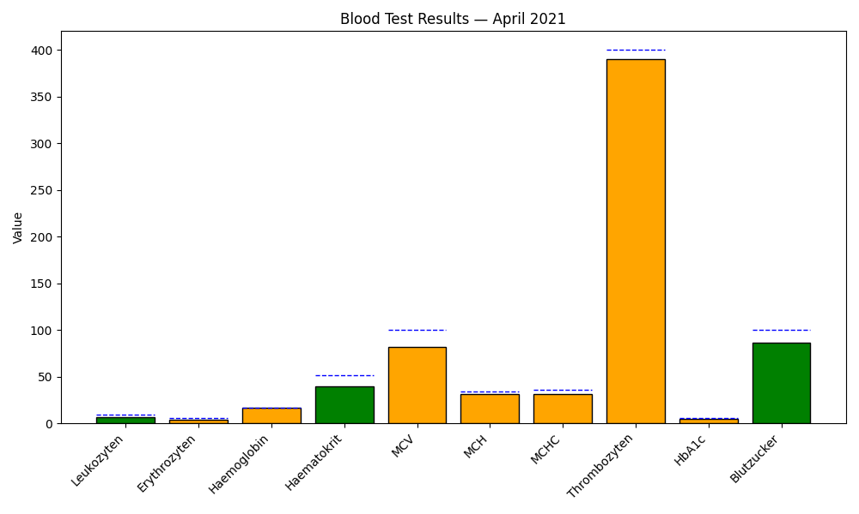
Bar Chart — Values by Marker

Slide 4
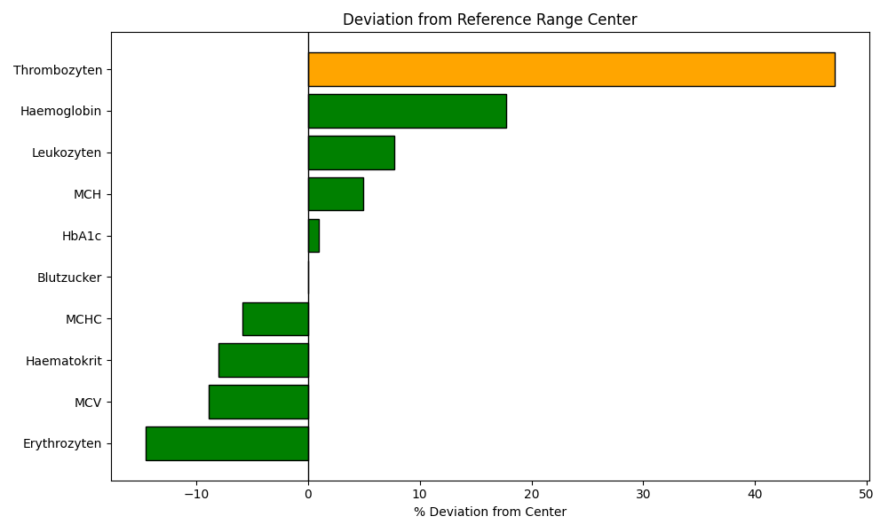
Deviation Chart — % Deviation from Center

Slide 5
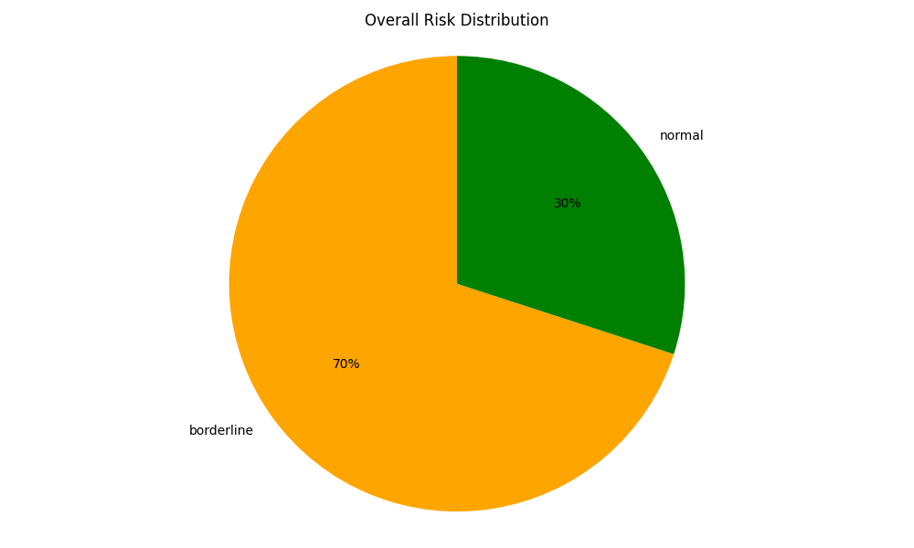
Status Distribution

Slide 6
Conclusion
Total markers evaluated: 10
7 marker(s) with risk level: borderline
Largest deviation: Thrombozyten (47.17% from center)
Recommendations: review borderline markers and consider clinical correlation.

