Slide 1
Doctor's Report
Structured OCR results from a German laboratory report
Test date: 01.02.22
5 markers extracted
1 notable values
CSV + JSON summary included
5 extracted markers
1 notable values

Slide 2
Executive Overview
Clean summary of the extracted blood test data
Total markers
5
Normal
4
Notable
1

Slide 3
Normal Values
Values inside the reference range
Marker | Value | Unit | Reference
Calcium | 27.36 | mmol/l | 2.05- 212.55
HDL- Cholesterin | 48.0 | mg/dl | > 40
Kreatinin | 0.95 | mg/dl | < 1.2
Triglyceride | 128.0 | mg/dl | < 150

Slide 4
Abnormal Values
Values outside or close to the reference range
Marker | Value | Unit | Reference
Cholesterin | 197.0 | mg/dl | < 200

Slide 5
Abnormal Values
Values outside or close to the reference range
Marker | Value | Unit | Reference | Status
Cholesterin | 197.0 | mg/dl | < 200 | borderline

Slide 6
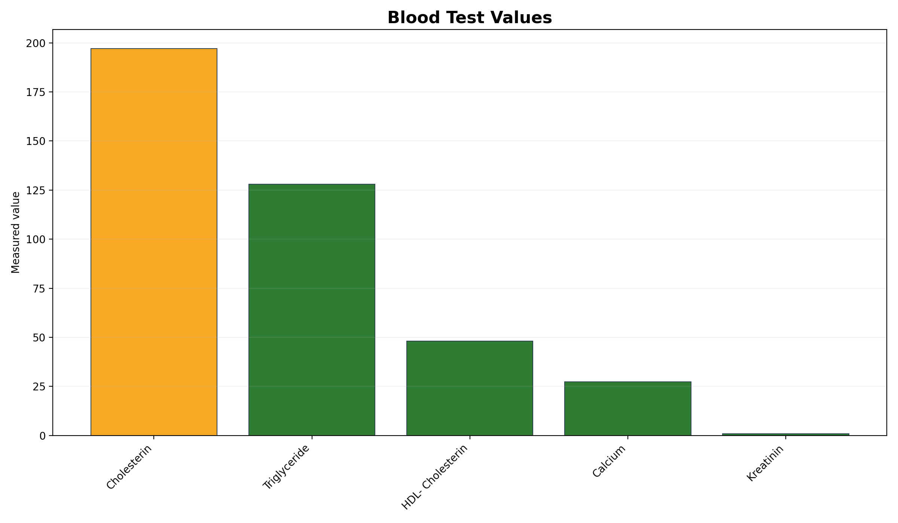
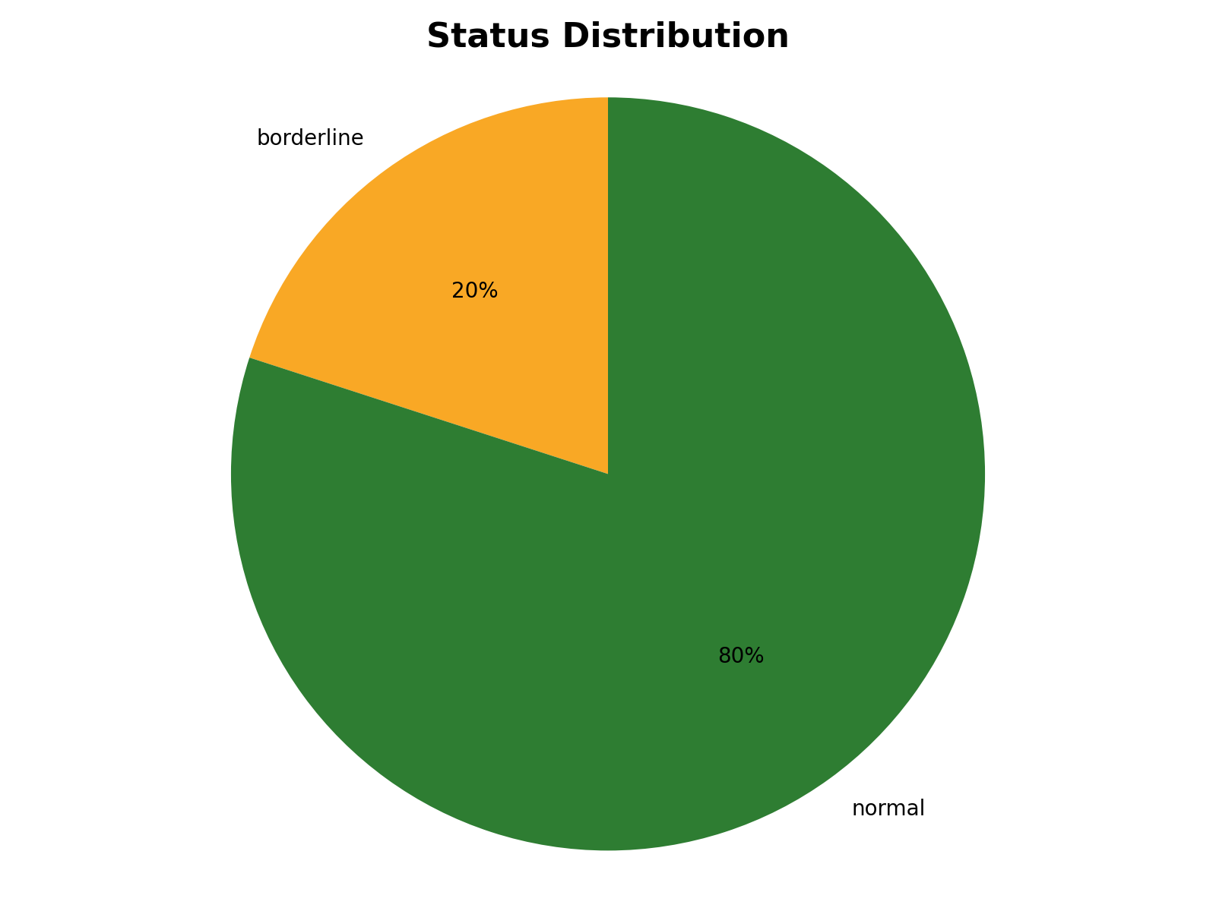
Visual Summary
Simple charts derived from the extracted values

Slide 7
Recommendations
Data-driven next steps based on notable values
Review lipid values with your clinician, especially if they remain above target on repeat testing.
This report is informational and does not replace medical advice.

