Slide 1
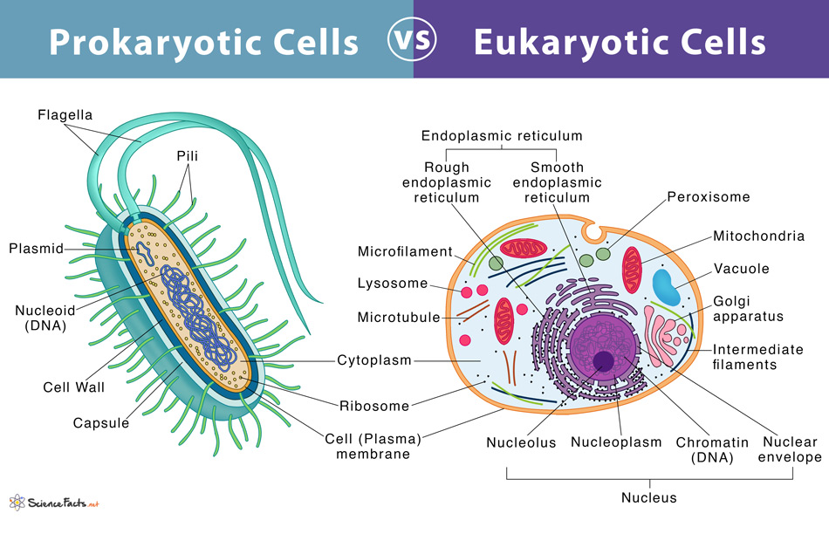
Prokaryotes vs. Eukaryotes

Slide 2
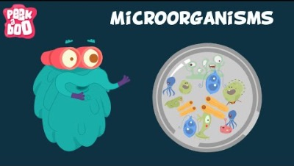
Microorganisms

Slide 3
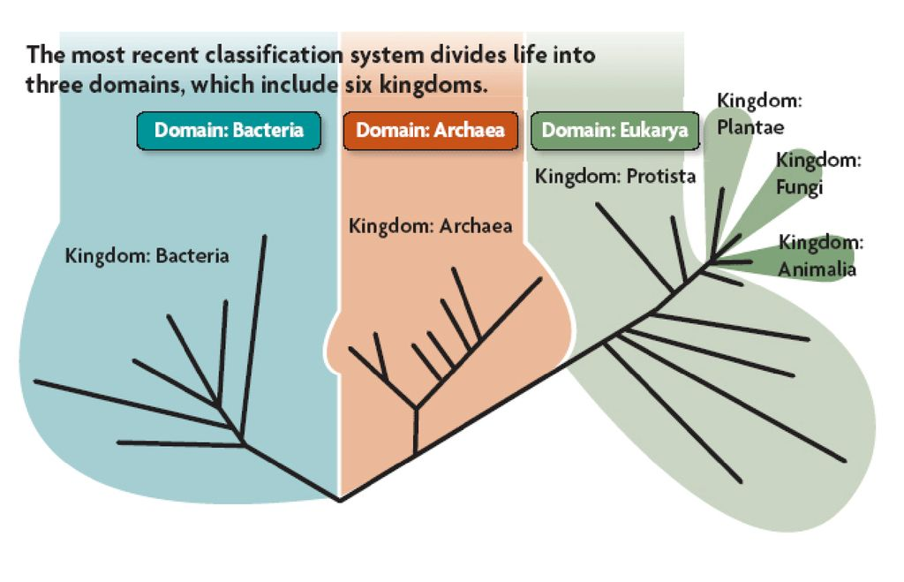
Organisms are classified into three domains and six kingdoms
The domains are;
Archaea
Bacteria
Eukarya
The kingdoms are;
Archaebacteria (ancient bacteria)
Eubacteria (true bacteria)
Protista
Fungi
Plantae
Animalia

Slide 4

Old & Odd: Archaea, Bacteria & Protists

Slide 5
Prokaryotic cell vs. Eukaryotic cell
All living organisms can be grouped into two types based on their fundamental cell structure. They are prokaryotes and eukaryotes, and the cells they possess are called prokaryotic cells and eukaryotic cells.
Prokaryotic cells: NO nucleus
Eukaryotic cells: NUCLEUS and other organelles

Slide 6
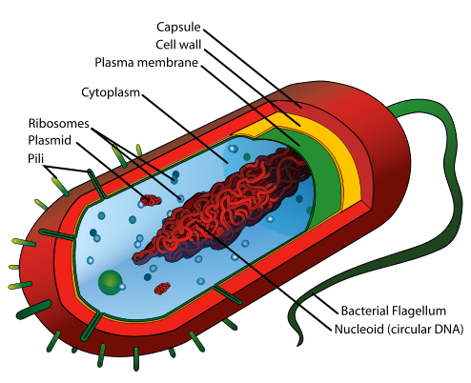
prokaryote

Slide 7
Prokaryote
The defining difference between prokaryotic and eukaryotic cells is the lack of a ‘true’ nucleus in prokaryotic cells. The word ‘prokaryotic’ means ‘before nucleus’ and eukaryotic cells are thought to have evolved from prokaryotic cells.
Prokaryotic cells make up the organisms found in the two Kingdoms of life known as Bacteria and Archaea. Bacteria and archaea are literally found almost everywhere on Earth and in far greater abundance than any eukaryotic organism such as plants and animals.
METABOLISM OF PROKARYOTIC CELLS
Prokaryotic organisms have evolved a wide range of ways of to take energy from the environment. Compared to eukaryotic cells that have only evolved to transfer energy through photosynthesis and respiration, prokaryotic cells can obtain energy through photosynthesis, respiration, nitrogen fixation, denitrification, sulfate reduction and methanogenesis. This is the diversity of ways prokaryotic cells can take energy from their surrounding environment.
SIZE OF PROKARYOTIC CELLS
Prokaryotic cells are tiny. They are about 10% as wide as the eukaryotic cells of plants, animals or fungi.
Prokaryotic cells have never evolved to produce multicellular organisms as eukaryotic cells have. All prokaryotes are single-celled microorganisms. Often cells aggregate together to form colonies. A colony of prokaryotic cells often make changes to their surrounding environments that benefits the individual cells.

Slide 8
Prokaryote
The defining difference between prokaryotic and eukaryotic cells is the lack of a ‘true’ nucleus in prokaryotic cells. The word ‘prokaryotic’ means ‘before nucleus’ and eukaryotic cells are thought to have evolved from prokaryotic cells.
Prokaryotic cells make up the organisms found in the two Kingdoms of life known as Bacteria and Archaea. Bacteria and archaea are literally found almost everywhere on Earth and in far greater abundance than any eukaryotic organism such as plants and animals.
METABOLISM OF PROKARYOTIC CELLS
Prokaryotic organisms have evolved a wide range of ways of to take energy from the environment. Compared to eukaryotic cells that have only evolved to transfer energy through photosynthesis and respiration, prokaryotic cells can obtain energy through photosynthesis, respiration, nitrogen fixation, denitrification, sulfate reduction and methanogenesis. This is the diversity of ways prokaryotic cells can take energy from their surrounding environment.
SIZE OF PROKARYOTIC CELLS
Prokaryotic cells are tiny. They are about 10% as wide as the eukaryotic cells of plants, animals or fungi.
Prokaryotic cells have never evolved to produce multicellular organisms as eukaryotic cells have. All prokaryotes are single-celled microorganisms. Often cells aggregate together to form colonies. A colony of prokaryotic cells often make changes to their surrounding environments that benefits the individual cells.

Slide 9
Prokaryote
PROKARYOTIC CELLS DO NOT HAVE A NUCLEUS
Instead of DNA being enclosed in a nuclear membrane, as it is in eukaryotic cells, the DNA of prokaryotic cells is tightly coiled in a region of the cell called the ‘nucleoid’. The nucleoid is not a ‘true’ nucleus because the DNA is not surrounded by a membrane. Prokaryotic cells have a single ring of DNA and contain roughly 0.1% of the DNA of a typical eukaryotic cell.
PROKARYOTIC CELLS DON’T HAVE ORGANELLES
prokaryotic cells can perform functions such as photosynthesis and cellular respiration.
PROKARYOTIC CELLS ARE SURROUNDED BY A PLASMA MEMBRANE AND A CELL WALL
Plasma membranes are a feature common to all cells, both eukaryotic and prokaryotic. They surround the internal material of cells such as the DNA and cytoplasm. Plasma membranes are made from fat-like molecules called phospholipids. Carbohydrates and proteins are also scattered through the phospholipid membrane to help move substances in and out of the cell and to allow cells to communicate with each other.
Some prokaryotes have cell wall (consist of peptidoglycan) which is different than those of plants (cellulose) and fungi (chitin). The cell wall is very important to a prokaryotic cell. It helps in a number of ways such as maintaining the shape of the cell, providing protection and preventing the cell from bursting open. Prokaryotic cell walls are far more complex than the cell walls of plants. They are an essential part of bacterial cells and are often the focus of modern antibiotics. If an antibiotic is able to breakdown the complex structure of the cell wall, they are likely to be effective at killing off populations of bacteria.
RIBOSOMES
Ribosomes are small structures made from protein and RNA that are not surrounded in a membrane. Because they lack a membrane they are not considered to be organelles.
FLAGELLA and PILLI
Flagella make it possible for prokaryotic cells to move and are found in around 50% of known bacteria species. They are completely different to the flagella found in the eukaryotic cells of animals and fungi. Pilli are external growths that bacterial cells use to stick to each other or to the substrate they are living on.

Slide 10
Prokaryote
PROKARYOTIC CELLS DO NOT HAVE A NUCLEUS
Instead of DNA being enclosed in a nuclear membrane, as it is in eukaryotic cells, the DNA of prokaryotic cells is tightly coiled in a region of the cell called the ‘nucleoid’. The nucleoid is not a ‘true’ nucleus because the DNA is not surrounded by a membrane. Prokaryotic cells have a single ring of DNA and contain roughly 0.1% of the DNA of a typical eukaryotic cell.
PROKARYOTIC CELLS DON’T HAVE ORGANELLES
prokaryotic cells can perform functions such as photosynthesis and cellular respiration.
PROKARYOTIC CELLS ARE SURROUNDED BY A PLASMA MEMBRANE AND A CELL WALL
Plasma membranes are a feature common to all cells, both eukaryotic and prokaryotic. They surround the internal material of cells such as the DNA and cytoplasm. Plasma membranes are made from fat-like molecules called phospholipids. Carbohydrates and proteins are also scattered through the phospholipid membrane to help move substances in and out of the cell and to allow cells to communicate with each other.
Some prokaryotes have cell wall (consist of peptidoglycan) which is different than those of plants (cellulose) and fungi (chitin). The cell wall is very important to a prokaryotic cell. It helps in a number of ways such as maintaining the shape of the cell, providing protection and preventing the cell from bursting open. Prokaryotic cell walls are far more complex than the cell walls of plants. They are an essential part of bacterial cells and are often the focus of modern antibiotics. If an antibiotic is able to breakdown the complex structure of the cell wall, they are likely to be effective at killing off populations of bacteria.
RIBOSOMES
Ribosomes are small structures made from protein and RNA that are not surrounded in a membrane. Because they lack a membrane they are not considered to be organelles.
FLAGELLA and PILLI
Flagella make it possible for prokaryotic cells to move and are found in around 50% of known bacteria species. They are completely different to the flagella found in the eukaryotic cells of animals and fungi. Pilli are external growths that bacterial cells use to stick to each other or to the substrate they are living on.

Slide 11
Why is size small?
The size of a prokaryotic cell is restricted by its metabolism. Because prokaryotic cells lack organelles, their cellular processes aren’t as efficient as eukaryotic cells, which is why they are unable to grow as large.
Increases in the size of a cell lead to increases in nutrient and energy demands. Nutrients enter a cell through the plasma membrane but as a cell gets bigger, the volume of the cell increases faster than the surface area of the plasma membrane and energy demands increase more than the energy supply.
To counteract the difference between the supply and demand of nutrients and energy, cells must become more efficient at using their supply of nutrients and energy. Eukaryotic cells with organelles have evolved far more efficient methods for using their supply of nutrients and energy and so they have been able to grow much larger than prokaryotic cells.

Slide 12
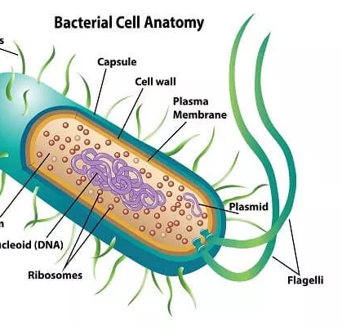
What Advantages Do Prokaryotes Have Over Eukaryotes?
Prokaryotes have the advantages associated with greater simplicity, including;
rapid reproduction,
rapid mutation and adaptation to new environments,
more diverse metabolic systems (living in hostile environment).
Eukaryotic life, including all multicellular organisms, could not exist without prokaryotes. One notable example is in the nitrogen cycle. Only certain bacteria are capable of splitting the triple bond of nitrogen gas to create nitrogen compounds, which are crucial, particularly to producers. Animals of all kinds rely on symbiotic bacteria to aid in digestion.

Slide 13
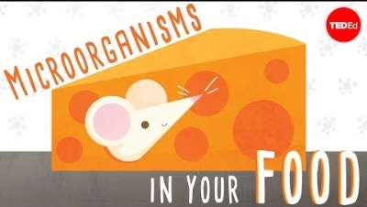
The beneficial bacteria that make delicious food

Slide 14
Eukaryote

Slide 15
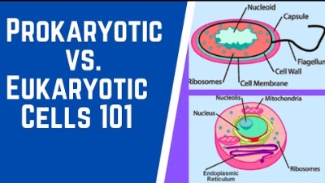
Prokaryotic Vs. Eukaryotic Cells

Slide 16
Eukaryotic cell

Slide 17
Eukaryotic cell has organells
Plasma Membrane: It is the outer covering of each cell. Present in cells of plants, animals and microorganisms. It is a living and quite thin, flexible and selectively permeable membrane. Made up of lipids, proteins and a small number of carbohydrates. Its major function is to hold cellular contents and control the passage of materials in and out of the cell.
Cell Wall: Present in plants and fungi and presents outside the plasma membrane. It is nonliving, quite thick and rigid but generally permeable. It is made up of cellulose (plant) or chitin (fungi). Its major function is to provide protection and strength to the cell.
Nucleus: It is a spherical cellular component, centrally located in the cell and covered chromosomes. Bounded by two nuclear membranes forming a nuclear envelope. The nuclear envelope is connected to the Endoplasmic reticulum (ER). There is nucleolus where is a place of Ribosome production.
Endoplasmic Reticulum: Produce lipids (fats) and steroid hormones, involved in detoxifying a number of organic chemicals converting them to safer water-soluble products. There are ribosome on it (rough ER)
Golgi apparatus: It consists of a set of membrane-bounded, fluid-filled vesicles, vacuoles and flattened cisternae (closed sacs). It is absent in bacteria, blue-green algae, mature sperms and red blood cells of mammals and other animals. Its main function is secretory. It packages material synthesised inside the cell and dispatches them. It produces vacuoles or secretory vesicles which contain cellular secretions like enzymes etc. It is also involved in the secretion of cell wall, plasma membrane and lysosomes.

Slide 18
Eukaryotic cell has organells
Lysosomes: there are digestive enzymes to digest foreign proteins, bacteria and viruses. So, it is a kind of garbage disposable system of the cell. And also known as suicidal bags as when the cells get damaged, lysosomes may burst and enzymes eat up their own cells.
Vacuoles: are fluid-filled or solid filled membrane-bound spaces. They are a kind of storage sacs. In animal cell vacuoles if present is small and temporary as compared to plant cell. It helps to maintain the osmotic pressure in a cell and provide turgidity and rigidity to the plant cells. They also store toxic metabolic by-products or end products of plant cells.
Centrosome: is found only in animal cells. As it helps in cell division for the separation of chromosomes by spindle fiber (iğ iplikçikleri). In plant cells, there is no centrosome!
Peroxisomes: They carry out some oxidative reactions like detoxification or removal of toxic substances from the cell.
PLASTID: Present in plant cells and is absent in animal cells. They have their own genome and have the power to divide. There are three types:
Chromoplasts (coloured plastids) : various colours to flowers to attract insects for pollination. (colored fruits and vegetables)
Chloroplasts (Green-coloured plastids) are present in green algae and higher plants. They have a green pigment called chlorophyll and help in the photosynthesis of food. So, known as “kitchens of the cell”.
Leucoplasts (colourless plastids) store food in the form of carbohydrates (starch), fats and proteins.
Mitochondria: organelles where eukaryotes extract energy from their food by cellular respiration.

Slide 19
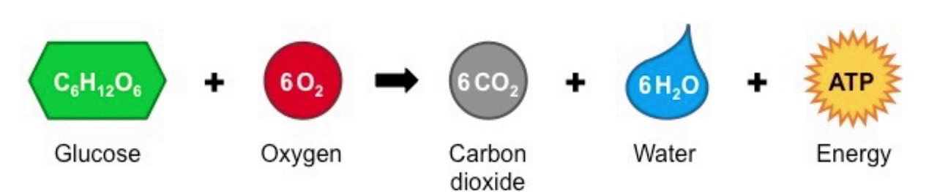
Mitochondria
The mitochondria are the organelles where eukaryotes extract energy from their food by cellular respiration.
Mitochondria are like the power plants of the cell because they transfer energy from food to ATP. ATP is an easy form of energy for cells to use, so mitochondria help cells get usable energy.

Slide 20
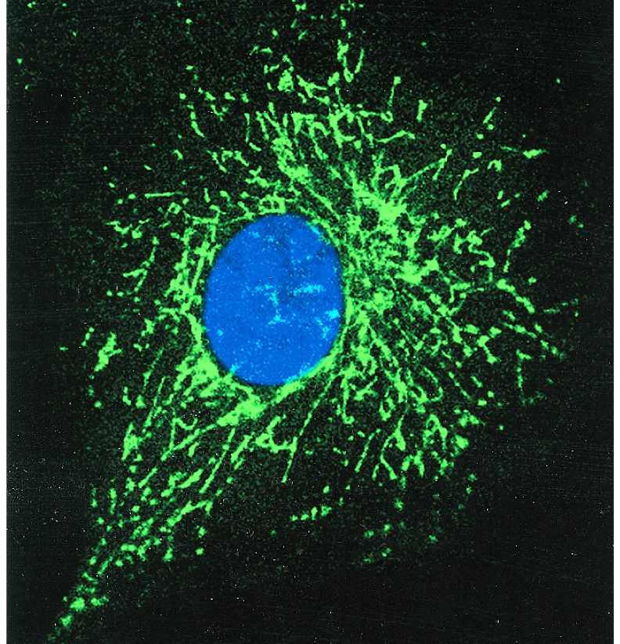
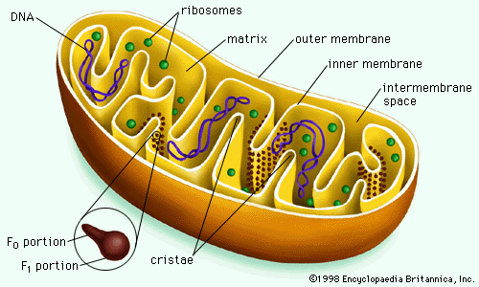
Mitochondria Generate Energy from Food to Power the Cell
The number of mitochondria in a cell can vary widely by organism, tissue, and cell type.
C.merolae (algae) contain single mitochondrion and a single chloroplast (plastid). Liver and muscle cells have 1000-10000 whereas Red blood cell doesn’t. Human ovum (egg) cells have between 100 000 and 600 000 mitochondria vs sperm has few hundreds!
Mitochondria also contain ribosomes for protein synthesis and a small, circular DNA (chromosome) that contains the code for some mitochondrial proteins. The ribosomes and DNA of mitochondria resemble those found in bacterial cells.
Endosymbiotic theory explains the origin of mitochondria and chloroplast

Slide 21
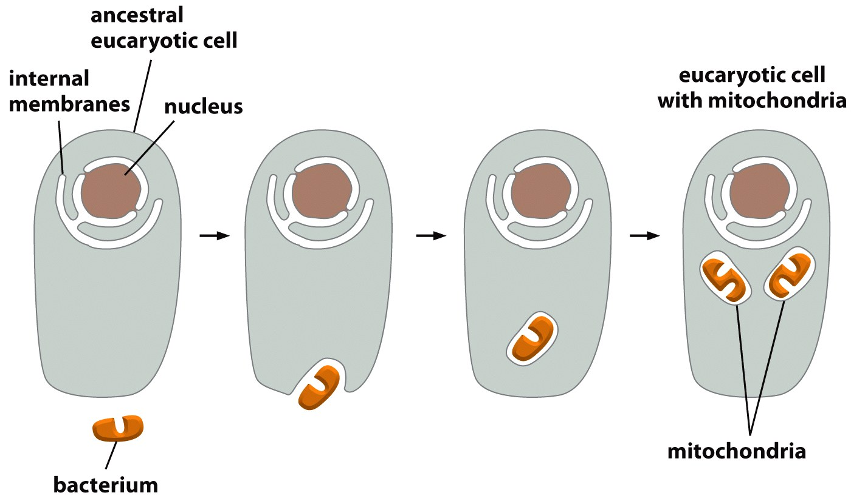
Endosymbiotic theory : Mitochondria evolved from bacteria
The structures and genomes are basically similar between mitochondria and Rickettsial bacteria

Slide 22
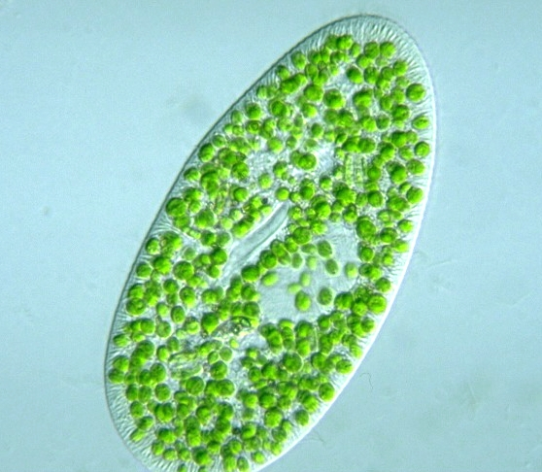
Mutualistic symbiotic relationship (Paramecium vs Chlorella)
Paramecium bursaria, found in almost all kinds of freshwater habitats, is a species of ciliate protozoan that has a mutualistic symbiotic relationship with green alga called Chlorella.

Slide 23
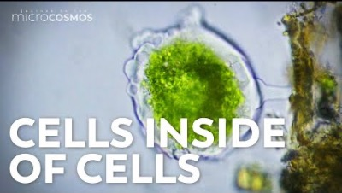
Where Did Eukaryotic Cells Come From? - Endosymbiotic Theory

Slide 24
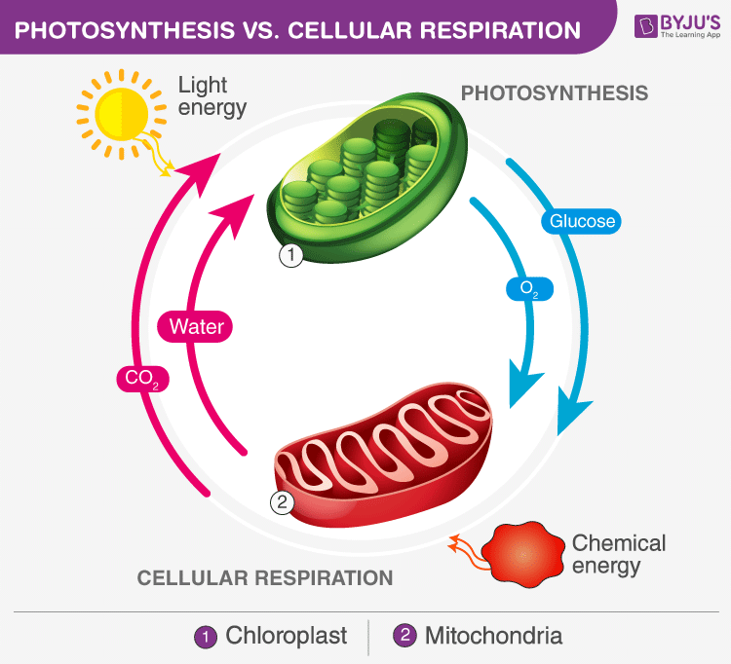
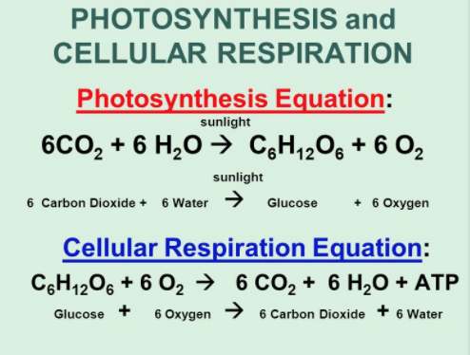
Chloroplast Present in green algae and higher plants. They have a green pigment called chlorophyll and help in the photosynthesis of food.

Slide 25
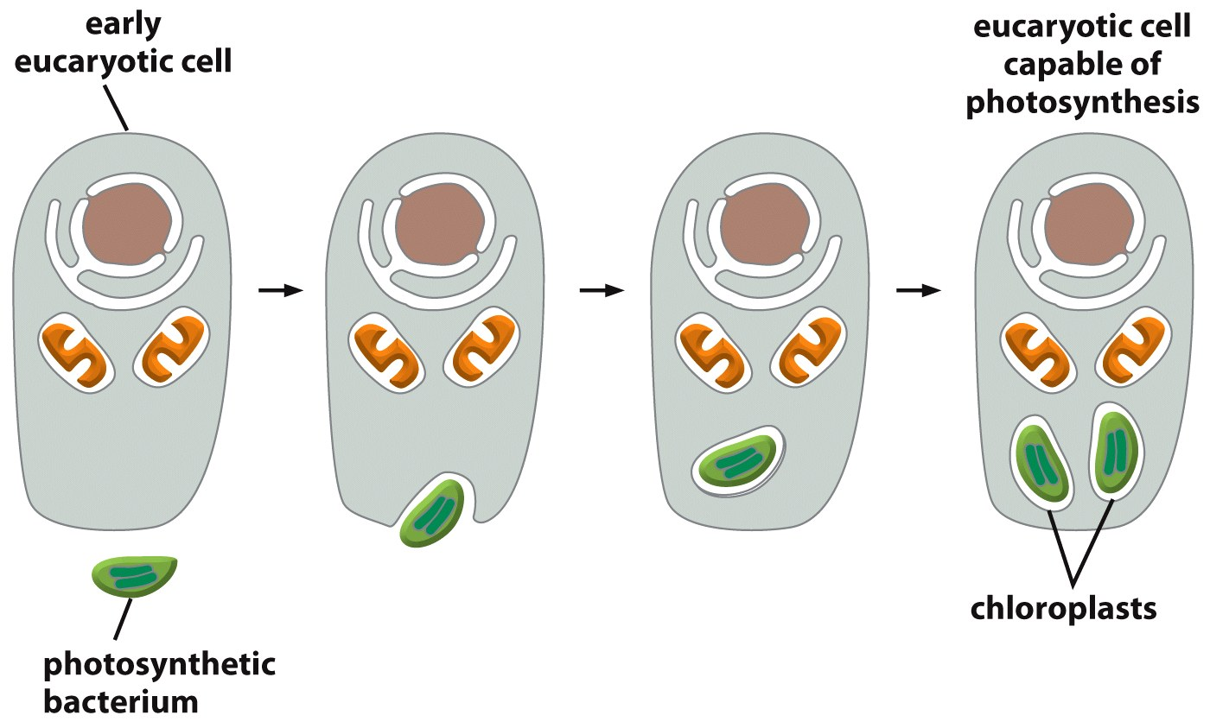
Endosymbiotic theory : Chloroplast evolved from bacteria
The structures and genomes are basically similar between mitochondria and cyanobacteria bacteria

Slide 26
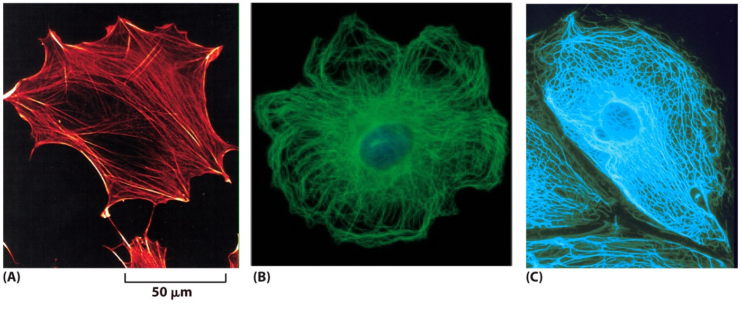
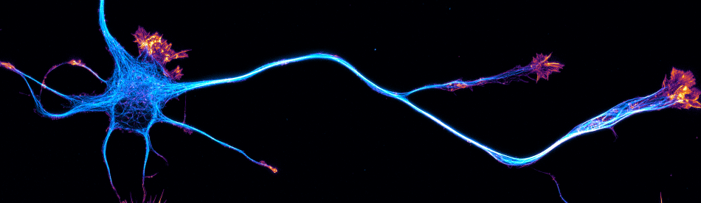
Cytoskeleton (Cell skeleton)
It is a network of proteins. These proteins underlie membranes, giving them shape and support, much like scaffolding can support a building. Cytoskeletal proteins run like tracks through cells, enabling the movement of vesicles and organelles like trains on a railroad track.

Slide 27
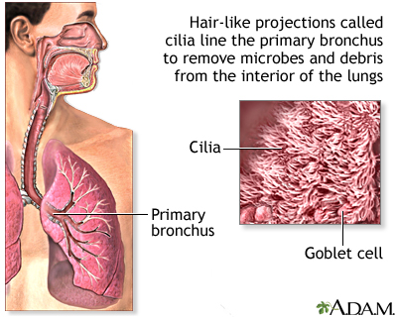
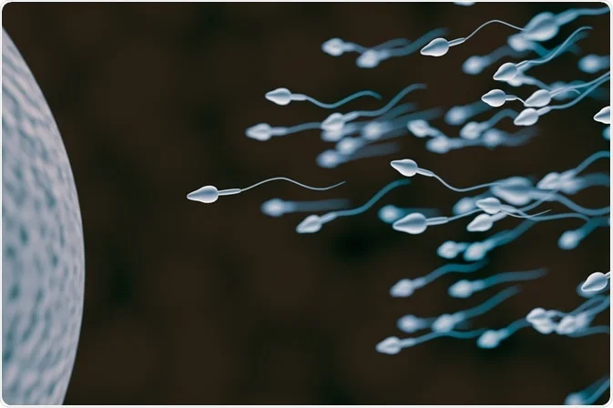
Cilia and flagella
Cilia and flagella are essentially the same structure, but cilia are typically shorter and more numerous on the surface of the cell whereas flagella are typically longer in length and fewer in number.
Cilia and flagella are motile cellular appendages found in most microorganisms (bacteria, archea,protists) and animals, but not in higher plants. Some cells, such as microscopic protists and sperm cells, swim using cilia and flagella.
Cilia are found on cells that make up the surfaces of tissues, such as cells in the respiratory and genital tracts of humans, where the cilia beat to move fluid and materials along the surface. For example, The respiratory tract in humans is lined with cilia that keep inhaled dust, smog, and potentially harmful microorganisms from entering the lungs. The beating of cilia moves mucus upward where you can cough it out of the body.
Flagella are found primarily on gametes. For single-celled eukaryotes (protist), cilia and flagella are essential for the locomotion of individual organisms.

Slide 28
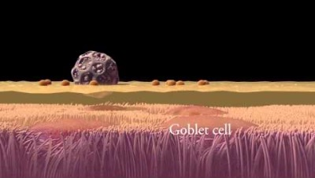
Function of cillia in lung airway

Slide 29
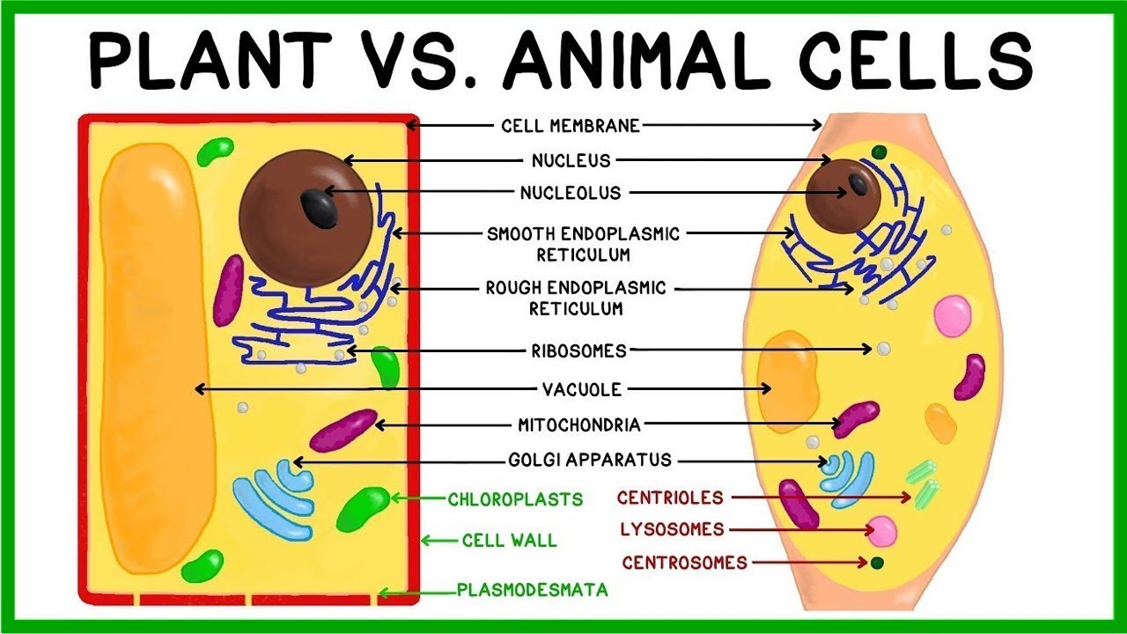
Animal Cell vs Plant Cell

Slide 30
Animal Cell vs Plant Cell
Animal Cell | Plant cell
It does not have a cell wall. | It consists of a cellulose cell wall outside the cell membrane.
Are irregular or round in shape. | Are square or rectangular in shape.
Centrosomes and centrioles are present. | Centrosomes and centrioles are absent.
Plastids (chloroplast) are absent | Plastids are present.
Vacuoles are usually small and sometimes they are absent. | Vacuoles are few large or single and centrally positioned vacuole.
Cilia is present in most animal cells. Flagella is present in some animals (sperm) | Cilia and flagella are absent.
Mitochondria is present and numerous in number. | Mitochondria is present but fewer in number
The mode of nutrition is heterotrophic. | The mode of nutrition is primarily autotrophic.
Single highly complex and prominent Golgi apparatus is present. | Many simpler units of Golgi apparatus called dictyosomes are present.

Slide 31
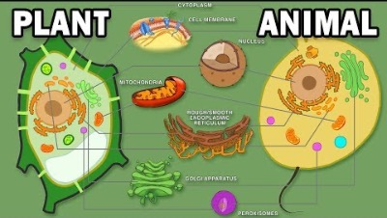
Plant vs Animal cells

Slide 32
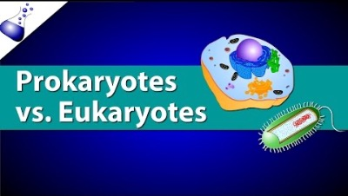
Prokaryotic Vs. Eukaryotic Cells (recommended to watch)

