Slide 1

INNOVATIONS IN DISTANCE LEARNING TECHNOLOGIES
By Alan May

Slide 2
Why are distance learning technologies important
Helps make education more accessible (remote regions, limited mobility persons)
Learners can reach educators that are in different countries
Allows for easier collaboration

Slide 4
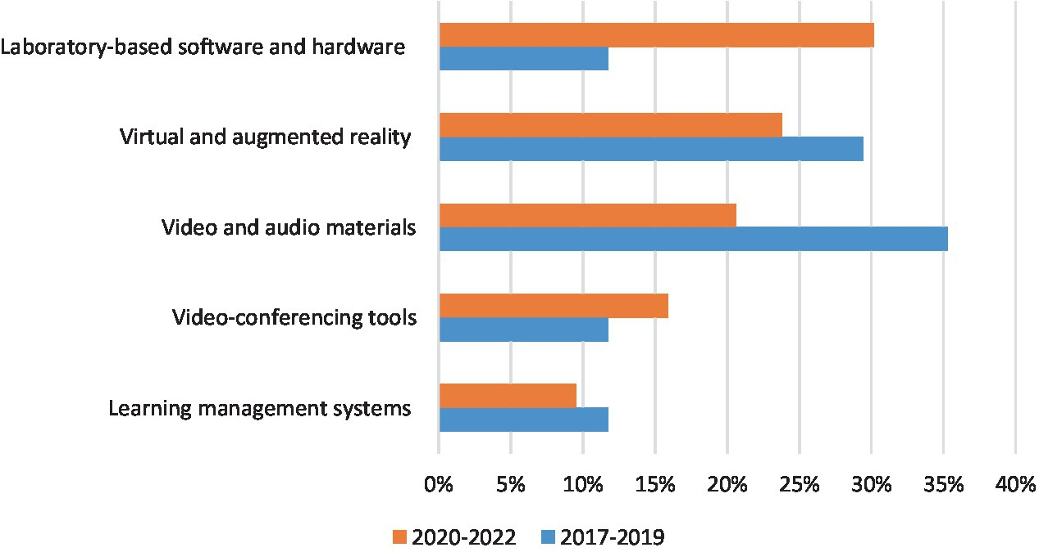
Technology usage over time

Slide 5
Refences
Slide3 chart: https://www.researchgate.net/figure/Country-wise-classification-using-Classifier-algorithm_tbl2_335920660
Slide4 image: https://analythical.com/blog/animating-charts-in-powerpoint

