Slide 1

E-COMMERCE ORDER & CUSTOMER
ANALYTICS
Business Performance Review
Executive dashboard and decision insights
Presented by
Tuna Santra

Slide 2
Executive Summary
A concise view of commercial performance, customer mix, and operational health.
Net Revenue
Orders
Avg Order Value
Delivery Rate
₹393,144
100
₹3,931
83%
After discounts
Transaction volume
Revenue / order
Delivered orders
What the data says
• West is the largest revenue region at ₹138,824 (35.3% of net revenue).
• Electronics leads categories with ₹140,692 in net revenue.
• Loyal customers generate ₹141,180; new customers generate ₹138,473.
• Returned + cancelled orders represent 10% of orders, creating an operational improvement opportunity.
Management priorities
• Protect West momentum while improving lower-performing regions.
• Use Electronics and Fashion as core growth engines.
• Convert new customers into repeat buyers through targeted retention.
• Reduce returns/cancellations and resolve pending orders faster.
2

Slide 3
Objectives
Key objectives of the e-commerce order and customer analytics project.
• Analyse order-level transaction data and establish a reliable KPI scorecard.
• Measure net revenue, gross sales, order volume, units sold, average order value, discounting, and customer ratings.
• Identify high-performing regions, categories, products, customer segments, and payment methods.
• Evaluate delivery, return, cancellation, and pending-order patterns to identify operational leakage.
• Convert analytical findings into actionable recommendations for revenue growth, customer retention, and operational improvement.
5

Slide 4
Dataset Description
Structure of the supplied Raw_Data sheet.
Data Area | Fields / Measures
Order Information | Order ID, Order Date, Order Status
Customer Information | Customer ID, Customer Name, Gender, Age
Geography | City, State, Region
Product | Product, Category, Quantity, Unit Price
Commercial | Discount, Shipping Cost, Gross Sales, Net Revenue
Transaction | Payment Method
Customer Experience | Rating, Customer Segment
Dataset Size | 100 records • 100 orders • 20 customers • 257 units
6

Slide 5
KPI Scorecard
Core measures calculated directly from the supplied workbook.
Net Revenue
Gross Sales
Orders
Customers
Units Sold
₹393,144
₹429,243
100
20
257
After discounts
Before discounts
Unique order IDs
Unique customer IDs
Total quantity
Average Order Value
Average Rating
₹3,931
3.98/5
Net revenue / order
Customer feedback
8

Slide 6
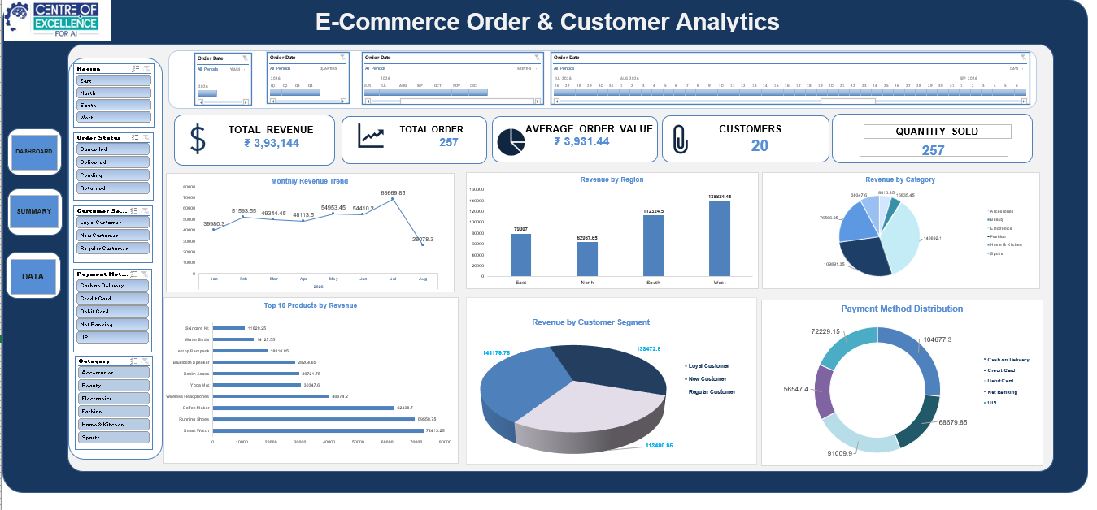
E-Commerce Order & Customer Analytics Dashboard

Slide 7
Conclusion
Overall interpretation of the e-commerce analytics.
• The dataset provides a complete business-performance view across 100 orders and 20 customers.
• Net revenue of ₹393,144 and AOV of ₹3,931 establish the commercial baseline.
• Regional and category analysis identifies the strongest revenue pools for focused action.
• Customer-segment analysis shows a meaningful repeat-purchase base while leaving room to convert more new customers.
• Order-health analysis highlights returns, cancellations, and pending orders as practical improvement areas.
• The dashboard structure can be refreshed as new transactions are added to the source workbook.
17

Slide 8
Conclusion
Overall interpretation of the e-commerce analytics.
• The dataset provides a complete business-performance view across 100 orders and 20 customers.
• Net revenue of ₹393,144 and AOV of ₹3,931 establish the commercial baseline.
• Regional and category analysis identifies the strongest revenue pools for focused action.
• Customer-segment analysis shows a meaningful repeat-purchase base while leaving room to convert more new customers.
• Order-health analysis highlights returns, cancellations, and pending orders as practical improvement areas.
• The dashboard structure can be refreshed as new transactions are added to the source workbook.
17

Slide 9
E-COMMERCE ORDER & CUSTOMER ANALYTICS
Thank You

