Slide 1

SUPERMARKET SALES
ANALYSIS
Power BI Dashboard Project
Anudip Foundation
Presented by: Tuna Santra & Mainak Das

Slide 2
Project Overview
Sales data is transformed into an interactive dashboard for analysis and presentation.
Analyze overall sales, profit, quantity and delivery performance.
Compare product categories and sub-categories.
Understand performance across states and regions.
Analyze customer segments and payment methods.
Track sales and profit trends over time.
Use interactive slicers to explore the dashboard.
2

Slide 3
Dataset & Key Fields
The supplied Power BI report references the following analytical fields.
Financial
Sales • Profit • Quantity
Product
Category • Sub-Category
Geography
State • Region
Customer
Segment
Payment
Payment Method
Time
Order Date
Operations
AvgDelivery
3

Slide 4
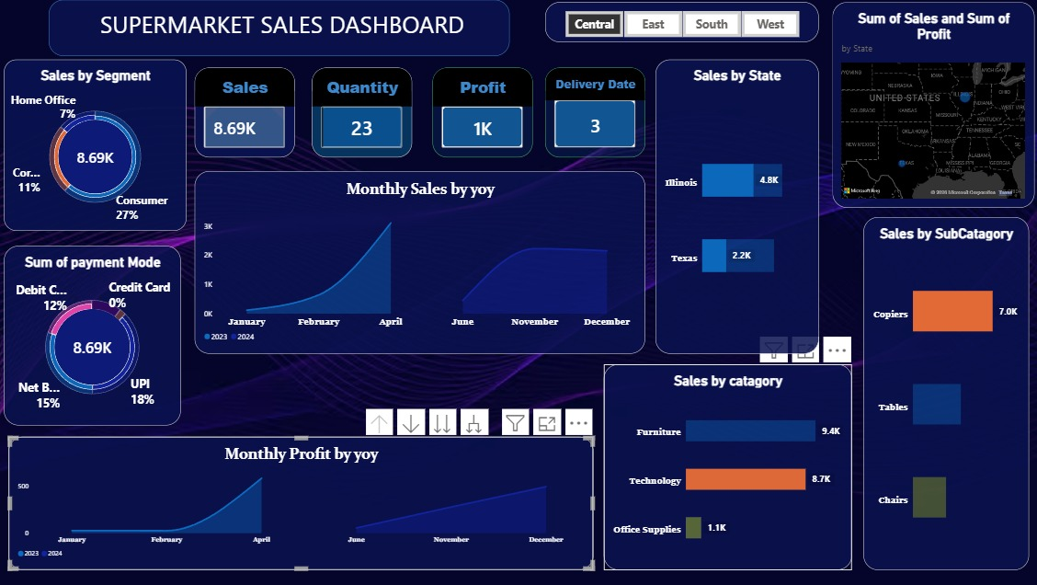
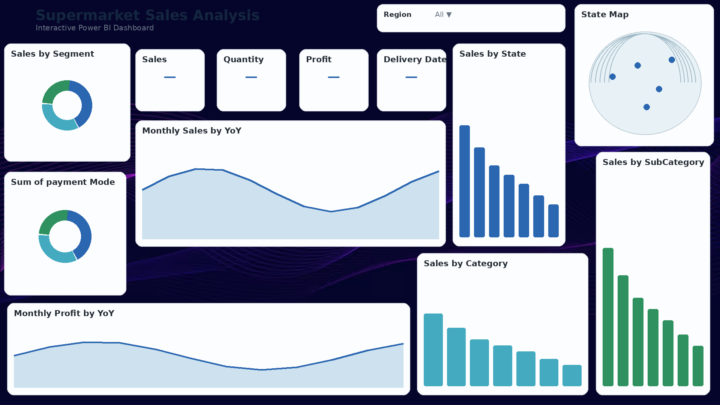
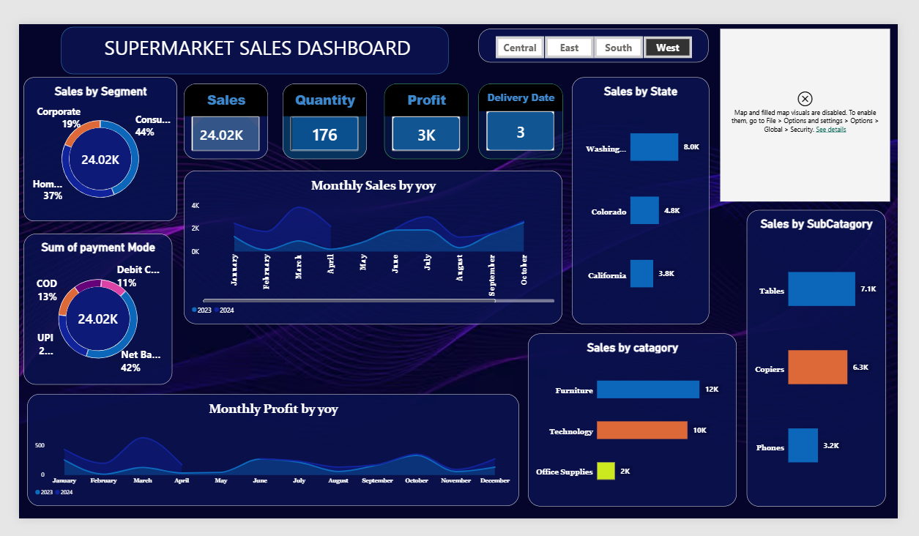
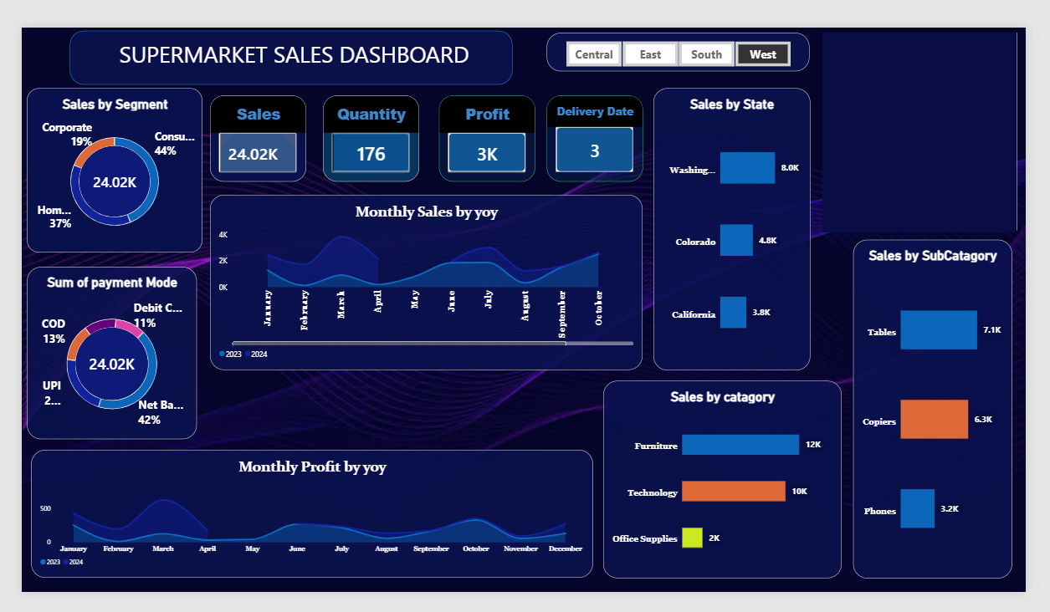
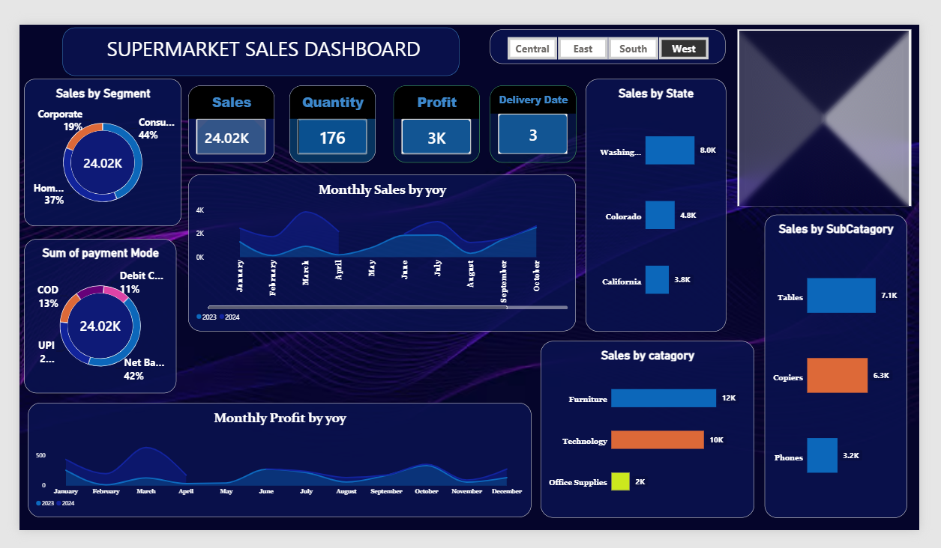
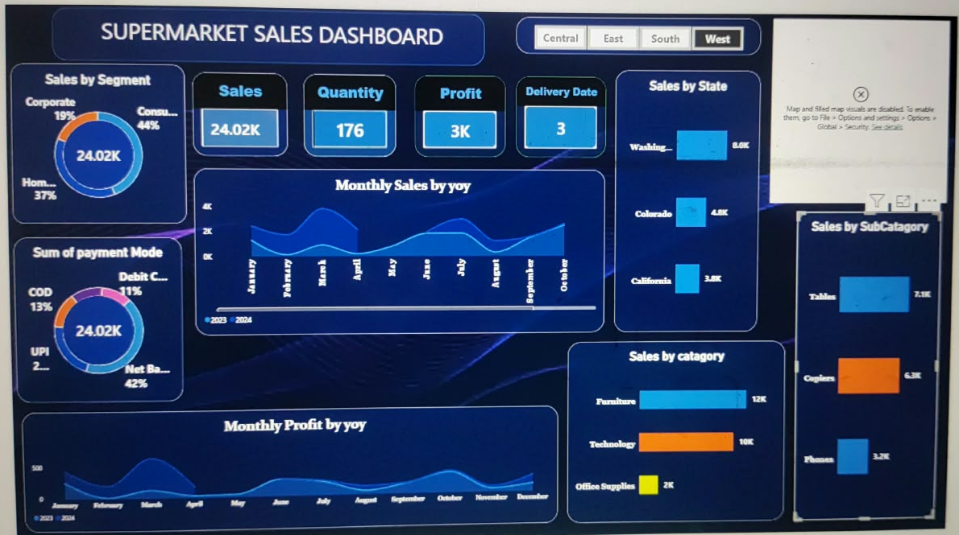
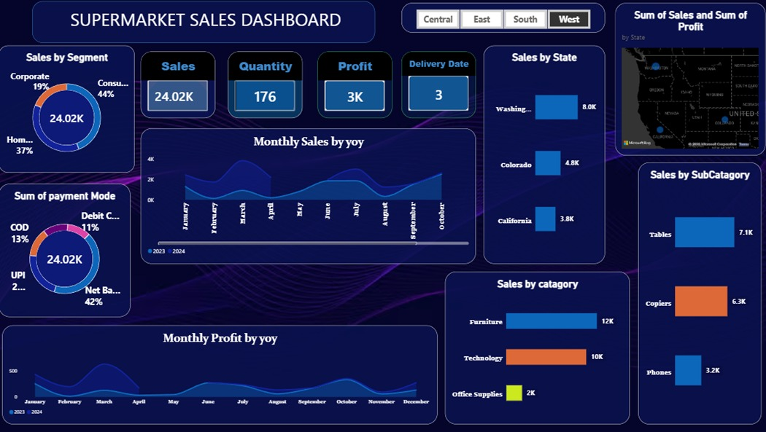
Power BI Dashboard – Full View
Screenshot recreated from the supplied Power BI report definition.
4

Slide 5
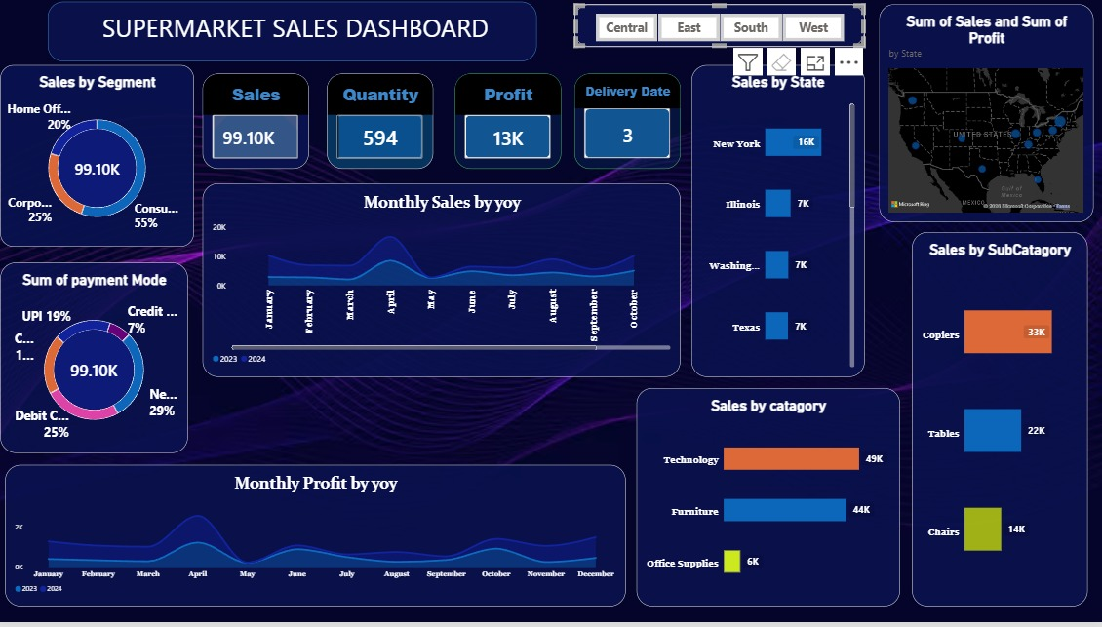
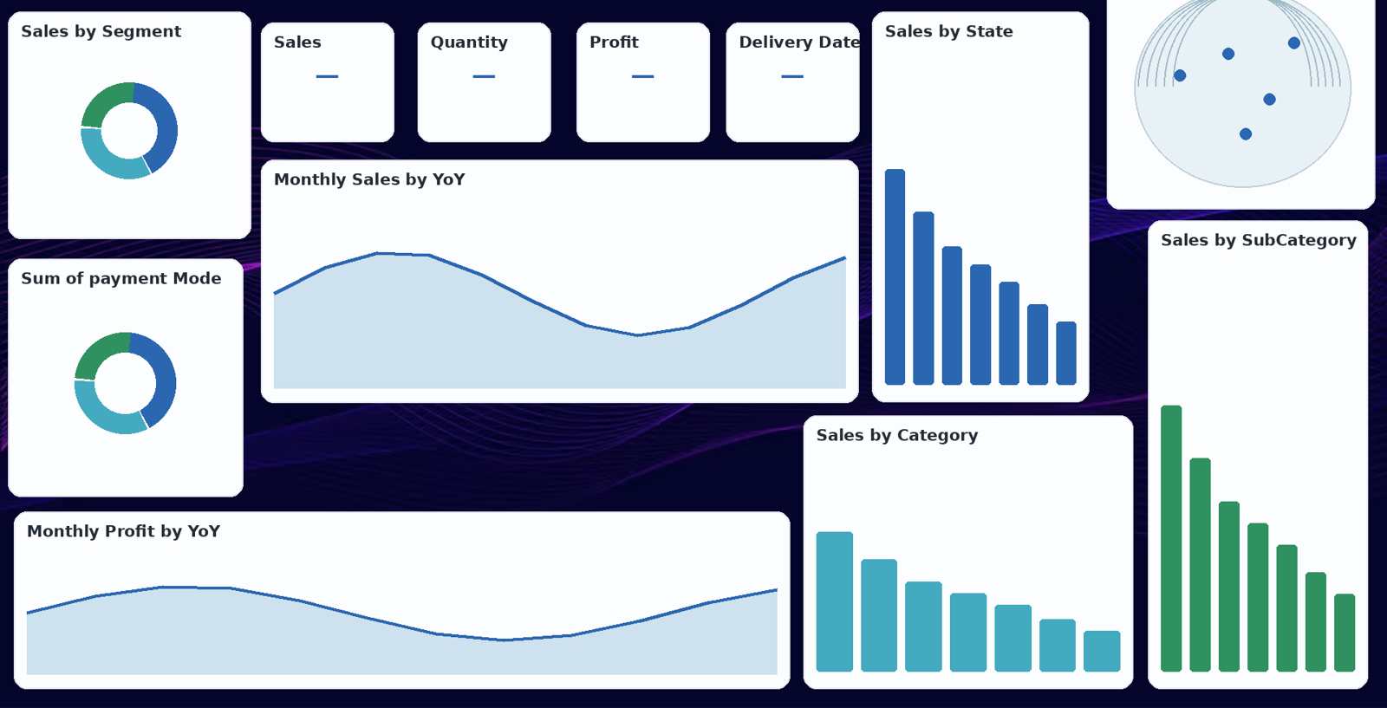
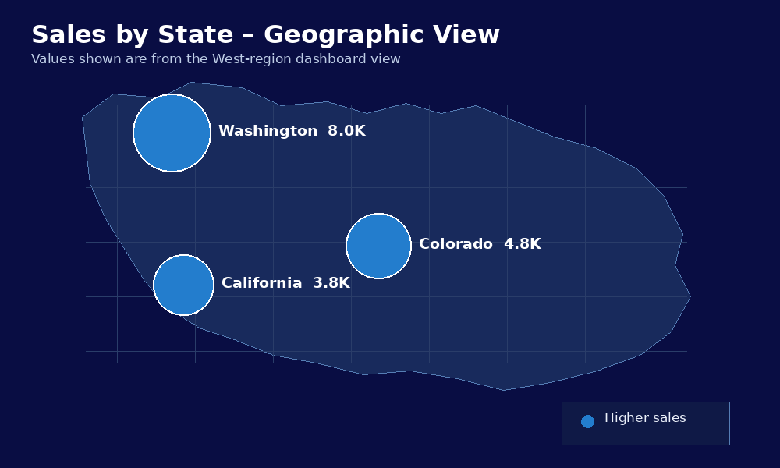
Dashboard – Visual & Slicer Details
The report contains KPI cards, charts, map visuals and a Region slicer.
Geography Analysis
The dashboard includes a state-level geographic visual showing both Sales and Profit.
State comparison
The map allows geographic differences in sales and profit to be viewed across states.
Interactive filtering
The Central, East, South and West slicer changes the geographic and other dashboard visuals.
Central-region example
Illinois and Texas are visible in the supplied Central-region dashboard.
West-region example
Washington, Colorado and California are visible in the supplied West-region dashboard.
Business value
Geographic analysis helps identify locations contributing strongly to sales and profit and areas for further investigation.
Geographic Analysis
The dashboard includes a state-level geographic view. The captured Power BI environment did not render the map visual, so the map above presents the state-level values visible in the dashboard for presentation.
5

Slide 6
Dashboard Features
Main Power BI components visible in the supplied report.
KPI Cards
Sales, Profit, Quantity and Average Delivery
Product Analysis
Category and Sub-Category sales
Trend Analysis
Monthly Sales and Monthly Profit
Geographic Analysis
State chart and map
Customer Analysis
Segment distribution
Payment Analysis
Payment-method distribution
Interactivity
Region slicer filters the report
6

Slide 7
Business Questions the Dashboard Addresses
How are total sales, profit and quantity performing?
Which categories and sub-categories generate the most sales?
How does performance differ between states and regions?
Which customer segments contribute to sales?
Which payment methods are most commonly represented?
How do sales and profit change month by month?
How does the selected Region affect the other visuals?
7

Slide 8
Project Workflow
1
Data
Collect and inspect the sales dataset.
2
Preparation
Check fields, dates and data quality.
3
Power BI
Load the data and build the report.
4
Visualization
Create KPI cards, charts and map.
5
Slicers
Add Region filtering for interaction.
6
Presentation
Use visuals to communicate findings.
8

Slide 9
THANK YOU
Anudip Foundation
Supermarket Sales Analysis
Tuna Santra • Mainak Das

