Slide 1
CROMNIA

Slide 2
ADVENTAGES
OF
TURKEY
Our Company
CROMNIA has been established in 2009 as a contract research organization (CRO) in Izmir, Turkey
ADVENTAGES
OF
CROMNIA
OUR
TEAM
ABOUT
CROMNIA
NEW BYLAW
IN
TURKEY
Cromnia
ABOUT
IZMIR
ABOUT
TURKEY

Slide 3
ADVENTAGES
OF
TURKEY
Our Company
CROMNIA has a wide scope in the management of Phase II - IV of clinical and observational research projects in all therapeutic areas
In addition, CROMNIA supports Phase I studies in collaboration with Phase I Units of Medical Faculties
ADVENTAGES
OF
CROMNIA
OUR
TEAM
ABOUT
CROMNIA
NEW BYLAW
IN
TURKEY
Cromnia
ABOUT
IZMIR
ABOUT
TURKEY

Slide 4
ADVENTAGES
OF
TURKEY
Our Company
Besides medical doctors in its clinical team, CROMNIA has a wide range of investigator database throughout the country
CROMNIA provides appropriate proactive solutions and coordination with related parties to avoid and/or resolve any possible issues that may occur during a research project
ADVENTAGES
OF
CROMNIA
OUR
TEAM
ABOUT
CROMNIA
NEW BYLAW
IN
TURKEY
Cromnia
ABOUT
IZMIR
ABOUT
TURKEY

Slide 5
ADVENTAGES
OF
TURKEY
Our Services
Site Selection and Feasibility
Clinical and Observational Trial Management
Regulatory Affairs
Medical Writing
Site Coordinator Services
Medical Translation
Investigator Meeting Organization
ADVENTAGES
OF
CROMNIA
OUR
TEAM
ABOUT
CROMNIA
NEW BYLAW
IN
TURKEY
Cromnia
ABOUT
IZMIR
ABOUT
TURKEY

Slide 6
ADVENTAGES
OF
TURKEY
Our Team
The founder members of CROMNIA have adequate individual experience in conducting many clinical trials in various therapeutic areas
ADVENTAGES
OF
CROMNIA
OUR
TEAM
ABOUT
CROMNIA
NEW BYLAW
IN
TURKEY
Cromnia
ABOUT
IZMIR
ABOUT
TURKEY

Slide 7
ADVENTAGES
OF
TURKEY
Our Experience
ADVENTAGES
OF
CROMNIA
OUR
TEAM
Therapeutic Area | Indication | Phase
Cardiovascular | Atrial fibrillation | III
Dermatology | Onychomycosis | III
Gastroenterology | Ulcerative colitis | III
Hematology | Non-Hodgkin’s Lymphoma | III
Immunology | Assessing Immunogenicity and safety of IC43 | II
Infectious Diseases | Nasocomial Pneumonia | III
Nephrology | Chronic renal failure | III
ABOUT
CROMNIA
NEW BYLAW
IN
TURKEY
Cromnia
ABOUT
IZMIR
ABOUT
TURKEY

Slide 8
ADVENTAGES
OF
TURKEY
Our Experience
ADVENTAGES
OF
CROMNIA
OUR
TEAM
Therapeutic Area | Indication | Phase
Nephrology | Renal transplantation | IV
Neurology | Multiple sclerosis | IV
Oncology | Lung cancer | III
Physical Treatment & Rehabilitation | Osteoporosis | III
Psychiatry | Attention deficit hiperactivity disorder | III
Respiratory Diseases | Asthma | III
ABOUT
CROMNIA
NEW BYLAW
IN
TURKEY
Cromnia
ABOUT
IZMIR
ABOUT
TURKEY

Slide 9

Objectivity and
Morality is
Necessary for
Integrity and
Accuracy of your data
Cromnia

Slide 10
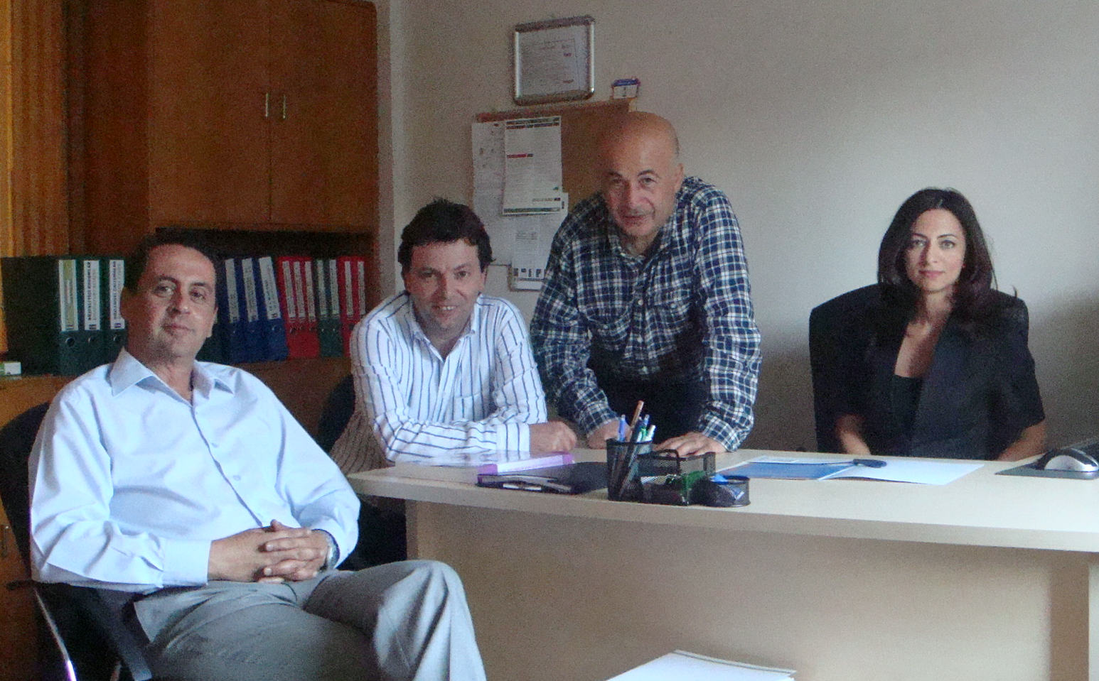

Cromnia
Thank you for allowing your time..

