Slide 1

NovaWallet Ledger Service
Case Study · Backend Engineer Assessment · .NET 9 / C#
September 2026
BABATUNDE OLADEJO

Slide 2
THE PROBLEM
WHAT WE ARE BUILDING
HARD CONSTRAINTS (non-negotiable)
Create & manage NGN wallets
Credit wallet — inbound NIP simulation
Atomic P2P transfer with concurrency safety
Idempotency — safe retries, no double-spend
Paginated statement & audit trail
Daily outbound limit (₦500k, WAT midnight reset)
JWT bearer auth on every endpoint
Consistent RFC 7807 error responses
All amounts stored as long in kobo — no float/double
Balance must NEVER go negative under concurrency
JWT bearer check on all business endpoints
RFC 7807 Problem Details on every error
Docker compose up — single command startup
Rate limiting · Outbox pattern · Correlation IDs
Health/readiness endpoints

Slide 3
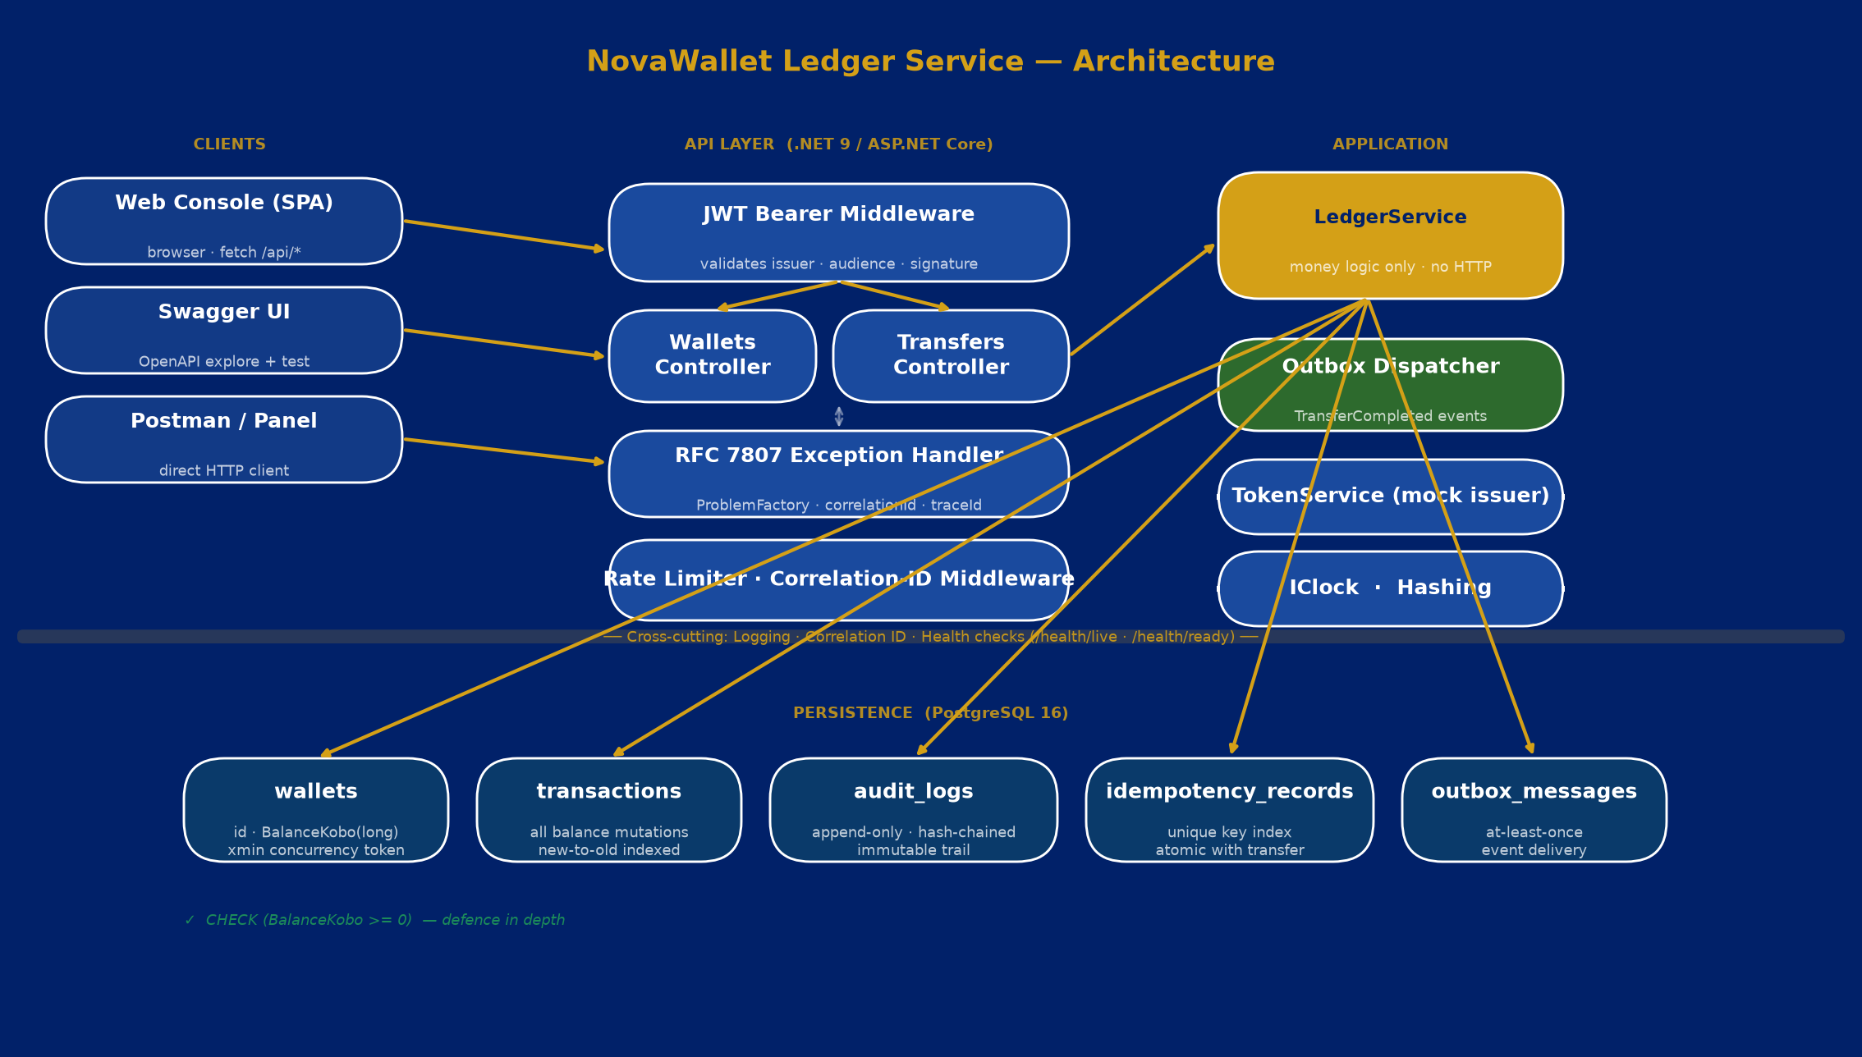
ARCHITECTURE
Clean layering — controllers stay thin, all money logic in one place

Slide 4
MONEY INTEGRITY
Every kobo is a long integer. No float. No decimal. No rounding drift — ever.
INTEGER ARITHMETIC
DB-LEVEL DEFENCE
NO DIVISION WITHOUT POLICY
BalanceKobo stored as long
All amounts passed as long kobo
checked() catches overflow
1 NGN = 100 kobo exactly
CHECK (BalanceKobo >= 0)
Backstop independent of app logic xmin row as concurrency token
Migration-verified at startup
No fees / splits yet → no rounding
Future: document who absorbs
remainder kobo before merging
any feature that divides
from.BalanceKobo = fromBefore - req.AmountKobo; to.BalanceKobo = checked(toBefore + req.AmountKobo);

Slide 5
CONCURRENCY SAFETY
100 concurrent transfers against a wallet funded for exactly 50 → 50 succeed · 50 rejected · balance drains to ₦0.00 · 0 double-spends
HOW IT WORKS
WHY NAIVE APPROACH FAILS
SELECT … FOR UPDATE on both wallet rows
Rows locked in wallet-id order (alphabetic Guid)
→ prevents deadlocks on opposing-direction transfers
ReadCommitted transaction holds both locks
Balance check + debit/credit + audit inside one tx
DB CHECK (BalanceKobo >= 0) as final backstop
xmin optimistic token catches any unlocked path
Read-check-write without a lock:
Two threads both read balance=1000
Both decide 1000 >= 600, both proceed
Both debit → balance ends at -200 ❌
Optimistic-only (xmin) under high contention:
Most retries still succeed, but under burst
load retries storm the DB ❌
Our approach: lock first, check inside lock ✓

Slide 6
IDEMPOTENCY
Client sends transfer
+ Idempotency-Key: abc
Key found in DB?
(fast path)
Return stored
response (201)
Idempotent-Replayed: true
Execute transfer +
write idempotency record
in ONE transaction
Same payload hash?
409 Conflict key reused with
different body
The critical design decision
The idempotency record is written in the SAME database transaction as the balance mutation. There is no window where the transfer commits but the record does not — so a retry can never double-process money. Concurrent replays race on a unique index: the loser rolls back entirely.
Replay same key + same body
Returns original 201 response
Idempotent-Replayed: true header
Money moved exactly once
Reuse key + different body
409 Conflict
idempotency_key_reused error code
Original transfer unchanged

Slide 7
ALL REQUIREMENTS MET
CAPABILITY
REQUIREMENT
Daily Limit
₦500,000 / wallet / WAT day. Computed from TransferOut rows under the same lock — always consistent with concurrent transfers. No counter. No reset cron.
Statement
GET /api/wallets/{id}/statement · paginated, newest-first · page/pageSize · totalCount for client paging
Audit Log
Separate append-only audit_logs table. SHA-256 hash-chained — tamper-evidence. balanceBefore / balanceAfter / correlationId on every row.
JWT Auth
JwtBearer validates issuer · audience · lifetime · HMAC signature. POST /api/auth/token is a mock issuer — the middleware and claims handling is what's scored.
Rate Limiting
Token-bucket per authenticated subject (JWT sub → ClaimTypes.NameIdentifier). POST /api/transfers only.
Outbox Pattern
TransferCompleted event written in the SAME transaction as the balance mutation. OutboxDispatcher hosted service drains asynchronously — at-least-once, no dual-write.
Health Checks
/health/live and /health/ready with DB connectivity check — suitable for Kubernetes liveness/readiness probes.
Error Handling
Every error (validation, domain, malformed JSON, DB down) → application/problem+json with type, machine-readable title, correlationId, traceId, timestamp.

Slide 8
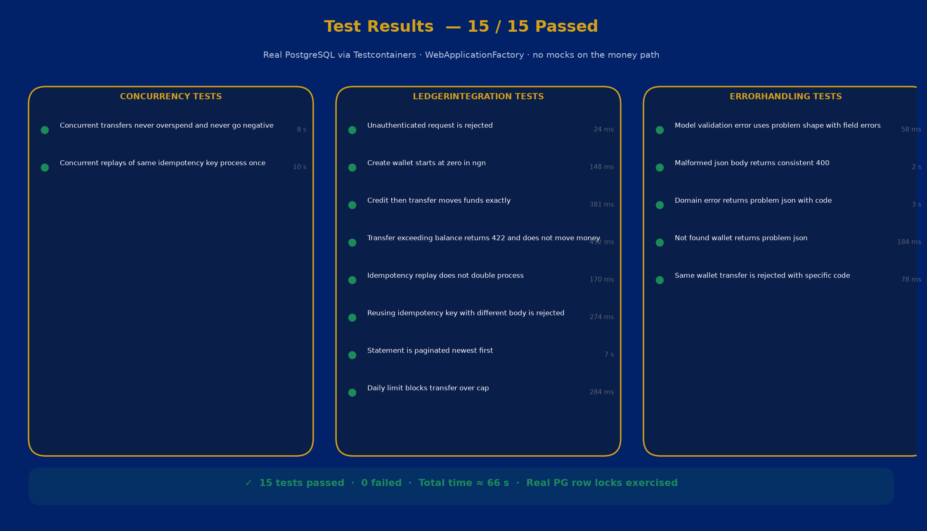
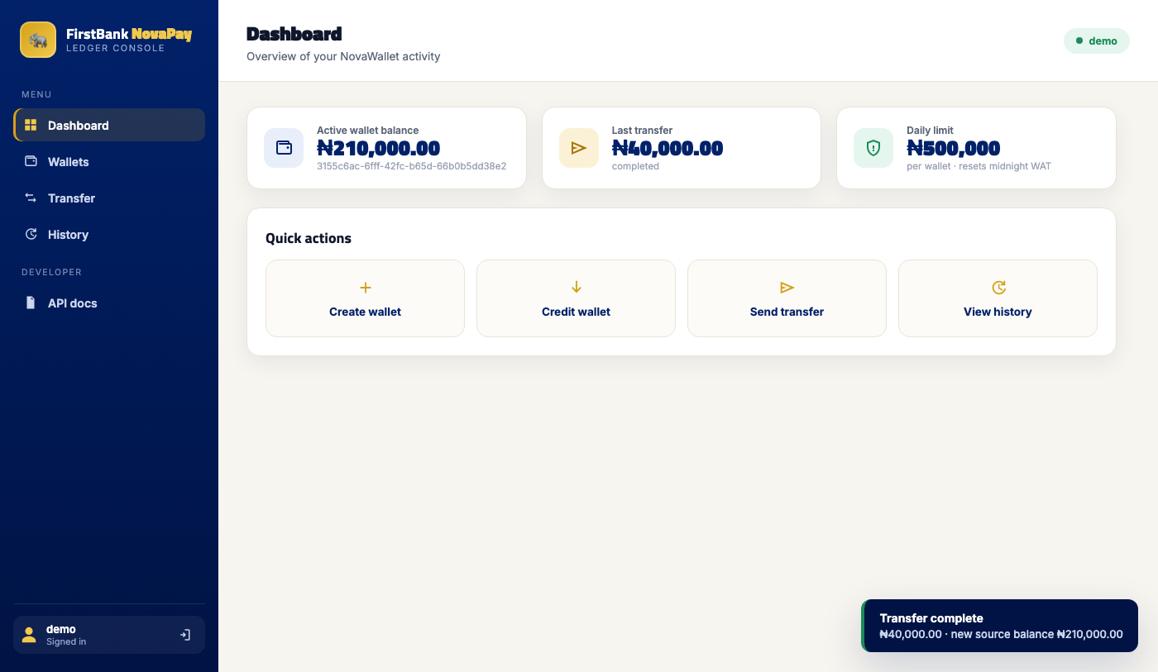
TEST RIGOUR + DEMO
15 / 15 tests passed · Real PostgreSQL via Testcontainers · concurrency proven under load

Slide 9
THANKS!
Do you have any questions?
babatundeoladejo16@gmail.com
+2348102992169
https://babz-portfolio.vercel.app/
Please keep this slide for attribution

Slide 10
AI USAGE & JUDGMENT
Used AI to move fast — and caught where it was wrong for a financial system
BUG 1 — Runtime crash in validation
[property: Required] on positional records compiled fine but crashed every request at runtime.
ASP.NET Core silently ignores validation attrs on record properties — they must bind to the constructor parameter.
Caught by running the service. Fixed by removing the property: target.
BUG 2 — Concurrency lock silently broken
AI wrote: SELECT * FROM wallets FOR UPDATE.
xmin is a PostgreSQL SYSTEM column — not returned by SELECT *.
EF projected xmin as the concurrency token → 'column n.xmin does not exist' on every transfer.
Without xmin, the entire optimistic-lock backstop was gone — a critical financial safety defect.
Caught by hitting transfer against the live container. Fixed by listing all columns explicitly including xmin.
BUG 3 — Rate limiter bucketed all users together
AI partitioned by httpContext.User.Identity?.Name — which is null for JWT tokens that only carry sub.
JwtBearer maps sub → ClaimTypes.NameIdentifier, not Identity.Name.
Every caller shared the same IP-based bucket. Caught by the concurrency load test:
expected 50 successes, got ~15 with TooManyRequests.
Fixed by partitioning on ClaimTypes.NameIdentifier ?? sub ?? Name ?? IP.

Slide 11
OPERATING CONTEXT
Where the Nigerian fintech constraints touch this design specifically
₦ in kobo · no float Implemented ✓
Tiered KYC (BVN / NIN) Seam identified — next build
Enforced end-to-end. Critical note: any future feature that divides kobo (fee splits, FX, interest) produces remainders. Document rounding policy before merging.
Daily limit is a function of KYC tier, not a global constant. DailyOutboundLimitKobo should resolve per-wallet from KycTier. Attaches to TransferAsync limit check.
NIBSS NIP rails Outbox ready · states deferred
USSD *894# Server-side kobo ✓
Inbound credit = external notification; must be idempotent on NIP session ID (not client header). Outbound = pending → settled/failed, not instant. Outbox pattern is the right foundation.
No JWT for feature phones. USSD gateway auth by MSISDN+PIN, calls API on user's behalf. Naira→kobo must be server-side — already enforced; UI conversion is convenience only.
NDPA 2023 Schema correct · retention TBD
CBN consumer protection Errors transparent ✓ · Reversal TBD
Audit log stores correlationId + customerId — not raw BVN/NIN. Immutability vs. erasure rights: resolve by storing identifiers by reference. Retention window needed.
Customers must be told why a transfer failed — error codes do this. Honest gap: no reversal/refund path. A failed outbound NIP leg must return funds. Next to build.

Slide 12
WHAT I'D BUILD NEXT
Deliberate scope decisions — and the honest gaps
PRIORITY BACKLOG
KEY TRADE-OFFS
1
KycTier on Wallet → per-tier daily limit
CBN tiered KYC — most impactful regulatory gap
Pessimistic locks over optimistic retry
Correct under burst load; avoids retry storms. Queue cleanly, don't retry-stampede.
2
Reversal / refund endpoint
Consumer-protection requirement for failed NIP legs
Daily limit from history, no counter
3
Pending / settled transaction states
Outbound NIP transfers are async, not instant-final
Always consistent; no reset cron job; no crash leaves a counter wrong.
4
USSD adapter — MSISDN + PIN principal
Feature-phone / low-connectivity users on *894#
Mock JWT issuer
The middleware and claims handling is what's scored — not building an IdP.
5
NDPA retention policy on audit_logs
Data-subject erasure rights vs. immutable audit

