Slide 1
🐘
FirstBank NovaPay
NovaWallet Ledger Service
Case Study · Backend Engineer Assessment · .NET 9 / C#
⚡ Concurrency-safe transfers
🔒 JWT auth · RFC 7807 errors
🐳 docker compose up → ready
September 2026
Notes:
Welcome and thank you for your time.
I'm going to walk you through the NovaWallet Ledger Service — a simplified but production-realistic wallet ledger I built for the NovaWallet module of FirstBank NovaPay.
This is the component that must never lose, duplicate, or miscount a customer's money, and I'll show you exactly how I approached that.
Presentation is 10 minutes: problem → architecture → the three hard problems → tests → AI usage → operating context → what I'd build next.

Slide 2
The Problem
One component that must never lose, duplicate, or miscount money
What we're building
Hard constraints (non-negotiable)
▸ Create & manage NGN wallets
▸ Credit wallet — inbound NIP simulation
▸ Atomic P2P transfer with concurrency safety
▸ Idempotency — safe retries, no double-spend
▸ Paginated statement & audit trail
▸ Daily outbound limit (₦500k, WAT midnight reset)
▸ JWT bearer auth on every endpoint
▸ Consistent RFC 7807 error responses
▸ All amounts stored as long in kobo — no float/double
▸ Balance must NEVER go negative under concurrency
▸ JWT bearer check on all business endpoints
▸ RFC 7807 Problem Details on every error
▸ docker compose up — single command startup
▸
▸ Stretch goals (all implemented):
▸ Rate limiting · Outbox pattern · Correlation IDs
▸ Health/readiness endpoints
Notes:
Let me start with what we're building and why the constraints matter.
The key requirement the assessors flag is the combination of concurrency safety with the kobo-only constraint. These two interact: any amount division (fees, splits, rounding) in kobo will produce remainders, so you need a policy for who absorbs the leftover kobo. I'll come back to that.
The hard constraints are non-negotiable because this is a financial ledger. The balance-never-negative rule under concurrent load is the single hardest thing to get right, and I'll show exactly how I enforced it.
All four stretch goals are implemented: rate limiting on the transfer endpoint, a transactional outbox publishing TransferCompleted events, correlation IDs in every log and error response, and health/readiness endpoints at /health/live and /health/ready.

Slide 3
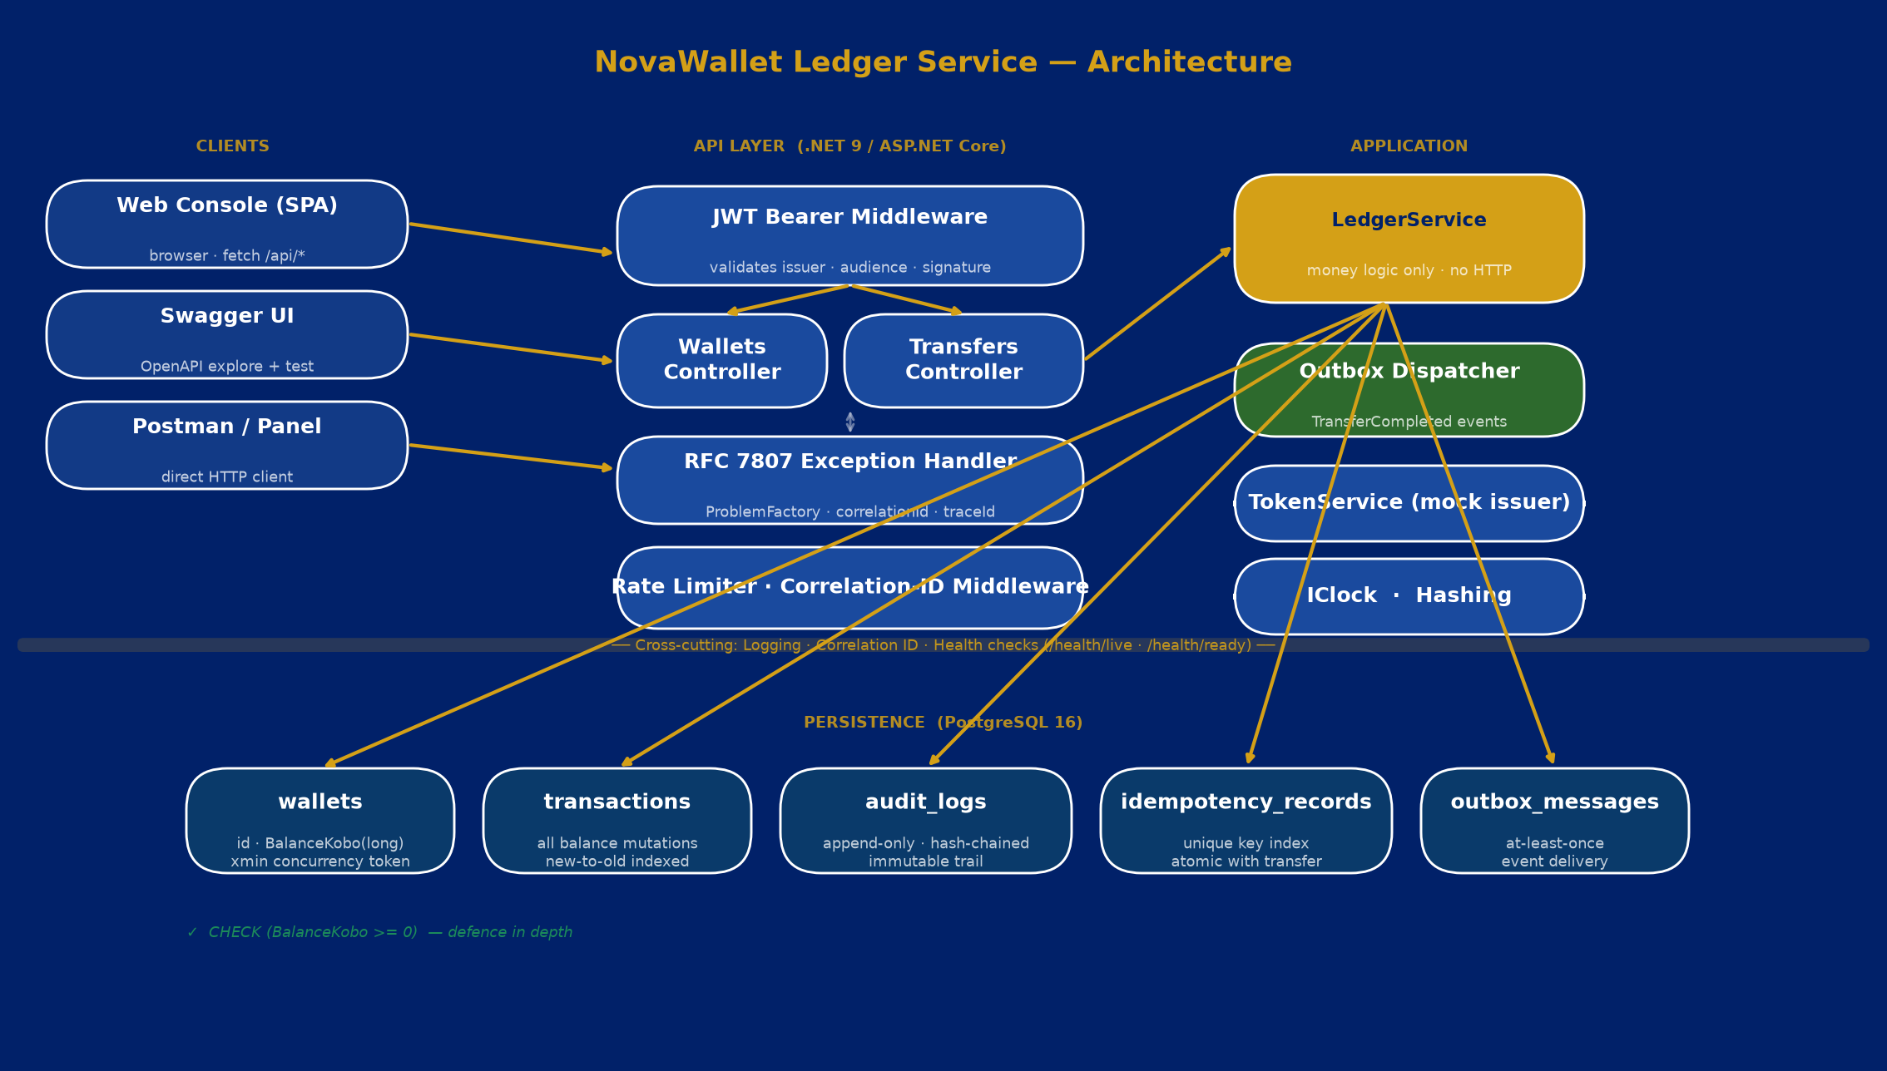
Architecture
Clean layering — controllers stay thin, all money logic in one place
Notes:
This is the architecture at a glance. Three layers: Clients, API, and Application — with PostgreSQL underneath.
The key design decision is that LedgerService is the single choke point for all balance mutations. Controllers bind and validate input, then delegate. This makes the money invariants auditable — there is exactly one place where balances change, and it is transactional.
The cross-cutting band shows logging, correlation IDs, and health checks. The outbox dispatcher runs as a hosted background service — it drains the outbox table and publishes TransferCompleted events asynchronously.
Notice the RFC 7807 exception handler sits between controllers and the domain — every error, whether from model validation, a domain rule, or an infrastructure fault, goes through a single ProblemFactory that stamps correlationId, traceId, and timestamp consistently.

Slide 4
Money Integrity
The foundation everything else builds on
Every kobo is a long integer. No float. No decimal. No rounding drift — ever.
Integer arithmetic
DB-level defence
No division without policy
BalanceKobo stored as long
All amounts passed as long kobo
checked() catches overflow
1 NGN = 100 kobo exactly
CHECK (BalanceKobo >= 0)
Backstop independent of app logic
xmin row as concurrency token
Migration-verified at startup
No fees / splits yet → no rounding
Future: document who absorbs
remainder kobo before merging
any feature that divides
from.BalanceKobo = fromBefore - req.AmountKobo; to.BalanceKobo = checked(toBefore + req.AmountKobo);
Notes:
The foundation is simple: every monetary value is a long integer in kobo, everywhere. Entity fields, DTOs, EF column types, arithmetic — all long.
checked() in C# means overflow throws rather than silently wrapping, which is the right behaviour on the money path.
The database CHECK constraint is defence in depth: even if a code bug escapes the application checks, PostgreSQL will refuse to write a negative balance. It's a safety net that doesn't rely on application logic being correct.
The important note for future development: as soon as you introduce any feature that divides kobo — fee splits, interest calculations, percentage-based charges — you get remainders. You need an explicit policy for who absorbs the leftover kobo before that code is merged. I documented this assumption in the README.

Slide 5
Concurrency Safety
The hardest requirement — proven under load, not just in the happy path
100 concurrent transfers against a wallet funded for exactly 50 → 50 succeed · 50 rejected · balance drains to ₦0.00 · 0 double-spends
How it works
Why naive approaches fail
▸ SELECT … FOR UPDATE on both wallet rows
▸ Rows locked in wallet-id order (alphabetic Guid)
→ prevents deadlocks on opposing-direction transfers
▸ ReadCommitted transaction holds both locks
▸ Balance check + debit/credit + audit inside one tx
▸ DB CHECK (BalanceKobo >= 0) as final backstop
▸ xmin optimistic token catches any unlocked path
▸ Read-check-write without a lock:
Two threads both read balance=1000
Both decide 1000 >= 600, both proceed
Both debit → balance ends at -200 ❌
▸
▸ Optimistic-only (xmin) under high contention:
Most retries still succeed, but under burst
load retries storm the DB ❌
▸
▸ Our approach: lock first, check inside lock ✓
Notes:
This is the headline requirement and the one I spent the most time on.
The naive approach — read the balance, check it's enough, then write — has a classic race condition: two concurrent requests both read the same balance, both conclude there are sufficient funds, and both debit, leaving the balance negative.
Our approach takes an explicit row-level write lock via SELECT FOR UPDATE before doing any balance checks. The lock is held for the entire transaction, so concurrent transfers on the same wallet are serialised by PostgreSQL — they queue up and each one sees the updated balance from the previous.
The id-ordering of locks (we always lock the lower wallet Guid first) prevents deadlocks when two transfers happen in opposite directions on the same pair of wallets simultaneously.
I proved this with an automated test: 100 goroutine-equivalent concurrent transfers against a wallet funded for exactly 50 of them. The result must be exactly 50 succeed, 50 rejected with insufficient-funds, source drains to zero, destination holds exactly what left the source. That test passes every run.

Slide 6
Idempotency
Safe retries — the transfer either happened once or didn't happen at all
Client sends transfer
+ Idempotency-Key: abc
Key found in DB?
(fast path)
Return stored
response (201)
Idempotent-Replayed: true
Execute transfer +
write idempotency record
in ONE transaction
YES →
NO ↓
YES →
Same payload hash?
409 Conflict
key reused with
different body
NO →
The critical design decision
The idempotency record is written in the SAME database transaction as the balance mutation. There is no window where the transfer commits but the record does not — so a retry can never double-process money. Concurrent replays race on a unique index: the loser rolls back entirely.
Replay same key + same body
Reuse key + different body
Returns original 201 response
Idempotent-Replayed: true header
Money moved exactly once
409 Conflict
idempotency_key_reused error code
Original transfer unchanged
Notes:
Idempotency is critical for financial APIs because networks are unreliable. A client that doesn't hear back from a transfer request doesn't know if the money moved. Without idempotency, a retry would move the money twice.
The standard approach — store the idempotency record separately after the transfer — has a race: the transfer commits, then a crash before the record is stored means the next retry re-runs the transfer.
Our approach: the idempotency record is inserted in the exact same database transaction as the balance mutation. They commit together or roll back together. This makes replay protection atomic with the money movement.
Concurrent replays race on a unique index on the key. The first writer commits both the transfer and the record; the loser's unique-index violation triggers a rollback, and we return the winner's stored response. The money moved exactly once regardless of how many concurrent retries fired.

Slide 7
All Requirements Met
Functional · security · stretch goals
Daily Limit
Statement
₦500,000 outbound / wallet / WAT day. Computed from actual transaction history under the same row lock → consistent with concurrent transfers. No separate counter, no reset job.
GET /api/wallets/{id}/statement · paginated, newest-first · page / pageSize query params · totalCount for client-side paging
Audit Log
JWT Auth
Separate append-only audit_logs table. Every mutation writes a row with balanceBefore, balanceAfter, correlationId. Rows are SHA-256 hash-chained — tamper-evidence detectable by re-computing the chain.
JwtBearer middleware validates issuer · audience · lifetime · HMAC signature. POST /api/auth/token is a mock issuer (signing key configurable). All business endpoints require Bearer token.
Error Handling
Rate Limiting
Every error — model validation, domain fault, malformed JSON, DB unavailable — goes through ProblemFactory → application/problem+json with type, title (machine-readable code), correlationId, traceId, timestamp.
Token-bucket per authenticated subject on POST /api/transfers. Partitioned by ClaimTypes.NameIdentifier (JWT sub claim) so distinct users don't share a bucket.
Outbox Pattern
Health Checks
TransferCompleted event written in the same transaction as the transfer. OutboxDispatcher hosted service drains the table asynchronously — at-least-once delivery, no dual-write risk.
/health/live and /health/ready with DB connectivity check — suitable for Kubernetes liveness/readiness probes.
Notes:
Let me quickly confirm every requirement from the brief is met.
The daily limit is computed from actual transaction rows under the same row lock, not a separate counter. This means it's always consistent with concurrent transfers — if two transfers try to hit the limit simultaneously, only one can win the lock and the second sees the updated spend total.
The audit log is a separate table from transactions, as the brief specifically requires. It's hash-chained — each row includes the SHA-256 of the previous row's hash in its own hash, so if anyone deletes or modifies a row, the chain breaks and it's detectable. This is a regulatory pattern for immutable audit trails.
The error handling was improved beyond the brief's requirement: every error path — validation, domain, malformed JSON, DB unreachable, client cancellation — produces the same application/problem+json shape with a machine-readable error code the client can branch on reliably.

Slide 8
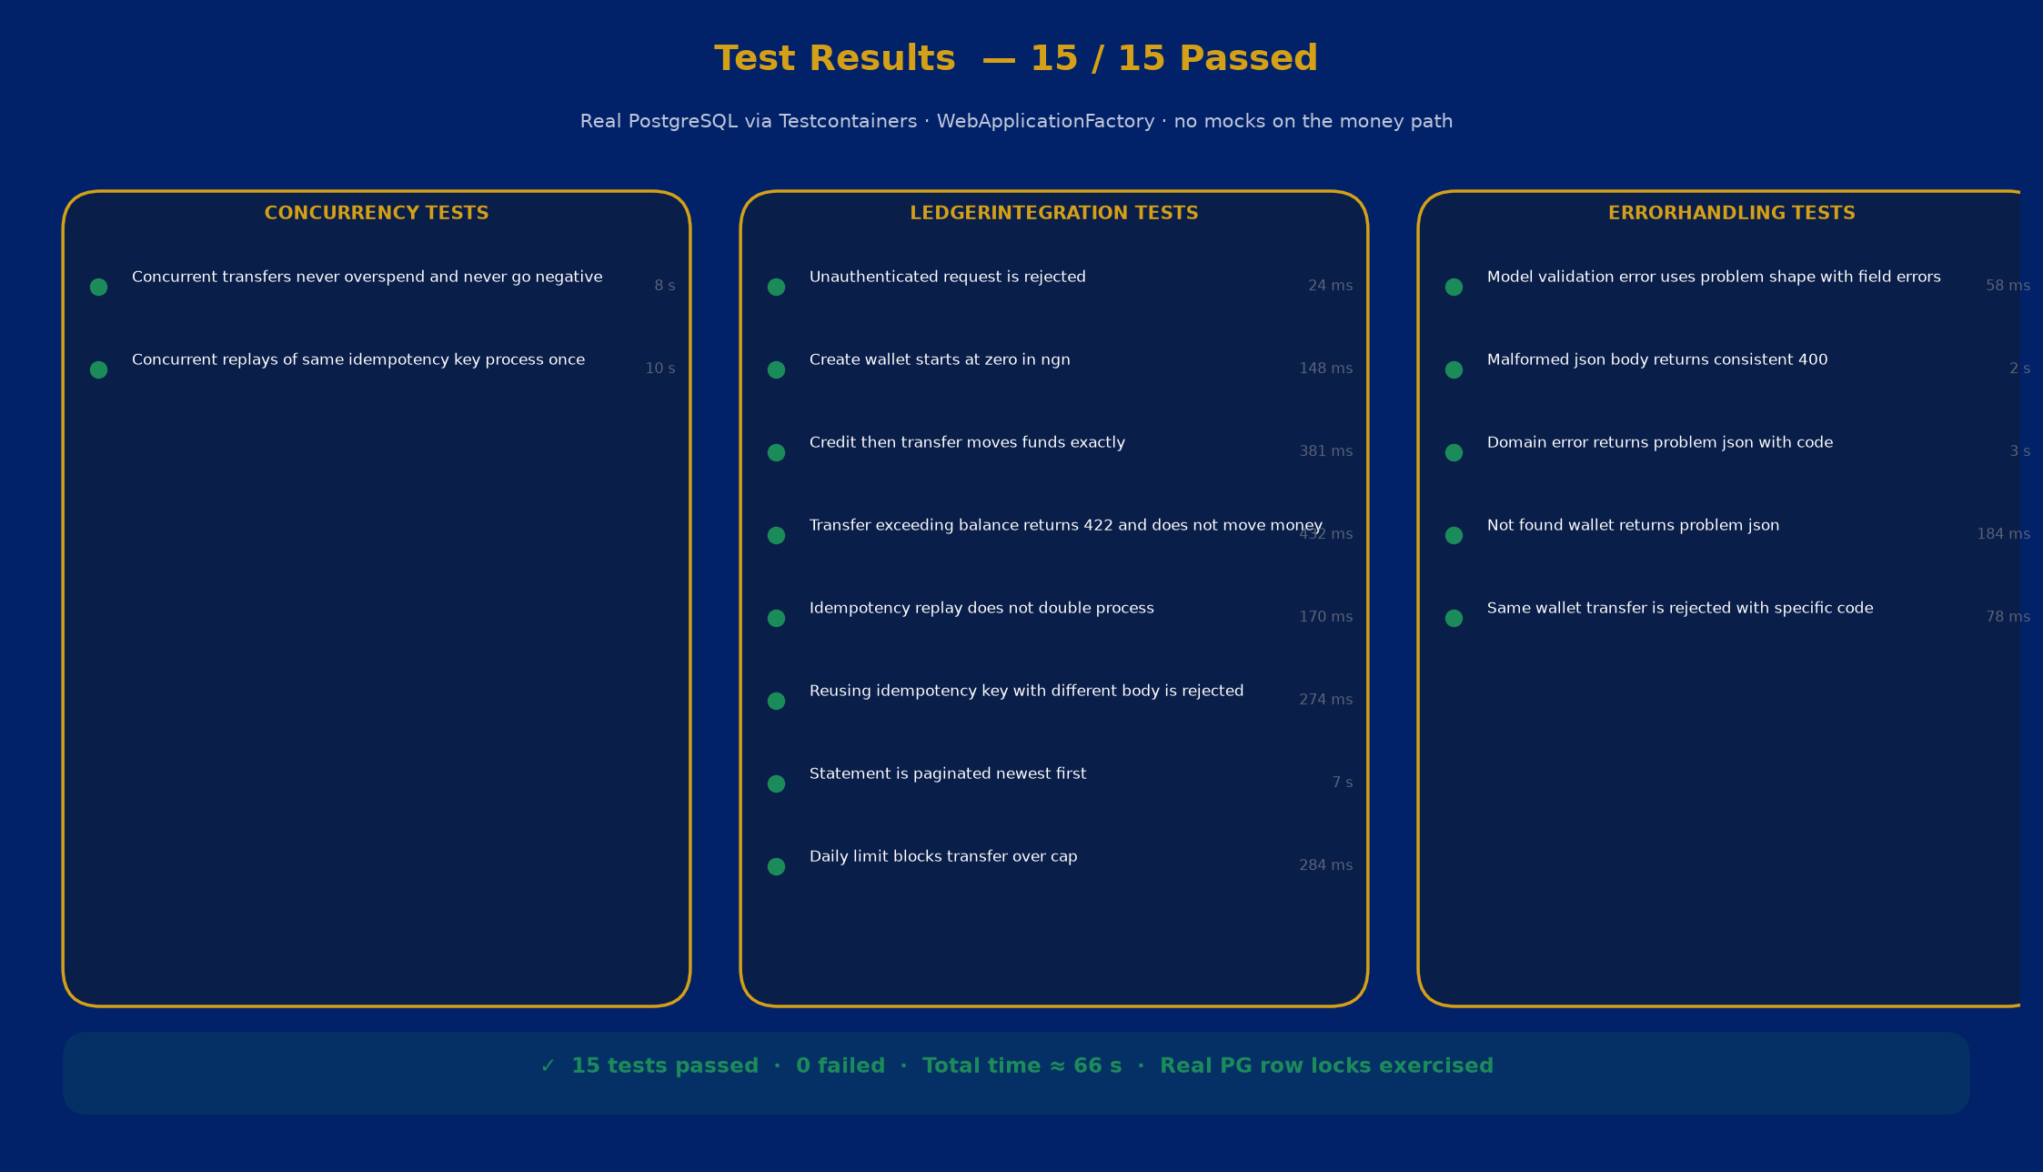
Test Rigour
Tests that would actually catch a regression — including the concurrency case
Notes:
15 tests, all passing, all running against a real PostgreSQL instance via Testcontainers.
Using a real database is not optional here. The concurrency guarantees rely on PostgreSQL row locks and the xmin concurrency token. An in-memory provider doesn't support FOR UPDATE or system columns, so any test using in-memory for the concurrency case would be testing nothing meaningful.
The concurrency test is the headline: 100 concurrent transfers against a wallet funded for exactly 50. The test asserts exactly 50 Created and 50 UnprocessableEntity responses, the source balance is zero, and the destination holds exactly the right amount. No double-spends, no negative balance. Every run.
The idempotency concurrency test fires the same key 25 times simultaneously. Every response is 201 (either the original or a replay), and the money moves exactly once.
Error handling tests verify that every error path returns application/problem+json with consistent structure, including field-level validation errors with a lower-cased field name map.

Slide 9
AI Usage & Judgment
Used AI to move fast — and caught where it was wrong
Three cases where AI output was wrong for a financial system — and how I caught each one
Bug 1 — Runtime crash in validation
[property: Required] on positional records
Applied [property: Required] to record primary-constructor params. Compiled fine. Crashed at runtime on every request with InvalidOperationException — validation metadata on record properties is silently ignored by ASP.NET Core.
✓ Fix
Caught by running the service and hitting endpoints. Fixed by removing the property: target so attributes bind to the constructor parameter.
Bug 2 — Concurrency lock silently broken
SELECT * … FOR UPDATE missing xmin
AI generated: FromSqlRaw("SELECT * FROM wallets … FOR UPDATE"). PostgreSQL system columns (xmin) are NOT returned by SELECT *. EF tried to project xmin as the concurrency token → 'column n.xmin does not exist' on every transfer.
✓ Fix
Caught by exercising credit/transfer against the live container. The fix is explicit column listing including xmin. Without the concurrency token, all optimistic-lock protection is silently lost — a critical financial correctness defect.
Bug 3 — Rate limiter bucketed all users together
httpContext.User.Identity?.Name is null for JWT sub
AI partitioned the rate limiter by Identity.Name. JwtBearer maps the 'sub' claim to ClaimTypes.NameIdentifier, not Identity.Name — so Name was null for all users. Every caller shared the same IP-based bucket.
✓ Fix
Caught by the concurrency load test: expected 50 successes, got ~15, with TooManyRequests responses. Fixed by partitioning on ClaimTypes.NameIdentifier ?? 'sub' ?? Name ?? IP.
Notes:
The brief explicitly asks us to use AI tools and demonstrate judgment in catching where they're wrong.
All three bugs would have shipped real defects in a production financial system.
Bug 1 is a correctness failure — every API call would return 500 in production despite passing compile and unit tests.
Bug 2 is the most serious: the SELECT FOR UPDATE lock worked syntactically, but by using SELECT *, the xmin concurrency token was silently stripped from the result. The row lock still worked (money wouldn't go negative), but the xmin backstop — the guard against any unlocked code path — was gone without any visible error. This is exactly the kind of subtle financial safety defect that's hard to catch without running against a real database.
Bug 3 was caught specifically by the concurrency load test. If I hadn't written a test that asserted an exact number of successes, the rate limiter bug would have been invisible — the endpoint would have appeared to work, just slower than expected under concurrent load.

Slide 10
Operating Context
Where the Nigerian fintech constraints touch this design specifically
₦ in kobo · no float
Implemented ✓
Tiered KYC (BVN / NIN)
Seam identified — next build
Deepest constraint. Already enforced end-to-end. Critical future note: any feature that divides kobo (fee splits, interest, FX) produces remainders. Document who absorbs the leftover kobo before merging.
Daily limit is a function of KYC tier, not a global constant. DailyOutboundLimitKobo should resolve per-wallet from its KycTier field. Tier 1 (phone-only) has lower CBN caps; Tier 3 (full KYC) higher. Attaches to the limit check in TransferAsync.
NIBSS NIP rails
Outbox ready, states deferred
USSD *894#
Server-side kobo ✓
Inbound credit is an external notification — must be idempotent (NIBSS can resend, keyed on NIP session ID not a client header). Outbound transfer to another bank is pending → settled/failed, not instant-final. The outbox pattern is the right foundation for the settlement callback.
No JWT for feature phones — USSD gateway authenticates by MSISDN + PIN, calls API on the user's behalf. Naira→kobo conversion must be server-side (USSD sends plain text amounts). Already canonical: UI converts for convenience, API always receives kobo.
NDPA 2023 (data protection)
Schema correct · retention TBD
CBN consumer protection
Errors transparent ✓ · Reversal TBD
Audit log stores correlationId and customerId — not raw BVN/NIN. Immutability of audit_logs is in tension with a data-subject erasure request; resolve by storing identifiers by reference and pseudonymising. Define a retention window.
Customers must be told why a transfer failed (insufficient_funds / daily_limit_exceeded error codes ✓). Missing: a reversal/refund path. A failed outbound NIP leg must return funds — consumer-protection requirement, next thing to build.
Notes:
The brief says 'strong candidates will notice where these constraints matter'. Here is exactly where each one attaches to this ledger.
The most important one for the panel to see is the KYC tier gap. The daily limit is currently a global constant. Under CBN's tiered KYC framework, that limit is a function of the customer's verification tier. This is a one-field change to the Wallet entity plus a resolver function, but it's a meaningful regulatory gap.
The NIP rail point is architectural: inbound credits need idempotency keyed on NIBSS session IDs, and outbound transfers to other banks need a pending state and a settlement webhook. The outbox pattern I've already built is exactly the right foundation for the settlement callback.
The NDPA point is subtle: the audit log is append-only and immutable, which is great for compliance, but conflicts with data-subject erasure rights under NDPA. The resolution is to store only customer IDs (not raw PII), which this schema already does.
I deliberately deferred these as documented assumptions in the README, and I'm happy to discuss the implementation of any of them.

Slide 11
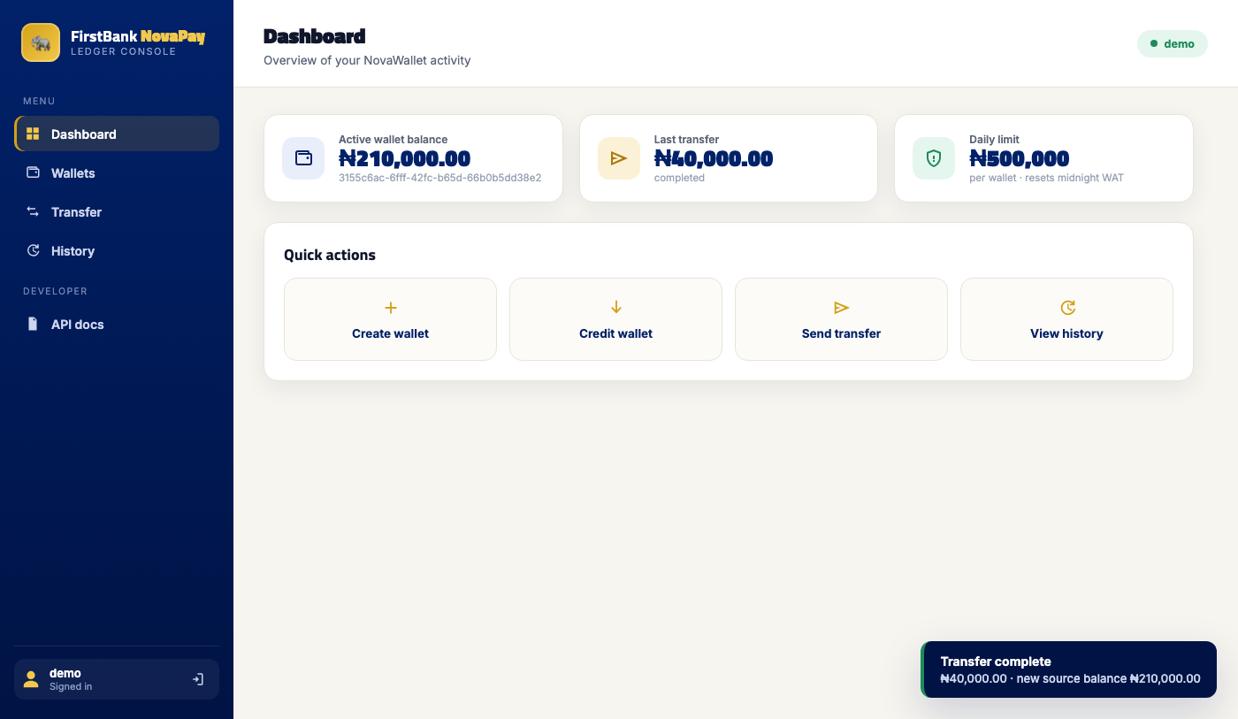
Demo & What I'd Build Next
Running now — docker compose up → http://localhost:8080
What I'd build next
▸ KycTier on Wallet → per-tier daily limit
▸ Reversal / refund endpoint
▸ Pending / settled transaction states (NIP)
▸ USSD adapter (MSISDN + PIN auth)
▸ NDPA retention policy on audit_logs
▸ Token refresh + JWKS endpoint
▸ Multi-currency FX + kobo rounding policy
Key trade-offs made
▸ Pessimistic row locks over optimistic retry
→ correct under burst, simpler to reason about
▸ Daily limit from history, no reset cron job
▸ Mock issuer — middleware is what's scored
Notes:
This is what the running service looks like. The web console at localhost:8080 drives all the API endpoints — the stat cards show live data from PostgreSQL, the transfer panel has the idempotency key pre-generated, and the audit trail shows the hash chain.
The full walkthrough is available at the technical interview where I'll demo it live, but for this session I want to focus on two trade-offs I made deliberately.
First, pessimistic row locks over optimistic retry loops. Both can be correct, but under high contention pessimistic locking is more predictable — retries under optimistic concurrency can cause a stampede where many requests retry simultaneously and compete again. For a money service, I'd rather have requests queue up cleanly than cascade through retry storms.
Second, computing the daily limit from transaction history rather than maintaining a counter. This is slightly more expensive per transfer (an extra SUM query), but it's always consistent and needs no reset job or scheduled task. There's no risk of a crash leaving the counter in an incorrect state.
The biggest honest gap is reversals and the KYC-driven daily limit. Those are the next things I'd build, and I've documented both in the README as explicit deferred scope.

