Slide 1
MOBILE MONEY · FRAUD DETECTION
TrustRail
A synthetic-data fraud detection pipeline for mobile money — feature engineering, a gradient-boosted risk model, and a live Claude-powered explainability layer.
0.987
95.1%
0.15%
Precision-Recall AUC
on held-out test set
Recall @ 0.5 threshold
False positive rate
PORTFOLIO MVP
Notes:
This is TrustRail — a fraud detection pipeline I built for mobile money transactions. Headline numbers: 0.987 precision-recall AUC, 95% recall, and a false positive rate under a fifth of one percent. Everything you'll see is built on synthetic data since real transaction data isn't something a portfolio project can access.

Slide 2
01 · THE PROBLEM
Fraud is rare, fast, and expensive to miss
01
Catch it fast
~1.5%
Fraud has to be scored before the transaction settles — the decision window is milliseconds, not hours.
02
Stay precise
of mobile money transactions are fraudulent — but a missed case can drain a customer's entire balance in minutes.
False positives block real customers. Every flag has an operational cost, not just a benefit.
03
Explain every flag
A model that predicts “not fraud” every time already scores 98%+ accuracy. Accuracy is the wrong metric.
A raw probability score isn't actionable — an analyst needs a reason before they act on it.
TRUSTRAIL
2
Notes:
The core problem: fraud is rare — about one to two percent of transactions — but expensive to miss. That rarity is exactly why plain accuracy is useless here; a model that never flags anything still scores ninety-eight percent. So the whole system is designed around three constraints: catch it fast, stay precise, and explain every flag.

Slide 3
02 · APPROACH
Four stages, one pipeline
Synthetic data stands in for real transaction logs — everything downstream is built the way it would be in production.
01
02
03
04
Synthetic Ledger
Feature Engineering
Risk Model
Explainability
20,000 transactions, 2,000 users, four injected fraud patterns — 30% deliberately stealthy to avoid a trivially separable dataset.
Rolling per-user & per-recipient windows computed with strict time-causality — velocity, amount z-scores, device/SIM flags.
Gradient-boosted trees, time-based train/test split, evaluated on precision-recall and precision@K — not plain accuracy.
Every flagged case gets a live, plain-language reasoning summary — the layer an analyst actually reads before acting.
numpy · pandas
bisect · rolling windows
XGBoost-class model
Claude API — live
TRUSTRAIL
3
Notes:
I built this as four independent stages. A synthetic transaction ledger with realistic, sometimes deliberately stealthy fraud patterns. Feature engineering with strict time-causality — no peeking at the future. A gradient-boosted risk model evaluated on a time-based split. And an explainability layer, which I'll show live in a moment.

Slide 4
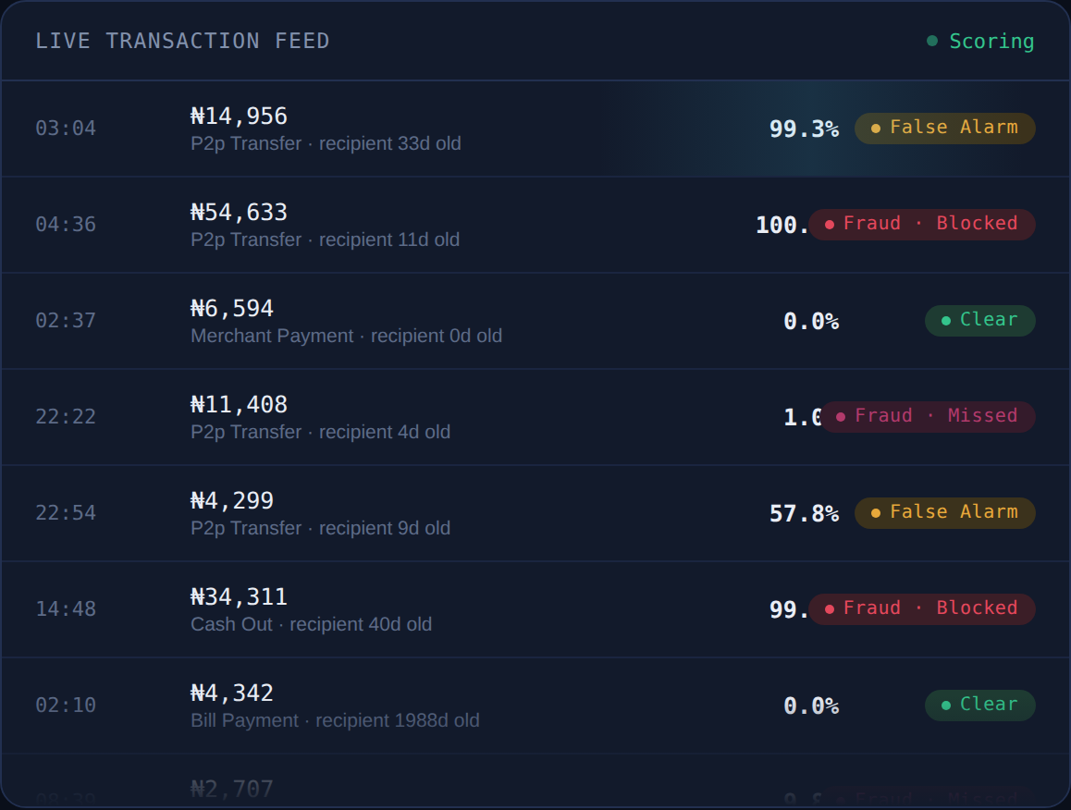
03 · THE CONSOLE
Every transaction gets scored
before it settles
A single-page monitoring console — a live scanning ledger, model performance panels, and an interactive case-review table with a real Claude-generated analyst note.
Live transaction feed, scored in real time
Precision-recall & precision@K evaluation
Click-through case review with risk gauge
TRUSTRAIL
4
Notes:
This is the actual console — a live scanning ledger that scores transactions in real time, plus model performance panels and a case-review table analysts would actually use.

Slide 5
04 · MODEL PERFORMANCE
Evaluated the way fraud actually gets caught
Held-out test set: 4,000 transactions, 61 actual fraud cases · time-based 80/20 split
Precision @ Top-K% Flagged
3,933
6
True Negative
False Positive
cleared correctly
false alarm
3
58
False Negative
True Positive
fraud missed
fraud caught
TRUSTRAIL
5
Notes:
On the evaluation side: the confusion matrix shows fifty-eight of sixty-one fraud cases caught, only six false alarms out of thirty-nine hundred legitimate transactions. And precision-at-K shows the operational tradeoff — if analysts can only review the top one percent of transactions, they still catch two-thirds of all fraud.

Slide 6
04 · MODEL PERFORMANCE
What actually drives the risk score
Permutation importance — the drop in average precision when a feature is shuffled
Takeaway
Where the money is going, and how it compares to the sender's own history, matters far more than raw amount or device signals alone.
That should inform where future feature engineering effort goes — deeper recipient-network features, not more device fingerprinting.
TRUSTRAIL
6
Notes:
Feature importance turned up something genuinely useful: recipient account age and how the amount compares to the sender's own history matter far more than device signals. That's a real finding, not just a chart.

Slide 7
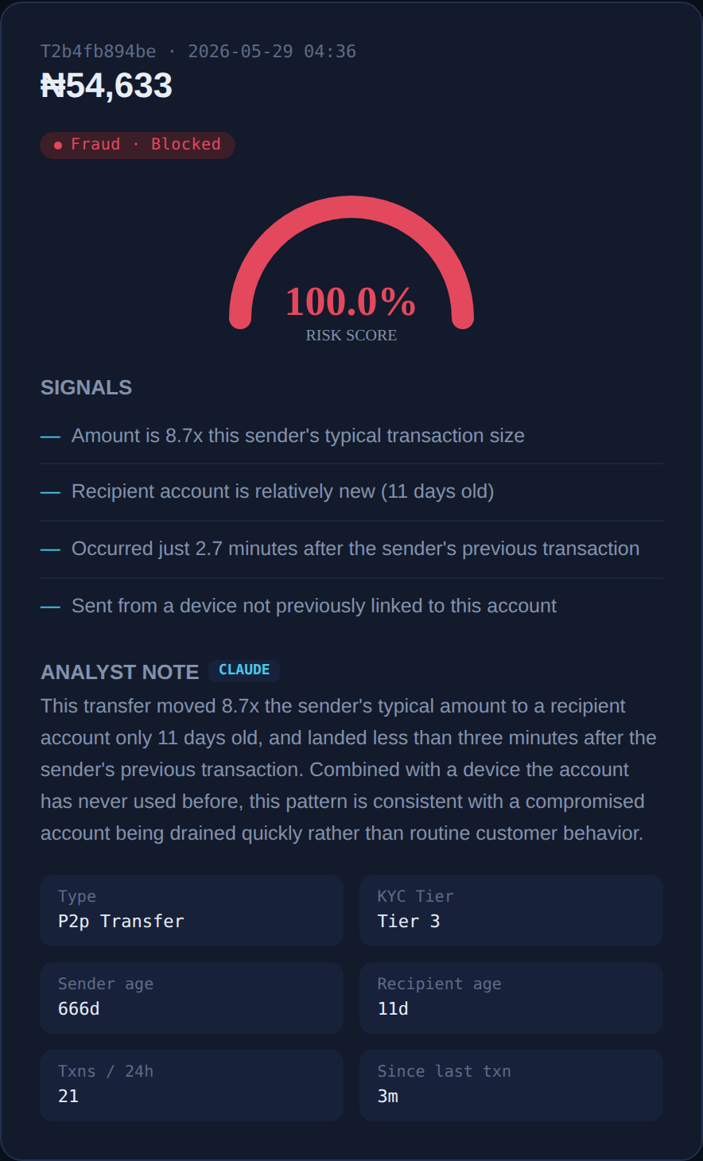
05 · EXPLAINABILITY
Claude explains every flag,
live
The model's top features are computed instantly as “Signals.” Selecting a case then fires a real call to the Claude API, which writes the analyst-facing explanation in natural language — not a canned template.
NO API KEY NEEDED HERE
The artifact environment proxies the call. A deployed version would need a small backend holding the Anthropic API key instead.
TRUSTRAIL
7
Notes:
Here's the part I actually wired up live: when you click a flagged transaction, the computed risk signals appear instantly, but then a real call goes out to the Claude API, which writes the analyst-facing explanation in natural language — not a template.

Slide 8
06 · HONEST ASSESSMENT
What's real, and what's next
KNOWN LIMITATIONS
NEXT STEPS
All data is synthetic — no real platform data used or claimed
Deeper recipient/network features for mule detection
Mule-network detection needs a longer-horizon graph feature
Real-time feature store to replace batch CSV pipeline
A near-perfect score on an earlier dataset was treated as a red flag and fixed, not shipped
Backend proxy so the Claude explainability call works outside the artifact environment
TRUSTRAIL
8
Notes:
I want to be upfront about the limits too — this is all synthetic data, the mule-detection feature is still weak, and I deliberately caught and fixed a too-perfect model score earlier because it was a red flag, not a win.

Slide 9
TECHNICAL STACK
Built end to end
Data & Features
Python · pandas · numpy · bisect-based rolling windows
Model
Gradient-boosted trees (XGBoost-class) · scikit-learn evaluation
Explainability
Claude API — live analyst note generation
Console
Single-file HTML/CSS/JS — no build step, no server dependency
TrustRail — a portfolio fraud-detection MVP demonstrating pipeline architecture, evaluation discipline, and live explainability.
TRUSTRAIL
9
Notes:
That's TrustRail end to end — Python and pandas for the pipeline, a gradient-boosted model, live Claude explainability, and a single-file console with no backend needed. Thanks for watching.

