Slide 1
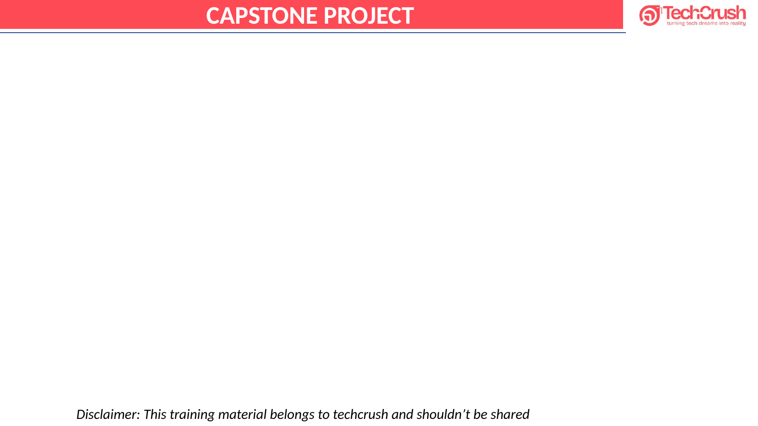
TechCrush Capstone Project
PROJECT 2
Building a Secure Small Office Network
Network diagram, security controls, Packet Tracer simulation, threat response and reflection

Slide 2
Group No. 6
Active Project 2 Team Members
1. John-Francis Nnadi — CYBE/2026/TC-6/0959
2. Dauda Musefiu Adetunji — CYBE/2026/TC-6/0250
3. Oyediji Toluwalase David — CYBE/2026/TC-6/0392
4. Victor Akan Essien — CYBE/2026/TC-6/0042
5. Anikweobi Onyebuchi John — CYBE/2026/TC-6/0163
6. Isaiah Bobby Onyekachi — CYBE/2026/TC-6/0684
7. Andrea Kosisoschukwu Ogbuli — CYBE/2026/TC-6/0960
8. Lucky Simeon, Monsigia — CYBE/2026/TC-6/0676
9. Tunde Opeyemi Adejumo — CYBE/2026/TC-6/0872
10. Jamaldeen Akinkunmi Oni — CYBE/2026/TC-6/0893
11. Roqeebah Ogunbowale — CYBE/2026/TC-6/0924
12. UGOCHUKWU PRINCEWILL OKAFOR — CYBE/2026/TC-6/0072
13. OLUWASEUN ADELADAN — CYBE/2026/TC-6/1016

Slide 3
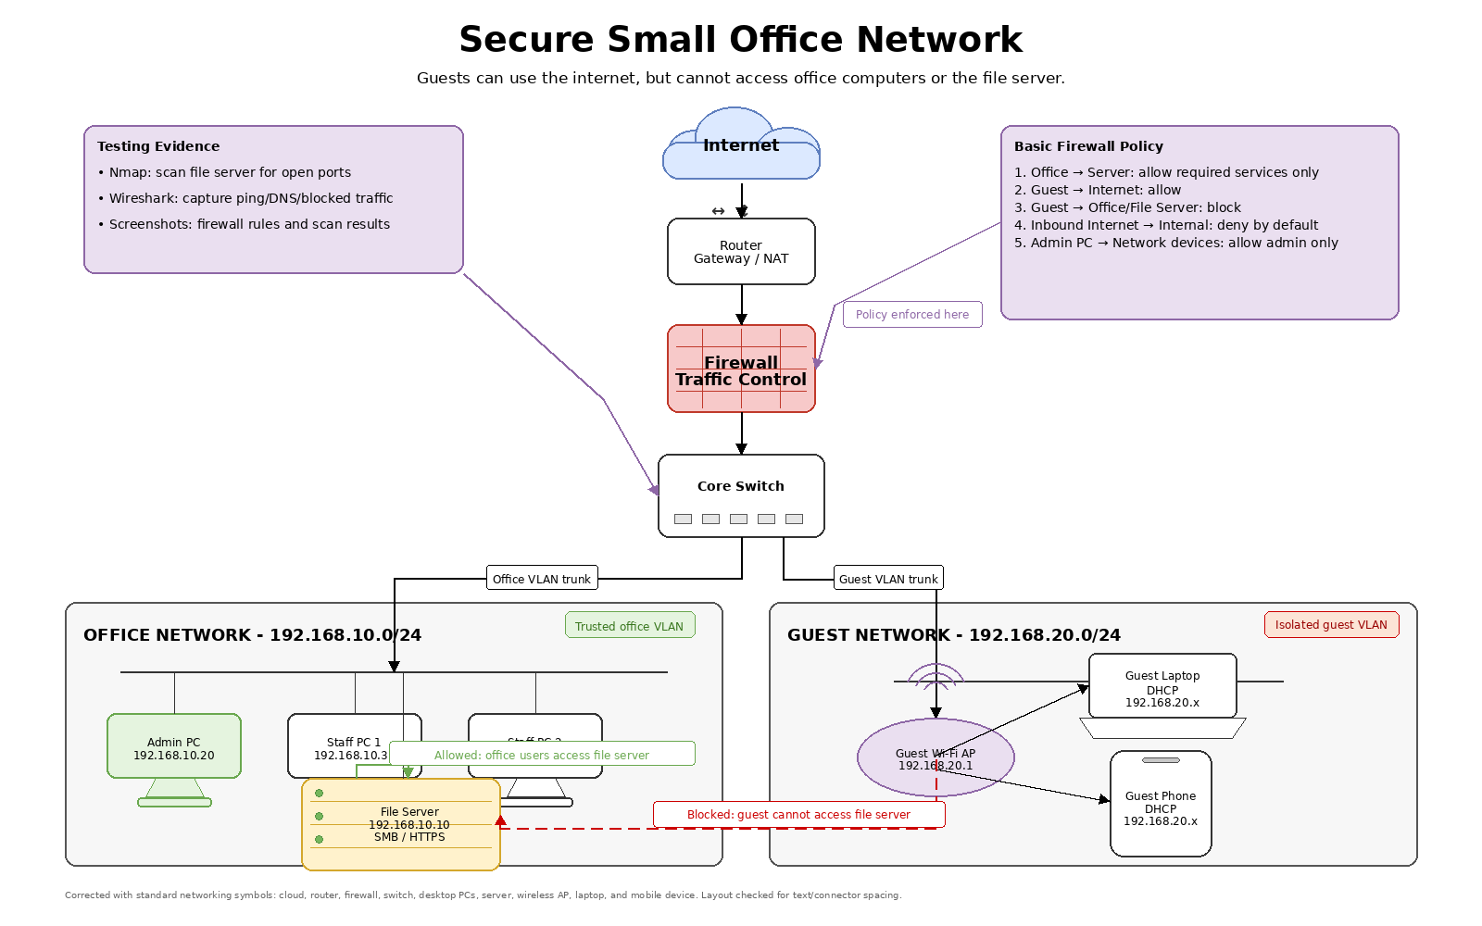
Outline
• Aim and Objective
• Concept of Project
• Network Design
• Devices and IP Address Plan
• Security Controls Implemented
• Methodology and Tools Used
• Packet Tracer Testing Evidence
• Simulated Threat and Response
• Results, Reflection and Conclusion
• References

Slide 4
Aim and Objective
Aim
Objectives
• Design and secure a basic small office network.
• Show how simple controls prevent guest users from reaching internal systems.
• Build confidence in explaining how networks are attacked and defended.
• Draw a secure layout with router, firewall, switch, office devices, server and internet connection.
• Separate office and guest users into different network zones.
• Apply firewall and access-control rules to block guest access to the file server.
• Test and explain allowed office traffic and blocked guest traffic.

Slide 5
Concept of Project
• The network is divided into a trusted Office Network and a lower-trust Guest Network.
• The File Server stays inside the office subnet as a protected internal resource.
• Guests can use internet access through the guest Wi-Fi but cannot reach office devices.
• A firewall traffic-control point enforces the separation between both zones.
• Packet Tracer tests confirm the expected allowed and blocked traffic paths.

Slide 6
Network Design
Clean diagram showing the office zone, guest zone, firewall policy and protected file server.
Guests can use the internet, but cannot access office computers or the file server.

Slide 7
Devices and IP Address Plan
Trusted Office Zone
Guest Zone
• Office Network: 192.168.10.0/24
• Office Gateway: 192.168.10.1
• Admin PC: 192.168.10.10
• Staff PC 1: 192.168.10.21
• Staff PC 2: 192.168.10.22
• File Server: 192.168.10.50
• Guest Network: 192.168.20.0/24
• Guest Gateway: 192.168.20.1
• Guest Wi-Fi AP: 192.168.20.2
• Guest Devices: 192.168.20.100-200
• Guest devices are separated from internal office resources.
Key decision: the file server remains in the trusted office subnet while guest devices stay in a separate low-trust subnet.

Slide 8
Basic Network Security Controls
1. Firewall Rules
2. Network Segmentation
3. Access Control
• Office users can access the file server on required services.
• Guest-to-office traffic is blocked.
• Guest internet/DNS/DHCP is allowed.
• Office uses 192.168.10.0/24.
• Guest uses 192.168.20.0/24.
• Different zones reduce unauthorized access risk.
• Admin PC is treated as the management workstation.
• Sensitive management access is limited.
• Strong passwords should be applied in a full deployment.
Core logic: Office to Server allowed | Guest to Office blocked | Guest to Internet allowed

Slide 9
Methodology and Tools Used
Methodology
Tools Used
• Identified office requirements: staff need file-server access, guests need internet-only access.
• Designed the network zones and IP plan using draw.io.
• Built the topology in Cisco Packet Tracer with office and guest devices.
• Tested Admin PC access to the File Server.
• Tested Guest Laptop access to the same File Server.
• Used Simulation Mode to observe packet movement.
• draw.io: clean final network diagram.
• Cisco Packet Tracer: network simulation and ping tests.
• IP address plan: device and subnet consistency.
• Threat simulation notes: guest-device attack and response scenario.
• Project report materials: final explanation and evidence.

Slide 10
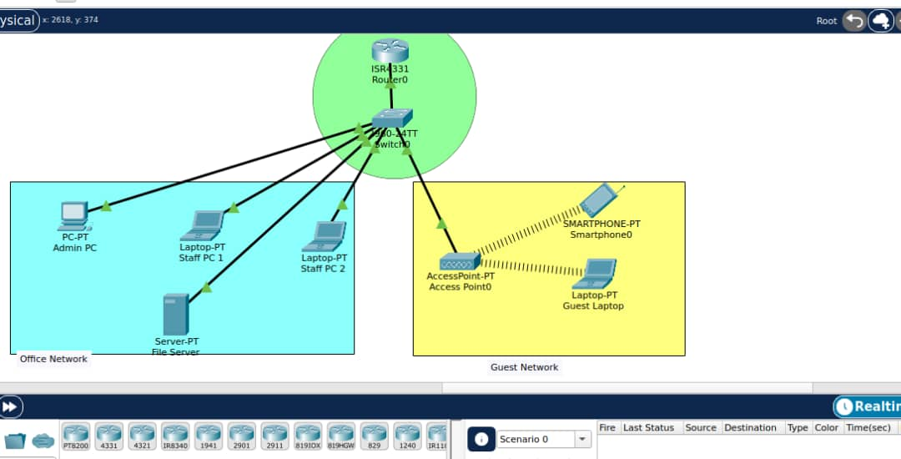
Packet Tracer Topology Evidence
The topology was built in Cisco Packet Tracer with office and guest sections separated.
Topology showing Router0, Switch0, Admin PC, Staff PCs, File Server, AccessPoint0, Guest Laptop and Smartphone0.

Slide 11
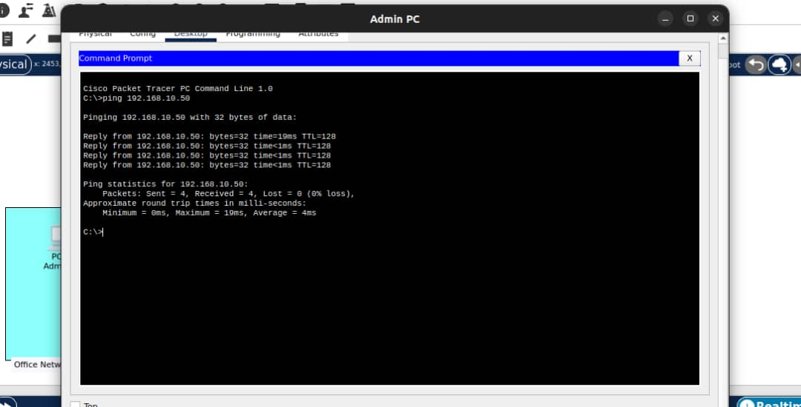
Test 1: Admin PC to File Server Allowed
Trusted office traffic should be able to reach the internal File Server.
Admin PC ping to 192.168.10.50 succeeds with four replies and 0% packet loss.

Slide 12
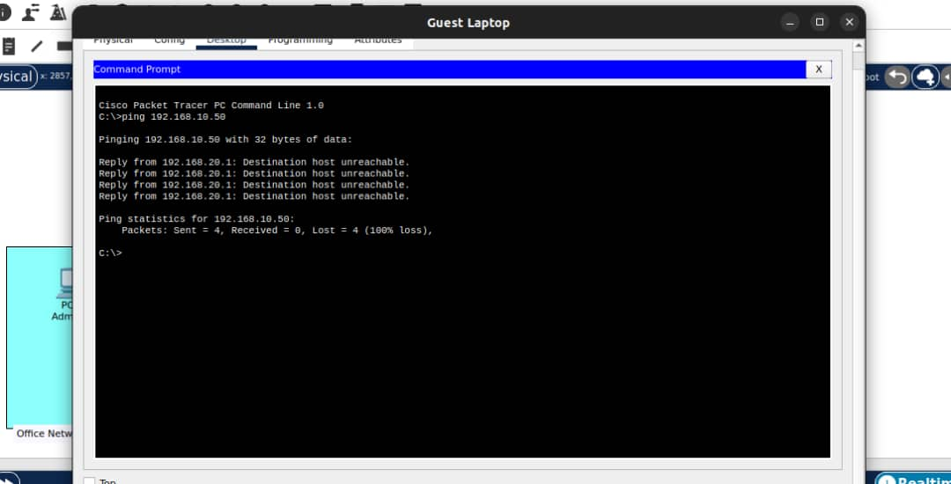
Test 2: Guest Laptop to File Server Blocked
Guest traffic should not reach the office File Server.
Guest Laptop ping to 192.168.10.50 fails with Destination host unreachable and 100% packet loss.

Slide 13
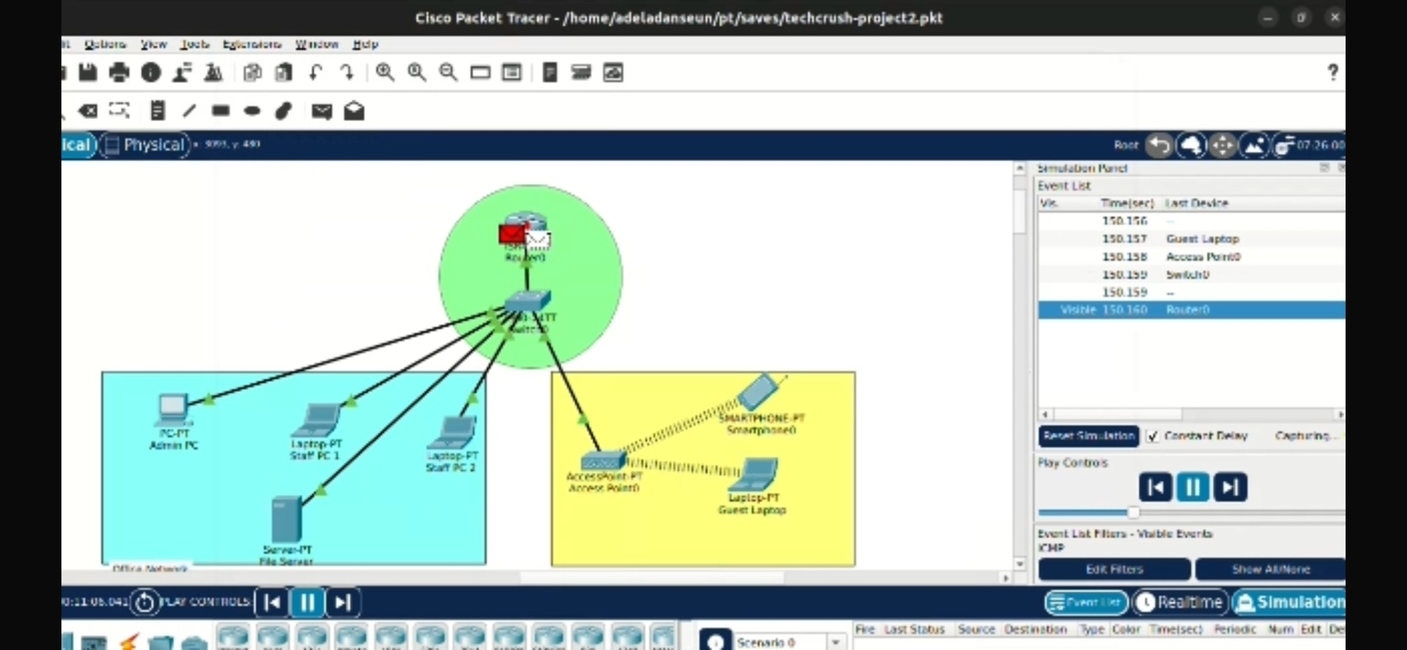
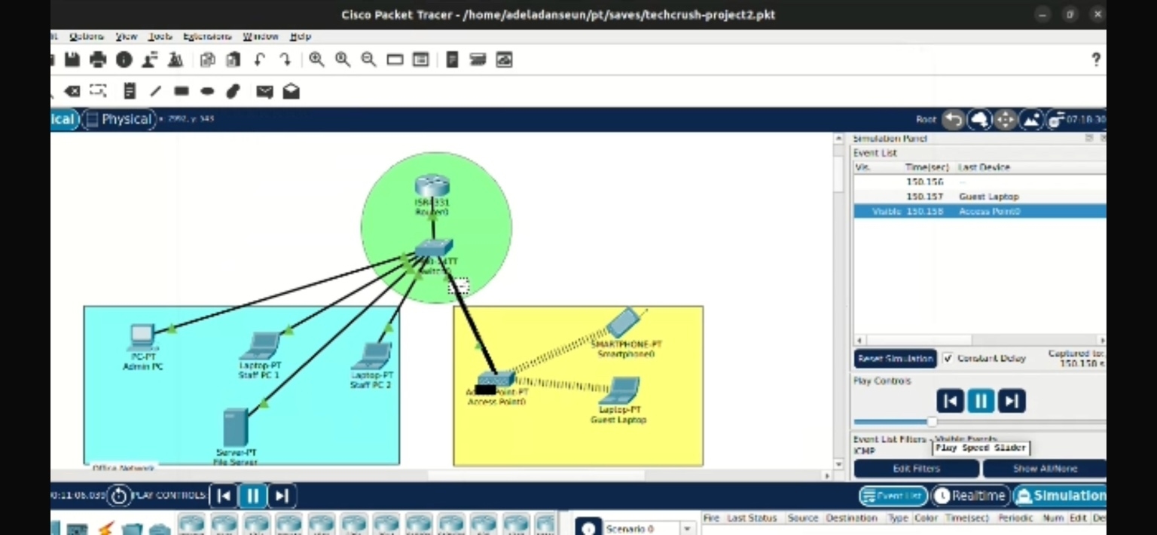
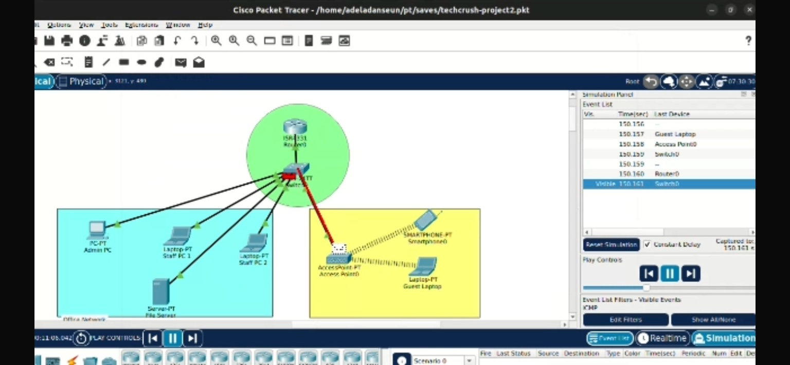
Simulation Mode PDU/Event List Evidence
Packet Tracer Simulation Mode was used to show packet movement through the designed network.
Simulation overview and event list
Packet movement around the guest path
Blocked guest path toward office side
• The screenshots support the practical test, not just the static diagram.
• Traffic movement can be observed through the guest device, access point, switch and router path.
• The blocked guest path is consistent with the configured security goal.

Slide 14
Simulated Threat and Response
Threat Scenario
Controls That Stop It
Admin Response
• A guest connects to Wi-Fi and receives a 192.168.20.x address.
• The guest tries to discover or access the internal file server at 192.168.10.50.
• Guest devices remain in 192.168.20.0/24.
• Firewall policy blocks Guest Network to Office Network traffic.
• The File Server remains inside 192.168.10.0/24.
• Identify the guest source device.
• Isolate it if needed.
• Check event information/logs.
• Confirm that no server access occurred.
• Document the incident and review rules.

Slide 15
Results and Reflection
Key Results
What We Learned
• Required devices were included.
• Office and guest zones were separated.
• Admin PC reached the File Server.
• Guest Laptop failed to reach the server.
• Simulation Mode showed packet movement.
• Guest Wi-Fi must be separated from office resources.
• Security should protect the server while still allowing normal staff work.
• Controls must be tested, not only drawn.
• A secure design needs addressing, access rules and verification.
Future improvement: add firewall-rule screenshots, controlled Nmap scans, Wireshark captures and firewall logging in a full live-lab setup.

Slide 16
Conclusion
• The project demonstrates how a small office network can be designed and defended with clear zones and basic access controls.
• The final design includes the required devices and separates office users from guest users.
• The Admin PC can reach the File Server at 192.168.10.50, confirming normal office access.
• The Guest Laptop cannot reach the same server, confirming guest isolation.
• The threat scenario and Simulation Mode evidence show how unauthorized guest access is stopped.

Slide 17
References
• Cisco Systems. Cisco Packet Tracer documentation and networking simulation materials.
• Kurose, J. F., and Ross, K. W. Computer Networking: A Top-Down Approach.
• Stallings, W. Data and Computer Communications.
• diagrams.net / draw.io documentation for network diagramming.
• Course lecture materials and classroom notes on LAN design, VLANs, ACLs, wireless security and small office network security.
• Project materials reviewed: network diagram, IP address plan, Packet Tracer tests, Simulation Mode screenshots and threat-response notes.

Slide 18

THANK YOU
Group 6 | Project 2: Secure Small Office Network

