Slide 1
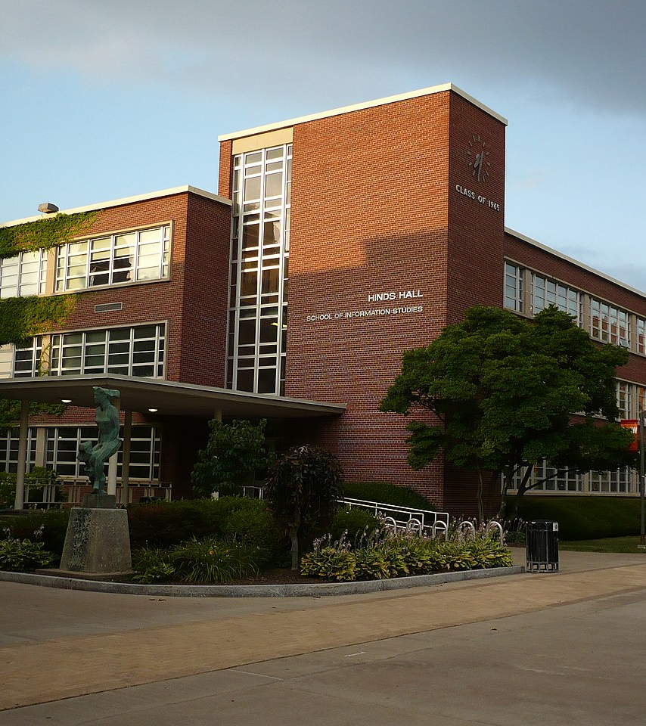
Data Science Portfolio Milestone
Images are for illustrative purposes only.
Sahil Nanavaty
M.S. in Applied Data Science

Slide 2
Introduction
During my Master of Science in Applied Data Science at Syracuse University, I engaged in diverse projects that enhanced my practical skills and solidified my theoretical knowledge.
The projects highlighted in this presentation directly reflect abilities specified in the program learning outcomes.

Slide 3
Program Learning Outcomes
Collect, store, and access data by identifying and leveraging applicable technologies
Create actionable insight across a range of contexts (e.g. societal, business, political), using data and the full data science life cycle
Apply visualization and predictive models to help generate actionable insight
Use programming languages such as R and Python to support the generation of actionable insight
Communicate insights gained via visualization and analytics to a broad range of audiences (including project sponsors and technical team leads)
Apply ethics in the development, use and evaluation of data and predictive models (e.g., fairness, bias, transparency, privacy)

Slide 4

IST 687 - Steam Player Count Analysis
Analyzed Steam player count data to understand PC gaming market trends, focusing on game popularity, average and peak player counts, and monthly gains/losses.
Aimed to determine optimal times of the year for game releases or updates for strategic marketing and publishing decisions.
Used R to gather and organize extensive player data from Kaggle, ensuring a robust dataset.

Slide 5
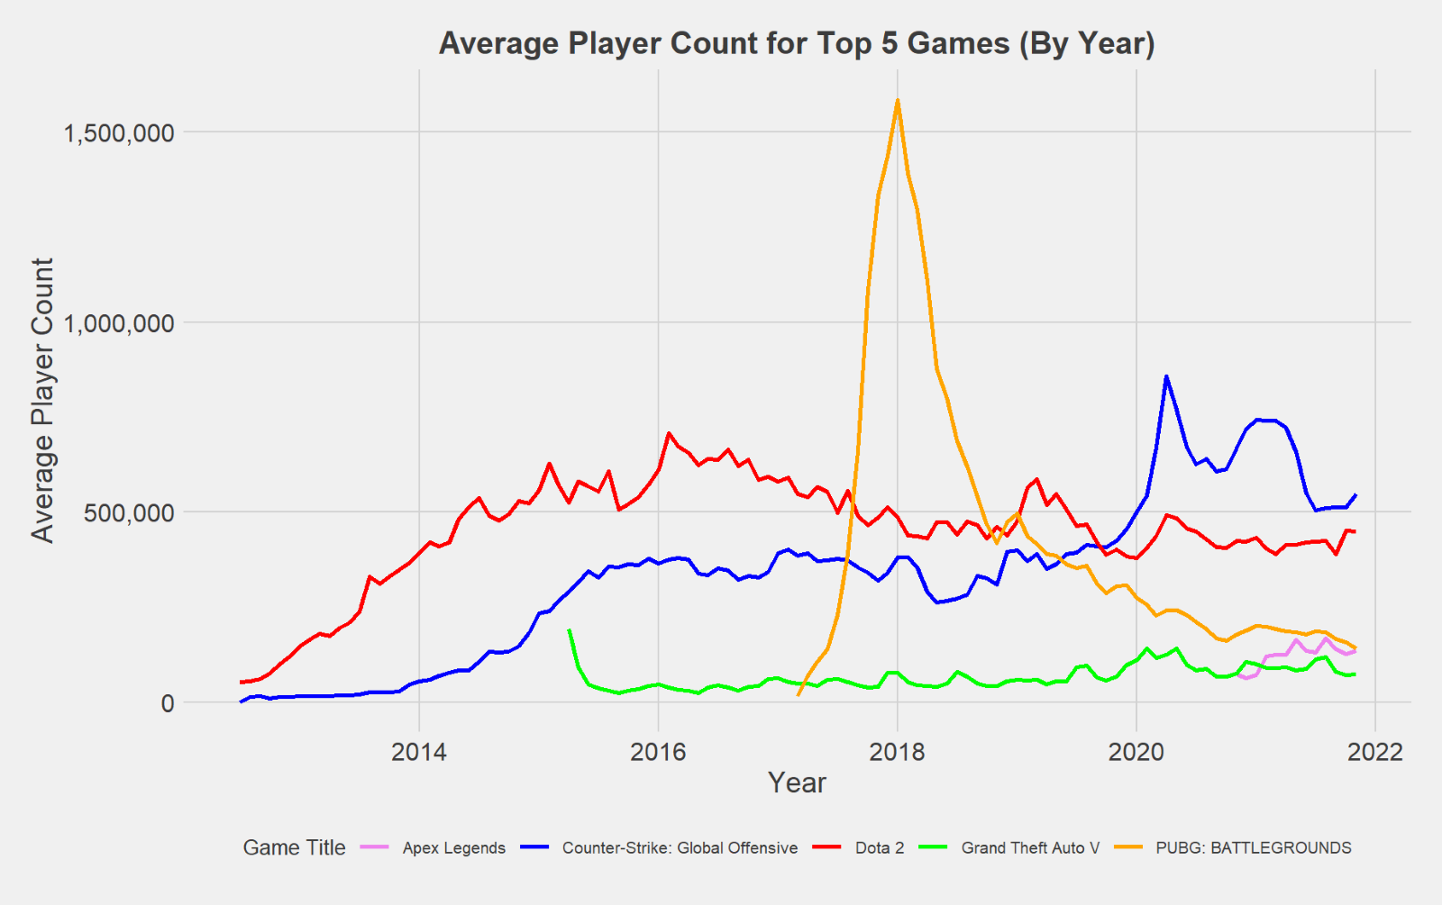
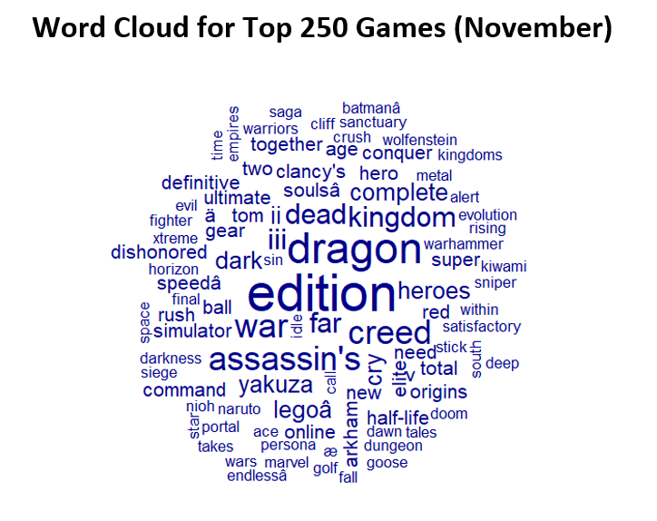
IST 687 - Steam Player Count Analysis
Applied statistical techniques to identify patterns in player engagement and developed RStudio scripts to automate data processing and analysis.
Demonstrated skills in managing large datasets, identifying business problems, and deriving actionable insights for data-driven decision-making.

Slide 6


IST 659 – DataQuest Account Administration
DataQuest
Designed and implemented a database for storing and managing membership data in the fictional MMO game DataQuest, focusing on user accounts, characters, and guild memberships.
Defined stakeholders and business rules, developing conceptual and logical data models to support database operations.
Created SQL DDL scripts for tables with primary keys, unique constraints, and foreign key constraints, ensuring data integrity and scalability through normalization.

Slide 7
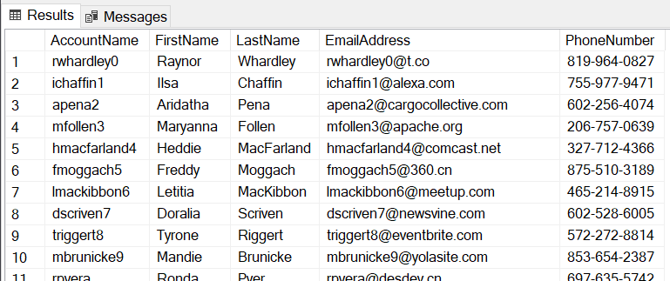
IST 659 – DataQuest Account Administration
Populated the database with realistic data and developed complex SQL queries and views for actionable insights into player behavior and system usage.
Ensured ethical design with strict access controls and compliance with data privacy regulations, while optimizing query performance and scalability through indexing and refinement.

Slide 8

SCM 651 - Loan Analysis
Analyzed factors influencing customer loan decisions using Logit and Probit regression analyses, focusing on attributes like monthly average spending, education, family, and income.
Found that certificate of deposit ownership increases loan likelihood, while credit card ownership decreases it.
Explored interaction effects, revealing that higher education combined with a larger family size decreases loan likelihood, while higher spending alongside higher income increases it.

Slide 9
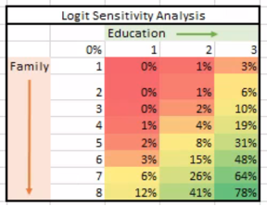
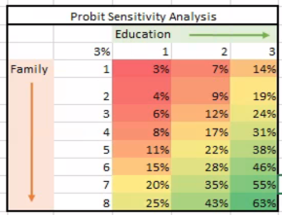
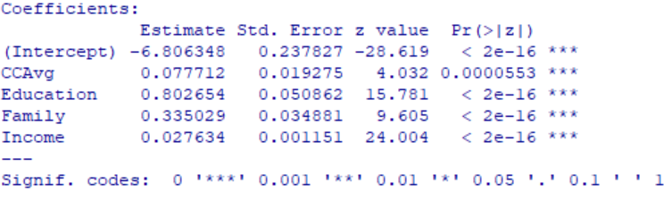
SCM 651 - Loan Analysis
Developed a final model highlighting significant variables and conducted a neural network analysis, showing that monthly spending and income had the most substantial impact on loan decisions.
Leveraged Microsoft Excel for statistical analysis and sensitivity testing, providing actionable, data-driven insights to aid financial institutions in making informed loan decisions.

Slide 10
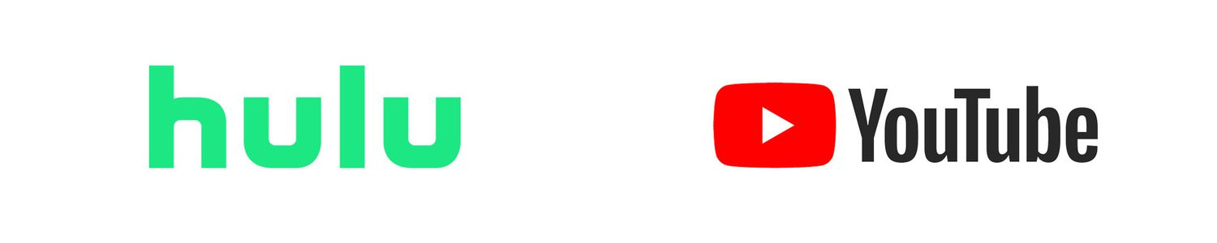
IST 736 – Movie Recommendation System
The rise of streaming services has transformed how audiences select movies, shifting from word-of-mouth to navigating numerous options across platforms.
To improve user engagement, I contributed to a movie recommendation project that tailored selections to individual preferences using predictive analytics.
Implemented various machine learning models: Naive Bayes for large datasets, SVM for text classification, and clustering algorithms for segmenting user preferences.

Slide 11
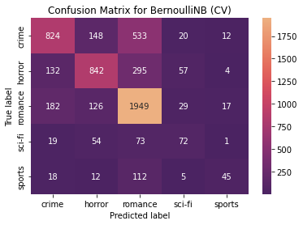
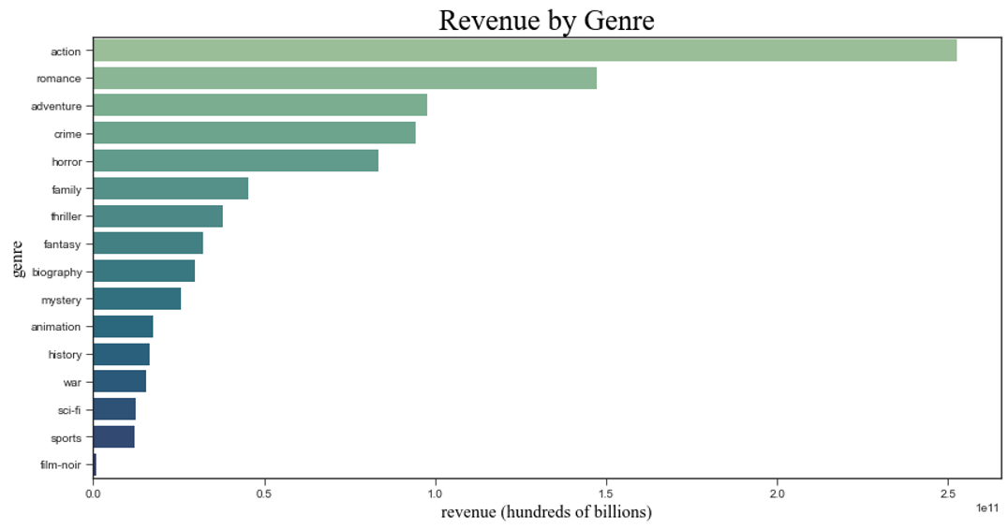
IST 736 – Movie Recommendation System
Utilized natural language processing techniques like TF-IDF vectorization to preprocess vast datasets of movie descriptions and reviews.
The project generated actionable insights, enhancing the movie recommendation process and user engagement, showcasing my proficiency in data science methodologies and predictive analytics.

Slide 12

IST 719 – Disney Movie Success Story
Analyzed historical box office data from Disney movies to identify trends and patterns that influence box office success.
Employed R for data cleansing and preparation, ensuring accuracy and reliability, and developed multiple visualizations using R plots.
Enhanced visualizations with Adobe Illustrator to combine data plots, design elements, and contextual cues into a coherent artifact.

Slide 13
IST 719 – Disney Movie Success Story
Showcased skills in using data visualization tools to communicate complex insights effectively, minimizing viewer cognitive overload, and supporting data-driven business decisions.

