Slide 1
Chapter Section 5: CPU Scheduling

Slide 2
Chapter 5: CPU Scheduling
Basic Concepts
Scheduling Criteria
Scheduling Algorithms
Thread Scheduling
Multiple-Processor Scheduling
Operating Systems Examples

Slide 3
Objectives
Describe various CPU scheduling algorithms
Assess CPU scheduling algorithms based on scheduling criteria
Describe the scheduling algorithms used in the Windows, Linux, and Solaris operating systems

Slide 4
Process Scheduling
There are always a lot of processes active in same time but only one or few CPUs
The action of assigning a process to a CPU (moving from ready state to running state) is called scheduling
The process scheduler selects among available processes for next execution on CPU core
Goal -- Maximize CPU use, quickly switch processes onto CPU core
Maintains scheduling queues of processes
Ready queue – set of all processes residing in main memory, ready and waiting to execute
Wait queues – set of processes waiting for an event (i.e., I/O)
Device queues – set of processes waiting for an I/O device
Processes migrate among the various queues

Slide 5
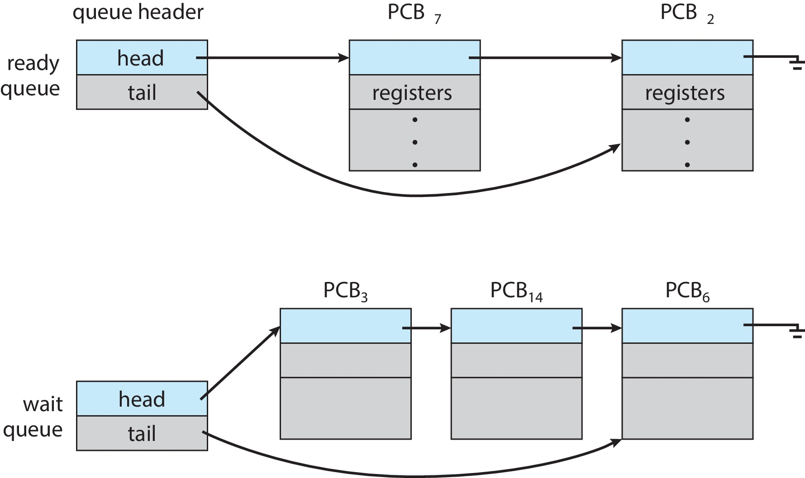
Ready and Wait Queues

Slide 6
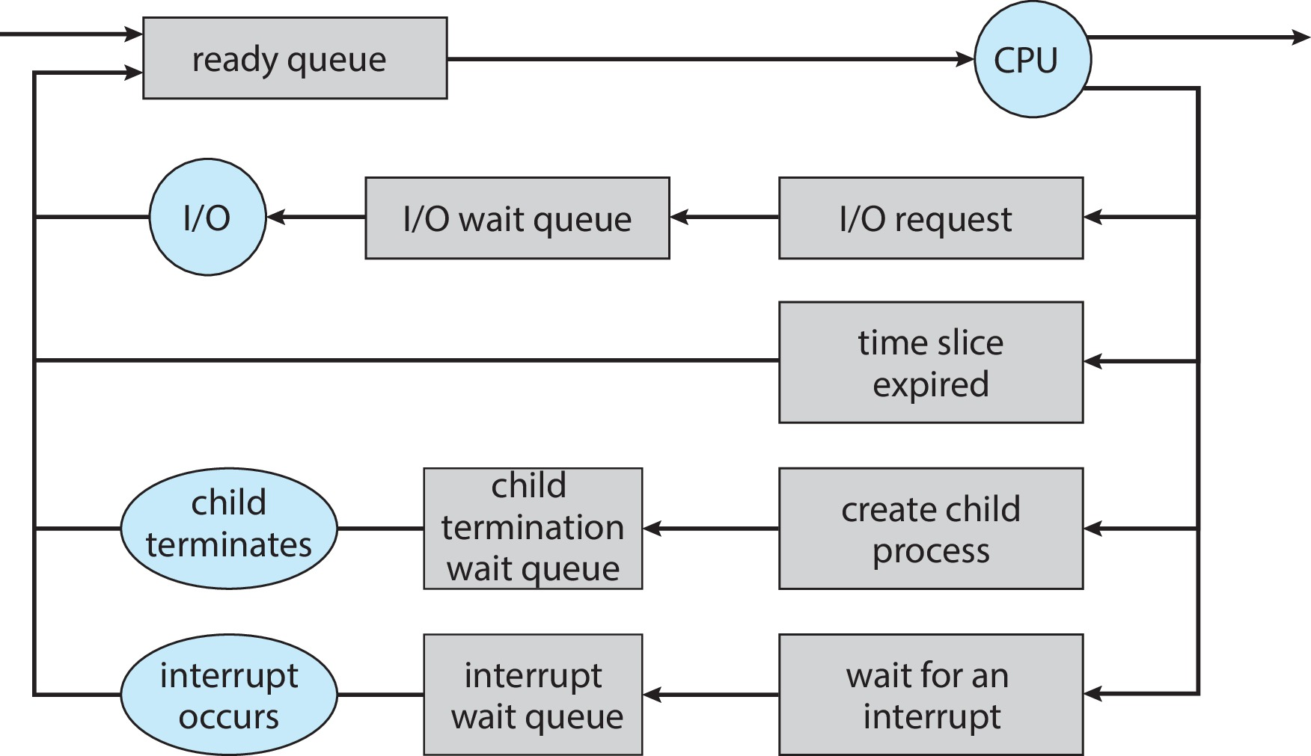
Representation of Process Scheduling

Slide 7
Process context
A context switch is the act of removing one process from the running state and replacing it by another.
The process context is the information that the operating systems needs about the process to restart it after a context switch.
For example, when a process is interrupted
the current value of the program counter and processor registers (context data) need to be saved
the state of the process is changed to “blocked” or “ready”
This information is stored in the process control block (PCB).

Slide 8
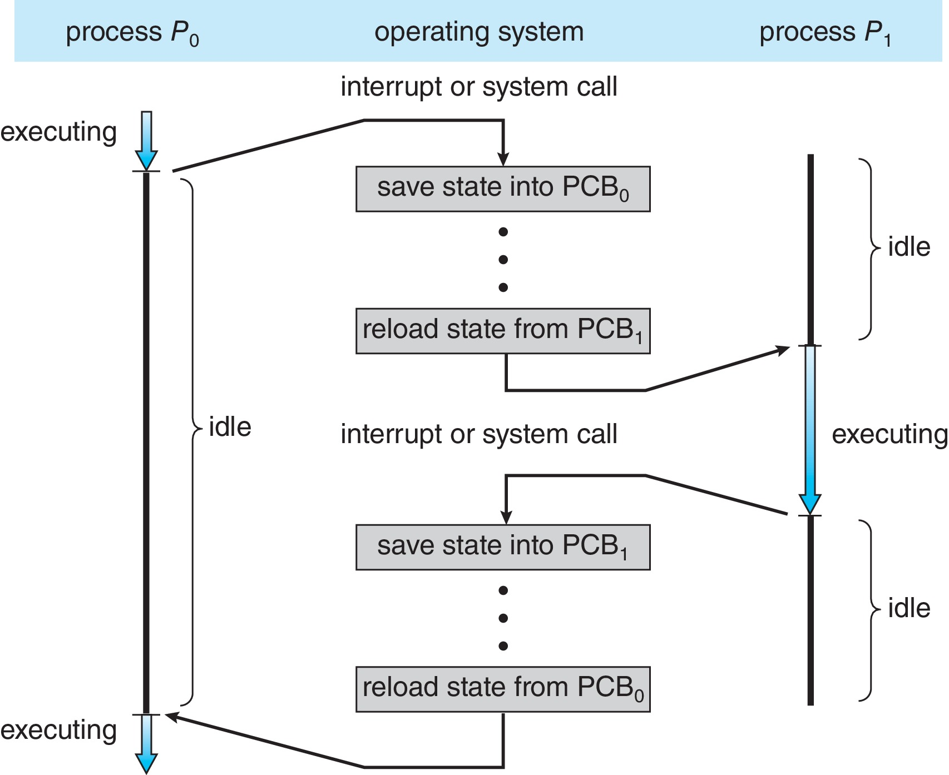
Context Switch from Process to Process
A context switch occurs when the scheduler removes a process from CPU to replace it by another process.
System save the state of the old process into its PCB and load the saved state of the new process from its PCB.

Slide 9
Steps in a Context Switch
The steps in a context switch are:
Save context of processor including program counter and other registers
Update the process control block of the process that is currently in the Running state
Move process control block to appropriate queue – ready; blocked; ready/suspend
Select another process for execution
Update the process control block of the process selected
Update memory-management data structures
Restore context of the selected process
Notes:
If the currently running process is to be moved to another state (Ready, Blocked, etc.), then the OS must make substantial changes in its environment.
The steps involved in a full process switch are as follows:
1. Save the context of the processor, including program counter and other registers.
2. Update the process control block of the process that is currently in the Running state.
This includes changing the state of the process to one of the other states (Ready; Blocked; Ready/Suspend; or Exit). Other relevant fields must also be updated, including the reason for leaving the Running state and accounting information.
3. Move the process control block of this process to the appropriate queue (Ready;Blocked on Eventi; Ready/Suspend).
More next slide
9

Slide 10
Context Switch
Context-switch time is pure overhead; the system does no useful work while switching
The more complex the OS and the PCB ➔ the longer the context switch
Time dependent on hardware support
Some hardware provides multiple sets of registers per CPU ➔ multiple contexts loaded at once

Slide 11
Context Switch: threads
Always do process context switch if OS does not implement multithreads
Need context switch of the whole PCB
Perform kernel threads context switch if multithreading OS
Context switch between threads in the same process is faster than context switching between processes.
Context switch between threads from different processes still requires a process context switch

Slide 12
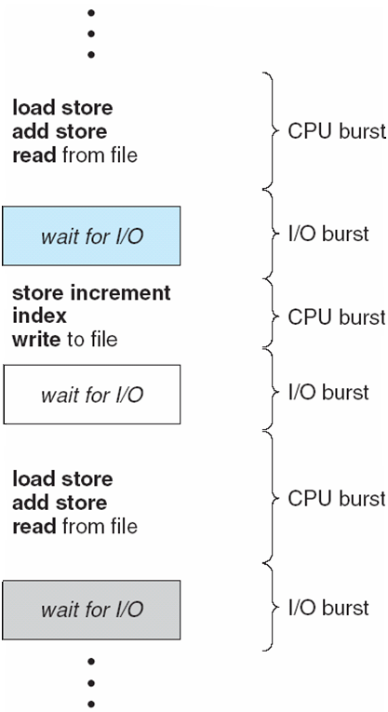
Processes execution
CPU scheduling depends on process execution which can be divided into cycles of CPU execution and I/O wait
CPU–I/O Burst Cycles
Processes alternate between these two states
CPU burst follows by a I/O burst follows by CPU burst follows by I/O burst, and so on

Slide 13
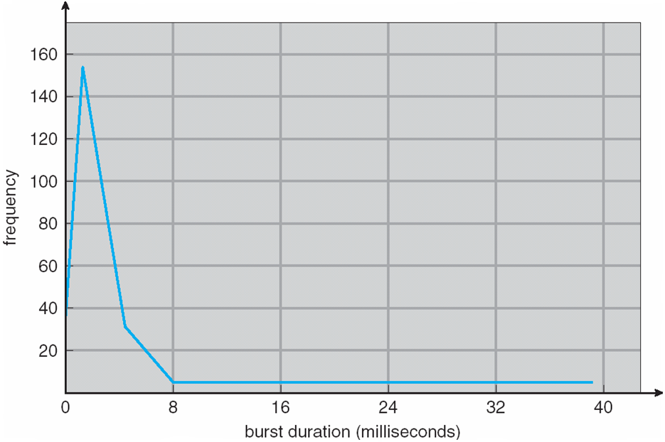
Histogram of CPU-burst Times
CPU burst distribution has been measured
Large number of small CPU burst and a small number of large CPU burst

Slide 14
Processes characterization
Interactive processes spend more time performing and waiting for I/O and generally experience short CPU bursts:
Compute-intensive processes, conversely, spend more time running instructions and less time on I/O. They exhibit long CPU bursts:
CPU
I/O
CPU
I/O
CPU
I/O
CPU
I/O

Slide 15
Scheduling algorithms
Scheduling algorithms are classified as either preemptive or nonpreemptive
In nonpreemptive scheduling algorithms:
once the CPU has been allocated to a process, the process keeps the CPU until it releases it either:
by terminating or
by switching to the waiting state
In preemptive scheduling algorithms, the scheduler
may place time quantums for the execution of processes, then processes switch from running to ready state or
may forcibly removes a process from the CPU once a process with higher priority enters the ready queue

Slide 16
Preemptive Scheduling
+
Better service to the overall set of processes (no monopolization of CPU)
-
more overhead then nonpreemptive
might de-schedule a process that update a data structure needed by another process
Data structure is in inconsistent state
To prevent this, need synchronization mechanisms

Slide 17
Scheduling Criteria
CPU utilization – How busy the CPU is?
Usually try to maximize this criterion, i.e. keep the CPU as busy as possible
Throughput – # of processes that complete their execution per time unit
Usually try to maximize this criterion
Turnaround time – amount of time to execute a particular process, from submission to completion
Waiting in memory, ready and I/O queues, running on the CPU (minimize)
Waiting time – amount of time a process spent in the ready queue (minimize)
Response time – amount of time it takes from when a request was submitted until the first response is produced, not output (for time-sharing environment, minimize)

Slide 18
Scheduling Criteria
System, performance oriented:
Focus on effective and efficient utilization of the CPU
Max CPU utilization
Max throughput
User oriented:
How the user or process perceived execution
Min response time
User oriented and performance related:
Min turnaround time; Min waiting time; Min response time

Slide 19
Scheduling Algo: Optimization Criteria
When selecting a scheduling algorithm, which of the following criteria are optimized:
CPU utilization, throughput, turnaround time, waiting time, response time
Usually not possible to optimize all of them because they may contradict each other
Min response time requires frequent context switching which reduces throughput
May seek to optimize average over all executing processes

Slide 20
Different Scheduling Algorithms
Real CPU schedulings are complexe combinations of different scheduling algorithms
We describe a small set of basic scheduling algorithms:
First-Come First-Serve (FCFS scheduling algorithm)
Shortest-Job-First (SJF scheduling algorithm)
Round-Robin (RR scheduling algorithm)
Priority scheduling algorithm
Multilevel queues

Slide 21
First-Come, First-Served Scheduling
FCFS:
Ready queue is FIFO
The simplest of the process scheduling algo.
Easy to implement
A non-preemptive scheduling algo, once a process is scheduled it runs until the end or until it executes an I/O
FCFS is not optimal, further we should expect large variations in the average waiting time
Tend to favor CPU-bound over I/O-Bound, once a CPU-bound has the CPU all the I/O-bound processes must wait

Slide 22
First- Come, First-Served (FCFS) Scheduling
Process Burst Time
P₁ 24
P₂ 3
P₃ 3
Suppose that the processes arrive in the order: P₁ , P₂ , P₃ The Gantt Chart for the schedule is:
Waiting time for P₁ = 0; P₂ = 24; P₃ = 27
Average waiting time: (0 + 24 + 27)/3 = 17

Slide 23
FCFS Scheduling (Cont.)
Suppose that the processes arrive in the order:
P₂ , P₃ , P₁
The Gantt chart for the schedule is:
Waiting time for P₁ = 6; P₂ = 0; P₃ = 3
Average waiting time: (6 + 0 + 3)/3 = 3
Much better than previous case
Convoy effect - short process behind long process
Consider one CPU-bound and many I/O-bound processes

Slide 24
Shortest-Job-First (SJF) Scheduling
Associate with each process the length of its next CPU burst
Select from the ready queue the process with the shortest next CPU burst
SJF is optimal – gives minimum average waiting time for a given set of processes
Preemptive version called shortest-remaining-time-first
How do we determine the length of the next CPU burst?
Could ask the user
Estimate

Slide 25
Example of SJF
ProcessArriva l Time Burst Time
P₁ 0.0 6
P₂ 2.0 8
P₃ 4.0 7
P₄ 5.0 3
SJF scheduling chart
Average waiting time = (3 + 16 + 9 + 0) / 4 = 7
With FCFS scheduling algo, average waiting would have been 10.25

Slide 26
SJF
SJF is provably optimal with respect to minimizing the average waiting time
Moving short process before long one decreases the waiting time of the short more than increases the waiting time of the long process
However, the length of the next CPU burst time is unknown

Slide 27

Determining Length of Next CPU Burst
Can only estimate the length – should be similar to the previous one
Then pick process with shortest predicted next CPU burst
Can be done by using the length of previous CPU bursts, using exponential averaging
If α =0, τ_{n+1} = τ_{n}, recent information does not count
If α =1, τ_{n+1} = α t_{n}, only the actual last CPU burst counts
Commonly, α set to ½

Slide 28
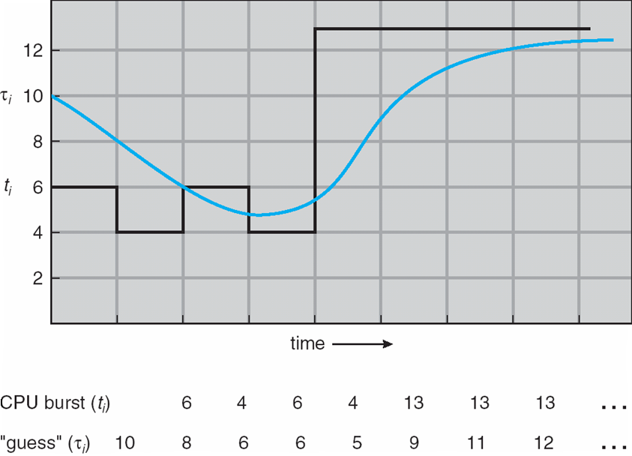
Example of Exponential Averaging
The initial prediction can be defined as a constant or as an overall system average, below τ₀ = 10 (estimation at t₀)
So, the figure below shows an exponential average with α = 1/2 and τ₀ = 10.

Slide 29
Example of Exponential Averaging
τ₁ = .5 * t₀ + .5 * τ₀
= .5 * 6 + .5 * 10 = 8
τ₂ = .5 * t₁ + .5 * τ₁
= .5 * 4 + .5 * 8 = 6
τ₃ = .5 * t₂ + .5 * τ₂
= .5 * 6 + .5 * 6 = 6
τ₄ = .5 * t₃+ .5 * τ₃
= .5 * 4 + .5 * 6 = 5
τ₅ = .5 * t₄ + .5 * τ₄
= .5 * 13 + .5 * 5 = 9
Actual
Guess

Slide 30
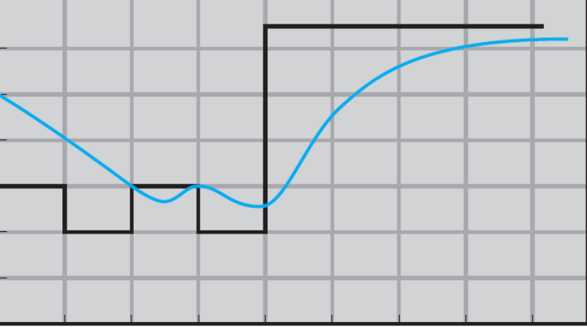
Example of Exponential Averaging
α = 0.7, τ₀ = 10
τ₁ = . * t₀ + . * τ₀
= . * 6 + . * 10 =
τ₂ = .7* t₁ + .5 * τ₁
=
τ₃ = .7 * t₂ + .5 * τ₂
=
τ₄ = .7 * t₃+ .5 * τ₃
=
τ₅ = .7 * t₄ + .5 * τ₄
=

Slide 31
Preemptive SJF: Shortest-remaining-time-first
A new process arrives at the ready queue while a previous process
is still executing.
The next CPU burst of the newly arrived process is
shorter than what is left of the currently executing process.
A preemptive SJF algorithm preempts the currently executing process
In the next example Process P1 is started at time 0, since it is the only process in the queue.
Then process P2 arrives at time 1. The remaining time for process P1 (7 milliseconds) is larger than the time required by process P2 (4 milliseconds)
Process P1 is preempted, and process P2 is scheduled.

Slide 32
Preemptive SJF: Shortest-remaining-time-first
Now we add the concepts of varying arrival times and preemption to the analysis
ProcessA arri Arrival TimeT Burst Time
P₁ 0 8
P₂ 1 4
P₃ 2 9
P₄ 3 5
Preemptive SJF Gantt Chart
Average waiting time = [(10-1)+(1-1)+(17-2)+(5-3)]/4 = 26/4 = 6.5

Slide 33
Round Robin (RR)
Similar FCFS as new process enter at the tail of the ready queue and process at the head is next for the CPU
However, it is a preemptive FCFS
Each process gets a small unit of CPU time (time quantum), usually 10-100 milliseconds.
After this time has elapsed, the process is preempted and added to the tail of the ready queue.

Slide 34
Example of RR with Time Quantum = 4
Process Burst Time
P₁ 24
P₂ 3
P₃ 3
The Gantt chart is:

Slide 35
Example of RR with Time Quantum = 4
Typically, higher average turnaround than SJF, but better response
q should be large compared to context switch time
q usually 10 milliseconds to 100 milliseconds,
Context switch < 10 microseconds

Slide 36
Round Robin (RR)
If there are n processes in the ready queue and the time quantum is q, then each process gets 1/n of the CPU time in chunks of at most q time units at once.
No process waits more than (n-1)q time units.
Performance depends on the size of the time quantum
q large ⇒ performance same as FCFS
q small ⇒ q must be large with respect to context switch, otherwise overhead is too high

Slide 37
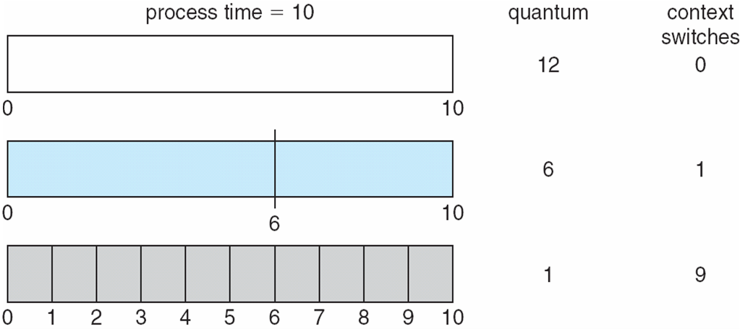
Quantum Time and Context Switch Time
Process time = 10, quantum time = 12, then 0 context switch
If quantum time = 1, needs 9 context switches for a process time of 10

Slide 38
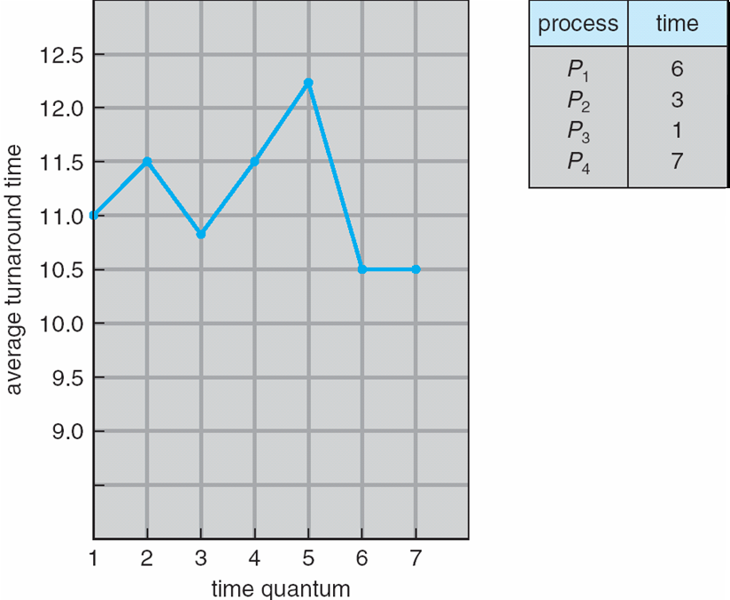
Turnaround Time Varies With Time Quantum
Turnaround time – amount of time to execute a particular process
See detail calculations

Slide 39
Priority Scheduling
A priority number (integer) is associated with each process
The CPU is allocated to the process with the highest priority (smallest integer ≡ highest priority)
Preemptive
Nonpreemptive
SJF is priority scheduling where priority is the inverse of predicted next CPU burst time

Slide 40
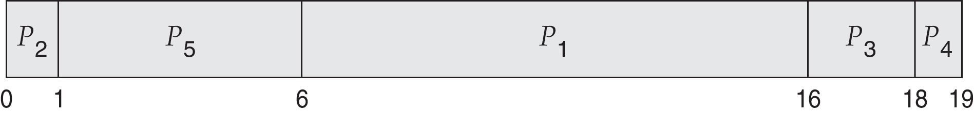
Example of Priority Scheduling
ProcessA arri Burst TimeT Priority
P₁ 10 3
P₂ 1 1
P₃ 2 4
P₄ 1 5
P₅ 5 2
Priority scheduling Gantt Chart
Average waiting time = 8.2

Slide 41
Priority Scheduling
Problem ≡ Starvation – low priority processes may never execute
IBM 7094 at MIT in 1973 they found a process that had been submitted in 1967 but not yet scheduled
Solution ≡ Aging – as time progresses increase the priority of the process

Slide 42
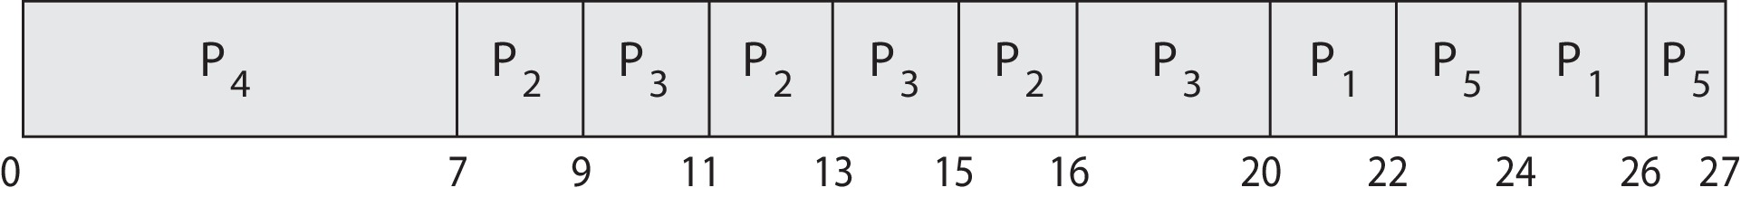
Priority Scheduling w/ Round-Robin
ProcessA arri Burst TimeT Priority
P₁ 4 3
P₂ 5 2
P₃ 8 2
P₄ 7 1
P₅ 3 3
Run the process with the highest priority. Processes with the same priority run round-robin
Gantt Chart with time quantum = 2

Slide 43
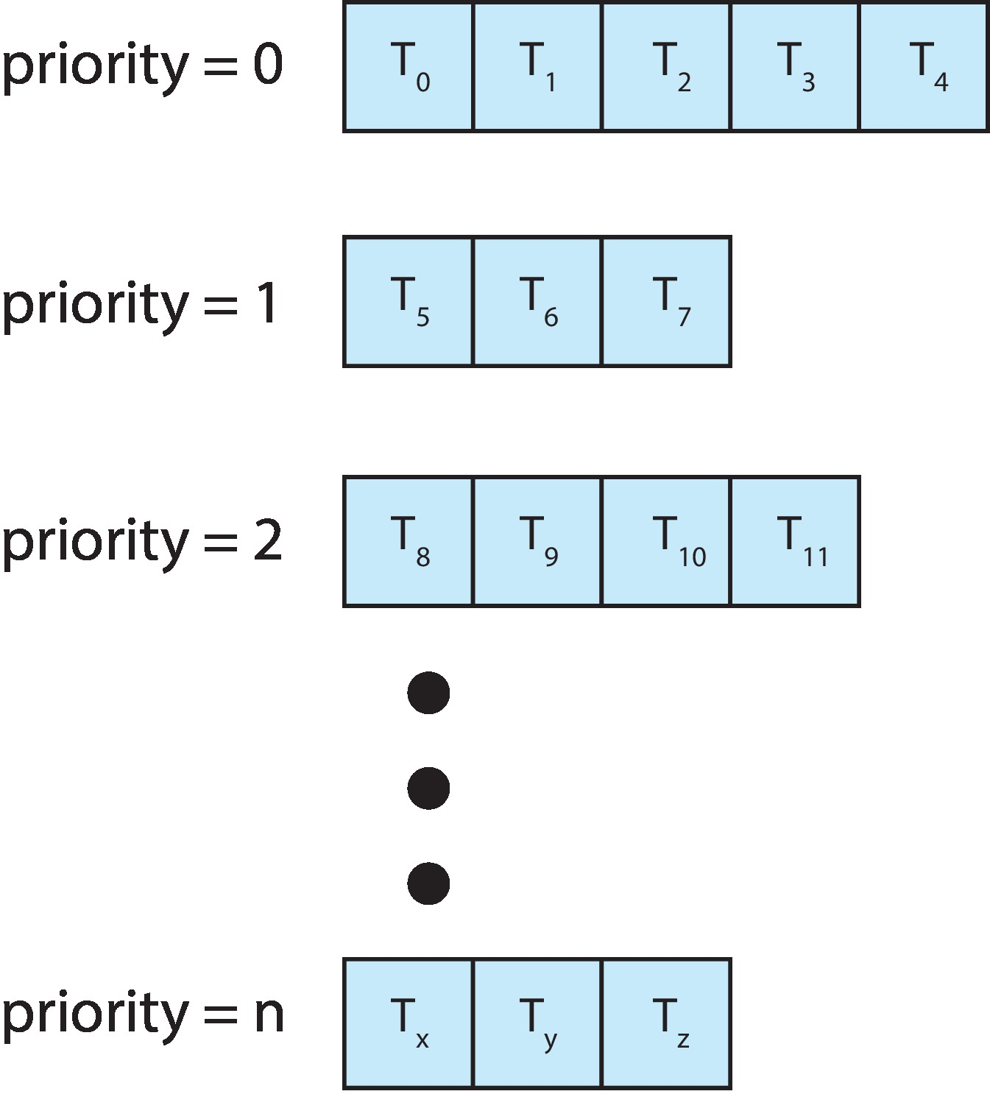
Multilevel Queue
Brake the ready queue into several queues
Relevant when processes have clearly different scheduling needs
Some processes may be highly interactive, need RR, while others are heavily computing intensive, better with FCFS
With priority scheduling, have separate queues for each priority.
Schedule each process in a queue according to its priority
Must have a scheduling policy between queues

Slide 44
Multilevel Feedback Queue
Allow processes to move between the various queues
Intend to separate processes according to their CPU bursts:
CPU bound processes (with large burst time) get demoted to lower priority queues
I/O bound and interactive processes (short CPU burst) move into higher priority queues
Each queue has its scheduling strategy adapted to the type of processes entering the queue

Slide 45
Multilevel Feedback Queue
Multilevel-feedback-queue scheduler defined by the following parameters:
Number of queues
Scheduling algorithms for each queue
Method used to determine when to upgrade a process
Method used to determine when to demote a process
Method used to determine which queue a process will enter when that process needs service (usually the queue with the highest priority)

Slide 46
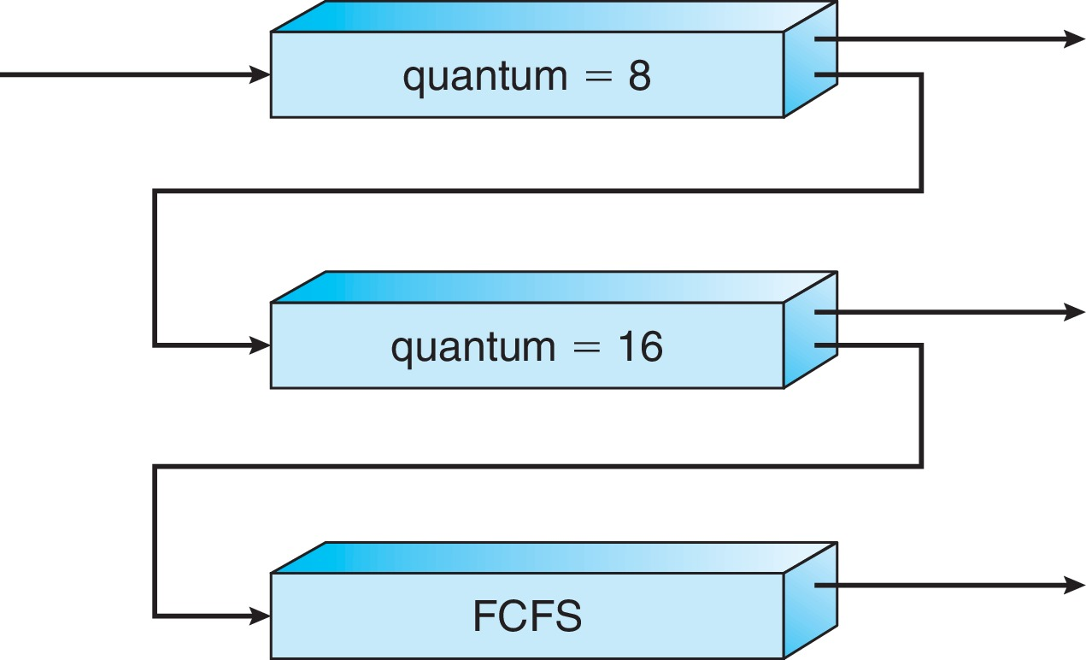
Example: Multilevel Feedback Queue
Three queues:
Q₀ – With time quantum of 8 milliseconds
Q₁ – With time quantum of 16 milliseconds
Q₂ – FCFS
Scheduling
A new process enters queue Q₀
Processes gain CPU in FCFS, each process receives 8 milliseconds
If process does not finish in 8 milliseconds, the process is moved to queue Q₁
At Q_{1,} processes receives 16 additional milliseconds
If it still does not complete, it is preempted and moved to queue Q₂

Slide 47
Operating System Examples
Solaris scheduling
Windows scheduling
Linux scheduling

Slide 48
Solaris
Preemptive priority-based scheduling
Six classes available
Time sharing (default) (TS)
Interactive (IA)
Real time (RT)
System (SYS)
Fair Share (FSS)
Fixed priority (FP)
Each class has a pre-defined range of priorities
A thread belongs to only one class
Each class has its own scheduling algorithm
The time sharing class is a multi-level feedback queue

Slide 49
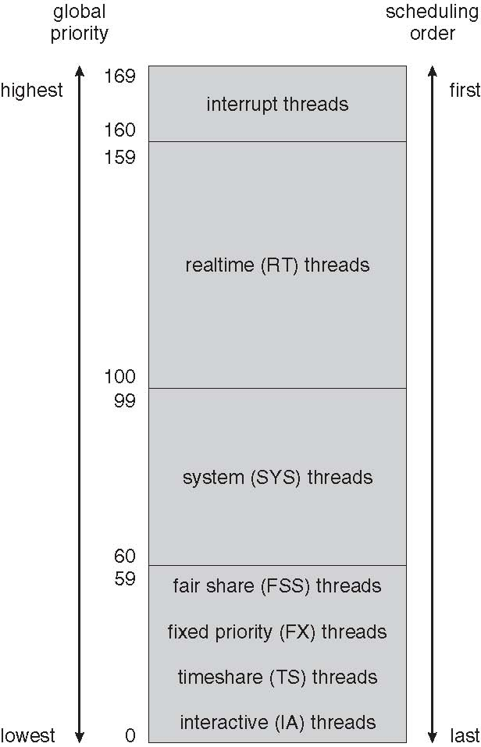
Solaris: Global Priority
Within each class there are different priorities and different scheduling algorithms.
Kernel threads (such as the scheduler) are run in the system class
Threads in the real time class are given the highest priority
A real-time thread (i.e., audio, video processes) will run before threads in any other class
In general, few threads belong to the real-time class.

Slide 50
Solaris: Global Priority
The default scheduling class for a thread is time sharing.
The scheduling policy for the time-sharing class dynamically alters priorities and assigns time slices (quantum) of different lengths using a multilevel feedback queue.
There is an inverse relationship between priorities and time slices. The higher the priority, the smaller the time slice; and the lower the priority, the larger the time slice

Slide 51
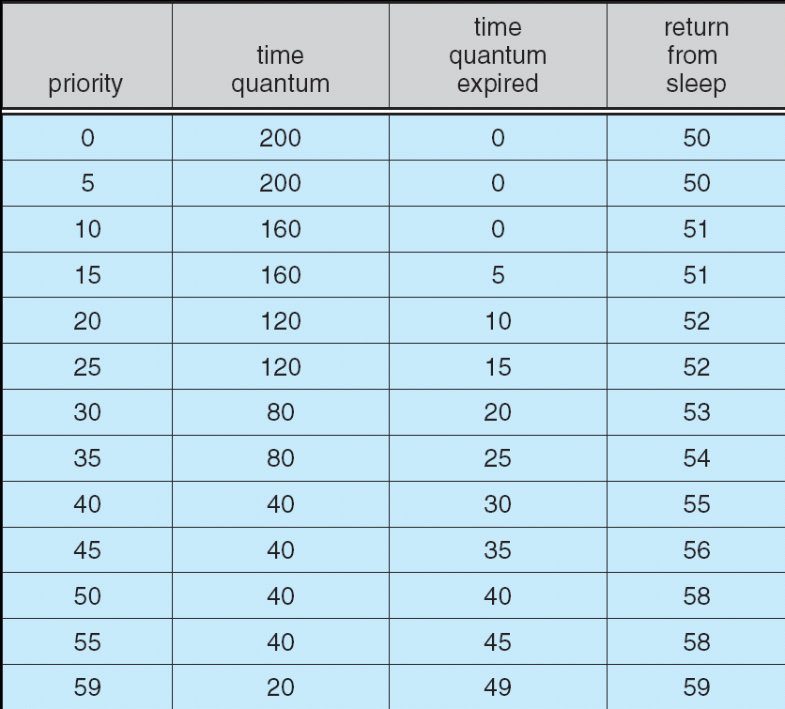
Solaris
The scheduling policy for the time-sharing and interactive threads. Classes dynamically alters priorities of threads using a multilevel feedback queue
New priority of
a thread that has
used its entire
time slice
Penalize CPU-
bound processes
Inverse relationship between
priorities and time
slices
CPU-bound processes
have lower priorities
Interactive processes
have good response time
Priority of a
thread that is
returning from
Waiting for I/O
Provide good
response time for
interactive processes

Slide 52
Solaris Scheduling (Cont.)
Scheduler converts class-specific priorities into a per-thread global priority
Thread with highest priority runs next
Runs until (1) blocks, (2) uses time slice, (3) preempted by higher-priority thread
Multiple threads at same priority selected via RR

Slide 53
Windows Scheduling
Windows scheduler is a priority-based, preemptive scheduling algorithm
Use a 32 priority levels to determine the order of threads execution
Uses a queue for each scheduling priority
Traverses the set of queues from highest to lowest until it finds a thread that is ready to run
Priorities divided into two classes:
The variable class contains threads with priority 1 to 15 and the real-time class contains threads from priority 16 to 31

Slide 54
Determining threads priority
The priority of each thread is determined by the following criteria:
The priority class of its process
The priority level of the thread within the priority class of its process
The priority class and priority level are combined to form the base priority of a thread.

Slide 55
Process priority classes
Each process belong to one of 6 priority classes:
REALTIME_PRIORITY_CLASS
HIGH_PRIORITY_CLASS
ABOVE_NORMAL_PRIORITY_CLASS
NORMAL_PRIORITY_CLASS
BELOW_NORMAL_PRIORITY_CLASS
IDLE_PRIORITY_CLASS
Except for real time processes, process priorities in other classes can vary, so these processes belong to the variable class.

Slide 56
Thread priority levels
Each thread has one of the following relative priority levels:
TIME_CRITICAL
HIGHEST
NORMAL
BELOW_NORMAL
LOWEST
IDLE
Windows overall thread priorities depends on the process priority and relative class of the thread

Slide 57
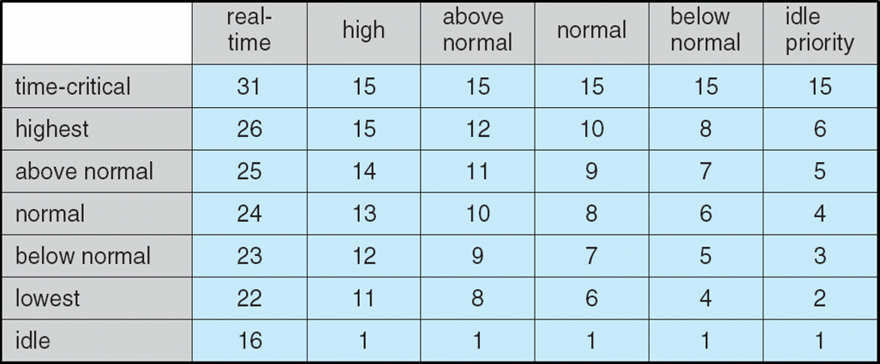
Windows thread priority
Windows processes can belong to one of 6 priority classes
Within a priority class, a thread has a relative priority level

Slide 58
Windows Scheduling
New processes are typically members of the NORMAL_PRIORITY_CLASS.
The initial priority of a thread is typically the base priority (which is the normal relative priority) of the process the thread belongs to
For example, if a process belongs to high priority, then a new thread priority for this process will be 13
PROCESSES
THREADS

Slide 59
Priorities
Threads priorities are divided into two classes:
the variable class contains threads having priorities from1 to 15
the real-time class contains threads with priorities ranging from 16 to 31. (There is also a thread running at priority 0 that is used for memory management.)
The scheduler uses a queue for each scheduling priority and traverses the set of queues from highest to lowest until it finds a thread that is ready to run.

Slide 60
Pre-emptive scheduling
A thread selected to run will run until it is either
preempted by a higher-priority thread
it terminates
its time quantum ends
it calls a blocking system call, such as for I/O.
If a higher-priority real-time thread becomes ready while a lower-priority thread is running, the lower-priority thread will be preempted.
This preemption gives a real-time thread preferential access to the CPU when the thread needs such access.

Slide 61
Multilevel feedback
When a thread’s time quantum runs out and its priority is lower, then the thread is interrupted
Its priority is lowered to limit the CPU consumption of CPU-bound thread.
However, the priority of a thread is never lowered below the base priority of the thread to which it belongs (the normal thread priority)
For example, the priority of a thread belonging to a process with high priority can never go lower than priority 13
The function SetThreadPriority() can set threads to lower priorities

Slide 62
Multilevel feedback
When a variable-priority thread is released from a wait operation
Its priority is increased. Tend to give good response times to interactive threads
Increases more when the I/O is a keyboard strike
Increases less when the I/O is file access

Slide 63
Linux
Like Solaris and Windows, the Linux scheduler is a preemptive, priority-based algorithm.
Has two separate class of tasks: normal and real time (unlike Solaris and Windows which have 6 classes)
Each class has a different scheduling algorithm
Real-time tasks are assigned static priorities
The “normal” class use the completely fair scheduling (CFS) algorithm
CFS is designed to favor interactive tasks
Notes:
Low-priority task → compute-bound task → short quanta → 容易preempted 且分的時間又少,
很慘…
Nice → other tasks

Slide 64
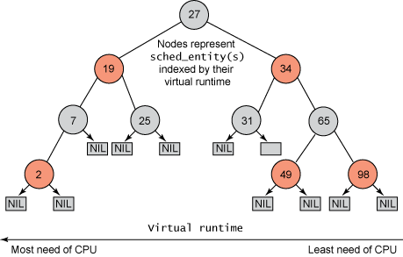
The CFS scheduler
Linux CFS does not have priority queues, rather it uses a red-black tree where nodes in the tree are tasks ready to be executed
CFS records in nanosecond the time a tasks has run, this is called vruntime (virtual runtime)
The scheduler tracks the vruntime for all tasks.
The lower a task's vruntime, the more deserving the task is for execution
A task ready to execute is inserted in the red-black tree in a position according to its vruntime, the smallest the vruntime the more on the left of the RBT the task will be
The leftmost node is scheduled next for execution
Pre-empted tasks are placed on the right side
of the tree

Slide 65
Target latency
CFS does not have fixed timeslices (run robin) and explicit priorities.
The amount of time for a given task on a processor is computed dynamically
The target latency is an elapse time during which all the tasks must have got access to the CPU
For example, if the target latency is 20ms, then all the tasks will execute inside the 20 ms
Each task has a quantum time inside the 20ms according to its priority.
If the number of runnable tasks double (for example from 4 to 8) then the time slice for each task becomes smaller
In this idealized context, the first task to run will be the one that has the smallest vruntime

Slide 66
How this all work
Typically, I/O bound tasks have short CPU burst, thus their vruntime is smaller
Furthermore, there is a decay factor associated with priority that impacts the calculation of vruntime
For “nice” tasks (priority 0), the vruntime is the same as the amount of CPU used, for example, if the task has used 200ms so far, then its vruntime is 200
Tasks with high priority have had a higher decay factor, thus the new vruntime will be smaller than the time used to compute, maybe 180ms
On the other hand, for tasks with low priority, the decay is lower, maybe the new vruntime after execution will be 220ms
Linux scheduler is unlike Solaris, where quantum time is assigned to each task according to its priority, Linux assigns a different quantum time for each task:
Quantum time of T_x = T_x priority + T_x CPU time used + Scheduler current latency

Slide 67
Impacts of “nice” on priorities
The priority of a task can be modified by the nice value.
The range of nice values [-20,19].
Default of nice is 0, if nice > 0, a task has a lower priority.
If nice < 0, the task gets a higher priority
Nice impacts the scheduling priority as follow:
If a task has nice = 0, its vruntime = its actual physical run time, for example 200ms
If a task has nice > 0, its vruntime > its actual physical run time
If a task has nice < 0, its vruntime < its actual physical run time
An interactive task, tends to spend a lot of time in I/O queues, it is I/O-bound; hence, such a task tends to have a relatively low vruntime,
which tends to move the task towards the front of the scheduling line.

Slide 68
Impacts of “nice” on time slices
Nice values impact time quantas as well
Nice can be determined by the user with the command nice
Nice -10 command will lower the priority of “command”
The scheduler also changes the priorities of tasks
Tasks with shorter I/O times are often more CPU-bound, and will have adjustments closer to +5 after execution
To have shorter time quantas.
Tasks that are interactive are more likely to have adjustments closer to -5.
Nice values change the weight a task has in the determination of the time quantas for each task in the latency target.
Assume 3 tasks T1, T2, T3, with respective nice -5, 0, 5. T1 may have weight 5, T2 = 3 and T1 = 2. Total of weights = 10. Thus, T1 gets ½ of the latency target, T2 get 3/10 and T1 get 1/5
If target latency = 20ms, T1 runs 10ms, T2 = 6ms, T3 = 2ms

Slide 69
Relations between real-time and normal
Real-time tasks are assigned static priorities within the range of 0 to 99
Normal tasks are typically assigned priorities in the range between 100-139
These ranges may vary across different Linux flavors
However, in all cases, all real-time tasks must be executed (completed, or idle) before any normal task can run on the CPU

Slide 70
Ubuntu priority levels
See the priority of tasks Ubuntu: ps –l
Or “top”
Different output of the priority levels for same tasks
Linux implementations are required to have minimum 32 real-time priority levels
40 levels dynamically changing priorities

Slide 71
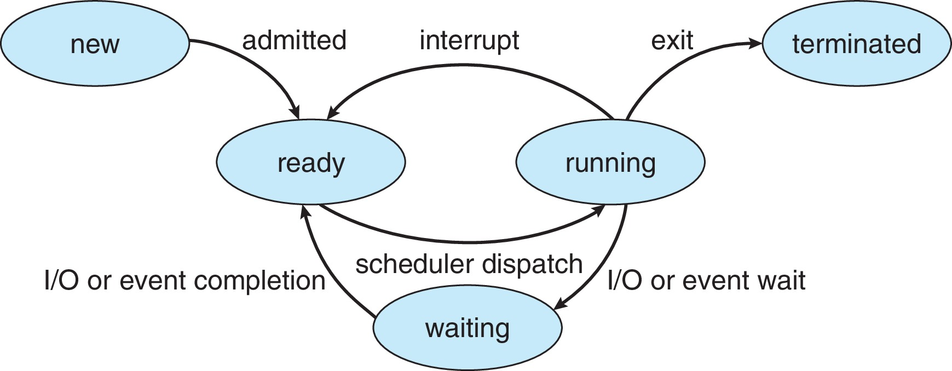
Summary on scheduling
Process states
Process execution cycle
CPU
I/O
CPU
I/O
Process scheduling

Slide 72
End of Section 5

