Slide 1



Heuristic Algorithms for Solving the Survivable Problem in the Design of Last Mile Communication Networks
Nguyen Thi Minh, Vo Khanh Trung, Huynh Thi Thanh Binh
Hanoi University of Science and Technology

Slide 2
Outline
Introduction
Previous works
Proposed algorithms
Experimental results
Conclusion

Slide 3
Introduction

Slide 4
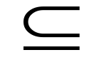
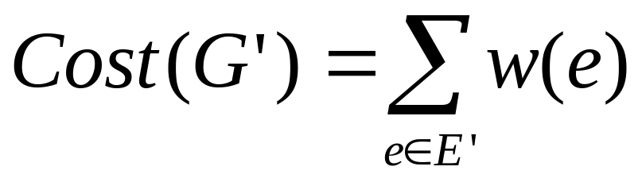
Introduction
Given a connected, weighted, undirected graph G = (V, E) and C V
Minimize:
Objective:
  G’ is sub-graph of G
  connecting all customers C and satisfies the connection requirements

Slide 5
Introduction
Connection requirements
  Simple connection(C1): there exists a path to infrastructure nodes.
  Redundant connection(C2): there exists two edges disjoint paths to infrastructure nodes.
Infrastructure nodes: set of nodes infrastructure network.
This problem is known to be NP-hard When |C1| > 0 and |C2| > 0 [Kerivin 2005].

Slide 6
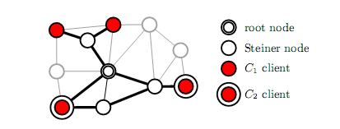
Introduction
In this given graph, we have four nodes:
Infrastructure node
C = C1 U C2 : Customer nodes
Terminal nodes: root nodes U customer nodes

Slide 7
Applications
Telecommunication network (e.g. SDH/SONET, ATM, WDM, IP)
In the design of the last mile of the real-world communication networks

Slide 8
Previous works

Slide 9
Previous works
Exact and Aproximate approaches
Wagner and Raidl (2007) | Integer linear program (ILP) with multi-commodity network flow(MCF) | V=190, E=377, C1+ C2 = 6
ILOG: CPLEX (2006) | ILP - CPLEX | V=2804, E=3208, C1 + C2 = 12
Leiner and Raidl (2010) | Branch-and-cut | V=190, E= 377, C1 + C2 = 13
Lucena (2004) Liubic (2006), Cunha (2009), | PCSTP (price-collecting Steiner tree problem) | C1 + C2 <15
Cannuto(2001) | Multi-start local search | V = 2804, E = 3082
Thomas Bucsics, (2007) | Meta-heuristic appoaches | V = 3867, E= 8477
Leiner and Raidl (2008) | ILP+Lagrangian Decomposition | V= 3867, E = 46307
M. Stoer (1992), Kerivin (2005) | Survey for SNDP
Heuristic approaches
Notes:
The survey 2005, Kerivin has showed that survivabe network has reseached from 60 last century
Until now, there are many reseach about this problem.
Giải thuật

Slide 10
Proposed algorithms

Slide 11
Proposed algorithms
Multi Source Shortest Path Tree (MSSP)
One-Sourced Shortest Path (OSSP)
Random Node Selection (RNS)

Slide 12
Proposed algorithms
Goal: With each type-1 customer needs 1 path to root node and
Type-2 customer needs at least 2 disjoint path connect to root node
Solving problem:
  Step 1: Find a path for every customers to the infrastructure network
  Step 2: Find another path for type-2 customers (ensure that exists two edges disjoint paths from node k to infrastructure nodes )

Slide 13
MSSP algorithm

Slide 14
Multi Source Shortest Path Tree (MSSP)
Step1: Find all-pairs-shortest-path between nodes in the set of terminal nodes.
V1->all nodes in the all-pairs-shortest-path
Step2: E1-> edge set from E if its two nodes are in V1.
Step3: Find a minimum spanning tree on the G1=(V1,E1,c)
Step4: Augmentation for type-2 customer nodes

Slide 15

Note:
MSSP algorithm
Infrastructure node
Steiner node
Customer node type-1
Customer node type-2

Slide 16
Source Graph
MSSP algorithm
0
1
2
Infrastructure
1
5
Set of terminal node: {1, 2, 6, 7}
4
22
19
2
15
3
100
5
10
7
23
4
9
3
6
35
7
Notes:
The first, we find all-pairs-shortest-paths between elements in the set of terminal nodes. The nodes appear along
the paths is included in a set labeled V1. By using V1, we build a set named E1 as follows:
Initially, we assign empty value to the set E1. We choose one edge named e from E (E is a set of edges of the graph G = (V, E)). If two nodes of e are included in V1, we add e to E1. The process is repeated until all elements of E are selected. When the process is ended, we obtain a graph denoted G1 = (V1, E1). We find a minimum spanning tree on the graph. The obtained tree is called Steiner tree.

Slide 17
Steiner tree
MSSP algorithm
0
Find shortest path:
From 1 to 2: 1 - 2
From 1 to 6: 1 – 4 – 3 - 6
From 1 to 7: 1 – 4 - 7
From 2 to 6: 2 – 1 – 4 – 3 - 6
From 2 to 7: 2 – 1 – 4 - 7
From 6 to 7 6 – 3 – 4 - 7
1
2
1
4
2
3
7
4
6
7
Total Cost = 14
Notes:
The first, we find all-pairs-shortest-paths between elements in the set of terminal nodes. The nodes appear along
the paths is included in a set labeled V1. By using V1, we build a set named E1 as follows:
Initially, we assign empty value to the set E1. We choose one edge named e from E (E is a set of edges of the graph G = (V, E)). If two nodes of e are included in V1, we add e to E1. The process is repeated until all elements of E are selected. When the process is ended, we obtain a graph denoted G1 = (V1, E1). We find a minimum spanning tree on the graph. The obtained tree is called Steiner tree.

Slide 18
Solution
MSSP algorithm
0
1
2
1
5
4
2
3
7
9
4
6
7
Total Cost = 28
Notes:
Find another path for type-2 customers (ensure that exists two edges disjoint paths from node k to infrastructure nodes )

Slide 19
OSSP algorithm

Slide 20
One-Sourced Shortest Path (OSSP)
Step 1: Find the shortest path between nodes in the set of terminal nodes. And computing total cost
Step 2: Select Central node which has minimum total shortest path’s cost from it to terminal node
Step 3: Building Steiner tree: the shortest path tree to central node to terminal nodes
Step4: Augmentation for type-2 customer nodes

Slide 21
Source Graph
OSSP algorithm
0
1
2
Infrastructure
1
5
Set of terminal node: {1, 2, 6, 7}
4
22
19
2
15
3
100
5
10
7
23
4
9
3
6
35
7
Notes:
The purpose of this algorithm is to minimize Steiner tree’s cost and simultaneously keep augmentation process for each customer node (type-2) as MSSP algorithm above. First, we find the shortest path between nodes in the set of terminal nodes to the infrastructure nodes. Then, we select a node called “Central node”. Central node is the node which total shortest paths’ cost from it to terminal nodes is minimal. Building the shortest path tree from central node to terminal nodes obtains a Steiner tree.

Slide 22
Find shortest path tree with root is node 1
OSSP algorithm
Consider node 1:
0
1
2
1
4
Total = SP(2)+SP(6)+SP(7)
= 0 + 7 + 8
= 15
2
3
7
4
6
7
Notes:
The purpose of this algorithm is to minimize Steiner tree’s cost and simultaneously keep augmentation process for each customer node (type-2) as MSSP algorithm above. First, we find the shortest path between nodes in the set of terminal nodes to the infrastructure nodes. Then, we select a node called “Central node”. Central node is the node which total shortest paths’ cost from it to terminal nodes is minimal. Building the shortest path tree from central node to terminal nodes obtains a Steiner tree.

Slide 23
Find shortest path tree with root is node 2
OSSP algorithm
Consider node 2:
0
1
2
1
4
Total = SP(1)+SP(6)+SP(7)
= 0 + 7 + 8
= 15
2
3
7
4
6
7
Notes:
The purpose of this algorithm is to minimize Steiner tree’s cost and simultaneously keep augmentation process for each customer node (type-2) as MSSP algorithm above. First, we find the shortest path between nodes in the set of terminal nodes to the infrastructure nodes. Then, we select a node called “Central node”. Central node is the node which total shortest paths’ cost from it to terminal nodes is minimal. Building the shortest path tree from central node to terminal nodes obtains a Steiner tree.

Slide 24
Find shortest path tree with root is node 3
OSSP algorithm
Consider node 3:
0
1
2
1
Total = SP(1)+SP(2)+SP(6)+SP(7)
= 3 + 3 + 4 + 9
= 19
4
2
3
7
4
6
7
Notes:
The purpose of this algorithm is to minimize Steiner tree’s cost and simultaneously keep augmentation process for each customer node (type-2) as MSSP algorithm above. First, we find the shortest path between nodes in the set of terminal nodes to the infrastructure nodes. Then, we select a node called “Central node”. Central node is the node which total shortest paths’ cost from it to terminal nodes is minimal. Building the shortest path tree from central node to terminal nodes obtains a Steiner tree.

Slide 25
Find shortest path tree with root is node 4
OSSP algorithm
Consider node 4:
0
1
2
1
Total = SP(1)+SP(2)+SP(6)+SP(7)
= 1 + 1 + 6 + 7
= 15
4
2
3
7
4
6
7
Notes:
The purpose of this algorithm is to minimize Steiner tree’s cost and simultaneously keep augmentation process for each customer node (type-2) as MSSP algorithm above. First, we find the shortest path between nodes in the set of terminal nodes to the infrastructure nodes. Then, we select a node called “Central node”. Central node is the node which total shortest paths’ cost from it to terminal nodes is minimal. Building the shortest path tree from central node to terminal nodes obtains a Steiner tree.

Slide 26
Find shortest path tree with root is node 5
OSSP algorithm
Consider node 5:
0
1
2
1
Total = SP(1)+SP(2)+SP(6)+SP(7)
= 11 + 11 + 16 + 3
= 41
4
2
3
5
7
4
3
6
7
Notes:
The purpose of this algorithm is to minimize Steiner tree’s cost and simultaneously keep augmentation process for each customer node (type-2) as MSSP algorithm above. First, we find the shortest path between nodes in the set of terminal nodes to the infrastructure nodes. Then, we select a node called “Central node”. Central node is the node which total shortest paths’ cost from it to terminal nodes is minimal. Building the shortest path tree from central node to terminal nodes obtains a Steiner tree.

Slide 27
Find shortest path tree with root is node 6
OSSP algorithm
Consider node 6:
0
1
2
1
Total = SP(1)+SP(2)+SP(7)
= 7 + 7 + 13
= 27
4
2
3
7
4
6
7
Notes:
The purpose of this algorithm is to minimize Steiner tree’s cost and simultaneously keep augmentation process for each customer node (type-2) as MSSP algorithm above. First, we find the shortest path between nodes in the set of terminal nodes to the infrastructure nodes. Then, we select a node called “Central node”. Central node is the node which total shortest paths’ cost from it to terminal nodes is minimal. Building the shortest path tree from central node to terminal nodes obtains a Steiner tree.

Slide 28
Find shortest path tree with root is node 7
OSSP algorithm
Consider node 7:
0
1
2
1
Total = SP(1)+SP(2)+SP(6)
= 8 + 8 + 13
= 29
4
2
3
7
4
6
7
Notes:
The purpose of this algorithm is to minimize Steiner tree’s cost and simultaneously keep augmentation process for each customer node (type-2) as MSSP algorithm above. First, we find the shortest path between nodes in the set of terminal nodes to the infrastructure nodes. Then, we select a node called “Central node”. Central node is the node which total shortest paths’ cost from it to terminal nodes is minimal. Building the shortest path tree from central node to terminal nodes obtains a Steiner tree.

Slide 29
Node 1 has total=15 (is minimal)
OSSP algorithm
0
1
2
1
5
Total Cost = 28
4
2
3
7
4
9
6
7
Notes:
Thêm cạnh để có 2 đường đi đến nút 7

Slide 30
RNS algorithm

Slide 31
Random Node Selection (RNS)
Construct sub-set V’ of V
  |V’|=k% |V|
For each s in V’
  Construct the shortest path tree Gs in which s is the root node and terminal node is leaf node
  Gr=Augmentation path for Gs with each type-2 node
  Select Gr which has minimum cost

Slide 32
Source Graph
RNS algorithm
0
1
2
Infrastructure
1
5
Set of terminal node: {1, 2, 6, 7}
4
22
19
2
15
3
100
5
10
7
23
4
9
3
Select three nodes: {1, 4, 7}
6
35
7

Slide 33
RNS algorithm
0
1
2
Consider node 1:
1
5
Total Cost = 28
4
2
3
7
4
9
6
7
Step 1: Find shortest path tree with root is node 1
Step 2: Augmentation path

Slide 34
RNS algorithm
0
1
2
Consider node 4:
1
5
Total Cost = 28
4
2
3
7
4
9
6
7
Step 1: Find shortest path tree with root is node 4
Step 2: Augmentation path

Slide 35
RNS algorithm
0
1
2
Consider node 7:
1
5
Total Cost = 28
4
2
3
7
4
9
6
7
Step 1: Find shortest path tree with root is node 7
Step 2: Augmentation path

Slide 36
RNS algorithm
0
1
2
1
5
4
2
3
7
4
9
6
7
Result: Best Cost is 28

Slide 37
Experiment Results

Slide 38
Problem instances
The real-world instances include 135 Euclidean instances and the random instances include 100 Non-Euclidean instances
https://www.ads.tuwien.ac.at/people/mleitner/sndp/sndpinstances.tar.gz

Slide 39
Experiment Setup
Set of experiments
  Compare: GRASP Greedy Randomized Adaptive Search Procedure, MSSP, OSSP, RNS

Slide 40
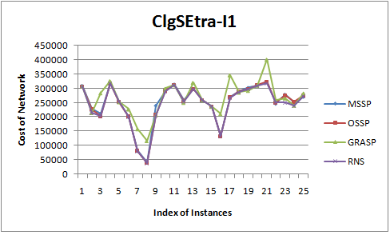
Experiment Results
The best result found by the MSSP, OSSP, GRASP, and RNS on ClgSExtra-I1 instances
Notes:
Figure 1 shows that on ClgSExtra instances: the obtained solutions by our heuristic algorithm (RNS) are better than GRASP [3] about 76%, better than MSSP about 84 %, better than OSSP about 80%.-

Slide 41
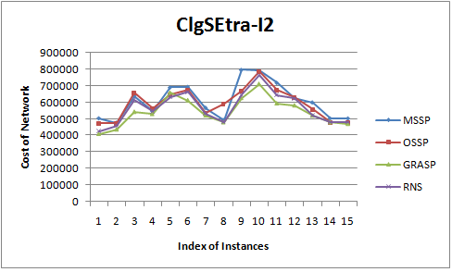
Experiment Results
The best result found by the MSSP, OSSP, GRASP, and RNS on ClgSExtra-I1 instances.
Notes:
-The same in Figure 2, 3, 4, 5, 6, 7 also shows that on random problem in-stances, the results found by propose algorithm are the best in four algo-rithms.

Slide 42
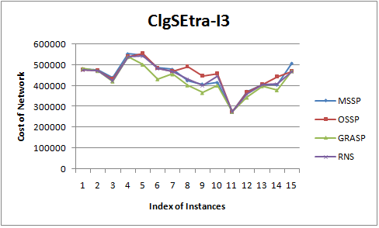
Experiment Results
The best result found by the MSSP, OSSP, GRASP, and RNS on ClgSExtra-I3 instances
Notes:
-The same in Figure 2, 3, 4, 5, 6, 7 also shows that on random problem in-stances, the results found by propose algorithm are the best in four algo-rithms.

Slide 43
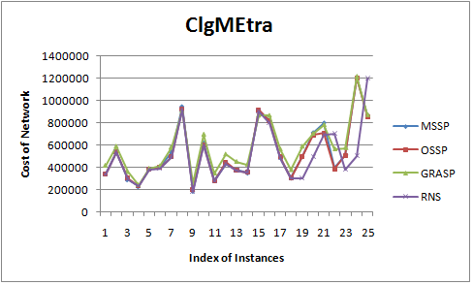
Experiment Results
The best result found by the MSSP, OSSP, GRASP, and RNS on ClgMExtra instances
Notes:
-The same in Figure 2, 3, 4, 5, 6, 7 also shows that on random problem in-stances, the results found by propose algorithm are the best in four algo-rithms.

Slide 44
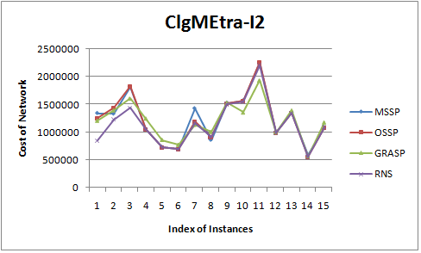
Experiment Results
The best result found by the MSSP, OSSP, GRASP, and RNS on ClgMExtra-I2 instances
Notes:
-The same in Figure 2, 3, 4, 5, 6, 7 also shows that on random problem in-stances, the results found by propose algorithm are the best in four algo-rithms.

Slide 45
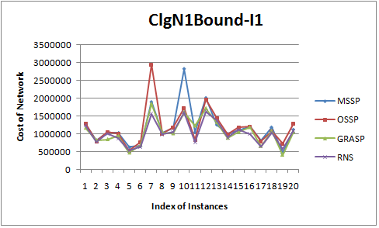
Experiment Results
The best result found by the MSSP, OSSP, GRASP, and RNS on ClgNBound-I1 instances
Notes:
-The same in Figure 2, 3, 4, 5, 6, 7 also shows that on random problem in-stances, the results found by propose algorithm are the best in four algo-rithms.

Slide 46
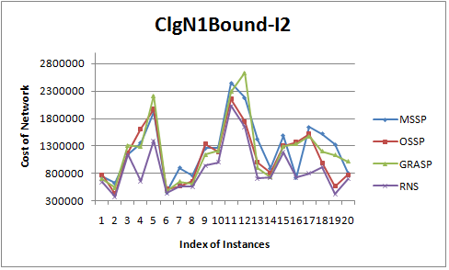
Experiment Results
The best result found by the MSSP, OSSP, GRASP, and RNS on ClgNBound-I2 instances
Notes:
-The same in Figure 2, 3, 4, 5, 6, 7 also shows that on random problem in-stances, the results found by propose algorithm are the best in four algo-rithms.

Slide 47
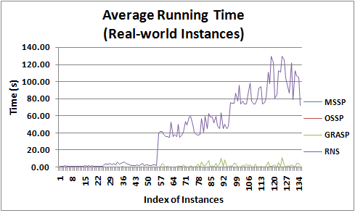
Experiment Results
The average running time of the MSSP, OSSP, GRASP and RNS on the real-world instances
Notes:
-Figure 8 shows that, on the real-world instances, RNS needs using the longest average running time, but within ac-ceptable time.

Slide 48
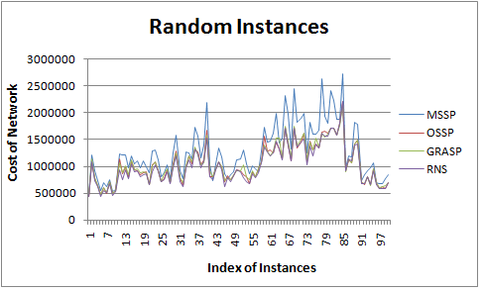
Experiment Results
The best result found by the MSSP, OSSP, GRASP, and RNS on Random instances
Notes:
-Figure 9 shows that on random problem instances, the results found by MSSP [20] are the worst result and found by RNS are the best.

Slide 49
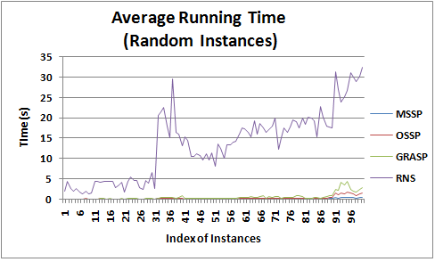
Experiment Results
The average running time of the MSSP, OSSP, GRASP and RNS on the real-world instances
Notes:
figure 10 shows that, on the random instances, RNS needs using the longest average running time, but within ac-ceptable time.

Slide 50
Conclusion
Conclusion:
  Propose three new heuristic algorithms called RNS
  The results show that the proposed approach can be attractive for solving SNDP
Work future:
  Using heuristic and meta-heuristic algorithm to improve results
  Apply GA for problem

Slide 51
Thanks

