Slide 1
COMPLEXITY

Slide 2
Content
Algorithms and data structures
Algorithm analysis and design
Algorithm design
Algorithm analysis
Several classes of algorithms

Slide 3
Solve problems by computer
Two elements make up a computer program
Data structure
Algorithm
Data Structure + Algorithm = Program

Slide 4
Algorithm
Definition : is a sequence of statements that strictly and explicitly defines a sequence of operations on some object, such that after a finite number of steps we achieve the desired result.
Each algorithm has an input and an output;

Slide 5
Features of the algorithm
Determination
Stationary (finite)
Rightness
Universality
Possibility
Notes:
+ Determinism: The operations, objects, and means in the algorithm must have clear meanings and must not cause confusion .
+ Stationary: The algorithm must stop and give the result after a finite number of steps
+ Correctness: After performing the algorithms according to the specified procedure, the algorithm gives results that satisfy the specification for all cases of input objects and means.
Universality: Algorithms must be easy to modify to adapt to any problem in the class of problems
+ Feasibility: The algorithm must be converted into a program, the size is small enough, the algorithm must be executed by the computer in the time allowed.

Slide 6
Algorithm design
From problem to program
Real math problems
#include…
Design
Program
Algorithmic design techniques:
Divide and conquer, dynamic planning, backtracking ..vv
Programming language:
C/C++, JAVA…
Algorithm
Programme

Slide 7
Algorithm design
Given a problem, how to come up with an algorithm to solve it?
Design strategy:
Greedy method
Divide-and-conquer
Dynamic programming
Backtracking
…

Slide 8
Algorithm Analysis
When an algorithm is built, the requirements are
Requirements for the correctness of the algorithm
The simplicity of the algorithm.
Space (memory) requirements
Time requirements
Notes:
+ Correctness of the algorithm: does the algorithm give the correct solution or not?
+ Note: The correctness (including feasibility) is required to be confirmed not only by some comparative tests but must be rigorously proven by mathematical tools.
+ Simplicity of the algorithm. Often we want an algorithm that is simple, easy to understand, and easy to program
+ Space requirements: Is the built-in algorithm suitable for computer memory?
+ Time requirements: Is the running time of the algorithm fast?

Slide 9
Analyze the running time of the algorithm
The execution time of the algorithm depends on the following factors:
Input data
The speed of performing mathematical operations of the computer (computer hardware)
Compiler
Notes:
This empirical evaluation cannot compare algorithms with each other
Experimental evaluation: Write a program and run it on a computer
We have to come up with a way to evaluate runtime regardless of language, compiler, or machine speed

Slide 10
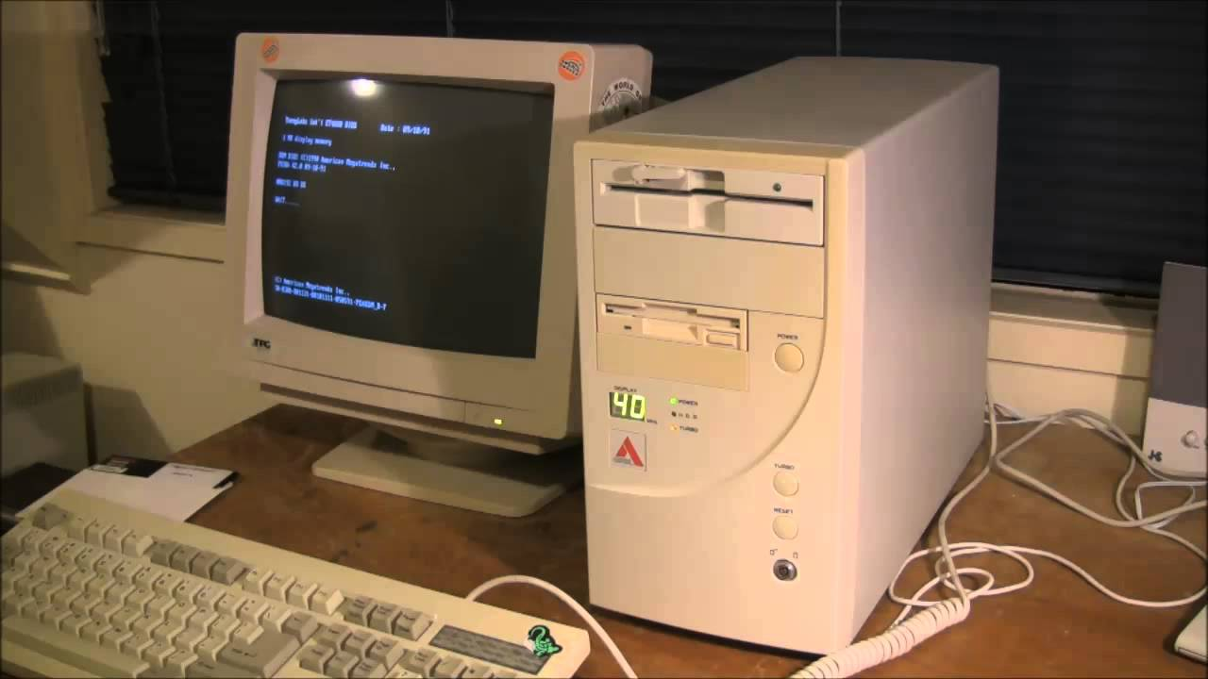

Computational complexity
Some other factors affect the calculation speed
Computer speed

Slide 11
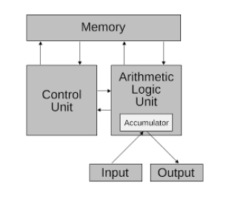
Computational complexity
Some other factors affect the calculation speed
Architecture of the computer

Slide 12
Big-O notation
O (big-Oh) :
Functions f(n) and g(n):
f(n) = (g(n)), if exist in the constant number positive c and n for f(n) ≤ cg(n) when n ≥ n _{o.}
Notes:
The functions f(n) and g(n) are two non-negative functions of the non-negative integer argument n.
f(n) = O(g(n)) means that the function f(n) is bounded on by the function g(n) with some constant factor when n is large enough
+ Example. Assuming f(n) = 5n ³ + 2n ² + 13n + 6 , we have:
f(n) = 5n ³ + 2n ² + 13n + 6 <= 5n ³ + 2n ³ + 13n ³ + 6n ³ = 26n ³
The above inequality holds for all n >= 1, and we have n ₀ = 1, c = 26. Therefore, we can say f(n) = O(n ³ ).
Each function will have many upper bounds

Slide 13
Determine the computational complexity
T1(n) and T2(n) are the execution time of the two program phases P1 and P2 where T1(n) = O(f(n)); T2(n) = O(g(n))
Addition rule :
The execution time of the next segment P1 then P2 will be
T1(n) + T2(n) = O(max(f(n),g(n))).
Multiplication rule :
The execution time of nested P1 and P2 will be:
T1(n)T2(n) = O(f(n)*g(n))

Slide 14
General Rules
Assignment, read, write, goto are elementary operations:
The execution time is: O(1)
Selection command: if-else has the form
if (<condition>)
command 1
else
command 2
Notes:
Selection command: if-else
Condition evaluation time is T0(n), instruction execution time 1 is T1(n), instruction execution time 2 is T2(n). The execution time of the if-else selection instruction will be the maximum of the times T0(n) + T1(n) and T0(n) + T1(n).
The common case is to check the condition that only needs O(1). Then if T1(n) = O(f(n)), T2(n) = O(g(n)) , then the running time of the if-else statement is O(max (f(n)), g( n))).

Slide 15
General Rules
The switch statement is evaluated similarly to the if-else statement.
Looping statements: for, while, do-while
Need to evaluate the maximum number of iterations, let's say it's L(n)
Next evaluate the running time of each iteration as Ti (n), (i=1,2,..., L(n) ₎
Each iteration, the cost of checking the iteration condition, is T ₀ (n).
The cost of the iteration instruction is:
Notes:
Note: the if-else statement has two options, while the switch statement can have more than two options.
Note that the execution time of the body of a loop statement at different iterations can be different, assuming the execution time of the loop body at the i-th time (i=1,2,..., L(n) )) is Ti(n)
The common case is: checking an iterable condition (usually evaluating an expression) takes only O(1) time, the execution time of the iterations is the same, and assuming we can evaluate to O( f(n)); then, if the number of iterations is evaluated as O(g(n)), then the running time of the iteration instruction is O(g(n)f(n)).

Slide 16
Some examples
Case1 : for (i=0; i<n; i++)
for (j=0; j<n; j++)
k++;
Case 2 : for (i=0; i<n; i++)
k++;
for (i=0; i<n; i++)
for (j=0; j<n; j++)
k++;
Case 3 : for (int i=0; i<n-1; i++)
for (int j=0; j<i; j++)
int k+=1;
O(n ² )
O(n ² )
O(n ² )

Slide 17
Some examples
int MaxSubSum1( const int a[], int n) {
int maxSum =0;
for ( int i =0; i < n; i ++)
for ( int j= i ; j<n; j++ ) {
int thisSum =0;
for ( int k= i ; k<=j; k++)
thisSum +=a[k];
if ( thisSum > maxSum )
maxSum = thisSum ;
}
return maxSum ;
}
O(n ³ )

Slide 18
Some examples
int MaxSubSum2(const int a[], int n) {
int maxSum=0;
for (int i=0; i<n; i++) {
thisSum=0;
for (int j=i; j<n; j++) {
thisSum+=a[j];
if (thisSum>maxSum)
maxSum=thisSum;
}
}
return maxSum;
}
O(n ² )

Slide 19
Some examples
int MaxSubSum3(const int a[], int n) {
int maxSum=0, thisSum=0;
for (int j=0; j<n; j++) {
thisSum+=a[j];
if (thisSum>maxSum)
maxSum=thisSum;
else if (thisSum<0)
thisSum=0;
}
return maxSum;
}
O(n)

Slide 20
Some examples
Sum=0
for (j=0;j<N;j++)
for (k=0;k<N*N;k++)
Sum++;
O(N ³ )

Slide 21
Algorithm classification
Complexity
O(1) constant complexity
O(logn) logarithmic complexity
O(n) Linear Complexity
O(nlogn) complexity nlogn
O(n ^{b} ) polynomial complexity
O(b ^{n} ) exponential complexity
O(n!) factorial complexity

Slide 22
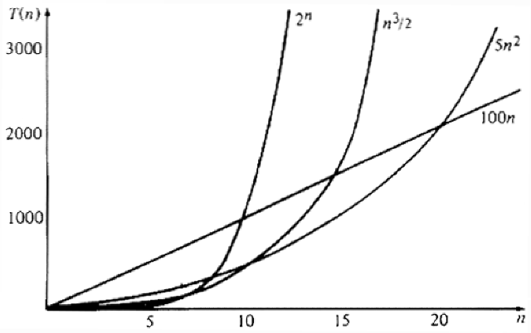
Algorithm classification

Slide 23
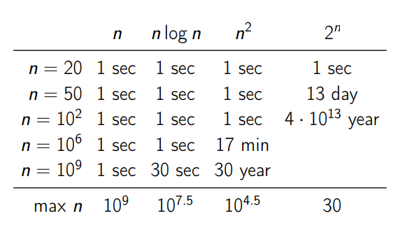
Algorithm classification
Estimated time with a computer clocked at 1Ghz

Slide 24
Evaluate complexity in three cases
Computational complexity of the algorithm in the cases
Worst
The best
Medium
Notes:
The complexity of the algorithm depends not only on the size of the input data, but also on the properties of the data

Slide 25
Evaluate complexity in three cases
Example: Sequential Search Algorithm
int sequenceSearch( int x, int a[], int n){
for ( int i=0;i<n;i++){
if (x==a[i]) return i;
}
return -1;
}

Slide 26
Evaluate complexity in three cases
Best: the first element is the one to find, the number of comparisons is 2 T(n) ~ O(2) = O(1)
Worst: compare to last element, number of comparisons is 2n  T(n) ~ O(n)
Average: compare to the i-th element, 2*i comparisons are needed, so the average needs
(2+4+6+…+2n)/n=2(1+2+…+n)/n=n+1
· T(n) ~ O(n)

Slide 27
Online programming experience
Based on an assessment of computational complexity:
If the estimated number of command lines is not more than 10 ⁷ then the algorithm will run fine for a period of 1 second
If the estimated number of command lines is greater than 10 ⁸ then you should think and choose another solution

