Slide 1
LESSON 4. GREEDY

Slide 2
Content
Introduction to the greedy algorithm
Problems with greedy algorithms
Approximate greed
Some applied problems

Slide 3
OPTIMIZATION PROBLEM
Find min { f(X) : X ∈D }.
or find max { f(X) : X ∈D }.
D is a finite set of elements satisfying some property P.
D = { X = ( x ₁ , x ₂ ,..,x _{n} ) ∈A ₁ ×A ₂ ×A _{n} : X satisfies the property P }
X ∈D: option
Function f(X): objective function
Domain D: Set of options.

Slide 4
GRAY ALWAYS
Greedy Algorithm:
Main idea:
Select local optimum at each step
Desire to find the globally optimal choice.
Greedy algorithms are often not general. There needs to be a solid foundation in math.
Time complexity is usually much better than Full Browsing and Branching

Slide 5



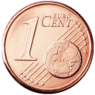



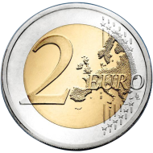
MONEY EXCHANGE PROBLEM
Description of the problem:
Given an amount of money and set of coins.
Find a way to change money so that the number of coins is the minimum.
Case 1: consider the set of coins 1, 2, 5, 10, 20, 50
Notes:
5

Slide 6
MONEY EXCHANGE PROBLEM
Solution France greed :
Choose the copper coin are from price treat big arrive small
Need exchange 72 cents
Notes:
6

Slide 7
MONEY EXCHANGE PROBLEM
Notes:
7

Slide 8
MONEY EXCHANGE PROBLEM
Notes:
8

Slide 9
MONEY EXCHANGE PROBLEM
The result is optimal!
Notes:
9

Slide 10
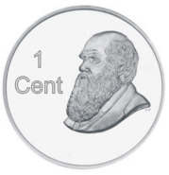


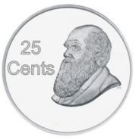
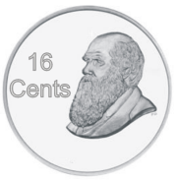


MONEY EXCHANGE PROBLEM
Case 2: Set of coins 1, 4, 9, 16, 25, 36, 49

Slide 11
MONEY EXCHANGE PROBLEM
Results according to greedy algorithm:
72 = 49 + 16 + 4 + 1 + 1 + 1

Slide 12
MONEY EXCHANGE PROBLEM
Optimal results: Just 2 coins 36.

Slide 13
MONEY EXCHANGE PROBLEM
Comments :
Why is the case 1 the greedy algorithm gives the optimal result, the case 2 does not?
Wallet example install put greedy for _ post maths change money
void greedy( int value, int coins[], int ans [], int n) {
for ( int i = n - 1; i >= 0; -- i ) {
ans [ i ] = 0;
while ( coins[ i ] <= value ) {
value -= coins[ i ];
ans [ i ]++;
}
}
}

Slide 14
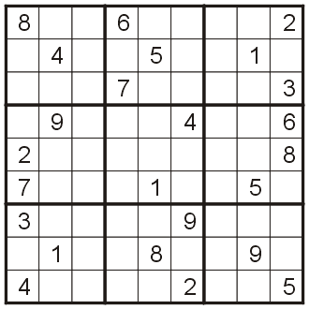
PROBLEM SUDOKU

Slide 15
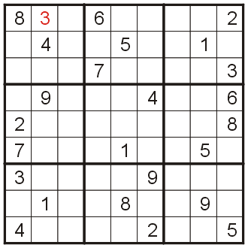
PROBLEM SUDOKU
Consider how to be greedy by value from small to large.

Slide 16
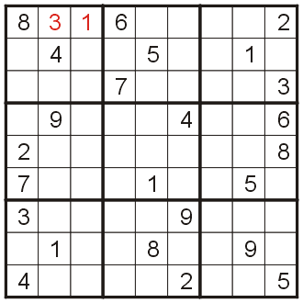
PROBLEM SUDOKU

Slide 17
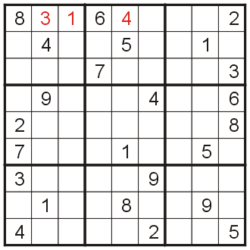
PROBLEM SUDOKU

Slide 18
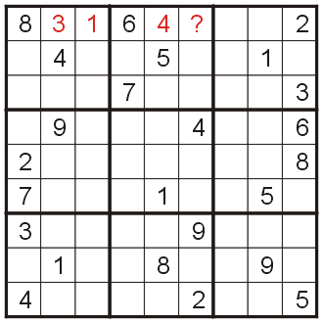
PROBLEM SUDOKU

Slide 19
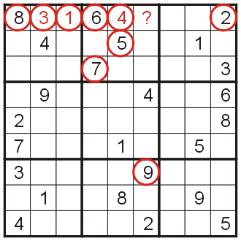
PROBLEM SUDOKU
Unsolvable with greed!

Slide 20
0-1 KNAPSACK PROBLEM
Consider the following problem (a version of the bag problem)
A production project has a total lead time of 26 weeks
Each product (from A to J) has a given execution time and value
Arrange the order of production of the products so that the total value is maximum.
Notes:
20

Slide 21
0-1 KNAPSACK PROBLEM
Product ID | Completion Time (wks) | Expected Revenue ($1000)
A | 15 | 210
B | 12 | 220
C | 10 | 180
D | 9 | 120
E | 8 | 160
F | 7 | 170
G | 5 | 90
H | 4 | 40
I | 3 | 60
J | 1 | ten

Slide 22
0-1 KNAPSACK PROBLEM
Product ID | Completion Time (wks) | Expected Revenue (1000$)
A | 15 | 210
B | 12 | 220
C | 10 | 180
D | 9 | 120
E | 8 | 160
F | 7 | 170
C | 5 | 90
H | 4 | 40
I | 3 | 60
J | 1 | 10
Solution Greed over time:
Project A: 15 wks
Project C: 10 wks
Project J: 1 wk
Total time: 26 wks
Value:
$400 000

Slide 23
0-1 KNAPSACK PROBLEM
Greedy solution by value:
Project B: $220K CZK
Project C: $180K CZK
Project H: $60K CZK
Project K: $10K CZK
Total time: 26 wks
Value:
$470 000
Product ID | Completion Time (wks) | Expected Revenue (1000$)
B | 12 | 220
A | 15 | 210
C | 10 | 180
F | 7 | 170
E | 8 | 160
D | 9 | 120
G | 5 | 90
I | 3 | 60
H | 4 | 40
J | 1 | 10

Slide 24
0-1 KNAPSACK PROBLEM
Product ID | Completion Time (wks) | Expected Revenue ($1000) | Revenue Density ($/wk)
A | 15 | 210 | 14,000
B | 12 | 220 | 18 333
C | 10 | 180 | 18 000
D | 9 | 120 | 13 333
E | 8 | 160 | 20 000
F | 7 | 170 | 24 286
G | 5 | 90 | 18 000
H | 4 | 40 | 10 000
I | 3 | 60 | 20 000
J | 1 | 10 | 10 000

Slide 25
0-1 KNAPSACK PROBLEM
Product ID | Completion Time (wks) | Expected Revenue ($1000) | Revenue Density ($/wk)
F | 7 | 170 | 24 286
E | 8 | 160 | 20 000
I | 3 | 60 | 20 000
B | 12 | 220 | 18 333
C | 10 | 180 | 18 000
G | 5 | 90 | 18 000
A | 15 | 210 | 14,000
D | 9 | 120 | 13 333
H | 4 | 40 | 10 000
J | 1 | 10 | 10 000
Greedy solution in value-to-time ratio:
Project F: $24 286/wk
Project E: $20 000/wk
Project I: $20 000/wk
Project G: $18,000/wk
Project J: $10 000/wk
Total time: 24 wks
Value:
$490 000

Slide 26
0-1 KNAPSACK PROBLEM
Exhaustive browsing solution:
Project C: $180 000
Project E: $170 000
Project F: $150,000
Project J: $10 000
Total time: 26 wks
Value:
$520 000
Product ID | Completion Time (wks) | Expected Revenue ($1000) | Revenue Density ($/wk)
A | 15 | 210 | 14,000
B | 12 | 220 | 18 333
C | 10 | 180 | 18 000
D | 9 | 120 | 13 333
E | 8 | 160 | 20 000
F | 7 | 170 | 24 286
G | 5 | 90 | 18 000
H | 4 | 40 | 10 000
I | 3 | 60 | 20 000
J | 1 | 10 | 10 000

Slide 27
0-1 KNAPSACK PROBLEM
Comment: Greedy solutions give only near-optimal values.
Algorithm | Expected Revenue
By time time | $400 000
By price treat | $470 000
By billion rate price value / time time | $490 000
Vet shallow | $520 000

Slide 28
APPLICATION PROBLEMS
In graph theory
Find the smallest spanning tree: KRUSKAL, PRIM, BORUVKA
Find the shortest path DIJKSTRA
Other math problems
Money exchange problem
Work arrangement problem
Wiring problem
Character string sorting problem

Slide 29
WORK ORDERING PROBLEM
Problem:
Given a set of n jobs, each job is represented by a pair of start time si and finish time fi (i=1, 2, .., n).
Select as many jobs as can be performed sequentially by a single machine or individual without conflict.
Each job executes only one at a time.
FOR EXAMPLE:
Input:
Number of jobs: 6
Start time Start []= { 1, 3, 0, 5, 8, 5}
Finish time Finish[]= { 2, 4, 6, 7, 9, 9}
Output:
OPT[] = {0, 1, 3, 4 }

Slide 30
WORK ORDERING PROBLEM
Sort work ( N,S[], F[]):
Input :
N is the number of jobs.
S[] start time.
F[] end time.
Ouput : The most executed list.
Actions :
Step 1 Sort in ascending order of end time.
Step 2 (Initialization) Select the first job as the optimal solution (OPT=1). N = N\{1};
Step 3 (Repeat).
For each job ϕ N
if ( S[j] >=F[i]) { OPT = OPT ∪ j; i = j; N = N\{i} }
Step 4 (Return Result)

Slide 31
WORK ORDERING PROBLEM
Eg:
Number of actions n = 8.
Start time S[] = {1, 3, 0, 5, 8, 5, 9, 14}.
End time F [] = {2, 4 , 6, 7, 9, 9, 12, 18}.
I | i= ? j =? | (S[j] >=F[i]) ? i=? | OPT=?
 |  |  | OPT = OPT ∪ {1}.
first | i=1; j=2; | (3>=2): Yes; i=2. | OPT = OPT ∪ {2}.
2 | i=2; j=3; | (0>=4): No; i=2. | OPT = OPT ∪φ .
3 | i=2; j=4; | (5>=4): Yes; i=4. | OPT = OPT ∪ {4}.
4 | i=4; j=5; | (8>=7): Yes; i=5. | OPT = OPT ∪ {5}.
5 | i=5; j=6; | (5>=9): No; i=5. | OPT = OPT ∪φ .
6 | i=5; j=7; | (9>=9): Yes; i=7. | OPT = OPT ∪ {7}.
7 | i=7; j=8; | (14>=12): Yes; i=8. | OPT = OPT ∪ {8}.
OPT = { 1, 2, 4, 5, 7, 8}

Slide 32
WIRING PROBLEM
Problem
Given n strings of different lengths . It is necessary to connect the wires together into one wire.
The cost of joining two wires together is calculated as the total length of the two wires.
The task of the problem is to find a way to connect the wires together into a wire so that the cost of connecting the wires together is minimal . best.
Eg:
Number of wires: 4; String length L[]={4, 3, 2, 6}
Small wiring costs most: OPT = 2 9
Making:
Wire 3 connects to wire 2 => 3 strings with lengths 4, 5, 6.
Wire length 4 connected to wire length 5 => 2 strings with lengths of 6 , 9.
Connect the remaining two wires 6+9 = 15.
Minimum total cost is 5 + 9 + 15 = 29.

Slide 33
WIRING PROBLEM
Algorithm greedily using priority queues .
Input: n: number of wires; L[] : wiring cost.
Output: Minimum wiring cost.
Actions :
Step 1 . Make pq a priority queue that stores length n wires.
Step 2 (Iteration).
OPT = 0;
while (pq.size>1) {
First = pq.top; pq.pop();
Second = pq.top; pq.pop();
OPT = OPT + First + Second;
Pq.push(First + Second);
}
Step 3 (Return results). Return(OPT);

Slide 34
WIRING PROBLEM
Input:
Number of wires n = 8.
Wiring cost L[] = { 9, 7, 12, 8, 6, 5, 14, 4}.
Output: Minimum wiring cost.
I | Value First , Second | OPT=? | Priority status of goods .
 |  | 0 | 4, 5, 6, 7, 8, 9, 12, 14
1 | First=4; Second=5 | 9 | 6, 7, 8, 9, 9 , 12, 14
2 | First=6; Second=7 | 22 | 8, 9, 9, 12, 13 , 14
3 | First=8; Second=9 | 39 | 9, 12, 13, 14, 17
4 | First=9; Second=12 | 60 | 13, 14, 17, 21
5 | First=13; Second=14 | eighty seven | 17, 21, 27
6 | First=17; Second=21 | 125 | 27, 38
7 | First=27; Second=38 | 190 | 65
OPT = 190

Slide 35
PROBLEM TO SET CHARACTERISTICS
Problem
Given a character string s[] of length n and a natural number d.
Rearrange the characters in the string s[] so that two identical characters are separated by a distance d .
If the problem has multiple solutions , give the first arrangement found . If the problem has no solution, give the message "No". experience”.

Slide 36
PROBLEM TO SET CHARACTERISTICS
Eg:
Input:
String S [ ] =“ABB”;
Distance d = 2.
Output : BAB
Input:
String S [ ] = “AAA”;
Distance d = 2.
Output : No solution.
Input:
String S [ ] =“GEEKSFORGEEKS”;
Distance d = 3.
Output : EGKEGKESFESFO

Slide 37
PROBLEM TO SET CHARACTERISTICS
Algorithm
Input: Character string S[]. Spacing between characters d.
Output : The sequence of characters is rearranged to satisfy the requirements of the problem.
Actions :
Step 1 . Find Freq[] is the number of occurrences of each character in the string.
Step 2. Sort in descending order by the number of characters appearing.
Step 3 . (Repeat).
i = 0; k =<Number of characters in Freq[]>;
while ( (i < k ) {
p = Max(Freq);
for ( t = 0; t<p; t++ )
if (i+(t*d)>n ) { < No solution>; return;>}
KQ[i + (t*d)]= Freq[i].kytu;
} i++;
}
Step 4 (Return Result): Return(KQ);

Slide 38
PROBLEM TO SET CHARACTERISTICS
Freq[]
G | 2
E | 4
K | 2
S | 2
F | 1
O | 1
R | 1
Freq[]
E | 4
G | 2
K | 2
S | 2
F | 1
O | 1
R | 1
Sort in descending order of occurrences.
 | Performance[I + p*d]
I =0 | E |  |  | E |  |  | E |  |  | E
i=1 | E | G |  | E | G |  | E |  |  | E
i=2 | E | G | K | E | G | K | E |  |  | E
i=3 | E | G | K | E | G | K | E | S |  | E | S
i=4 | E | G | K | E | G | K | E | S | F | E | S
i=5 | E | G | K | E | G | K | E | S | F | E | S | O
i=6 | E | G | K | E | G | K | E | S | F | E | S | O | R

