Slide 1
LESSON 6. Algorithms with Stacks

Slide 2
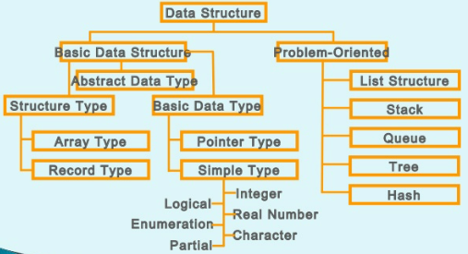
SUMMARY OF DATA STRUCTURE

Slide 3
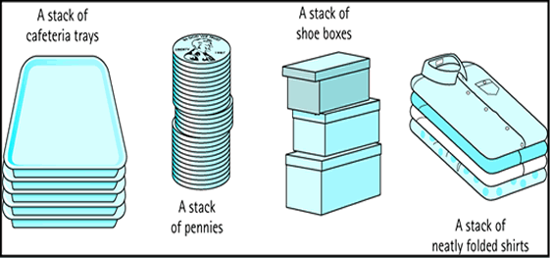
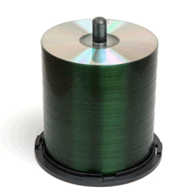
STACK
What is a stack?
Is a list but operations are performed only at one vertex of list.
Nature
First In Last Out: FILO

Slide 4
STACK
Stack Structure Abstraction
Special description evil Whether
A = (a ₀ , a ₁ , …, a _{n -1} )
where a _{n-1} is the vertex compartment arrange
push(x)
pop()
isEmpty ()
isFull ()
size()
top()

Slide 5
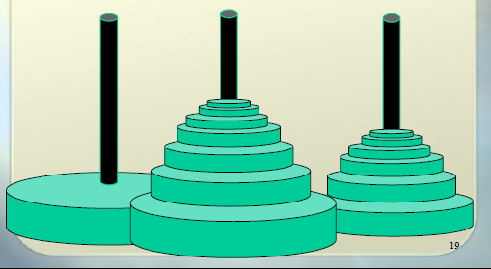
Two methods of representing the stack
Contiguous representation : the data elements of the stack are stored contiguously in memory (Array).
Discrete representation : the data elements of the stack are stored discretely in memory (Linked List).
Example . Array-based stack representation.
typedef struct {
int top; // Top of stack where all operations take place
int node[MAX]; // Data stored in stack includes MAX elements
} Stack;
top
node[top]
top
top
node[top]
node[top]
Notes:
5

Slide 6
USING Arrays
Actions:
Empty ( stack s )
Full ( stack s )
push ( stack s, item x
Pop ( stack s )
Example
Top= MAX-1
MAX-1
MAX-1
9
…
…
7
2
2
5
first
first
3
0
0
first
Notes:
6

Slide 7
USING Arrays
int Empty( stack *s ) {
if ( stack ->top == -1 ) // If top = -1
return (1);
return(0);
}
Notes:
7

Slide 8
USING Arrays
Check stack fullness:
int Full( stack *s ) {
if ( stack ->top == MAX-1 )
return (1);
return(0);
}
Notes:
8

Slide 9
USING Arrays
void push( stack *s, int x ) {
if ( !Full(s))
s ->top = (s ->top) +1;
node[s ->top] = x;
}
else < stack overflow >;
}
Notes:
9

Slide 10
USING Arrays
int Pop( stack *s ) {
if ( !Empty(s)) {
x = Node[s ->top];
s ->top = (s ->top) -1;
return (x) ;
}
else { < empty stack report >; return (∞); }
}
Notes:
10

Slide 11
Eg. Let the stack store up to 5 elements. Start execution at empty state.
top = -1
top =0
top =1
top = 2
top =3
top =4
Push(s,9)
9
Push(s,7)
7
7
Push(s,5)
5
5
5
push(s,3)
3
3
3
3
push(s,1)
first
first
first
first
first
top =4
top =3
top = 2
top =1
top =0
top = -1
9
Pop(s)
7
7
Pop(s)
5
5
5
Pop(s)
3
3
3
3
Pop(s)
first
first
first
first
first
Pop(s)
Notes:
11

Slide 12
Stack operations based on singly linked lists
Stack = { Single DSLK + [<Add-Top:(Push)>; <Del-Top: (Pop)> ] }
Stack = { Single DSLK + [<Add-Bottom:(Push)>; <Del-Bottom: (Pop)> ] }
Operations on the stack :
struct node{
int info;
struct node *link;
}*Stack;
class stack_list{
public:
node *push(node *, int);
node *pop(node *);
void traverse(node *);
stack_list(){ Stack = NULL; }
};
Notes:
12

Slide 13
node *stack_list::push(node *Stack, int item) {
node *tmp; tmp = new (struct node);
tmp->info = item; tmp->link = Stack; Stack = tmp;
return Stack;
}
node *stack_list::pop(node *Stack) { node *tmp;
if (Stack == NULL) cout<<" Stack is empty "<<endl;
else { tmp = Stack;
cout<<“ Node has been removed : "<<tmp->info<<endl;
Stack = Stack->link; free(tmp);
}
return Stack;
}
void stack_list::traverse(node *Stack) {
node *ptr; ptr = Stack;
if (Stack == NULL) cout<<" Stack is empty "<<endl;
else { cout<<“ Elements of the stack :"<<endl;
while (ptr != NULL) {
cout<<ptr->info<<endl; ptr = ptr->link;
}
}
}
Notes:
13

Slide 14
APPLICATIONS OF Stacks
De-recursion
Control brackets
Representation and conversion between mathematical representations
Browse trees, browse graphs…
Notes:
14

Slide 15
STL LIBRARY IN C++
<set>
<multiset>
<map>
<multimap>
<unordered_set>
<unordered_multiset>
<unordered_map>
<unordered_multimap>
<bitset>
<valarray>
<array>
<vector>
<deque>
<forward_list>
<list>
<stack>
<queue>
<priority_queue>

Slide 16
Stack declaration and usage example
#include < iostream >
#include <stack>
#include < conio.h >
using namespace std ;
int main()
{
stack< int > mystack ;
for ( int i =0; i < 5; ++ i ) mystack.push ( i *2);
cout << " Thuc Hien pop _ _ phan tu ..." ;
while (! mystack.empty ()){
cout << ' ' << mystack.top ();
mystack.pop ();
}
cout << '\n' ;
return 0;
}

Slide 17
Illustrate operations
sports works | output | compartment arrange
push(3) |  | (3)
push(5) |  | (3, 5)
pop() |  | (3)
top() | 3 | (3)
push(8) |  | (3, 8)
pop() |  | (3)
size() | first | (3)
pop() |  | ()
pop() | error : compartment arrange hollow | ()
push(15) |  | (15)
top() | 15 | (15)

Slide 18
COMMENTS ON Stacks
Advantages
Let n be the number of elements of the stack
Usable space is O ( n )
Each operation executes in O (1) time
Restrictions (with array setting)
The maximum size of the stack must be specified in advance and cannot be changed
Attempting to push a new element onto a full stack will raise an implementation-specific exception.

Slide 19
Example: Check the expression of symmetrical brackets
Each opening bracket "(", "[", "{" must be paired with a closing bracket ")", "]", "}" respectively.
Eg
symmetry: ( )(( )){([( )])}
disproportionate: ((( )(( )){([( )]))}
disproportionate: )(( )){([( )])}
disproportionate: ({[ ])}
disproportionate :(

Slide 20
Suffix
Suffix Expression:
a + b ab +
a - b ab -
a * b ab *
a / b ab /
(P) P
Notes:
20

Slide 21
Algorithm to convert P infix expression to suffix expression
Step 1 (Initialization) : stack = ∅; Out = ∅;
Step 2 (Iteration):
For each X∈P do
2.1. If x =' (' : push(stack, x);
2.2. If x is an operand: x⇒Out;
2.3. If x ∈ { +, -, *, / }
y = get(stack);
If priority(x)≥priority(y): push(stack, x);
If priority(x)<priority(y):
y = Pop(stack); y⇒Out; push(stack, x);
c) If stack = ∅: push(stack, x);
2.4. If x =')':
y = Pop(stack);
While (y!='(' ) do
y⇒Out; y = Pop(stack);
EndWhile;
EndFor;
Step 3 (Complete the suffix expression) :
While ( stack ∅ ) do
y = Pop(stack); y⇒Out;
EndWhile;
Step 4 (Return results) :
Return(Out).
Notes:
21

Slide 22
Algorithm testing: P =
x P | Step | Stack | Out
x ='(' | 2.1 | (
x =a | 2.2 | ( | a
x =+ | 2.3.a | (+ | a
x = b | 2.2 | (+ | ab
x =* | 2.3.a | ( + * | ab
x = c | 2.2 | ( + * | abc
x =')' | 2.3 |  | abc * +
x =- | 2.2.c | - | abc * +
x ='(' | 2.1 | - ( | abc * +
x =a | 2.2 | - ( | abc * + a
x =/ | 2.2.a | - ( / | abc * + a
x = b | 2.2 | - ( / | abc * + ab
x =+ | 2.3.b | - ( + | abc * + ab/
x =c | 2.2 | - ( + | abc * + ab/c
x =')' | 2.4 |  | abc * + ab/c + -
P = abc * + ab/c + -
Notes:
22

Slide 23
CALCULATION OF Suffix Expressions
Algorithm to calculate suffix expression value ?
Step 1 (Initialization) :
stack = ∅;
Step 2 (Iteration):
For each X∈P do
2.1. If x is an operand:
push(stack, x);
2.2. If x ∈ { +, -, *, / }
TH2 = Pop(stack, x);
TH1 = Pop(stack, x);
c) Results = TH1 ⊗ TH2;
d) Push (stack, result);
EndFor;
Step 4 (Return results) :
Return(Pop(stack)).
Notes:
23

Slide 24
Example : P = 6 2 4 * + 6 2 / 4 + -
4
2
6
8
6
2
6
14
3
14
4
3
14
7
14
7
*
+
/
/
+
-

Slide 25
PROBLEM: FIRST RIGHT IS BIGGER
PROBLEM DESCRIPTION
Given a sequence A[] consisting of N elements. For each A[i], you need to find the first right element greater than it. If it does not exist, print -1.
FOR EXAMPLE:
Range A[] = { 4, 5, 2, 25}
RESULTS : R[] = {5, 25, 25, -1}
SOLUTION:
The usual way of doing it: complexity O(n ² )
Using Stack: O(n) complexity

Slide 26
PROBLEM: FIRST IS BIGGER
SETTING
void xuly(int a[], int n){
stack<int> st;
int R[n], i;
for(i=n-1;i>=0;i--){
while(!st.empty() && a[i] >= st.top()) st.pop();
if(st.empty()) R[i] = -1;
else R[i] = st.top();
st.push(a[i]);
}
for(i=0;i<n;i++) cout << R[i] << " ";
cout << endl;
}

Slide 27
SOME OTHER APPLICATION PROBLEMS
Convert between expressions:
Midterms
Suffixes
Prefix
Check for redundancy of brackets
Calculate the length of the longest correct bracket sequence
Count the number of brackets that need to be reversed
Find the area of the largest rectangle

