Slide 1
LESSON 7. QUEUE

Slide 2
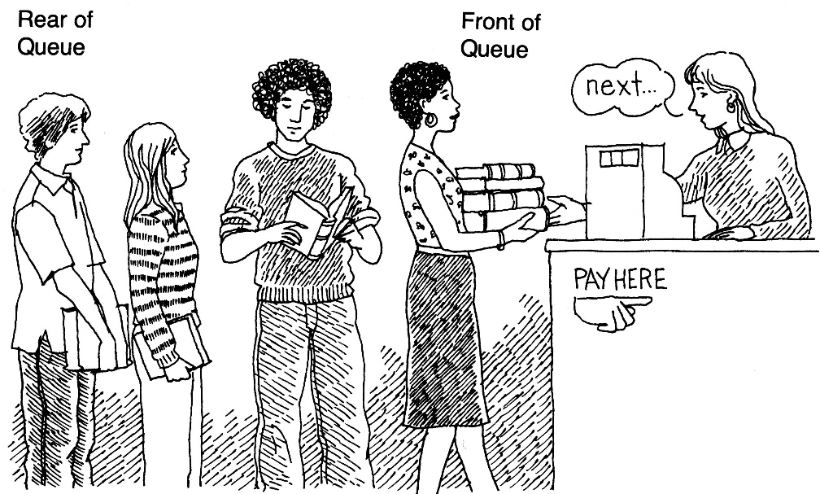
Queue?
Ordered list of elements.
The queue has two ends:
Add at the end.
Take out at the top.
( FIFO : First In, First Out).

Slide 3
Describing queues in programming
Necessary information
Element type
Input / Output
Maximum quantity
bool isEmpty ()
bool isFull ()
Enqueue ( or push)
Dequeue ( or pop)

Slide 4
Object type queue description
enqueue(o)
dequeue()
isEmpty()
getFront()
createQueue()

Slide 5
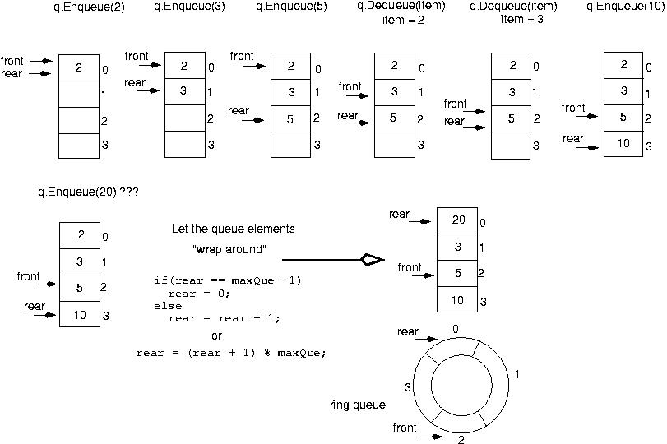
Round queue example

Slide 6
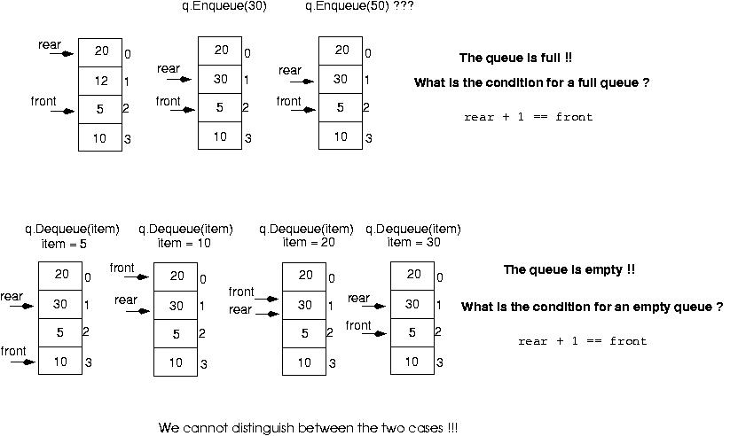
Round queue example

Slide 7
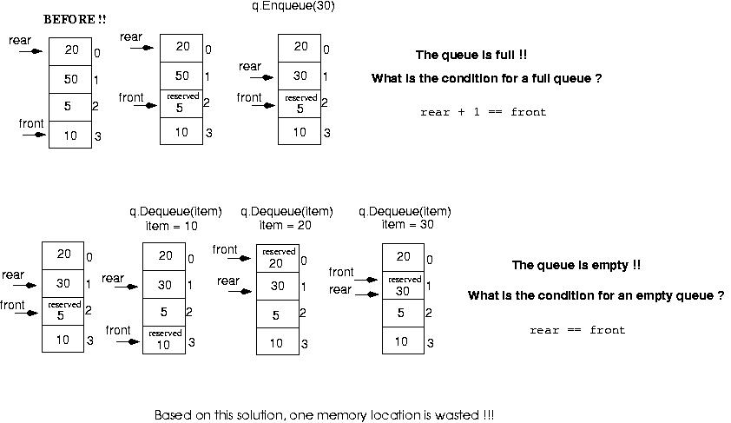
Round queue example

Slide 8
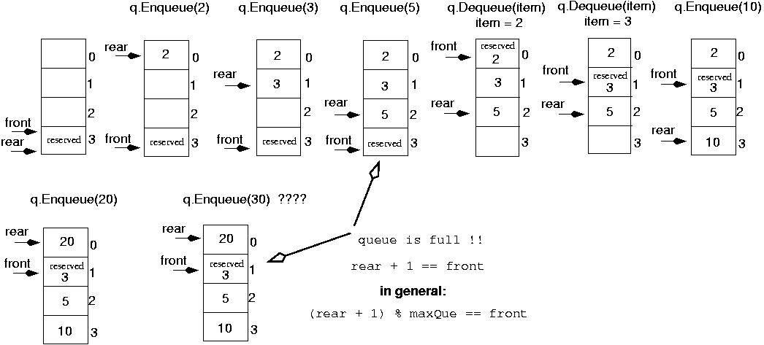
Round queue example
Initialize front and rear

Slide 9
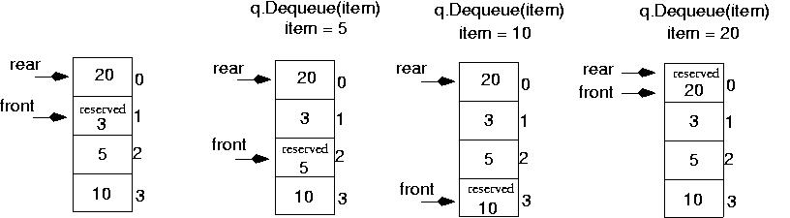
Round queue example
Queue is empty now!!
rear == front

Slide 10
USING Arrays
template<class ItemType>
class QueueType {
public:
QueueType(int);
QueueType();
~QueueType();
void MakeEmpty();
bool isEmpty() const;
bool isFull() const;
void Enqueue(ItemType);
void Dequeue(ItemType&);
private:
int front;
int rear;
ItemType* items;
int maxQue;
};

Slide 11
USING Arrays
QueueType<ItemType>::QueueType(int max){
maxQue = max + 1;
front = maxQue - 1;
rear = maxQue - 1;
items = new ItemType[maxQue];
}

Slide 12
USING Arrays
QueueType<ItemType>::~QueueType()
{
delete [] items;
}
void QueueType < ItemType >:: MakeEmpty ()
{
front = maxQue - 1;
rear = maxQue - 1;
}

Slide 13
USING Arrays
bool QueueType<ItemType>::isEmpty() const
{
return (rear == front);
}
bool QueueType<ItemType>::isFull() const
{
return ( (rear + 1) % maxQue == front);
}

Slide 14
USING Arrays
void QueueType<ItemType>::Enqueue (ItemType newItem)
{
rear = (rear + 1) % maxQue;
items[rear] = newItem;
}
void QueueType < ItemType >:: Dequeue ( ItemType & item)
{
front = (front + 1) % maxQue ;
item = items[front];
}

Slide 15
USING Arrays
if(!q.isFull())
q.Enqueue(item);
if(!q.isEmpty())
q.Dequeue(item);

Slide 16
Queue in C++ STL
STL
queue <type> Q;
front()
back()
push(x)
pop()
empty()
size()
swap()

Slide 17
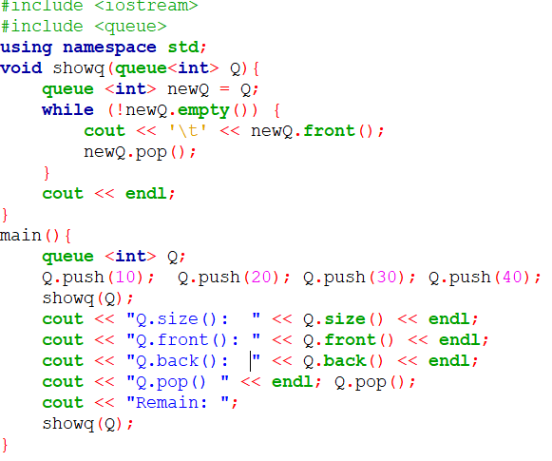
Example using Queue in STL

Slide 18
APPLICATIONS
BFS technique
Step 1: enter queue
Step 2: Repeat
Consider status state S at the beginning
remove the S from queue
Inser some state to queue from S to row wait
Step 3: Conclude thesis conclude fruit

Slide 19
APPLICATIONS
Case 1: No need mark
Binary BFS
Case 2: Mark using array.
BFS in graph
Case 3: Mark using set or map.

